Slide 1

Oh Dear God
Alain made a PowerPoint presentation
1

Slide 2

Short
I swear it will be short. Really. Not much here.

Slide 3
Goals for this meeting
Primary:
  Get the OSG Software Team synchronized and working towards our strategy for packaging the OSG Software Stack as RPMs.
  Train members of the team so they are all capable of making RPMs with the VDT's infrastructure
Secondary:
  We want to verify the build process, that it makes sense and will work with packaging future versions (e.g. SL6)
  We will discuss the testing process for RPM-based releases.
  We will discuss what is needed and how to proceed with updating the documentation
  Package as much of the VDT as we can. Targets include:
    OSG WN & OSG Client (mostly done)
    VOMS server (VOMS & VOMS Admin)
    OSG CE

Slide 4
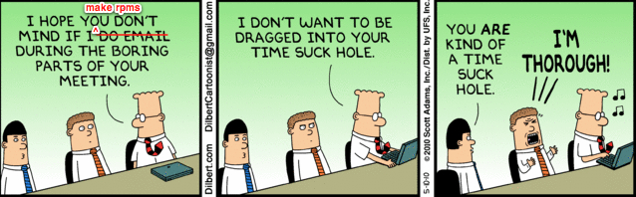
How will the meeting run?
(a.k.a isn’t the agenda rather vague?)
This morning: Lots of talking
  Approach, technical details, Q&A
The rest of the time:
  Mostly working together making RPMs
  Mixed up with a bit of talking as we have questions to resolve as a group

Slide 5

Ask question!
I really don’t have that much to say
So take this opportunity to ask questions!

Slide 6
Principle of Community Packaging
The OSG Software Team should be a good community citizen when it comes to packaging: When possible, we should use packages from existing and/or broader communities; when that is not possible, we should make our own packaging but contribute them back to the broader communities. Therefore, we should package software only when one of the following is true:
a) The software is not already packaged; or
b) The software is packaged but needs significant changes to be acceptable to our users. (Different version, extra patches, etc...)
Otherwise we should use the existing packaging provided by external developers or software repositories.
https://twiki.grid.iu.edu/bin/view/SoftwareTeam/CommunityPackagingProposal

Slide 7
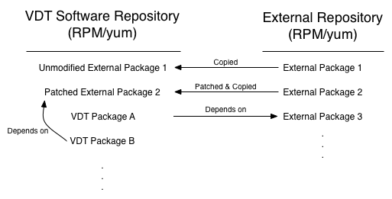
Example

Slide 8
Transition Goals
Stop non-urgent Pacman/VDT support
  One more release, in ITB now, done in July
Ship entire VDT as RPMs
  Red Hat Enterprise Linux 5 & variants
  32 & 64 bit
  Copy (pass-through) from EMI
  Use EPEL & OS where appropriate
Mid-August
  Present state so far at OSG Site Admin meeting to get feedback.
  Hoping for:
    Worker Node
    Client
    Complete VOMS (VOMS + VOMS Admin)
    CE? (May be a stretch)
December
  Complete set, ready to install during LHC shutdown
https://twiki.grid.iu.edu/bin/view/SoftwareTeam/NPTransition

Slide 9
Open, unanswered questions
Approach to configuration?
Need for and approach to non-root installations?
Implications on testing at all stages

Slide 10
Future goals
Other OS support?
  RHEL 6 and variants?
  Debian 6?
  Others?

Slide 11
Technical approach: Principles
https://twiki.grid.iu.edu/bin/view/SoftwareTeam/RPMDevelopmentGuide
Packages should adhere to community standards (e.g., Fedora Packaging Guidelines) when possible, and significant deviations must be documented
Every released package must be reproducible from data stored in our system
Upstream source files (which should not be modified) should be clearly separated from files owned by the OSG Software Team
Building source and binary packages from our system should be easy and efficient
External developers should have a clear and effective system for developing and contributing packages
We should use standard tools from relevant packaging and development communities when appropriate

Slide 12
Upstream source cache
Place to put:
  Pass-through source RPMs
  Source tarballs
Structure:
  …/package-name/version/file
Multiple locations
  Official version is at UW-Madison
  Can be (partially) cached/developed on your computer

Slide 13
Source code repo
https://vdt.cs.wisc.edu/svn
OSG-owned source code:
  $SVN/software/package-name/…
Packaging structure:
  native/redhat/trunk/package-name/…
Within a package directory:
  README
  upstream/
  osg/
WARNING: Do fresh checkouts!

Slide 14
Example: pass-through RPM
xrootd/README
xrootd/upstream/developer.srpm.source

Slide 15
Example: Package a build
Just Package:
ndt/osg/ndt.spec
ndt/upstream/developer.tarball.source
Package & Patch:
lcg-utils/osg/lcg-utils.spec
lcg-utils/osg/lcg_utils_makefile_cleanup.patch
lcg-utils/upstream/cvs_tarball.source

Slide 16
Build Process
Commit packaging to SVN
Put sources in cache
Use vdt-build
  rpmbuild Quick check with rpmbuild
  mock Proper build with mock
  batlab Full build/push with batlab/koji

Slide 17

Things you need to do
Get access to Subversion (Scot)
Get access to JIRA (Alain)
Get access to Build & Test (?)
Get access to UW-CS for uploads
Make an RPM

