Slide 1
Production
Sep 5, 2012
Dan Fraser

Slide 2
Current Production Focus
Transition to RPMs
  44(31) sites using RPM based installs
  59(70) sites still using Pacman install
  All the main RPMs have been released
    Incl. Gums and Gratia
  Still working on a few issues / bugs
    Blocker bug with Atlas (closing in)
  (A)BCD to help bring Tim up to speed?
  Documentation for RPMs is usable
    https://twiki.grid.iu.edu/bin/view/Documentation/Release3/WebHome

Slide 3
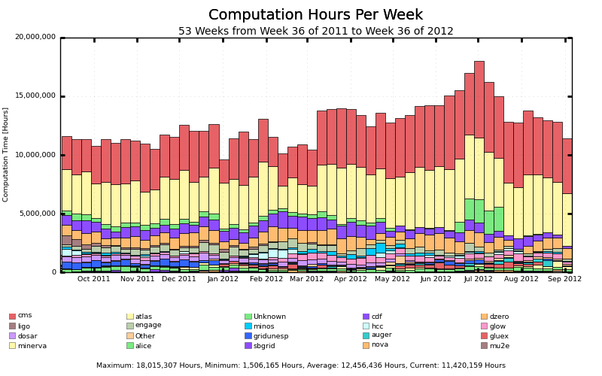
Overall Production

Slide 4
A sites change
Stopped Campfire support of OSG sites

Slide 5
Some Production Issues…
Effort from the entire team
  HTPC testing at BNL (Capability needs improvement)
  New critical bug in certain Condor configurations
  Encouraging sites to upgrade to OSG1.25+
    Critical bug in condor
  Adding lots of new services to GOC …
  SE-only publishing issue
  Ongoing GRAM-5 production issues (memory leaks, scaling, etc.)
  CA updates no longer automated by OSG (RPM)
  GUMS-Voms compatibility with CERN (progress ongoing)
  …

Slide 6
Production Challenges
New monitoring tools suitable for a glide-in based system.
  May require data from the VO’s, more than the glide-in system.
How “autonomous” are the sites?
  Now that we promise security through a central glide-in system
  What is OSG’s policy on encouraging sites to upgrade?

Slide 7
Campus Grid Status
Campus grid working in production:
  Glow, Diagrid (All Condor campus grids)
  Nebraska
  University of Florida (not used much)
Pre-Production/testing:
  RENCI
  Virginia Tech (Bio-tech)
    http://gratiaweb.grid.iu.edu/gratia/xml/glidein_hours_bar_smry?probe=condor:dhcpseven237.bioinformatics.vt.edu
  Virginia Tech (Belle, DayaBay)
  FIU

Slide 8
Launching the Campus Infrastructure Center
Center where researchers can learn about and adopt campus technologies.
  Led by Rob Gardner
First steering committee meeting yesterday

Slide 9
Campus Grids Project Plan
    https://twiki.grid.iu.edu/bin/view/CampusGrids/CampusInfrastructureProjectPlan
Release of BOSCO V1
  Completed 2 mos late in Aug.
    Also includes support for SGE
  Included Documentation and usability testing.
    Offered to two users (UWash, Pegasus team)
Features needed for v1.1 (multiple releases):
  Accounting (integrated probe)
  Multi-user support (real)
  Eliminate restriction of same OS
  Support users who want to flock

Slide 10
Campus Grid Issues
Need more interest in adopting Bosco
Use OIM for campus map
  Being tested

