Slide 1
2011 OSG Summer School
An introduction to
Distributed High-Throughput Computing
with emphasis on
Grid computing
by Igor Sfiligoi
University of California San Diego

Slide 2
Me and DHTC
Working with distributed computing
since 1996
Working with Grids
since 2005
Leader of the OSG glidein factory ops
since 2009
Deeply involved in glidein development
and deployments
Mostly worked with HEP (KLOE, CDF, CMS)

Slide 3

High Throughput Computing
Alain yesterday introduced you to HTC
  The concept of getting as many CPU cycles as possible over the long run
Based on batch job processing
  No interactive access to resources
Scheduler

Slide 4
HTC in words
As our esteemed Miron would put it
HTC is about extending the compute power of my own machine.
I could run my work on my own machine, but then it would take a very large number of calendar days/months/years to complete.
To finish the computation in a reasonable time, I have to expand the capacity of my own machine by obtaining and using temporary resources.

Slide 5
DHTC
Introduction to
Distributed High Throughput Computing

Slide 6
What is DHTC
So what is Distributed HTC???
  HTC is always distributed, right?
What we mean here is
MASSIVELY distributed
  i.e. more than you can afford
  to host and operate in one place

Slide 7
Anatomy of DHTC
So DHTC is about computing on
more than one HTC system
Scheduler
Scheduler
Scheduler

Slide 8
Why is it different?
Not a single system anymore
  Most likely does not have a shared file system
  Different clusters likely operated by different people
    You may have a different account
  Different clusters may use different technologies
  (e.g. Condor vs PBS)
Usually harder to use than regular HTC
  Just as using a HTC cluster is harder
  than using a single desktop

Slide 9
Why DHTC
Many reasons:
  Practical
  (a site has a limit to how much HW can host)
  Political
  (you only get money for HW if it is hosted at X)
  Economical
  (hosting and operating HW myself is too expensive)
  (someone else can offer you hosted HW for less)
  Opportunistic
  (owners of site X have temporarily no jobs, might as well allow others to use them (for free or for pay))

Slide 10
DHTC in real life
Campus-wide scheduling
  e.g. U.Wisc Condor flocking
Scientific Grids
  e.g. OSG, Teragrid, EGI
Hosted servers
  e.g. Rackspace
Cloud computing
  e.g. Amazon EC2

Slide 11
Campus-wide scheduling
Connects HTC clusters ran by different departments
High trust between them
  Sysadmins can talk to each other
  Trust may be imposed from above (e.g. CIO)
May use the same technology, which makes life much easier
  Condor flocking
  an excellent example
Won't go in more detail.

Slide 12
Scientific Grids
Widely distributed
  OSG is US wide
Moderate trust
  Too many participants
  OSG – O(100) sites and O(1k) users
Many technologies
  Joining sites may have existing infrastructure
Will spend most time on this

Slide 13
Hosted computing
Commercial offering
Lease a server for $$/month
Similar to buying and hosting your own HW
  Install whatever you want on them
  But not in your LAN
May be a good solution if you need a boost in capacity for a few months
Won't go in more detail.

Slide 14
Cloud computing
A mix between hosted computing and Grids
Job-based like a Grid
  But “jobs” are Virtual Machines, not just processes
You get your own machines like in hosted cmp.
  They just happen to be VMs
  You install whatever you want in them
  There is an economic factor
  (although there is a push for scientific clouds
  as well)
Won't go in more detail.

Slide 15
DHTC
Grid computing

Slide 16
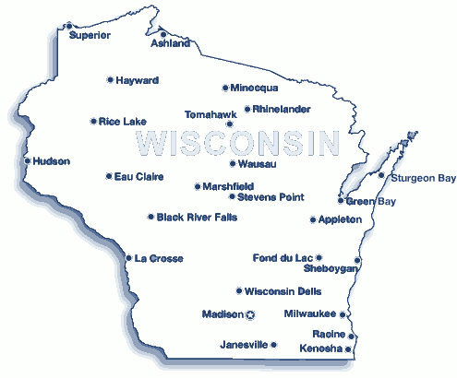
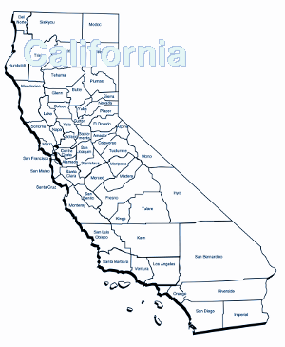
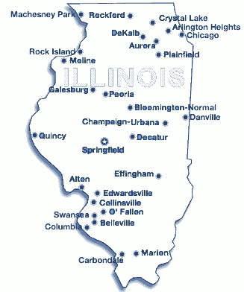
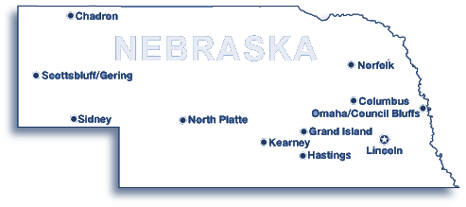
Grid computing
Think of it as DHTC over WAN
Scheduler
Scheduler
Scheduler

Slide 17
Remote access
Major difference compared to HTC is that we need remote access
  A gatekeeper
    Often called a CE
    (Compute Element)
CE
Scheduler

Slide 18
Many options
Batch system native
  e.g. Condor-C
SSH
  Then locally condor_submit, bsub, ...
Grid gatekeepers
  Globus
  CREAM
  ARC
Will hide site details

Slide 19
Grid gatekeepers
Each site potentially uses
a different local HTC system
A Grid gatekeeper abstracts the API
  Same remote calls for site-local Condor, PBS, ...
Makes life easier for users
  No need to know site details
Used by most major Grid communities
  e.g. OSG, Teragrid, EGI
Just learn
“Grid” commands

Slide 20
Grid CE = Abstraction layer
This assumes
all sites use the
same CE SW
Grid_Submit
Grid_Submit
CE
CE
LSF
Condor
CE
PBS

Slide 21
Condor as a Grid client
Condor can be used as a “universal client”
Can submit jobs to remote HTC systems
  Using the “Grid” universe
  Supports most CE APIs
Same job commands as for Condor HTC
  condor_submit, condor_q, etc.
But very different under the hood!
Known as
Condor-G
See next slide

Slide 22
Condor-G
Condor-G does not manage remote resources
  It just forwards and monitors jobs to remote HTC sys
  No condor_status
No matchmaking
  User explicitly specifies
  API and site to use
condor_submit
“Grid UNL”
condor_schedd
Grid_submit
Grid_q
Limited resource
selection available
with external support
CE
Scheduler

Slide 23
Job partitioning problem
Pure Grid computing requires job partitioning
Many
queues
Grid_Submit
Grid_Submit
CE
CE
LSF
Condor
CE
PBS

Slide 24
Job partitioning = Hard problem
Job partitioning is a hard problem
Especially in the Grid
  Many different technologies (e.g. Condor vs PBS)
  Owned by many different admins
  With an abstracted API in between
Some automation highly desirable
  gliteWMS
  OSG MM
No really good
solutions

Slide 25
Get your hands dirty
This is all the theory you need to know for now
Exercise time
Feel free to ask question

