Slide 1
OSG Finance Board Report
Kent Blackburn
OSG Resources co-Manager (w/ Paul Avery)
Open Science Grid Council Meeting
March 8th 2007

Slide 2
Resources Managers
Resources Manager and Finance Board oversee all matters related to the costs and resources of the OSG program of work.
  Advise the Executive Director.
  Handle all change requests.
  Cover Consortium and External Project contributions also.
  Advise on agreements and OSG (VO) allocations.
  Helped by 1 FTE project staff- Project Associate (Chander Sehgal).

Slide 3
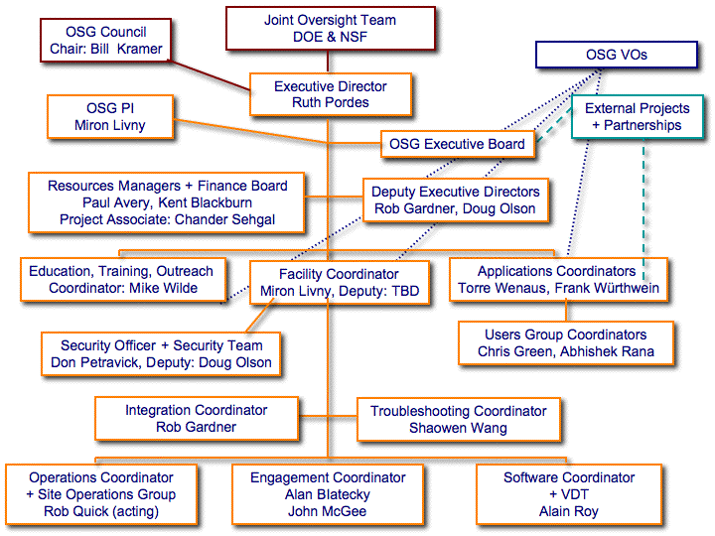
OSG Resources Managers and Finance Board

Slide 4
OSG Funding
OSG is funded by 6 program offices
  DOE ASCR, DOE HEP, DOE NP,
  NSF MPS, NSF OCI, NSF OISE.
Broadly speaking the funding supports :
  OCI : Engagement of new communities
  ASCR: Computer Science aspects of Software (VDT, Security, Storage), Troubleshooting and Integration, Training and outreach.
  NP: Security and Integration (some)
  OISE: Outreach & Interoperability with Scandinavia.
  HEP/MPS: Operations, Software (VDT), Extensions, Security, Integration, Administration and Communications.

Slide 5
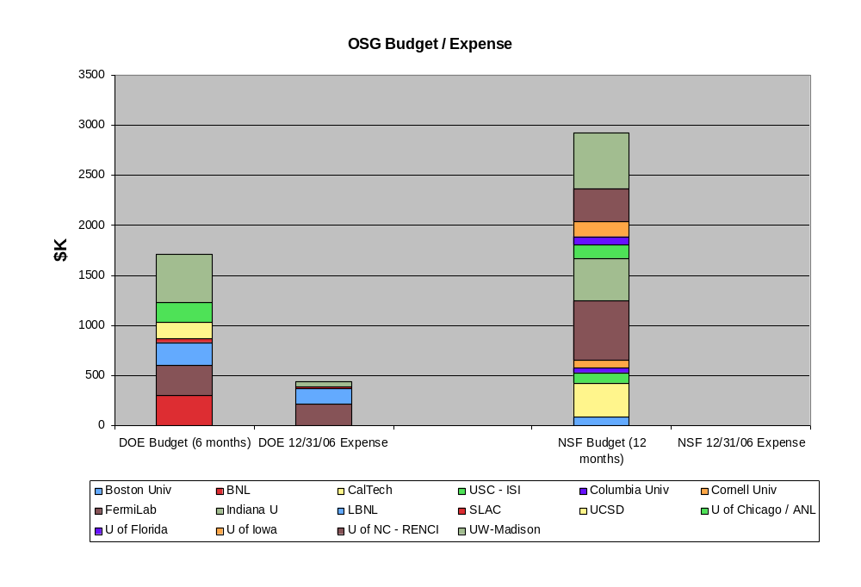
EXPENSES AS OF 12/31/06
DOE funding sent directly to institutions
NSF funding hinges on completion of SOW signatures: 6 completed

Slide 6
Statements of Work
Major accomplishment to get details of commitments and deliverables agreed to and “tied” to the WBS.
Made good progress, although process through the signatories slower than we would have guessed.
Major changes by Institution Sponsored Research Offices (SROs) slows things down at the end:
  New overhead costs at Caltech and Fermilab.
  Iowa, Boston: SRO response to “open source software” statement - now solved.
  Key staff turnover.

Slide 7
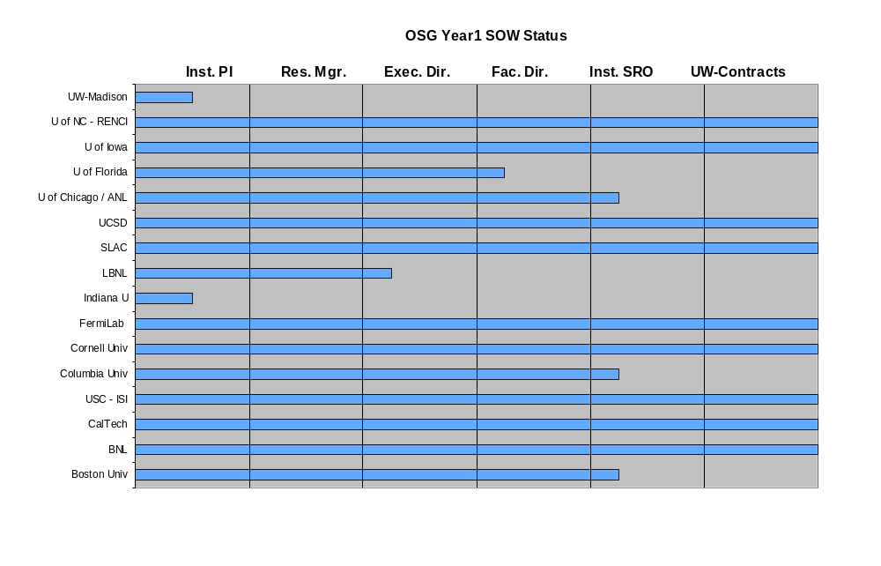
Status of
Statements Of Work
Progress on the Signature Trail

Slide 8
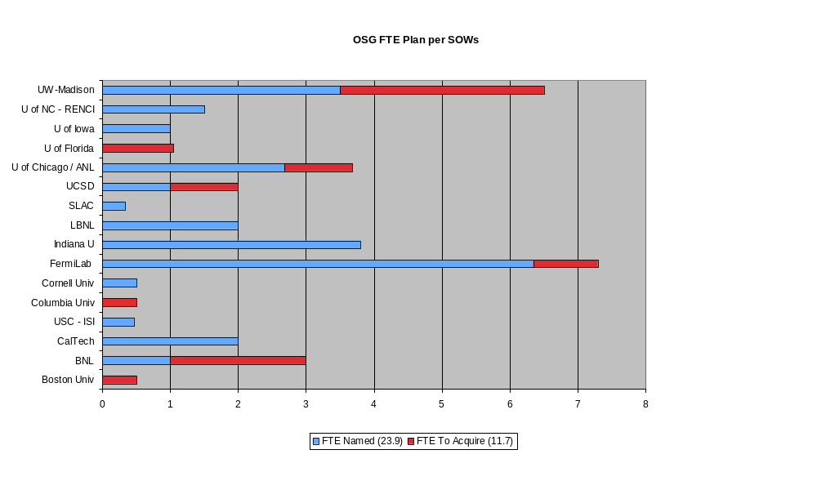
Status of FTE Availability from Current SOWs

Slide 9
Finance Board Charge
“The Finance Board evaluates contributions, including contributions pledged from the stakeholder organizations, for the relations with the funding agencies, for contract policies, and for all administrative matters. The Resources Manager is chair of the Finance Board.”
All important decisions are reported to the Executive Board and the OSG Council.
Requests for a change in the financial allocations can be made to the Finance Board by the Executive Board, stakeholder organizations, or project resource managers…, a Resource Change Proposal is submitted to the Executive Board for approval. Once agreed to by the Executive Board it is confirmed by the Council.”
        from the management plan
First 2 change requests are for funding for travel to present at Taiwan Grid Conference (agreed to) and for $5K hardware for EOT training (in discussion)
  A few more changes in the works this week addressing new WBS items.

Slide 10
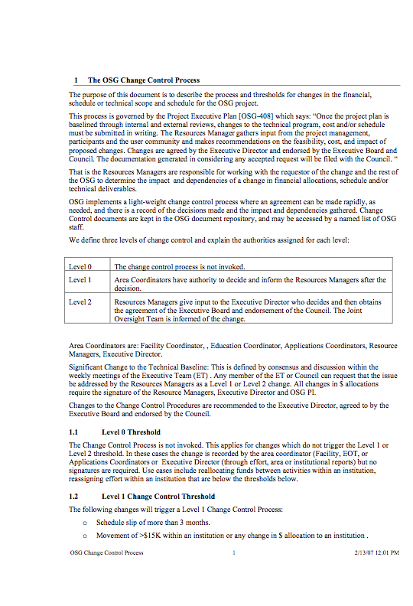

Change Control Process:(DocDB 523)

Slide 11
Finance Board Meetings
First Finance Board meeting Dec 14th Caltech; Minutes are open
  Aligned with meeting of Executive Board.
Agreed on ~Quarterly meetings + as-needed. Next meeting in April + some time at the all hands meeting.
Acknowledge very useful guidance and input from Jim Yeck to the work of the Resources Managers and Finance Board.
Tracking expenditures quarterly.
Next Finance Board Meeting April 25th or 26th.

Slide 12
Reporting Effort & Accomplishments
SOWs include agreement to monthly individual effort reports and quarterly Institutional PI reports (as well as area coordinators).
Reports posted.
Effort is being tracked.
Six month project report has been submitted to Agencies.
Action item to rationalize reporting into useful and ongoing structure.

