Slide 1
BWCTL
August 9th 2011, OSG Site Admin Workshop
Jason Zurawski – Internet2 Research Liaison

Slide 2

Agenda
Tutorial Agenda:
  Network Performance Primer - Why Should We Care? (30 Mins)
  Introduction to Measurement Tools (20 Mins)
  Use of NTP for network measurements (15 Mins)
  Use of the BWCTL Server and Client (25 Mins)
  Use of the OWAMP Server and Client (25 Mins)
  Use of the NDT Server and Client (25 Mins)
  perfSONAR Topics (30 Mins)
  Diagnostics vs Regular Monitoring (20 Mins)
  Use Cases (30 Mins)
  Exercises
<number> – 11/08/26, © 2011 Internet2

Slide 3
BWCTL – What is it?
BWCTL is:
  A command line client application
  A scheduling and policy daemon
  Wraps the throughput testing tools Iperf and Nuttcp.
These tests are able to measure:
  Maximum TCP bandwidth (with various tuning options available)
  The delay, jitter, and datagram loss of a network when doing a UDP test
<number> – 11/08/26, © 2011 Internet2

Slide 4
Problem Statement
Users want to verify available bandwidth/throughput:
  Between their site and a remote resource
  Between two remote resources
  Validate/Verify an SLA
Methodology:
  Verify available bandwidth from each endpoint to points in the middle
  Determine problem area(s)
  Re-run tests over time – requires access to tool instead of doing a ‘one off’ test
<number> – 11/08/26, © 2011 Internet2

Slide 5
Throughput? Bandwidth?
The term “throughput” is vague
  Capacity: link speed
    Narrow Link: link with the lowest capacity along a path
    Capacity of the end-to-end path = capacity of the narrow link
  Utilized bandwidth: current traffic load
  Available bandwidth: capacity – utilized bandwidth
    Tight Link: link with the least available bandwidth in a path
  Achievable bandwidth: includes protocol and host issues
45 Mbps
10 Mbps
100 Mbps
45 Mbps
source
sink
Narrow Link
Tight Link
(Shaded portion shows background traffic)
<number> – 11/08/26, © 2011 Internet2

Slide 6
Typical Solution
Run “iperf” or similar tool on two endpoints and hosts on intermediate paths
  Roadblocks:
    Need software on all test systems
    Need permissions on all systems involved (usually full shell accounts*)
    Need to coordinate testing with others *
    Need to run software on both sides with specified test parameters *
Desirable features for an alternate method
  ‘Daemon’ to run in the background
  Protocol to exchange results/errors
  Works with firewalls
  Protect resources
(* BWCTL was designed to help with these)
<number> – 11/08/26, © 2011 Internet2

Slide 7
Implementation
Applications
  Daemon (bwctld)
  Client (bwctl)
Open Source License & Development
  Modified BSD (http://www.internet2.edu/membership/ip.html)
  Mailing lists for developer communication – come join us!
Protocol Abstraction Library
  Will support development of new clients
  Add custom ‘hooks’ into the policy (e.g. add authentication via OpenID or similar)
<number> – 11/08/26, © 2011 Internet2

Slide 8
Server Functionality (bwctld)
bwctld on each test host
  Accepts requests for “iperf” tests including time slot and parameters for test
  Responds with a tentative reservation or a denied message
  Reservations by a client must be confirmed with a “start session” message
  Acts as the “Resource Broker”
  Runs the test
  Both “sides” of test get results
<number> – 11/08/26, © 2011 Internet2

Slide 9
Client Functionality (bwctl)
bwctl client application makes requests to both endpoints of a test
  Communication can be “open”, “authenticated”, or “encrypted” (encrypted reserved for future use)
  Requests include a request for a time slot as well as a full parameterization of the test
  “Third party” requests – run a test on two distributed hosts
  If no server is available on the localhost, client handles test endpoint
  *Mostly* the same command line options as testers (e.g. iperf, nuttcp – read the help or man pages to be sure…)
<number> – 11/08/26, © 2011 Internet2

Slide 10
TCP Measurements
Measures TCP Achievable Bandwidth
  Measurement includes the end system
  Sometimes called “memory-to-memory” tests
  Set expectations for well coded application
Limits of what we can measure
  TCP hides details
  In hiding the details it can obscure what is causing errors
Many things can limit TCP throughput
  Loss
  Congestion
  Buffer Starvation
  Out of order delivery
<number> – 11/08/26, © 2011 Internet2

Slide 11
TCP – Quick Overview
Data Packet
  Contains some header overhead, and the broken up chunk of user data
ACK Packet
  Acknowledge the receipt of a data packet, “cumulative” in nature
SACK Packet
  Selective acknowledgement for a specific missing segment
MSS
  Maximum segment size (largest size of packets on a given network segment)
Congestion Control
  Process of self regulating flow speed due to loss in the network (e.g. making it fair)
Slow Start
  Avoid sending more data than the network is capable of consuming. Goal is to reach a loss (establishes window size by relying on acks)
<number> – 11/08/26, © 2011 Internet2

Slide 12
TCP – Quick Overview
Congestion Avoidance
  Additive-increase/Multiplicative-decrease [AIMD] scheme to find a fair speed for a TCP flow by adjusting the sending window. Starts low (2 x MSS) and increase
Fast Retransmit
  Retransmit a single segment after receiving duplicate ACKs for the prior numbered segment
Fast Recovery
  Re-send packets in a window after a timeout
Bandwidth Delay Product
  The amount of “in flight” data allowed for a TCP connection
  BDP = bandwidth * round trip time
  Example: 1Gb/s cross country, ~100ms
    1,000,000,000 b/s * .1 s = 100,000,000 bits
    100,000,000 / 8 = 12,500,000 bytes
    12,500,000 bytes / (1024*1024) ~ 12MB
<number> – 11/08/26, © 2011 Internet2

Slide 13
TCP – Quick Overview
Congestion Control Algorithms (selectable in the Linux Kernel)
  RENO (Slow Start, Cong. Avoidance, Fast Retransmit, Fast Recovery)
  Cubic (Optimized for LFN [Long Fat Networks] with large latency, Cubic growth pattern)
  HTCP (still additive-increase/multiplicative-decrease [AIMD], more agressive as loss decreases on high BDP paths)
<number> – 11/08/26, © 2011 Internet2

Slide 14
TCP – Quick Overview
General Operational Pattern
  Sender buffers up data to send into segments (respect the MSS) and numbers each
  The ‘window’ is established and packets are sent in order from the window
  The flow of data and ACK packets will dictate the overall speed of TCP for the length of the transfer
<number> – 11/08/26, © 2011 Internet2

Slide 15
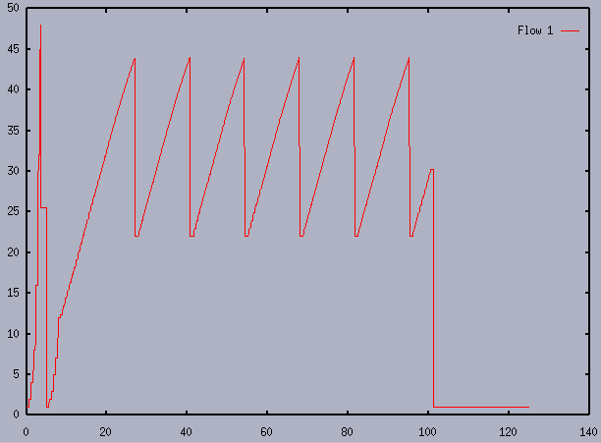
TCP – Quick Overview (Typical Sawtooth)
<number> – 11/08/26, © 2011 Internet2

Slide 16
TCP – Quick Overview
General Operational Pattern – cont
  TCP starts slow, until it can establish the available resources on the network.
  The idea is to grow the window until a loss is observed
  This is the signal to the algorithm that it must limit the window for the time being, it can slowly build it back up
<number> – 11/08/26, © 2011 Internet2

Slide 17
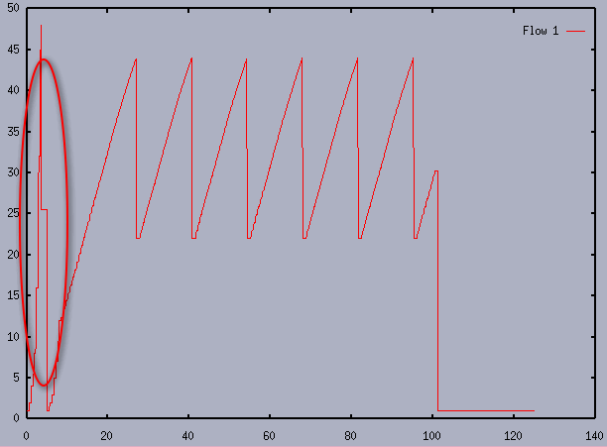
TCP – Quick Overview (Slow Start)
<number> – 11/08/26, © 2011 Internet2

Slide 18
TCP – Quick Overview
General Operational Pattern – cont
  Receiver will acknowledge packets as they arrive
    ACK Each (old style)
    Cumulative ACK (“I have seen everything up to this segment”
    Selective ACK (sent to combat a complete retransmit of the window)
  TCP relies on loss to a certain extent – it will adjust it’s behavior after each loss
    Congestive (e.g. reaching network limitation, or due to traffic)
    Non-congestive (due to actual problems in the network)
  Congestion avoidance stage follows slow start, window will remain a certain size and data rates will increase/decrease based on loss in the network
  Congestion Control algorithms modify the behavior over time
    Control how large the window may grow
    Control how fast to recover from any loss
<number> – 11/08/26, © 2011 Internet2

Slide 19
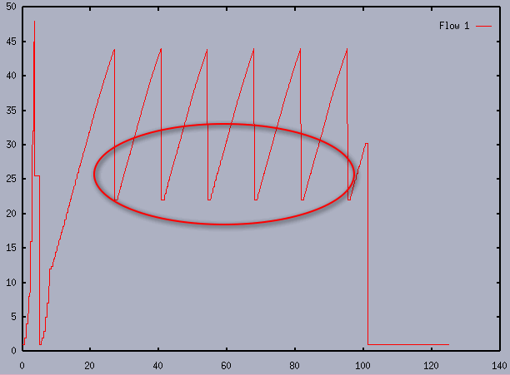
TCP – Quick Overview (Cong. Avoidance)
<number> – 11/08/26, © 2011 Internet2

Slide 20
TCP Performance: Window Size
Use TCP auto tuning if possible
  Linux 2.6, Mac OS X 10.5, FreeBSD 7.x, and Windows Vista
  Allow the OS to decide how large the window needs to be based on current resources and performance
The –w option can be used to request a particular buffer size.
  Use this if your OS doesn’t have TCP auto tuning
  This sets both send and receive buffer size.
  The OS may need to be tweaked to allow buffers of sufficient size.
  See http://fasterdata.es.net/fasterdata/host-tuning/ for more details
Parallel transfers may help as well, the –P option can be used for this
To get full TCP performance the TCP window needs to be large enough to accommodate the Bandwidth Delay Product
<number> – 11/08/26, © 2011 Internet2

Slide 21
TCP Parallel Streams
Parallel streams can help in some situations
TCP attempts to be “fair” and conservative
  Sensitive to loss, but more streams hedge bet
  Circumventing fairness mechanism
    1 bwctl stream vs. n background: bwctl gets 1/(n+1)
    X bwctl streams vs. n background: bwctl gets x/(n+x)
    Example: 2 background, 1 bwctl stream: 1/3 = 33%
    Example: 2 background, 8 bwctl streams: 8/10 = 80%
How?
  The –P option sets the number of streams/threads to use
  There is a point of diminishing returns
<number> – 11/08/26, © 2011 Internet2

Slide 22
TCP Performance: Read/Write Buffer Size
TCP breaks the stream into pieces transparently
Longer writes often improve performance
  Let TCP “do it’s thing”
  Fewer system calls
How?
  -l <size> (lower case ell)
  Example –l 128K
UDP doesn’t break up writes, don’t exceed Path MTU
<number> – 11/08/26, © 2011 Internet2

Slide 23
UDP Measurements
UDP provides greater transparency
We can directly measure some things TCP hides
  Loss
  Jitter
  Out of order delivery
Use -b to specify target bandwidth
  Default is 1M
  Two sets of multipliers
    k, m, g multipliers are 1000, 1000²,1000³
    K, M, G multipliers are 1024, 1024²,1024³
  Eg, -b 1m is 1,000,000 bits per second
<number> – 11/08/26, © 2011 Internet2

Slide 24
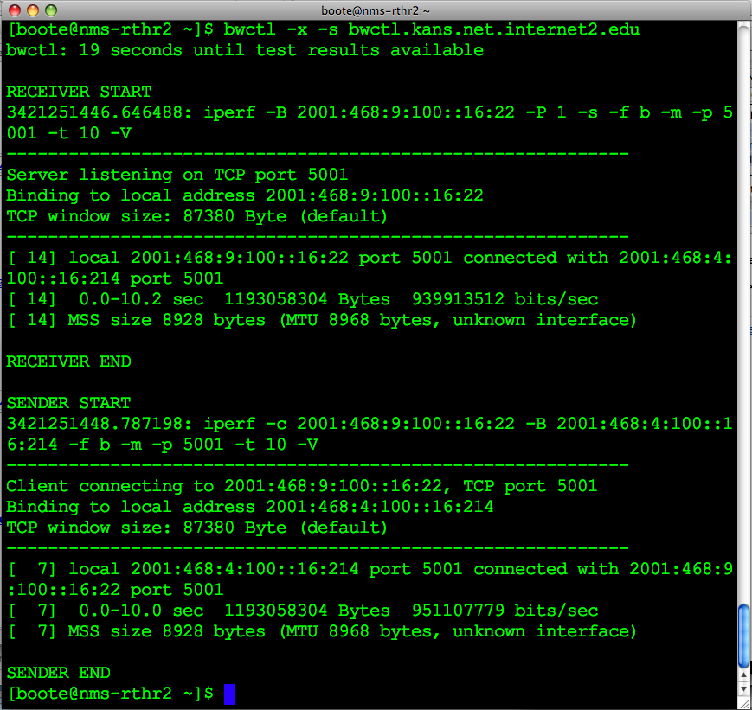
Example
<number> – 11/08/26, © 2010 Internet2

Slide 25
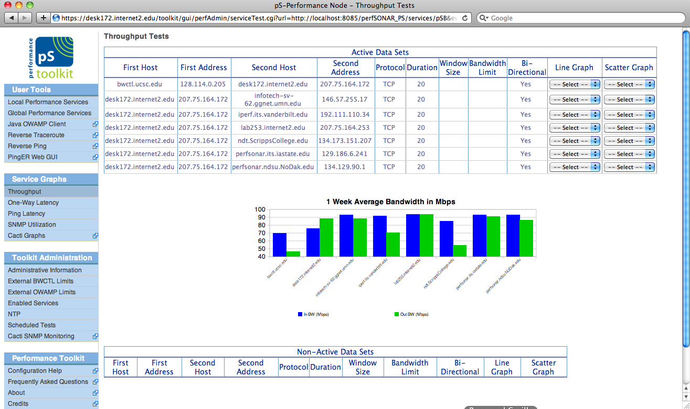
BWCTL GUIs
<number> – 11/08/26, © 2011 Internet2
Notes:
Regular bandwidth tests available via perfSONAR

Slide 26
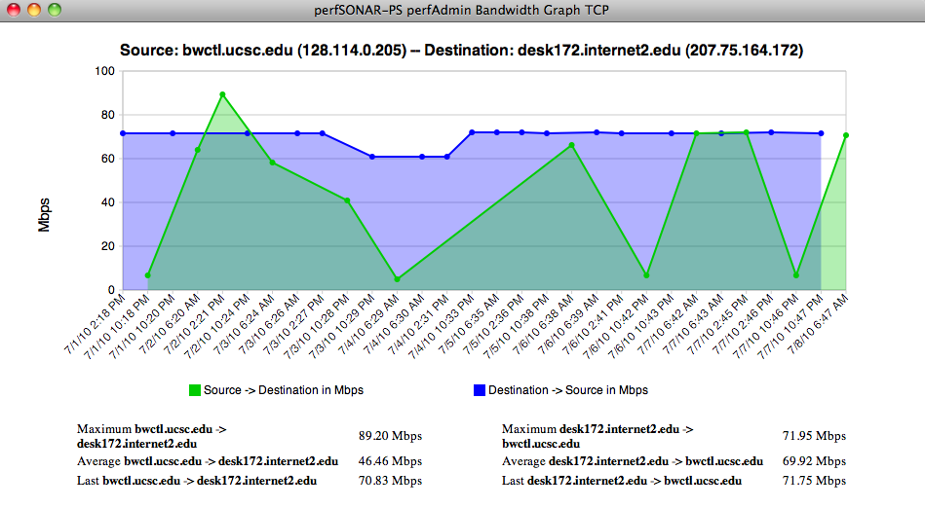
BWCTL GUIs
<number> – 11/08/26, © 2011 Internet2
Notes:
Bandwidth graph available from perfSONAR

Slide 27
Resource Allocation
Each connection is “classified” (authentication)
Each classification is hierarchical and has an associated set of hierarchical limits:
  Connection policy (allow_open_mode)
  Bandwidth (allow_tcp,allow_udp,bandwidth)
  Scheduling (duration,event_horizon,pending)
    A time slot is simply a time-dependent resource that needs to be allocated just like any other resource. It therefore follows the resource allocation model.
<number> – 11/08/26, © 2011 Internet2

Slide 28
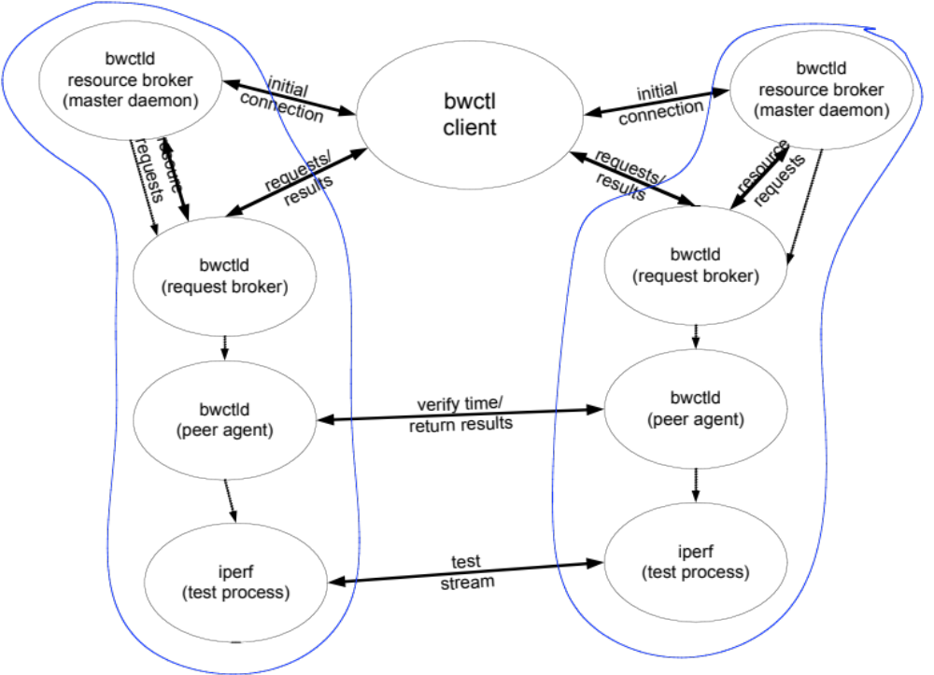
3rd Party Testing
<number> – 11/08/26, © 2011 Internet2

Slide 29
General Requirements
Iperf version 2.0.x
NTP (ntpd) synchronized clock on the local system
  Used for scheduling
  More important that errors are accurate than the clock itself
Firewalls:
  Lots of ports for communication and testing – see the web for specifics
End hosts must be tuned!
  http://fasterdata.es.net/fasterdata/host-tuning
  http://www.psc.edu/networking/perf_tune.html
<number> – 11/08/26, © 2011 Internet2

Slide 30
Supported Systems
Source Code
  All modern Unix distributions (Free BSD/Linux)
  OS X
Packages
  Support for CentOS 5.5 (x86)
  Packages have been shown to operate on similar systems (CentOS, Fedora, RHEL, and x86_64 architecture)
<number> – 11/08/26, © 2011 Internet2

Slide 31
Security Considerations
DoS source
  Imagine a large number of compromised BWCTLD servers being used to direct traffic
DoS target
  Someone might attempt to affect statistics web pages to see how much impact they can have
Resource consumption
  Time slots
  Network bandwidth
<number> – 11/08/26, © 2011 Internet2

Slide 32
Policy Approaches
Restrictive for UDP
  Allow between peers
  Limit bandwidth, and time of tests
More liberal for TCP tests
  Open for all (or peers)
  Limit length of tests
Protect AES keys!
  If being used
<number> – 11/08/26, © 2011 Internet2

Slide 33
Availability
Currently available
  http://www.internet2.edu/performance/bwctl
  http://software.internet2.edu
Mail lists:
  https://lists.internet2.edu/sympa/info/bwctl-users
    bwctl-users@internet2.edu
  https://lists.internet2.edu/sympa/info/bwctl-announce
    bwctl-announce@internet2.edu
<number> – 11/08/26, © 2011 Internet2

Slide 34
BWCTL
August 9th 2011, OSG Site Admin Workshop
Jason Zurawski – Internet2 Research Liaison
For more information, visit http://www.internet2.edu/workshops/npw
<number> – 11/08/26, © 2011 Internet2

Slide 35
Tester Applications
Iperf is primary “tester”
  Well known – widely used
Problems integrating exec’d tool
  Server initialization (port number allocation)
  error conditions
  No indication of partial progress (How full was the send buffer when the session was killed?)
thrulay/nuttcp are available also
<number> – 11/08/26, © 2011 Internet2

Slide 36
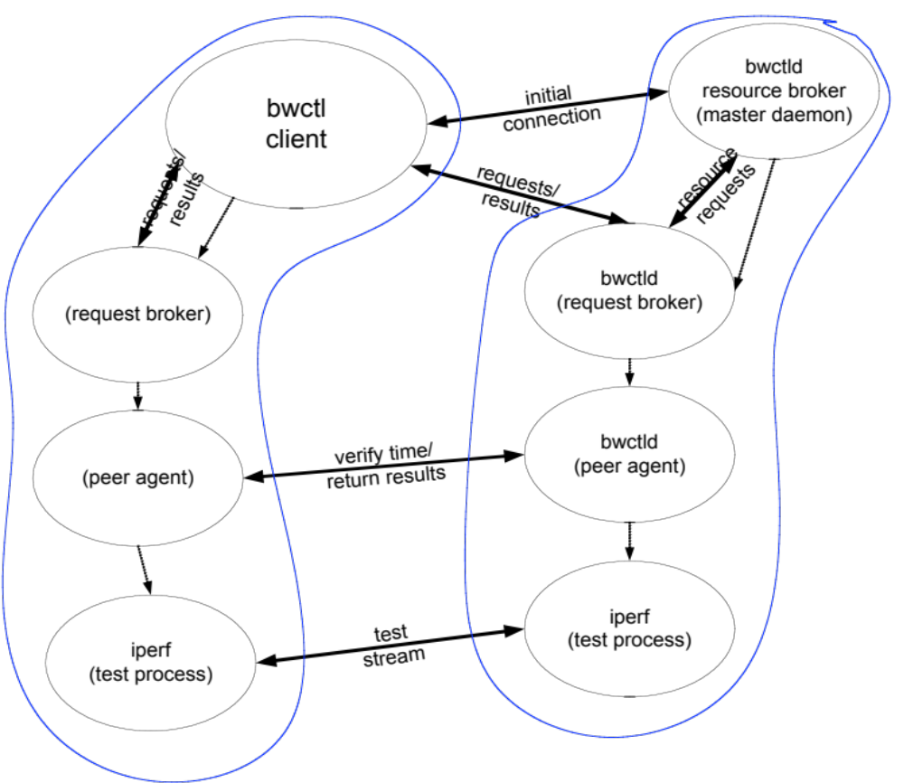
Testing with no “Local” Server
<number> – 11/08/26, © 2010 Internet2

