Slide 1



Campus Condor Pools
Mats Rynge – rynge@renci.org
Renaissance Computing Institute
University of North Carolina, Chapel Hill
Slide content from Using Condor: an Introduction - Condor Week

Slide 2
Outline
What is a campus Condor pool?
Example deployments
Tarheel Grid
Introduction to Condor

Slide 3
Campus Compute Resources
There is no place like home!
HPC (High Performance Computing)
  Topsail/Emerald (UNC), Sam/HenryN/POWER5 (NCSU), Duke Shared Cluster Resource (Duke)
HTC (High Throughput Computing)
  Tarheel Grid, NCSU Condor pool, Duke departmental pools

Slide 4
What is a campus Condor pool?
Enable departments and researchers on campus to share their existing computers
The same departments and researchers will have access to a larger pool of resources when they need to do large computations
Community driven project
  Enabled by central/department IT
Mix of resource types, operating systems, configurations such as UID and file system setups

Slide 5


What is a campus Condor pool? (cont)
Department
HPC
Workstation
Central Manager
Lab/Library
Department
Department
Department
Workstation
Notes:
Central IT dedicated resources, computer labs, libraries, departmental compute resources, computers in research labs, grad student work stations, …

Slide 6
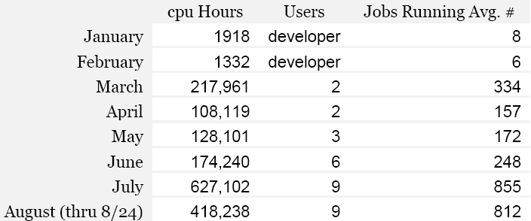
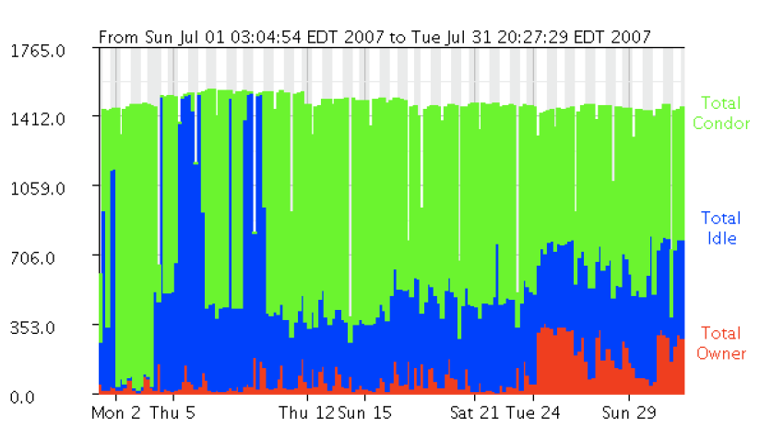
Clemson Campus Condor Pool
Machines in 50 different locations on Campus
~1,700 job slots
>1.8M hours served in
6 months
Users from Industrial and Chemical engineering, and Economics
Fast ramp up of usage
Accessible to the OSG through a gateway

Slide 7
Clemson (cont.)
1085 windows machines, 2 linux machines (central and a OSG gatekeeper), condor reporting 1563 slots
845 maintained by CCIT
241 from other campus depts
>50 locations
From 1 to 112 machines in one location
Student housing, labs, library, coffee shop
Mary Beth Kurz, first condor user at Clemson:
    March 215,000 hours, ~110,000 jobs
    April 110,000 hours, ~44,000 jobs

Slide 8

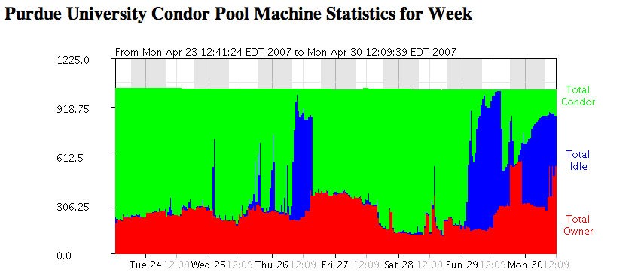
14,000 CPUs available
Campus Condor pool backfills idle nodes in PBS clusters - provided 5.5 million CPU-hours in 2006, all from idle nodes in clusters
Use on TeraGrid: 2.4 million hours in 2006 spent Building a database of hypothetical zeolite structures; 2007: 5.5 million hours allocated to TG
http://www.cs.wisc.edu/condor/PCW2007/presentations/cheeseman_Purdue_Condor_Week_2007.ppt

Slide 9
Condor
Distributed workload manager
  Central broker to handle distributed submit nodes, and distributed execution nodes
High Throughput Computing (HTC)
  Perfect for:
    Parameter sweeps
    Monte Carlo simulation
    Workflows
    Other serial applications
Well proven technology

Slide 10
Condor Features
Flexible scheduling policy engine via ClassAds
  Preemption, suspension, requirements, preferences, groups, quotas, settable fair-share, system hold…
Facilities to manage BOTH dedicated CPUs (clusters) and non-dedicated resources (desktops)
Transparent Checkpoint/Migration for many types of serial jobs
No shared file-system required
Workflow management (inter-dependencies)
Fault-tolerant: can survive crashes, network outages
Platforms: Linux i386/IA64, Windows 2k/XP, MacOS, Solaris, IRIX, HP-UX, Compaq Tru64, … lots.

Slide 11
Tarheel Grid
ITS provides central services (collector, negotiator, one submit node, …)
Campus departments / researches can join their existing compute resources to the pool, and share with the community
Resource owners have full control over the policy for their resources

Slide 12
Machines currently in the
Tarheel Grid pool
Old Baobab nodes
A set of ISIS machines
Odum Institute lab machines
Open Science Grid cluster at RENCI
Workstations / dedicated processing machines
158 slots Linux X86
41 slots Linux X86_64
2 slots Linux PPC64
54 slots Windows

Slide 13
Using Condor: an Introduction

Slide 14
Definitions
Job
  The Condor representation of your work
Machine
  The Condor representation of computers and that can perform the work
Match Making
  Matching a job with a machine “Resource”
Central Manager
  Central repository for the whole pool
  Performs job / machine matching, etc.

Slide 15
Job
Jobs state their requirements and preferences:
  I require a Linux/x86 platform
  I prefer the machine with the most memory
  I prefer a machine in the chemistry department

Slide 16
Machine
Machines state their requirements and preferences:
  Require that jobs run only when there is no keyboard activity
  I prefer to run Albert’s jobs
  I am a machine in the physics department
  Never run jobs belonging to Dr. Heisenberg

Slide 17
The Magic of Matchmaking
Jobs and machines state their requirements and preferences
Condor matches jobs with machines
  Based on requirements
  And preferences “Rank”

Slide 18
Getting Started:
Submitting Jobs to Condor
Overview:
  Choose a “Universe” for your job
  Make your job “batch-ready”
  Create a submit description file
  Run condor_submit to put your job in the queue

Slide 19
1. Choose the “Universe”
Controls how Condor handles jobs
Choices include:
  Vanilla
  Standard
  Grid
  Java
  Parallel
  VM

Slide 20
2. Make your job batch-ready
Must be able to run in the background
No interactive input
No GUI/window clicks
  Who needs ‘em anyway

Slide 21
Make your job batch-ready (details)…
  Job can still use STDIN, STDOUT, and STDERR (the keyboard and the screen), but files are used for these instead of the actual devices
  Similar to UNIX shell:
    $ ./myprogram <input.txt >output.txt

Slide 22
3. Create a Submit Description File
A plain ASCII text file
Condor does not care about file extensions
Tells Condor about your job:
  Which executable, universe, input, output and error files to use, command-line arguments, environment variables, any special requirements or preferences (more on this later)
Can describe many jobs at once (a “cluster”), each with different input, arguments, output, etc.

Slide 23
Simple Submit Description File
# Simple condor_submit input file
# (Lines beginning with # are comments)
# NOTE: the words on the left side are not
# case sensitive, but filenames are!
Universe = vanilla
Executable = cosmos
Output = cosmos.out
Queue

Slide 24
4. Run condor_submit
You give condor_submit the name of the submit file you have created:
  condor_submit cosmos.submit
condor_submit:
  Parses the submit file, checks for errors
  Creates a “ClassAd” that describes your job(s)
  Puts job(s) in the Job Queue

Slide 25
ClassAd ?
Condor’s internal data representation
  Similar to classified ads (as the name implies)
  Represent an object & its attributes
    Usually many attributes
  Can also describe what an object matches with

Slide 26
ClassAd Details
ClassAds can contain a lot of details
  The job’s executable is “cosmos”
  The machine’s load average is 5.6
ClassAds can specify requirements
  I require a machine with Linux
ClassAds can specify preferences
  This machine prefers to run jobs from the physics group

Slide 27
ClassAd Details (continued)
ClassAds are:
  semi-structured
  user-extensible
  schema-free
  Attribute = Expression

Slide 28
ClassAd Example
Example:
MyType = "Job"
TargetType = "Machine"
ClusterId = 1377
Owner = “einstein"
Cmd = “cosmos"
Requirements =
(
(Arch == "INTEL") &&
(OpSys == "LINUX") &&
(Disk >= DiskUsage) &&
( (Memory * 1024)>=ImageSize )
)
…
String
Number
Boolean

Slide 29
The Dog
ClassAd for the “Job”
. . .
Requirements =
(type == “Dog”) &&
(color == “Brown”) &&
(price <= 15)
. . .
ClassAd
Type = “Dog”
Color = “Brown”
Price = 12

Slide 30
Example: condor_submit and condor_q
% condor_submit cosmos.submit
Submitting job(s).
1 job(s) submitted to cluster 1.
% condor_q
-- Submitter: perdita.cs.wisc.edu : <128.105.165.34:1027> :
ID OWNER SUBMITTED RUN_TIME ST PRI SIZE CMD
1.0 einstein 4/15 06:52 0+00:00:00 I 0 0.0 cosmos
1 jobs; 1 idle, 0 running, 0 held
%

Slide 31
Email about your job
Condor sends email about job events to the submitting user
Specify “notification” in your submit file to control which events:
Notification = complete
Notification = never
Notification = error
Notification = always

Slide 32
“Clusters” and “Processes”
If your submit file describes multiple jobs, we call this a “cluster”
Each cluster has a unique “cluster number”
Each job in a cluster is called a “process”
  Process numbers always start at zero
A Condor “Job ID” is the cluster number, a period, and the process number (i.e. 2.1)
  A cluster can have a single process
    Job ID = 20.0 ·Cluster 20, process 0
  Or, a cluster can have more than one process
    Job ID: 21.0, 21.1, 21.2 ·Cluster 21, process 0, 1, 2

Slide 33
Submit File for a Cluster
# Example submit file for a cluster of 2 jobs
# with separate input, output, error and log files
Universe = vanilla
Executable = cosmos
Arguments = -f cosmos_0.dat
log = cosmos_0.log
Input = cosmos_0.in
Output = cosmos_0.out
Error = cosmos_0.err
Queue ·Job 2.0 (cluster 2, process 0)
Arguments = -f cosmos_1.dat
log = cosmos_1.log
Input = cosmos_1.in
Output = cosmos_1.out
Error = cosmos_1.err
Queue ·Job 2.1 (cluster 2, process 1)

Slide 34
Submit Description File for 1,000,000 Jobs
# Cluster of 1,000,000 jobs with different directories
Universe = vanilla
Executable = cosmos
Log = cosmos.log
Output = cosmos.out
Input = cosmos.in
Arguments = –f cosmos.dat
...
InitialDir = run_0 ·Log, input, output & error files -> run_0
Queue ·Job 3.0 (Cluster 3, Process 0)
InitialDir = run_1 ·Log, input, output & error files -> run_1
Queue ·Job 3.1 (Cluster 3, Process 1)
·Do this 999,998 more times…………

Slide 35
Submit File for a Big Cluster of Jobs
We just submitted 1 cluster with 1,000,000 processes
All the input/output files will be in different directories
The submit file is pretty unwieldy (over 5,000,000 lines!)
Isn’t there a better way?

Slide 36
Submit File for a Big Cluster of Jobs
(the better way)
We can queue all 1,000,000 in 1 “Queue” command
  Queue 1000000
Condor provides $(Process) and $(Cluster)
  $(Process) will be expanded to the process number for each job in the cluster
    0, 1, … 999999
  $(Cluster) will be expanded to the cluster number
    Will be 4 for all jobs in this cluster

Slide 37
$(Process)
The initial directory for each job can be specified using $(Process)
  InitialDir = run_$(Process)
  Condor will expand these to:
    “run_0”, “run_1”, … “run_999999” directories
Similarly, arguments can be variable
  Arguments = -n $(Process)
  Condor will expand these to:
    “-n 0”, “-n 1”, … “-n 999999”

Slide 38
Better Submit File for 1,000,000 Jobs
# Example condor_submit input file that defines
# a cluster of 100000 jobs with different directories
Universe = vanilla
Executable = cosmos
Log = cosmos.log
Input = cosmos.in
Output = cosmos.out
Error = cosmos.err
Arguments = –f cosmos.dat ·All share arguments
InitialDir = run_$(Process) ·run_0 … run_999999
Queue 1000000 ·Jobs 0 … 999999

Slide 39
Access to Data in Condor
Use shared filesystem if available
No shared filesystem?
  Condor can transfer files
    Can automatically send back changed files
    Atomic transfer of multiple files
    Can be encrypted over the wire
  Remote I/O Socket (parrot)

Slide 40
Condor File Transfer
ShouldTransferFiles = YES
  Always transfer files to execution site
ShouldTransferFiles = NO
  Rely on a shared filesystem
ShouldTransferFiles = IF_NEEDED
  Will automatically transfer the files if the submit and execute machine are not in the same FileSystemDomain
# Example submit file using file transfer
Universe = vanilla
Executable = cosmos
Log = cosmos.log
ShouldTransferFiles = IF_NEEDED
Transfer_input_files = dataset.$(Process), common.data
Transfer_output_files = TheAnswer.dat
Queue 600

Slide 41
Now what?
Some of the machines in the pool can’t run my jobs
  Not the right operating system for my executable
  Not enough RAM
  Not enough scratch disk space
  Required software not installed
  Etc.

Slide 42
Specify Requirements
An expression (syntax similar to C or Java)
Must evaluate to True for a match to be made
Universe = vanilla
Executable = cosmos
Log = cosmos.log
InitialDir = run_$(Process)
Requirements = Memory >= 4096 && Disk > 10000
Queue 1000000

Slide 43
Advanced Requirements
Requirements can match custom attributes in your Machine Ad
  Can be added by hand to each machine
  Or, automatically using the scripts
Universe = vanilla
Executable = cosmos
Log = cosmos.log
InitialDir = run_$(Process)
Requirements = ( (HasCosmosData =!= UNDEFINED) && \
(HasCosmosData == TRUE) )
Queue 1000000

Slide 44
And, Specify Rank
All matches which meet the requirements can be sorted by preference with a Rank expression.
Higher the Rank, the better the match
Universe = vanilla
Executable = cosmos
Log = cosmos.log
Arguments = -arg1 –arg2
InitialDir = run_$(Process)
Requirements = Memory >= 4096 && Disk > 10000
Rank = (KFLOPS*10000) + Memory
Queue 1000000

Slide 45
My jobs aren’t running!!

Slide 46
Check the queue
Check the queue with condor_q:
bash-2.05a$ condor_q
-- Submitter: x.cs.wisc.edu : <128.105.121.53:510> :x.cs.wisc.edu
ID OWNER SUBMITTED RUN_TIME ST PRI SIZE CMD
5.0 einstein 4/20 12:23 0+00:00:00 I 0 9.8 cosmos -arg1 –n 0
5.1 einstein 4/20 12:23 0+00:00:00 I 0 9.8 cosmos -arg1 –n 1
5.2 einstein 4/20 12:23 0+00:00:00 I 0 9.8 cosmos -arg1 –n 2
5.3 einstein 4/20 12:23 0+00:00:00 I 0 9.8 cosmos -arg1 –n 3
5.4 einstein 4/20 12:23 0+00:00:00 I 0 9.8 cosmos -arg1 –n 4
5.5 einstein 4/20 12:23 0+00:00:00 I 0 9.8 cosmos -arg1 –n 5
5.6 einstein 4/20 12:23 0+00:00:00 I 0 9.8 cosmos -arg1 –n 6
5.7 einstein 4/20 12:23 0+00:00:00 I 0 9.8 cosmos -arg1 –n 7
6.0 einstein 4/20 13:22 0+00:00:00 H 0 9.8 cosmos -arg1 –arg2
8 jobs; 8 idle, 0 running, 1 held

Slide 47
Look at jobs on hold
% condor_q –hold
-- Submiter: x.cs.wisc.edu : <128.105.121.53:510> :x.cs.wisc.edu
ID OWNER HELD_SINCE HOLD_REASON
6.0 einstein 4/20 13:23 Error from starter on skywalker.cs.wisc.edu
9 jobs; 8 idle, 0 running, 1 held
Or, See full details for a job
% condor_q –l 6.0

Slide 48
Check machine status
Verify that there are idle machines with condor_status:
bash-2.05a$ condor_status
Name OpSys Arch State Activity LoadAv Mem ActvtyTime
vm1@tonic.c LINUX INTEL Claimed Busy 0.000 501 0+00:00:20
vm2@tonic.c LINUX INTEL Claimed Busy 0.000 501 0+00:00:19
vm3@tonic.c LINUX INTEL Claimed Busy 0.040 501 0+00:00:17
vm4@tonic.c LINUX INTEL Claimed Busy 0.000 501 0+00:00:05
Total Owner Claimed Unclaimed Matched Preempting
INTEL/LINUX 4 0 4 0 0 0
Total 4 0 4 0 0 0

Slide 49
Look in Job Log
Look in your job log for clues:
bash-2.05a$ cat cosmos.log
000 (031.000.000) 04/20 14:47:31 Job submitted from host: <128.105.121.53:48740>
...
007 (031.000.000) 04/20 15:02:00 Shadow exception!
Error from starter on gig06.stat.wisc.edu: Failed to open '/scratch.1/einstein/workspace/v67/condor-test/test3/run_0/cosmos.in' as standard input: No such file or directory (errno 2)
0 - Run Bytes Sent By Job
0 - Run Bytes Received By Job
...

Slide 50
Better analysis: condor_q –better-analyze
bash-2.05a$ condor_q -better-ana 29
The Requirements expression for your job is:
( ( target.Memory > 8192 ) ) && ( target.Arch == "INTEL" ) &&
( target.OpSys == "LINUX" ) && ( target.Disk >= DiskUsage ) &&
( TARGET.FileSystemDomain == MY.FileSystemDomain )
Condition Machines Matched Suggestion
--------- ---------------- ----------
1 ( ( target.Memory > 8192 ) ) 0 MODIFY TO 4000
2 ( TARGET.FileSystemDomain == "cs.wisc.edu" )584
3 ( target.Arch == "INTEL" ) 1078
4 ( target.OpSys == "LINUX" ) 1100
5 ( target.Disk >= 13 ) 1243

Slide 51
Job Policy Expressions
User can supply job policy expressions in the submit file.
Can be used to describe a successful run.
on_exit_remove = <expression>
on_exit_hold = <expression>
periodic_remove = <expression>
periodic_hold = <expression>

Slide 52
Job Policy Examples
Do not remove if exits with a signal:
  on_exit_remove = ExitBySignal == False
Place on hold if exits with nonzero status or ran for less than an hour:
  on_exit_hold = ( (ExitBySignal==False) && (ExitSignal != 0) ) || ( (ServerStartTime - JobStartDate) < 3600)
Place on hold if job has spent more than 50% of its time suspended:
  periodic_hold = CumulativeSuspensionTime > (RemoteWallClockTime / 2.0)

Slide 53
DAGMan
Directed Acyclic Graph Manager
DAGMan allows you to specify the dependencies between your Condor jobs, so it can manage them automatically for you.
  E.G.: “Don’t run job ‘B’ until job ‘A’ has completed successfully.”
Notes:
In the simplest case…

Slide 54
What is a DAG?
A DAG is the data structure used by DAGMan to represent these dependencies.
Each job is a “node” in the DAG.
Each node can have any number of “parent” or “children” nodes – as long as there are no loops!
Job A
Job B
Job C
Job D
Notes:
a DAG is the best data structure to represent a workflow of jobs with dependencies
children may not run until their parents have finished – this is why the graph is a directed graph … there’s a direction to the flow of work
In this example, called a “diamond” dag, job A must run first; when it finishes, jobs B and C can run together; when they are both finished, D can run; when D is finished the DAG is finished
Loops, where two jobs are both descended from one another, are prohibited because they would lead to deadlock – in a loop, neither node could run until the other finished, and so neither would start – this restriction is what makes the graph acyclic

Slide 55
DAGs large and small
DAGMan can scale up to huge DAGs
  LIGO runs 500,000 node DAGs
DAGMan is useful even in the small cases!
  What about a simple 2 job DAG?
    Run database query
    Process output
    Can all be run on one machine--no Condor pool necessary
DAGMan can be used as a Condor job throttle
  Lots of nodes with no dependencies
Notes:
In the simplest case…

Slide 56
Defining a DAG
A DAG is defined by a .dag file, listing each of its nodes and their dependencies:
  # diamond.dag
  Job A a.sub
  Job B b.sub
  Job C c.sub
  Job D d.sub
  Parent A Child B C
  Parent B C Child D
each node will run the Condor job
specified by its accompanying
Condor submit file
Job A
Job B
Job C
Job D
Notes:
This is all it takes to specify the example “diamond” dag

Slide 57
Condor Commands Cheat Sheet
condor_status
condor_submit
condor_q
condor_rm
condor_submit_dag

Slide 58
E N D

