Slide 1
Rsv-control
Marco Mambelli – marco@hep.uchicago.edu
Site Coordination meeting
October 1, 2009

Slide 2
rsv-control
Utility to control and manage OSG-RSV and its probe
List metrics
Enable/disable metrics
Test probes
Configure probes
Start/stop and setup RSV
Resource and Service Validation (RSV) framework
RSV within the OSG monitoring and information system
Probes and metrics
Site operations

Slide 3
OSG Monitoring and Information
OSG Information Management (OIM) System
MyOSG
Resource and Service Validation (RSV)
BDII
Generic Information Provider (GIP)
CEMon
Resource Selection Service (ReSS)
Gratia
https://twiki.grid.iu.edu/twiki/bin/view/MonitoringInformation/WebHome

Slide 4
OSG-RSV
Framework to run probes and consumers
Provide local validation of an OSG resource
Collect centrally monitoring information
Can run separately
Integrated with the OSG resource
configure-osg configuring also the OSG-RSV framework

Slide 5
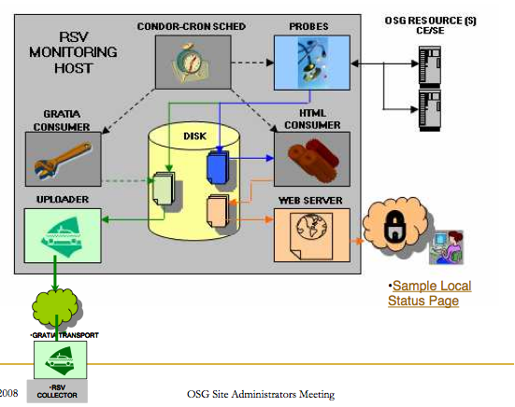
OSG-RSV framework (courtesy of Arvind Gopu)
Metric
Probe
Consumer
Uploader
Web server
Scheduler

Slide 6
Probe
Script that accepts specific input parameters and returns output respecting a standard defined in WLCG
Identified by the file name
Can provide one or more metric
Self describing
Provided by a developer (not necessarily GOC)
Collected and distributed (as probe-set) by GOC, the Grid Operation Center
https://twiki.cern.ch/twiki/bin/view/LCG/GridMonitoringProbeSpecification

Slide 7
Metric
Value that OSG wants to measure, collect or verify, e.g. the version of the installed OSG software or the consistency of some directories
For the benefit of the system administrator, a Virtual Organization, users of the grid, Open Science Grid itself
Useful for verification and troubleshooting: green light
For monitoring
For accounting
For resource selection

Slide 8
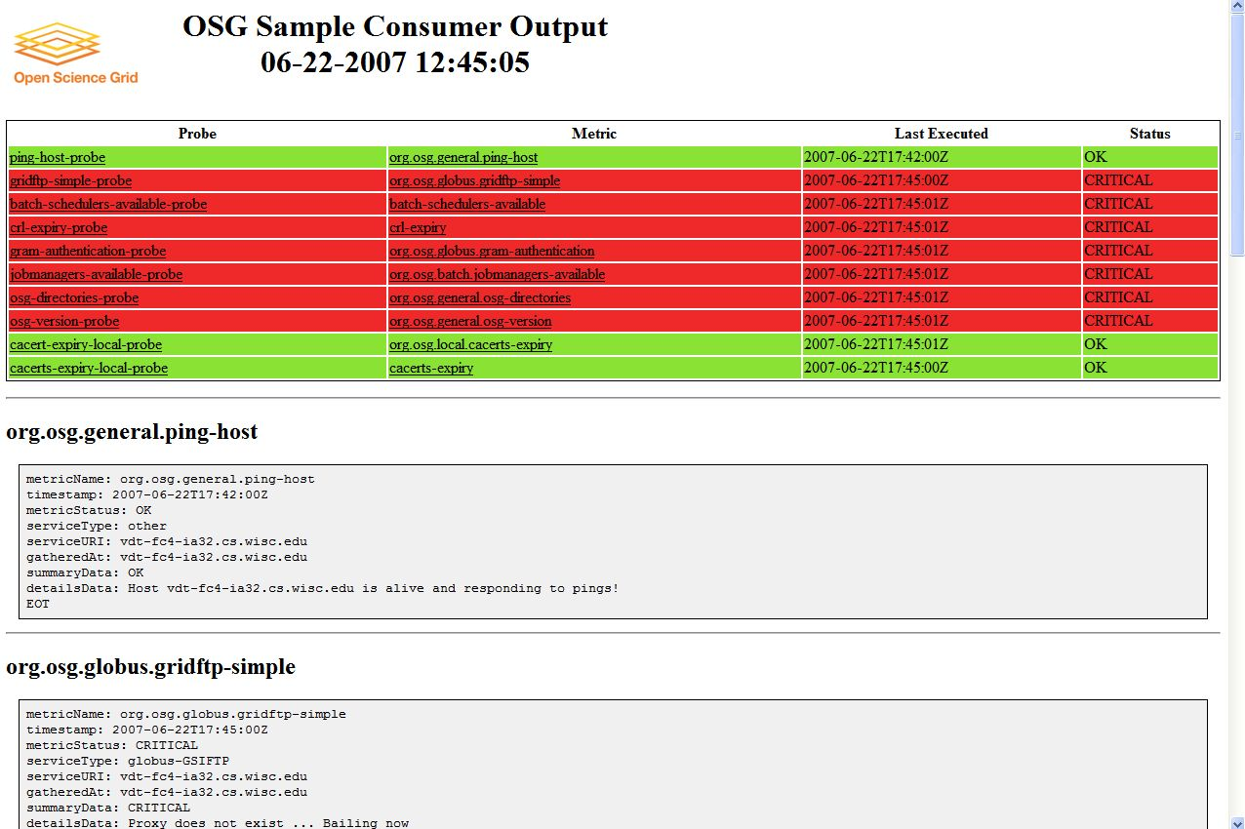
Consumer
HTML consumer generates local Web pages
Gratia consumer reports to the gratia accounting system

Slide 9
Probes in RSV
Probes are Perl scripts
Use a wrapper and utilities provided in RSV
Scheduled using CondorCron
Probe ID: <filename>@<metricname>__<host>
All files referring a metric (submit, stdout, stderr, log) start with the probe ID
http://rsv.grid.iu.edu/documentation/help/
https://twiki.grid.iu.edu/bin/view/ArchivedDocumentation/ITB/ITB090/ValidateRSV-Probes

Slide 10
Rsv-control
Python modules to work with probes, the OSG-RSV installation, the scheduler (CondorCron) and the utility
A wrapper to set the environment and invoke the Python code
Provides ability to list installed probes and their status, to enable/disable probes and to test them
The plan is to extend the tool and support more functionalities covering the operation of probes and OSG-RSV framework

Slide 11
Rsv-control: use
usage: rsv-control [ --verbose ]
--help | -h
--version
--list [ --wide | -w | --full-width] [ --format <format> ] [ all | <probeID>]
--enable [--user <user>] --metric <metric-name> --host <host-name>
--enable [--user <user>] --service <service-name> --host <host-name>
--disable [--user <user>] --metric <metric-name> --host <host-name>
--disable [--user <user>] --service <service-name> --host <host-name>
--full-test [--user <user>] --metric <metric-name> --host <host-name>
--test [--user <user>] --metric <metric-name> --host <host-name>

Slide 12
List
List probe information. If no probe is specified in the argument all probes are listed in a short tabular form. Each line has probe name, type and status or host (if the probe is enabled). Lines may be truncated to fit the page. The table list one line for each enabled metric. If that metric is not enabled against any host, it list one line with the metric status (probably DISABLED).
Formatting option:
wide: Wide list display (156 columns instead of the 76 by default)
full-width: Avoid truncation in probe listing
format: Specify the information to list
local: status in OSG-RSV
brief: status for the submitter (condor-cron)
long: long status (output of 'condor_cron_q ID')
full: full status (full list of classads returned by condor-cron)
log: dump of the log file (userlog for condor-cron)
out: dump of the stdout returned by the probe execution againsts the specific host
err: dump of the stderr returned by the probe execution againsts the specific host

Slide 13
Test
Run against the HOST (URI) the probe returning METRIC. Probe is executed and output returned. No file is written.
metric: Specify the metric to enable/disable (e.g. org.osg.general.ping-host)
host: Specify the host FQDN and optionally the port to be used by the probe (e.g. host or host:port). This is optional depending on the requirement of the probe. See the documentation for the specific probe
user: Specify the user to use to run the probe. You must be able to switch to that user.

Slide 14
Full test
Test against the HOST (URI) the probe returning METRIC. It takes the same arguments of Test.
Probe is executed within the OSG-RSV framework, only once, immediately.
Testing a probe will not affect normal execution but will create some files in the installation. Log, output and error files are different.

Slide 15
Enable/disable
Enable or disable a probe or a SERVICE. Support the same options as test and service.
service: Specify the service type of the probes to enable/disable. All the probes matching the service type will be enabled/disabled (e.g. OSG-CE)
Modify the configuration files and submits/removes the job from CondorCron
Idempotent: multiple invocation will not change the final result (probe enabled/disabled)

Slide 16
Installation and setup (temporary)
Installation (choose a directory)
<download> rsvcontrol-test-v010.tar.gz
tar xvzf rsvcontrol-test-v010.tar.gz
export PATH=$PATH:`pwd`/rsvctrl-test/bin
Setup
$VDT_LOCATION/setup.sh
export PATH=$PATH:<install_dir>/rsvctrl-test/bin/
https://twiki.grid.iu.edu/bin/view/ReleaseDocumentation/RsvControl

Slide 17
Example
rsv-control --list
Metric | Service | Hostname
------------------------------------------+---------------+--------------------
...osg.batch.jobmanager-condor-ext-status | OSG-CE | DISABLED
org.osg.batch.jobmanager-condor-status | OSG-CE | DISABLED
org.osg.batch.jobmanager-default-status | OSG-CE | uct3-edge7.uchic...
...sg.batch.jobmanager-ext-default-status | OSG-CE | DISABLED
org.osg.batch.jobmanager-fork-ext-status | OSG-CE | DISABLED
org.osg.batch.jobmanager-fork-status | OSG-CE | DISABLED
...atch.jobmanager-loadleveler-ext-status | OSG-CE | DISABLED
...sg.batch.jobmanager-loadleveler-status | OSG-CE | DISABLED
org.osg.batch.jobmanager-lsf-ext-status | OSG-CE | DISABLED
org.osg.batch.jobmanager-lsf-status | OSG-CE | DISABLED
...atch.jobmanager-managedfork-ext-status | OSG-CE | DISABLED
...sg.batch.jobmanager-managedfork-status | OSG-CE | DISABLED
org.osg.batch.jobmanager-pbs-ext-status | OSG-CE | DISABLED
org.osg.batch.jobmanager-pbs-status | OSG-CE | DISABLED
org.osg.batch.jobmanagers-available | OSG-CE | uct3-edge7.uchic...
org.osg.certificate.supportedvo.verify | OSG-CE | DISABLED
org.osg.certificates.cacert-expiry | OSG-CE | uct3-edge7.uchic...
org.osg.certificates.crl-expiry | OSG-CE | uct3-edge7.uchic...

Slide 18
More information
OSG-RSV
http://rsv.grid.iu.edu/documentation/vdt-package.html
http://rsv.grid.iu.edu/documentation/rsv-contact-info.html
rsv-control
https://twiki.grid.iu.edu/bin/view/ReleaseDocumentation/RsvControl
Send your feedback!
marco@hep.uchicago.edu
Support
OSG tickets: https://ticket.grid.iu.edu/goc/open
OSG Campfire: http://integrationcloud.campfirenow.com/6e62e

