Slide 1

Introduction to OSG Storage
Suchandra Thapa
Computation Institute
University of Chicago
March 19, 2009
GSAW 2009 Clemson

Slide 2
Overview
Storage in OSG
  Storage for VDT
  Storage Extension
  Support
  Certification
  Community tools
  Documentation
  Support
  GIP & Storage Element
Bestman
  Overview
  “full-mode”/“gateway”
  “gateway”/Xrootd installation
dCache
  Overview
  Monitoring tools
  Opportunistic storage
  Gratia Probes
March 19, 2009
GSAW 2009 Clemson

Slide 3
Why do we care about storage?
Sites are growing to the point where putting a bunch of disks and nfs exporting it no longer works
  Too much space needed to make it economical
    LHC projects will generate several petabytes of data a year
    Typical Tier 2 sites have on the order of 500TB – 1PB of storage space
  I/O contention and loads will bring down a normal NFS server
March 19, 2009
GSAW 2009 Clemson

Slide 4
Why care about storage (the sequel)?
Would like additional information on storage
  Let users easily get space information (available/used) without checking sites individually
Advertise space availability and allow disk space to be reserved
  If your site is sponsored by a VO like ATLAS, you don’t want to have another VO come in and use up all the space
March 19, 2009
GSAW 2009 Clemson

Slide 5
Solutions for OSG Storage
OSG Storage for VDT is a well integrated distributed project between Wisconsin
and Fermilab. Activities:
Packaging storage software for VDT
  Srm/dCache
  BeStMan
  BeStMan-gateway/Xrootd (NEW)
Simplify configuration/installation for OSG
Help VOs to use storage on OSG sites
Develop and run validation tests
Develop/maintain/package accounting and monitoring tools
Support/test/package community tools
Provide users and admins support
Perform troubleshooting and debugging
OSG liaison to storage developer groups
Educate OSG community about storage, provide documentation
Participate in grid schools organized by OSG
March 19, 2009
GSAW 2009 Clemson

Slide 6
OSG Storage Extension
Project
Tightly related to OSG Storage for VDT
Goals for this year:
  Develop software to match storage attributes of a job to a Storage Element
  Develop web interface
    for SE discovery and authorization check
    for creating and managing space reservations
  Work on consolidation of monitoring functionalities of Storage Elements into one interface.
  Provide electronic means for sites to announce SE maintenance period
March 19, 2009
GSAW 2009 Clemson

Slide 7
Support Challenges
Complicated, highly distributed services
Huge variety of configuration options (software and hardware)
Widely diverse utilization patterns
dCache is known for poor error diagnostics, exception handling and propagation
We do not enough experience with Xrootd
Lack of monitoring/diagnostic tools
Support team does not have access to the service. Support personnel
  Often are not authorized to use the service as user
  Can not access site logs and configuration
  Often can not access storage monitoring pages on the site
We would like to ask storage administrators for cooperation in:
Notifying us about the reoccurring problems
Provide us access to log files, configuration files
March 19, 2009
GSAW 2009 Clemson

Slide 8
Certification
Maintain test stands
  6 nodes test stand for dCache
  Planning to have 5 nodes test stand for BeStMan-gateway/xrootd
Develop/run validation test suites before software is released to VDT
  dCache test suite covers:
    all srm-fermi-client commands
    data replication
    space management
    load tests
  BeSTMan testing provided by LBL
    Site registration, daily test results - http://datagrid.lbl.gov/osg
    Site could run tests with srm-tester-2 – instructions at https://twiki.grid.iu.edu/twiki/bin/view/Storage/BeStMan
  BeStMan-gateway/Xrootd covers:
    all supported srm-lbl-client /srm-fermi-client commands – work in progress at Fermilab
March 19, 2009
GSAW 2009 Clemson

Slide 9
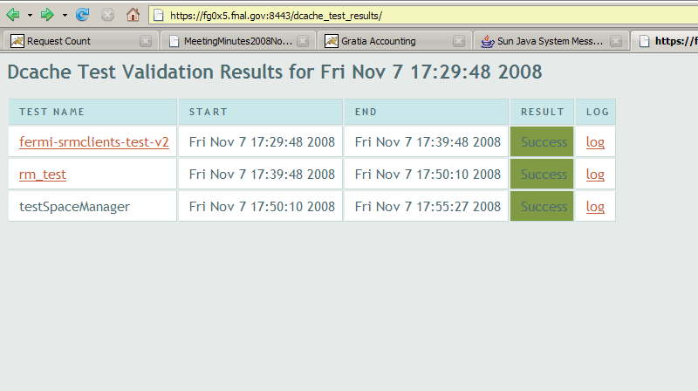
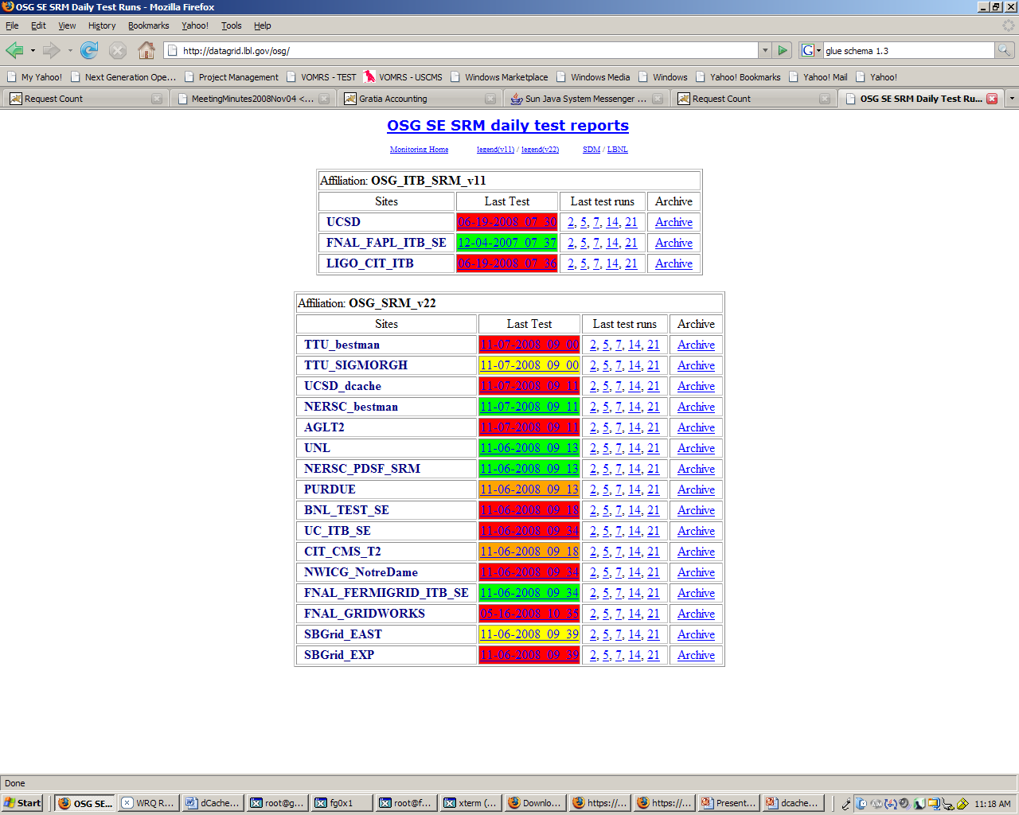
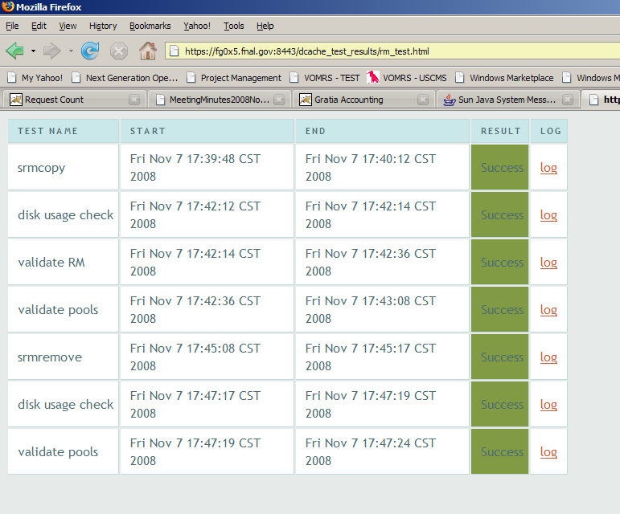
Test Suites Results
LBL SRM Tester Results
Fermilab Validation Test Suite Results
March 19, 2009
GSAW 2009 Clemson

Slide 10
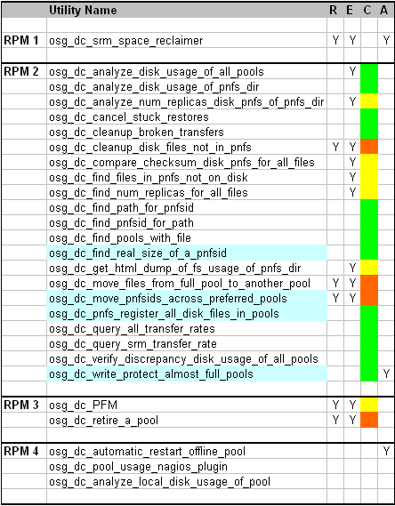
Community-contributed toolkit
Goal is to provide a boost in effectiveness and efficiency ofoperating the deployed storage
Download from http://datagrid.ucsd.edu/toolkit
Is packaged as rpms
Collected/packaged by A. Rana
March 19, 2009
GSAW 2009 Clemson

Slide 11
Storage Documentation
Revised documentation
Main Page:
  https://twiki.grid.iu.edu/twiki/bin/view/Documentation/WebHome
Useful links under Storage Element administrators:
  Opportunistic Storage/Space Reservation
  Opportunistic Storage Model for USCMS
  Gratia Storage Probes
  Tools, Tips, FAQs
  dCache Installation/references
  BeStMan references
March 19, 2009
GSAW 2009 Clemson

Slide 12
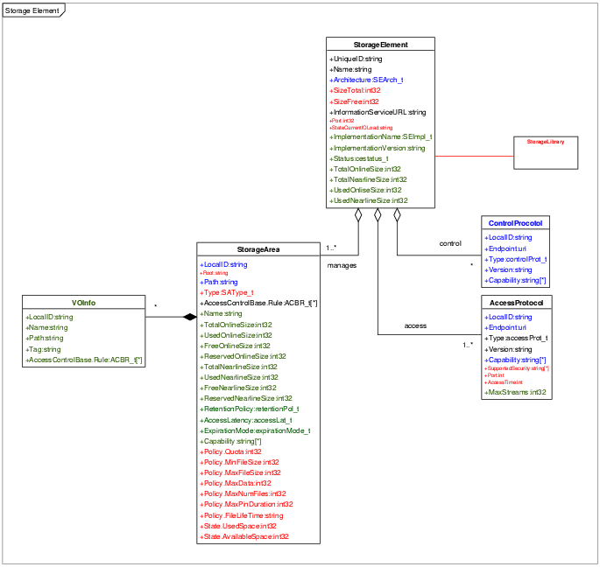
Storage Element Discovery
Glue Schema 1.3
  ControlProtocol
    SRM
  AccessProtocol
    gsiftp
  Storage Area
    Groups of Pools
    VOInfo
      Path
GIP/CeMon
  Collects information on CE
  Sends BDII/ReSS information
  ReSS Information is used for job matching
March 19, 2009
GSAW 2009 Clemson

Slide 13
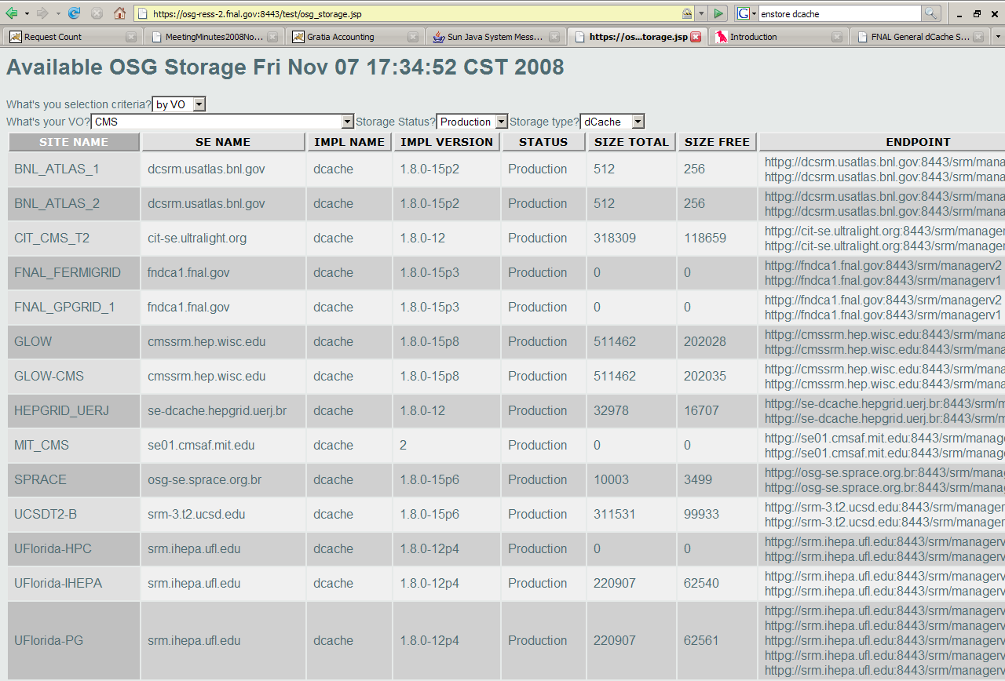
Storage Discovery Example
You can find what sites support your VO or what information is advertised by a site about SE: https://osg-ress-2.fnal.gov:8443/test/osg_storage.jsp
March 19, 2009
GSAW 2009 Clemson

Slide 14
Berkley Storage Management (BeStMan)
What is BeStMan?
  Developed in LBNL by Scientific Data Management Research Group
  Full implementation of SRM v2.2 for disk based storage systems and mass storage systems
  Supports transfer services:
    GsiFtp
    Ftp
    Http
    Https
  Supports multiple transfer servers
  GSI security with either grid-mapfile or GUMS server
Who would benefit from BeStMan?
  Sites with limited hardware resources
  Sites with limited admin effort
BeStMan could be used in two modes:
  Full mode
  Gateway mode
March 19, 2009
GSAW 2009 Clemson

Slide 15
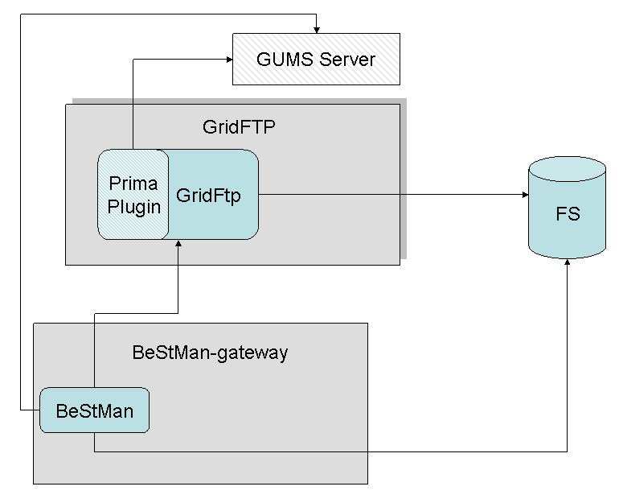
BeStMan-gateway
Generic SRM v2.2 load balancing frontend for GridFTP servers
Light-weight implementation of SRM v2.2 for POSIX file systems
  srmPing
  srmLs
  srmRm
  srmMkdir
  srmRmdir
  srmPrepareToPut (Status, PutDone)
  srmPrepareToGet(Status,ReleaseFiles)
Designed to work with any Posix-like file systems
  NFS, GPFS, GFS, NGFS, PNFS, HFS+, PVFS, AFS, Lustre, XrootdFS, Hadoop
Doesn’t support queuing or disk space management
March 19, 2009
GSAW 2009 Clemson

Slide 16
BeStMan-gateway/Xrootd
Xrootd - is designed to provide POSIX-like access to files and their enclosing directory namespace
BeStMan-gateway needs the following additional components to work with Xrootd
  FUSE - File System in User Space http://fuse.sourceforge.net
  XrootdFS - implements a Posix filesystem for an Xrootd storage cluster http://wt2.slac.stanford.edu/xrootdfs/xrootdfs.html
GridFtp needs Data Storage Interface (DSI) module in order to work with Xrootd storage
March 19, 2009
GSAW 2009 Clemson

Slide 17
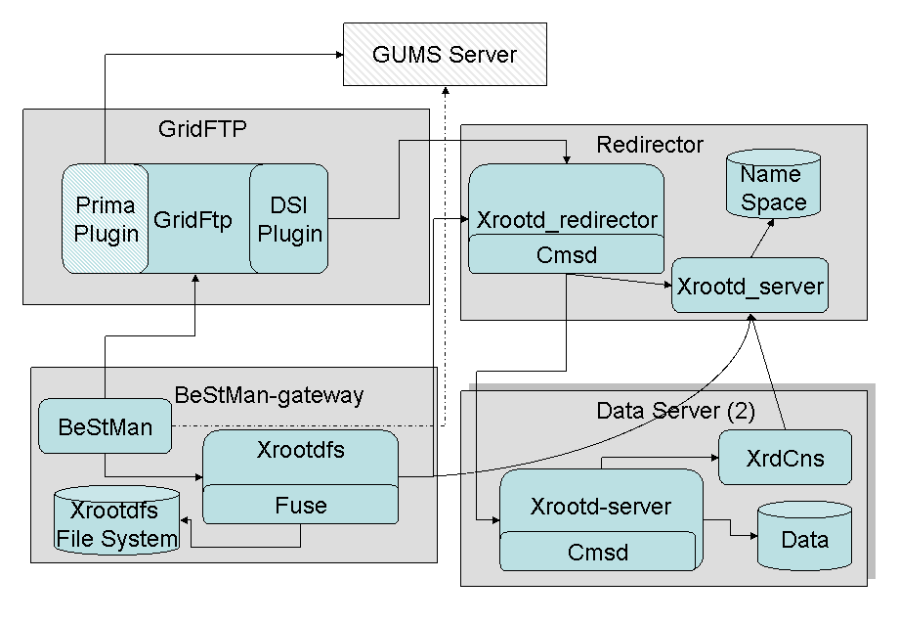
BeStMan-gateway/Xrootd Architecture
March 19, 2009
GSAW 2009 Clemson

Slide 18
Before Installing
BeStMan-gateway/Xrootd
How many nodes could be used for storage?
  Minimum number of nodes is 3:
  BeStMan, XroodFS, fuse, GridFtp
  Xrootd redirector
  Xrootd data server node
Chose authorization mechanism do you prefer?
  GUMS
  gridmap-file
Do you need to support static space tokens?
Select name for Mount Point for XrootdFS on BeStMan node
Decide how to partition storage areas on Xrootd redirector and data server nodes
March 19, 2009
GSAW 2009 Clemson

Slide 19
XrootdFs Installation (I)
Install fuse using “yum install” or rpms (e.g http://rpmfind.net/linux/rpm2html/search.php?query=fuse)
  fuse-2.7.3-1
  fuse-libs-2.7.3-1
  kernel-module-fuse-2.6.9-78.0.1.EL-2.7.3-1
Install and configure XrootdFS
  pacman -get http://vdt.cs.wisc.edu/vdt_XXX_cache/XrootdFS
  $VDT_LOCATION/vdt/setup/configure_xrootdfs \
  --user <user> \
  --cache <mount-point> \
  --xrdr-host <hostname> \
  --xrdr-storage-path <path>
March 19, 2009
GSAW 2009 Clemson

Slide 20
BeStMan-gateway
Installation (II)
Install and configure BestMan
  pacman -get OSG:Bestman
  $VDT_LOCATION/vdt/setup/configure_bestman --server y \
  --user <user> \
  --cert <service_cert> \
  --key <service_key> \
  --http-port <public_port> \
  --https-port <secured_port> \
  --gums-host <GUMS hostname> \
  --gums-port <GUMS port number> \
  --gums-dn <Client DN for GUMS interface> \
  --use-xrootd \
  --with-tokens-list "<TOKEN_1_NAME>[desc:<TOKEN_1_DESC][TOKEN_1_SIZE_GB];TOKEN_2_NAME[desc:TOKEN_2_DESC][TOKEN_2_SIZE]" \
  --with-transfer-servers <GridFTP server list>
Modify /etc/sudoers
  Cmnd_Alias SRM_CMD = /bin/rm, /bin/mkdir, /bin/rmdir, /bin/mv, /bin/ls
  Runas_Alias SRM_USR = ALL, !root
  <user_name> ALL=(SRM_USR) NOPASSWD: SRM_CMD
March 19, 2009
GSAW 2009 Clemson

Slide 21
GridFtp Installation (II)
Install and configure GridFtp
  pacman -get OSG:Xrootd-GridFTP
  $VDT_LOCATION/vdt/setup/configure_gridftp --use-xrootd \
  --xrootd-host <hostname> \
  --xrootd-mount-point <mount_point> \
  --xrootd-storage-path < path>
March 19, 2009
GSAW 2009 Clemson

Slide 22
Xrootd-Redirector Installation
(IV)
Install and configure Xrootd redirector
  pacman -get OSG:Xrootd
  $VDT_LOCATION/vdt/setup/configure_xrootd \
  --server y \
  --this-is-xrdr \
  --user <user> \
  --xrdr-storage-path <path> \
  --xrdr-storage-cache <cache> \
  --with-tokens-list "<TOKEN_1_NAME>[desc:<TOKEN_1_DESC][TOKEN_1_SIZE_GB];TOKEN_2_NAME[desc:TOKEN_2_DESC][TOKEN_2_SIZE]" \
  --public-cache-size <PUBLIC_SPACE_SIZE>
March 19, 2009
GSAW 2009 Clemson

Slide 23
Xrootd Data Server Installation
(V)
Install and configure Xrootd data server
  pacman -get OSG:rootd
  $VDT_LOCATION/vdt/setup/configure_xrootd \
  --server y \
  --user <user> \
  --xrdr-host <hostname> \
  --xrdr-storage-path <path> \
  --xrdr-storage-cache <cache> \
  --with-tokens-list "<TOKEN_1_NAME>[desc:<TOKEN_1_DESC][TOKEN_1_SIZE_GB];TOKEN_2_NAME[desc:TOKEN_2_DESC][TOKEN_2_SIZE]" \
  --public-cache-size <PUBLIC_SPACE_SIZE>
March 19, 2009
GSAW 2009 Clemson

Slide 24
Start/stop order for
BeStMan-gateway/Xrootd
Use vdt-control –on/--off mechanism
Start severs in the following order (use reverse order to stop):
  Xrootd redirector
  Xrootd data server
  GridFtp
  XrootdFs/Bestman-gateway
Test
  srm-ping srm://<BeStMan_host>:8443/srm/v2/server
  srm-copy file:////tmp/test srm://<BeStMan_host>.gov:8443/srm/v2/server\?SFN=<MOUNT_POINT>/test -spacetoken <TOKEN_1_NAME>
March 19, 2009
GSAW 2009 Clemson

Slide 25
BeStMan in VDT
BeStMan is one of data storage solutions supported by OSG. BeStMan-gateway, BeStMan-gateway/Xrootd requested by ATLAS are just released in VDT
Current version of software
  BeStMan - 2.2.1.2.e1
  XrootdFS - 2.2.1.1
  GridFTP-Xrootd ,xrootd-dsi-20080828-1632
  Prima 0.7.1
  Xrootd - 20080828-1632
VDT configuration script tailored to set up BeStMan “full mode”/gateway for Tier-2/Tier-3
BeStMan srm-clients are distributed as a part of VDT client cache
  Fermi client
  LBNL client
  LCG-utils
There are several installations of BeStMan on OSG sites
March 19, 2009
GSAW 2009 Clemson

Slide 26
dCache Main Features
nfs-mountable namespace
Multiple access protocols
  dcap (posix io), gsidcap
  xrootd (posix io)
  gsiftp (multiple channels)
Replica Manager
  Set min/max number of replicas
Role-based authorization
  Selection of authorization mechanisms
Opportunistic storage
Billing
Admin interface
  ssh, jython
InformationProvider (not in production - yet)
  SRM and gsiftp described in glue schema
Platform, fs independent (Java)
  32 and 64-bit linux, solaris; ext3, xfs, zfs
March 19, 2009
GSAW 2009 Clemson

Slide 27
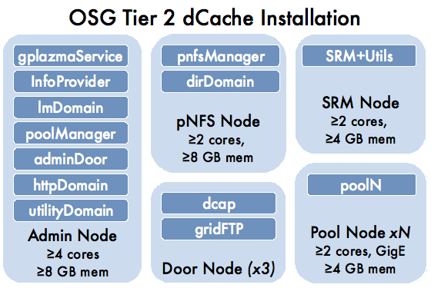
dCache OSG Tier-2 site Architecture
Slide courtesy of Ted Hesselroth (from presentation: “Installing and Using SRM-dCache”)
March 19, 2009
GSAW 2009 Clemson

Slide 28
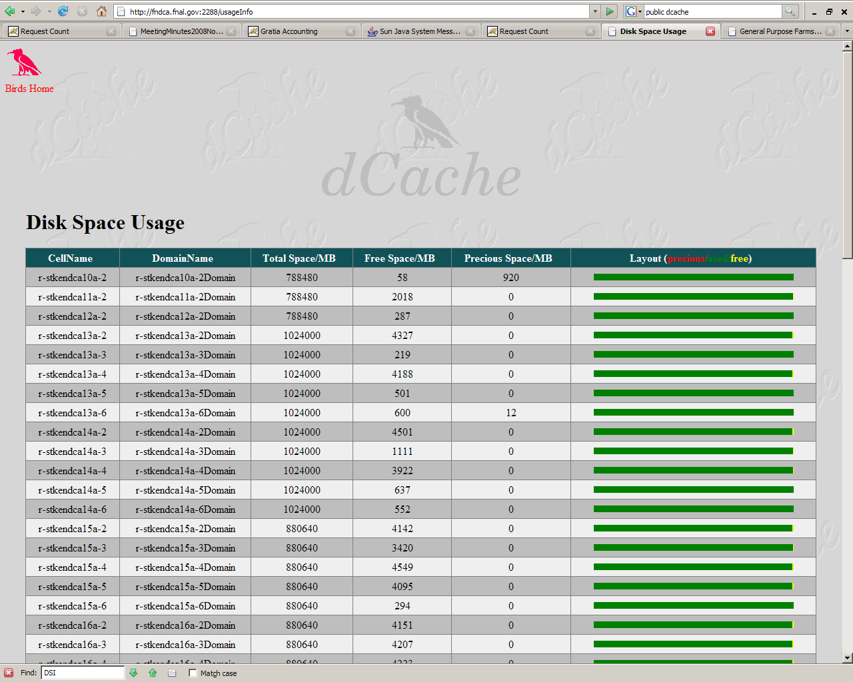
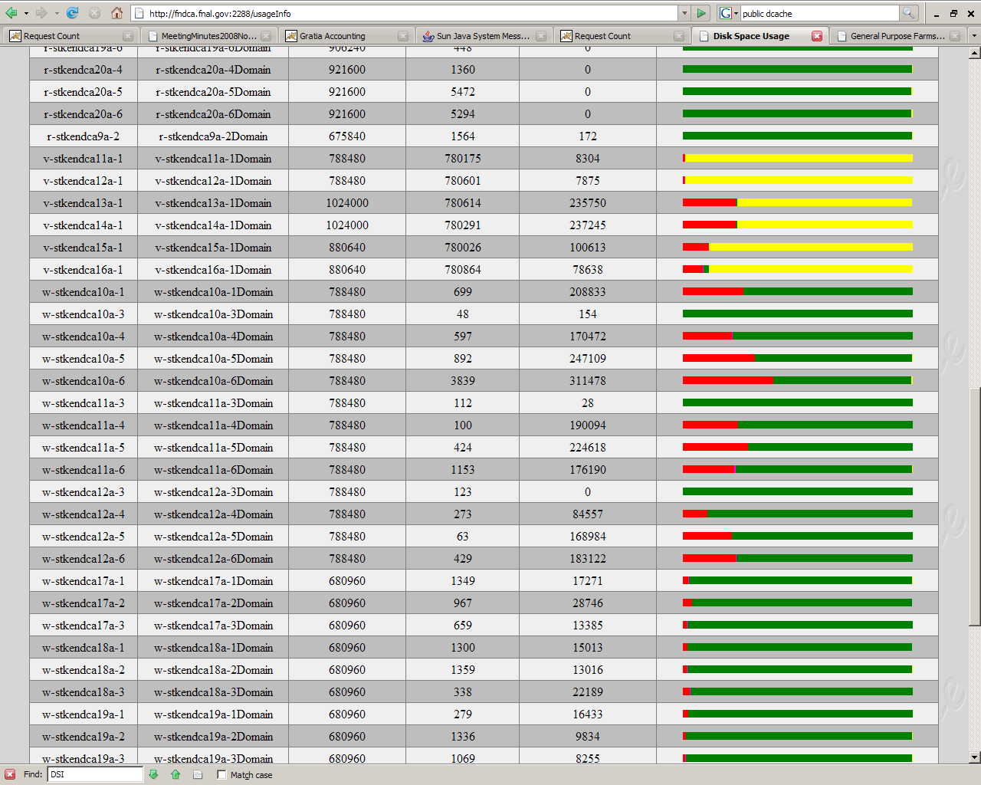
dCache Monitoring
Numerous ways to monitor
dCache
Info Pages - http://localhost:2288
SrmWatch - http://localhost:8080/srmwatch/
Admin Interface ( UI or from command line)
Scripts/web pages built by community
  http://fndca.fnal.gov
  http://fndca2a.fnal.gov:9090/lps/plots/src/plots.lzx
March 19, 2009
GSAW 2009 Clemson

Slide 29
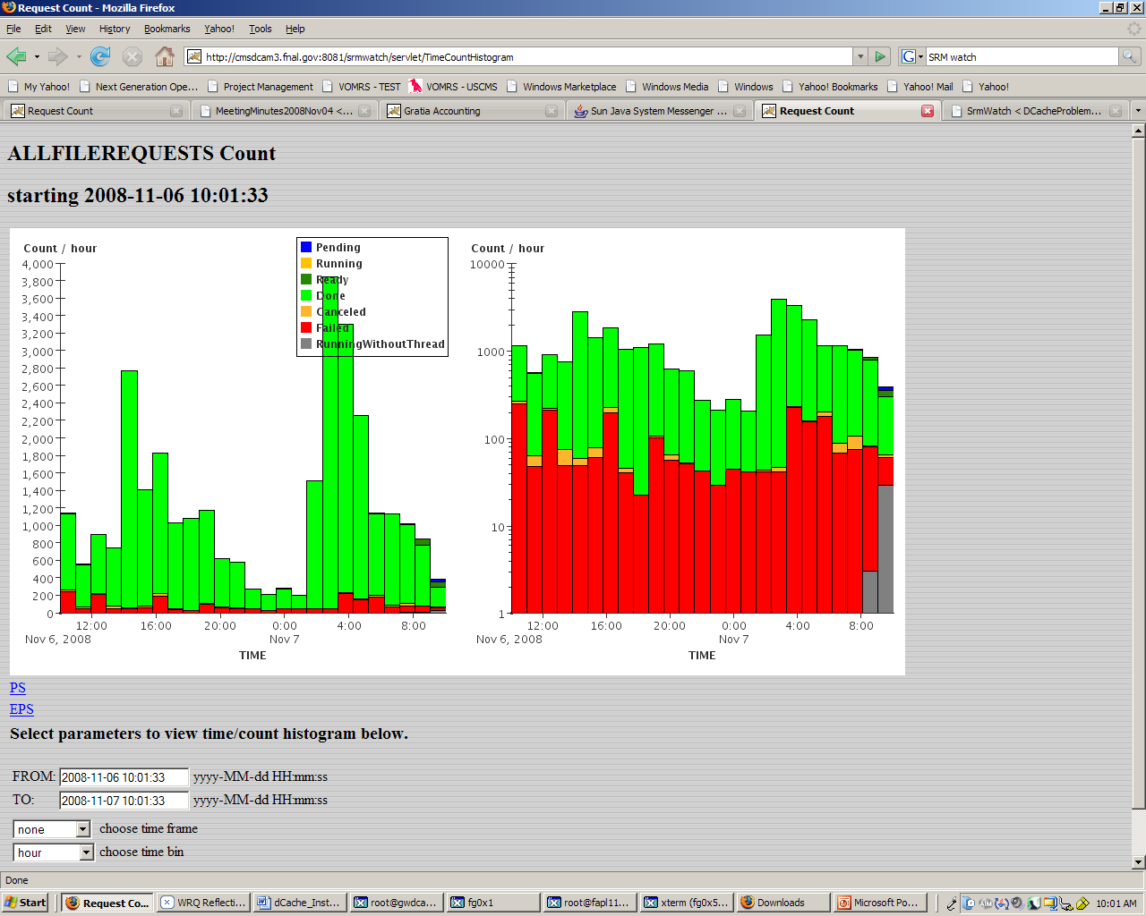
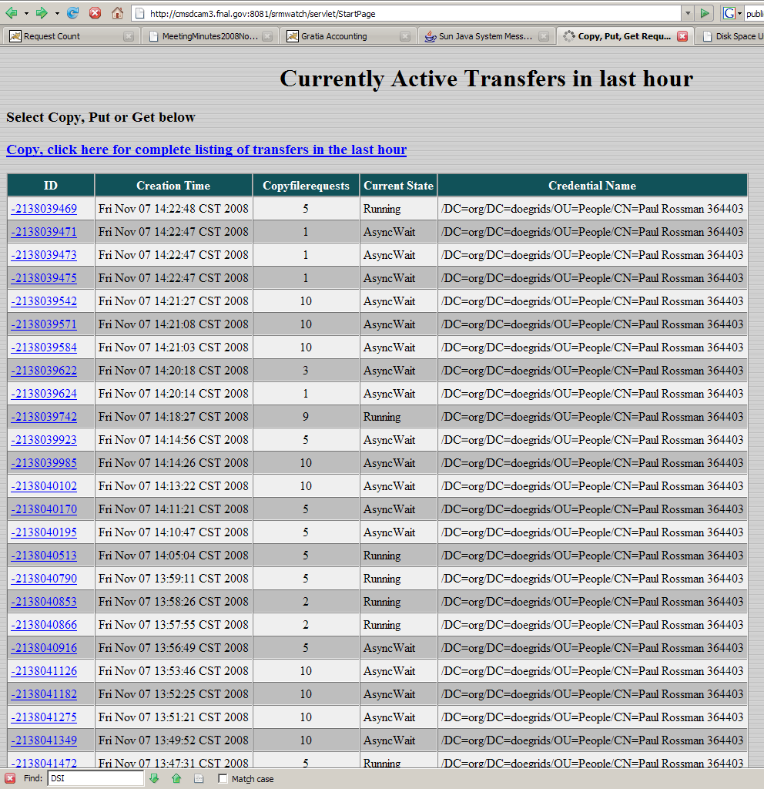
SRMWatch Examples
March 19, 2009
GSAW 2009 Clemson

Slide 30
Gratia Service
Gratia is the accounting service for OSG is provided by the Gratia
external project.
Main goal is to provide the stakeholders with a reliable and accurate set of views of the Grid resources usage.
Job and other accounting information gathered by Gratia probes run on the compute element or other site nodes are reported to a Gratia collectors
  Fermi collector: http://gratia-fermi.fnal.gov:8886/gratia-reporting
  OSG collector: http://gratia.opensciencegrid.org:8886/gratia-reporting
Accounting records collected by Gratia are forwarded to the EGEE accounting system, APEL:
  http://www3.egee.cesga.es/gridsite/accounting/CESGA/osg_view.html
March 19, 2009
GSAW 2009 Clemson

Slide 31
dCache Gratia Probes
dCache Gratia Probes
  Storage Probe
  Transfer Probe
Storage Probe
  Is responsible for reporting storage capacity and storage usage
  Gets the pool information from the dCache admin server
  Gets the SRM information from the SRM tables in the SRM Postgres database
  Runs as a cron job on the host running the Postgres database server for SRM
Transfer Probe
  Reports the details of each file transfer into or out of a dCache file server
  Gets this information from the dCache "billing" database.
  Runs as a daemon process
  For performance reasons, sites with large dCache billing databases are advised to alter the "billinginfo" table by indexing specific tables in order speed up the search for newly added records
March 19, 2009
GSAW 2009 Clemson

Slide 32
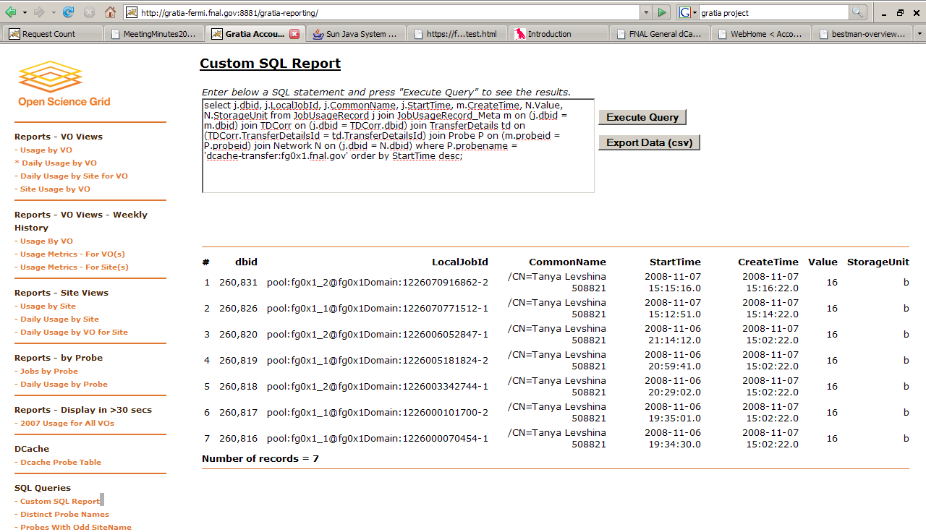
Gratia Transfer Probes Report
March 19, 2009
GSAW 2009 Clemson

Slide 33
dCache Information Service
A snapshot of the current status of a dCache instance for external consumption
  Works independently of the rest of dCache.
  Pools information for various dCache components (configurable update period).
Doesn't provide historic data
Not an info-provider but GIP is a customer
Access data:
  Via the admin interface
  Via XML Conduit - A TCP connection get complete state as XML.
  Web front-end
  Supports some advanced features:
Derived data (re-)calculated as state changes.
Multiple output formats and transports.
If additional metrics, data formats or transports are needed, they can be added
March 19, 2009
GSAW 2009 Clemson

Slide 34
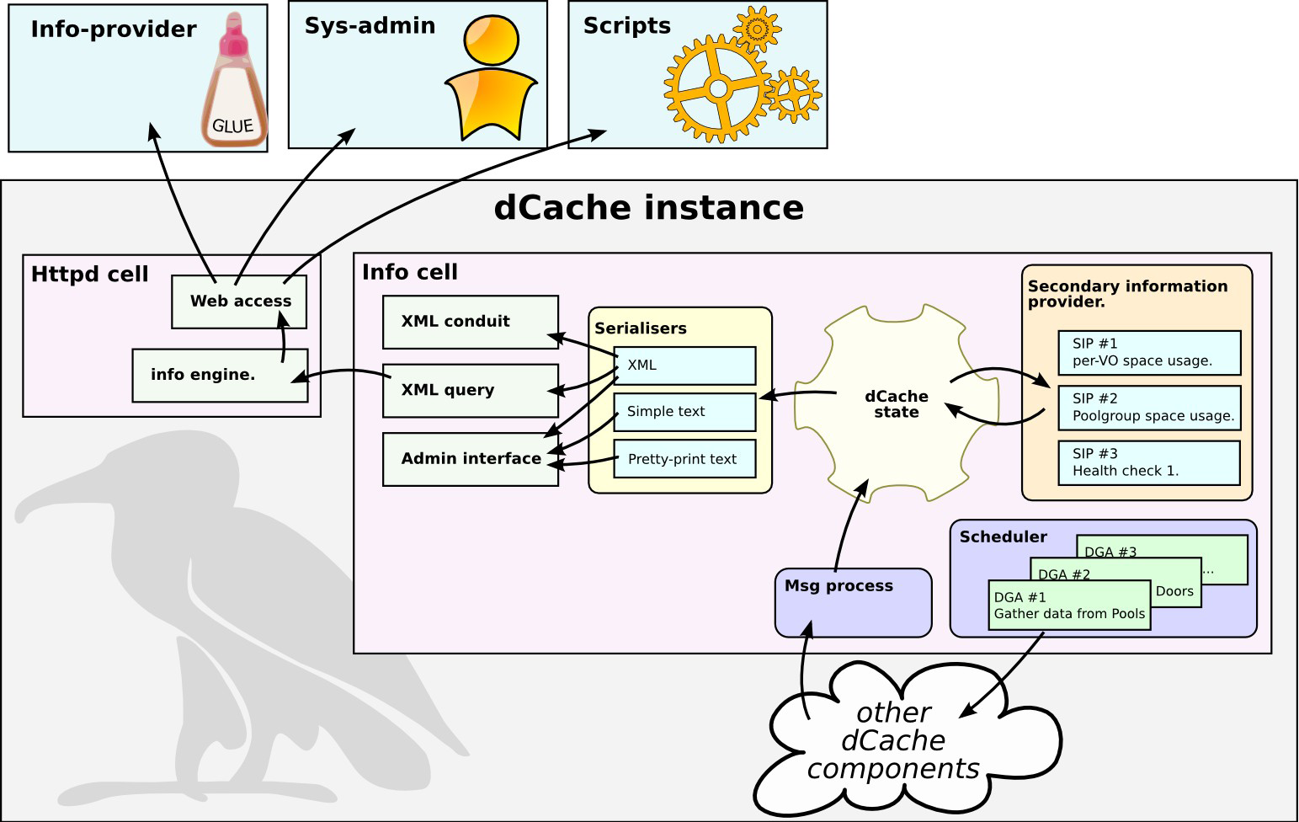
Information Service Architecture
From Paul Millar’s presentation: “dCache seminar: introducing the info service “
http://www.dcache.org/manuals/dCache-info-20080813.pdf
March 19, 2009
GSAW 2009 Clemson

Slide 35
Opportunistic Storage
Opportunistic Storage in dCache 1.8 with SRM 2.2
  Provides a capability of specifying a portion of the total storage for opportunistic use
  Allows particular VOs and Roles a privilege to use space other than that included in opportunistic storage
  Files created through opportunistic use will not be permanently available in the storage system
  A storage site administrator may configure the site for opportunistic use through space reservation.
  Creation of space reservations is controlled by use of link groups
  The administrator may assign storage pools to link groups
  Certain pools are designated for opportunistic use.
Numerous documents describing how to install and operate Opportunistic Storgae on Tier-2 sites
  https://twiki.grid.iu.edu/twiki/bin/view/Storage/OpportunisticStorageSetup
  https://twiki.grid.iu.edu/bin/view/Storage/OpportunisticStorageModelForCMS
March 19, 2009
GSAW 2009 Clemson

Slide 36
dCache in VDT
dCache is one of the data storage solutions supported by OSG
dCache could be installed from VDT
Current version is vdt 2.2.8 (dcache 1.8.0.15 p11)
Distribution contains dCache-server, pnfs, postgress, gratia probes rpms and a configuration script tailored to set up dCache for Tier-2/Tier-3
Configuration script allows to do system setup, enable opportunistic storage, replication etc
dCache-clients are distributed as a part of VDT client cache
  Fermi client
  LBNL client
  LCG-utils
There are multiple installations of dCache on OSG sites
March 19, 2009
GSAW 2009 Clemson

Slide 37
Summary
We will continue to work on improving storage packaging in VDT
  Feedback is welcome!
We are trying to make support more efficient by providing FQA, debugging the most frequently occurred problems, working with developers on improving logging and error diagnostic
  The quality of the support depends greatly on Storage Admins cooperation!!!
We will add BeStMan test stand and will do BeStMan/Xrootd certification the same way it is done with dCache release
We will be glad to accept/package more community tools
We are trying to maintain documentation up-to-date, adding new interesting references and “how to do” tips
  Please let us know if we are missing some important topics!
As a liaison to software developers we will be happy to pass your requests/suggestions
March 19, 2009
GSAW 2009 Clemson

Slide 38
Acknowledgements
Tanya Levshina
March 19, 2009
GSAW 2009 Clemson

