Slide 1
SAMD21 – Overview, Debugging, Tips and Tricks
Dr. Edras Pacola
May 2024

Slide 2
Agenda
SAMD21 Architecture Overview
SAMD21 Curiosity Nano
MPLABX, Compiler and Harmony
SERCOM and SysTick Timer / USART Hello World
Blinky with Callbacks
External Interrupts
SERCOM I2C / SPI
Console and Commands

Slide 3
SAMD21 Architecture Overview
Cortex-M0+
Designed for low-power and efficient operation
32-bit ARMv6-M architecture
A single-cycle multiply and hardware division
Nested Vectored Interrupt Controller (NVIC) for fast handling of interrupts
Interrupt Priorities
Nested Interrupts
Dynamic Priorities
Up to 48 MHz operating frequency
Operating Voltage: 1.62V – 3.63V
Low Power:
Active@48MHz, 3.3V: 3.64mA
Idle@8Mhz, 3.3V: 1.28mA
Standby@32KHz, 3.3V: 12.8uA

Slide 4
SAMD21 Architecture Overview
SAMD21G17A - Features and Peripherals
Peripheral Category | Peripheral Type | Description | Quantity
Memory | FLASH | In-System Self-programmable | 128KB
 | SRAM | Volatile Memory | 16KB
Input/Output | GPIO | General-Purpose Input/Outpu | 38
 | EIC | External Interrupt Controller | 16
Timer/Counter | TC (Timer Counter) | Multiple 16-bit or 32-bit timers/counters | 3
 | TCC (Control Timer/Counter) | High-resolution timers/counters for PWM and waveform generation | 4
 | RTC (Real-Time Counter) | 32-bit counter with calendar and alarm functions | 1
 | WDT (Watchdog Timer) | System reset generation upon timeout | 1

Slide 5
SAMD21 Architecture Overview
SAMD21G17A - Features and Peripherals
Peripheral Category | Peripheral Type | Description | Quantity
Communication | SERCOM | Serial Communication Interface (USART/SPI/I2C) | 6
 | USB | Full-speed USB device and embedded host, with 8 endpoints | 1
Analog | ADC | 12-bit resolution, up to 350 ksps | 1 / 14 channels
 | DAC | 10-bit resolution | 1
 | AC | Analog Comparator | 2
 | PTC | Peripheral Touch Controller | 120/10
DMA |  | Supports data transfers between memory and peripherals without CPU intervention | 12 channels

Slide 6
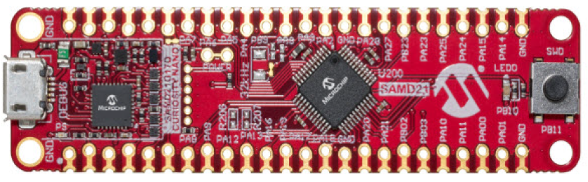
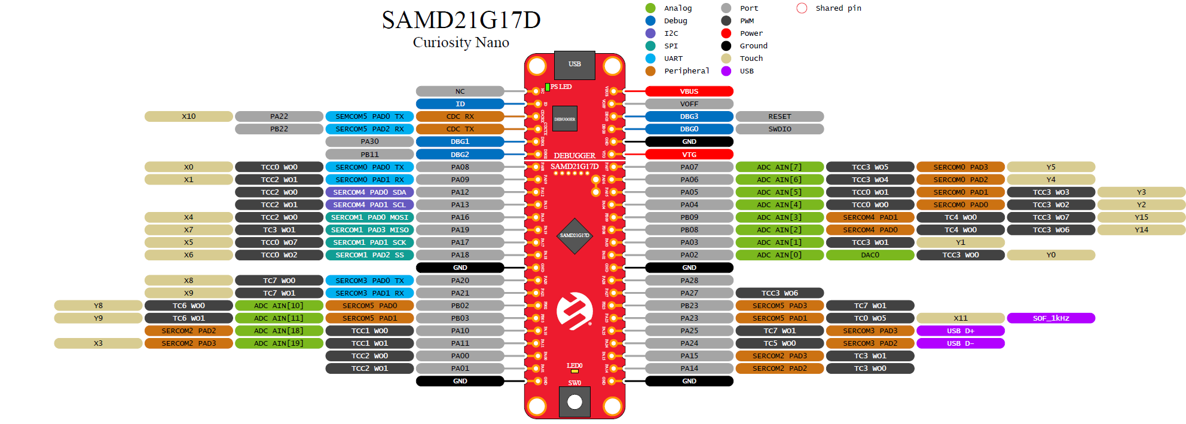
SAMD21 Curiosity Nano
Hardware
https://ww1.microchip.com/downloads/aemDocuments/documents/MCU32/ProductDocuments/UserGuides/SAMD21-Curiosity-Nano-Evaluation-Kit-User-Guide-DS70005409D.pdf

Slide 7
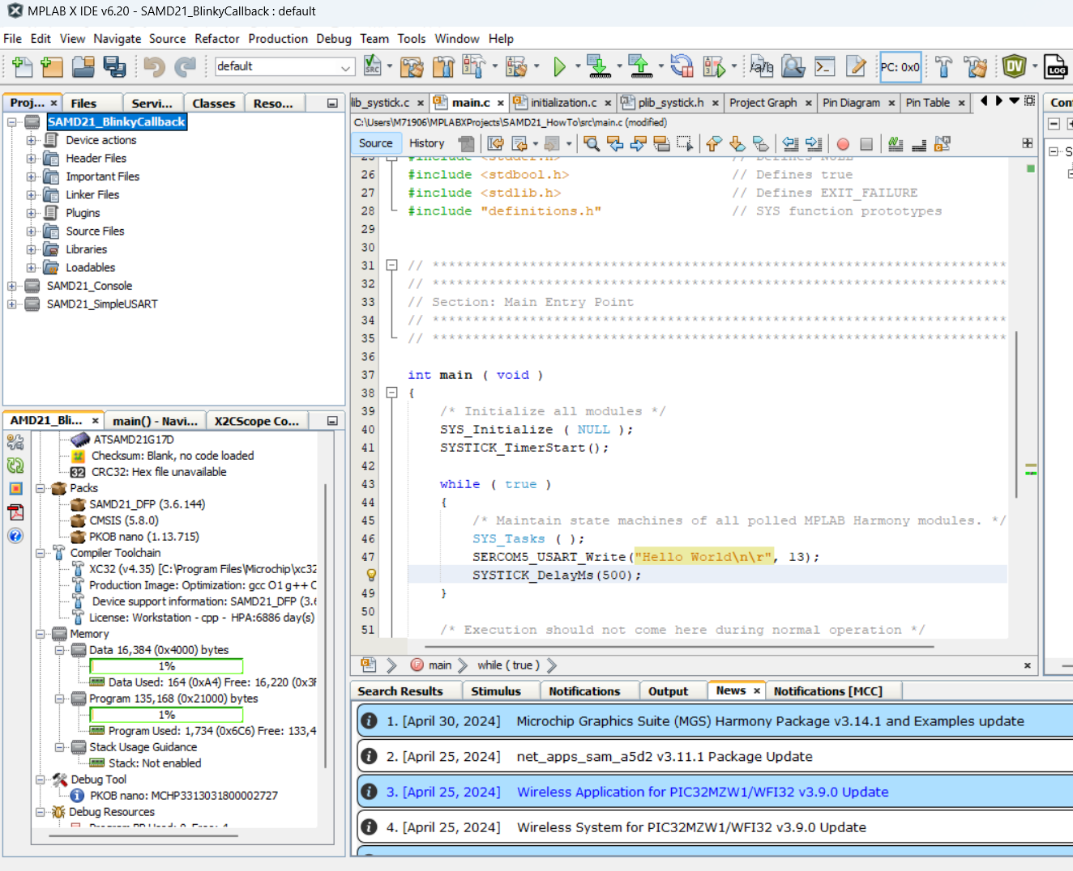

MPLABX, Compiler and Harmony
IDE and Compiler
Download MPLabX 6.20 (IDE)
Download XC32 v4.35 (Compiler)

Slide 8
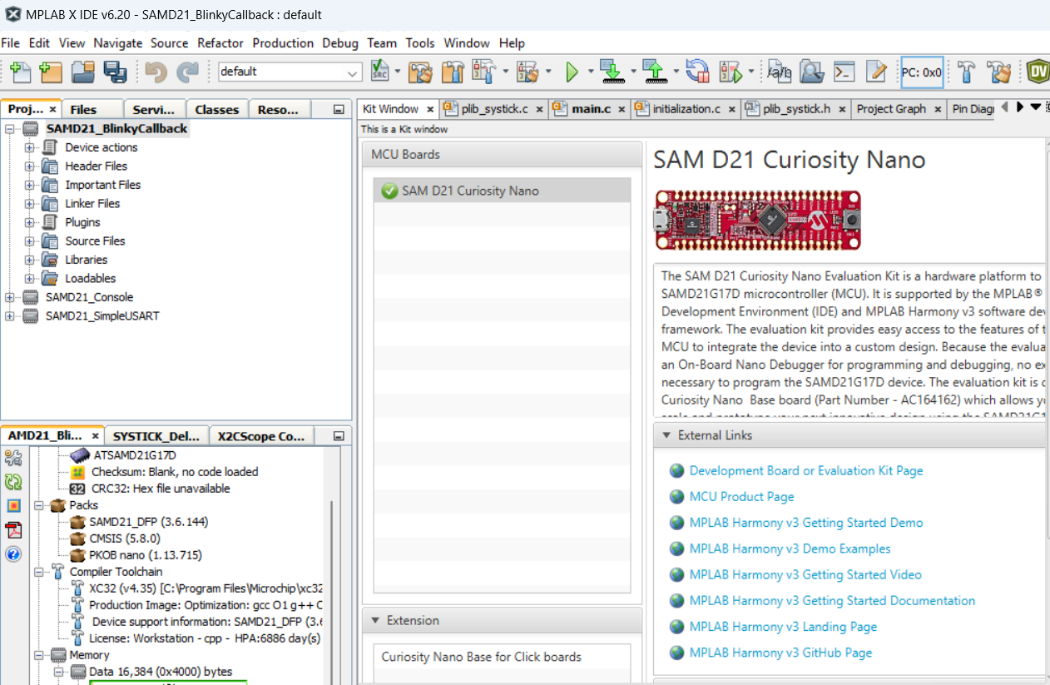
MPLABX, Compiler and Harmony
IDE and Compiler
Connecting the SAMD21 Curiosity to the host computer, device is recognized under Kit Window

Slide 9
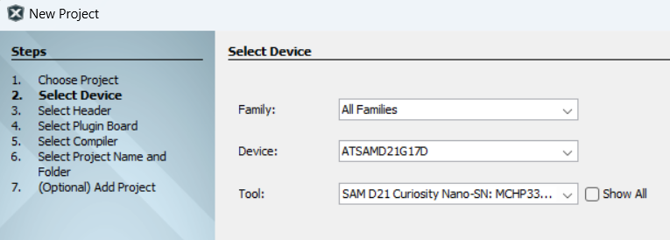
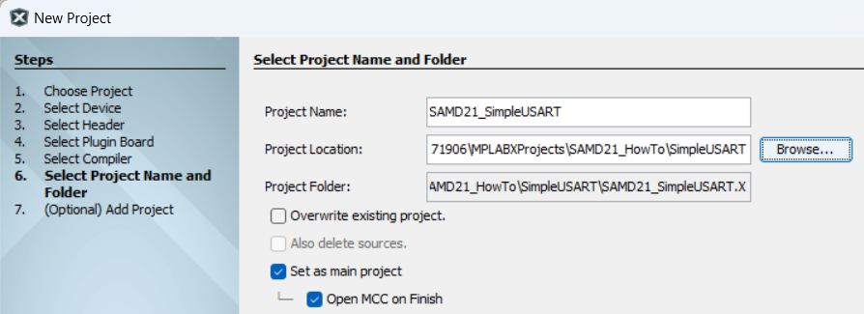

MPLABX, Compiler and Harmony
IDE and Compiler – Creating a new Project
New Project > Microchip Embedded > Application Project
Select Compiler, and after Project Location
TIP!
Folder Structure
If it is the first time using MCC Harmony, deselect this option

Slide 10


MPLABX, Compiler and Harmony
Harmony / Automatic Code Generation
MPLAB® Harmony v3 is a fully integrated embedded software development framework that provides flexible and interoperable software modules to simplify the development of value-added features and reduce your product’s time to market.

Slide 11
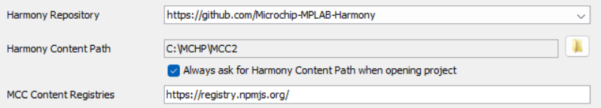
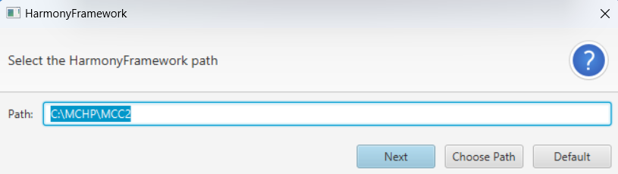
MPLABX, Compiler and Harmony
Harmony / Automatic Code Generation
TIP! Before opening MCC for the first time:
Click on Tools > Options > Plugins
Select a folder to work as local repository for your harmony files.
Every time you open an MCC/Harmony project:
Select the local repository that you want to use!
Make sure you have a stable Internet connection when loading new Harmony content

Slide 12
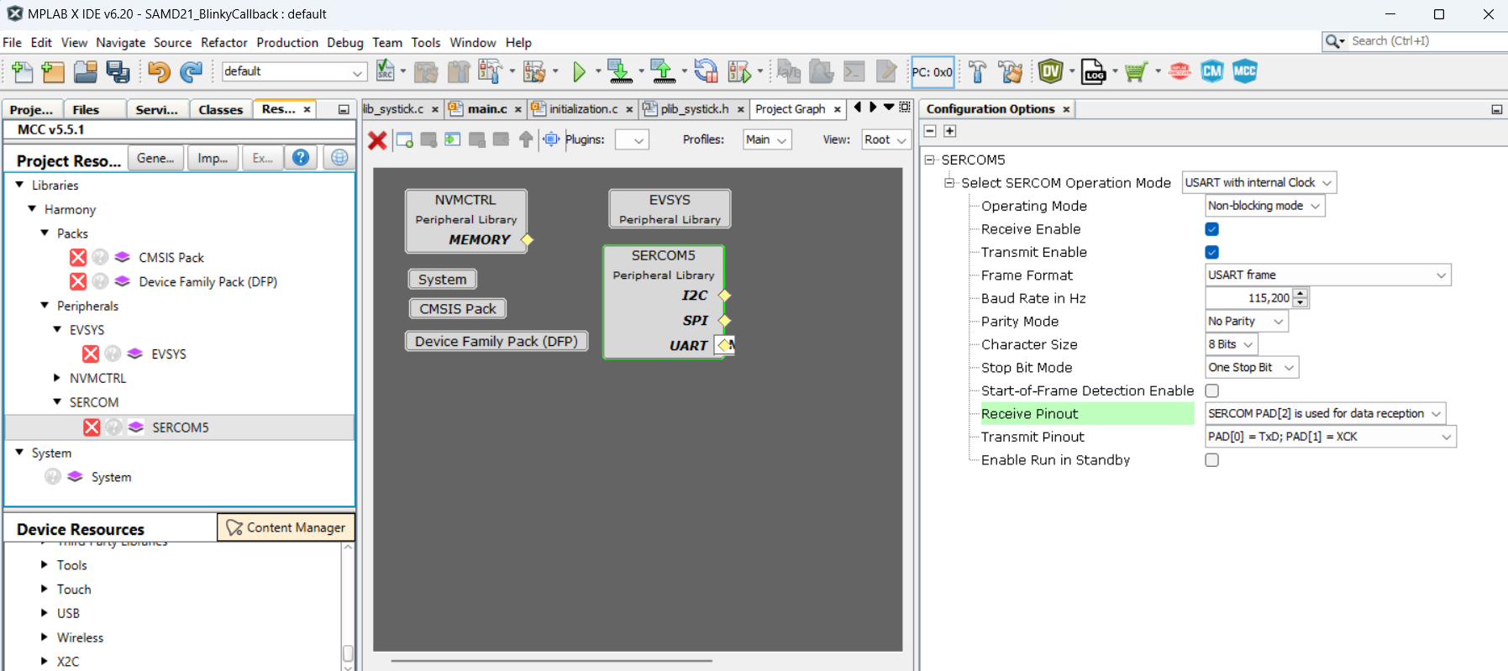
MPLABX, Compiler and Harmony
Harmony / Automatic Code Generation
Click here

Slide 13
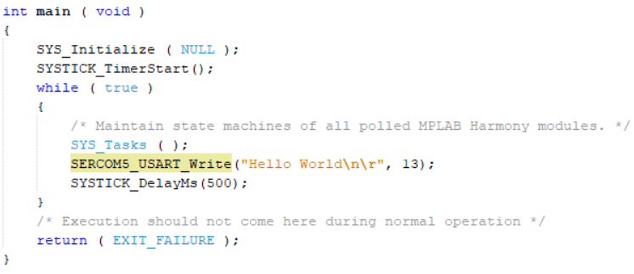
SERCOM and SysTick Timer / USART Hello World
First Example
Output “Hello World” through the USART each 500 ms and blink an LED
Make sure you have a terminal app to view Serial Port Data, i.e. Teraterm
Clock Source: DFLL@48MHz
Enable Systick peripheral
SERCOM5
Set pin according to the pad number
PA22 TX, SERCOM5 PAD0
PB22 RX, SERCOM5 PAD2
Configure RX and TX to the respective PAD number
Check Hardware details for pin numbers
Set LED as GPIO Output
PB10
Generate Code

Slide 14
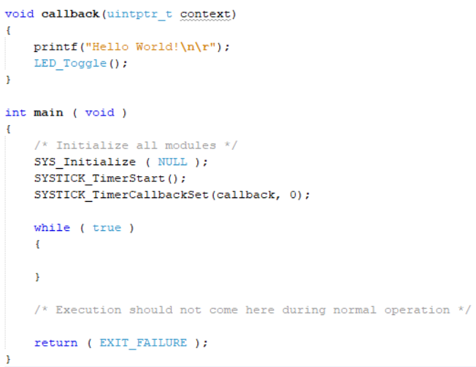
Blinky with Callbacks
Second Example
Use of Callbacks
Make sure you have a terminal app to view Serial Port Data, i.e. Teraterm
Clock Source: DFLL@48MHz
Enable Systick peripheral
Enable Interrupt
set period to 300
SERCOM5
Set pin according to the pad number
PA22 TX, SERCOM5 PAD0
PB22 RX, SERCOM5 PAD2
Configure RX and TX to the respective PAD number
Check Hardware details for pin numbers
Set LED as GPIO Output
PB10
Add Harmoy/Tools: STDIO
and connect to SERCOM5
Generate Code

Slide 15
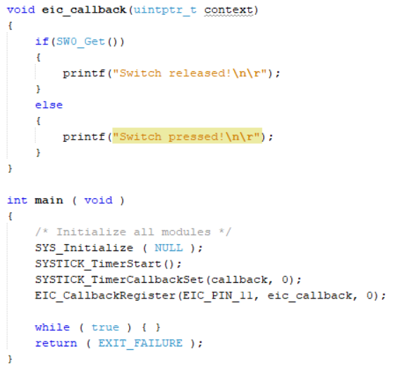
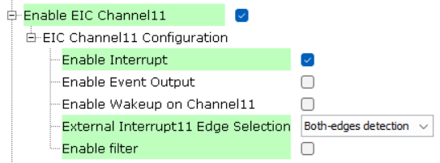
External Interrupts
Third Example
External Interrupts
Same steps as previous
Add EIC peripheral
On Pin Configuration Set PB11 as EIC_EXTINT11
Name it as SW0
Don’t forget to enable Pull-up! see HW details
Generate Code

Slide 16
I2C, SPI, Hal files
Fourth Example
External Interrupts
Same steps as previous
Add EIC peripheral
On Pin Configuration Set PB11 as EIC_EXTINT11
Name it as SW0
Don’t forget to enable Pull-up! see HW details
Generate Code

