Slide 1
dsPIC33AK + 10BASE-T1S Heartbeat Demo
LED Synchronization & Throughput over Single Pair Ethernet
July 2026

Slide 2
System Architecture
Two identical boards, one firmware
Role selected at boot (button)
SERVER (nodeId=1, .101)
Blinks LED at 500ms
Sends 1-byte UDP heartbeat
Measures RTT (~507 us)
CLIENT (nodeId=0, .100)
Mirrors LED from server
Sends 1-byte ACK back
10BASE-T1S Features
PLCA multi-drop bus
2-node configuration
Sub-ms deterministic latency
Protocol Stack
LAN8651 MAC-PHY (SPI)
lwIP (UDP/IP)
TC6 SPI Protocol
Timer: 100MHz free-running
10ns resolution, no ISR

Slide 3
Performance & Packet Analysis
Heartbeat Round-Trip Time: 507 us average
Server to Client: 1 byte payload, 55 bytes on wire
Client to Server: 1 byte ACK, 55 bytes on wire
RTT jitter: +/- 3 us (highly deterministic)
Measurement resolution: 10 ns (free-running 100MHz timer)
iperf UDP Throughput: 9.47 Mbps (95% of 10 Mbps link)
Packet size: 1460 bytes payload, 1514 bytes on wire
~5.9 MB transferred per 5-second interval
RTT Breakdown (each direction ~250 us):
SPI transfer: ~80 us | PLCA slot: ~30 us | Wire: ~5 us

Slide 4
Key Takeaways
10BASE-T1S enables deterministic, low-latency Ethernet
Sub-millisecond RTT on a multi-drop bus topology
PLCA ensures collision-free, bounded access
Near-maximum link utilization (95%)
9.47 Mbps sustained UDP throughput on 10 Mbps link
Minimal protocol overhead at application layer
Single firmware, dual-role architecture
Same binary on both boards - simplifies deployment
Role via GPIO at boot - no configuration needed
Coexistence of control + bulk traffic
1-byte heartbeat for real-time signaling
Heartbeat pauses during iperf for clean measurement

Slide 5
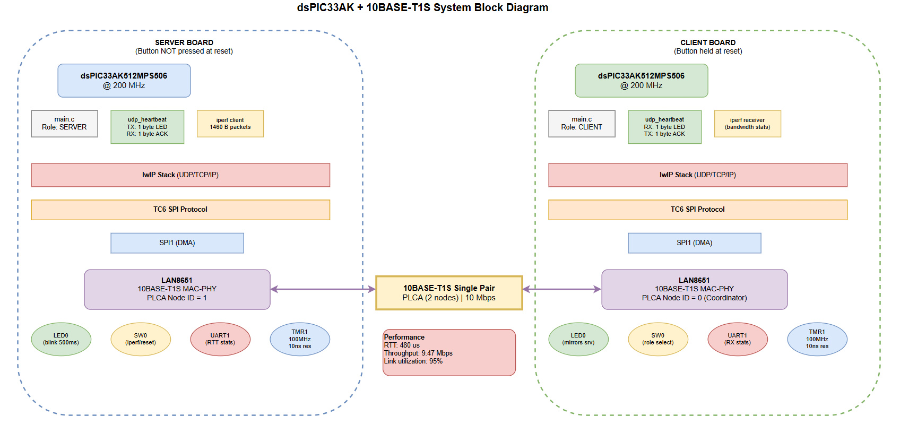
Block-Diagram
https://sales.microchip.bloqq.io/#M6a5f4dfc23fe7ca41be98e74

Slide 6
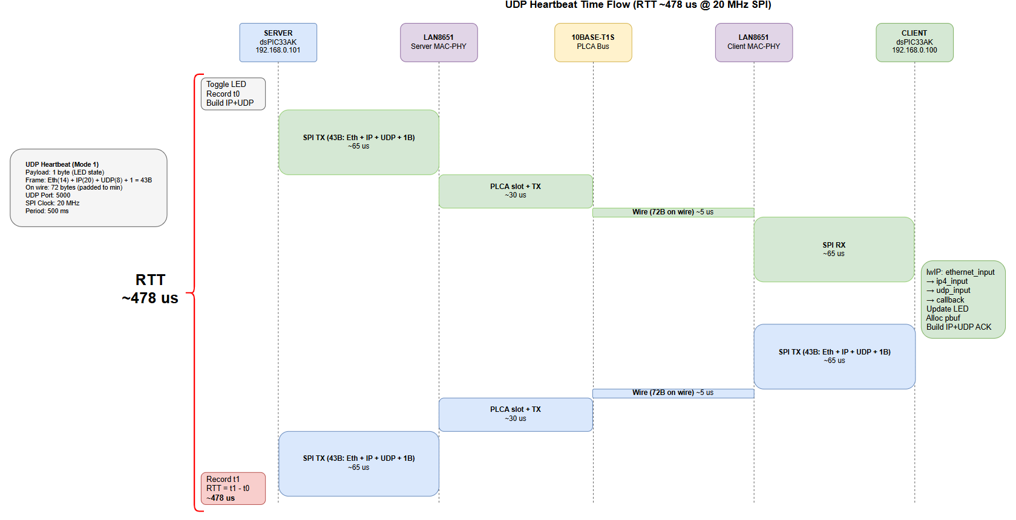
Time Flow Chart - UDP
https://sales.microchip.bloqq.io/#M6a5f4e2a23fe7ca41be98e75#%7B%22pageId%22%3A%228Z2_M-jXWNjm8V0-_wRM%22%7D

Slide 7
Legal notice
SOFTWARE:
You may use Microchip software exclusively with Microchip products. Further, use of Microchip software is subject to the copyright notices, disclaimers, and any license terms accompanying such software, whether set forth at the install of each program or posted in a header or text file. Notwithstanding the above, certain components of software offered by Microchip and 3rd parties may be covered by "open source" software licenses – which include licenses that require that the distributor make the software available in source code format. To the extent required by such open source software licenses, the terms of such license will govern.
NOTICE & DISCLAIMER:
These materials and accompanying information (including, for example, any software, and references to 3rd party companies and 3rd party websites) are for informational purposes only and provided "AS IS." Microchip assumes no responsibility for statements made by 3rd party companies, or materials or information that such 3rd parties may provide. MICROCHIP DISCLAIMS ALL WARRANTIES, WHETHER EXPRESS, IMPLIED, OR STATUTORY, INCLUDING ANY IMPLIED WARRANTIES OF NONINFRINGEMENT, MERCHANTABILITY, AND FITNESS FOR A PARTICULAR PURPOSE. IN NO EVENT WILL MICROCHIP BE LIABLE FOR ANY DIRECT OR INDIRECT, SPECIAL, PUNITIVE, INCIDENTAL, OR CONSEQUENTIAL LOSS, DAMAGE, COST, OR EXPENSE OF ANY KIND RELATED TO THESE MATERIALS OR ACCOMPANYING INFORMATION PROVIDED TO YOU BY MICROCHIP OR OTHER THIRD PARTIES, EVEN IF MICROCHIP HAS BEEN ADVISED OF THE POSSIBILITY OF SUCH DAMAGES OR THE DAMAGES ARE FORESEEABLE. PLEASE BE AWARE THAT IMPLEMENTATION OF INTELLECTUAL PROPERTY PRESENTED HERE MAY REQUIRE A LICENSE FROM THIRD PARTIES.
TRADEMARKS:
The Microchip name and logo, the Microchip logo, Adaptec, AnyRate, AVR, AVR logo, AVR Freaks, BesTime, BitCloud, chipKIT, chipKIT logo, CryptoMemory, CryptoRF, dsPIC, FlashFlex, flexPWR, HELDO, IGLOO, JukeBlox, KeeLoq, Kleer, LANCheck, LinkMD, maXStylus, maXTouch, MediaLB, megaAVR, Microsemi, Microsemi logo, MOST, MOST logo, MPLAB, OptoLyzer, PackeTime, PIC, picoPower, PICSTART, PIC32 logo, PolarFire, Prochip Designer, QTouch, SAM-BA, SenGenuity, SpyNIC, SST, SST Logo, SuperFlash, Symmetricom, SyncServer, Tachyon, TempTrackr, TimeSource, tinyAVR, UNI/O, Vectron, and XMEGA are registered trademarks of Microchip Technology Incorporated in the U.S.A. and other countries. APT, ClockWorks, The Embedded Control Solutions Company, EtherSynch, FlashTec, Hyper Speed Control, HyperLight Load, IntelliMOS, Libero, motorBench, mTouch, Powermite 3, Precision Edge, ProASIC, ProASIC Plus, ProASIC Plus logo, Quiet-Wire, SmartFusion, SyncWorld, Temux, TimeCesium, TimeHub, TimePictra, TimeProvider, Vite, WinPath, and ZL are registered trademarks of Microchip Technology Incorporated in the U.S.A. Adjacent Key Suppression, AKS, Analog-for-the-Digital Age, Any Capacitor, AnyIn, AnyOut, BlueSky, BodyCom, CodeGuard, CryptoAuthentication, CryptoAutomotive, CryptoCompanion, CryptoController, dsPICDEM, dsPICDEM.net, Dynamic Average Matching, DAM, ECAN, EtherGREEN, In-Circuit Serial Programming, ICSP, INICnet, Inter-Chip Connectivity, JitterBlocker, KleerNet, KleerNet logo, memBrain, Mindi, MiWi, MPASM, MPF, MPLAB Certified logo, MPLIB, MPLINK, MultiTRAK, NetDetach, Omniscient Code Generation, PICDEM, PICDEM.net, PICkit, PICtail, PowerSmart, PureSilicon, QMatrix, REAL ICE, Ripple Blocker, SAM-ICE, Serial Quad I/O, SMART-I.S., SQI, SuperSwitcher, SuperSwitcher II, Total Endurance, TSHARC, USBCheck, VariSense, ViewSpan, WiperLock, Wireless DNA, and ZENA are trademarks of Microchip Technology Incorporated in the U.S.A. and other countries. SQTP is a service mark of Microchip Technology Incorporated in the U.S.A. The Adaptec logo, Frequency on Demand, Silicon Storage Technology, and Symmcom are registered trademarks of Microchip Technology Inc. in other countries. GestIC is a registered trademark of Microchip Technology Germany II GmbH & Co. KG, a subsidiary of Microchip Technology Inc., in other countries. All other trademarks mentioned herein are property of their respective companies. © 2019, Microchip Technology Incorporated, All Rights Reserved.

