Slide 1
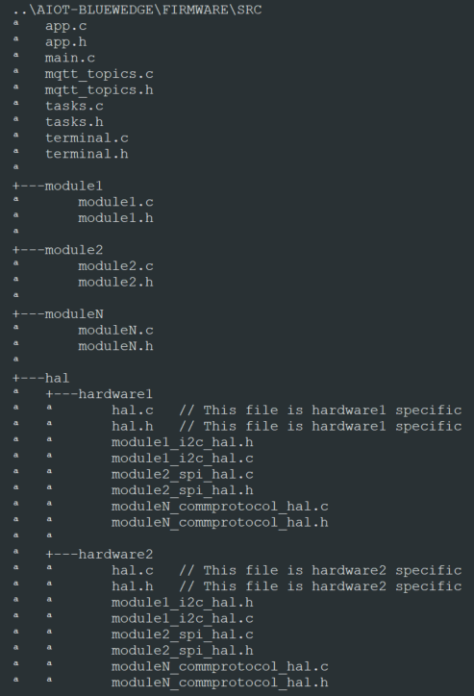
module1.h
module1.c
module1_hal.h
module1_hal.c
hal.h
hal.c
app.h
app.c
main.c
Module generic implementation
Hardware specific Module definition
Hardware specific Board definition
User Application implementation
main.c
Folder tree example

