Slide 1
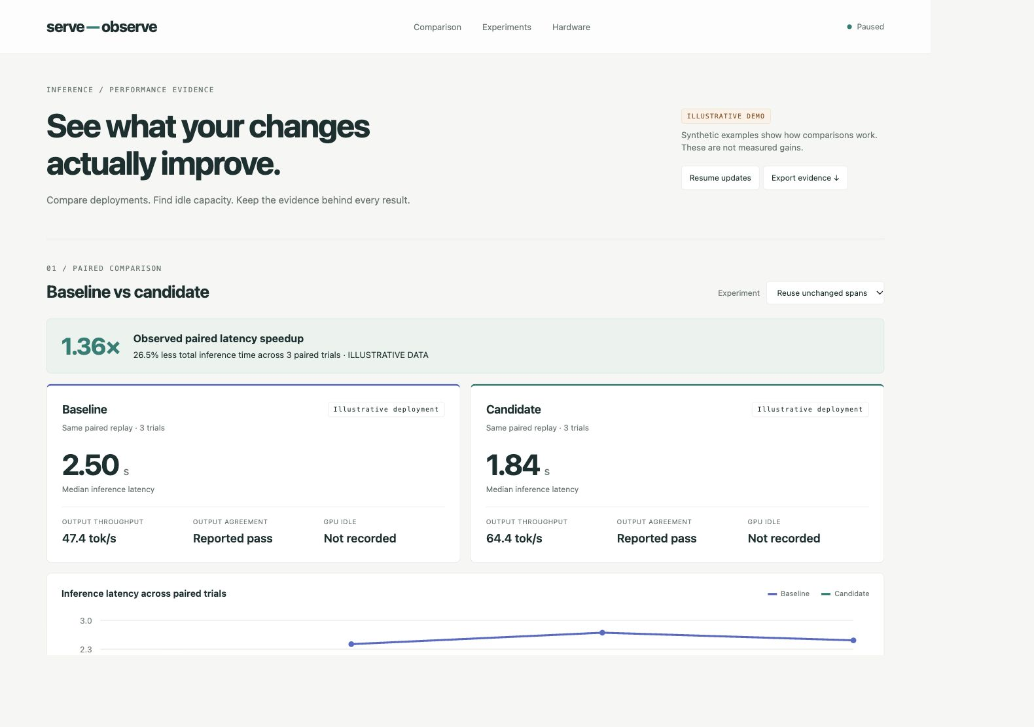
serve—observe
See what your inference changes improve.
Compare a baseline with a candidate.
Keep the evidence behind every result.
Paired latency and throughput
GPU activity alongside request demand
Experiment history and structured exports
Self-hosted Python library + dashboard
No account. No hosted telemetry service.
OPEN SOURCE / INFERENCE PERFORMANCE EVIDENCE
01

Slide 2
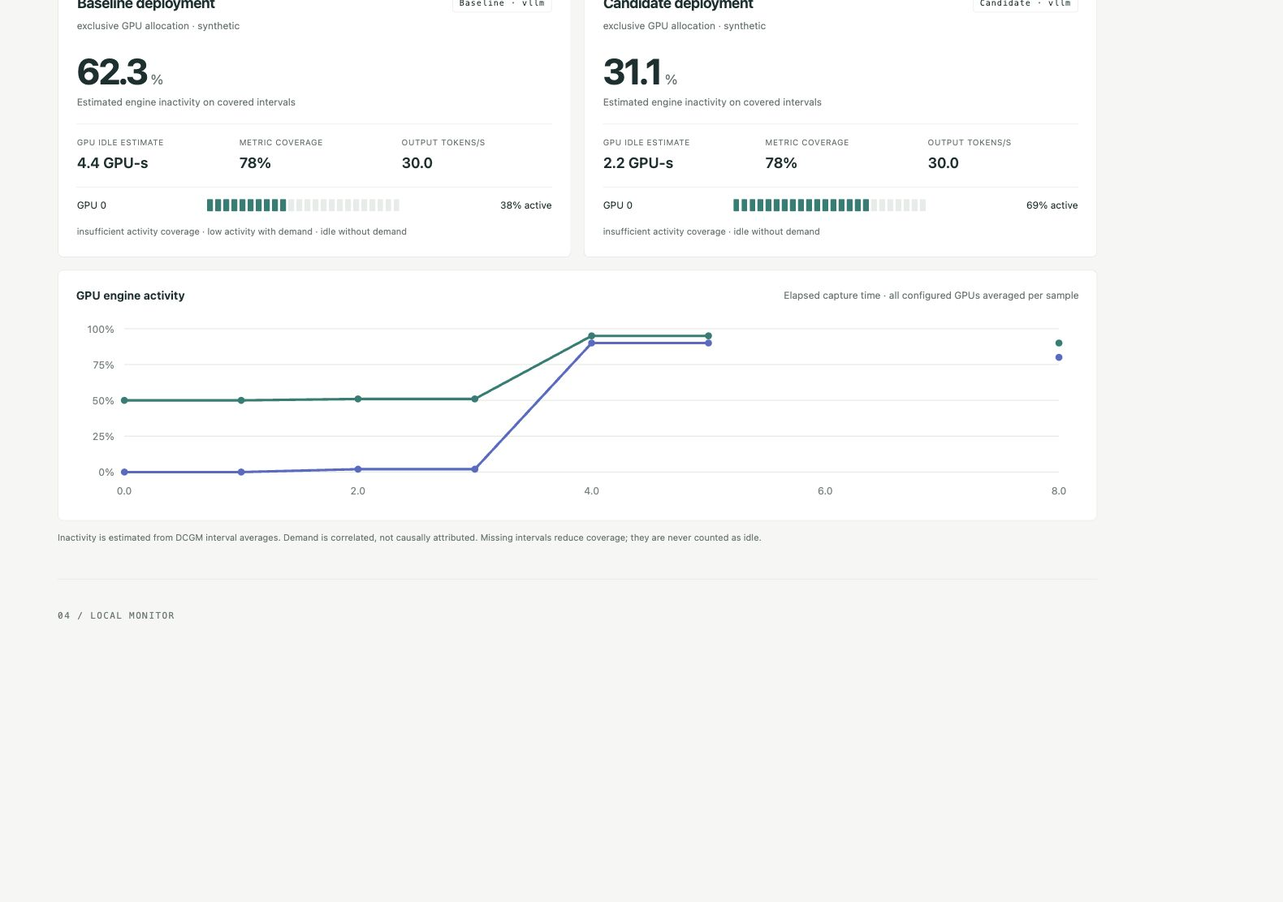
serve—observe
Two deployments. One view of the evidence.
Where is capacity going?
Compare GPU engine activity and estimated inactivity on covered intervals.
Missing data reduces coverage.
Idle with demand is a clue to investigate, not a diagnosis.
SCREENSHOT: SYNTHETIC DEMO
OPEN SOURCE / INFERENCE PERFORMANCE EVIDENCE
02

Slide 3
serve—observe
Make every experiment reviewable.
1× = parity
Each point compares one candidate with its own paired reference.
Retain regressions. Verify output agreement. Use a fixed workload and latency constraints.
ILLUSTRATIVE DATA — NOT MEASURED GAINS
OPEN SOURCE / INFERENCE PERFORMANCE EVIDENCE
03

Slide 4
serve—observe
Give people and agents the same evidence.
01 Observe
02 Compare
03 Review
Collect NVIDIA DCGM and serving metrics outside the request path.
Replay the same workload against baseline and candidate. Record paired results.
Inspect latency, throughput, correctness claims and GPU coverage before keeping a change.
SQLite captures → JSON evidence → dashboard + optimization tools
Alpha: real NVIDIA deployments still need hardware validation. Apple host counters are system-wide.
OPEN SOURCE / INFERENCE PERFORMANCE EVIDENCE
04

