Slide 1
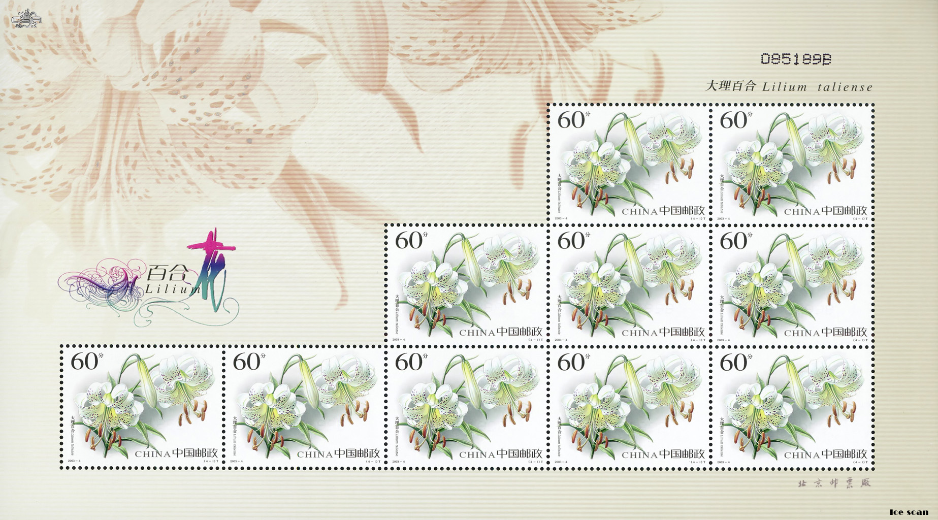

美丽的集邮册

Slide 2
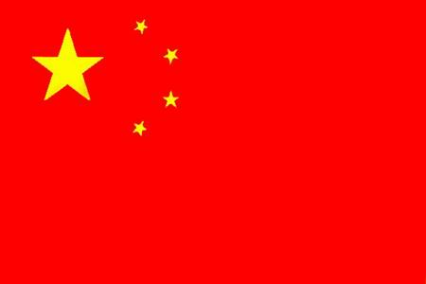

PPT模板下载：www.1ppt.com/moban/ 行业PPT模板：www.1ppt.com/hangye/
节日PPT模板：www.1ppt.com/jieri/ PPT素材下载：www.1ppt.com/sucai/
PPT背景图片：www.1ppt.com/beijing/ PPT图表下载：www.1ppt.com/tubiao/
优秀PPT下载：www.1ppt.com/xiazai/ PPT教程： www.1ppt.com/powerpoint/
Word教程： www.1ppt.com/word/ Excel教程：www.1ppt.com/excel/
资料下载：www.1ppt.com/ziliao/ PPT课件下载：www.1ppt.com/kejian/
范文下载：www.1ppt.com/fanwen/ 试卷下载：www.1ppt.com/shiti/
教案下载：www.1ppt.com/jiaoan/

Slide 3
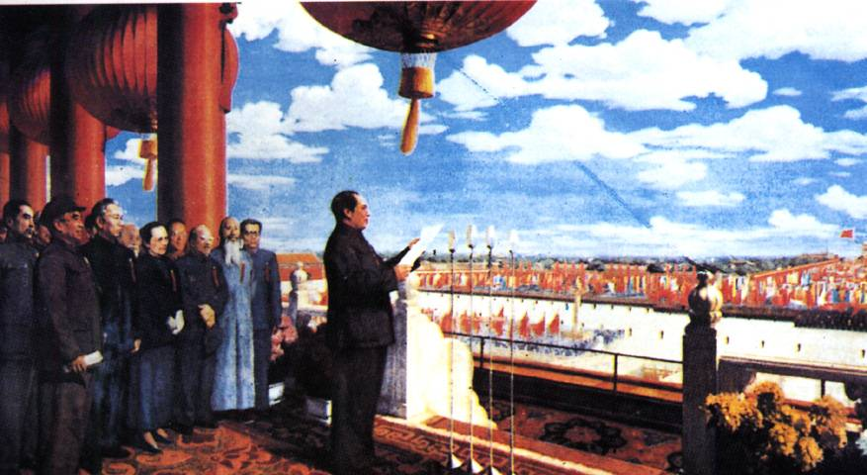

Slide 4
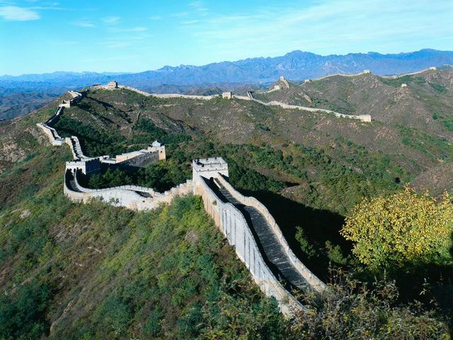

Slide 5
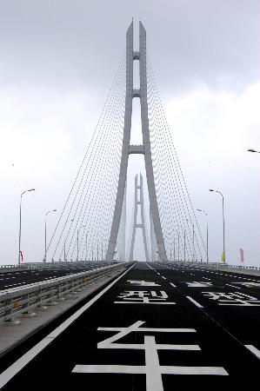

Slide 6
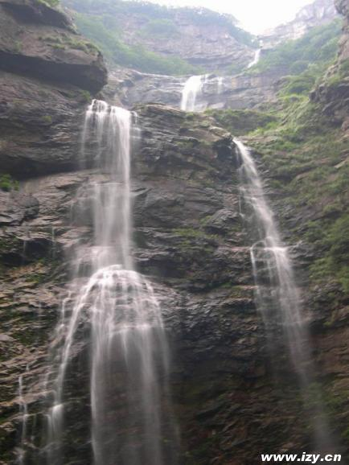

Slide 7


Slide 8


Slide 9
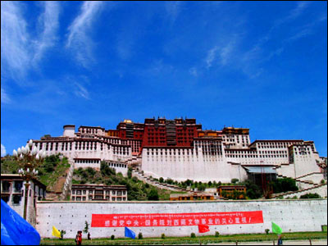

Slide 10


Slide 11


Slide 12


Slide 13


Slide 14
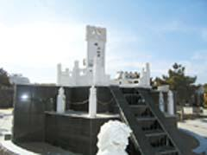

Slide 15
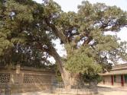

Slide 16
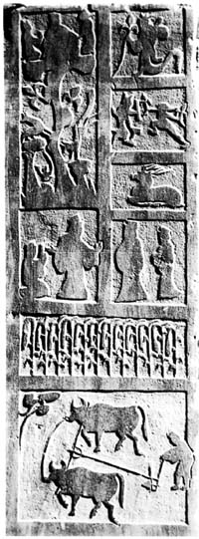

Slide 17
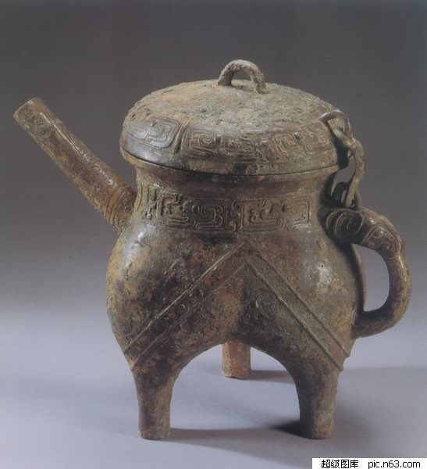


Slide 18
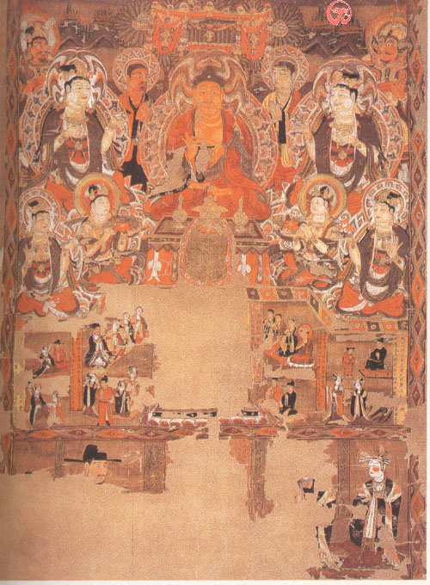

Slide 19


Slide 20
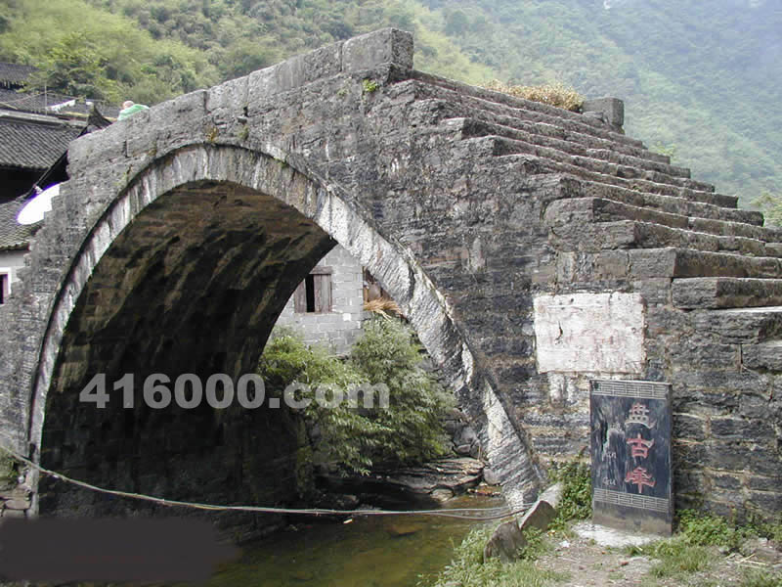

Slide 21
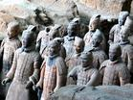

Slide 22
