Slide 1

Predicting Airbnb Prices
Edrick Keane

Slide 2
Predicting Airbnb Prices is Valuable for Airbnb Hosts
As the capital city of Indonesia, Jakarta is one of the most popular destinations in Indonesia. Thus, there is a lot of potential profit that could be obtained by property owners through listing a home on Airbnb in Jakarta.
However, it’s hard for a new host to determine the rate for nightly stay. This research aims to solve this problem by predicting the best rate by using machine learning model which is trained with data from Airbnb listings.

Slide 3
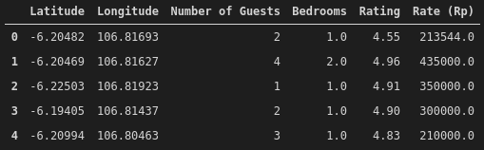
Data Preprocessing and Wrangling
Data obtained from Airbnb API to get the listings of given districts within Central Jakarta.
Duplicates, highly correlated features, and missing data in rating feature were dropped.
Data with room type: shared room, minimum nights > 3, and number of guests > 4 were dropped.
Cleaned data contains 5 features.
Figure 1. Listings After Feature Selection

Slide 4
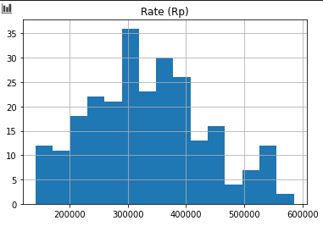
Rate (Rp)’s Distribution is Normal
Figure 2. Rate (Rp) Distribution

Slide 5
Conclusion and Future Directions
RMSE for K-Value of 11 is Rp 86800.
The best rate for the specified host data is Rp 272,000.
Improve accuracy by obtaining more dataset.
Obtain bookings as feature.

Slide 6
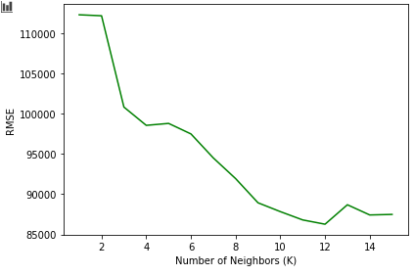
Best K-Value and Prediction Result
K = 11
Host data = {‘Latitude’: -6.164886, ‘Longitude’: 106.832088, ‘Number of Guests’: 1., ‘Bedrooms’: 1., ‘Rating’: 4.5}
The best rate for the specified host data is Rp 272,000.
Figure 3. RMSE vs K-Value

Slide 7
Thank you edric.keane13@gmail.com
Edrick Keane

