Slide 1
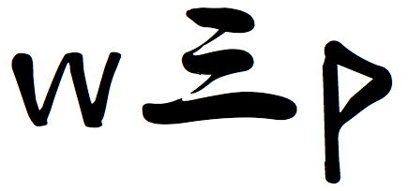
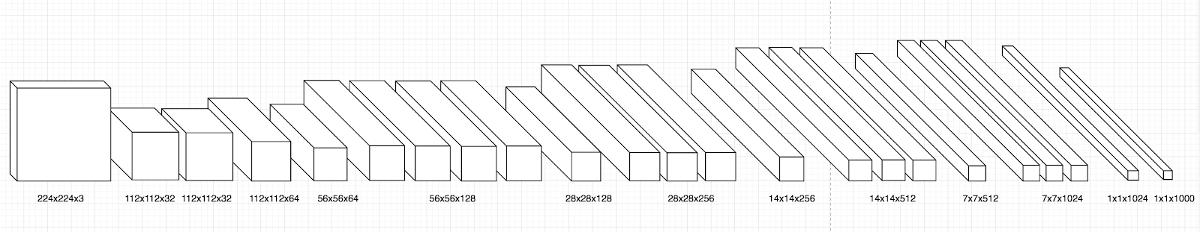
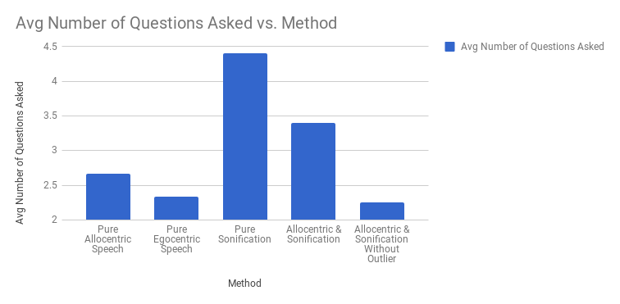
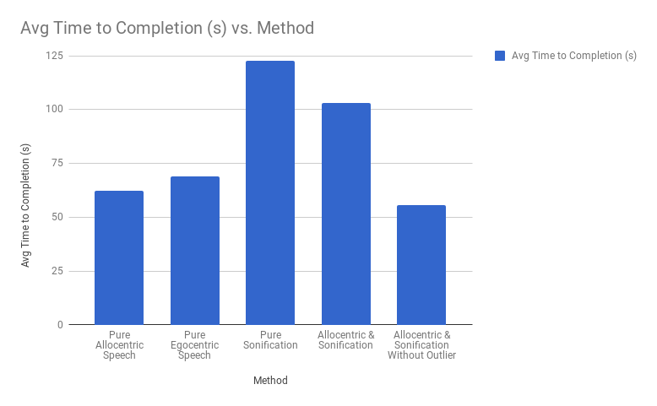
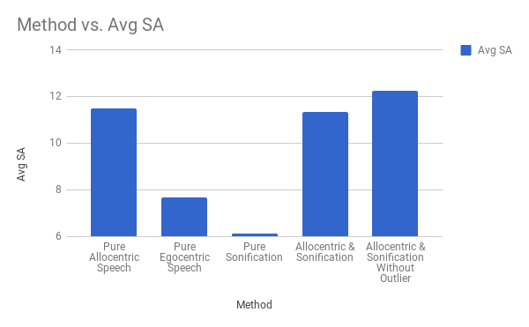
SYSTEMS DESIGN ENGINEERING
GROUP 13
MIRU
Final Solution
Linda Wang
Edrick Wong
Justin Wong
Anshuman Patnaik
Solution Architecture
Motivation, Scope, and Objectives Identify
Purpose
Improve the kitchen experience for visually impaired individuals
Target Users
Visually impaired individuals who once had vision and
Live in a shared, average North American household with access to a normal kitchen
Dislikes common aids that would label them as blind individuals
Prefer to perform tasks individually, seeking as little help from others as possible
Analysis, Design, and Validation Methods
Choosing Audio Feedback
Sustained Attention to Response Task (SART) engineering evaluation model was used to measure the effectiveness of different alternatives of audio feedback to improve situational awareness
Pure allocentric speech
Pure egocentric speech
Pure sonification
Allocentric & sonification
Image Preprocessing
Object Detection Model
MobileNet SSD
Good for mobile vision applications
Light weight deep neural network
Fast for inference
Long Term Goal
Create a natural-feeling assistive system that offloads cognitive resources from the user in the kitchen
Short Term Goal
Reduce cognitive workload required for blind users to locate and recognize displaced objects in the kitchen
Validation Methods
End-to-end user testing with SART
Data split: 1387 train/462 test
Intersection over union
Mean average precision
mAP is taken using the mean of average precisions over IoUs at 0.5 to 0.95 taking step sizes of 0.05
mAP reported using testing data set mean AP at IoU=0.5:0.05:0.95
Scope
Objects
Bottle
Cup
Bowl
Kettle
Environment
Kitchen
Table
Social, Economic, and Environmental Impacts
Social
Empower blind individuals in the kitchen
Does not degrade look-and-feel of kitchen
Choosing Front-end Client
 | Weight | Amazon Alexa | Google Assistant
Development Speed | 1 | 3 | 5
Cost to Purchase (fixed) | 5 | 5 | 4
Integration and Hosting | 2 | 3 | 4
Development Collaboration | 4 | 0 | 4
Cost to Use (variable) | 3 | 4 | 5
Sum |  | 3(1) + 5(5) + 3(2) + 0(4) + 4(3) = 46 | 5(1) + 4(5) + 4(2) + 5(4) + 5(3) = 64
Rank |  | 2 | 1
Continue |  | No | Yes

