Slide 1
DNA Computing
Jan Prokaj

Slide 2
Overview
DNA structure
Tools of DNA computing
Model of DNA computer
Solving Hamiltonian Path problem
Challenges
Summary

Slide 3
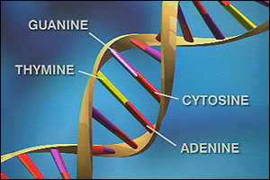
DNA
Double-stranded polynucleotide
Each strand is a series of 4 different nucleotides
  Adenine (A), Guanine (G), Thymine (T), Cytosine (C)

Slide 4
DNA
Watson-Crick pairing
  Bases pair: A-T, C-G
Complementary strands
  ATCGAACT complements TAGCTTGA
Two complementary strands anneal
  twist around to form a double-helix

Slide 5
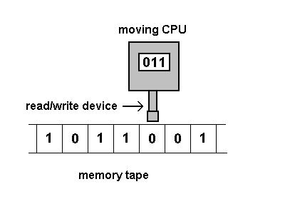
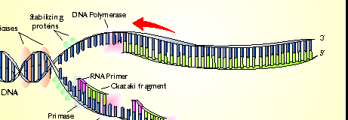
Tools: DNA Replication
Uses an enzyme DNA polymerase
DNA polymerase reads a template strand to produce a complementary strand
Needs a “start signal” -- DNA primer
Obvious similarity with Turing machine

Slide 6
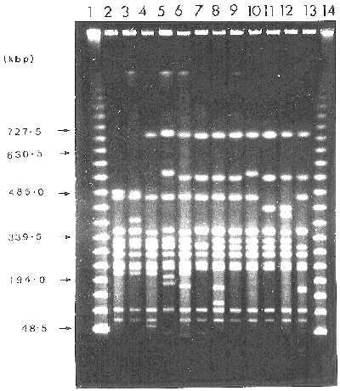
Other tools
DNA ligase
  Bonds two DNA strands into one
Restriction enzymes
  Cut DNA at a particular place
Gel electrophoresis
  Separates DNA by length
  Shorter strands move quicker than longer strands under applied current

Slide 7
Model of DNA computer
Test tube is a set of molecules of DNA (multi-set of finite strings over the alphabet {A,C,G,T})
Operations on the tube:
  Separate (extract)
  Merge
  Detect
  Amplify

Slide 8
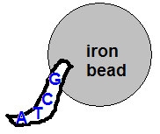
Separate
Tube T, string S {A,C,G,T}
+(T,S)
  all the molecules in T containing S
-(T,S)
  All the molecules in T not containing S
Done using a magnetic bead
system or affinity column

Slide 9
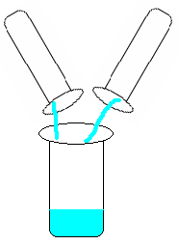
Merge
Tubes T₁, T₂
U(T₁, T₂) = T₁ U T₂
Done by pouring T₁ and T₂ into one test tube

Slide 10
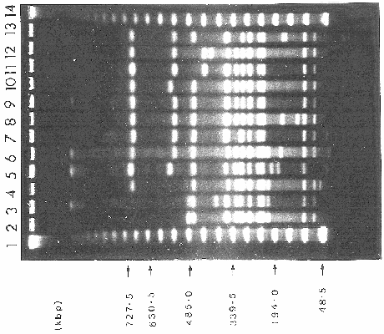
Detect
Given a tube T, say yes if T contains at least one DNA molecule, and say no if it contains none.
Done using PCR with appropriate primers, followed by gel electrophoresis

Slide 11
Amplify
Given a tube T, produce two tubes T’(T) and T’’(T), such that T = T’(T) = T’’(T)
Complex process, prone to error
May be preferable to avoid it

Slide 12
Simple program
Input(T)
T₁ = -(T,C)
T₂ = -(T₁,G)
T₃ = -(T₂,T)
Output(Detect(T₃))
Given some input tube T, this program outputs whether it contains DNA entirely composed of A

Slide 13
Hamiltonian Path problem (HPP)
Find a path in a graph that contains each vertex once, starting and ending at a specified start and end vertex
NP-complete

Slide 14
Possible solution
Given a graph with n vertices
Generate a set of random paths
For each path in the set
  Check whether that path starts at the start vertex and ends with the end vertex
  Check if that path passes through n vertices
  For each vertex, check if that path passes through that vertex
If the set is not empty, there is a Hamiltonian path

Slide 15
Solving HPP with DNA
Detroit
Chicago
Boston
Atlanta
Edges represent non-stop flights
Determine whether there is a Hamiltonian Path starting in Atlanta, ending in Detroit

Slide 16
Solving HPP with DNA
Encode this graph in a DNA
Vertices are assigned a random DNA sequence
  Atlanta: ACTTGCAG
  Boston: TCGGACTG
Edges (flights) are formed by concatenating the 2nd half of the originating city and the 1st half of the destination city
  Atlanta-Boston: GCAGTCGG

Slide 17
Solving HPP with DNA
Each city also has a complementary name
  Atlanta: TGAACGTC
Synthesize all cities and edges (flights)
Mix all these sequences in a common test tube along with DNA ligase, salt, …
  Only a pinch (10¹⁴ molecules) of each sequence and 1/50th teaspoon of solution needed
Within a second, you have an answer! How?

Slide 18
Solving HPP with DNA
Atlanta-Boston (GCAGTCGG) meets Boston complement (AGCCTGAC)
  GCAGTCGG
  AGCCTGAC
Now, encounter Boston-Chicago (ACTGGGCT)
  GCAGTCGGACTGGGCT
  AGCCTGAC
…

Slide 19
Solving HPP with DNA
At least one of the many molecules formed is the Hamiltonian path
All the paths were created simultaneously
  Hundreds of trillions of molecules involved in biochemical reactions
  Massive parallelism
Now the problem is discarding the wrong paths, and keeping the answer

Slide 20
Solving HPP with DNA
Use Polymerase Chain Reaction (PCR) to replicate DNA with the correct start and end city
Put one primer on Atlanta and one primer on Detroit
The right answer is replicated exponentially, while the wrong paths are replicated linearly or not at all

Slide 21
Solving HPP with DNA
Use gel electrophoresis to identify the molecules with the right length
Finally, use affinity separation procedure to weed out paths without all the cities
  Iterative procedure (for each vertex/city)
  Probe molecules attached on iron balls attract the correct strands; the rest is poured out
If any DNA is left in the tube, it is the Hamiltonian Path
Overall, this took 7 days in the lab

Slide 22
DNA Computing
Extremely dense information storage
  1 g DNA can store as much information as approximately 1 trillion CDs
Extreme parallelism
Extreme energy efficiency
  1 J enough for 2¹⁹ ligase operations vs. 10⁹ operations on supercomputes (1994)

Slide 23
Challenges
Mapping the problem to DNA, and DNA operations
Extracting the answer takes time, tedious
Large problems may not fit into test tube
Suited for specific problems, difficult to generalize
  Desktop DNA computer remains to be seen

Slide 24
Summary
DNA computing has a lot of potential
  Massive parallelism, dense storage
Can solve NP-complete problems quickly
  Really, any problem requiring brute-force search of all solutions
Suited for specific problems
Getting output takes time

Slide 25
References
Adleman, L.M. Computing with DNA. Scientific American. Vol. 279 (1998). Issue 2. 54-61.
Adleman, L.M. Molecular Computation of Solutions to Combinatorial Problems. Science. Vol. 266 (1994). 1021-1024.
Brandt, I. DNA Computers. http://users.aol.com/ibrandt/ discover_article.html . 1995.
Forbes, N. Imitation of Life. Cambridge: MIT Press, 2004.
Lipton, R. DNA Solution of Hard Computational Problems. Science. Vol. 268 (1995). 542-545.

