Slide 1

DNA COMPUTING
Deepthi Bollu
CSE 497:Computational issues in Molecular Biology
Professor- Dr. Lopresti
April 13, 2004

Slide 2
Outline of Lecture
Introduction.
Biochemistry basics.
Adleman’s Hamiltonian path problem.
Danger of errors.
Limitations.

Slide 3

Introduction
Ever wondered where we would find the new material needed to build the next generation of microprocessors????
  HUMAN BODY (including yours!)…….DNA computing.
“Computation using DNA” but not “computation on DNA”
Initiated in 1994 by an article written by Dr. Adleman on solving HDPP using DNA.

Slide 4
Uniqueness of DNA
Why is DNA a Unique Computational Element???
Extremely dense information storage.
Enormous parallelism.
Extraordinary energy efficiency.
Notes:
Deepthi Bollu April 13,2004

Slide 5
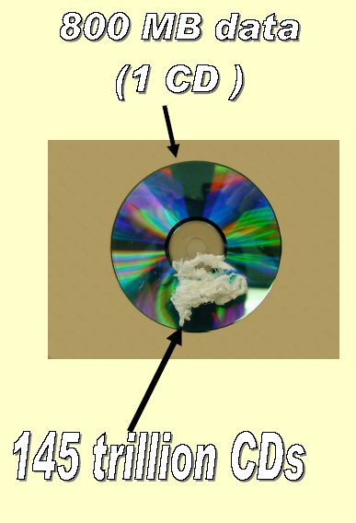
Dense Information Storage
This image shows 1 gram of DNA on a CD. The CD can hold 800 MB of data.
The 1 gram of DNA can hold about 1x10¹⁴ MB of data.
The number of CDs required to hold this amount of information, lined up edge to edge, would circle the Earth 375 times, and would take 163,000 centuries to listen to.

Slide 6

How Dense is the Information Storage?
with bases spaced at 0.35 nm along DNA, data density is over a million Gbits/inch compared to 7 Gbits/inch in typical high performance HDD.
Check this out………..

Slide 7
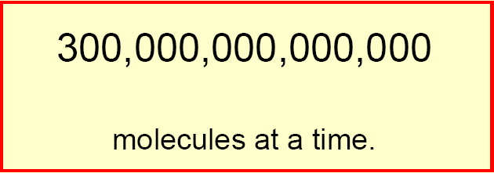
How enormous is the parallelism?
A test tube of DNA can contain trillions of strands. Each operation on a test tube of DNA is carried out on all strands in the tube in parallel !
Check this out……. We Typically use

Slide 8

How extraordinary is the energy efficiency?
Adleman figured his computer was running
2 x 10¹⁹ operations per joule.

Slide 9
A Little More………
Basic suite of operations: AND,OR,NOT & NOR in CPU while cutting, linking, pasting, amplifying and many others in DNA.
Complementarity makes DNA unique. Ex: in Error correction.

Slide 10
Biochemistry Basics

Slide 11
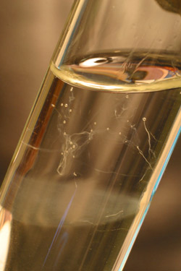
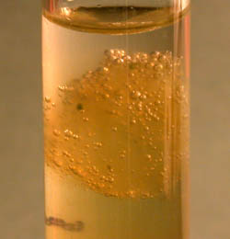
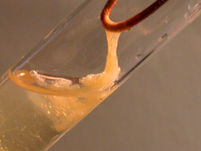
Extraction
  given a test tube T and a strand s, it is possible to extract all the strands in T that contain s as a subsequence, and to separate them from those that do not contain it.
Spooling the DNA with a metal hook or similar device
Precipitation of more DNA strands in alcohol
Formation of DNA strands.

Slide 12
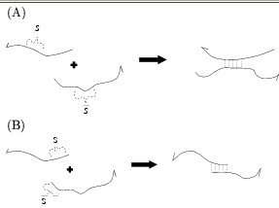
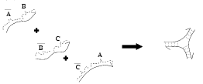
Annealing
The hydrogen bonding between two complimentary sequences is weaker than the one that links nucleotides of the same sequence.It is possible to pair(anneal) and separate(melt) two antiparallel and complementary single strands.
Curves represent single strands of DNA ogilonucleotides. The half arrow head represents the 3’ end of the strand. The dotted lines indicate the hydrogen bonding joining the strands.

Slide 13
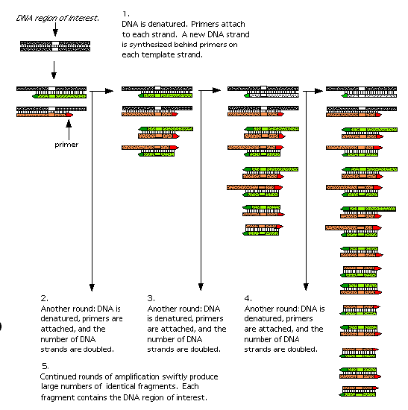
Polymerase Chain Reaction
PCR: One way to amplify DNA.
PCR alternates between two phases: separate DNA into single strands using heat; convert into double strands using primer and polymerase reaction.
PCR rapidly amplifies a single DNA molecule into billions of molecules

Slide 14
Gel Electrophoresis
Used to measure the length of a DNA molecule.
Based on the fact that DNA molecules are –ve ly charged.
Gel Electrophoresis

Slide 15
How to fish for known molecules?
Annealing of complimentary strands can be used for fishing out target molecules.
Denature the double stranded molecules.
The probe for s molecules would be s.
We attach probe to a filter and pour the solution S through it.
We get double stranded molecules fixed to filter and the solution S’ resulting from S by removing s molecules.
Filter is then denatured and only target molecule remains.
Adleman attached probes to magnetic beads.

Slide 16
Adleman’s solution of the Hamiltonian Directed Path Problem(HDPP).
I believe things like DNA computing will eventually
lead the way to a “molecular revolution,” which
ultimately will have a very dramatic effect on the world. – L. Adleman

Slide 17
The Problem
A directed Graph G=(V,E)
|V|=n, |E|=m and two distinguished vertices V_{in} = s and V_{out}= t.
Verify whether there is a path (s,v1,v2,….,t)
  which is a sequence of “one-way” edges that begins in V_{in} and V_{out}
  whose length (in no.of edges) is n-1 and (i.e. enters all vertices.)
  Whose vertices are all distinct
  (i.e. enters every vertex exactly once.)
  A CLASSIC NP-COMPLETE PROBLEM!!!

Slide 18
Example
  What happens if some edge ex:2→4 is removed from the graph??
  What happens if the designated vertices are changed to V_{in} = 2 and V_{out} =4??
2
6
s
4
t
3
5
A directed Graph. An st hamiltonian path is (s,2,4,6,3,5,t).Here V_{in}=s and V_{out}=t.

Slide 19
Why not brute force algorithm?
Brute force algorithm is to
  Generate all possible paths with exactly n-1 edges
  Verify whether one of them obeys the problem constraints.
Problem: How many paths can there be???
such paths could be (n-2)!
So, what did Dr. Adleman use?
‘Generate and test’ strategy where number of random paths were generated and tested.

Slide 20
Adleman’s Experiment
makes use of the DNA molecules to solve HDPP.
good thing about random path generation-each path can be generated independent of all others bringing into picture-- “Parallelism” . On the other hand adding “Probability” too.
No. of Lab procedures grows linearly with the no. of vertices in the graph.
Linear no. of lab procedures is due to the fact that an exponential no. of operations is done in parallel.
At the heart, it is a brute force algorithm executing an exponential number of operations.

Slide 21
Algorithm(non-deterministic)
1.Generate Random paths
2.From all paths created in step 1, keep only those that start at s and end at t.
3.From all remaining paths, keep only those that visit exactly n vertices.
4.From all remaining paths, keep only those that visit each vertex at least once.
5.if any path remains, return “yes”;otherwise, return “no”.

Slide 22
Step 1.Random Path Generation.
Assumptions
  Random single stranded DNA sequences with 20 nucleotides are available.
  Generation of astronomical number of copies of short DNA strands is easy to do.
Vertex representation
  Each vertex v in the graph is associated with a random 20-mer sequence of DNA denoted by S_{v.}.
  For each such sequence obtain its complement S_{v.}
  Generate many copies of each S_{v} sequence in test tube T_{1.}

Slide 23
For example, the sequences chosen to represent vertices 2,4 and 5 are the following:
S₂ = GTCACACTTCGGACTGACCT
S₄ = TGTGCTATGGGAACTCAGCG
S₅ = CACGTAAGACGGAGGAAAAA
The reverse complement of these sequences are:
S₂ = AGGTCAGTCCGAAGTGTGAC
S₄ = CGCTGAGTTCCCATAGCACA
S₅ = TTTTTCCTCCGTCTTACGTG
5’ 20 mer 3’

Slide 24
Step1. Random Path Generation.
Edge representation
  For each edge u→v in the graph, the oligonucleotide S_{u→v} is created that is 3’ 10-mer of S_{u} followed by 5’ 10-mer of S_{v}
  If u=s then it is all of S_{u} or if v=t then it is all of S_{v.}(i.e.each edge denoted by 20-mer while the edge that involves either s or t is a 30-mer.)
  With this construction, S_{uv} = S_{vu}. (Preservation of Edge Orientation.)
  Generate many copies of each S_{uv} sequence in test tube T₂

Slide 25
5’ S₂ 3’
5’ S₄ 3’
Edge(2,4)
5’ S₄ 3’
5’ S₅ 3’
Edge(4,5)

Slide 26
S₂ = GTCACACTTCGGACTGACCT
S₄ = TGTGCTATGGGAACTCAGCG
S₅ = CACGTAAGACGGAGGAAAAA
S₂ = AGGTCAGTCCGAAGTGTGAC
S₄ = CGCTGAGTTCCCATAGCACA
S₅ = TTTTTCCTCCGTCTTACGTG
So,we build edges (2,4) and (4,5) from the above sequences obtaining them in the following manner:
(2,4) = GGACTGACCTTGTGCTATGG
(4,5) = GAACTCAGCGCACGTAAGAC

Slide 27
Step1.Random Path Generation
Path Construction
  Pour T1 and T2 into T3.
  In T3 many ligase reactions will take place.
  (Ligase Reaction or ligation: There is an enzyme called Ligase, that causes concatenation of two sequences in a unique strand.)

Slide 28
Step1.Random Path Generation
By executing these 3 operations,we get many random paths for the following reasons:
Consider S_{u},S_{v},S_{w},S_{uv},S_{vw} for u,v,w distinct vertices.
10 base suffix of one S_{u} sequence will bind to the 10 base prefix of one S_{uv} sequence. (one is complement of the other.)
At the same time 10-base suffix of same sequence S_{uv} binds to the 10-base prefix of one S_{v} sequence
S_{v} 10-base suffix binds to the 10-base prefix of one S_{vw} sequence.
The final double strand thus obtained encodes (u,v,w) in G.

Slide 29
Examples of random paths formed
S₂
S₄
S₆
S₂
s
S₃
E_{2→4}
E_{4→6}
E_{6→2}
E_{2→s}
E_{s→3}
S₆
S₃
S₅
t
E_{6→3}
E_{3→5}
E_{5→t}
s
S₂
E_{s→2}

Slide 30
Formation of Paths from Edges and compliments of vertices
Edge u→v
Edge v→w
S_{u}
S_{v}
S_{w}

Slide 31
Finally the path (2,4,5) will be encoded by the following double strand.
5’ (2,4)
GTCACACTTCGGACTGACCTTGTGCTATGG……………
CAGTGTGAAGCCTGACTGGAACACGATACCCTTGAGTCGC
← S₂ S₄ →
(4,5) 3’
……….. GAACTCAGCGCACGTAAGACGGAGGAAAAA
…..GTGCATTCTGCCTCCTTTTT
S₅ ←

Slide 32
Step 2
“keep only those that start at s and end at t.”
Product of step 1 was amplified by PCR using primers S_{s} and S_{t}.
By this, only those molecules encoding paths that begin with vertex s and end with vertex t were amplified.

Slide 33
Step 3
“keep only those that visit exactly n vertices”
Product of step 2 is run on agarose gel and the 140bp (since 7 vertices) band was excised and soaked in doubly distilled H₂O to extract DNA.
This product is PCR amplified and gel purified several times to enhance its purity.

Slide 34
Step 3
“keep only those that visit exactly n vertices”
DNA is negatively charged.
Place DNA in a gel matrix at the negative end. (Gel Electrophoresis)
Longer strands will not go as far as the shorter strands.
In our example we want DNA that is 7 vertice times 20 base pairs, or 140 base pairs long.

Slide 35
Step 4
“keep only those that visit each vertex at least once”
From the double stranded DNA product of step3, generate single stranded DNA.
Incubate the single stranded DNA with S₂ conjugated to the magnetic beads.
Only single stranded DNA molecules that contained the sequence S₂ annealed to the bound S₂ and were retained
Process is repeated successively with S₄,S₆,S₃,S₅

Slide 36
Step 4
“keep only those that visit each vertex at least once”
Filter the DNA searching for one vertex at a time.
Do this by using a technique called Affinity Purification. (think magnetic beads)
s
2
4
6
3
5
t
5
compliment
Magnetic bead

Slide 37
Step 5:Obtaining the Answer
Conduct a “graduated PCR” using a series of PCR amplifications.
Use primers for the start, s and the n^{th} item in the path.
So to find where vertex 4 lies in the path you would conduct a PCR using the primers from vertex s and vertex 4.
You would get a length of 60 base pairs.
60 / 20 nucleotides in the path = 3rd vertex.

Slide 38
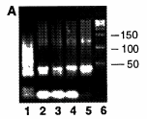
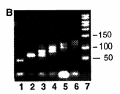
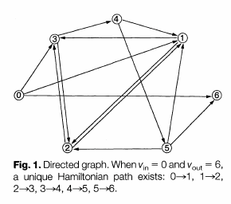
B. Graduated PCR of the product from step 3( 1 thru 6)
the molecular weight marker is in lane 7.
A. Product of the ligation reaction (lane 1),
PCR amplification of the product of the ligation reaction ( 2 thru 5)
molecular weight marker in base pairs (lane 6).
NOTE: These figures relate to the graph used by Dr. Adleman.

Slide 39
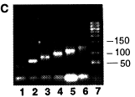
C. Graduated PCR of the final product of the experiment, revealing the Hamiltonian Paths ( 1 thru 6 ).
The molecular weight marker is in lane 7.

Slide 40
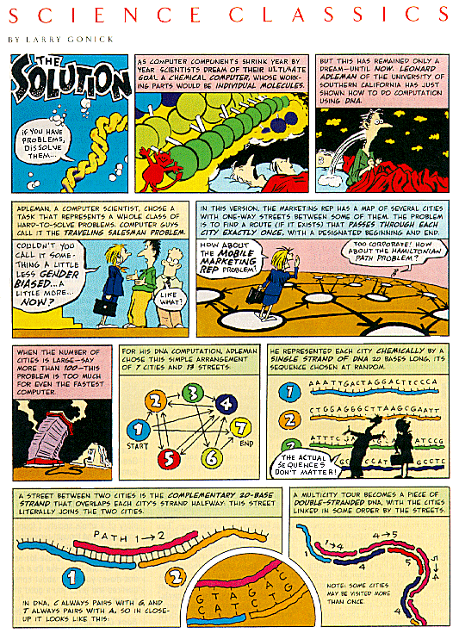
Discover magazine published an article in comic strip format about Leonard Adleman's discovery of DNA computation. Not only entertaining, but also the most understandable explanation of molecular computation I have Ever seen.

Slide 41
Recap of HDPP
1. Generate random paths through graph G. (Annealing and Ligation)
2. Select paths that begin with V_{in} and terminate with V_{out}. (PCR with selected primers)
3. From step 2, select those paths with exactly n vertices. (Gel purification)
4. From step 3, select those paths that contain every vertex. (Magnetic bead purification)
5. If any paths exist from step 4, then there exists a Hamiltonian path. (PCR)

Slide 42
DANGEROUS ERRORS

Slide 43
Danger of Errors possible
Assuming that the operations used by Adleman model are perfect is not true.
  Biological Operations performed during the algorithm are susceptible to error
  Only that which happens within the boundaries of 3 dimensional world are counted…lot of probability involved!
Errors take place during the manipulation of DNA strands. Most dangerous operations:
  The operation of Extraction
  Undesired annealings.

Slide 44
The operation of Extraction
What would happen if a ‘good’ path were lost during one of the extraction operations in step4?
-FALSE NEGATIVE!
-Adleman’s suggestion: to amplify the content of the test tube.
What if a ‘bad’ path is taken as if it were ‘good’?
-FALSE POSITIVE!!
-Less dangerous,because the solution could be verified at the end of the computation.

Slide 45
Undesired Annealings
Types of Undesired annealings-
  Partial Matches:A strand u could anneal with one that’s similar to ū, but it is not the right one.
  Undesired matches between two shifted strands:
  Ex:A strand vu could partially anneal with ūw.
  Finally,a strand could anneal with itself, losing its linear structure.
How can the probability of all these undesired annealings be decreased??
  with an opportune choice of strands used to encode the data of the problem.

Slide 46
LIMITATIONS

Slide 47
DNA Vs Electronic computers
At Present,NOT competitive with the state-of-the-art algorithms on electronic computers
  Only small instances of HDPP can be solved.Reason?..for n vertices, we require 2^n molecules.
  Time consuming laboratory procedures.
  Good computer programs that can solve TSP for 100 vertices in a matter of minutes.
  No universal method of data representation.

Slide 48
Size restrictions
Adleman’s process to solve the traveling salesman problem for 200 cities would require an amount of DNA that weighed more than the Earth.
The computation time required to solve problems with a DNA computer does not grow exponentially, but amount of DNA required DOES.

Slide 49
Error Restrictions
DNA computing involves a relatively large amount of error.
As size of problem grows, probability of receiving incorrect answer eventually becomes greater than probability of receiving correct answer

Slide 50
Hidden factors affecting complexity
There may be hidden factors that affect the time and space complexity of DNA algorithms with underestimating complexity by as much as a polynomial factor because:
  they allow arbitrary number of test tubes to be poured together in a single operation.
  Unrealistic assessment of how reactant concentrations scale with problem size.

Slide 51
Some more……….
Different problems need different approaches.
requires human assistance!
DNA in vitro decays through time,so lab procedures should not take too long.
No efficient implementation has been produced for testing, verification and general experimentation.

Slide 52
THE FUTURE!
Algorithm used by Adleman for the traveling salesman problem was simple. As technology becomes more refined, more efficient algorithms may be discovered.
DNA Manipulation technology has rapidly improved in recent years, and future advances may make DNA computers more efficient.
The University of Wisconsin is experimenting with chip-based DNA computers.
DNA computers are unlikely to feature word processing, emailing and solitaire programs.
Instead, their powerful computing power will be used for areas of encryption, genetic programming, language systems, and algorithms or by airlines wanting to map more efficient routes. Hence better applicable in only some promising areas.

Slide 53
THANK YOU!
It will take years to develop a practical, workable DNA computer.
But…Let’s all hope that this DREAM comes true!!!

Slide 54
References
“Molecular computation of solutions to combinatorial problems”- Leonard .M. Adleman
“Introduction to computational molecular biology” by joao setubal and joao meidans -Sections 9.1 and 9.3
“DNA computing, new computing paradigms” by G.Paun, G.Rozenberg, A.Salomaa-chapter 2

