Slide 1
Lecture 7 Artificial neural networks: Supervised learning
Introduction, or how the brain works
The neuron as a simple computing element
The perceptron
Multilayer neural networks
Accelerated learning in multilayer neural networks
The Hopfield network
Bidirectional associative memories (BAM)
Summary

Slide 2
Introduction, or how the brain works
Machine learning involves adaptive mechanisms that enable computers to learn from experience, learn by example and learn by analogy. Learning capabilities can improve the performance of an intelligent system over time. The most popular approaches to machine learning are artificial neural networks and genetic algorithms. This lecture is dedicated to neural networks.

Slide 3
A neural network can be defined as a model of reasoning based on the human brain. The brain consists of a densely interconnected set of nerve cells, or basic information-processing units, called neurons.
The human brain incorporates nearly 10 billion neurons and 60 trillion connections, synapses, between them. By using multiple neurons simultaneously, the brain can perform its functions much faster than the fastest computers in existence today.

Slide 4
Each neuron has a very simple structure, but an army of such elements constitutes a tremendous processing power.
A neuron consists of a cell body, soma, a number of fibers called dendrites, and a single long fiber called the axon.

Slide 5
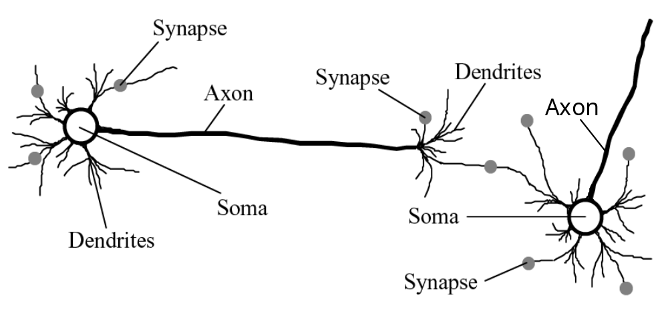
Biological neural network

Slide 6
Our brain can be considered as a highly complex, non-linear and parallel information-processing system.
Information is stored and processed in a neural network simultaneously throughout the whole network, rather than at specific locations. In other words, in neural networks, both data and its processing are global rather than local.
Learning is a fundamental and essential characteristic of biological neural networks. The ease with which they can learn led to attempts to emulate a biological neural network in a computer.

Slide 7
An artificial neural network consists of a number of very simple processors, also called neurons, which are analogous to the biological neurons in the brain.
The neurons are connected by weighted links passing signals from one neuron to another.
The output signal is transmitted through the neuron’s outgoing connection. The outgoing connection splits into a number of branches that transmit the same signal. The outgoing branches terminate at the incoming connections of other neurons in the network.

Slide 8
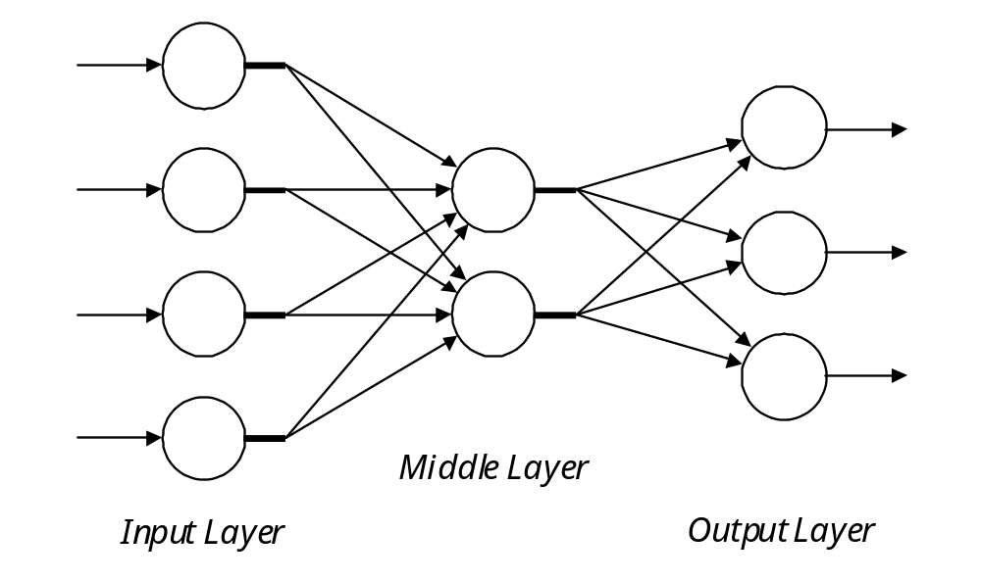
Architecture of a typical artificial neural network
I n p u t S i g n a l s
O u t p u t S i g n a l s

Slide 9
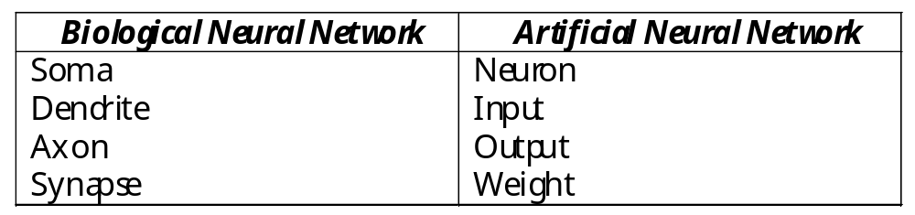
Analogy between biological and artificial neural networks

Slide 10
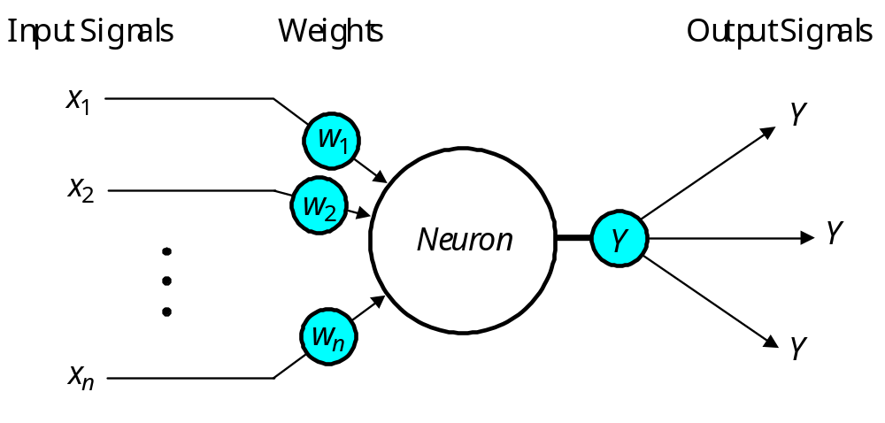
The neuron as a simple computing element
Diagram of a neuron

Slide 11
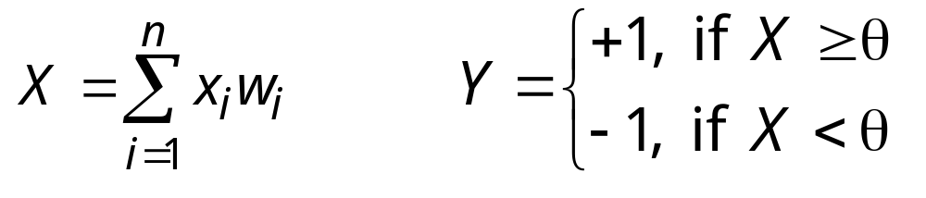
The neuron computes the weighted sum of the input signals and compares the result with a threshold value, θ. If the net input is less than the threshold, the neuron output is –1. But if the net input is greater than or equal to the threshold, the neuron becomes activated and its output attains a value +1.
The neuron uses the following transfer or activation function:
This type of activation function is called a sign function.

Slide 12
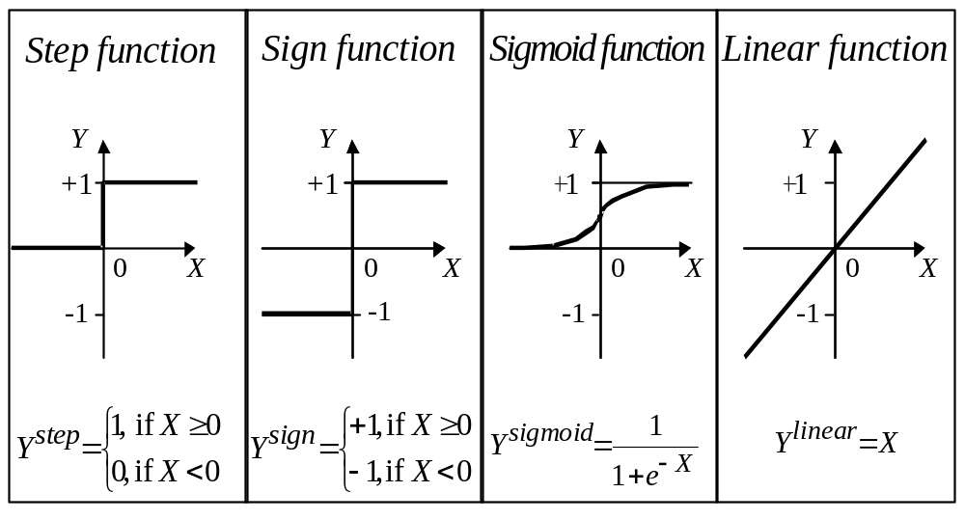
Activation functions of a neuron

Slide 13
Can a single neuron learn a task?
In 1958, Frank Rosenblatt introduced a training algorithm that provided the first procedure for training a simple ANN: a perceptron.
The perceptron is the simplest form of a neural network. It consists of a single neuron with adjustable synaptic weights and a hard limiter.

Slide 14
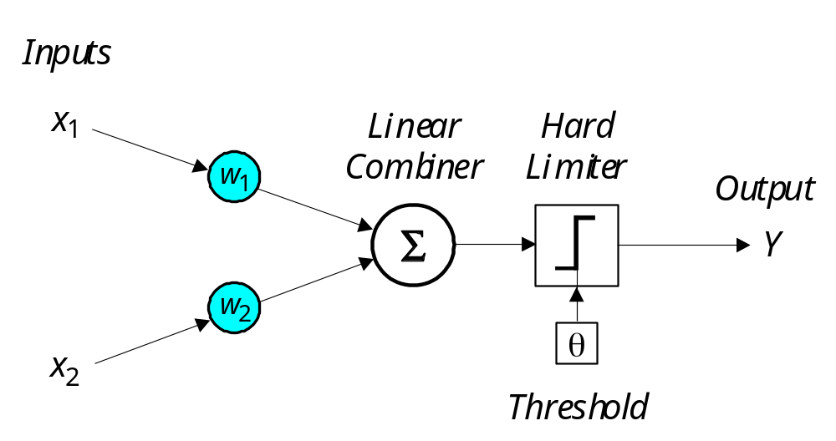
Single-layer two-input perceptron

Slide 15
The Perceptron
The operation of Rosenblatt’s perceptron is based on the McCulloch and Pitts neuron model. The model consists of a linear combiner followed by a hard limiter.
The weighted sum of the inputs is applied to the hard limiter, which produces an output equal to +1 if its input is positive and −1 if it is negative.

Slide 16
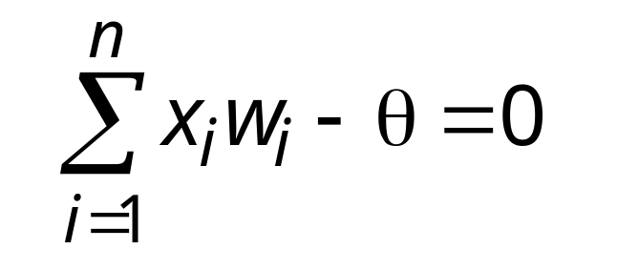
The aim of the perceptron is to classify inputs, x₁, x₂, . . ., x_{n}, into one of two classes, say A₁ and A₂.
In the case of an elementary perceptron, the n- dimensional space is divided by a hyperplane into two decision regions. The hyperplane is defined by the linearly separable function:

Slide 17
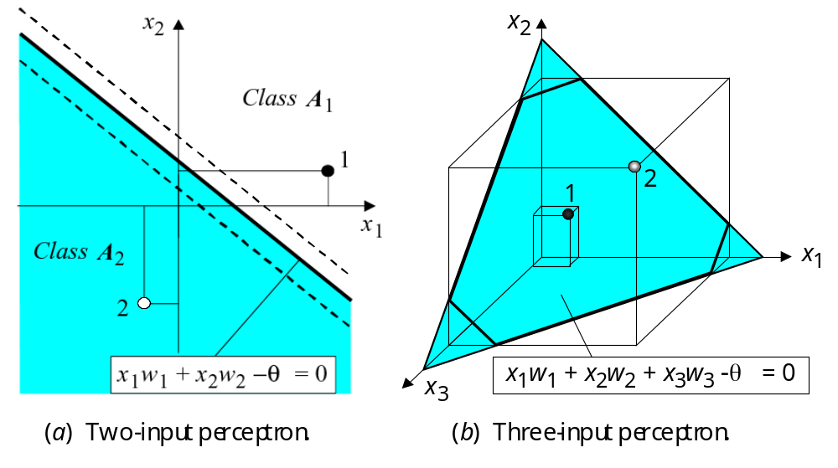
Linear separability in the perceptrons

Slide 18
How does the perceptron learn its classification tasks?
This is done by making small adjustments in the weights to reduce the difference between the actual and desired outputs of the perceptron. The initial weights are randomly assigned, usually in the range [−0.5, 0.5], and then updated to obtain the output consistent with the training examples.

Slide 19
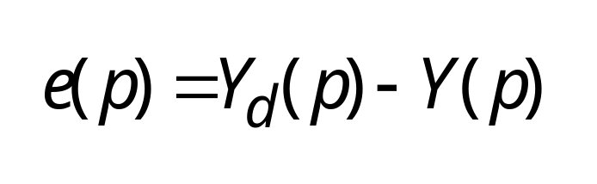
If at iteration p, the actual output is Y(p) and the desired output is Y_{d} (p), then the error is given by:
where p = 1, 2, 3, . . .
Iteration p here refers to the pth training example presented to the perceptron.
If the error, e(p), is positive, we need to increase perceptron output Y(p), but if it is negative, we need to decrease Y(p).

Slide 20
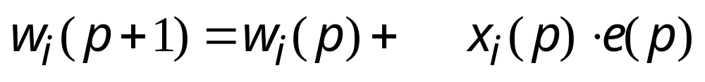
The perceptron learning rule



where p = 1, 2, 3, . . . α is the learning rate, a positive constant less than unity.
The perceptron learning rule was first proposed by Rosenblatt in 1960. Using this rule we can derive the perceptron training algorithm for classification tasks.

Slide 21
Perceptron’s training algorithm
Step 1: Initialisation Set initial weights w₁, w₂,…, w_{n} and threshold θ to random numbers in the range [−0.5, 0.5].
If the error, e(p), is positive, we need to increase perceptron output Y(p), but if it is negative, we need to decrease Y(p).

Slide 22
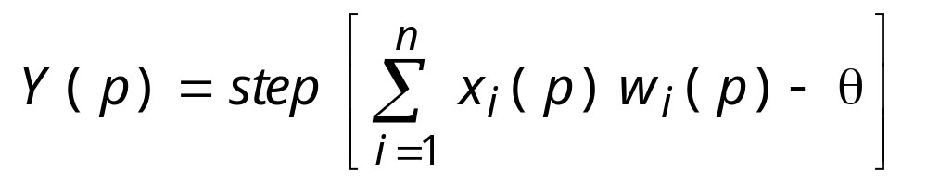
Perceptron’s training algorithm (continued)
Step 2: Activation Activate the perceptron by applying inputs x₁(p), x₂(p),…, x_{n}(p) and desired output Y_{d} (p). Calculate the actual output at iteration p = 1
where n is the number of the perceptron inputs, and step is a step activation function.

Slide 23
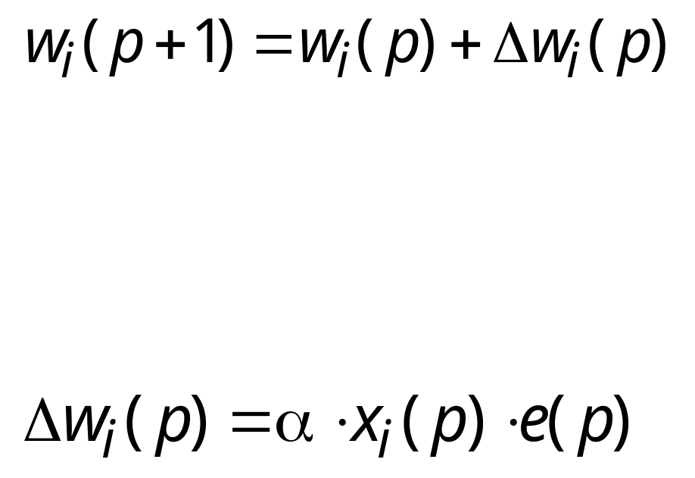
Perceptron’s training algorithm (continued)
Step 3: Weight training Update the weights of the perceptron
where Δw_{i}(p) is the weight correction at iteration p.
The weight correction is computed by the delta rule:
.
Step 4: Iteration Increase iteration p by one, go back to Step 2 and repeat the process until convergence.

Slide 24
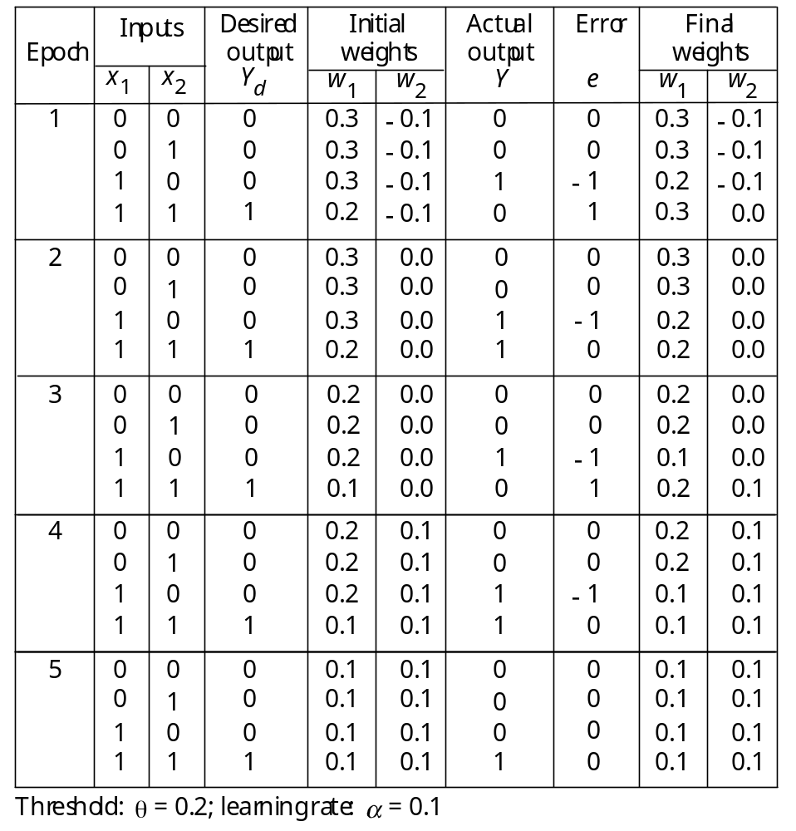
Example of perceptron learning: the logical operation AND

Slide 25
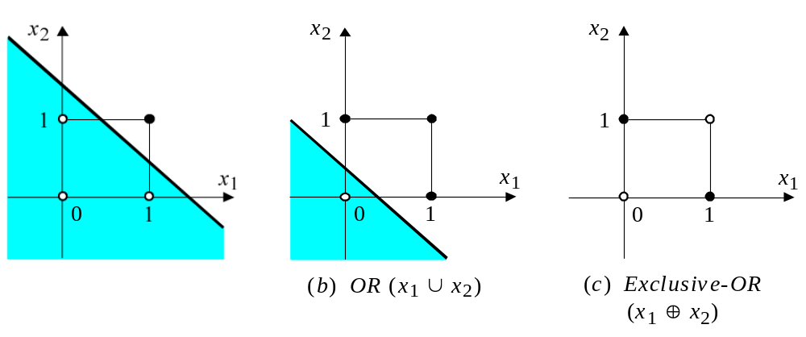
Two-dimensional plots of basic logical operations
(a) AND (x₁ ∩ x₂)
A perceptron can learn the operations AND and OR, but not Exclusive-OR.

Slide 26
Multilayer neural networks
A multilayer perceptron is a feedforward neural network with one or more hidden layers.
The network consists of an input layer of source neurons, at least one middle or hidden layer of computational neurons, and an output layer of computational neurons.
The input signals are propagated in a forward direction on a layer-by-layer basis.

Slide 27
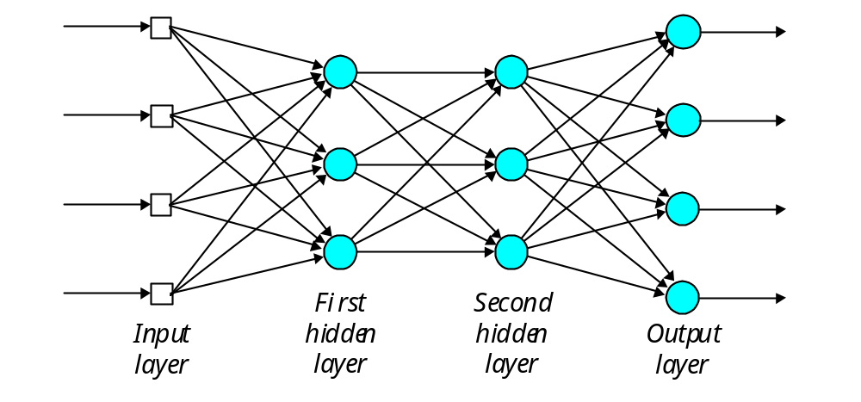
Multilayer perceptron with two hidden layers
I n p u t S i g n a l s
O u t p u t S i g n a l s

Slide 28
What does the middle layer hide?
A hidden layer “hides” its desired output. Neurons in the hidden layer cannot be observed through the input/output behaviour of the network. There is no obvious way to know what the desired output of the hidden layer should be.
Commercial ANNs incorporate three and sometimes four layers, including one or two hidden layers. Each layer can contain from 10 to 1000 neurons. Experimental neural networks may have five or even six layers, including three or four hidden layers, and utilise millions of neurons.

Slide 29
Back-propagation neural network
Learning in a multilayer network proceeds the same way as for a perceptron.
A training set of input patterns is presented to the network.
The network computes its output pattern, and if there is an error − or in other words a difference between actual and desired output patterns − the weights are adjusted to reduce this error.

Slide 30
In a back-propagation neural network, the learning algorithm has two phases.
First, a training input pattern is presented to the network input layer. The network propagates the input pattern from layer to layer until the output pattern is generated by the output layer.
If this pattern is different from the desired output, an error is calculated and then propagated backwards through the network from the output layer to the input layer. The weights are modified as the error is propagated.

Slide 31
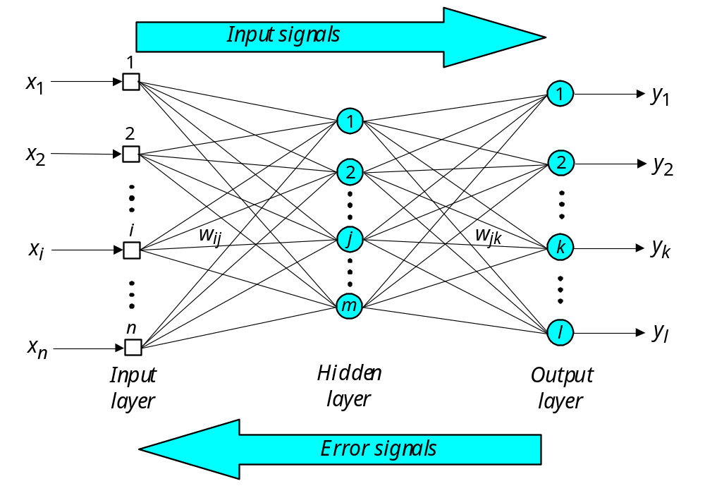
Three-layer back-propagation neural network

Slide 32
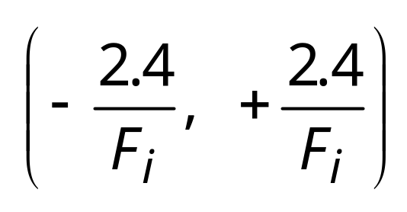
The back-propagation training algorithm
Step 1: Initialisation Set all the weights and threshold levels of the network to random numbers uniformly distributed inside a small range:
where F_{i} is the total number of inputs of neuron i in the network. The weight initialisation is done on a neuron-by-neuron basis.

Slide 33
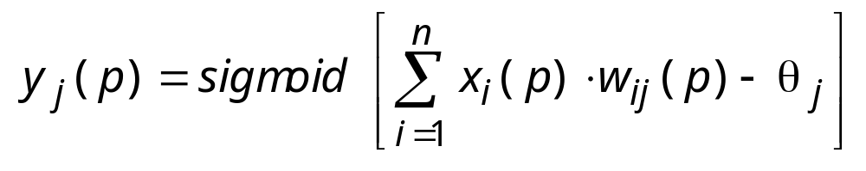
Step 2: Activation Activate the back-propagation neural network by applying inputs x₁(p), x₂(p),…, x_{n}(p) and desired outputs y_{d,1}(p), y_{d,2}(p),…, y_{d,n}(p).
(a) Calculate the actual outputs of the neurons in the hidden layer:
where n is the number of inputs of neuron j in the hidden layer, and sigmoid is the sigmoid activation function.

Slide 34
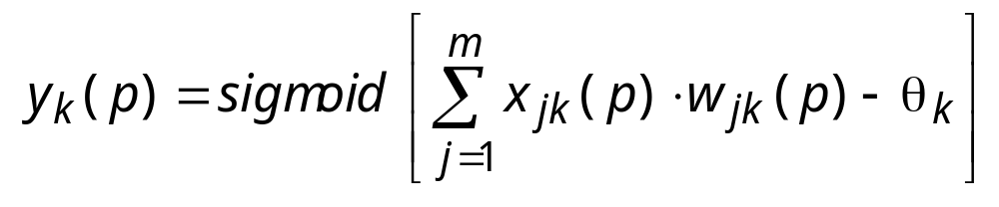
Step 2 : Activation (continued)
(b) Calculate the actual outputs of the neurons in the output layer:
where m is the number of inputs of neuron k in the output layer.

Slide 35
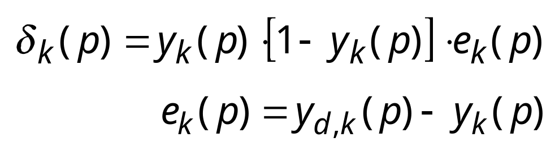
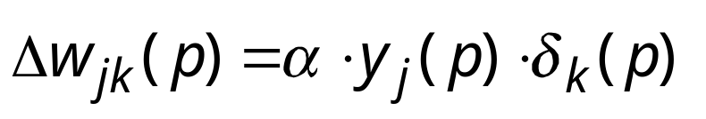
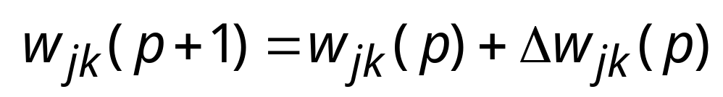
Step 3: Weight training Update the weights in the back-propagation network propagating backward the errors associated with output neurons. (a) Calculate the error gradient for the neurons in the output layer:
where
Calculate the weight corrections:
Update the weights at the output neurons:

Slide 36
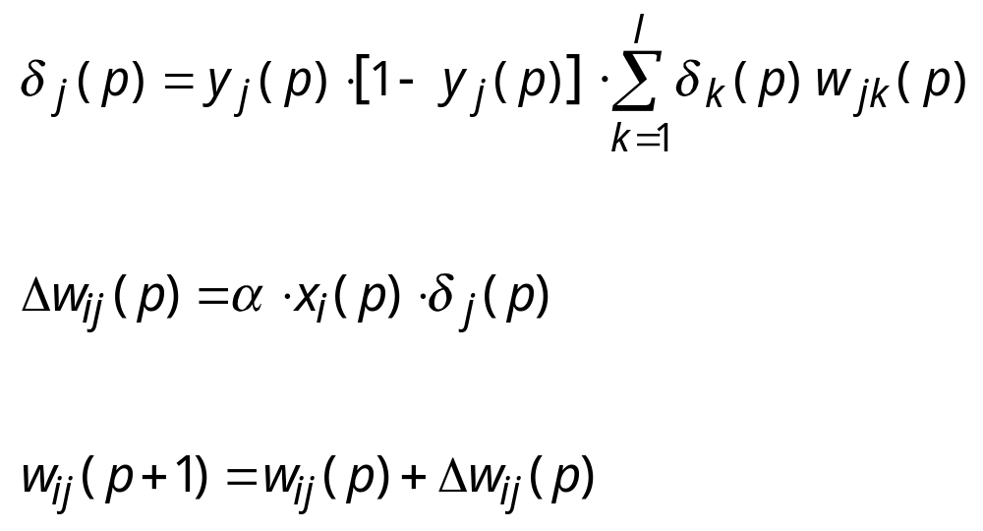
Step 3: Weight training (continued)
(b) Calculate the error gradient for the neurons in the hidden layer:
Calculate the weight corrections:
Update the weights at the hidden neurons:

Slide 37
Step 4: Iteration Increase iteration p by one, go back to Step 2 and repeat the process until the selected error criterion is satisfied.
As an example, we may consider the three-layer back-propagation network. Suppose that the network is required to perform logical operation Exclusive-OR. Recall that a single-layer perceptron could not do this operation. Now we will apply the three-layer net.

Slide 38
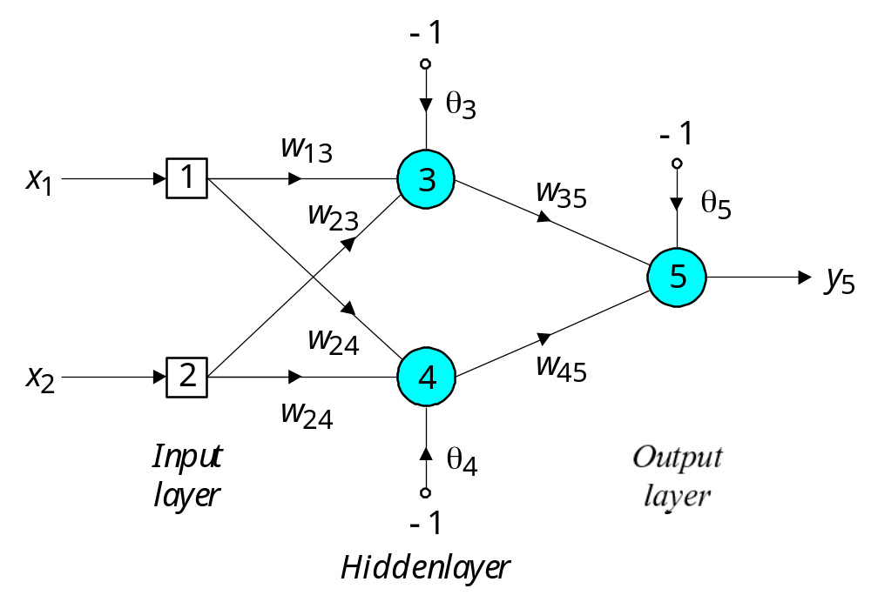
Three-layer network for solving the Exclusive-OR operation

Slide 39
The effect of the threshold applied to a neuron in the hidden or output layer is represented by its weight, θ, connected to a fixed input equal to −1.
The initial weights and threshold levels are set randomly as follows: w₁₃ = 0.5, w₁₄ = 0.9, w₂₃ = 0.4, w₂₄ = 1.0, w₃₅ = −1.2, w₄₅ = 1.1, θ₃ = 0.8, θ₄ = −0.1 and θ₅ = 0.3.

Slide 40
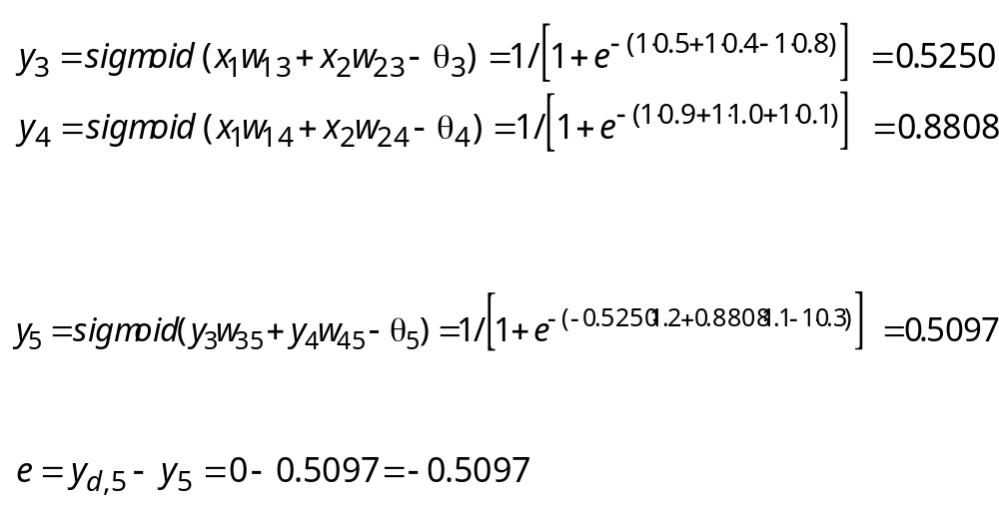
We consider a training set where inputs x₁ and x₂ are equal to 1 and desired output y_{d,5} is 0. The actual outputs of neurons 3 and 4 in the hidden layer are calculated as
Now the actual output of neuron 5 in the output layer is determined as:
Thus, the following error is obtained:

Slide 41
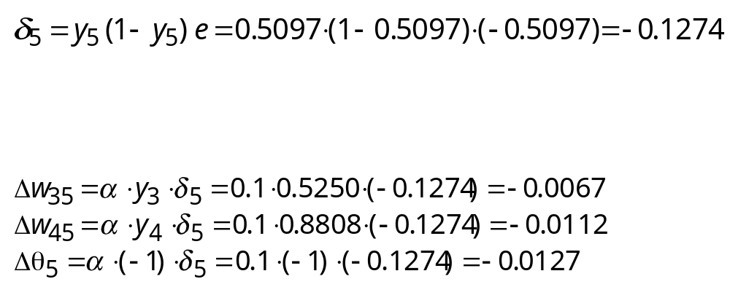
The next step is weight training. To update the weights and threshold levels in our network, we propagate the error, e, from the output layer backward to the input layer.
First, we calculate the error gradient for neuron 5 in the output layer:
Then we determine the weight corrections assuming that the learning rate parameter, α, is equal to 0.1:

Slide 42
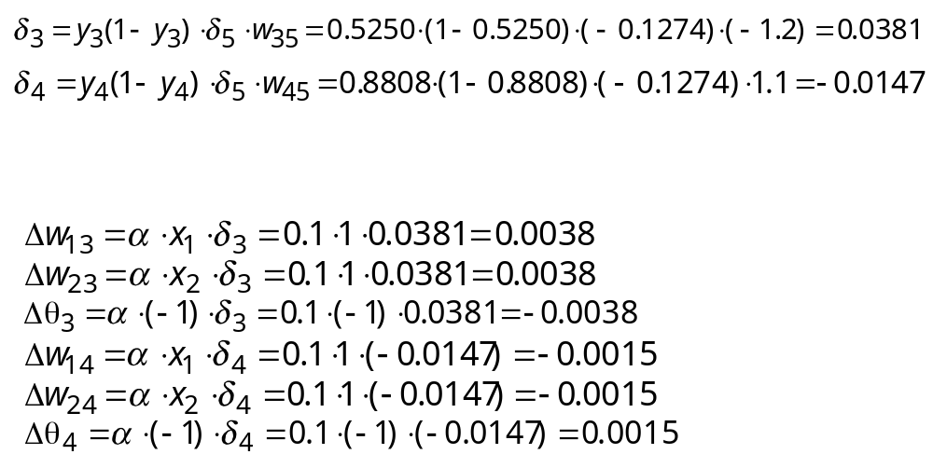
Next we calculate the error gradients for neurons 3 and 4 in the hidden layer:
We then determine the weight corrections:

Slide 43
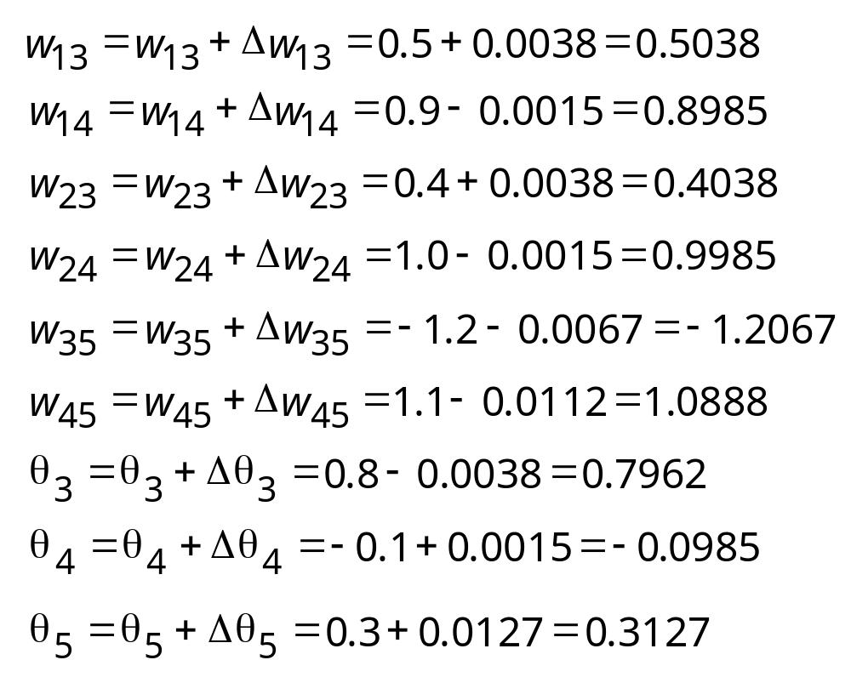
At last, we update all weights and threshold:
The training process is repeated until the sum of squared errors is less than 0.001.

Slide 44
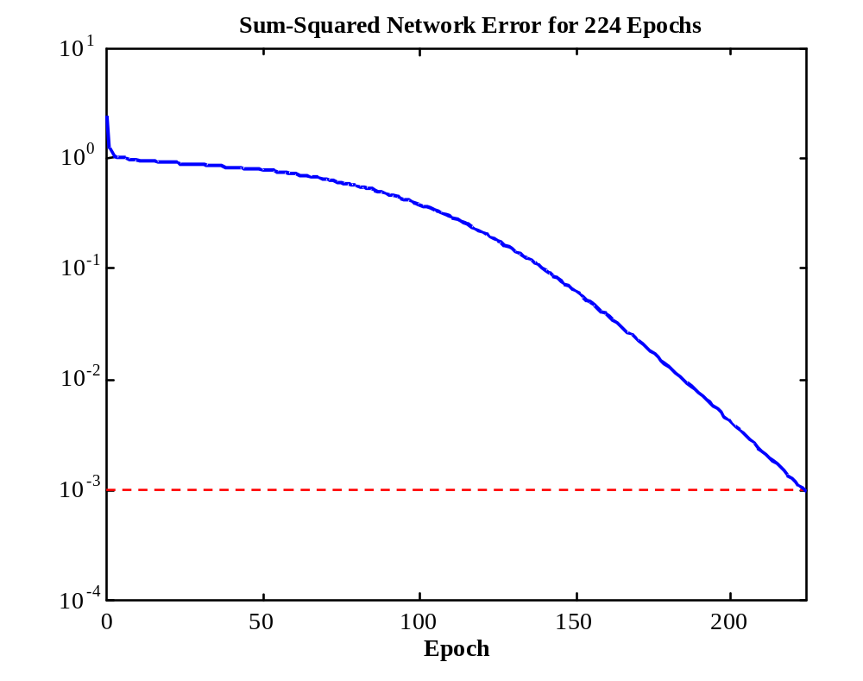
Learning curve for operation Exclusive-OR
Sum-Squared Error
Notes:
44

Slide 45
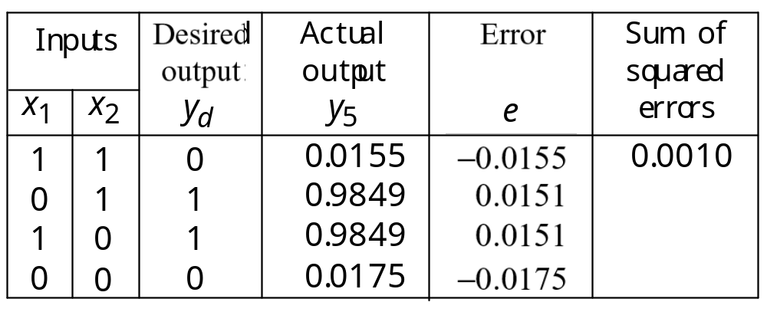
Final results of three-layer network learning

Slide 46
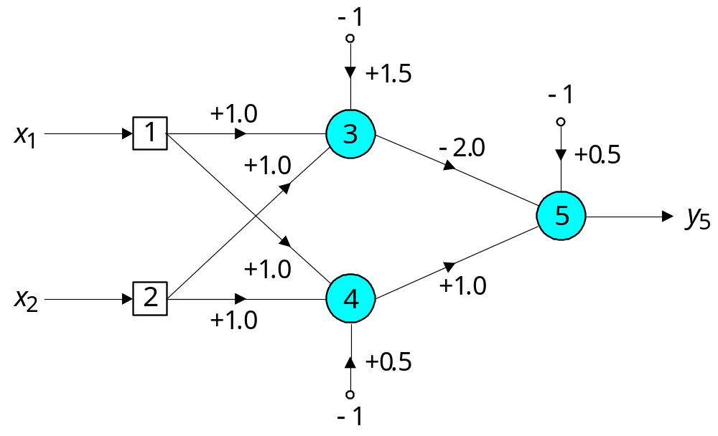
Network represented by McCulloch-Pitts model for solving the Exclusive-OR operation

Slide 47
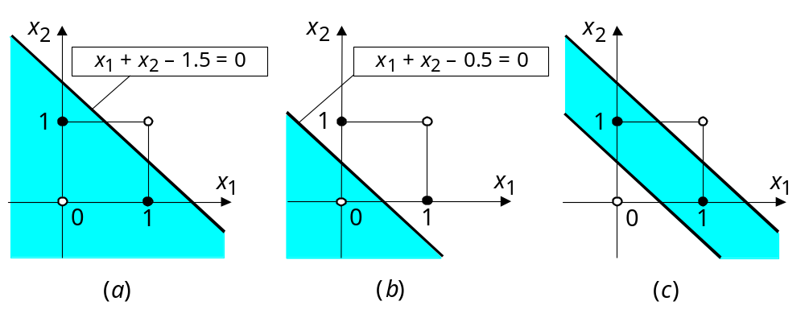
Decision boundaries
Decision boundary constructed by hidden neuron 3; (b) Decision boundary constructed by hidden neuron 4; (c) Decision boundaries constructed by the complete three-layer network

Slide 48
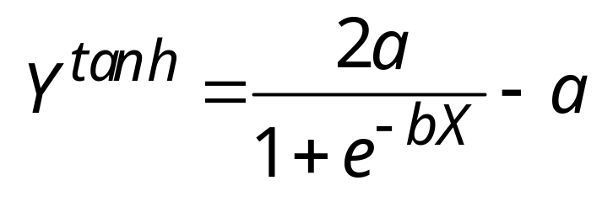
Accelerated learning in multilayer neural networks
A multilayer network learns much faster when the sigmoidal activation function is represented by a hyperbolic tangent:
where a and b are constants.
Suitable values for a and b are: a = 1.716 and b = 0.667

Slide 49
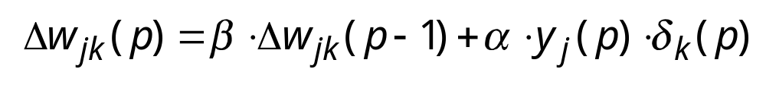
We also can accelerate training by including a momentum term in the delta rule:
where β is a positive number (0 ≤ β < 1) called the momentum constant. Typically, the momentum constant is set to 0.95.
This equation is called the generalised delta rule.

Slide 50
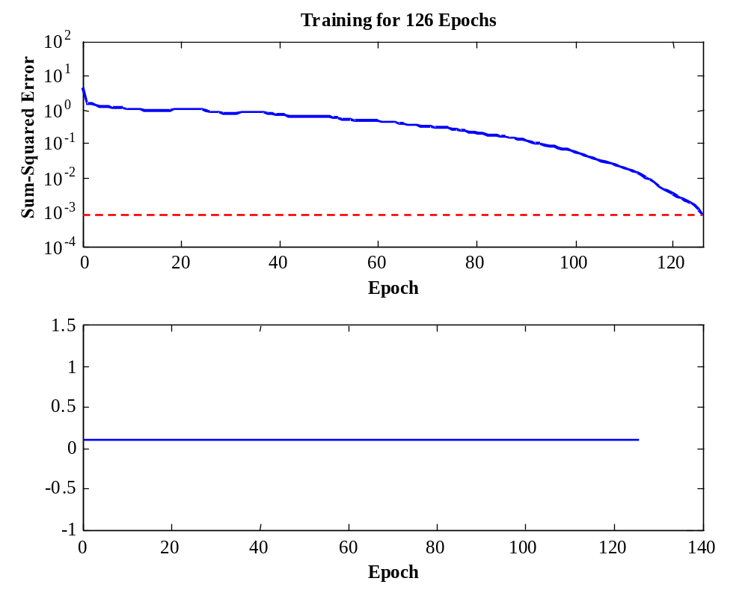
Learning with momentum for operation Exclusive-OR
Learning Rate

Slide 51
Learning with adaptive learning rate
To accelerate the convergence and yet avoid the danger of instability, we can apply two heuristics:
Heuristic 1 If the change of the sum of squared errors has the same algebraic sign for several consequent epochs, then the learning rate parameter, α, should be increased.
Heuristic 2 If the algebraic sign of the change of the sum of squared errors alternates for several consequent epochs, then the learning rate parameter, α, should be decreased.

Slide 52
Adapting the learning rate requires some changes in the back-propagation algorithm.
If the sum of squared errors at the current epoch exceeds the previous value by more than a predefined ratio (typically 1.04), the learning rate parameter is decreased (typically by multiplying by 0.7) and new weights and thresholds are calculated.
If the error is less than the previous one, the learning rate is increased (typically by multiplying by 1.05).

Slide 53
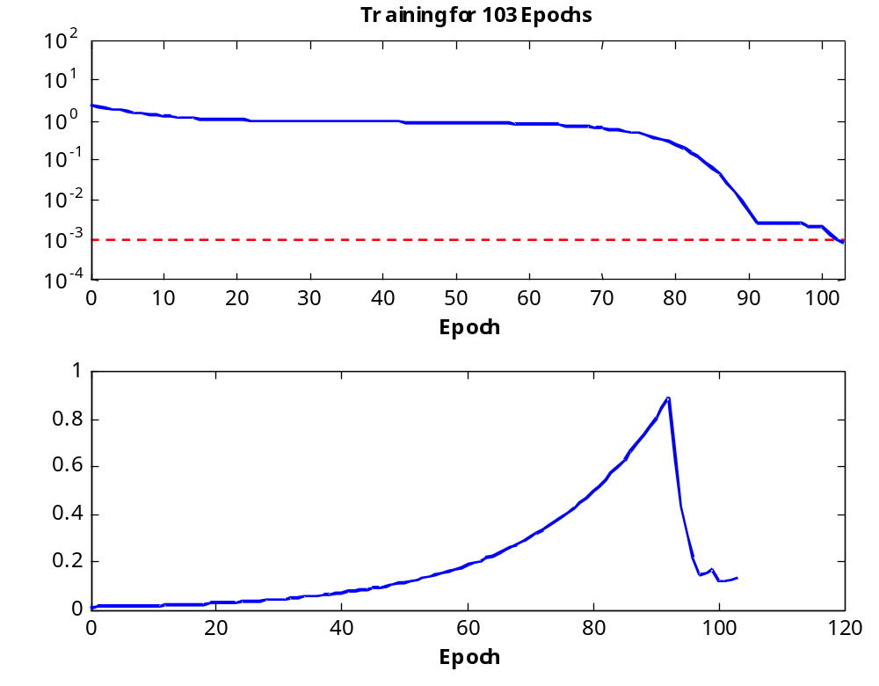
Learning with adaptive learning rate
Sum-Squared Erro
Learning Rate

Slide 54
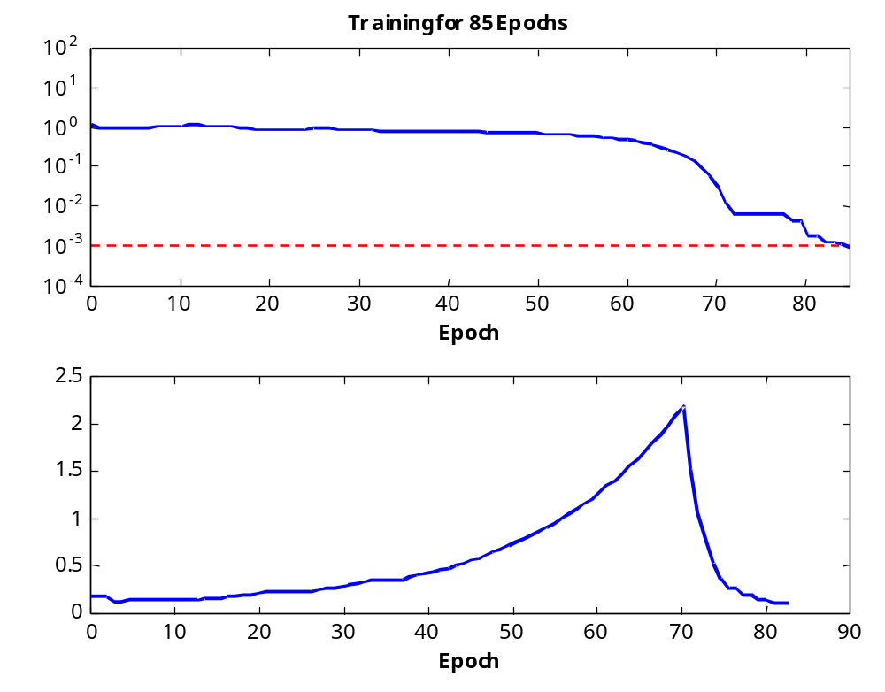
Learning with momentum and adaptive learning rate
Sum-Squared Erro
Learning Rate

Slide 55
The Hopfield Network
Neural networks were designed on analogy with the brain. The brain’s memory, however, works by association. For example, we can recognise a familiar face even in an unfamiliar environment within 100-200 ms. We can also recall a complete sensory experience, including sounds and scenes, when we hear only a few bars of music. The brain routinely associates one thing with another.

Slide 56
Multilayer neural networks trained with the back-propagation algorithm are used for pattern recognition problems. However, to emulate the human memory’s associative characteristics we need a different type of network: a recurrent neural network.
A recurrent neural network has feedback loops from its outputs to its inputs. The presence of such loops has a profound impact on the learning capability of the network.

Slide 57
The stability of recurrent networks intrigued several researchers in the 1960s and 1970s. However, none was able to predict which network would be stable, and some researchers were pessimistic about finding a solution at all. The problem was solved only in 1982, when John Hopfield formulated the physical principle of storing information in a dynamically stable network.

Slide 58
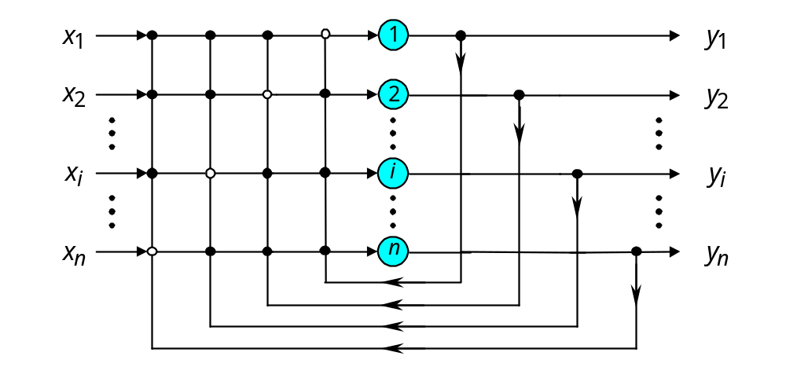
Single-layer n-neuron Hopfield network
I n p u t S i g n a l s
O u t p u t S i g n a l s

Slide 59
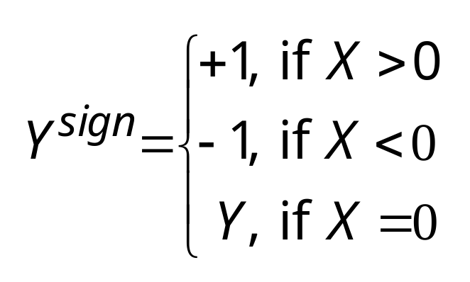
The Hopfield network uses McCulloch and Pitts neurons with the sign activation function as its computing element:

Slide 60
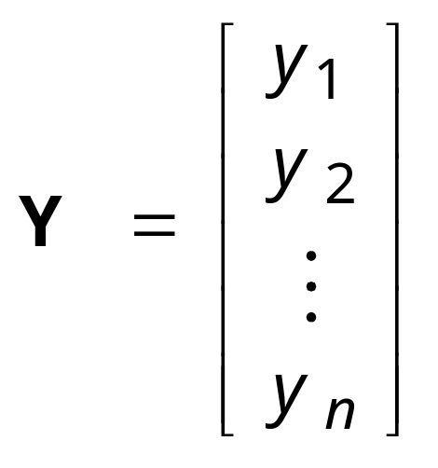
The current state of the Hopfield network is determined by the current outputs of all neurons, y₁, y₂, . . ., y_{n}.
Thus, for a single-layer n-neuron network, the state can be defined by the state vector as:

Slide 61
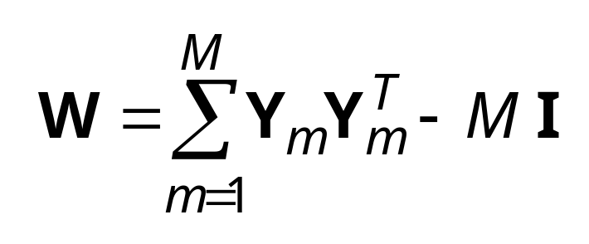
In the Hopfield network, synaptic weights between neurons are usually represented in matrix form as follows:
where M is the number of states to be memorised by the network, Y_{m} is the n-dimensional binary vector, I is n × n identity matrix, and superscript T denotes matrix transposition.

Slide 62
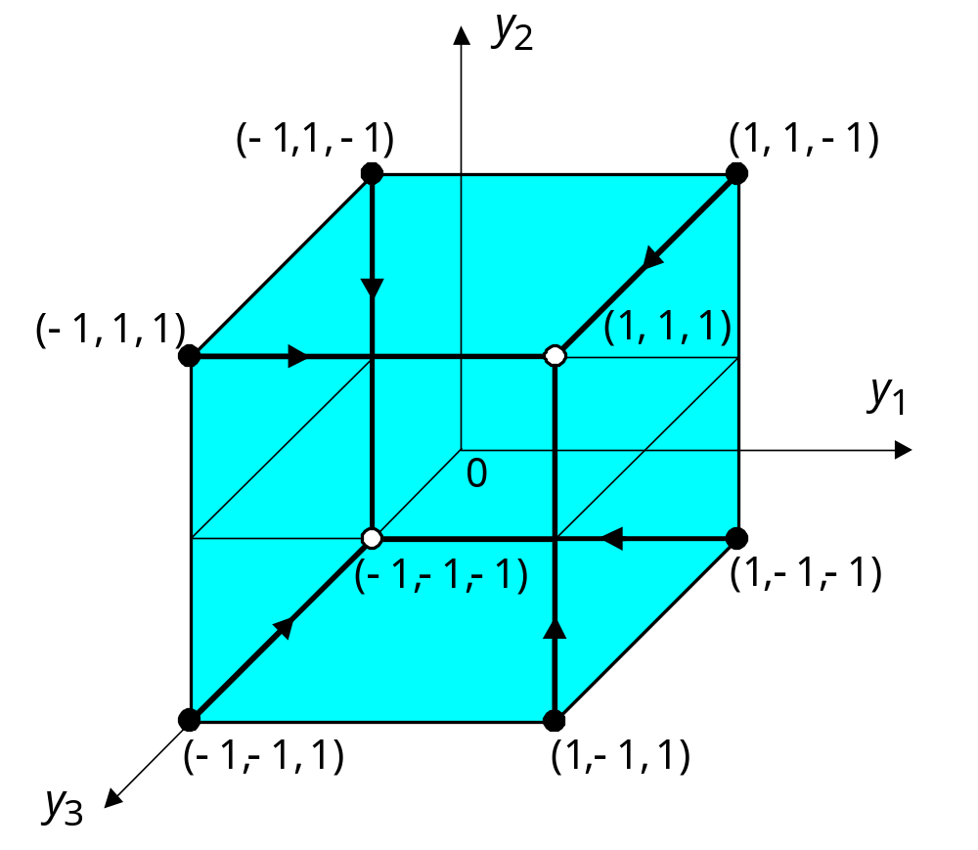
Possible states for the three-neuron Hopfield network

Slide 63
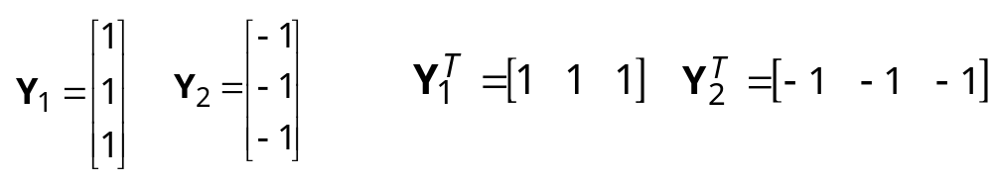
The stable state-vertex is determined by the weight matrix W, the current input vector X, and the threshold matrix θ. If the input vector is partially incorrect or incomplete, the initial state will converge into the stable state-vertex after a few iterations.
Suppose, for instance, that our network is required to memorise two opposite states, (1, 1, 1) and (−1, −1, −1). Thus,
or
where Y₁ and Y₂ are the three-dimensional vectors.

Slide 64
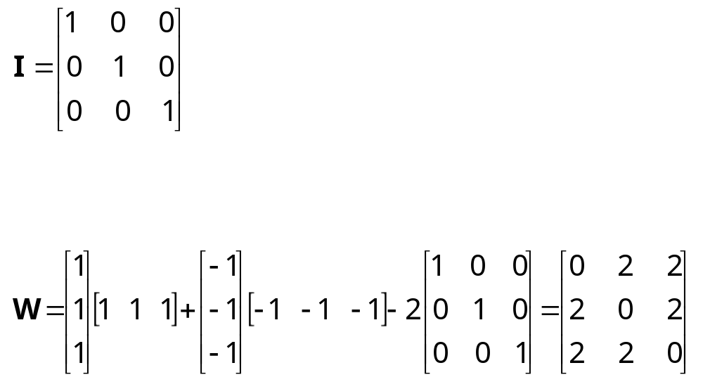
The 3 × 3 identity matrix I is
Thus, we can now determine the weight matrix as follows:
Next, the network is tested by the sequence of input vectors, X₁ and X₂, which are equal to the output (or target) vectors Y₁ and Y₂, respectively.

Slide 65
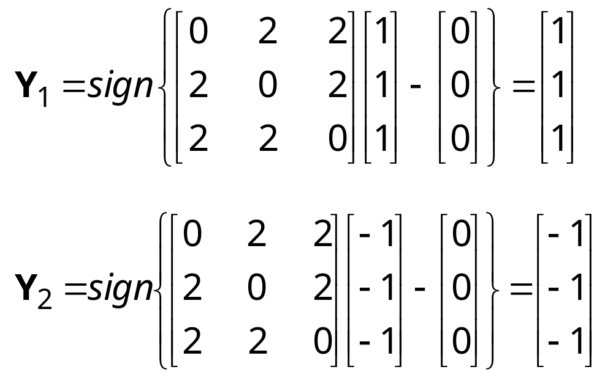
First, we activate the Hopfield network by applying the input vector X. Then, we calculate the actual output vector Y, and finally, we compare the result with the initial input vector X.

Slide 66
The remaining six states are all unstable. However, stable states (also called fundamental memories) are capable of attracting states that are close to them.
The fundamental memory (1, 1, 1) attracts unstable states (−1, 1, 1), (1, −1, 1) and (1, 1, −1). Each of these unstable states represents a single error, compared to the fundamental memory (1, 1, 1).
The fundamental memory (−1, −1, −1) attracts unstable states (−1, −1, 1), (−1, 1, −1) and (1, −1, −1).
Thus, the Hopfield network can act as an error correction network.

Slide 67
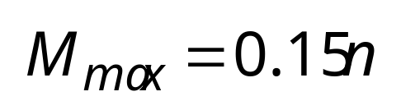
Storage capacity of the Hopfield network
Storage capacity is or the largest number of fundamental memories that can be stored and retrieved correctly.
The maximum number of fundamental memories M_{max} that can be stored in the n-neuron recurrent network is limited by

Slide 68
Bidirectional associative memory (BAM)
The Hopfield network represents an autoassociative type of memory − it can retrieve a corrupted or incomplete memory but cannot associate this memory with another different memory.
Human memory is essentially associative. One thing may remind us of another, and that of another, and so on. We use a chain of mental associations to recover a lost memory. If we forget where we left an umbrella, we try to recall where we last had it, what we were doing, and who we were talking to. We attempt to establish a chain of associations, and thereby to restore a lost memory.

Slide 69
To associate one memory with another, we need a recurrent neural network capable of accepting an input pattern on one set of neurons and producing a related, but different, output pattern on another set of neurons.
Bidirectional associative memory (BAM), first proposed by Bart Kosko, is a heteroassociative network. It associates patterns from one set, set A, to patterns from another set, set B, and vice versa. Like a Hopfield network, the BAM can generalise and also produce correct outputs despite corrupted or incomplete inputs.

Slide 70
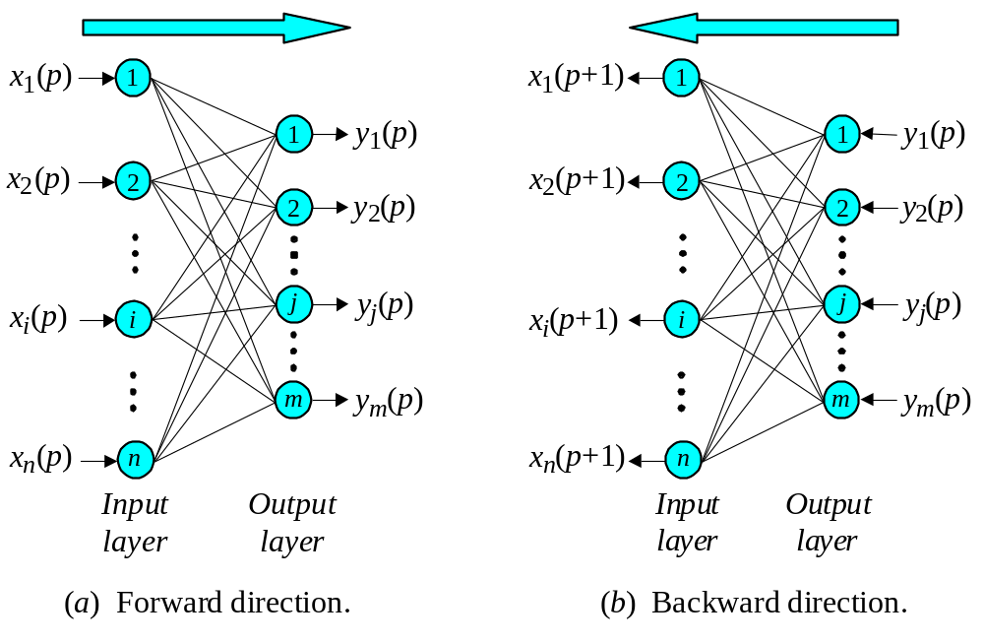
BAM operation

Slide 71
The basic idea behind the BAM is to store pattern pairs so that when n-dimensional vector X from set A is presented as input, the BAM recalls m-dimensional vector Y from set B, but when Y is presented as input, the BAM recalls X.

Slide 72
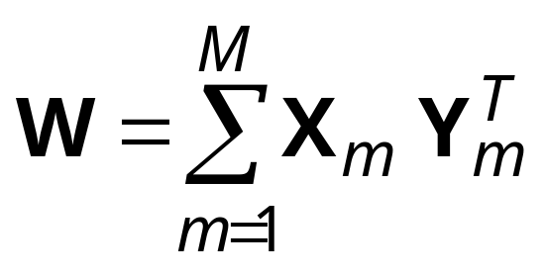
To develop the BAM, we need to create a correlation matrix for each pattern pair we want to store. The correlation matrix is the matrix product of the input vector X, and the transpose of the output vector Y^{T}. The BAM weight matrix is the sum of all correlation matrices, that is,
where M is the number of pattern pairs to be stored in the BAM.

Slide 73
Stability and storage capacity of the BAM
The BAM is unconditionally stable. This means that any set of associations can be learned without risk of instability.
The maximum number of associations to be stored in the BAM should not exceed the number of neurons in the smaller layer.
The more serious problem with the BAM is incorrect convergence. The BAM may not always produce the closest association. In fact, a stable association may be only slightly related to the initial input vector.

