Slide 1
Lecture 8
Artificial neural networks:
Unsupervised learning
Introduction
Hebbian learning
Generalised Hebbian learning algorithm
Competitive learning
Self-organising computational map:
Kohonen network
Summary

Slide 2
Introduction
The main property of a neural network is an ability to learn from its environment, and to improve its performance through learning. So far we have considered supervised or active learning − learning with an external “teacher” or a supervisor who presents a training set to the network. But another type of learning also exists: unsupervised learning.

Slide 3
In contrast to supervised learning, unsupervised or self-organised learning does not require an external teacher. During the training session, the neural network receives a number of different input patterns, discovers significant features in these patterns and learns how to classify input data into appropriate categories. Unsupervised learning tends to follow the neuro-biological organisation of the brain.
Unsupervised learning algorithms aim to learn rapidly and can be used in real-time.

Slide 4
Hebbian learning
In 1949, Donald Hebb proposed one of the key ideas in biological learning, commonly known as Hebb’s Law. Hebb’s Law states that if neuron i is near enough to excite neuron j and repeatedly participates in its activation, the synaptic connection between these two neurons is strengthened and neuron j becomes more sensitive to stimuli from neuron i.

Slide 5
Hebb’s Law can be represented in the form of two rules:
If two neurons on either side of a connection are activated synchronously, then the weight of that connection is increased.
If two neurons on either side of a connection are activated asynchronously, then the weight of that connection is decreased.
Hebb’s Law provides the basis for learning without a teacher. Learning here is a local phenomenon occurring without feedback from the environment.

Slide 6
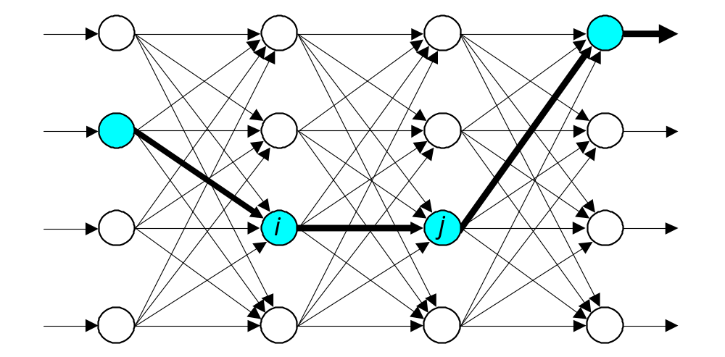
Hebbian learning in a neural network
O u t p u t S i g n a l s
I n p u t S i g n a l s

Slide 7
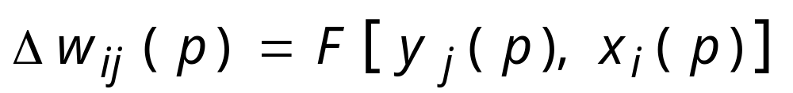
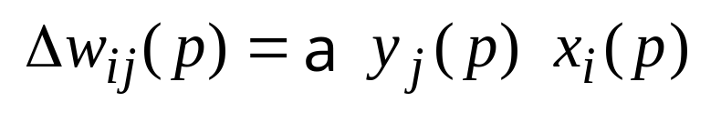
Using Hebb’s Law we can express the adjustment applied to the weight w_{ij} at iteration p in the following form:
As a special case, we can represent Hebb’s Law as follows:
where α is the learning rate parameter. This equation is referred to as the activity product rule.

Slide 8
Hebbian learning implies that weights can only increase. To resolve this problem, we might impose a limit on the growth of synaptic weights. It can be done by introducing a non-linear forgetting factor into Hebb’s Law:
where ϕ is the forgetting factor.
Forgetting factor usually falls in the interval between 0 and 1, typically between 0.01 and 0.1, to allow only a little “forgetting” while limiting the weight growth.

Slide 9
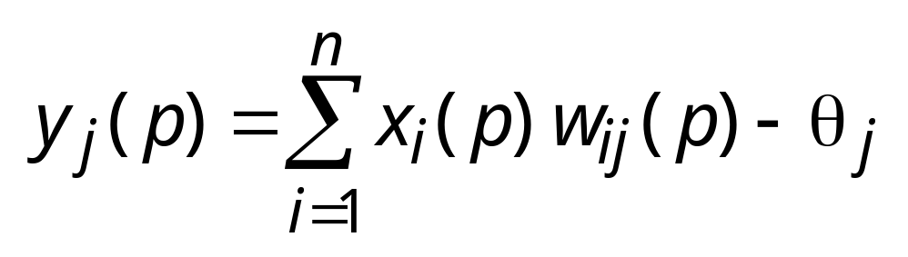
Hebbian learning algorithm
Step 1: Initialisation. Set initial synaptic weights and thresholds to small random values, say in an interval [0, 1 ].
Step 2: Activation. Compute the neuron output at iteration p
where n is the number of neuron inputs, and θ_{j} is the threshold value of neuron j.

Slide 10
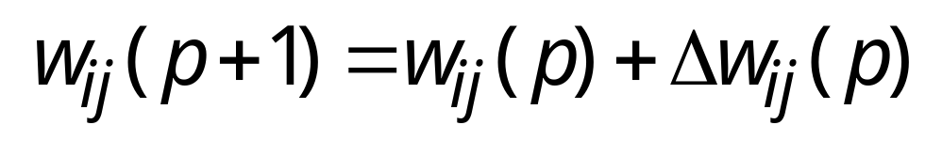
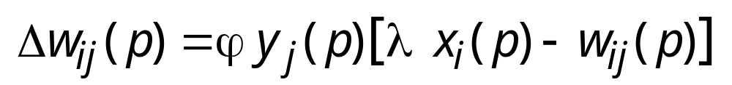
Step 3: Learning. Update the weights in the network:
where Δw_{ij}(p) is the weight correction at iteration p.
The weight correction is determined by the generalised activity product rule:
Step 4: Iteration. Increase iteration p by one, go back to Step 2.

Slide 11
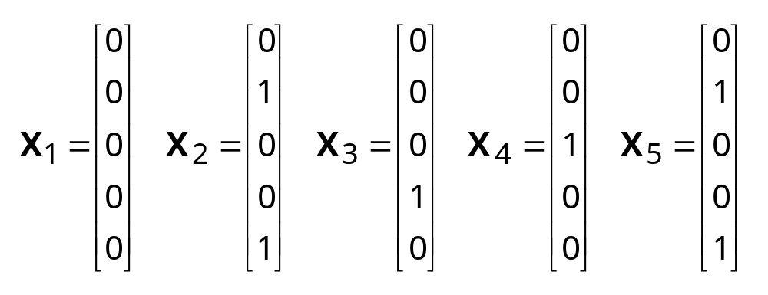
Hebbian learning example
To illustrate Hebbian learning, consider a fully connected feedforward network with a single layer of five computation neurons. Each neuron is represented by a McCulloch and Pitts model with the sign activation function. The network is trained on the following set of input vectors:

Slide 12
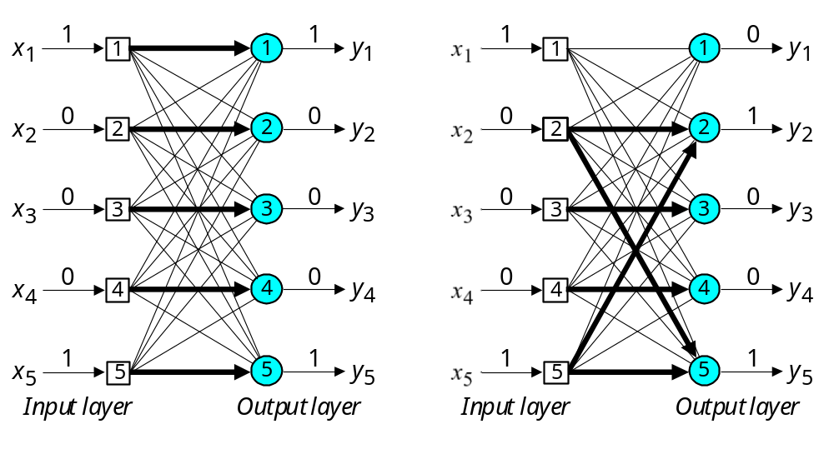
Initial and final states of the network

Slide 13
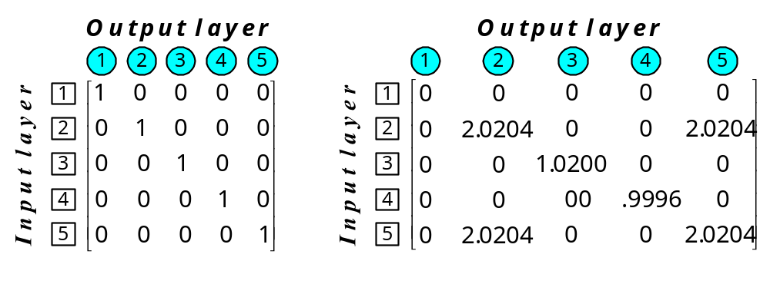
Initial and final weight matrices

Slide 14
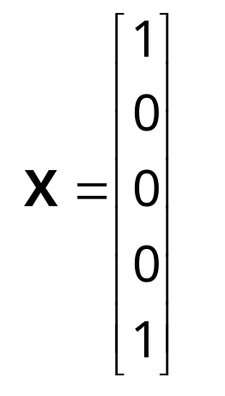
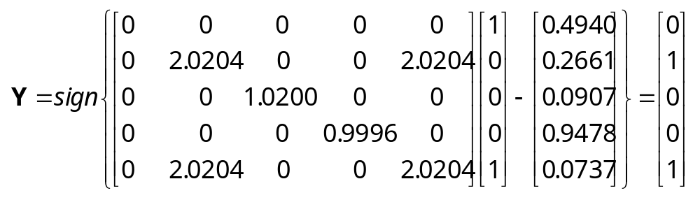
A test input vector, or probe, is defined as
When this probe is presented to the network, we obtain:

Slide 15
Competitive learning
In competitive learning, neurons compete among themselves to be activated.
While in Hebbian learning, several output neurons can be activated simultaneously, in competitive learning, only a single output neuron is active at any time.
The output neuron that wins the “competition” is called the winner-takes-all neuron.

Slide 16
The basic idea of competitive learning was introduced in the early 1970s.
In the late 1980s, Teuvo Kohonen introduced a special class of artificial neural networks called self-organising feature maps. These maps are based on competitive learning.

Slide 17
What is a self-organising feature map?
Our brain is dominated by the cerebral cortex, a very complex structure of billions of neurons and hundreds of billions of synapses. The cortex includes areas that are responsible for different human activities (motor, visual, auditory, somatosensory, etc.), and associated with different sensory inputs. We can say that each sensory input is mapped into a corresponding area of the cerebral cortex. The cortex is a self-organising computational map in the human brain.

Slide 18
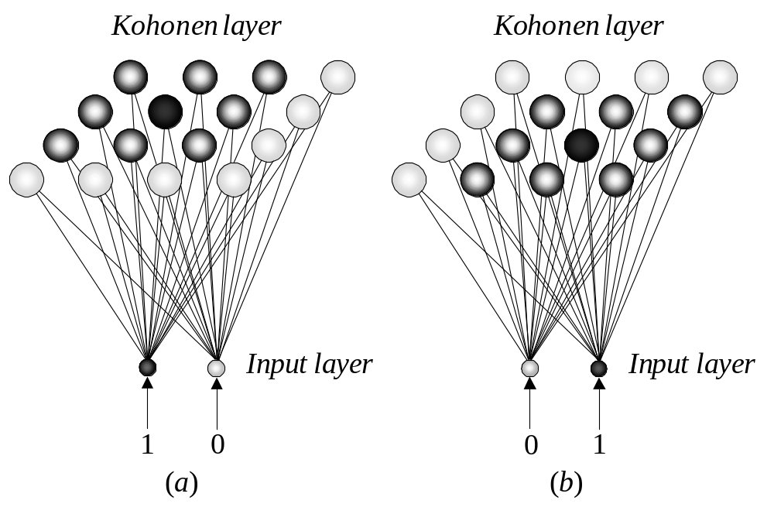
Feature-mapping Kohonen model

Slide 19
The Kohonen network
The Kohonen model provides a topological mapping. It places a fixed number of input patterns from the input layer into a higher- dimensional output or Kohonen layer.
Training in the Kohonen network begins with the winner’s neighbourhood of a fairly large size. Then, as training proceeds, the neighbourhood size gradually decreases.

Slide 20
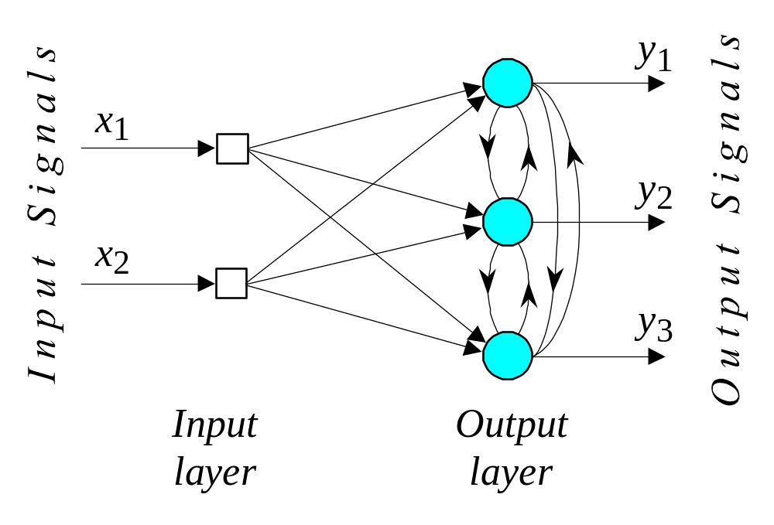
Architecture of the Kohonen Network

Slide 21
The lateral connections are used to create a competition between neurons. The neuron with the largest activation level among all neurons in the output layer becomes the winner. This neuron is the only neuron that produces an output signal. The activity of all other neurons is suppressed in the competition.
The lateral feedback connections produce excitatory or inhibitory effects, depending on the distance from the winning neuron. This is achieved by the use of a Mexican hat function which describes synaptic weights between neurons in the Kohonen layer.

Slide 22
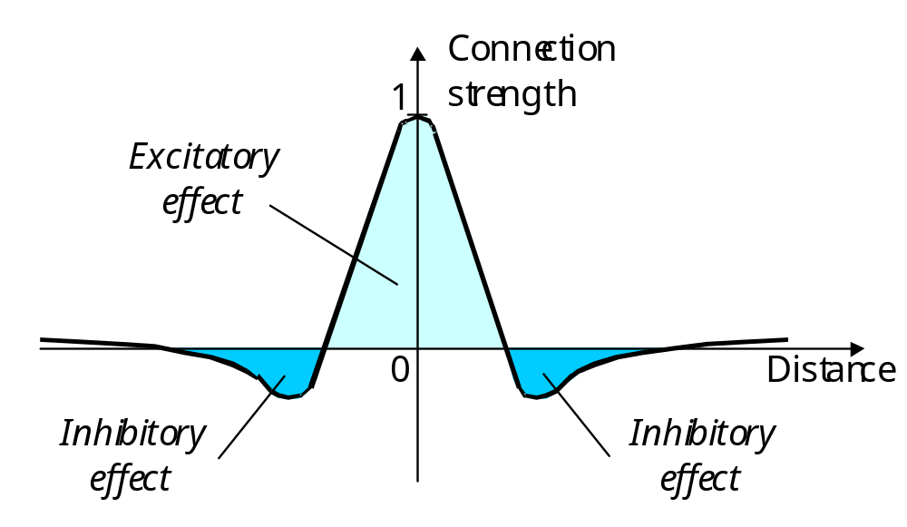
  The Mexican hat function of lateral connection

Slide 23
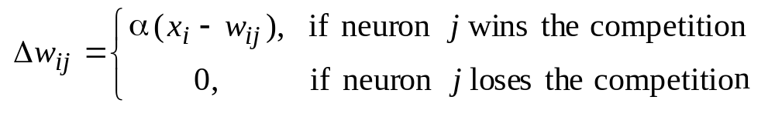
In the Kohonen network, a neuron learns by shifting its weights from inactive connections to active ones. Only the winning neuron and its neighbourhood are allowed to learn. If a neuron does not respond to a given input pattern, then learning cannot occur in that particular neuron.
The competitive learning rule defines the change Δw_{ij} applied to synaptic weight w_{ij} as
where x_{i} is the input signal and α is the learning rate parameter.

Slide 24
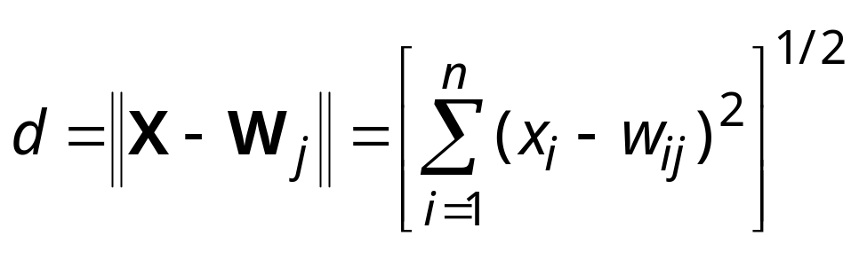
The overall effect of the competitive learning rule resides in moving the synaptic weight vector W_{j} of the winning neuron j towards the input pattern X. The matching criterion is equivalent to the minimum Euclidean distance between vectors.
The Euclidean distance between a pair of n-by-1 vectors X and W_{j} is defined by
where x_{i} and w_{ij} are the ith elements of the vectors X and W_{j}, respectively.

Slide 25
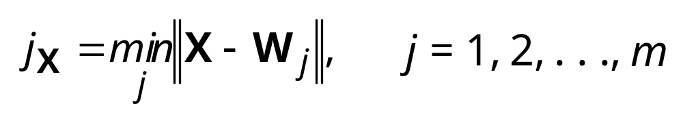
To identify the winning neuron, j_{X}, that best matches the input vector X, we may apply the following condition:
where m is the number of neurons in the Kohonen layer.

Slide 26
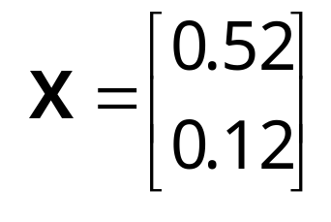
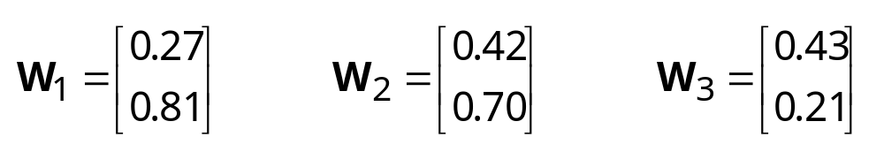
Suppose, for instance, that the 2-dimensional input vector X is presented to the three-neuron Kohonen network,
The initial weight vectors, W_{j}, are given by

Slide 27
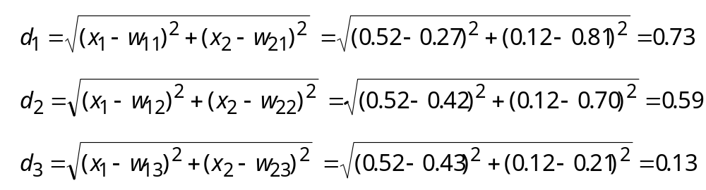
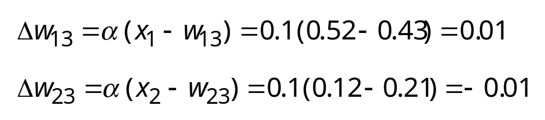
We find the winning (best-matching) neuron j_{X} using the minimum-distance Euclidean criterion:
Neuron 3 is the winner and its weight vector W3 is updated according to the competitive learning rule.

Slide 28
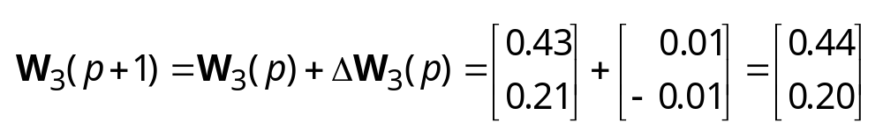
The updated weight vector W₃ at iteration (p + 1) is determined as:
The weight vector W₃ of the wining neuron 3 becomes closer to the input vector X with each iteration.

Slide 29
Competitive Learning Algorithm
Step 1: Initialisation.
Set initial synaptic weights to small random
values, say in an interval [0, 1], and assign a small
positive value to the learning rate parameter α.

Slide 30
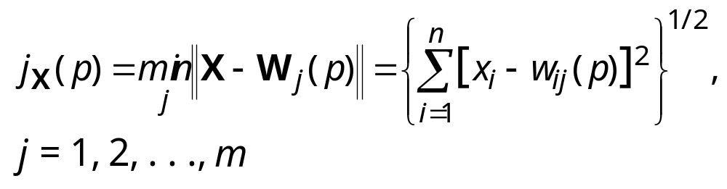
Step 2: Activation and Similarity Matching.
Activate the Kohonen network by applying the
input vector X, and find the winner-takes-all (best
matching) neuron j_{X} at iteration p, using the
minimum-distance Euclidean criterion
where n is the number of neurons in the input
layer, and m is the number of neurons in the
Kohonen layer.

Slide 31
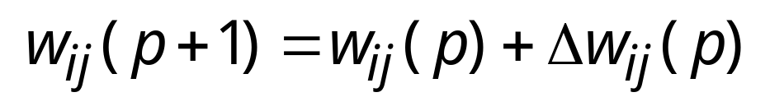
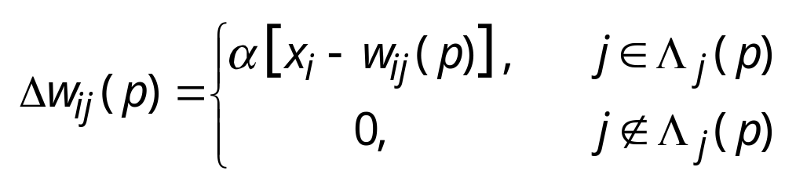
Step 3: Learning.
Update the synaptic weights
where Δw_{ij}(p) is the weight correction at iteration p.
The weight correction is determined by the
competitive learning rule:
where α is the learning rate parameter, and Λ_{j}(p) is
the neighbourhood function centred around the
winner-takes-all neuron j_{X} at iteration p.

Slide 32
Step 4: Iteration.
Increase iteration p by one, go back to Step 2 and
continue until the minimum-distance Euclidean
criterion is satisfied, or no noticeable changes
occur in the feature map.

Slide 33
Competitive learning in the Kohonen network
To illustrate competitive learning, consider the Kohonen network with 100 neurons arranged in the form of a two-dimensional lattice with 10 rows and 10 columns. The network is required to classify two-dimensional input vectors - each neuron in the network should respond only to the input vectors occurring in its region.
The network is trained with 1000 two-dimensional input vectors generated randomly in a square region in the interval between –1 and +1. The learning rate parameter a is equal to 0.1.

Slide 34
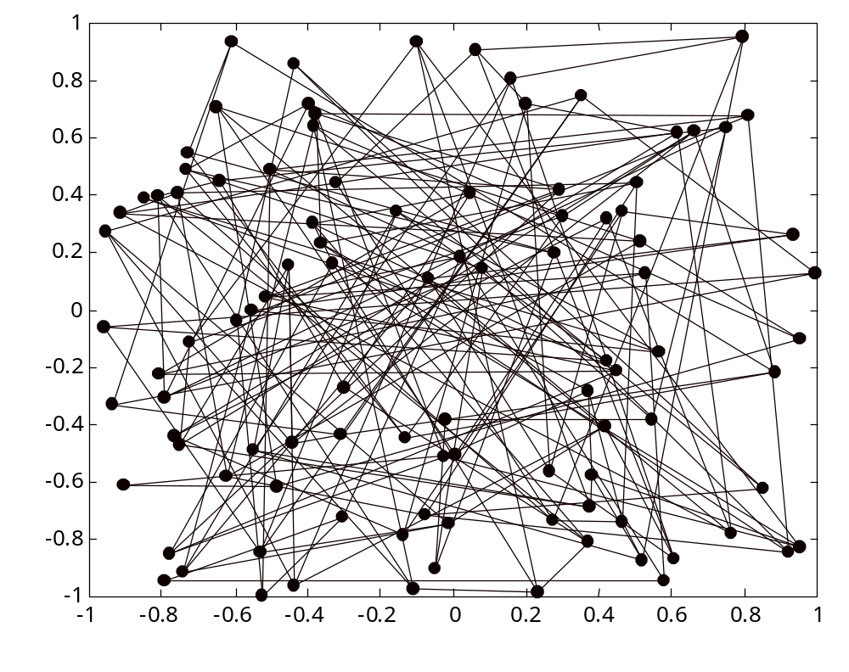
Initial random weights
W(2,j)
W(1,j)

Slide 35
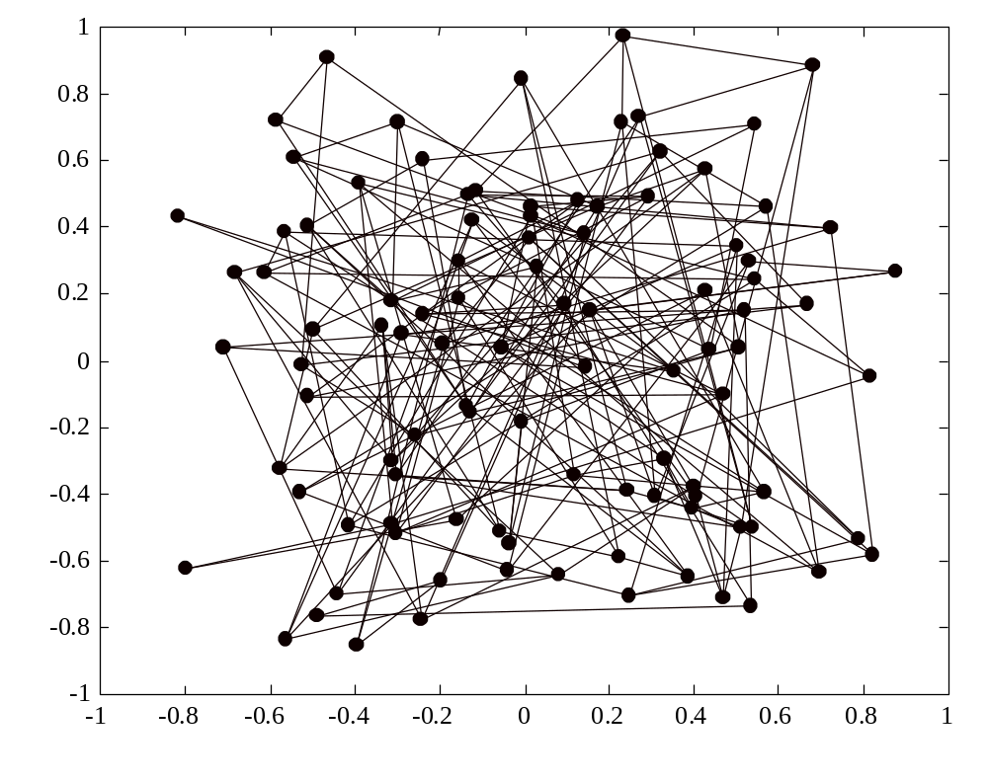
Network after 100 iterations
W(2,j)
W(1,j)

Slide 36
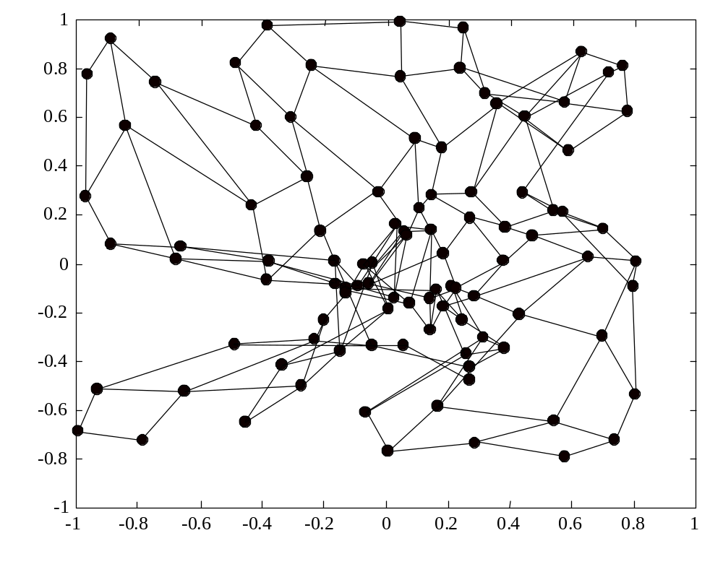
Network after 1000 iterations
W(2,j)
W(1,j)

Slide 37
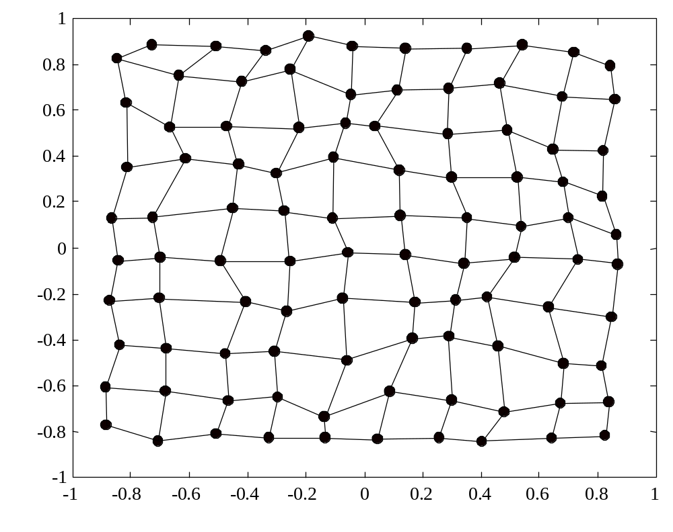
Network after 10,000 iterations
W(2,j)
W(1,j)

