Slide 1
Biologically Inspired Computing
An Introduction

Slide 2
Computation Inspired by Nature
Looking at nature to find solutions to the real world problems for which no known solution exists
Imitating Life of
  Human Brain
  Insects, Ants, Bees, Fish & Termites etc.
  Biological Evolution
  Artificial Life
  Immune System

Slide 3
Classical Computation vs Bio-Inspired Computation
Classical computing is good at:
Number-crunching
Thought-support (glorified pen-and-paper)
Rule-based reasoning
Constant repetition of well-defined actions.
Classical computing is bad at:
Pattern recognition
Robustness to damage
Dealing with vague and incomplete information;
Adapting and improving based on experience

Slide 4
Why don’t we have software that can do the following things well?
Automatically locate a small outburst of violent behaviour in a football crowd
Classify a plant species from a photograph of a leaf.
Make a cup of tea?

Slide 5
Basic Notes on Optimisation
We have 3 items as follows: (item 1: 20kg; item2: 75kg; item 3: 60kg)
Suppose we want to find the subset of items with total weight closest to 100kg
Which is the best?
000
110
101
100
111
001
010
011
Well done, you just searched the space of possible subsets. You
also found the optimal one. If the above set of subsets is called S,
and the subsets themselves are s1, s2, s3, etc …, you just optimised the
function “closest_to_100kg(s)”; i.e. you found the s which minimises the
function |(weight—100)| .

Slide 6
Search and Optimization
In general, optimisation means that you are trying to find the best solution you can (usually in a short time) to a given problem.
S
We always have a set S of all possible
solutions
s1
s2
s3
…
S may be small (as just seen)
S may be very, very, very, very large
(e.g all possible timetables for a 500-exam/3-week diet)
… in fact something like 10³⁰ is typical for real problems.
S may be infinitely large – e.g. all real numbers.

Slide 7
Pattern Recognition and
Optimization
These two things tend to come up a lot when we think of what we would like to be able to do with software, but usually can’t do.
But these are things that seems to be done very well indeed in Biology.
So it seems like a good idea to study how these things are done in biology – i.e. (usually) how computation is done by biological machines

Slide 8
How Biology Optimizes
We wish to design something – we want the best possible (or,
at least a very good) design.
The set S is the set of all possible designs. It is always much too
large to search through this set one by one, however we want to
find good examples in S.
In nature, this problem seems to be solved wonderfully well,
again and again and again, by evolution
Nature has designed millions of extremely complex machines, each
almost ideal for their tasks (assuming an environment that doesn’t
go haywire), using evolution as the only mechanism.
Clearly, this is worth trying for solving problems in science and industry.

Slide 9
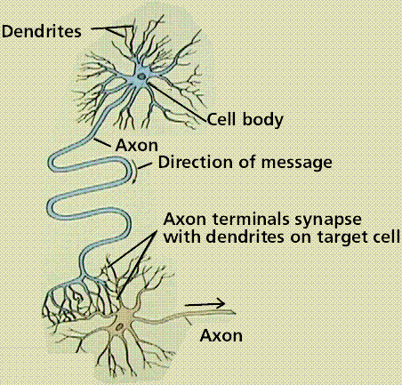
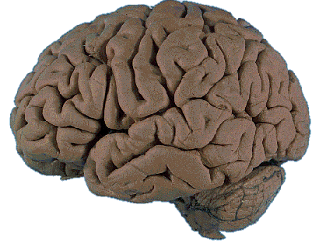
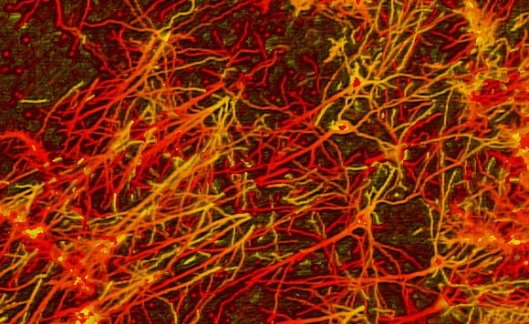
How brains seem to do pattern recognition
The business end of this is made of lots of these joined in networks like this
Much of our own “computations” are performed in/by this network

Slide 10
The key idea in brain-inspired computing
The brain is a complex
tangle of neurons, connected
by synapses

Slide 11
The key idea in brain-inspired computing
When neurons are active, they
send signals to others.

Slide 12
The key idea in brain-inspired computing
A neuron with lots of `strong’
active inputs will become active.

Slide 13
The key idea in brain-inspired computing
And, when connected neurons
are active at the same time, the
link between them gets stronger

Slide 14
The key idea in brain-inspired computing
So, suppose these neurons happen
to be active when you see a fluffy
animal with big eyes, small ears and a
pointed face

Slide 15
The key idea in brain-inspired computing
So, suppose these neurons happen
to be active when you see a fluffy
animal with big eyes, small ears and a
pointed face
… and suppose your mother then
says “Cat”, which excites this
additional neuron.

Slide 16
The key idea in brain-inspired computing
Links will then strengthen between
the active neurons
So when you see a similar animal
again, this neuron will probably
Automatically be activated, helping
you classify it.
A slightly different group of neurons
will respond to dogs, and sometimes
both the “cat” and “dog” group
will be active, but one will be more
active than the other …

Slide 17
Quick overview of BIC techniques we will learn about
Evolutionary algorithms:
Use nature’s evolution mechanism to evolve solutions to all kinds of problems. E.g. to find a very aerodynamic wing design, we essentially simulate evolution of a population of wing designs. Good designs stay in the population and breed to, poor designs die out. EAs are highly successful and come in many variants. There is also a lot to learn to understand how to apply them well to new problems. We will do quite a lot on EAs. EAs are all about optimisation, however classification is also an optimisation problem, so EAs work there too …

Slide 18
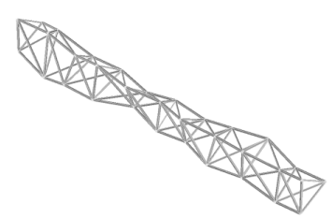
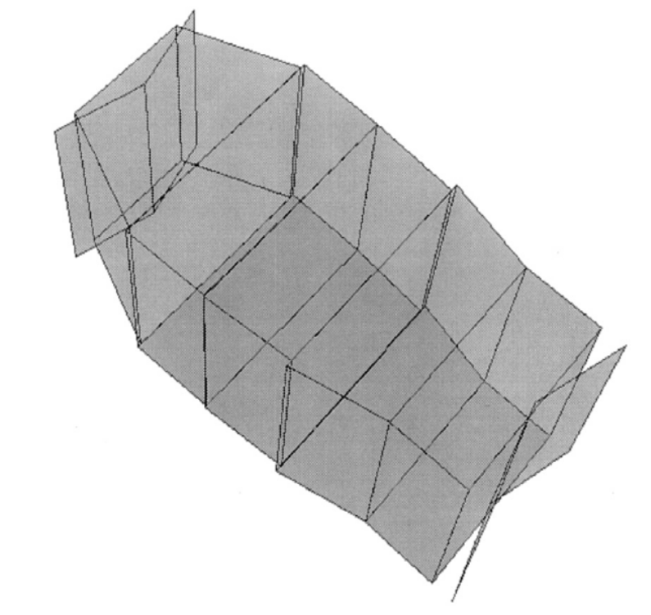
A genetically optimized
three-dimensional truss with
improved frequency response.
An EA-optimized concert-hall
design, which improves on human
designs in terms of sound quality
averaged over all listening points.

Slide 19
Swarm Intelligence
How do swarms of birds, fish, etc … manage to move so well as a unit? How do ants manage to find the best sources of food in their environment. Answers to these questions have led to some very powerful new optimisation methods, that are different to EAs. These include ant colony optimisation, and particle swarm optimisation.
Also, only by studying how real swarms work are
we able to simulate realistic swarming behaviour (e.g. as done in Jurassic Park, Finding Nemo, etc …)

Slide 20
Kohonen Networks
NT will teach you about neural computation, which is largely about how we can teach machines to do classification and pattern recognition – but there is a more fundamental type of neural-inspired method, which relates to making sense of the world around us without being trained or taught: this is what a Kohnonen network does
Cellular Automata
Cellular Automata (CA) are very simple computational systems that produce very complex behaviour, including `lifelike’ reproduction. CAs, as we will see, are also very useful for explaining/simulating biological pattern generation and other behaviours

Slide 21

Neural Computing
Pattern recognition using neural networks is the most widely used form of BIC in industry and science. We will learn about the most common and successful types of neural network.
This is Stanley, winner
of the DARPA grand
Challenge – a great
example of bio-inspired
computing winning over
all other entries, which
were largely `classical’

Slide 22
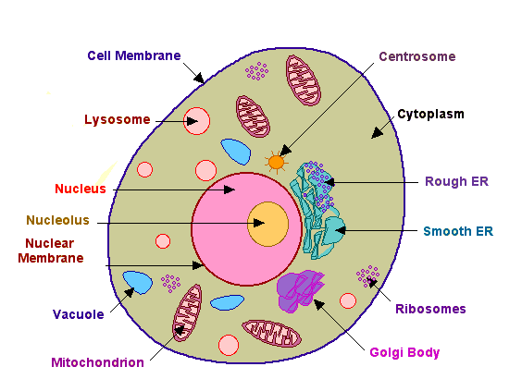
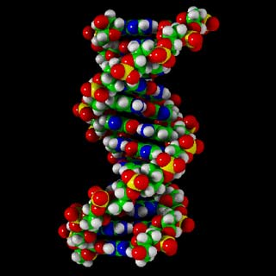
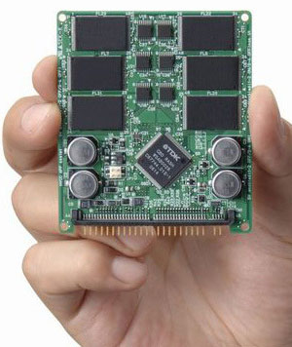
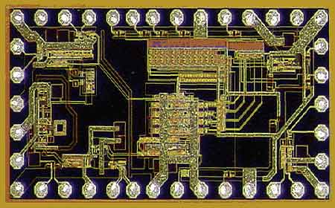
How Biological Computers Compute
With these
Not with these
class 1
PF will tell you more …

Slide 23
Look At Evolutionary Algorithms
Before we get into looking at Evolutionary Algorithms (as well as
other methods that do optimisation), we need to understand certain
things about optimisation, such as
  When we need clever methods to do it, and when we don’t
  What alternatives there are to EAs – no point designing
  an EA for an optimisation problem if it can be solved far
  more simply.
  The next lecture will then introduce evolutionary algorithms.

