Slide 1
Lecture 13
Knowledge engineering:
Building expert and fuzzy systems
Introduction, or what is knowledge engineering?
Will an expert system work for my problem?
Will a fuzzy expert system work for my problem?
Summary

Slide 2
What is knowledge engineering?
Davis’ law: “For every tool there is a task perfectly suited to it”.
But…
It would be too optimistic to assume that for every task there is a tool perfectly suited to it.

Slide 3
The process of building intelligent knowledge-
based systems is called knowledge engineering.
Knowledge engineering has six basic phases:
Phase 1: Problem assessment.
Phase 2: Data and knowledge acquisition.
Phase 3: Development of a prototype system.
Phase 4: Development of a complete system.
Phase 5: Evaluation and revision of the system.
Phase 6: Integration and maintenance of the system.

Slide 4
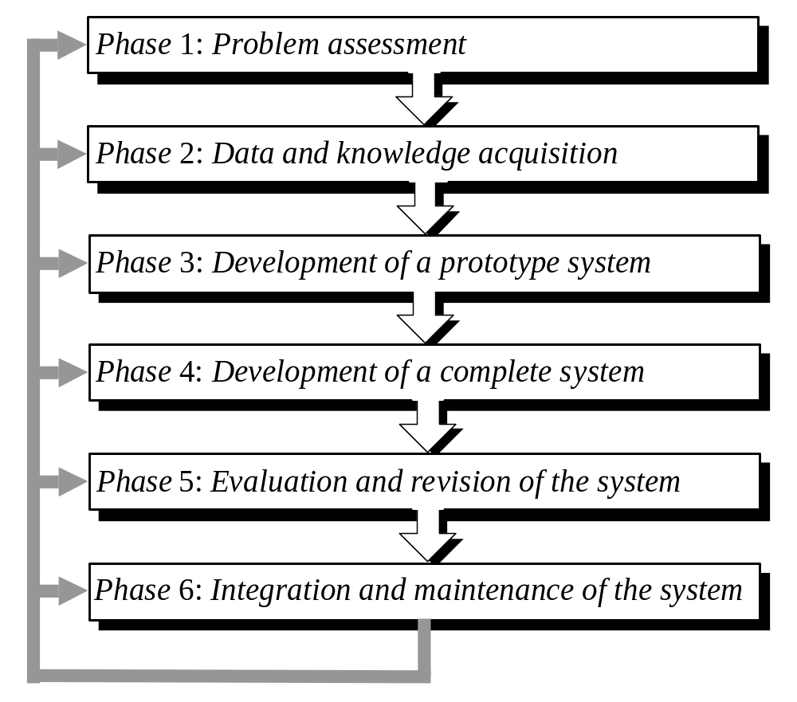
The process of knowledge engineering

Slide 5
Phase 1: Problem assessment
Determine the problem’s characteristics.
Identify the main participants in the project.
Specify the project’s objectives.
Determine the resources needed for building the system.

Slide 6
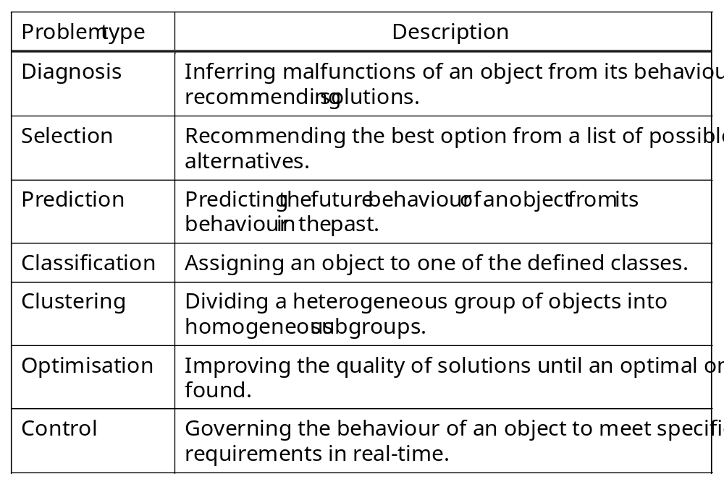
Typical problems addressed by intelligent systems

Slide 7
Phase 2: Data and knowledge acquisition
Collect and analyse data and knowledge.
Make key concepts of the system design more explicit.

Slide 8
The first issue is incompatible data.
Often the data we want to analyse store text in EBCDIC coding and numbers in packed decimal format, while the tools we want to use for building intelligent systems store text in the ASCII code and numbers as integers with a single- or double- precision floating point.
This issue is normally resolved with data transport tools that automatically produce the code for the required data transformation.

Slide 9
The second issue is inconsistent data.
Often the same facts are represented differently in different data bases. If these differences are not spotted and resolved in time, we might find ourselves, for example, analysing consumption patterns of carbonated drinks using data that does not include Coca-Cola just because it was stored in a separate database.

Slide 10
The third issue is missing data.
Actual data records often contain blank fields. Normally we would attempt to infer some useful information from them. In many cases, we can simply fill the blank fields in with the most common or average values. In other cases, the fact that a particular field has not been filled in might itself provide us with very useful information. For example, in a job application form, a blank field for a business phone number might suggest that an applicant is currently unemployed.

Slide 11
How do we approach knowledge acquisition?
Usually we start with reviewing documents and reading books, papers and manuals related to the problem domain.
Once we become familiar with the problem, we can collect further knowledge through interviewing the domain expert.
Then we study and analyse the acquired knowledge, and repeat the entire process again. Knowledge acquisition is an inherently iterative process.

Slide 12
Understanding the problem domain is critical for building intelligent system.
A classical example is given by Donald Michie.

Slide 13
A cheese factory had an experienced cheese-tester who was approaching retirement age. The factory manager decided to replace him with an “intelligent machine”. The human tester tested the cheese by sticking his finger into a sample and deciding if it “felt right”. So it was assumed the machine had to do the same – test for the right surface tension. But the machine was useless. Eventually, it turned out that the human tester subconsciously relied on the cheese’s smell rather than on its surface tension and used his finger just to break the crust and let the aroma out.

Slide 14
Phase 3: Development of a prototype system
Choose a tool for building an intelligent system.
Transform data and represent knowledge.
Design and implement a prototype system.
Test the prototype with test cases.

Slide 15
What is a prototype?
A prototype system is defined as a small version of the final system.
It is designed to test how well we understand the problem − to make sure that the problem-solving strategy, the tool selected for building a system, and techniques for representing acquired data and knowledge are adequate to the task.
It also provides us with an opportunity to persuade the sceptics and, in many cases, to actively engage the domain expert in the system’s development.

Slide 16
What is a test case?
A test case is a problem successfully solved in the past for which input data and an output solution are known.
During testing, the system is presented with the same input data and its solution is compared with the original solution.

Slide 17
Phase 4: Development of a complete system
Prepare a detailed design for a full-scale system.
Collect additional data and knowledge.
Develop the user interface.
Implement the complete system.

Slide 18
The main work at this phase is often associated with
adding data and knowledge to the system.
If, for example, we develop a diagnostic system, we might need to provide it with more rules for handling specific cases.
If we develop a prediction system, we might need to collect additional historical examples to make predictions more accurate.

Slide 19
Phase 5: Evaluation and revision of the system
Evaluate the system against the performance criteria.
Revise the system as necessary.

Slide 20
Intelligent systems, unlike conventional computer programs, are designed to solve problems that quite often do not have clearly defined “right” and “wrong” solutions.
To evaluate an intelligent system is , in fact, to assure that the system performs the intended task to the user’s satisfaction.
A formal evaluation of the system is normally accomplished with the test cases.
The system’s performance is compared against the performance criteria that were agreed upon at the end of the prototyping phase.

Slide 21
Phase 6: Integration and maintenance of the system
Make arrangements for technology transfer.
Establish an effective maintenance program.

Slide 22
Will an expert system work for my problem?
The Phone Call Rule: “Any problem that can be solved by your in-house expert in a 10-30 minute phone call can be developed as an expert system”.

Slide 23
Case study 1:
Diagnostic expert system
Diagnostic expert systems are relatively easy to develop:
Most diagnostic problems have a finite list of possible solutions,
Involve a rather limited amount of well- formalised knowledge, and
Often take a human expert a short time (say, an hour) to solve.

Slide 24
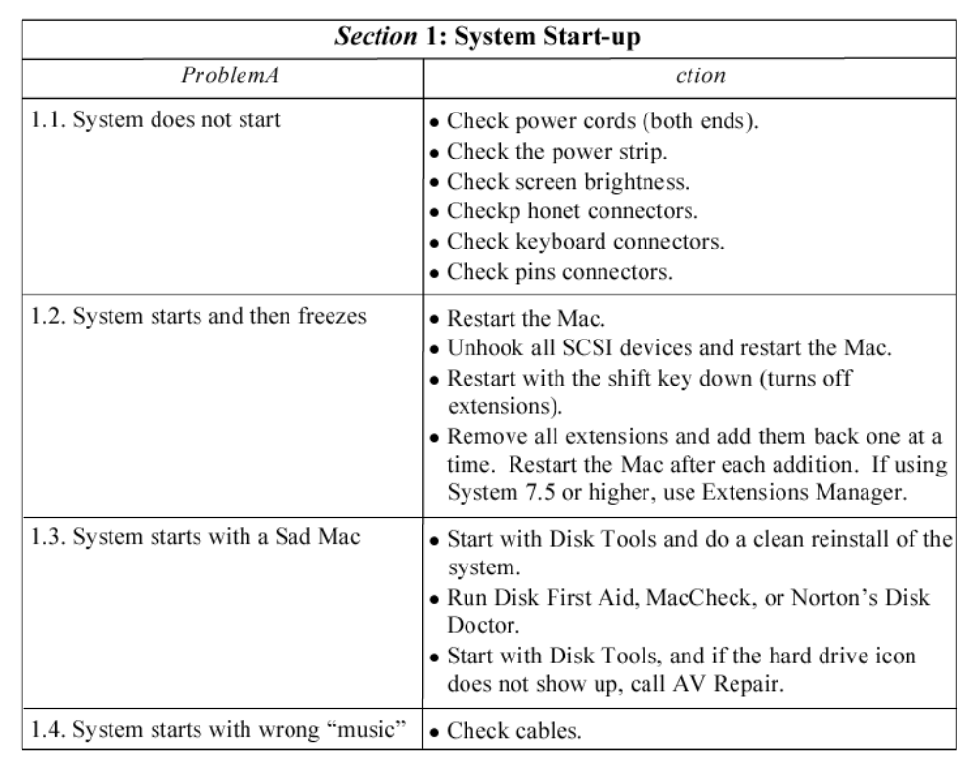
Troubleshooting manual for the Macintosh computer

Slide 25
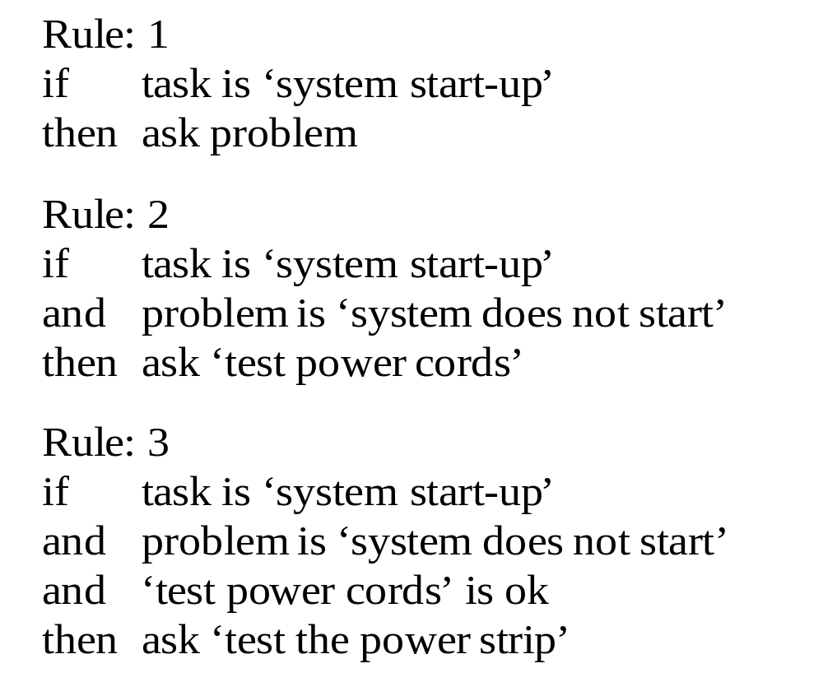
General rule structure
In each rule, we include a clause that identifies the current task:

Slide 26
How do we choose an expert system development tool?
Tools range from high-level programming languages such as LISP, PROLOG, OPS, C and Java, to expert system shells.
High-level programming languages offer a greater flexibility, but they require high-level programming skills.
Shells provide us with the built-in inference engine, explanation facilities and the user interface. We do not need any programming skills to use a shell – we enter rules in English in the shell’s knowledge base.

Slide 27
How do we choose an expert system shell?
When selecting an expert system shell, we consider
how the shell represents knowledge (rules or frames);
what inference mechanism it uses (forward or backward chaining);
whether the shell supports inexact reasoning and if so what technique it uses (Bayesian reasoning, certainty factors or fuzzy logic);
whether the shell has an “open” architecture allowing access to external data files and programs;
how the user will interact with the expert system (graphical user interface, hypertext).

Slide 28
Case study 2:
Classification expert system
Classification problems can be handled well by both expert systems and neural networks.
As an example, we will build an expert system to identify different classes of sail boats. We start with collecting some information about mast structures and sail plans of different sailing vessels. Each boat can be uniquely identified by its sail plans.

Slide 29
Eight classes of sailing vessels
Jib-headed Cutter
Gaff-headed Sloop
Staysail Schooner
Gaff-headed Schooner
Jib-headed Yawl
Gaff-headed Yawl
Jib-headed Ketch
Gaff-headed Ketch

Slide 30
Rules for the boat classification expert system
Sailing Vessel Classification Expert System: Mark 1
/*
Rule:
1
if
the number of masts
‘
is one
’
and
the shape of the mainsail
‘
is triangular
’
then
boat
is
Jib-headed
‘
C
utter
’
Rule:
2
if
‘
the
number
of
masts
’
i
s
one
and
the shape of the mainsail
‘
is quadrilateral
’
then
b
oat
is
Gaff-headed
‘
Sloop
’
Rule:
3
if
the number of masts
‘
’
is two
and
the main mast position
‘
’
is
forward of the short mast
‘
’
and
the short mast position
‘
’
is
forward of the helm
‘
’
and
‘
the
shape
of
the
mainsail
’
is
triangular
then
b
oat
is
Jib-headed
‘
Ketch
’
Rule:
4
if
the number of masts
‘
’
is two
and
the main mast position
‘
’
is
forward of the short mast
‘
’
and
the short mast position
‘
’
is
forward of the helm
‘
’
and
‘
the
s
hape
of the mainsail
is quadrilateral
’
then
b
oat is
Gaff-headed Ketch
‘
’

Slide 31
Continued
R
u
l
e
:
5 if
‘
t
h
e
n
u
m
b
e
r
o
f
m
a
s
t
s
’
i
s
t
w
o
a
n
d
‘
t
h
e
m
a
i
n
m
a
s
t
p
o
s
i
t
i
o
n
’
i
s
‘
f
o
r
w
a
r
d
o
f
t
h
e
s
h
o
r
t
m
a
s
t
’
a
n
d
‘
t
h
e
s
h
o
r
t
m
a
s
t
p
o
s
i
t
i
o
n
’
i
s
‘
a
f
t
t
h
e
h
e
l
m
’
a
n
d
‘
t
h
e
s
h
a
p
e
o
f
t
h
e
m
a
i
n
s
a
i
l
’
i
s
t
r
i
a
n
g
u
l
a
r
t
h
e
n
b
o
a
t
i
s
‘
J
i
b
-
h
e
a
d
e
d
Y
a
w
l
’
R
u
l
e
:
6
if
‘
t
h
e
n
u
m
b
e
r
o
f
m
a
s
t
s
’
i
s
t
w
o
a
n
d
‘
t
h
e
m
a
i
n
m
a
s
t
p
o
s
i
t
i
o
n
’
i
s
‘
f
o
r
w
a
r
d
o
f
t
h
e
s
h
o
r
t
m
a
s
t
’
a
n
d
‘
t
h
e
s
h
o
r
t
m
a
s
t
p
o
s
i
t
i
o
n
’
i
s
‘
a
f
t
t
h
e
h
e
l
m
’
a
n
d
‘
t
h
e
s
h
a
p
e
o
f
t
h
e
m
a
i
n
s
a
i
l
’
i
s
q
u
a
d
r
i
l
a
t
e
r
a
l
t
h
e
n
b
o
a
t
i
s
‘
G
a
f
f
-
h
e
a
d
e
d
Y
a
w
l
’
R
u
l
e
:
7
i
f
‘
t
h
e
n
u
m
b
e
r
o
f
m
a
s
t
s
’
i
s
t
w
o
a
n
d
‘
t
h
e
m
a
i
n
m
a
s
t
p
o
s
i
t
i
o
n
’
i
s
‘
a
f
t
t
h
e
s
h
o
r
t
m
a
s
t
’
a
n
d
‘
t
h
e
s
h
a
p
e
o
f
t
h
e
m
a
i
n
s
a
i
l
’
i
s
q
u
a
d
r
i
l
a
t
e
r
a
l
t
h
e
n
b
o
a
t
i
s
‘
G
a
f
f
-
h
e
a
d
e
d
S
c
h
o
o
n
e
r
’
R
u
l
e
:
8
i
f
‘
t
h
e
n
u
m
b
e
r
o
f
m
a
s
t
s
’
i
s
t
w
o
a
n
d
‘
t
h
e
m
a
i
n
m
a
s
t
p
o
s
i
t
i
o
n
’
i
s
‘
a
f
t
t
h
e
s
h
o
r
t
m
a
s
t
’
a
n
d
‘
t
h
e
s
h
a
p
e
o
f
t
h
e
m
a
i
n
s
a
i
l
’
i
s
‘
t
r
i
a
n
g
u
l
a
r
w
i
t
h
t
w
o
f
o
r
e
s
a
i
l
s
’
t
h
e
n
b
o
a
t
i
s
‘
S
t
a
y
s
a
i
l
S
c
h
o
o
n
e
r
’
/
*
*
*
*
*
*
*
*
*
*
*
*
*
*
*
*
*
*
*
*
*
*
*
*
*
*
*
*
*
*
*
*
*
*
*
*
*
*
*
*
*
*
*
*
*
*
*
*
*
*
*
*
*
*
*
*
*
*
*
*
*
*
*
*
*
*
*
*
*
*
*
*
*
*
*
/
*
T
h
e
S
E
E
K
d
i
r
e
c
t
i
v
e
s
e
t
s
u
p
t
h
e
g
o
a
l
s
e
e
k
b
o
a
t

Slide 32
Solving classification problems with certainty factors
Although solving real-world classification problems often involves inexact and incomplete data, we still can use the expert system approach.
However, we need to deal with uncertainties.
The certainty factors theory can manage
incrementally acquired evidence, as well as
information with different degrees of belief.

Slide 33
Uncertainty management in the boat classification expert system
/* Sailing Vessel Classification Expert System: Mark 2
control
cf
Rule: 1
if
the number of masts
‘
is one
’
then
boat is
Jib-headed Cutter
‘
’
{cf 0.4};
boat is
Gaff-headed Sloop
‘
’
{cf 0.4}
Rule: 2
if
the number of masts
‘
is one
’
and
the shape of the mainsail
‘
is triangular
’
then
boat is
Jib-headed Cutter
‘
’
{cf 1.0}
Rule: 3
if
the number of masts
‘
is one
’
and
the shape of the mainsail
‘
is quadrilateral
’
then
boat is
Gaff-headed Sloop
‘
’
{cf 1.0}
Rule: 4
the number of masts
‘
is two
if
’
then
boat is
Jib-headed Ketch
‘
’
{cf 0.1};
boat is
Gaff-headed Ketch
‘
’
{cf 0.1};
boat is
Jib-headed Yawl
‘
’
{cf 0.1};
boat is
Gaff-headed Yawl
‘
’
{cf 0.1};
boat is
Gaff-headed Schooner
‘
’
{cf 0.1};
boat is
Staysail Schooner
‘
’
{cf 0.1}

Slide 34
Continued
Rule:
5
if
number of masts
‘
’
is two
and
main mast position
‘
’
is
forward of the short mast
‘
’
then
boat is
Jib-headed Ketch
‘
’
{cf 0.2};
boat is
Gaff-headed Ketch
‘
’
{cf 0.2};
boat is
Jib-headed Yawl
‘
’
{cf 0.2};
boat is
Gaff-headed Yawl
‘
’
{cf 0.2}
Rule:
6
if
the number of masts
‘
’
is two
and
the main mast position
‘
’
is
aft the short mast
‘
’
then
boat is
Gaff-headed Schooner
‘
’
{cf 0.4};
boat is
Staysail Schooner
‘
’
{cf 0.4}
Rule:
7
if
the number of masts
‘
’
is two
and
the short mast position
‘
’
is
forward of the helm
‘
’
then
boat is
Jib-headed Ketch
‘
’
{cf 0.4};
boat is
Gaff-headed Ketch
‘
’
{cf 0.4}
Rule:
8
if
the number of masts
‘
’
is two
and
the short mast position
‘
’
is
aft the helm
‘
’
then
boat is
Jib-headed Yawl
‘
’
{cf 0.2};
boat is
Gaff-headed Yawl
‘
’
{cf 0.2};
boat is
Gaff-headed Schooner
‘
’
{cf 0.2};
boat is
Staysail Schooner
‘
’
{cf 0.2}

Slide 35
Continued
Rule:
9
if
the number of masts
‘
’
is two
and
the shape of the mainsail
‘
is triangular
’
then
boat is
Jib-headed Ketch
‘
’
{cf 0.4};
boat is
Jib-headed Yawl
‘
’
{cf 0.4}
Rule:
10
if
the number of masts
‘
’
is two
and
the shape of the mainsail
‘
is quadrilateral
’
then
boat is
Gaff-headed Ketch
‘
’
{cf 0.3};
boat is
Gaff-headed Yawl
‘
’
{cf 0.3};
boat is
Gaff-headed Schooner
‘
’
{cf 0.3}
Rule:
11
if
the number of masts
‘
’
is two
and
the shape of the mainsail
‘
’
is
triangular with two foresails
‘
’
then
boat is
Staysail Schooner
‘
’
{cf 1.0}
seek boat

Slide 36
Will a fuzzy expert system work for my problem?
If you cannot define a set of exact rules for each possible situation, then use fuzzy logic.
While certainty factors and Bayesian probabilities are concerned with the imprecision associated with the outcome of a well-defined event, fuzzy logic concentrates on the imprecision of the event itself.
Inherently imprecise properties of the problem make it a good candidate for fuzzy technology.

Slide 37
Case study 3:
Decision-support fuzzy systems
Although, most fuzzy technology applications are still reported in control and engineering, an even larger potential exists in business and finance. Decisions in these areas are often based on human intuition, common sense and experience, rather than on the availability and precision of data.
Fuzzy technology provides us with a means of coping with the “soft criteria” and “fuzzy data” that are often used in business and finance.

Slide 38
Mortgage application assessment is a typical problem to which decision-support fuzzy systems can be successfully applied.
Assessment of a mortgage application is normally based on evaluating the market value and location of the house, the applicant’s assets and income, and the repayment plan, which is decided by the applicant’s income and bank’s interest charges.

Slide 39
Fuzzy sets of the linguistic variable Market value
De
gr
ee
of
Me
mb
er
sh
ip
1.0
0.8
L
o
w
M
e
d
i
u
m
H
i
g
h
V
e
r
y
h
i
g
h
0.6
0.4
0.2
0.0
0
100
200
300
400
500
600
700
800
900
1
,
0
0
0
×
10
3
M
a
r
k
e
t
v
a
l
u
e
, $

Slide 40

Fuzzy sets of the linguistic variable Location
De
gr
ee
of
Me
mb
er
sh
ip
1.0
0.8
Ba
d
Fa
ir
Ex
ce
lle
nt
0.6
0.4
0.2
0.0
0
1
2 3
4 5
6 7 8
9 1
0
Lo
ca
ti
on

Slide 41

Fuzzy sets of the linguistic variable House
De
gr
ee
o
f
Me
mb
er
sh
ip
1.0
0.8
Ve
ry
lo
w
Lo
w
Me
di
um
Hi
gh
Ve
ry
hi
gh
0.6
0.4
0.2
0.0
0
1
2 3 4 5
6 7 8 9
10
Ho
us
e

Slide 42

Fuzzy sets of the linguistic variable Asset
De
gr
ee
of
Me
mb
er
sh
ip
1.0
0.8
Lo
w
Me
di
um
Hig
h
0.6
0.4
0.2
0.0
0
100
200
300
400
500
600
700
800
900
1,000
×
1
0
3
A
sse
t
$

Slide 43
Fuzzy sets of the linguistic variable Income
De
gr
ee
o
f
Me
mb
er
sh
ip
1.0
0.8
0.6
Lo
w
Me
di
um
Hig
h
Ve
ry
hig
h
0.4
0.2
0.0
0
10
20
30
40
50
60
70
80
90
100
×
1
0
3
In
co
me
,
$

Slide 44

Fuzzy sets of the linguistic variable Applicant
De
gr
ee
o
f
Me
mb
er
sh
ip
1.0
0.8
Lo
w
Me
di
um
Hi
gh
0.6
0.4
0.2
0.0
0
1
2 3 4 5 6
7 8 9
10
A
pp
lic
an
t

Slide 45

Fuzzy sets of the linguistic variable Interest
De
gr
ee
o
f
Me
mb
er
sh
ip
1.0
0.8
Lo
w
Medium
Hi
gh
0.6
0.4
0.2
0.0
0
1
2 3 4 5
6
7 8 9
10
In
te
re
st
,
%

Slide 46

Fuzzy sets of the linguistic variable Credit
De
gr
ee
o
f
Me
mb
er
sh
ip
1.0
0.8
Ve
ry
lo
w
Lo
w
Me
di
um
Hi
gh
Ve
ry
hi
gh
0.6
0.4
0.2
0.0
0
50
100
150
200
250
300
350
400
450
500
×
1
0
3
Cr
ed
it
,
$

Slide 47
Rules for mortgage loan assessment
Ru
le
Ba
se
1:
Ho
me
Ev
al
ua
ti
on
1.
If
Market_value is Low) then (House is Low)
(
2.
If (Location is Bad) then (House is Low)
3.
If
(Location
is
Bad)
and
(
Market_value is Low) then (House is
V
ery
_low)
4.
If
(Location
is
Bad)
and
Market_value is Medium) then (House is Low)
(
5.
If
(Location
is
Bad)
and
Market_value is High) then (House is Medium)
(
6.
If
(Location
is
Bad)
and
(Market_value
is V
ery
_high) then (House is High)
7.
If
(Location
is
Fair)
and
(
Market_value is Low) then (House is Low)
8.
If
(Location
is
Fair)
and
(M
a
rke
t_value is Medium) then (House is Medium)
9.
If
(Location
is
Fair)
and
Market_value is High) then (House is High)
(
10.
If
(Location
is
Fair)
and
(
Market_value
is
Very_high)
then
(House
is
V
ery_high)
11.
If
(Location
is
Excellent)
and
Market_value is Low) then (House is Medium)
(
12.
If
(Location
is
Excellent)
and
Market_value is Medium) then (House is High)
(
13.
If
(Location
is
Excellent)
and
(
Market_value is High) then (House is
V
ery_high)
14.
If
(Location
is
Excellent)
and
(
Market_value
is
ery_high) then (House is
V
V
ery_high)

Slide 48
Rules for mortgage loan assessment
Ru
le
Ba
se
2:
A
pp
lic
an
t
Ev
al
ua
ti
on
1
.
I
f
(
A
s
s
e
t
i
s
L
o
w
)
a
n
d
(
I
n
c
o
m
e
i
s
L
o
w
)
t
h
e
n
(
A
p
p
l
i
c
a
n
t
i
s
L
o
w
)
2
.
I
f
(
A
s
s
e
t
i
s
L
o
w
)
a
n
d
(
I
n
c
o
m
e
i
s
M
e
d
i
u
m
)
t
h
e
n
(
A
p
p
l
i
c
a
n
t
i
s
L
o
w
)
3
.
I
f
(
A
s
s
e
t
i
s
L
o
w
)
a
n
d
(
I
n
c
o
m
e
i
s
H
i
g
h
)
t
h
e
n
(
A
p
p
l
i
c
a
n
t
i
s
M
e
d
i
u
m
)
4
.
I
f
(
A
s
s
e
t
i
s
L
o
w
)
a
n
d
(
I
n
c
o
m
e
i
s
V
e
r
y
_
h
i
g
h
)
t
h
e
n
(
A
p
p
l
i
c
a
n
t
i
s
H
i
g
h
)
5
.
I
f
(
A
s
s
e
t
i
s
M
e
d
i
u
m
)
a
n
d
(
I
n
c
o
m
e
i
s
L
o
w
)
t
h
e
n
(
A
p
p
l
i
c
a
n
t
i
s
L
o
w
)
6
.
I
f
(
A
s
s
e
t
i
s
M
e
d
i
u
m
)
a
n
d
(
I
n
c
o
m
e
i
s
M
e
d
i
u
m
)
t
h
e
n
(
A
p
p
l
i
c
a
n
t
i
s
M
e
d
i
u
m
)
7
.
I
f
(
A
s
s
e
t
i
s
M
e
d
i
u
m
)
a
n
d
(
I
n
c
o
m
e
i
s
H
i
g
h
)
t
h
e
n
(
A
p
p
l
i
c
a
n
t
i
s
H
i
g
h
)
8
.
I
f
(
A
s
s
e
t
i
s
M
e
d
i
u
m
)
a
n
d
(
I
n
c
o
m
e
i
s
V
e
r
y
_
h
i
g
h
)
t
h
e
n
(
A
p
p
l
i
c
a
n
t
i
s
H
i
g
h
)
9
.
I
f
(
A
s
s
e
t
i
s
H
i
g
h
)
a
n
d
(
I
n
c
o
m
e
i
s
L
o
w
)
t
h
e
n
(
A
p
p
l
i
c
a
n
t
i
s
M
e
d
i
u
m
)
1
0
.
I
f
(
A
s
s
e
t
i
s
H
i
g
h
)
a
n
d
(
I
n
c
o
m
e
i
s
M
e
d
i
u
m
)
t
h
e
n
(
A
p
p
l
i
c
a
n
t
i
s
M
e
d
i
u
m
)
1
1
.
I
f
(
A
s
s
e
t
i
s
H
i
g
h
)
a
n
d
(
I
n
c
o
m
e
i
s
H
i
g
h
)
t
h
e
n
(
A
p
p
l
i
c
a
n
t
i
s
H
i
g
h
)
1
2
.
I
f
(
A
s
s
e
t
i
s
H
i
g
h
)
a
n
d
(
I
n
c
o
m
e
i
s
V
e
r
y
_
h
i
g
h
)
t
h
e
n
(
A
p
p
l
i
c
a
n
t
i
s
H
i
g
h
)

Slide 49
Rules for mortgage loan assessment
Ru
le
Ba
se
3:
Cr
ed
it
Ev
al
ua
ti
on
1.
If
(Income
is
Low)
and
(Interest
is
Medium)
then
(Credit
is
Very_low)
2.
If
(Income
is
Low)
and
(Interest
is
High)
then
(Credit
is
Very_low)
2.
If
(Inc
ome is Medium) and (Interest is High) then (Credit is Low)
4.
If
(Applicant
is
Low)
then
(Credit
is
Very_low)
5.
If
(House
is
Very_low)
then
(Credit
is
Very_low)
6.
If
(Applicant
is
Medium)
and
(House
is
Very_low)
then
(Credit
is
Low)
7.
If
(Applicant
is
M
edi
um)
and
(House
is
Low)
then
(Credit
is
Low)
8.
If (Applicant is Medium) and (House is Medium) then (Credit is Medium)
9.
If (Applicant is Medium) and (House is High) then (Credit is High)
10.
If
(Applicant
is
Medium)
and
(House
is
Very_high) then (Credit is High)
11.
If
(Applicant
is
High)
and
(House
is
Very_low)
then
(Credit
is
Low)
12.
If (Applicant is High) and (House is Low) then (Credit is Medium)
13.
If (Applicant is High) and (House is Medium) then (Credit is High)
14.
If
(Applicant
is
High)
and
House is High) then (Credit is High)
(
15.
If
(Applicant
is
High)
and
(House
is
Very_high)
then
(Credit
is
Very_high)

Slide 50
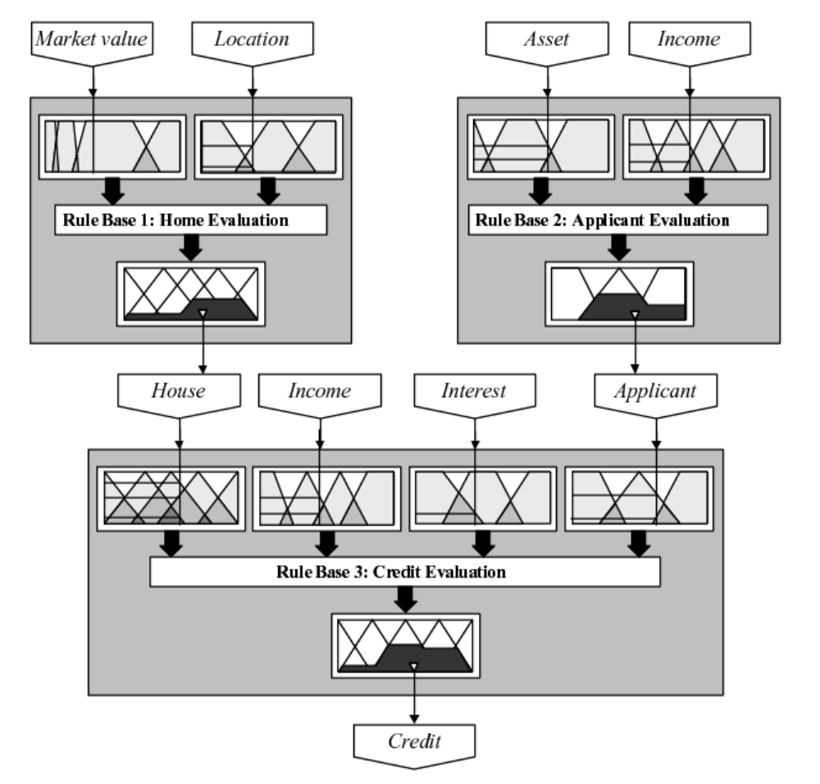
Hierarchical fuzzy model

Slide 51

Three-dimensional plots for Rule Base 1 and Rule base 2
9
8
8
7
7
6
6
5
5
4
4
3
3
2
1,000,000
100,000
600,000
8
10
1,
00
0,
00
0
4
6
M
arket value,
$
200,000
0
2
Location
0
(a)

Slide 52

Three-dimensional plots for Rule Base 3
400,000
10
8
10
5
6
2
4
0
0
Applicant
(
a
)
(
b
)

