Slide 1
Pattern Recognition with Evolutionary Computation
Chapter 3 of text

Slide 2
Standard Evolutionary algorithms 3.6
Procedure [P] = standard_EA (pc, pm)
Initialize P
F ← eval (P)
P ← select (P,f)
T ← 1
While not stopping criteria do
P ← reproduce (p, f, pc)
P ← variate (P, pm)
f ← eval (P)
P ←select (P, f)
t ← t + 1
End while
End procedure

Slide 3
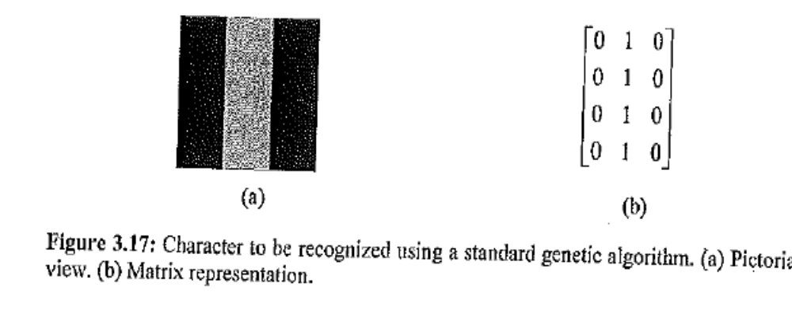

Slide 4
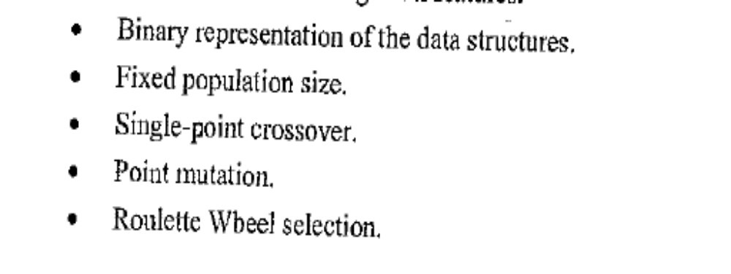
Basic Steps of the Algorithm

Slide 5
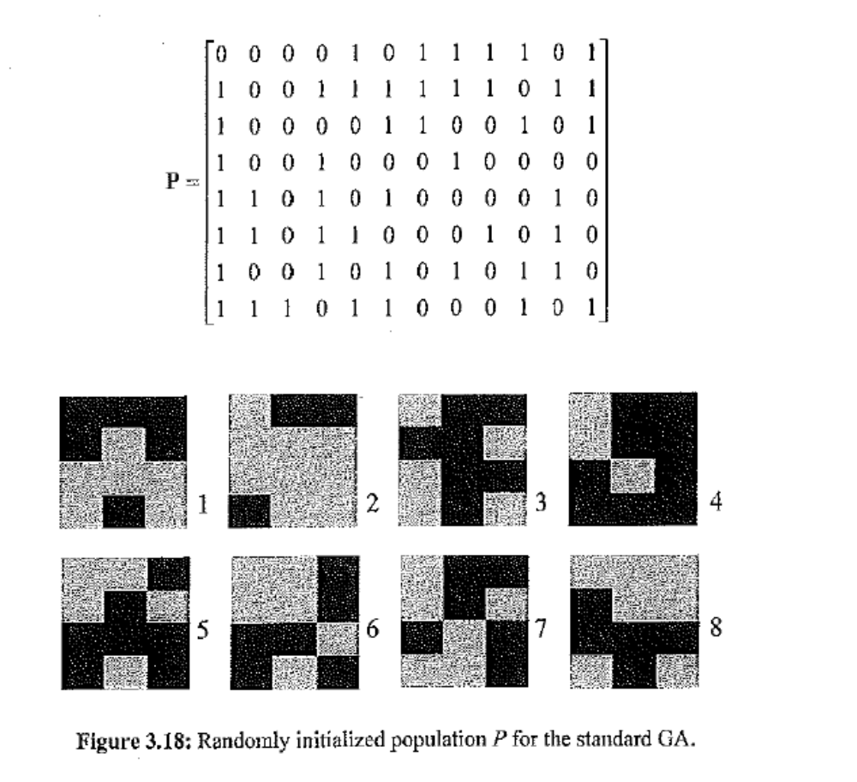

Slide 6
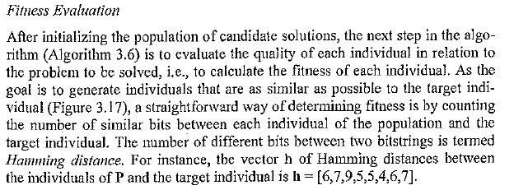

Slide 7
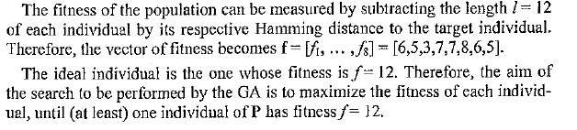

Slide 8
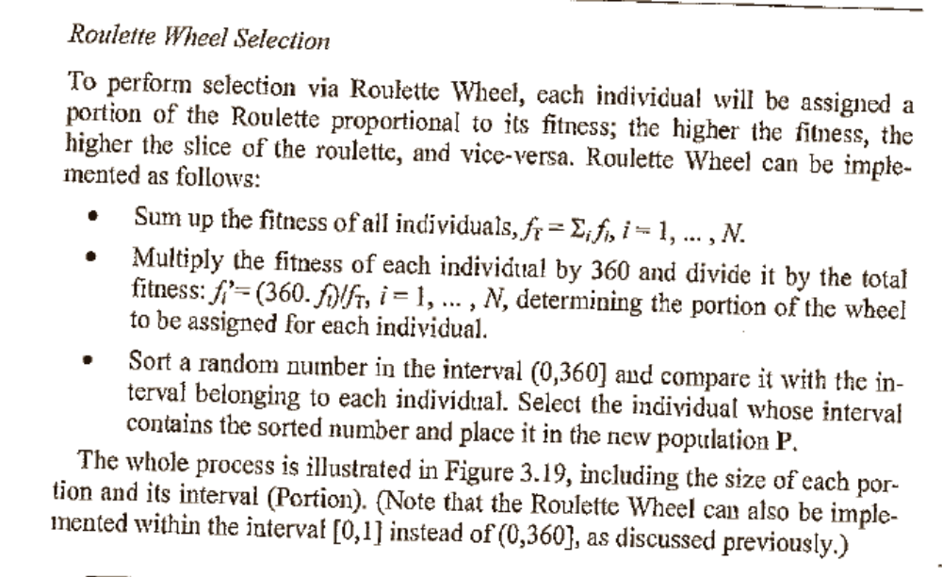

Slide 9
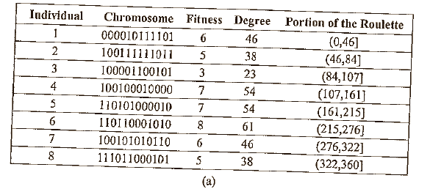

Slide 10
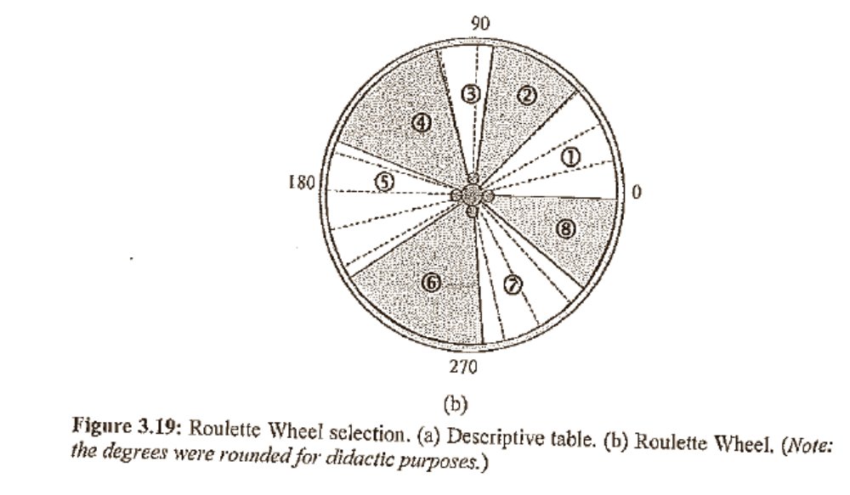

Slide 11
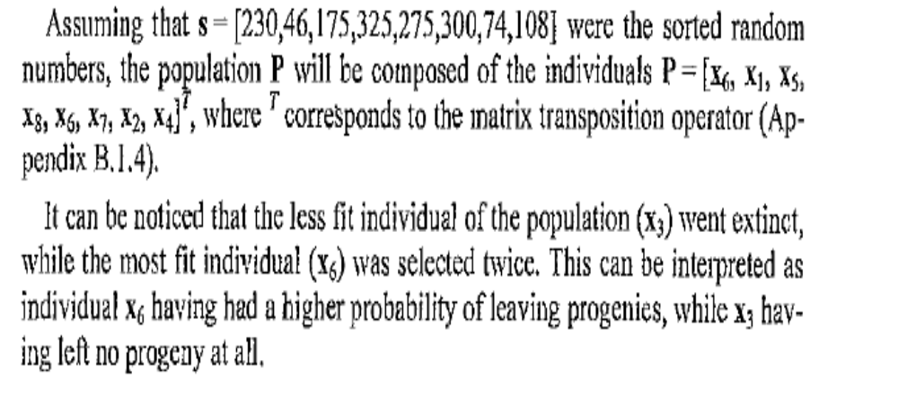

Slide 12
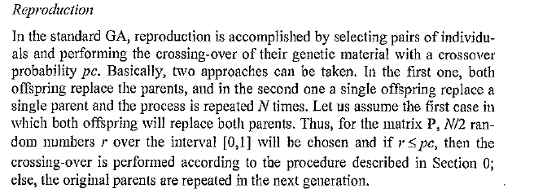

Slide 13
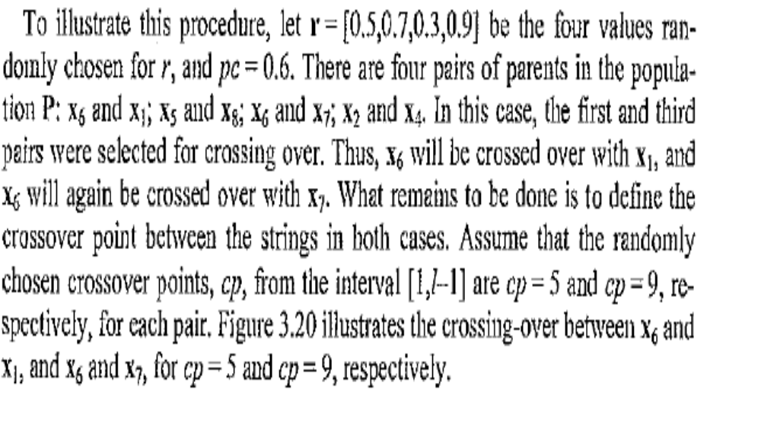

Slide 14
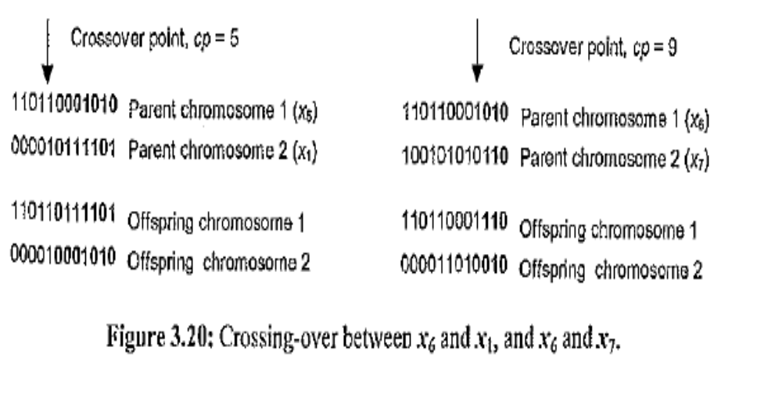

Slide 15
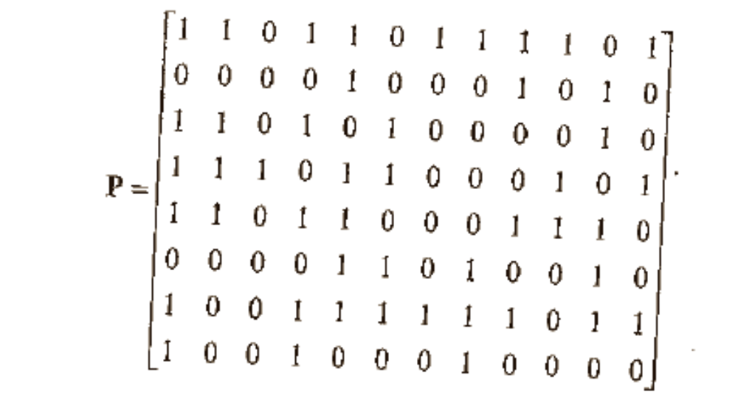
New population P
Average fitness = 47/8 = 5.87

Slide 16
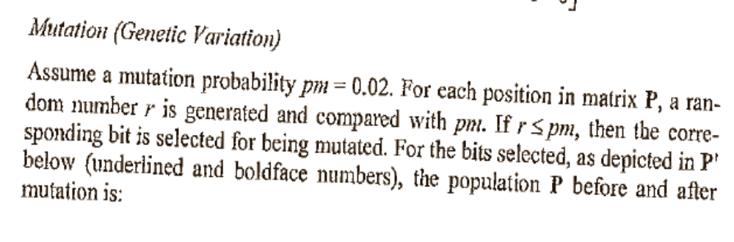
Mutation

Slide 17
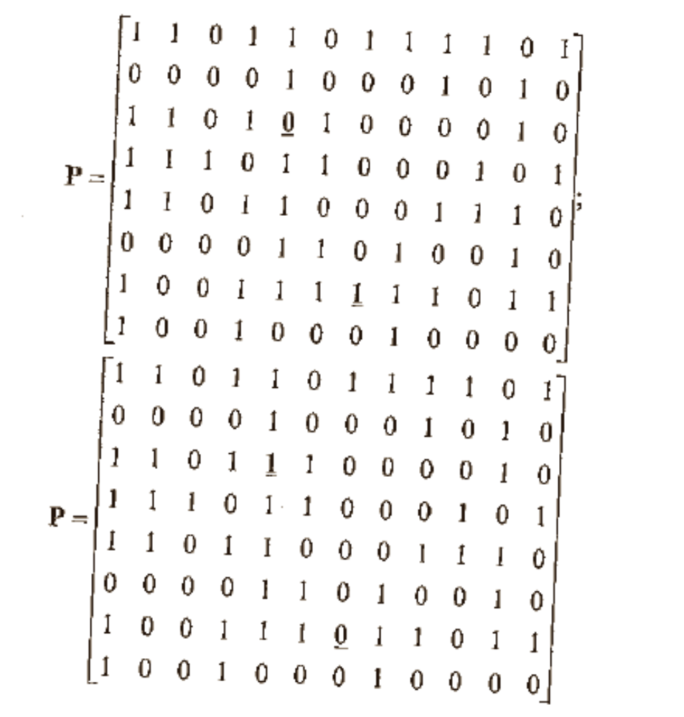
Population P before and after mutation

Slide 18
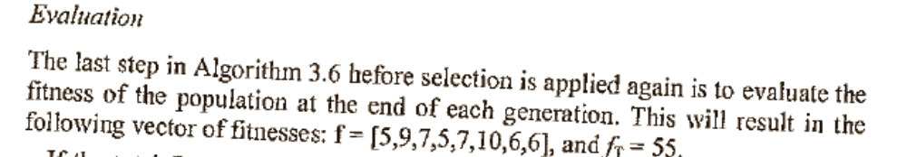
Evaluation
Average Fitness = f_{T}/N =55/8 =6.87
Where N is the total number in the population

Slide 19
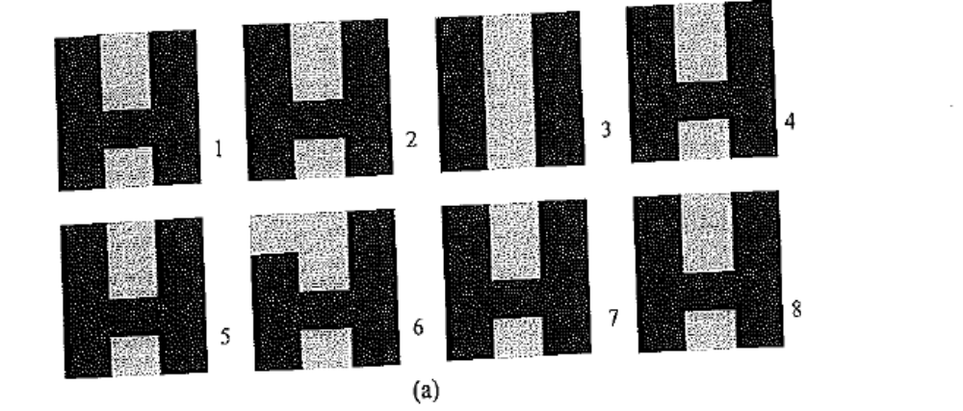
Final population evolved after 171 generations.

Slide 20
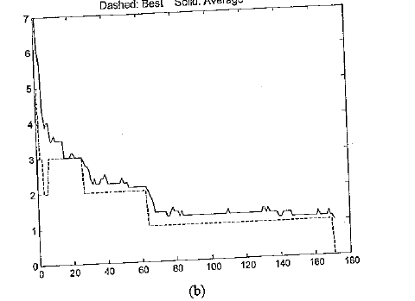
Best and Average Hamming Distance of the Population

