Slide 1

Swarm Intelligence
Corey Fehr
Merle Good
Shawn Keown
Gordon Fedoriw

Slide 2
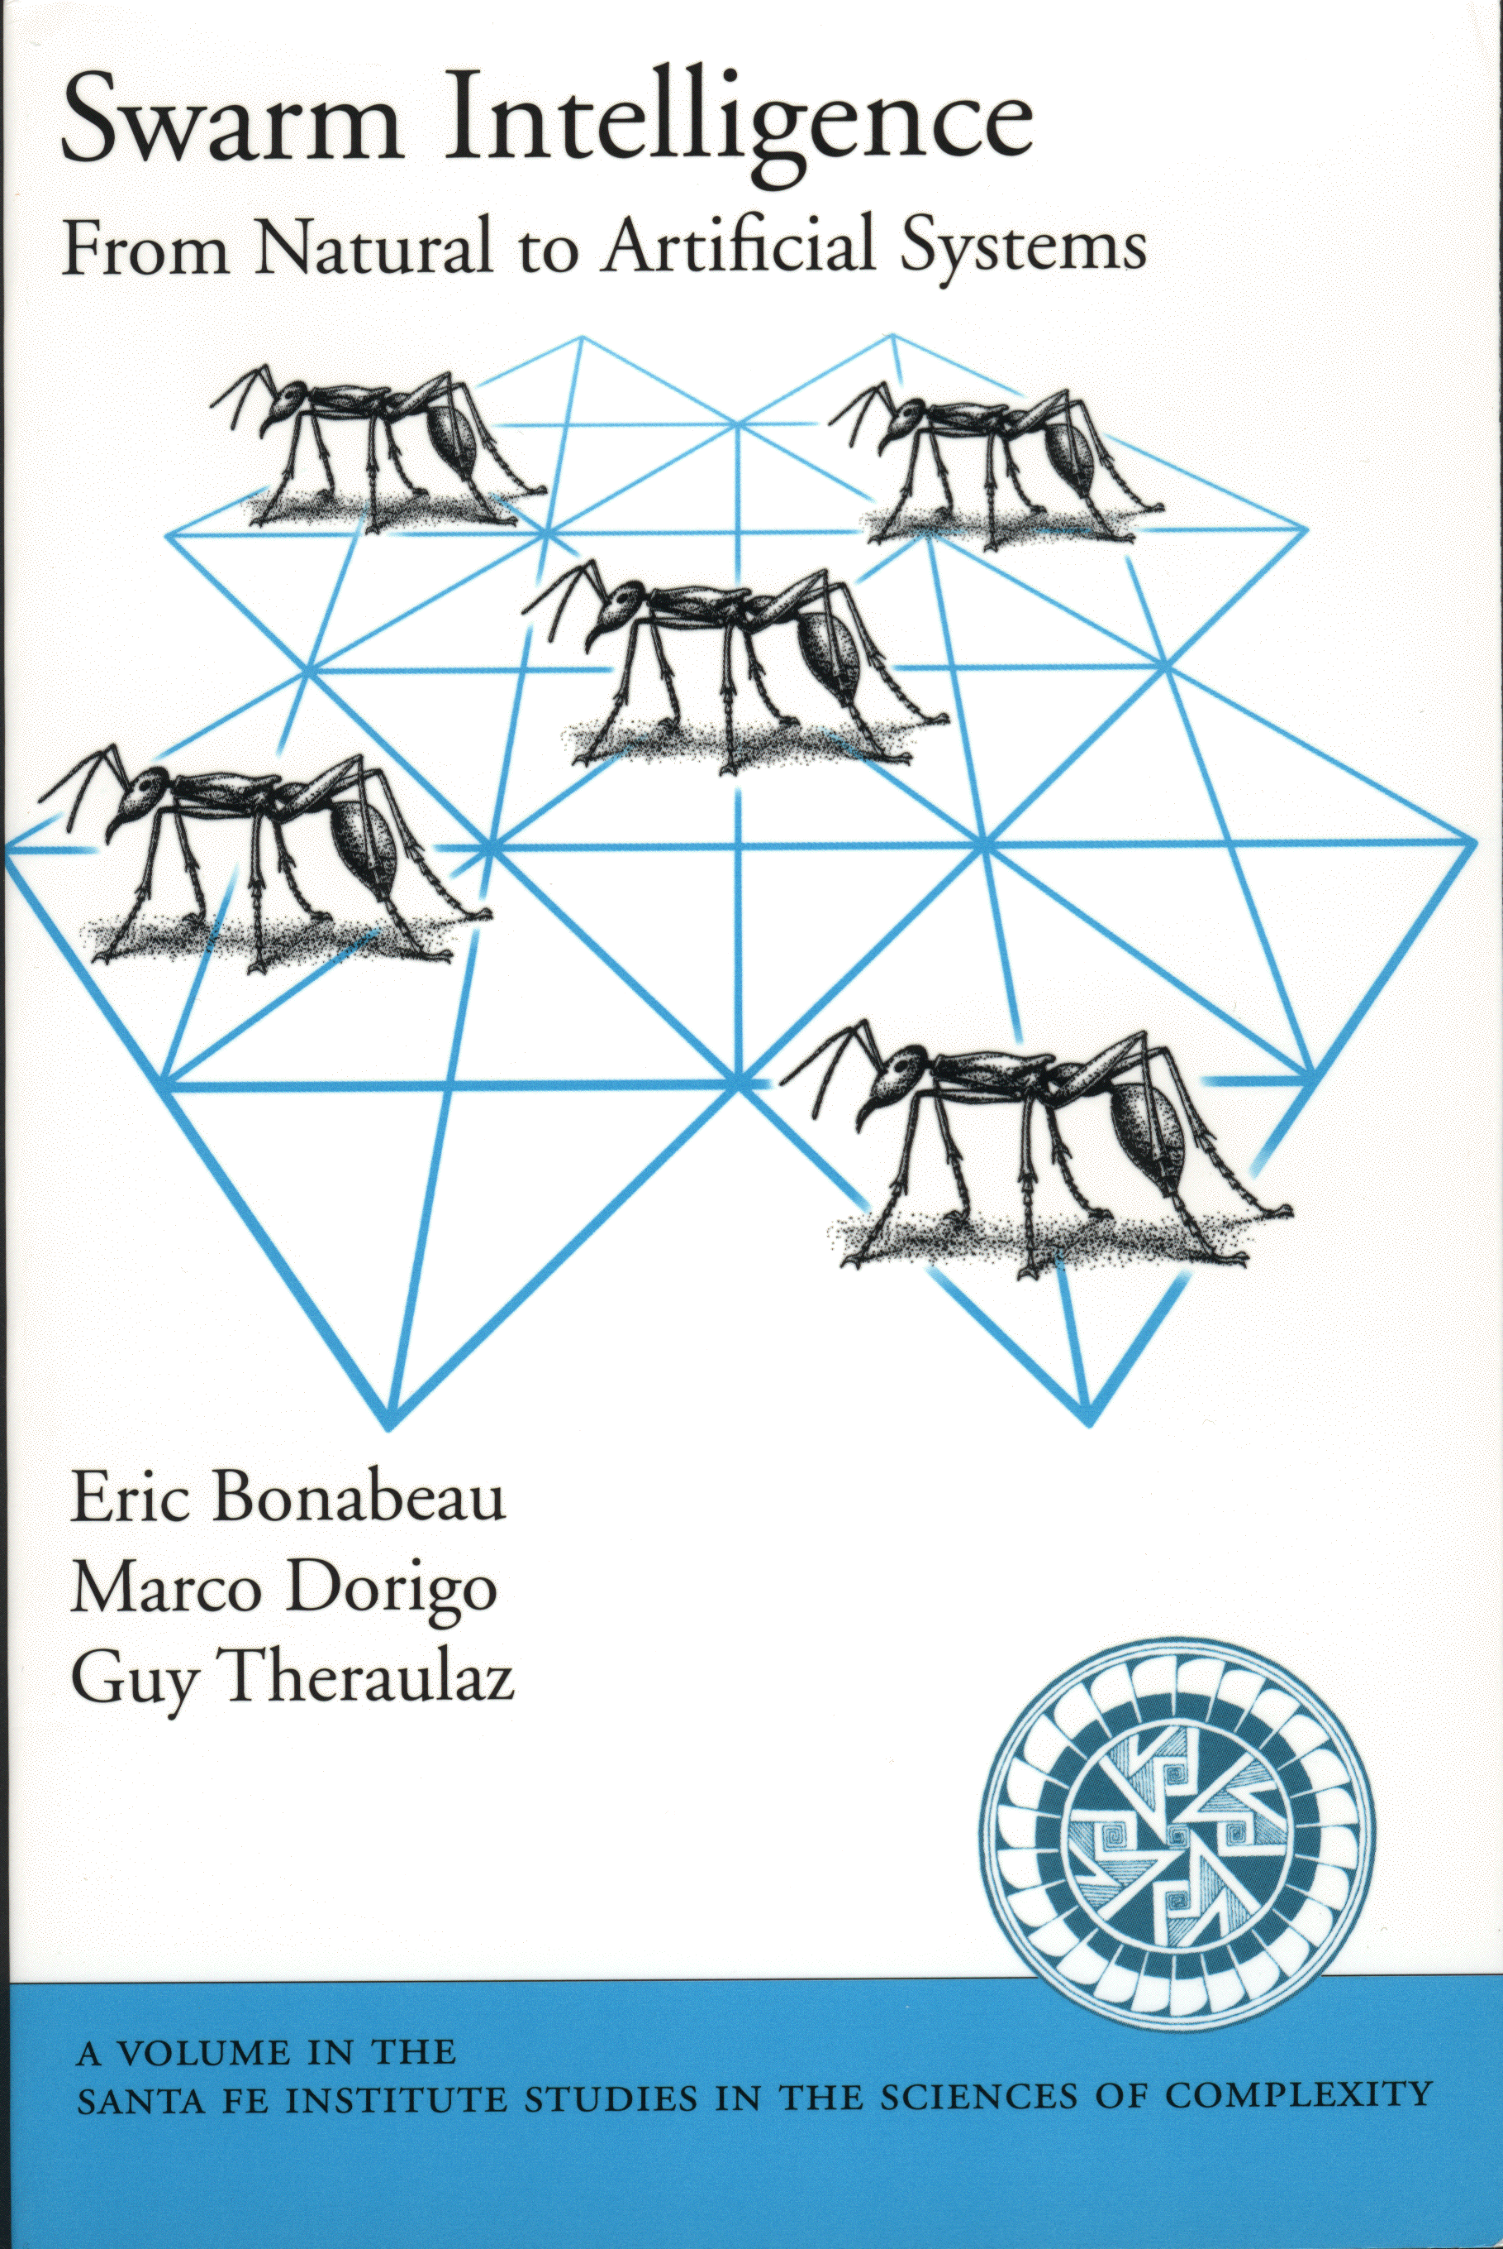


Slide 3
Ants in the Pants!
An Overview
Real world insect examples
Theory of Swarm Intelligence
From Insects to Realistic
A.I. Algorithms
Examples of AI applications

Slide 4
Real World Insect Examples

Slide 5
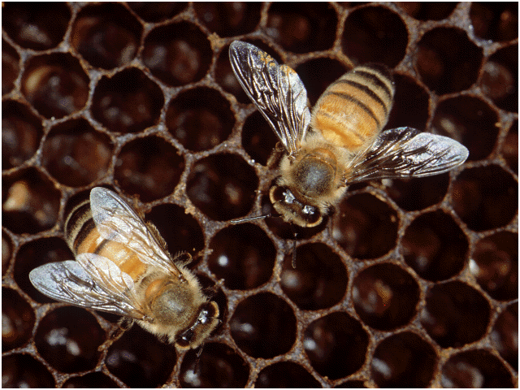
Bees

Slide 6
Bees
Colony cooperation
Regulate hive temperature
Efficiency via Specialization: division of labour in the colony
Communication : Food sources are exploited according to quality and distance from the hive
Notes:
Efficiency : Iindustrial Revolution
build a series of parallel wax combs, organized in concentric rings of brood, pollen collection & honey production

Slide 7
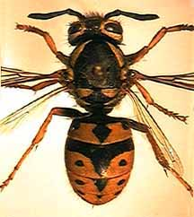
Wasps

Slide 8
Wasps
Pulp foragers, water foragers & builders
Complex nests
  Horizontal columns
  Protective covering
  Central entrance hole
Notes:
Division of labour

Slide 9
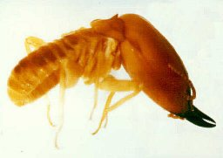
Termites

Slide 10
Termites
Cone-shaped outer walls and ventilation ducts
Brood chambers in central hive
Spiral cooling vents
Support pillars
Notes:
Possibly remove termite section if time is not an issue since we don't know a lot about them... or their function.

Slide 11
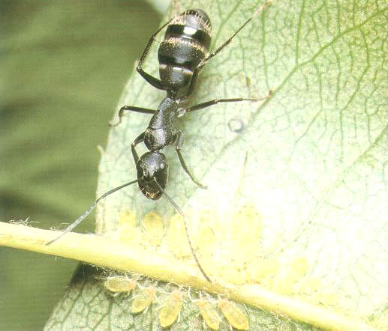
Ants
Notes:
Focus of presentation.
Why?
Easy to study
Predictable..
Ants in Pants was my favorite game

Slide 12
Ants
Organizing highways to and from their foraging sites by leaving pheromone trails
Form chains from their own bodies to create a bridge to pull and hold leafs together with silk
Division of labour between major and minor ants
Notes:
Possibly add pic on page 30... some side effects are that it is redundent?
division of labour : hunters and nest workers

Slide 13
Social Insects
Problem solving benefits include:
  Flexible
  Robust
  Decentralized
  Self-Organized
Notes:
Page 19
flex: take away major or minor and they compensate
robust: recover from changes in the environment shown in just a couple of slides
decentralized: In the case of ants Individual ants have their own agenda yet the cooperation and integration of these actions needs no supervisor.
self-organized: complex issue that will be discussed shortly.

Slide 14
Summary of Insects
The complexity and sophistication of
Self-Organization is carried out with no clear leader
What we learn about social insects can be applied to the field of Intelligent System Design
The modeling of social insects by means of
Self-Organization can help design artificial distributed problem solving devices. This is also known as Swarm Intelligent Systems.
Notes:
All of the social organizations involved with ants, bees, wasps and termites are quite impressive
Page 7

Slide 15
Swarm Intelligence in Theory

Slide 16
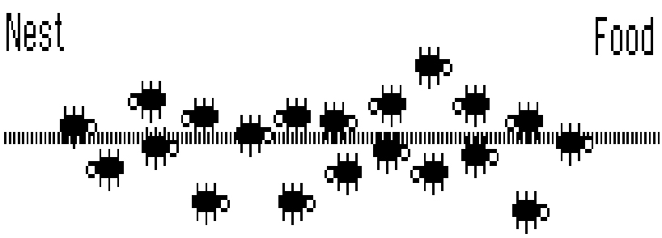
An In-depth Look at Real Ant Behaviour
Notes:
We want to talk in depth about how the algorithm works here

Slide 17
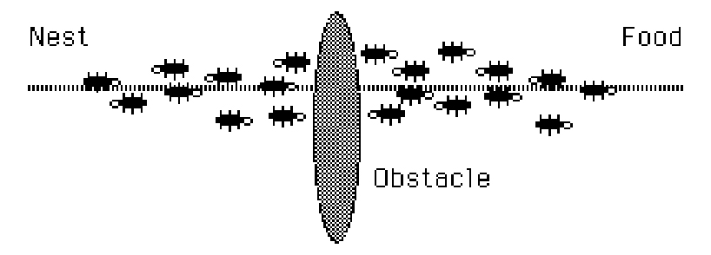
Interrupt The Flow

Slide 18
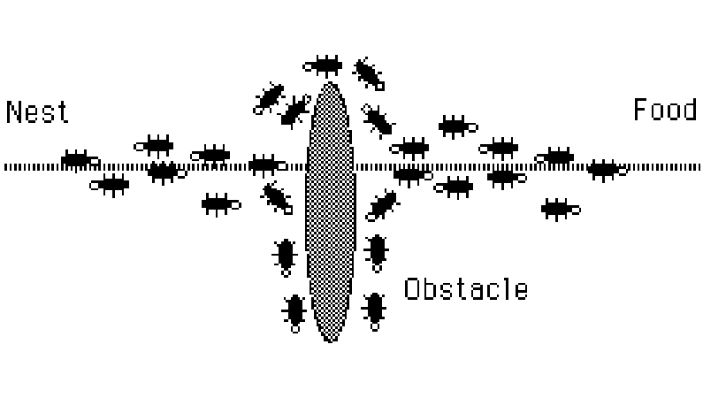
The Path Thickens!

Slide 19
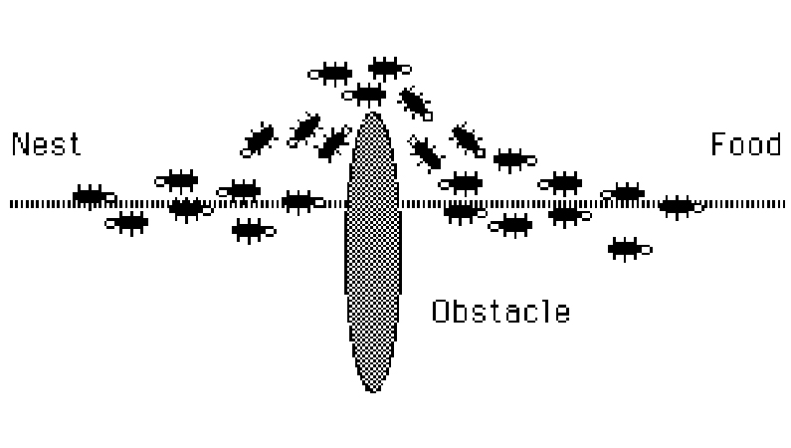
The New Shortest Path

Slide 20
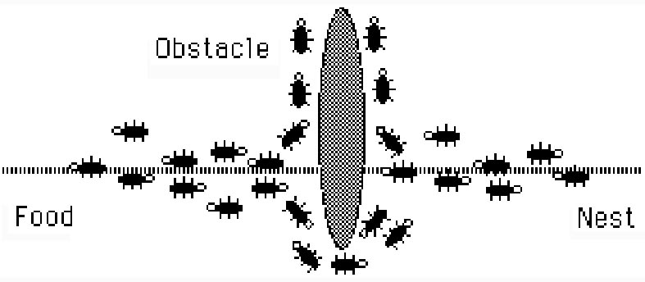
Adapting to Environment Changes
Notes:
With a change in the environment, swarm intelligent systems will adapt to this change and find the new optimal solution.
This is achieved because ants choose to follow a path withcertain probability, therefore ants are always re-testing paths that were previously found to ineffiecient.

Slide 21
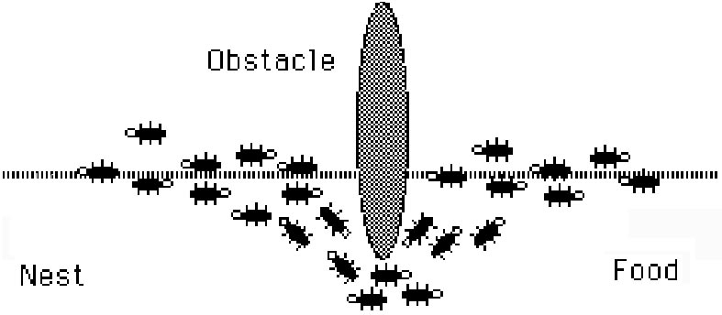
Adapting to Environment Changes
Notes:
Fully optimal solution found again.

Slide 22
Ant Pheromone and Food Foraging Demo

Slide 23
Problems Regarding Swarm Intelligent Systems
Swarm Intelligent Systems are hard to ‘program’ since the problems are usually difficult to define
  Solutions are emergent in the systems
  Solutions result from behaviors and interactions among and between individual agents
Notes:
read in book....
defining the problem and discovering the solution....
look in book for more information

Slide 24
Possible Solutions to Create Swarm Intelligence Systems
Create a catalog of the collective behaviours (Yawn!)
Model how social insects collectively perform tasks
  Use this model as a basis upon which artificial variations can be developed
  Model parameters can be tuned within a biologically relevant range or by adding non-biological factors to the model
Notes:
This slide could use some work. find it in the book

Slide 25
Four Ingredients of
Self Organization
Positive Feedback
Negative Feedback
Amplification of Fluctuations - randomness
Reliance on multiple interactions

Slide 26
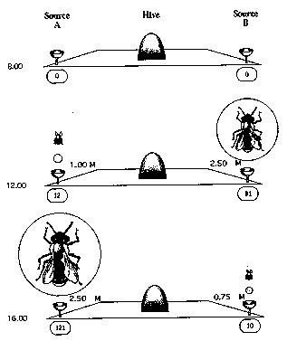

Slide 27
Recap: Four Ingredients of
Self Organization
Positive Feedback
Negative Feedback
Amplification of Fluctuations - randomness
Reliance on multiple interactions

Slide 28
Properties of
Self-Organization
Creation of structures
  Nest, foraging trails, or social organization
Changes resulting from the existence of multiple paths of development
  Non-coordinated & coordinated phases
Possible coexistence of multiple stable states
  Two equal food sources
Notes:
Page 12
spatiotemporal in other words...
bifurcations in other words...
Acceptable goal states

Slide 29
Types of Interactions
For Social Insects
Direct Interactions
  Food/liquid exchange, visual contact, chemical contact (pheromones)
Indirect Interactions (Stigmergy)
  Individual behavior modifies the environment, which in turn modifies the behavior of other individuals

Slide 30
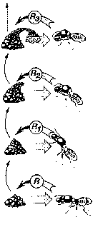
Stigmergy Example
Pillar construction in termites
Notes:
So this could be the point where termites are killed and the picture on page 18 is instead used and described with respect to ants...
Watch the last sentence it is already in the previous slide...!@!!!!!

Slide 31


Slide 32
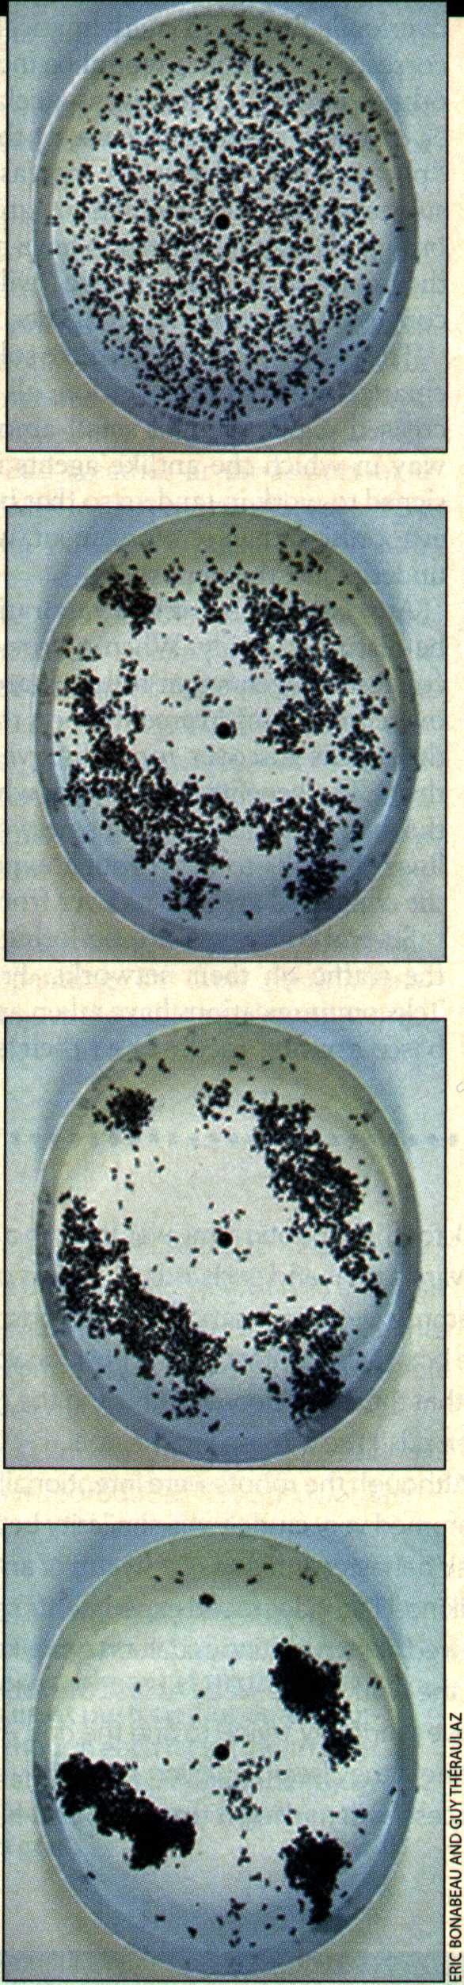
Stigmergy in
Action

Slide 33
Ants ≡ Agents
Stigmergy can be operational
  Coordination by indirect interaction is more appealing than direct communication
  Stigmergy reduces (or eliminates) communications between agents
Notes:
talk about termite example
incremental construction
flexibility - agents respond to perturbations of the environment.
Indirect communication is more appealing: agents are not as dependant on each other (they can leave cues behind for the next agent)

Slide 34
From Insects to Realistic
A.I. Algorithms

Slide 35
From Ants to Algorithms
Swarm intelligence information allows us to address modeling via:
  Problem solving
  Algorithms
  Real world applications

Slide 36
Modeling
Observe Phenomenon
Create a biologically motivated model
Explore model without constraints

Slide 37
Modeling...
Creates a simplified picture of reality
Observable relevant quantities become variables of the model
Other (hidden) variables build connections
Notes:
What does the last point mean?

Slide 38
A Good Model has...
Parsimony (simplicity)
Coherence
Refutability
Parameter values correspond to values of their natural counterparts
Notes:
Parsimony, Coherence, Refutability : Page 17 text

Slide 39
Travelling Salesperson Problem
Initialize
Loop /* at this level each loop is called an iteration */
Each ant is positioned on a starting node
Loop /* at this level each loop is called a step */
Each ant applies a state transition rule to incrementally
build a solution and a local pheromone updating rule
Until all ants have built a complete solution
A global pheromone updating rule is applied
Until End_condition
M. Dorigo, L. M. Gambardella : ftp://iridia.ulb.ac.be/pub/mdorigo/journals/IJ.16-TEC97.US.pdf
Ant Colony System: A Cooperative Learning Approach to the Traveling Salesman Problem

Slide 40
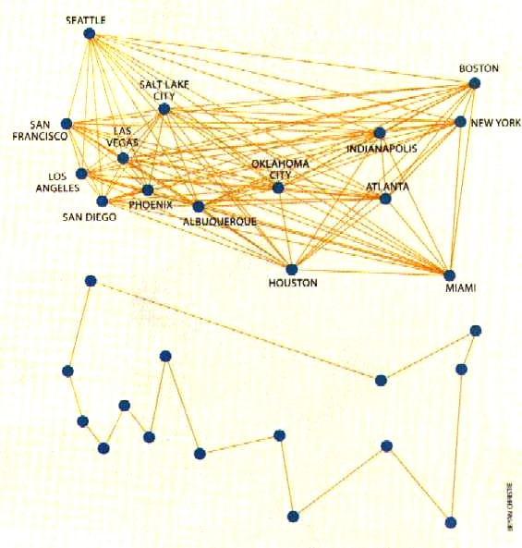
Traveling Sales Ants

Slide 41
Welcome to the Real World

Slide 42
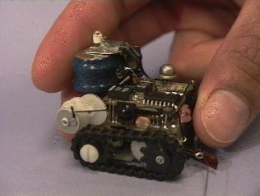
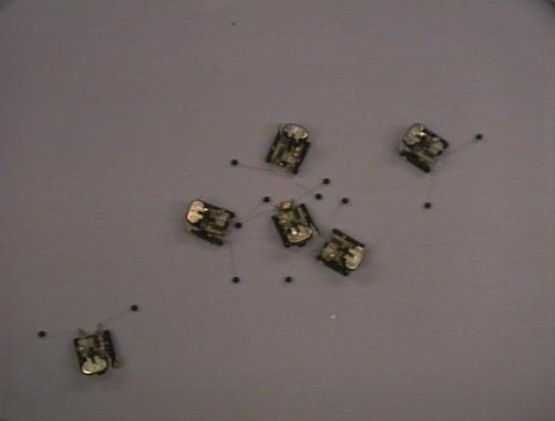
Robots
Collective task completion
No need for overly complex algorithms
Adaptable to changing environment

Slide 43
Robot Feeding Demo

Slide 44
Communication Networks
Routing packets to destination in shortest time
Similar to Shortest Route
Statistics kept from prior routing (learning from experience)

Slide 45
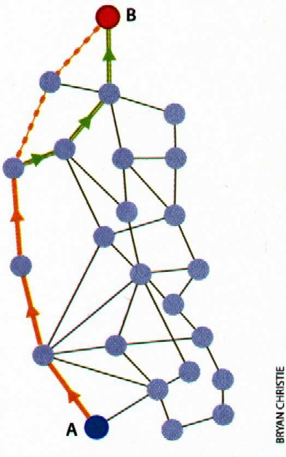
Shortest Route
Congestion
Adaptability
Flexibility

Slide 46
Antifying Website Searching
Digital-Information Pheromones (DIPs)
Ant World Server
Transform the web into a gigANTic neural net
Notes:
Our work may help to transform the web into a gigantic neural net. In that way, like the brain of a living organism, the Web will learn from what happens to it. With the digital information pheromones that it accumulates, it can help people do a better job of finding information faster and more accurately."
Practice? Imagine an ant-enabled Web site with tiny ant icons next to some links. Clicking on this icon will pop up a dialog box describing how useful the Web page behind the link had been to previous visitors. Problems? DIP abuse by marketers and spammers, accumulating a well-worn paths to particular pages which makes it hard to find another similar pages, and always asking Web searchers to rate their findings. Anyway, let's hope that Kantor and his colleagues will have their ants out of the lab by 2000...

Slide 47
Closing Arguments
Still very theoretical
No clear boundaries
Details about inner workings of insect swarms
The future…???

Slide 48
Dumb parts, properly connected into a swarm, yield smart results.
Kevin Kelly

Slide 49
The Future?
Miniaturization
Telecommunications
Cleaning Ship Hulls
Medical
Pipe Inspection
Satellite Maintenance
Self-Assembling Robots
Engine Maintenance
Job Scheduling
Pest Eradication
Combinatorial Optimization
Interacting Chips in Mundane Objects
Data Clustering
Vehicle Routing
Distributed Mail Systems
Optimal Resource Allocation

Slide 50
References
Ant Algorithms for Discrete Optimization Artificial Life
M. Dorigo, G. Di Caro & L. M. Gambardella (1999).
addr:http://iridia.ulb.ac.be/~mdorigo/
Swarm Intelligence, From Natural to Artificial Systems
M. Dorigo, E. Bonabeau, G. Theraulaz
The Yellowjackets of the Northwestern United States, Matthew Kweskin
addr:http://www.evergreen.edu/user/serv_res/research/arthropod/TESCBiota/Vespidae/Kweskin97/main.htm
Entomology & Plant Pathology, Dr. Michael R. Williams addr:http://www.msstate.edu/Entomology/GLOWORM/GLOW1PAGE.html
Urban Entomology Program, Dr. Timothy G. Myles addr:http://www.utoronto.ca/forest/termite/termite.htm

Slide 51
References Page 2
Gakken’s Photo Encyclopedia: Ants, Gakushu Kenkyusha
addr:http://ant.edb.miyakyo-u.ac.jp/INTRODUCTION/Gakken79E/Intro.html
The Ants: A Community of Microrobots at the MIT Artificial Intelligence Lab
addr: http://www.ai.mit.edu/projects/ants/
Scientific American March 2000 - Swarm Smarts
Pages: 73-79
Pink Panther Image Archive
addr:http://www.high-tech.com/panther/source/graphics.html
C. Ronald Kube, PhD
Collective Robotic Intelligence Project (CRIP).
addr: www.cs.ualberta.ca/~kube

Slide 52
Swarm Intelligence
Swarm intelligence (SI) is an artificial intelligence
technique based around the study of collective behavior in
decentralized, self-organized systems. The expression
"swarm intelligence" was introduced by Beni & Wang in
1989, in the context of cellular robotic systems
SI systems are typically made up of a population of simple
agents interacting locally with one another and with their
environment. Although there is normally no centralized
control structure dictating how individual agents should
behave, local interactions between such agents often lead
to the emergence of global behavior. Examples of systems
like this can be found in nature, including ant colonies, bird
flocking, animal herding, bacteria molding and fish
schooling.

Slide 53
ACO Ant colony optimization
ACO Ant colony optimization
Ant colony optimization or ACO is a metaheuristic
optimization algorithm that can be used to find
approximate solutions to difficult combinatorial optimization
problems. In ACO artificial ants build solutions by moving
on the problem graph and they, mimicking real ants,
deposit artificial pheromone on the graph in such a way
that future artificial ants can build better solutions. ACO
has been successfully applied to an impressive number of
optimization problems

Slide 54
PSO Particle swarm optimization
PSO Particle swarm optimization
Particle swarm optimization or PSO is a global optimization
algorithm for dealing with problems in which a best solution can
be represented as a point or surface in an n-dimensional space.
Hypotheses are plotted in this space and seeded with an initial
velocity, as well as a communication channel between the
particles. Particles then move through the solution space, and are
evaluated according to some fitness criterion after each time step.
Over time, particles are accelerated towards those particles within
their communication grouping which have better fitness values.
The main advantage of such an approach over other global
minimization strategies such as simulated annealing is that the
large number of members that make up the particle swarm make
the technique impressively resilient to the problem of local
minima

Slide 55
SDS Stochastic diffusion search
SDS Stochastic diffusion search
Stochastic Diffusion Search or SDS is an agent based probabilistic
global search and optimization technique best suited to problems where
the objective function can be decomposed into multiple independent
partial-functions. Each agent maintains a hypothesis which is iteratively
tested by evaluating a randomly selected partial objective function
parameterized by the agent's current hypothesis. In the standard
version of SDS such partial function evaluations are binary resulting in
each agent becoming active or inactive. Information on hypotheses is
diffused across the population via inter-agent communication. Unlike the
stigmergetic communication used in ACO, in SDS agents communicate
hypotheses via a one-to-one communication strategy analogous to the
tandem running procedure observed in some species of ant. A positive
feedback mechanism ensures that, over time, a population of agents
stabilize around the global-best solution. SDS is both an efficient and
robust search and optimization algorithm, which has been extensively
mathematically described

Slide 56
Applications
Applications
Swarm Intelligence-based techniques can be used in a number of
applications. The U.S. military is investigating swarm techniques
for controlling unmanned vehicles. NASA is investigating the use
of swarm technology for planetary mapping. A 1992 paper by M.
Anthony Lewis and George A. Bekey discusses the possibility of
using swarm intelligence to control nanobots within the body for
the purpose of killing cancer tumors. Artists are using swarm
technology as a means of creating complex interactive
environments. Disney's The Lion King was the first movie to make
use of swarm technology (the stampede of the wildebeests
scene). The movie "Lord of the Rings" has also made use of
similar technology during battle scenes. Swarm technology is
particularly attractive because it is cheap, robust, and simple.

Slide 57
Applications
Applications
Swarm Intelligence-based techniques can be used in a number of
applications. The U.S. military is investigating swarm techniques
for controlling unmanned vehicles. NASA is investigating the use
of swarm technology for planetary mapping. A 1992 paper by M.
Anthony Lewis and George A. Bekey discusses the possibility of
using swarm intelligence to control nanobots within the body for
the purpose of killing cancer tumors. Artists are using swarm
technology as a means of creating complex interactive
environments. Disney's The Lion King was the first movie to make
use of swarm technology (the stampede of the wildebeests
scene). The movie "Lord of the Rings" has also made use of
similar technology during battle scenes. Swarm technology is
particularly attractive because it is cheap, robust, and simpl

