Slide 1
Image Analysis and Computer Vision: Intro. to Imaging Techniques
DARK ENERGY IMAGING WITH CCDS
RADIO TELESCOPES
LASER IMAGING

Slide 2
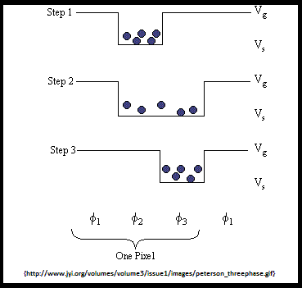
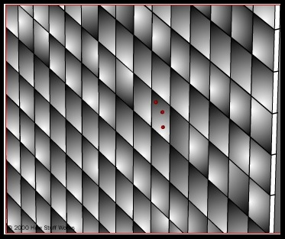
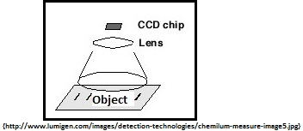
Dark Energy Imaging Using CCDs
CCD Basics
Simplest CCD element transfers photon intensity to voltage level
Full images require a 2-dimensional array of CCDs, a lens, & filters

Slide 3
Dark Energy Imaging Using CCDs
CCD Advantages in Astronomy
Custom software algorithms
Operation at very low temperatures
Dark Energy Imaging with Fermilab Special Purpose Camera
570 megapixel cluster of CCDs
Light focused with 4-meter telescoping lens
Utilizing specialized filters to analyze
  Redshift - the "Doppler-effect" of time and light
Working in collaboration with other teams to determine effects of Dark Energy

Slide 4
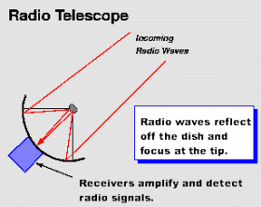
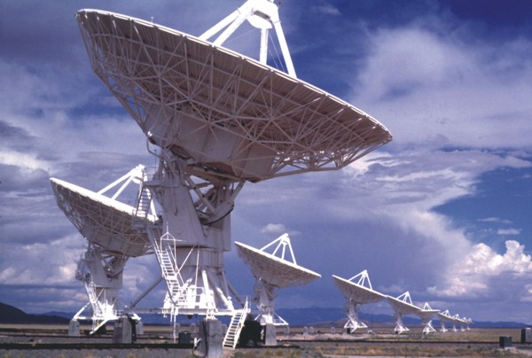
Radio Astronomy
Radio telescopes are very similar to radio receivers and RADAR
Galactic radio signals are millions of times weaker than the sensor can detect
Many methods to concentrate and amplify signals
Arrays of telescopes can enhance image quality through complex image processing
Imaging sensor of the telescopes are kept very cold to reduce noise

Slide 5
Laser Imaging
  Laser imaging often produce what are called point clouds; a set of xyz points that represent an object.
  Some laser scanners also have the ability to return color data of the scanned object.
  Light detection and ranging (Lidar) is a technique of imaging that uses a process similar to radar. It sends out laser pulses and monitors for reflection. The scattered or reflected light will change properties.

