Slide 1
CSC411- Machine Learning and Data Mining
Unsupervised Learning
University of Toronto (Mississauga Campus)
Tutorial 9– March 16th, 2007

Slide 2
Unsupervised Learning
Clustering
  K-Means algorithm
Reinforcement Learning
  Q-learning algorithm

Slide 3
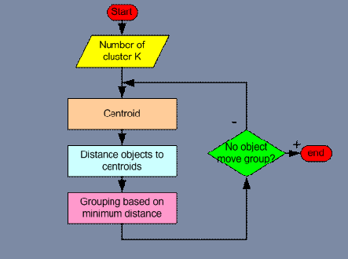
K-Means algorithm

Slide 4
K-Means algorithm
K
Input
Numerical Data Set
Numerical Data Set

Slide 5
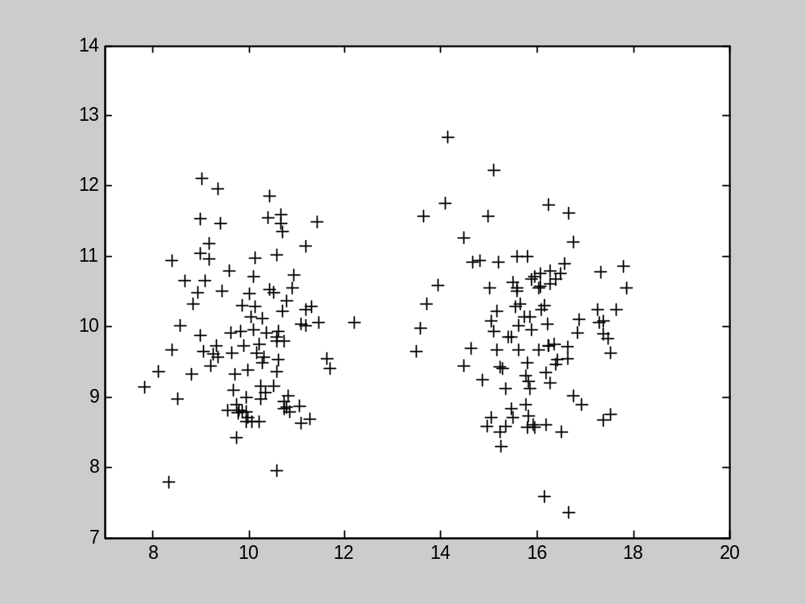
K-Means algorithm
Original Data (2 dimensions)

Slide 6
Reinforcement Learning
Markov Decision Processes (MDP)
  MDP(S, A, T, R)
    S: environment states
    A: actions available to the agent
    T: state transition function
    R: reward function
  At each step t:
    Observe current state St
    Choose action to perform At
    Receive reward(reinforcement) Rt= R(St, At)
    Next State St+1 = T(St, At)

Slide 7
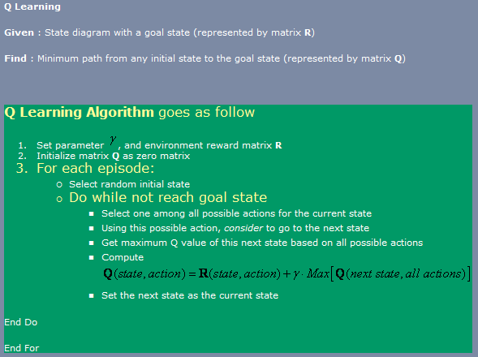
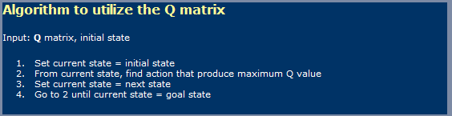
Q-learning algorithm

Slide 8
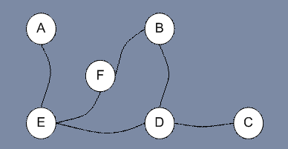
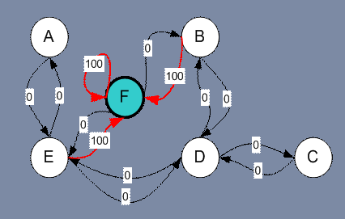
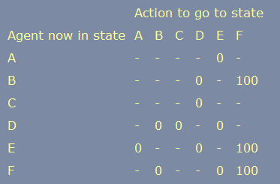

Q-learning algorithm

Slide 9
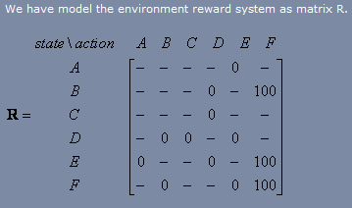

Slide 10
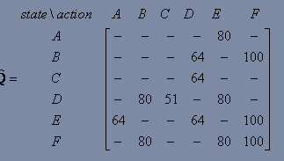
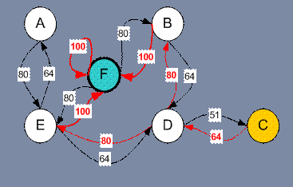

Slide 11
Try the Tower-of-Hanoi Game

Slide 12
Reference
Teknomo, Kardi. K-Means Clustering Tutorials. http:\\people.revoledu.com\kardi\ tutorial\kMean\

