Slide 1

Database Fundamentals
Lecture 6
Normalization
Prepared By: Eng. Doaa Soleiman
Notes:
To view this presentation, first, turn up your volume and second, launch the self-running slide show.

Slide 2

Lecture 6
Normalization
Definitions
First Normal Form
Second Normal Form
Third Normal Form
Notes:
To view this presentation, first, turn up your volume and second, launch the self-running slide show.

Slide 3

Definitions

Slide 4
Normalization
Process of organizing data to minimize duplication.
The process of decomposing unsatisfactory "bad" relations by breaking up their attributes into smaller relations
Guide in designing relational database by removing repeating groups and duplicates from relational tables.

Slide 5
Normalization
Normalization avoids:
Duplication of Data
Insert Anomaly
Delete Anomaly
Update Anomaly
Frequent Null Values

Slide 6
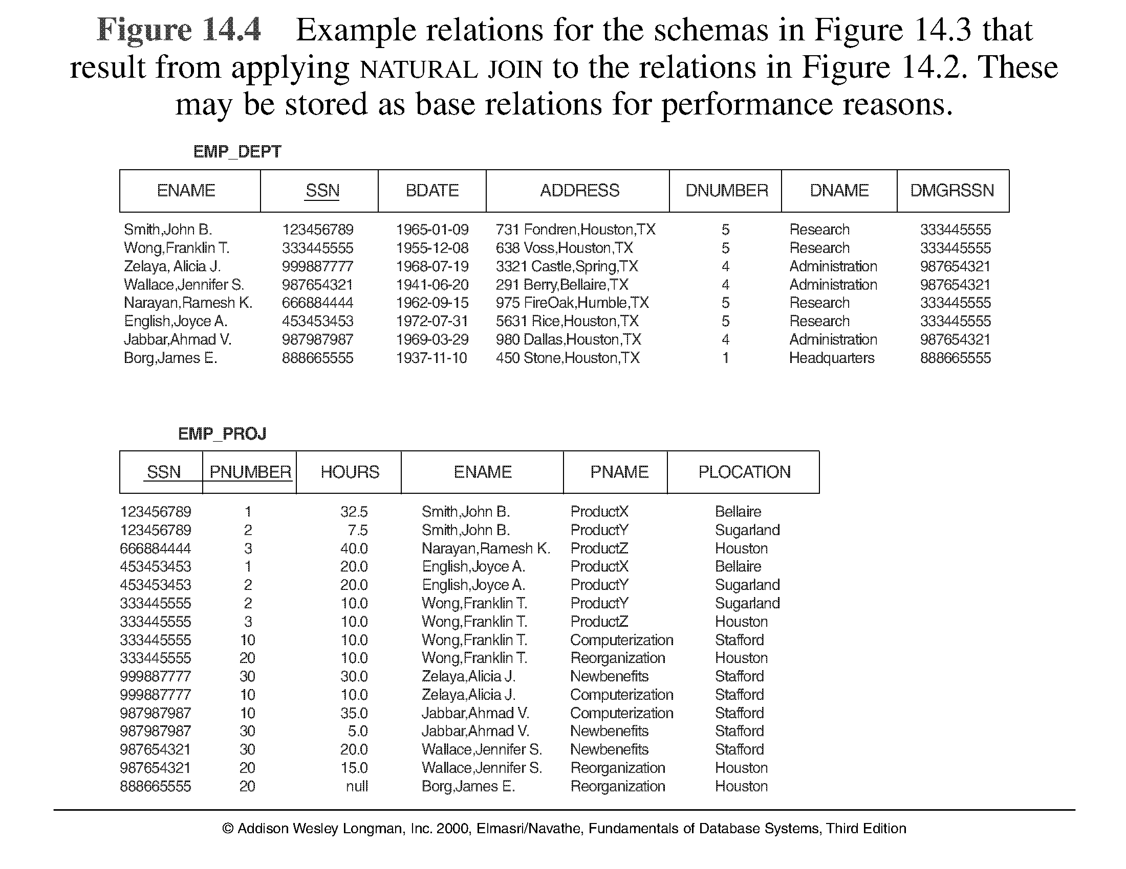

Slide 7
Relation
• Relational DBMS products store data in the form of relations (Special type of tables)
• Relation characteristics:
o Row contains data about the entity.
o Column contains data about attribute of an entity.
o Cell of the table holds a single value.
o All entries in a column are of the same kind.
o Each column has a unique name.
o Columns order is unimportant.
o Rows order is unimportant.
o No two rows are identical.

Slide 8
Keys Types
• One or more columns “Composite” of a relation that identifies a row.
• Relation has One unique PK
• Relation may have additional unique keys (Candidate Keys)

Slide 9
Redundancy
• The data is redundant if two or more identical values can be deleted without info being lost.
• Information is duplicated when the same data is stored more than once.
• Duplicated data is not a problem unless it is also redundant.
• Redundant data stores the same piece of information more than once.

Slide 10
Functional Dependency
• Attribute B has a functional dependency on attribute A if, for each value of attribute A, there is exactly one value of attribute B.
Example:
If A B
A determines B and
B is functionally dependent (FD) on A

Slide 11
Functional Dependency
• A B if “for every valid instance of A, that value of A uniquely determines the value of B”
or A B if “there exists at most one value of B for every value of A”

Slide 12
Functional Dependencies Examples
social security number determines employee name
SSN -> ENAME
project number determines project name and location
PNUMBER -> {PNAME, PLOCATION}
employee ssn and project number determines the hours per week that the employee works on the project
{SSN, PNUMBER} -> HOURS

Slide 13
Partial Key Dependency
When one non key attribute depends on the part of the key not on the whole key.

Slide 14
Transitive Dependency
When one non key attribute depends on another non key attribute.

Slide 15
Normal form
Condition using keys and FDs of a relation to certify whether a relation schema is in a particular normal form

Slide 16
First Normal Form
A table is in first normal form (1NF) if it meets the relation definition (no multivalued or composite attributes).
No Repeating Groups.
All columns (fields) must be atomic (No repeating items in columns).
Steps to be in 1NF:
Eliminate repeating groups in individual tables
Create a separate table for each set of related data.
Remove multi-value attribute.

Slide 17
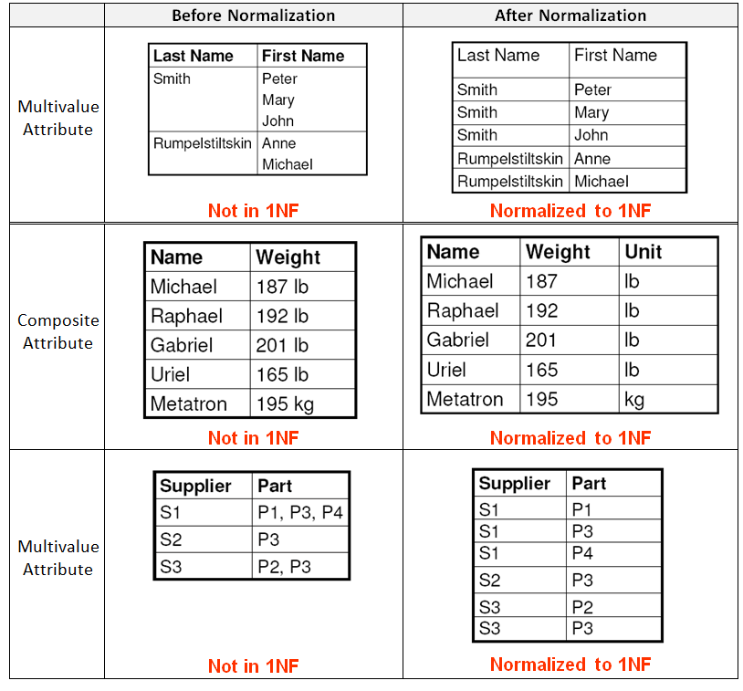

Slide 18
Second Normal Form
Relation is in Second Normal Form 2NF – if only if – it is in 1NF and every non key attribute is fully functionally dependent on the whole key.
No Partial Key Dependencies.
The problem arises when there is a composite key.

Slide 19
Second Normal Form
A relation is in 2NF if it is in 1NF and any one of these is true:
the PK consists of only 1 attribute
all attributes are part of the PK (no non-key attributes)
every non key attribute is functionally dependent on the whole PK

Slide 20
keys and dependencies
EMPLOYEE1 (Emp_ID, Name, Dept_Name, Salary)
determinant
Emp_ID | Name | Dept_Name | Salary
functional dependency

Slide 21
EMPLOYEE2
(Emp_ID, Course_Title, Name, Address, Salary, Date_Completed)
Emp_ID | Course_Title | Name | Address | Salary | Date_Comp.
not fully functionally dependant on the primary key

Slide 22
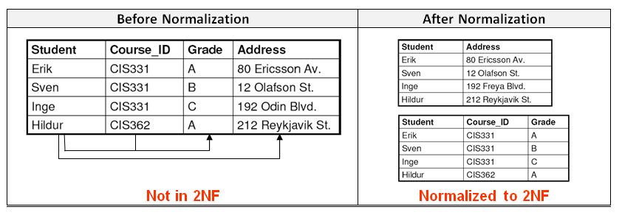

Slide 23
Third Normal Form
Relation is in Third Normal Form 3NF – if only if – it is in 2NF and if there is no transitive dependencies.
Transitive dependency occurs when one non key attribute functionally depend on another non key attribute.
If there is a relation in second normal form and has zero or one non key attribute then the relation is automatically in 3NF.

Slide 24
Transitive Dependency
transitive
dependency
Cust_ID | Name | Region | city

Slide 25
Cust_ID | Name | city | Region
Region | City
Cust_ID | Name | Region

Slide 26
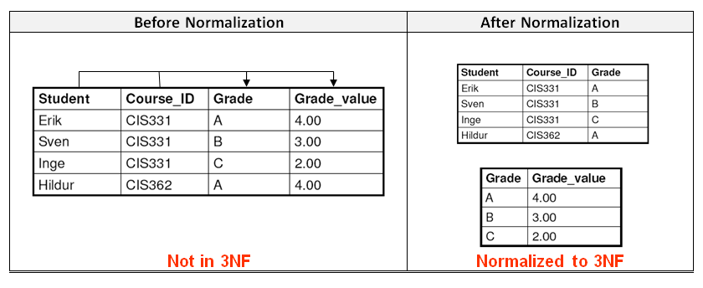

Slide 27
Example 1
(SalesOrderNo, Date, CustomerNo, CustomerName, Customer Add, ClerkNo, ClerkName, Item No, Description, Qty, Unit Price)

Slide 28
To Be in 1NF:
The repeating fields will be removed from the original data table, leaving the following.
• SalesOrderNo, Date, CustomerNo, CustomerName, CustomerAdd, ClerkNo, ClerkName
• SalesOrderNo, ItemNo, Description, Qty, UnitPrice [Repeating Fields]

Slide 29
To Be in 2NF:
Item No, Description
SalesOrderNo, Item No, Qty, UnitPrice
Unchanged Tables
SalesOrderNo, Date, CustomerNo, CustomerName, CustomerAdd, ClerkNo, ClerkName

Slide 30
To Be in 3NF:
• CustomerNo, CustomerName, CustomerAdd
• ClerkNo, ClerkName
• SalesOrderNo, Date, CustomerNo, ClerkNo
Unchanged Tables
• ItemNo, Description
• SalesOrderNo, ItemNo, Qty, UnitPrice

Slide 31
ITI Example
ITI Students Sheet
Platform Name : SWE Platform Description: Software Engineering
Graduate Profile: ALL
Appno | Name | F-code | Faculty | Major | Address | Telno | Found. Grade | Total Att. Hrs | Start date
123 | Ahmed | SC-phy | Science | Physics | Haram | 33868420 | A | 600 | 14 Sep
124 | Mona | Eng-cs | Engineering | Computer | Dokki | 33897455,33897445 | B | 591 | 15 Sep
127 | Ali | Com-ac | Commerce | Accounting | Nasr City | 22415939 | A | 550 | 21 Sep
223 | Karim | Med-bio | Medicine | Biochemistry | Sheraton | 22868456 | C | 600 | 14 Sep
Notes:
1NF :
Platform :pfname , pfdesc , pfgraduate
Students: pfname, appno, name , f-code ,faculty , major , address, Foundgrade, attd , start_date
Std_Tel: appno, telno
2NF:
Students: appno, name , f-code , faculty , major , address
Students_pf: pfname,appno, Foundgrade, attd , start_date
Unchanged Tables
Platform :pfname , pfdesc , pfgraduate
Std_Tel: appno, telno
3NF
Students: appno, name , f-code, address
Fac_majors:f-code , faculty name , major
Unchanged Tables
Platform :pfname , pfdesc , pfgraduate
Std_Tel: appno, telno
Students_pf: pfname,appno, Foundgrade, attd , start_date

Slide 32
1NF
Separate Repeating Groups into New Tables.
Repeating Groups Fields that may be repeated several times for one document/entity
Create a new table containing the repeating data
The primary key of the table (repeating group) is always a composite key; Usually document number and a field uniquely describing the repeating line, like an item number.

Slide 33
1NF
Platform :pfname , pfdesc , pfgraduate
Students: pfname, appno, name , faculty , major , address, Foundgrade, attd , start_date
Std_Tel: appno, telno

Slide 34
2NF
Students: appno, name , f-code, faculty , major , address
Students_pf: pfname,appno, Foundgrade, attd , start_date
Unchanged Tables
Platform :pfname , pfdesc , pfgraduate
Std_Tel: appno, telno

Slide 35
3NF
Students: appno, name , address, f-code
Fac_majors:faculty , major , f-code
Unchanged Tables
Platform :pfname , pfdesc , pfgraduate
Std_Tel: appno, telno
Students_pf: pfname,appno, Foundgrade, attd , start_date

Slide 36
Case Study
Relation (s#, country, currency, p#, qty)
where
s# supplier identification number (this is the primary key)
country name of country where supplier is located
currency: Currency of the country of each supplier
p# part number of part supplied
qty quantity of parts supplied to date
In order to uniquely associate quantity supplied (qty) with part (p#) and supplier (s#), a composite primary key composed of s# and p# is used.

