Slide 1


Inter-process Communications for Robotics Applications
Edward M. Roderick
Advisor: Dan Lofaro Ph.D

Slide 2
Why Robotics Needs Inter-Process Communications (IPCs)
Provides a Modular System
Flexibility of connectivity
Scalable
Ideal for complex systems
Reduces impact of subsystem failure
Increases safety in human proximity
More robust robot
Eases robot limitations:
Offloading computation
Remote sensing
Cloud databases
Lighter/Smaller robot
Communication to other robots
Diversity of programming languages/styles

Slide 3
Existing IPC Protocols
Sockets: A library of IPC methods with the POSIX specification based on Internet and domain addresses[2].
Shared Memory: A fast local IPC method based on reading and writing to the same memory address. Susceptible to synchronization issues[2].
IPC | Local Communication | Network Communication
UDP (Sockets) | Y | Y
TCP (Sockets) | Y | Y
ZeroMQ (TCP Based) | Y | Y
ROS (TCP Based) | Y | Y
ACH (Shared Memory) | Y | N
[2] N. Dantam and M. Stilman, “Robust and efficient communication for real-time multi-process robot software,” in Humanoid Robots (Humanoids), 2012 12th IEEE-RAS International Conference on, Nov 2012, pp. 316– 322.

Slide 4
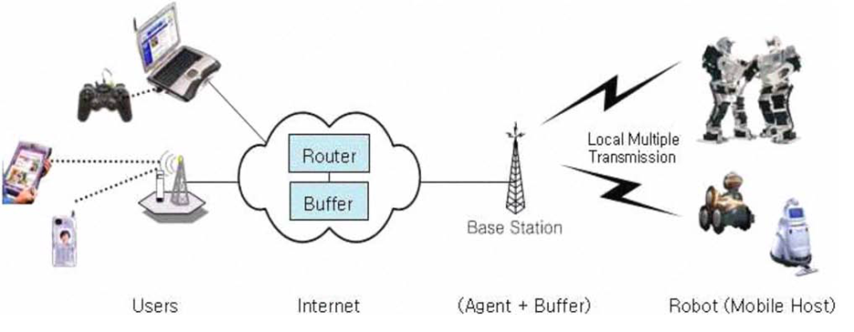
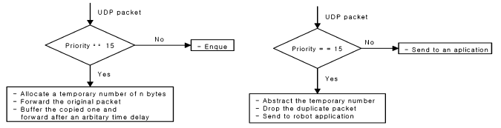
Sockets: TCP/UDP
Wireless control of mobile robots
Wireless controllers are common, as is Sockets
TCP retransmission causes delay time
UDP message limit 64 kbytes
Retransmission algorithm overcomes message losses
Assigned priority correlates to amount of retransmissions
Figure 1: Network architecture for mobile robots[7].
Figure x: Retransmission algorithm at the base station (left) and mobile robot (right) [7].
[7] D. K. Cho, S. H. Chun, J. G. Ahn, Y. S. Kwon, J. H. Eom, and Y. I. Kim, “A udp-based protocol for mobile robot control over wireless internet,” in Robot Communication and Coordination, 2009. ROBOCOMM ’09. Second International Conference on, March 2009, pp. 1–4.

Slide 5
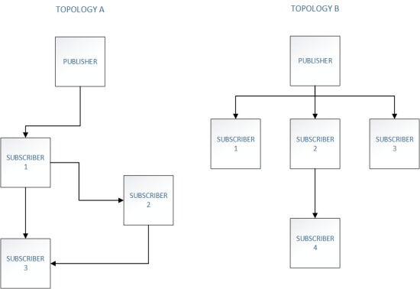
Sockets: ZeroMQ
ZeroMQ Theoretical Foundation
Topology is the primary concept in ZMQ
Uses TCP as underlying transport
Abstracts networking layer. Messages sent to topology instead of IP addresses.
Several messaging patterns:
Server/client
Publish/Subscribe
Request/Reply
Nodes can join and leave topologies dynamically
Figure 2: Example topologies of ZMQ messaging patterns. The flexibility of design is shown here [9].
[9] M. Sstrik, “zmq: The theoretical foundation,” 250bpm, Tech. Rep., 09 2011.

Slide 6
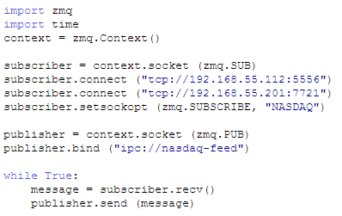
Sockets: ZeroMQ
Multithreading
Example Code (python) [10]
Easy to implement; very similar to sockets
Scalable
Lock free code, avoids synchronization issues
Prevents priority inversion
Multiple threads communicate over ZMQ topologies
Wide array of available programming languages
[10] P. Hintjens and M. Sustrik, “Multithreaded magic with zmq,” iMatrix Corporation, Tech. Rep., 09 2010.

Slide 7
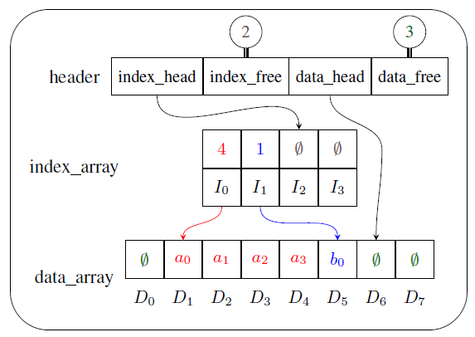
Shared Memory: ACH
Real-Time Multi-Process Robots
Low latency
Separate Data and index arrays allow for non head of line blocking
No data is lost when read or replaced, unlike sockets
Multiple readers and writers
Threadsafe via a mutex
Open source
Formally verified
Figure 3: Logical memory structure of ACH shared memory file
[2] N. Dantam and M. Stilman, “Robust and efficient communication for real-time multi-process robot software,” in Humanoid Robots (Humanoids), 2012 12th IEEE-RAS International Conference on, Nov 2012, pp. 316– 322.

Slide 8
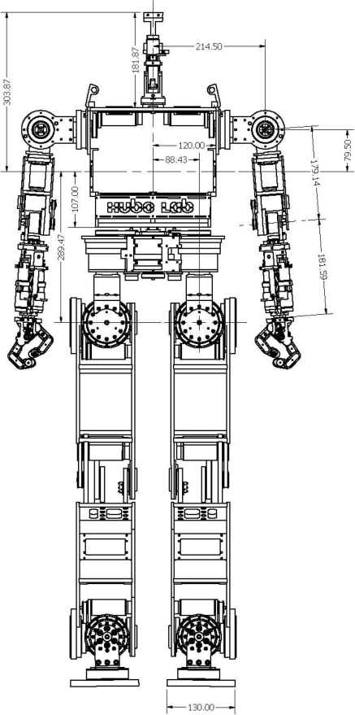
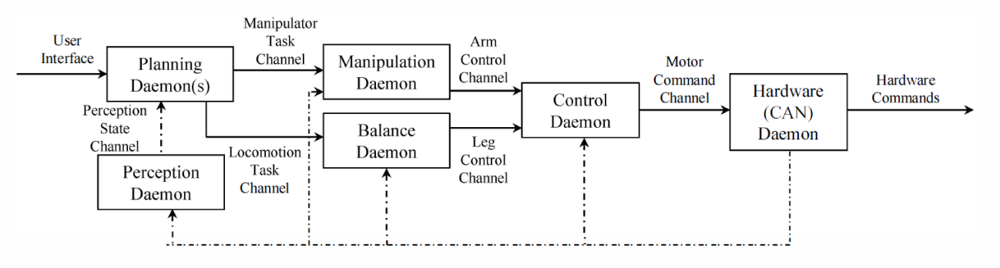
Shared Memory: ACH
Real-Time Multi-Process Robots / The ACH Library
Minimal latency is crucial for real time humanoid systems
Allows for proper priority inheritance
Prevents starvation
Publish/Subscribe or message bus interface
Muliple processes with varied priorities ensures critical processes run on time.
Figure 4: HUBO2 Platform[1]
Figure 5: Hubo2 Plus daemon communication flow chart[1].
[1] N. Dantam, D. Lofaro, A. Hereid, P. Oh, A. Ames, and M. Stilman, “The ach library: A new framework for real-time communication,” Robotics Automation Magazine, IEEE, vol. 22, no. 1, pp. 76–85, March 2015.
[4] M. Grey, N. Dantam, D. Lofaro, A. Bobick, M. Egerstedt, P. Oh, and M. Stilman, “Multi-process control software for hubo2 plus robot,” in Technologies for Practical Robot Applications (TePRA), 2013 IEEE International Conference on, April 2013, pp. 1–6.

Slide 9
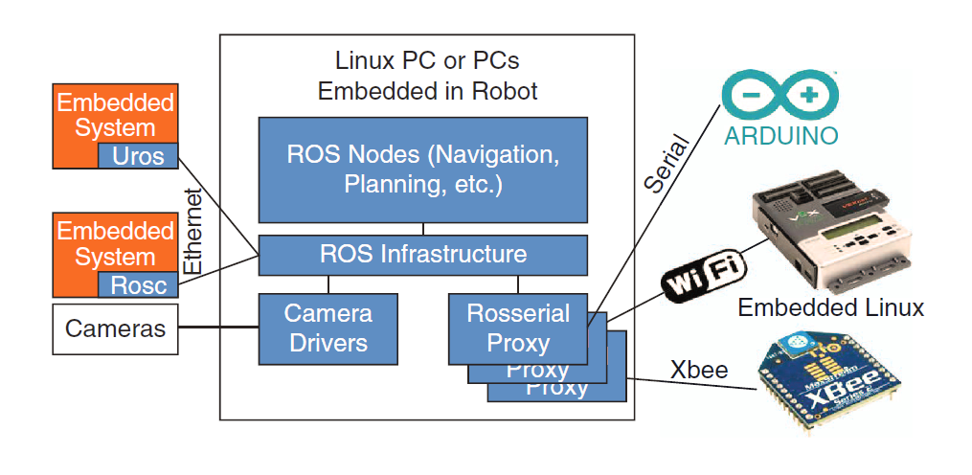
ROS
Embedded Systems
ROS cannot currently run on low level embedded systems.
Several interfaces exist for incorporating embedded systems.
Uses TCP as transport mechanism. Overhead can be detrimental to low powered systems.
Relies on communication links (Topics) and multiple processes (Nodes) to communicate between the core linux system and peripherals.
Must run a ROScore process that acts as intermediary between all nodes and topics. Can induce additional latency.
Figure 6: ROS example network diagram [3].
[3] P. Bouchier, “Embedded ros [ros topics],” Robotics Automation Magazine, IEEE, vol. 20, no. 2, pp. 17–19, June 2013.

Slide 10
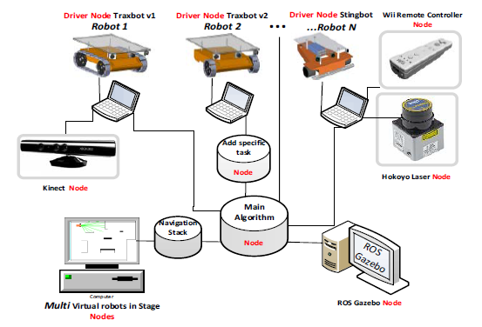
ROS
Educational Platforms for ROS
ROS excels at quickly incorporating off the shelf robots into large systems.
Large community with modular open source nodes reduces development time.
ROScore and heavy computation can be offloaded over computers defined in the ROSnetwork (TCP).
Allows for cheaper, smaller and more power efficient robots.
Ideal for educational systems
Figure 7: Network topology example with multiple robots, sensors, and tele-operation devices. All off the shelf hardware.
[12] A. Araujo, D. Portugal, M. Couceiro, and R. Rocha, “Integrating arduino-based educational mobile robots in ros,” in Autonomous Robot Systems (Robotica), 2013 13th International Conference on, April 2013, pp.
1–6.

Slide 11
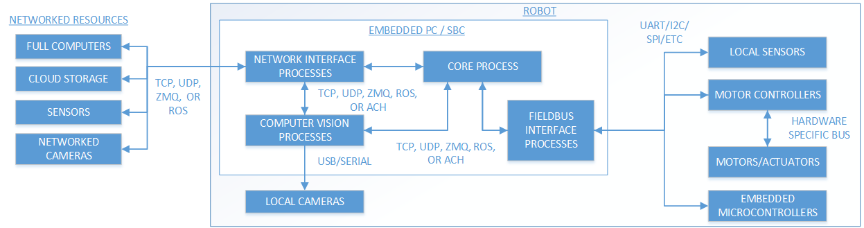
Typical System Layout
Figure 8: Typical layout of a robotic system
Modular design
Network communications
Integration of preexisting hardware
Choice software communication
Dealing with predetermined hardware communication

Slide 12
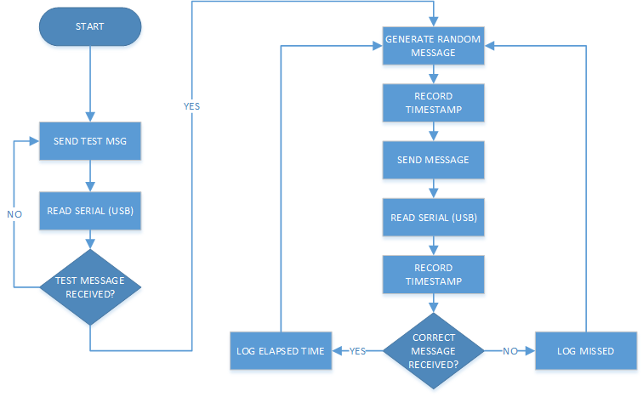
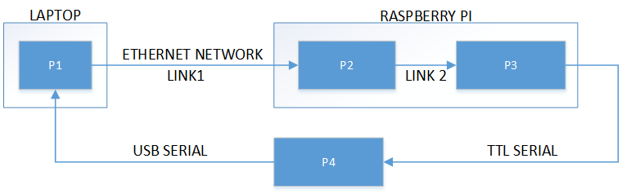
Test Setup
Single byte message
Test message eliminates handshaking from results[7].
10,000 samples
Millisecond accuracy of clock.
Figure 9: Operational flow chart of test setup.
Link 1: UDP, TCP, ZeroMQ, or ROS
Link 2: UDP, TCP, ZeroMQ, ROS, or ACH
Laptop, Raspberry Pi, OpenCM (Arduino)
Figure 10: System diagram of test setup.
[7] D. K. Cho, S. H. Chun, J. G. Ahn, Y. S. Kwon, J. H. Eom, and Y. I. Kim, “A udp-based protocol for mobile robot control over wireless internet,” in Robot Communication and Coordination, 2009. ROBOCOMM ’09. Second International Conference on, March 2009, pp. 1–4.

Slide 13
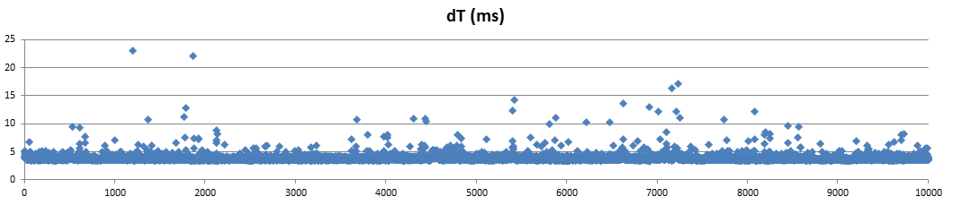
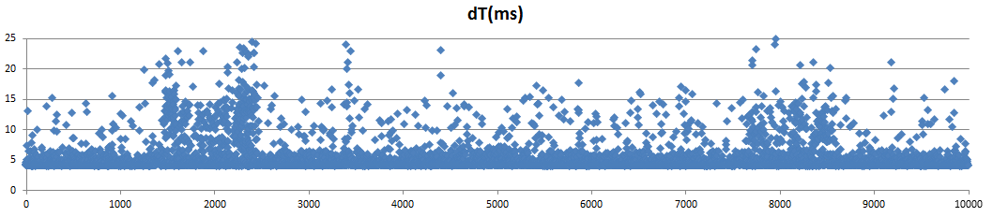
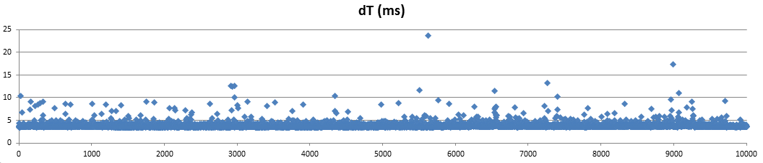
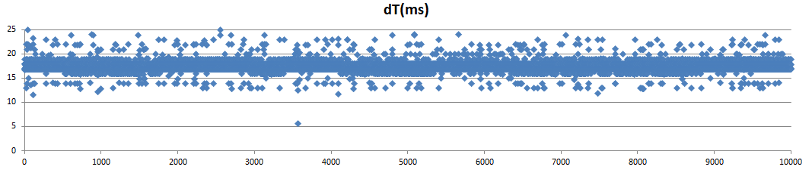
Test Results: Network Communication (Link 1)
Figure 11: UDP (Link 1 and 2) Test Results - Control
Figure 13: ZMQ (Link 1) and UDP (Link 2) Test Results
Figure 12: TCP (Link 1) and UDP (Link 2) Test Results
Figure 14: ROS (Link 1 and Link 2) Test Results
Item | UDP | TCP | ZMQ | ROS
Average (ms) | 3.834 | 3.829 | 5.285 | 13.09
Min (ms) | 3.359 | 3.399 | 3.943 | 4.860
Max (ms) | 95.063 | 42.006 | 92.746 | 706.840
Std Deviation(ms) | 1.441 | .768 | 3.639 | 12.921

Slide 14
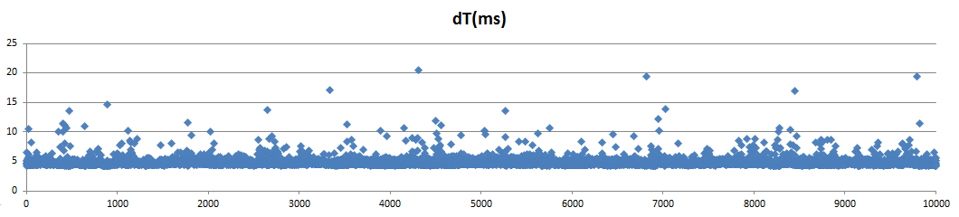
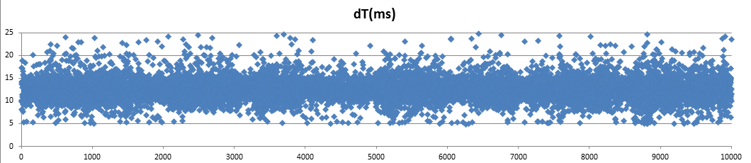
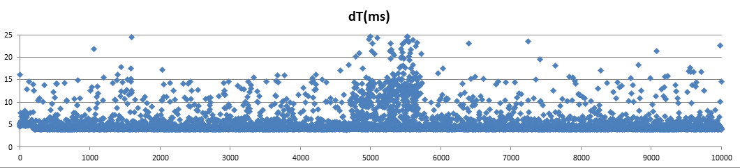
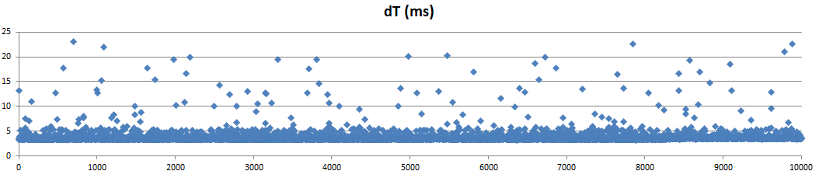
Test Results: Internal Communication (Link 2)
Figure 15: UDP (Link 1) and TCP (Link 2) Test Results
Figure 17: UDP (Link 1) and ROS (Link 2) Test Results
Figure 16: UDP (Link 1) and ZeroMQ (Link 2) Test Results.
Figure 18: UDP (Link 1) and ACH (Link 2) Test Results
Note: Control Data (UDP links 1 and 2) not repeated
Item | UDP | TCP | ZMQ | ROS | ACH
Average (ms) | 3.834 | 4.774 | 5.000 | 17.571 | 3.752
Min (ms) | 3.359 | 4.079 | 3.853 | 5.680 | 3.219
Max (ms) | 95.063 | 43.974 | 161.833 | 709.943 | 73.533
Std Deviation(ms) | 1.441 | 1.160 | 3.171 | 9.958 | 1.705

Slide 15
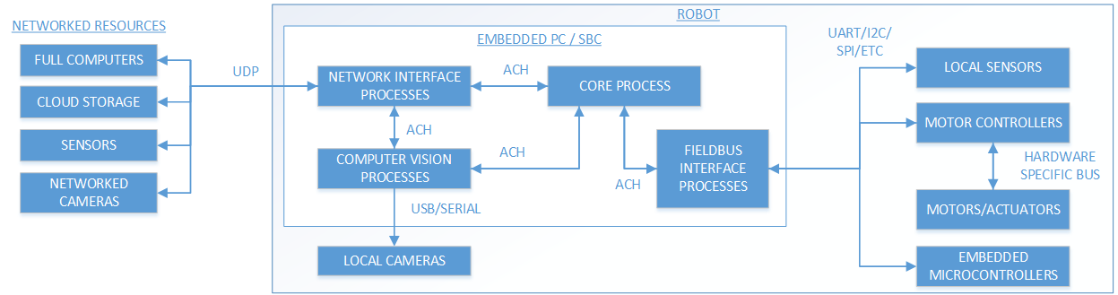

Ideal System Design
Figure 19: Ideal robotic system favoring minimal latency
Figure 20: Ideal robotic system favoring data reliability

Slide 16
References
[1] N. Dantam, D. Lofaro, A. Hereid, P. Oh, A. Ames, and M. Stilman, “The ach library: A new framework for real-time communication,” Robotics Automation Magazine, IEEE, vol. 22, no. 1, pp. 76–85, March 2015.
[2] N. Dantam and M. Stilman, “Robust and efficient communication for real-time multi-process robot software,” in Humanoid Robots (Humanoids), 2012 12th IEEE-RAS International Conference on, Nov 2012, pp. 316– 322.
[3] P. Bouchier, “Embedded ros [ros topics],” Robotics Automation Magazine, IEEE, vol. 20, no. 2, pp. 17–19, June 2013.
[4] M. Grey, N. Dantam, D. Lofaro, A. Bobick, M. Egerstedt, P. Oh, and M. Stilman, “Multi-process control software for hubo2 plus robot,” in Technologies for Practical Robot Applications (TePRA), 2013 IEEE International Conference on, April 2013, pp. 1–6.
[5] A. Shakhimardanov, N. Hochgeschwender, M. Reckhaus, and G. K. Kraetzschmar, “Analysis of software connectors in robotics,” in Intelligent Robots and Systems (IROS), 2011 IEEE/RSJ International Conference on, Sept 2011, pp. 1030–1035.
[6] J. Vella and S. Zammit, “Packet losses of multicast over 802.11n heterogeneous wireless local area network,” in Systems, Signals and Image Processing (IWSSIP), 2012 19th International Conference on,
April 2012, pp. 300–303.
[7] D. K. Cho, S. H. Chun, J. G. Ahn, Y. S. Kwon, J. H. Eom, and Y. I. Kim, “A udp-based protocol for mobile robot control over wireless internet,” in Robot Communication and Coordination, 2009. ROBOCOMM ’09. Second International Conference on, March 2009, pp. 1–4.
[8] A. Harris and J. Conrad, “Improving and designing sensors for the simulation environment for autonomous robots (sear),” in Southeastcon, 2013 Proceedings of IEEE, April 2013, pp. 1–5.
[9] M. Sstrik, “zmq: The theoretical foundation,” 250bpm, Tech. Rep., 09 2011.
[10] P. Hintjens and M. Sustrik, “Multithreaded magic with zmq,” iMatrix Corporation, Tech. Rep., 09 2010.
[11] S. Cousins, “Is ros good for robotics? [ros topics],” Robotics Automation Magazine, IEEE, vol. 19, no. 2, pp. 13–14, June 2012.
[12] A. Araujo, D. Portugal, M. Couceiro, and R. Rocha, “Integrating arduino-based educational mobile robots in ros,” in Autonomous Robot Systems (Robotica), 2013 13th International Conference on, April 2013, pp.
1–6.

