Slide 1
Cignetti Turnaround
WW25 2026

Slide 2
SUNPOWER DIRECT PROCESSES: TARGET TO FPY=100%
T Level | Stage | Process Owner/ Quality | Milesone1 | to | Milestone2 | Level 2 | Level 3 | RCCA | Latest FPY
T0 | S1 | KXW/DJF | Booking | to | Project Received | 12885 | 10848 | 147, D8 | Investigating*
T0 | S2 | SGS/DJF | Project Received | to | Layout and Upgrade Review | 12777 | 12304 | 147, D8 | Investigating*
T0 | S3 | SGS/DJF | Layout and Upgrade Review | to | Project Huddle | 12777 | 12304 |  | Investigating*
T0 | S4 | SGS/DJF | Project Huddle | to | FDC (Project Acceptance) | 12777 | 10470 | 137, D8 | 63%
T1 | S5 | SGS/DJF | Final Design Complete | to | Permit Pack Completed | 12777 | 12385 | 138, D6 | Investigating*
T1 | S6 | PXA/DJF | Permit Pack Completed | to | Request Permit | 12759 | 10823 |  | 100%
 |  | PKN/EZD |  |  | IXP1 Submission | 12649 | 12460 |  | Investigating*
T1 | S7 | PXA/DJF | Request Permit | to | Permit Approved | 12649 | 12556 |  | 100%
 |  | PKN/EZD | IXP1 Submission | to | IXP1 Approval | 12649 | 12556 | 222, D1 | 100%
T1 | S8 | SAH/DJF | Permit Approved/IXP1 Approval | to | Ready To Schedule | 12783 | 10961 |  | Investigating*
T1 | S9 | SAH/ZJW | Ready To Schedule | to | Install Scheduled | 12783 | 11819 |  | Investigating*
T1 | S10 | IPG/ZJW | Install Scheduled | to | Substantial Completion Verified | 12022 | 10496 | 188, D6 | 70%
T2 | S11 | KMM/RJG | Substantial Completion Verified | to | M2 Install Submission (Parallel) | No Spec | 12285/12430 | 228, D4 | 97%
T2 | S12 | KMM/RJG | M2 Submission | to | M2 Install Approved (Parallel) | No Spec | 12285/12430 | 228, D4 | 98%
T2 | S13 | RLJ/ZJW | Substantial Complete | to | Final Inspection Scheduled | 12807 | 11001 | 187, D3 | Investigating*
T2 | S14 | RLJ/ZJW | Final Inspection Scheduled | to | Final Inspection Verified | 12807 | 10899 | 187, D3 | 68%
T3 | S15 | PKN/EZD | Final Inspection Verified | to | Permission To Operate | 12834 | 11143 |  | Investigating*
 |  | KMM/RJG | Permission To Operate | to | M3 Activation Approved | No Spec | 12445 | 234, D3 | 100%
T3 | S16 | MBC/TGM | Permission To Operate | to | Grant PTO To Customer | 13050 | 13049 |  | Investigating*
Author: JYH/EVV/ERF, 6/16/2026
Owner: ERF
Spec: 10009
Source: 10009/N Section 5, page 14 (table)
* Salesforce Data gathering
Notes:
Add links to the spec
Put RCCA stage (D1,D2,etc etc)

Slide 3
SunPower Direct Final Design Complete FPY, WW25
Spec 10470
97%
Escalate to
SSB
SPEC 10470
RCCA 235, D1
(OPEN)
Author: EVV, 6/22/2026 Owner: SGS / BCB QA: DJF

Slide 4
SunPower Direct Final Design Complete FPY, WW25
RCCA 235. D1
(OPEN)
Spec 10470
Author: EVV, 6/22/2026 Owner: SGS / BCB QA: DJF
Specs L2: 12777 Specs L3: 10470

Slide 5
S10: SPWR Direct SCV Corporate QA Inspection, WW25
97%
Escalate to
SSB
Permit Set Mismatch, 1 Submission
RCCA188, D6 (CLOSED)
Tilt Photo,
1 Submission
RCCA188, D6 (CLOSED)
Missing Photos,
1 Submission
RCCA188, D6 (CLOSED)
Electrical Defect, 1 Submission
RCCA188, D6 (CLOSED) TRAINING – CMM-50A
Blurry Photo, Permit Set Mismatch, Electrical Defect
3 Submission
RCCA188, D6 (CLOSED)
DON'T PUT RAW SEWAGE
IN THEIR COMPUTER
CONTAINMENT
ROOT CAUSE CORRECTIVE ACTION
TRAINING
TGM-74A
ANDON CORD ACTIVATED
1/27/2026, 3PM
SSB-164A
RCCA188, D6 (OPEN)
SPEC 10496
ANDON CORD LIFTED 2/01/2026. 11:15AM Sunday
SSB-164B
Electrical Defect
6 Submission
Data Source: TGM/ZJW/EVV, 6/22/2026
SPEC: 10496, RCCA: 188, D6 * WW17, WW23: Revised the FPY Data to 100% for spec alignment.

Slide 6
SPWR Direct S10 SCV Corporate QA WW52-WW25’2026
Spec 10496
RCCA 188. D6
(CLOSED)
RCCA 195. D6
(OPEN)
RCCA 188. D6
(CLOSED)
2
1
Data Source: TGM/EVV, 6/22/2026
¹Funding Defect: AVL LightReach eligibility, PV Panel mismatch, Missing Cell kit
²Electrical Defect: Main breaker/sub-panel issues, Point of interconnection issues

Slide 7
SunPower Direct M1 Corporate QA Inspection, WW25
*
*
97%
Escalate to
SSB
SPEC 12285
ANDON CORD 1
RCCA 228
*
ROOT CAUSE CORRECTIVE ACTION
1 REJECT
ELECTRICAL ISSUE
(DESIGN)
CONTAINMENT
4 REJECTS. RCCA 228, D6 (OPEN)
ADDITIONAL TRAINING
SPEC 12285, REV N UPDATE
INSPECTION UPSTREAM
REQUIRED FOR DESIGN AND FIELD
SPEC 12285
ANDON CORD
RCCA 228, D6 (OPEN)
TRAINING
Author: RJG/EVV, 6/20/2026
Owner: KMM/AEP
* Additional Quality Staff Deployed and checked before submission to Corporate QA
WW24: FIELD, PCS Bundling, CT Issue, FUNDING CSLB Disclosure, Production Modelling. Decoder 2 KMM and 2 RYW
WW25: DESIGN: Electrical Issue. Decoder 1 RYW
Notes:
Update to 25.1

Slide 8
SunPower Direct M1 Corporate QA Inspection, WW25.5
*
*
97%
Escalate to
SSB
SPEC 12285
ANDON CORD 1
RCCA 228
*
CONTAINMENT
ROOT CAUSE CORRECTIVE ACTION
4 REJECTS. RCCA 228, D6 (OPEN)
ADDITIONAL TRAINING
SPEC 12285, REV N UPDATE
INSPECTION UPSTREAM
FOR DESIGN AND FIELD
1 REJECT
ELECTRICAL ISSUE
(DESIGN)
SPEC 12285
ANDON CORD
RCCA 228, D6 (OPEN)
TRAINING
Author: RJG/EVV, 6/20/2026
Owner: KMM/AEP
* Additional Quality Staff Deployed and checked before submission to Corporate QA
WW24: FIELD, PCS Bundling, CT Issue, FUNDING CSLB Disclosure, Production Modelling. Decoder 2 KMM and 2 RYW
WW25: DESIGN: Electrical Issue. Decoder 1 RYW
Notes:
Update to 25.1

Slide 9
SunPower Direct M1 Corporate QA Inspection, WW24-WW25
RCCA 228. D6
(OPEN)
Spec 12285
Author: RJG/EVV, 6/22/2026
Owner: KMM QA: RJG
* Additional Quality Staff Deployed and checked before submission to Corporate QA (from 21.2TD)
WW24: FIELD, PCS Bundling, CT Issue, FUNDING CSLB Disclosure, Production Modelling. Decoder 2 KMM and 2 RYW
WW25: DESIGN: Electrical Issue. Decoder 1 RYW

Slide 10
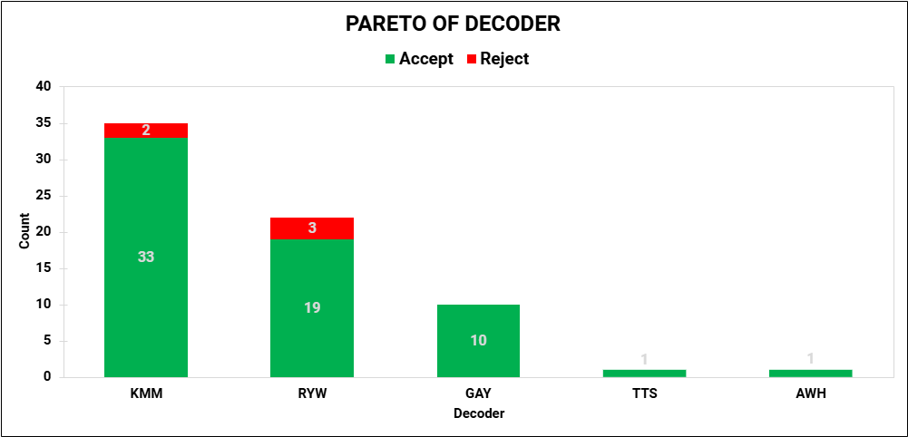
SunPower Direct M1 Corporate QA Inspection, WW24-WW25
RCCA 228. D6
(OPEN)
Spec 12285
Author: RJG/EVV, 6/22/2026
Owner: KMM/AEP

Slide 11
SunPower Direct M1 Corporate QA Inspection, WW19-WW25
RCCA 228. D6
(OPEN)
Spec 12285
Author: RJG/EVV, 6/22/2026
Owner: KMM QA: RJG
* Additional Quality Staff Deployed and checked before submission to Corporate QA (from 21.2TD)

Slide 12
SunPower Direct M1 Corporate QA Inspection, WW19-WW25
RCCA 228. D6
(OPEN)
Spec 12285
Author: RJG/EVV, 6/22/2026
Owner: KMM/AEP
* Additional Quality Staff Deployed and checked before submission to Corporate QA (from 21.2TD)

Slide 13
S14: SPWR Direct Final Inspection Verified FPY, WW18-WW25
97%
Escalation
to SSB
*
SPEC 12807
RCCA 187, D3
(OPEN)
**
Data Source: Salesforce/EVV, 6/22/2026 Owner: RLJ QA: TGM, ZJW
* ANDON CORD FOCUSED ON CREW FROM IL & MI – ZJW-30A
* WW20-24 Data Under Validation with RLJ (FIV Team)

Slide 14
SPWR Direct S14 Final Inspection Verified Pareto, WW18-WW25
RCCA 187, D3 (OPEN)
Spec 12807
SUBCATEGORY
1- Uncategorized: Attribution for review and category validation
2-AHJ: City or County Requirements
3-ELECTRICAL TECH (ET): Human Error
4-DESIGN: Incorrect Design, AB Design Process
5-INSPECTION: Schedule confirmation, Missing or incomplete required documentation
6-CUSTOMER
1
2
3
4
5
6
Data Source: Salesforce/EVV, 6/22/2026 Owner: RLJ QA Support: ZJW, TGM
* WW20-25 Data Under Validation with RLJ (FIV Team)

Slide 15
SPWR Direct S14 Final Inspection Verified Pareto, WW18-WW25
2ND LEVEL PARETO BY CREW
Data Source: Salesforce/EVV, 6/22/2026 Owner: RLJ QA Support: TGM, ZJW

Slide 16
SPWR Direct S14 Final Inspection Verified Pareto, WW11-WW18
BASELINE
Data Source: Salesforce/EVV, 5/11/2026 Owner: RLJ QA Support: TGM, ZJW MEMO ZJW-30A

Slide 17
SunPower Direct M2 Corporate QA Inspection, WW25
THIS IS CANDIDATE FOR ANDON CORD
97%
Escalate to
SSB
SPEC 12445
RCCA 234, D3
(OPEN)
Author: RJG/EVV, 6/20/2026
Owner: KMM/AEP
Spec: 12445

Slide 18
SunPower Direct M2 Corporate QA Inspection, WW25.5
THIS IS CANDIDATE FOR ANDON CORD
97%
Escalate to
SSB
SPEC 12445
RCCA 234, D3
(OPEN)
Author: RJG/EVV, 6/20/2026
Owner: KMM/AEP
Spec: 12445

Slide 19
SunPower Direct M2 Corporate QA Inspection, WW24-WW25
RCCA 234. D1
(OPEN)
Spec 12445
Incorrect Shine Disclosure (FUNDING)
Author: RJG/EVV, 6/22/2026
Owner: KMM/AEP

Slide 20
SunPower Direct M2 Corporate QA Inspection, WW24-WW25
RCCA 234. D3
(OPEN)
Spec 12445
Author: RJG/EVV, 6/22/2026
Owner: KMM/AEP
TGH – Tyson Hunter, LTD – Leo Miguel De Perio

Slide 21
SunPower Direct M2 Corporate QA Inspection, WW19-WW25
RCCA 234. D3
(OPEN)
Spec 12445
2 – Request new Shine Disclosure (FUNDING)
2 – Incorrect Shine Disclosure (FUNDING)
Author: RJG/EVV, 6/22/2026
Owner: KMM/AEP

Slide 22
SunPower Direct M2 Corporate QA Inspection, WW19-WW25
RCCA 234. D3
(OPEN)
Spec 12445
Author: RJG/EVV, 6/22/2026
Owner: KMM/AEP
TGH – Tyson Hunter, LTD – Leo Miguel De Perio
JDH – James Hampton, PXB – Pallavi Bhasker

Slide 23
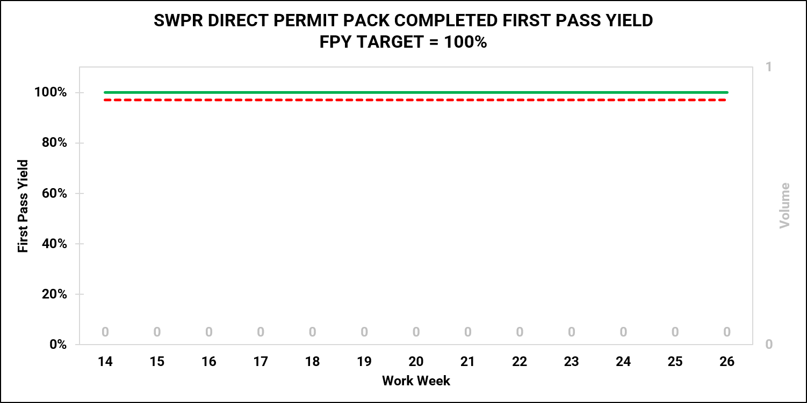
S5: SPWR Direct Permit Pack Complete QA FPY
97%
Escalation
to SSB
RE-INTORDUCE PERMIT PACK QA
REVISE PERMIT PACK QA TO REFLECT THE CORRECT PROCESS
TRAIN AND DEPLOY PERMIT PACK QA TO DESIGN TEAM
QUALITY AUDITS AGAINST THE SPEC
REVIVE THE FPY OF ENPHASE DESIGN
Author: EVV, 6/16/2026
Owner: SGS/BCB QA: DJF
Specs L2: 12777 Specs L4: 12385

Slide 24
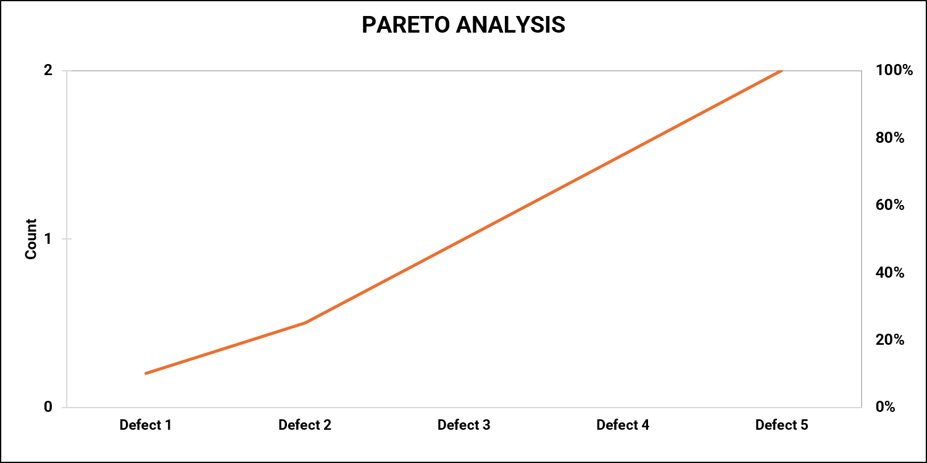
S5: SPWR Direct Permit Pack QA Pareto
Spec 12385
START WITH DESIGN DEFECTS FOR Q2 FROM FUNDING (M1 & M2)
PULL DATA FROM SALESFORCE BASED ON LAYOUT AND UPGRADE REVIEW
Author: EVV, 6/16/2026 Owner: SGS/BCB QA: DJF
Specs L2: 12777 Specs L4: 12385

Slide 25
NEW HOMES PROCESSES: TARGET TO FPY=100%
T Level | Stage | Process Owner/Quality | Milestone1 | to | Milestone2 | Level 2 | Level 3 | RCCA | LATEST FPY
T0 | C1 | SFA/RJG | Community Lead | to | Community Bid Request | 12321 | 10508 | 145, D6 | Investigating*
T0 | C2 | SFA/RJG | Community Bid Request | to | Community Bid Review | 12321 | 12507 |  | Investigating*
T0 | C3 | SFA/RJG | Community Bid Review | to | Community Award | 12321 | 12507 |  | Investigating*
T0 | C4 | MTO/TGM | Community Award | to | Final Design Approved | 11227 | 11463 |  | 100%
T0 | C5 | MQT/TGM | Final Design Approved | to | Production Trench | 13051 | 12507 |  | Investigating*
T1 | L6 | RIH/TGM | Production Trench | to | Lot Design Requested | 13044 | 10549 | 154, D8 | Investigating*
T1 | L7 | MTO/TGM | Lot Design Requested | to | Lot Design Completed | 11229 | 11466 | 154, D8 | 100% (WW21)
T1 | L8 | JMN/ZJW | Lot Design Completed | to | Lot Permit Approved | 11287 | 10506 | 150, D6 | Investigating*
T1 | L9 | RIH/ZJW | Lot Permit Approved | to | Rough Wire | 13044 | 10791 |  | Investigating*
T2 | L10 | RIH/TGM | Rough Wire | to | Install | 13044 | 10790 |  | Investigating*
T2 | L11 | ROS/TGM | Installation | to | Job Close Out (JCO) | 12752 | 10790 | 161, D6 | 100% (QC)
T3 | L12 | RIH/ZJW | Job Close Out (JCO) | to | Final Permit Approved | 13044 | 12327 |  | Investigating*
T4 | L13 | LKR/EZD | Final Permit Approved | to | Permission To Operate (PTO) | 12281 | 10853 | 148, D6 | 100% (CQA)
T5 | L14 | KAM/EZD/TGM | Permission To Operate (PTO) | to | Activation | 13058 | 12152 |  | Investigating*
T0 | C15 | RIH/EZD | Model Trench | to | Community Install Complete (Parallel) | 13044 | 11971 |  | Investigating*
T1 | L16P | LMR/RJG | Opportunity appt. confirmed | to | HO Contract Signed (Parallel) | 13037 | 10782 |  | Investigating*
T1 | L17P | PPV/RJG | HO Contract Signed | to | Escrow date (Parallel) | 13066 | 10670 |  | Investigating*
T2 | L18P | PPV/RJG | Job Close Out (JCO) | to | Escrow date (Parallel) | 13066 | 10670 | 148, D6 | Investigating*
T2 | L19P | LMR/RJG | Escrow date | to | TPO Contract Signed (Parallel) | 13037 | 12477 |  | Investigating*
T4 | L20P | AEP/RJG | TPO Contract Signed | to | M1 -Installation (Financier Approval) (Parallel) | 12752 | 10724 | 228, D4 | 100% (CQA)
T4 | L21P | AEP/RJG | M1 | to | M2 -Activation (Financier Approval) (Parallel) | 12752 | 10808 | 224, D6 | 100% (CQA)
Author: JYH/EVV/ERF, 5/30/2026
Owner: ERF
Spec: 10009
* Salesforce Data gathering
1 – PREVIOUS WEEK
2 – MONTHLY CADENCE
3 – ALBATROSS DATA ONLY
4 – PENDING SIGNOFF
5 – SPEC FOR UPDATE

