Slide 1

Solar PV Potential
India | 1000 m² roof × 80% coverage → 80.00 kWp system

Slide 2
Assumptions & Analysis Parameters
Default Conditions & Selected Parameters
Analysis Period
• Date Range: 01 Jan to 31 Dec
• Hour Range: 00:00 to 23:00
Solar PV Assumptions
• Country / Location: India
• Total Roof Size: 1000 m²
• Solar Coverage: 80% of roof area
• Effective PV Area: 800.0 m² → System Size: 80.00 kWp (10 m² = 1 kWp)
• Data Source: World Bank Global Solar Atlas 2.0 / SolarGIS PVOUT Level 1
• Values represent long-term monthly average specific yield (kWh/kWp.day)

Slide 3
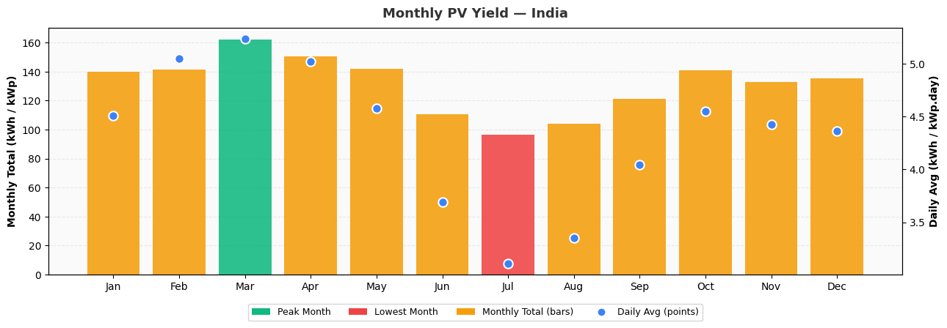
Solar PV Yield — India (Per kWp Reference)
Annual Yield
Annual Daily Average
Peak Month Total
Peak Day Average
1,577
4.32
162
5.23
kWh / kWp
kWh / kWp.day
kWh/kWp · Mar
kWh/kWp.d · Mar

Slide 4
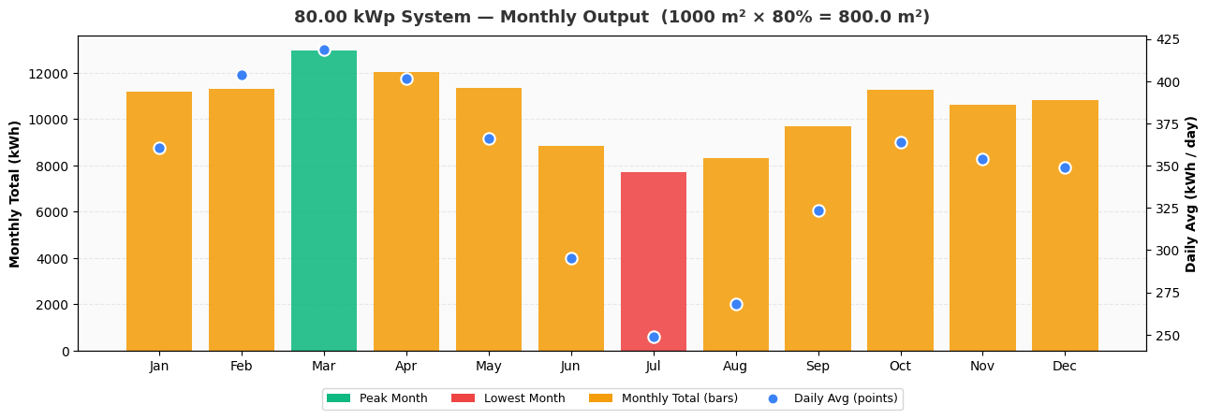
Solar PV System Yield — India (80.00 kWp)
Annual Yield (System)
Annual Daily Average
Peak Month Output
Peak Day Output
126,189
345.8
12,982
418.8
kWh / year
kWh / day
kWh · Mar
kWh/d · Mar

Slide 5
Annexure
About EDS
Environmental Design Solutions [EDS] is a sustainability advisory firm. Since 2002, EDS has worked on over 500 green building and energy efficiency projects worldwide. The team focuses on climate change mitigation, low-carbon design, building simulation, performance audits, and capacity building. EDS continues to contribute to the buildings community with useful tools through its IT services.
Disclaimer
Climate Zone Analyser is an outcome of the best efforts of building simulation experts at EDS.
• EDS does not assume responsibility for outcomes from its use. By using this Application, the User indemnifies EDS against any damages.
• EDS does not guarantee uninterrupted availability. By using this Application, the User agrees to share uploaded information with EDS for analysis and research purposes.
• Open-source resources used: Clima - Berkley, Streamlit, Python
• EDS is not liable to inform Users about updates to the Application or underlying resources
Acknowledgement
• Betti, G., et al. CBE Clima Tool Build. Simul. (2023). https://doi.org/10.1007/s12273-023-1090-5
• Streamlit, © Streamlit Inc., licensed under Apache 2.0
• Python © Python Software Foundation, licensed under PSF License Version 2

