Slide 1
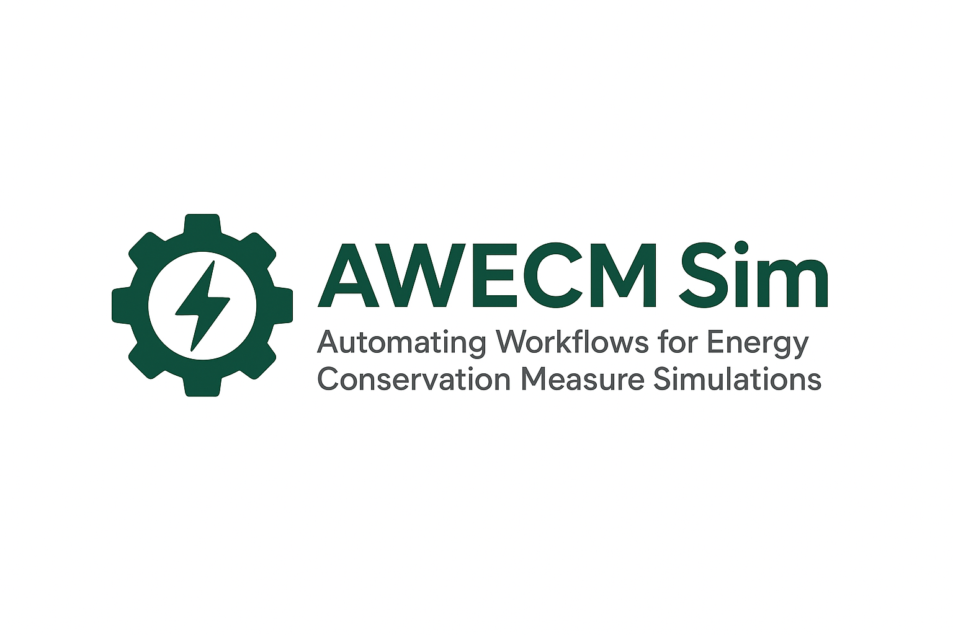

Awecm Sim
Automating Workflows for Energy Conservation Measure Simulations
Environmental Design Solutions Private Limited

Slide 2
Environmental Design Solutions Private Limited

Slide 3
Environmental Design Solutions Private Limited

Slide 4
Environmental Design Solutions Private Limited

Slide 5
Environmental Design Solutions Private Limited

Slide 6
Disclaimer
This report has been prepared solely for the intended recipient and is based on the data, assumptions, and methodologies available at the time of analysis. Environmental Design Solution Private Limited (EDS) does not guarantee the completeness or accuracy of external data sources.
The results, findings, and recommendations presented in this document are for informational and simulation purposes only and should not be interpreted as legal, financial, or design advice.
EDS shall not be held liable for any direct or indirect damages arising from the use or interpretation of this report. Users are responsible for independently verifying any information before making decisions.
Environmental Design Solutions Private Limited

Slide 7
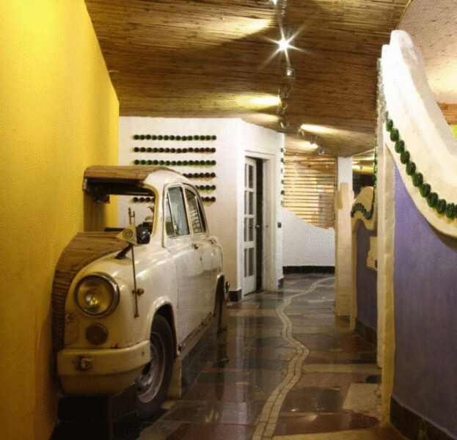
About EDS
Environmental Design Solutions (EDS) is a sustainability advisory firm established in 2002, specializing in green buildings, energy efficiency, and climate policy. EDS has completed 800+ projects globally and supports both policy-level development (e.g., ECBC, building codes, labeling programs) and building-level energy simulation and certification. Our expertise includes data analysis, benchmarking, GHG impact assessment, strategy consulting, and capacity building to promote sustainable built environments.
Environmental Design Solutions Private Limited

