Slide 1

Guest Lecture
Bodo Linz
02/11/20
Comparative genomics of Bordetella

Slide 2
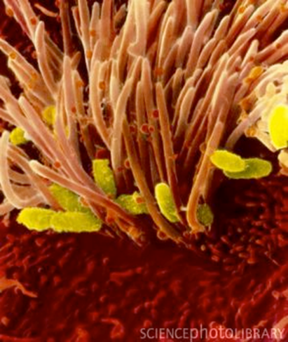
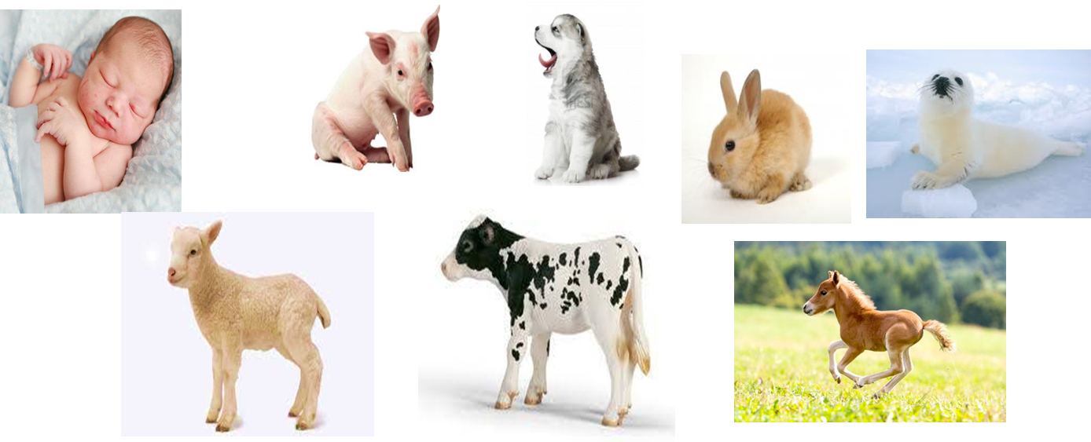
The Bordetellae
Beta-Proteobacteria
Include the classical bordetellae:
B. bronchiseptica
B. parapertussis
B. pertussis

Slide 3
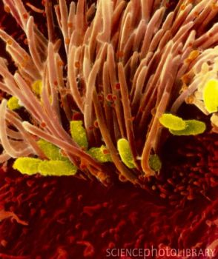
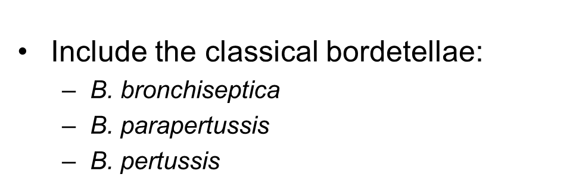
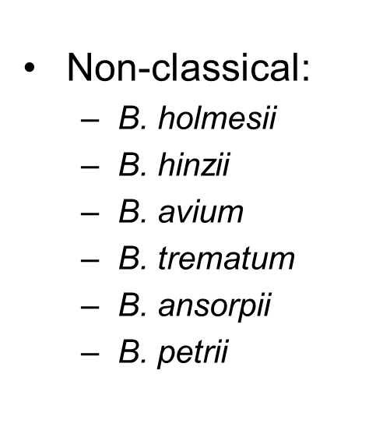
The Bordetellae
respiratory pathogens in animals and
in immuno-compromized humans
wound and ear infection in humans
environmental / ear infection in humans
+ several other recently described species

Slide 4
Neighbor-joining trees of 16S rRNA gene sequences and
8 concatenated ATP synthase proteins from Bordetella
A) 16S rRNA
B. bronchiseptica
classical bordetellae
B. parapertussis
B. pertussis
B. hinzii
B. holmesii
B. trematum
B. petrii
B. avium
B. ansorpii
Burkholderia
0.01
B) ATP synthase
B. holmesii
B. hinzii
B. avium
B. pertussis
B. trematum
B. bronchiseptica
classical bordetellae
B. parapertussis
B. petrii
Ralstonia
B. ansorpii
Burkholderia
0.05

Slide 5
128 Bordetella genomes
95 classical bordetellae:
58 B. bronchiseptica
2 B. parapertussis
34 B. pertussis
respiratory pathogens in
animals and humans
34 non-classical bordetellae:
18 B. holmesii
6 B. hinzii
1 B. avium
4 B. trematum
2 B. ansorpii
3 B. petrii
respiratory pathogens in animals and
in immuno-compromized humans
wound and ear infection in humans
environmental / ear infection in humans

Slide 6
questions
virulence-associated factors determining host specificity?
virulence-associated factors determining disease outcome?

Slide 7
Approach
genome-wide SNP-based phylogenetic tree
genome-wide presence/absence of genes
similar evolutionary trends?
Pairwise genome comparisons (ACT)
(Artemis Comparison Tool)
mapping of virulence-associated genes
Principle Components Analysis (PCA)
ACT: https://www.sanger.ac.uk/science/tools/artemis-comparison-tool-act

Slide 8
Approach
next
week’s
lecture
genome-wide SNP-based phylogenetic tree
align genomes
align short reads against reference genome
call SNPs
generate consensus sequence
alignment of multiple genomes
generate phylogenetic tree

Slide 9
Approach
data format: Sequence alignment in rows
Name SEQUENCE
SAMPLE01C CGTTGCTGGCCGGATTTGCGCAGCAGGCGCGCGATCTCGTGGTCGTGCGCATTGACGCCCGCCCGCGCATCGACCAGGAACACCAC
SAMPLE02A CGCTGCTGGCCGGATTTGCGCAGCAGGCGCGCGATCTCGTGGTCGTGCGCATTGACGCCCGCCCGCGCATCGACCAGGAACACCAC
SAMPLE03T CGCTGCTGGCCGGACTTGCGCAGCAGGCGCGCGATCTCGTGGTCGTGCGCATTGACGCCCGCCCGCGCATCGACCAGGAACACCAC
SAMPLE-04 CGCTGCTGGCCAGATTTACGGAGC----------TTTCGTGGTCGTGCGCGTTGACGCCGGCGCGCGCGTCGACCAGGAACACCAC
SAMPLE05G CGCTGCTGGCCGGATTTGCGCAGCAGGCGGGCGATTTCGTGGTCGTGCGCGTTGATGCCGGCACGGGCATCGACCAGGAACACGAC
SAMPLE06 CGCTGCTGGCCGGACTTGCGCAGCAGGCGGGCGATCTCGTGGTCATGCGCGTTGATCCCCGCCCGCGCGTCGACCAGGAAGACCAC
SAMPLE-7A CGCTGCTGACCGGACTTACGCAG---------------------------------------------------------------
SAMPLE08B CGCTGCTGGCCGGACTTGCGCAACAAGCGGGCGAT-----------------------CGGCCCGGGCGTCGACCAGGAACACCAC
SAMPLE09 CGCTGCTGCCCGGACTTGCGCAACAGGCGGGCGAT--------------------------------------------ACACCAC
Data format: 1 reference genome (5.3 MB), all other genomes aligned against it
Problem: missing data (dashes)
- gene not present
- gene so divergent that the sequence did not align
- multiple copies of a gene
Solution: remove all positions with missing data in any of the genomes

Slide 10
Approach
data format: Sequence alignment in rows
Name SEQUENCE
$1 $2 $1 = field 1; $2 = field 2
SAMPLE01C CGTTGCTGGCCGGATTTGCGCAGCAGGCGCGCGATCTCGTGGTCGTGCGCATTGACGCCCGCCCGCGCATCGACCAGGAACACCAC
SAMPLE-04 CGCTGCTGGCCAGATTTACGGAGC----------TTTCGTGGTCGTGCGCGTTGACGCCGGCGCGCGCGTCGACCAGGAACACCAC
SAMPLE05G CGCTGCTGGCCGGATTTGCGCAGCAGGCGGGCGATTTCGTGGTCGTGCGCGTTGATGCCGGCACGGGCATCGACCAGGAACACGAC
SAMPLE-7A CGCTGCTGACCGGACTTACGCAG---------------------------------------------------------------
awk: change strain names to lower case and replace '-' by '_'
- python: replace nucleotides by nucleotides plus tab
awk: remove extra tab at the end of each line
python: transpose rows to columns
awk: select only core loci
grep | wc: determine the number of loci in the resulting file
python: replace nucleotides by numbers
R: calculate matrix
python: transpose columns to rows
awk: add extra tab at the end of each line
python: replace nucleotides plus tab by nucleotides

Slide 11
Approach
data format: Sequence alignment in rows
Name SEQUENCE
$1 $2 $1 = field 1; $2 = field 2
SAMPLE01C CGTTGCTGGCCGGATTTGCGCAGCAGGCGCGCGATCTCGTGGTCGTGCGCATTGACGCCCGCCCGCGCATCGACCAGGAACACCAC
SAMPLE-04 CGCTGCTGGCCAGATTTACGGAGC----------TTTCGTGGTCGTGCGCGTTGACGCCGGCGCGCGCGTCGACCAGGAACACCAC
SAMPLE05G CGCTGCTGGCCGGATTTGCGCAGCAGGCGGGCGATTTCGTGGTCGTGCGCGTTGATGCCGGCACGGGCATCGACCAGGAACACGAC
SAMPLE-7A CGCTGCTGACCGGACTTACGCAG---------------------------------------------------------------
need to manipulate nucleotide sequence in all rows
problem: same letters in sequence names
solution: sequence name lower case, sequence upper case,
dashes in names as underline
awk: change strain names to lower case and replace '-' by '_'
MAKE THE SCRIPT USER FRIENDLY!!!
- write instructions to yourself
- let the computer display what it’s currently doing

Slide 12
awk: change strain names to lower case and replace '-' by '_‘
#!/bin/bash
# PhyGenome_Align_remove_missing_data.sh
# remove variably present loci, keep only core loci
# enter file names as needed
FILESNP="128genomes.phy"
NAMESNP=${FILESNP%%".phy"}
echo ""
echo "loading input file $NAMESNP"
echo ""
echo "awk: change strain names to lower case and '-' to '_'"
echo "-----------------------------------------------------"
# make sequence name lower case
cat $FILESNP | awk -v FS="\t" -v OFS="\t" '{$1=tolower($1); print $0}' > fake
Let’s go through this command →
write instructions to yourself
you can either define the input file once or enter it again and again throughout the script
echo “ ” - let the computer display to the user what it is currently doing

Slide 13
awk: change strain names to lower case and replace '-' by '_‘
# make sequence name lower case
cat $FILESNP | awk -v FS="\t" -v OFS="\t" '{$1=tolower($1); print $0}' > fake
# cat – concatenate
# open 1 file, open and combine (=concatenate) several files
# | pipe - string several commands together into a pipeline
# - input from memory, output into memory
# FS="\t" – Field Separator is tab: $1 $2
# OFS="\t" – Output Field Separator is tab
# '{}' – what to do
# $1=tolower($1) – new field $1 is lower case of current $1
# print $0 – print all fields
# > save as

Slide 14
awk: change strain names to lower case and replace '-' by '_‘
# make sequence name lower case
cat $FILESNP | awk -v FS="\t" -v OFS="\t" '{$1=tolower($1); print $0}' > fake
# replace (substitute) "-" to "_" in strain names
cat $FILESNP | awk -v FS="\t" -v OFS="\t" '{gsub(/-/,"_",$1); print $0}' > fake
# Why "gsub" and not "sub"? assume strain name: M1989-03-14
awk '{sub(/-/"_",$1);print $0}'
# replaces only 1st instance: M1989_03-14
awk '{gsub(/-/,"_",$1);print $0}'
# replaces ALL instances in a line: M1989_03_14

Slide 15
awk: change strain names to lower case and replace '-' by '_‘
# make sequence name lower case
cat $FILESNP | awk -v FS="\t" -v OFS="\t" '{$1=tolower($1); print $0}' > fake
# replace (substitute) "-" to "_" in strain names
cat $FILESNP | awk -v FS="\t" -v OFS="\t" '{gsub(/-/,"_",$1); print $0}' > fake
Let’s pipe it:
# replace "-" to "_" in strain names and lower case
cat $FILESNP | awk -v FS="\t" -v OFS="\t" '{$1=tolower($1); print $0}' | awk -v FS="\t" -v OFS="\t" '{gsub(/-/,"_",$1); print $0}' > fake
SAMPLE01C CGTTGCTGGCCGGATTTGCGCAGCAGGCGCGCGATCTCGTGGTCGTGCGCATTGACGCCCGCCCGCGCATCGACCAGGAACACCAC
SAMPLE-04 CGCTGCTGGCCAGATTTACGGAGC----------TTTCGTGGTCGTGCGCGTTGACGCCGGCGCGCGCGTCGACCAGGAACACCAC
sample01c CGTTGCTGGCCGGATTTGCGCAGCAGGCGCGCGATCTCGTGGTCGTGCGCATTGACGCCCGCCCGCGCATCGACCAGGAACACCAC
sample_04 CGCTGCTGGCCAGATTTACGGAGC----------TTTCGTGGTCGTGCGCGTTGACGCCGGCGCGCGCGTCGACCAGGAACACCAC

Slide 16
python: change nucleotides to nucleotides plus tab
# insert tab after each nucleotide to get independent loci, input_file "fake", output_file "fake2"
echo ""
echo "python: replace nucleotides by numbers plus tab"
echo "-----------------------------------------------------"
python2.6 ../../bin/replace_nucs_to_nucsplustab_in_file.py
# call python v2.6 # where is the script
sample01c CGTTGCTGG...
sample_04 CGCTGCTGG...
sample01c C G T T G C T G G
sample_04 C G C T G C T G G

Slide 17
Python script: replace_nucs_to_nucsplustab_in_file.py
#!/usr/bin/env python
input = open('fake', "r")
output = open('fake2', "w")
stext1 = 'A' rtext1 = 'A\t'
stext2 = 'C' rtext2 = 'C\t'
stext3 = 'G' rtext3 = 'G\t'
stext4 = 'T' rtext4 = 'T\t'
stext5 = '-' rtext5 = 'Z\t'
stext6 = 'N' rtext6 = 'Z\t'
output.write(input.read().replace(stext1, rtext1).replace(stext2, rtext2).replace(stext3, rtext3).replace(stext4, rtext4).replace(stext5, rtext5).replace(stext6, rtext6))
# why Z? Any letter not A C G T or N will do
(or not IUPAC depending on what you wanna do)

Slide 18
awk: remove extra tab at the end of the line
# remove extra tab at the end of each line
echo ""
echo "awk: remove extra tab at the end of each line"
echo "----------------------------------------------------"
cat fake2 | awk -v FS="\t" -v OFS="\t" '{sub(/[ \t]+$/, ""); print $0}' > fake3
- python: transpose rows to columns
# transform rows to columns
echo ""
echo "python: transpose rows to columns"
echo "----------------------------------------------------"
cat fake3 | python2.6 ../../bin/rows2columns_transposition.py > fake4
# This time we pipe python. Input from memory, output to memory.

Slide 19
Python script: rows2columns_transposition.py
#!/usr/bin/env python
"""
rows_to_colums_transposition.py
input(sys.stdin) : A file with strains and tab separated loci in rows
output (sys.stdout): A file with strains and loci in columns
"""
import sys
for c in zip(*(l.strip().split() for l in sys.stdin.readlines() if l.strip())):
print('\t'.join(c))

Slide 20
awk: select core loci (no missing data)
The story so far:
- we renamed $1 to lower case and changed “–” to “_”
- we replaced missing data (“-”, “N”) with “Z”
- we transposed rows to columns
sample1c sample_04 sample05g sample_7a
A G A A
A G T T
A G Z Z
C C C T
# select only rows that do not contain "Z" (=core loci only)
echo ""
echo "selecting core loci"
cat fake4 | grep -v "Z" > fake5
cat fake5 > fake5_$NAMESNP.txt
# grep – global regular expression print – (“grab”)
# -v --invert-match (select all lines that do not contain Z)

Slide 21
awk: select core loci (no missing data)
The story so far:
- we renamed $1 to lower case and changed “–” to “_”
- we replaced missing data (“-”, “N”) with “Z”
- we transposed rows to columns
- we selected core loci
sample1c sample_04 sample05g sample_7a
A G A A
A G T T
C C C T
How many loci did we end up with?
# determine the number of loci in the resulting file
cat fake5 | grep -v s | wc -l > fake5a
echo "The dataset from file '$NAMESNP' consists of $(cat fake5a) core loci. "
# grep -v s – select all lines that do not contain “s”
# wc -l – word count, count the number of lines (-l)
# cat fake5a – open file fake5a, which is just a number

Slide 22
awk: select core loci (no missing data)
The story so far:
- we renamed $1 to lower case and changed “–” to “_”
- we replaced missing data (“-”, “N”) with “Z”
- we transposed rows to columns
- we selected core loci
sample1c sample_04 sample05g sample_7a
A G A A
A G T T
C C C T
How many loci did we end up with?
# determine the number of loci in the resulting file
# grep -v s – requires a common character (“s”)in all names
# alternatively:
cat fake5 | awk 'NR>1' | wc -l > fake5a
# awk 'NR>1' – select all lines (=rows) after the first

Slide 23
python: replace nucs by numbers (fake5 > fake6)
as before (stext and rtext)
- python: transpose columns to rows
# transform columns to rows
echo "python: transpose columns to rows"
echo "----------------------------------------------------"
cat fake6 | python2.6 ../../bin/rows2columns_transposition.py > fake7
cat fake7 | awk ‘{print $0”\t”}’ > fake 8
cat fake8 | python2.6 ../../bin/replace_nucs_plus_tab_by_nucs.py > fake9
awk: add extra tab at the end of each line
python: replace nucleotides plus tab by nucleotides

Slide 24
write final output file
echo ""
echo "awk: writing output file"
echo "----------------------------------------------------"
cat fake9 | awk -v FS="\t" -v OFS="\t" '{print $1,$2}' > $NAMESNP-no-gaps.phy

Slide 25
R: Calculate Distance matrix
echo "R: Calculate Distance matrix."
echo "-----------------------------------------------------"
# Run R in '--slave' mode to incorporate in bash script
R --slave -f Dist_mat_Genomes.R
R:
another scripting language
awesome for calculations
syntax different from bash or python

Slide 26
Syntax: R vs Python
R: read file
a <-read.table(“fake6”, header=TRUE, sep=“\t”)
Python: read file
input = open('fake6', "r")
R: transpose rows to columns
y = t(x)
Python: transpose rows to columns
for c in zip(*(l.strip().split() for l in sys.stdin.readlines() if l.strip())):
print('\t'.join(c))
R: write file
write.table(m5, file = “SEQ1.dist”, sep = “\t”, row.names = FALSE, column.names = FALSE)
Python: write file
output = open('fake7', "w")

Slide 27
R: Calculate Distance matrices of SNPs and Genes
#!usr/bin/R
#delete all objects
rm(list = ls())
#load packages
library(ade4)
library(MASS)
a <-read.table(“fake6”, header=TRUE, sep=“\t”) ## load data
x = t(a) ## transform data to genomes by row and SNPs by col
SEQ1.dist <- as.dist(dist(x, “manhattan”)) ## calc matrix
m5 <- as.matrix(SEQ1.dist) ## write as matrix
write.table(m5, file = “SEQ1.dist”, sep = “\t”, row.names = FALSE, column.names = FALSE)

Slide 28
transfer distance matrix
change to MEGA format
MEGA – Molecular Evolutionary Genetics Analysis
load matrix and display tree
MEGA format:
https://www.megasoftware.net/
#mega
Title: distance matrix genome-wide SNPs in 128 Bordetella genomes;
[ 1] # sample_1a
[ 2] # sample02
[ 3] # sample3a
[ 4] # sample4c
[ 1 2 3 4 ]
[ 1]
[ 2] 0.007695584
[ 3] 0.000200096 0.007495488
[ 4] 0.00021632 0.007511712 0.000016224

Slide 29
Change matrix to MEGA format: either by hand in text editor or by scripting
echo "Writing output file."
echo ""
printf "#mega\nTitle distance matrix of genome sequences from 10 Bordetella species;\n\n" > 10gen.meg
cat 10gen.phy | awk 'NR==1' | awk -v FS="\t" -v OFS="" '{print "[ 1] #",$1}' >> 10gen.meg
cat 10gen.phy | awk 'NR==2' | awk -v FS="\t" -v OFS="" '{print "[ 2] #",$1}' >> 10gen.meg
cat 10gen.phy | awk 'NR==3' | awk -v FS="\t" -v OFS="" '{print "[ 3] #",$1}' >> 10gen.meg
cat 10gen.phy | awk 'NR==4' | awk -v FS="\t" -v OFS="" '{print "[ 4] #",$1}' >> 10gen.meg
cat 10gen.phy | awk 'NR==5' | awk -v FS="\t" -v OFS="" '{print "[ 5] #",$1}' >> 10gen.meg
cat 10gen.phy | awk 'NR==6' | awk -v FS="\t" -v OFS="" '{print "[ 6] #",$1}' >> 10gen.meg
cat 10gen.phy | awk 'NR==7' | awk -v FS="\t" -v OFS="" '{print "[ 7] #",$1}' >> 10gen.meg
cat 10gen.phy | awk 'NR==8' | awk -v FS="\t" -v OFS="" '{print "[ 8] #",$1}' >> 10gen.meg
cat 10gen.phy | awk 'NR==9' | awk -v FS="\t" -v OFS="" '{print "[ 9] #",$1}' >> 10gen.meg
cat 10gen.phy | awk 'NR==10' | awk -v FS="\t" -v OFS="" '{print "[10] #",$1,"\n"}' >> 10gen.meg
printf "[\t1\t2\t3\t4\t5\t6\t7\t8\t9\t10 ]\n" >> 10gen.meg
printf "[ 1]\n" >> 10gen.meg
cat 10gens.dist | awk 'NR==2' | awk -v FS="\t" -v OFS="" '{print "[ 2]\t",$1}' >> 10gen.meg
cat 10gens.dist | awk 'NR==3' | awk -v FS="\t" -v OFS="" '{print "[ 3]\t",$1,"\t",$2}' >> 10gen.meg
cat 10gens.dist | awk 'NR==4' | awk -v FS="\t" -v OFS="" '{print "[ 4]\t",$1,"\t",$2,"\t",$3}' >> 10gen.meg
cat 10gens.dist | awk 'NR==5' | awk -v FS="\t" -v OFS="" '{print "[ 5]\t",$1,"\t",$2,"\t",$3,"\t",$4}' >> 10gen.meg
cat 10gens.dist | awk 'NR==6' | awk -v FS="\t" -v OFS="" '{print "[ 6]\t",$1,"\t",$2,"\t",$3,"\t",$4,"\t",$5}' >> 10gen.meg
cat 10gens.dist | awk 'NR==7' | awk -v FS="\t" -v OFS="" '{print "[ 7]\t",$1,"\t",$2,"\t",$3,"\t",$4,"\t",$5,"\t",$6}' >> 10gen.meg
cat 10gens.dist | awk 'NR==8' | awk -v FS="\t" -v OFS="" '{print "[ 8]\t",$1,"\t",$2,"\t",$3,"\t",$4,"\t",$5,"\t",$6,"\t",$7}' >> 10gen.meg
cat 10gens.dist | awk 'NR==9' | awk -v FS="\t" -v OFS="" '{print "[ 9]\t",$1,"\t",$2,"\t",$3,"\t",$4,"\t",$5,"\t",$6,"\t",$7,"\t",$8}' >> 10gen.meg
cat 10gens.dist | awk 'NR==10' | awk -v FS="\t" -v OFS="" '{print "[10]\t",$1,"\t",$2,"\t",$3,"\t",$4,"\t",$5,"\t",$6,"\t",$7,"\t",$8,"\t",$9,"\n"}' >> 10gen.meg
echo ""
echo "Done."
echo ""

Slide 30
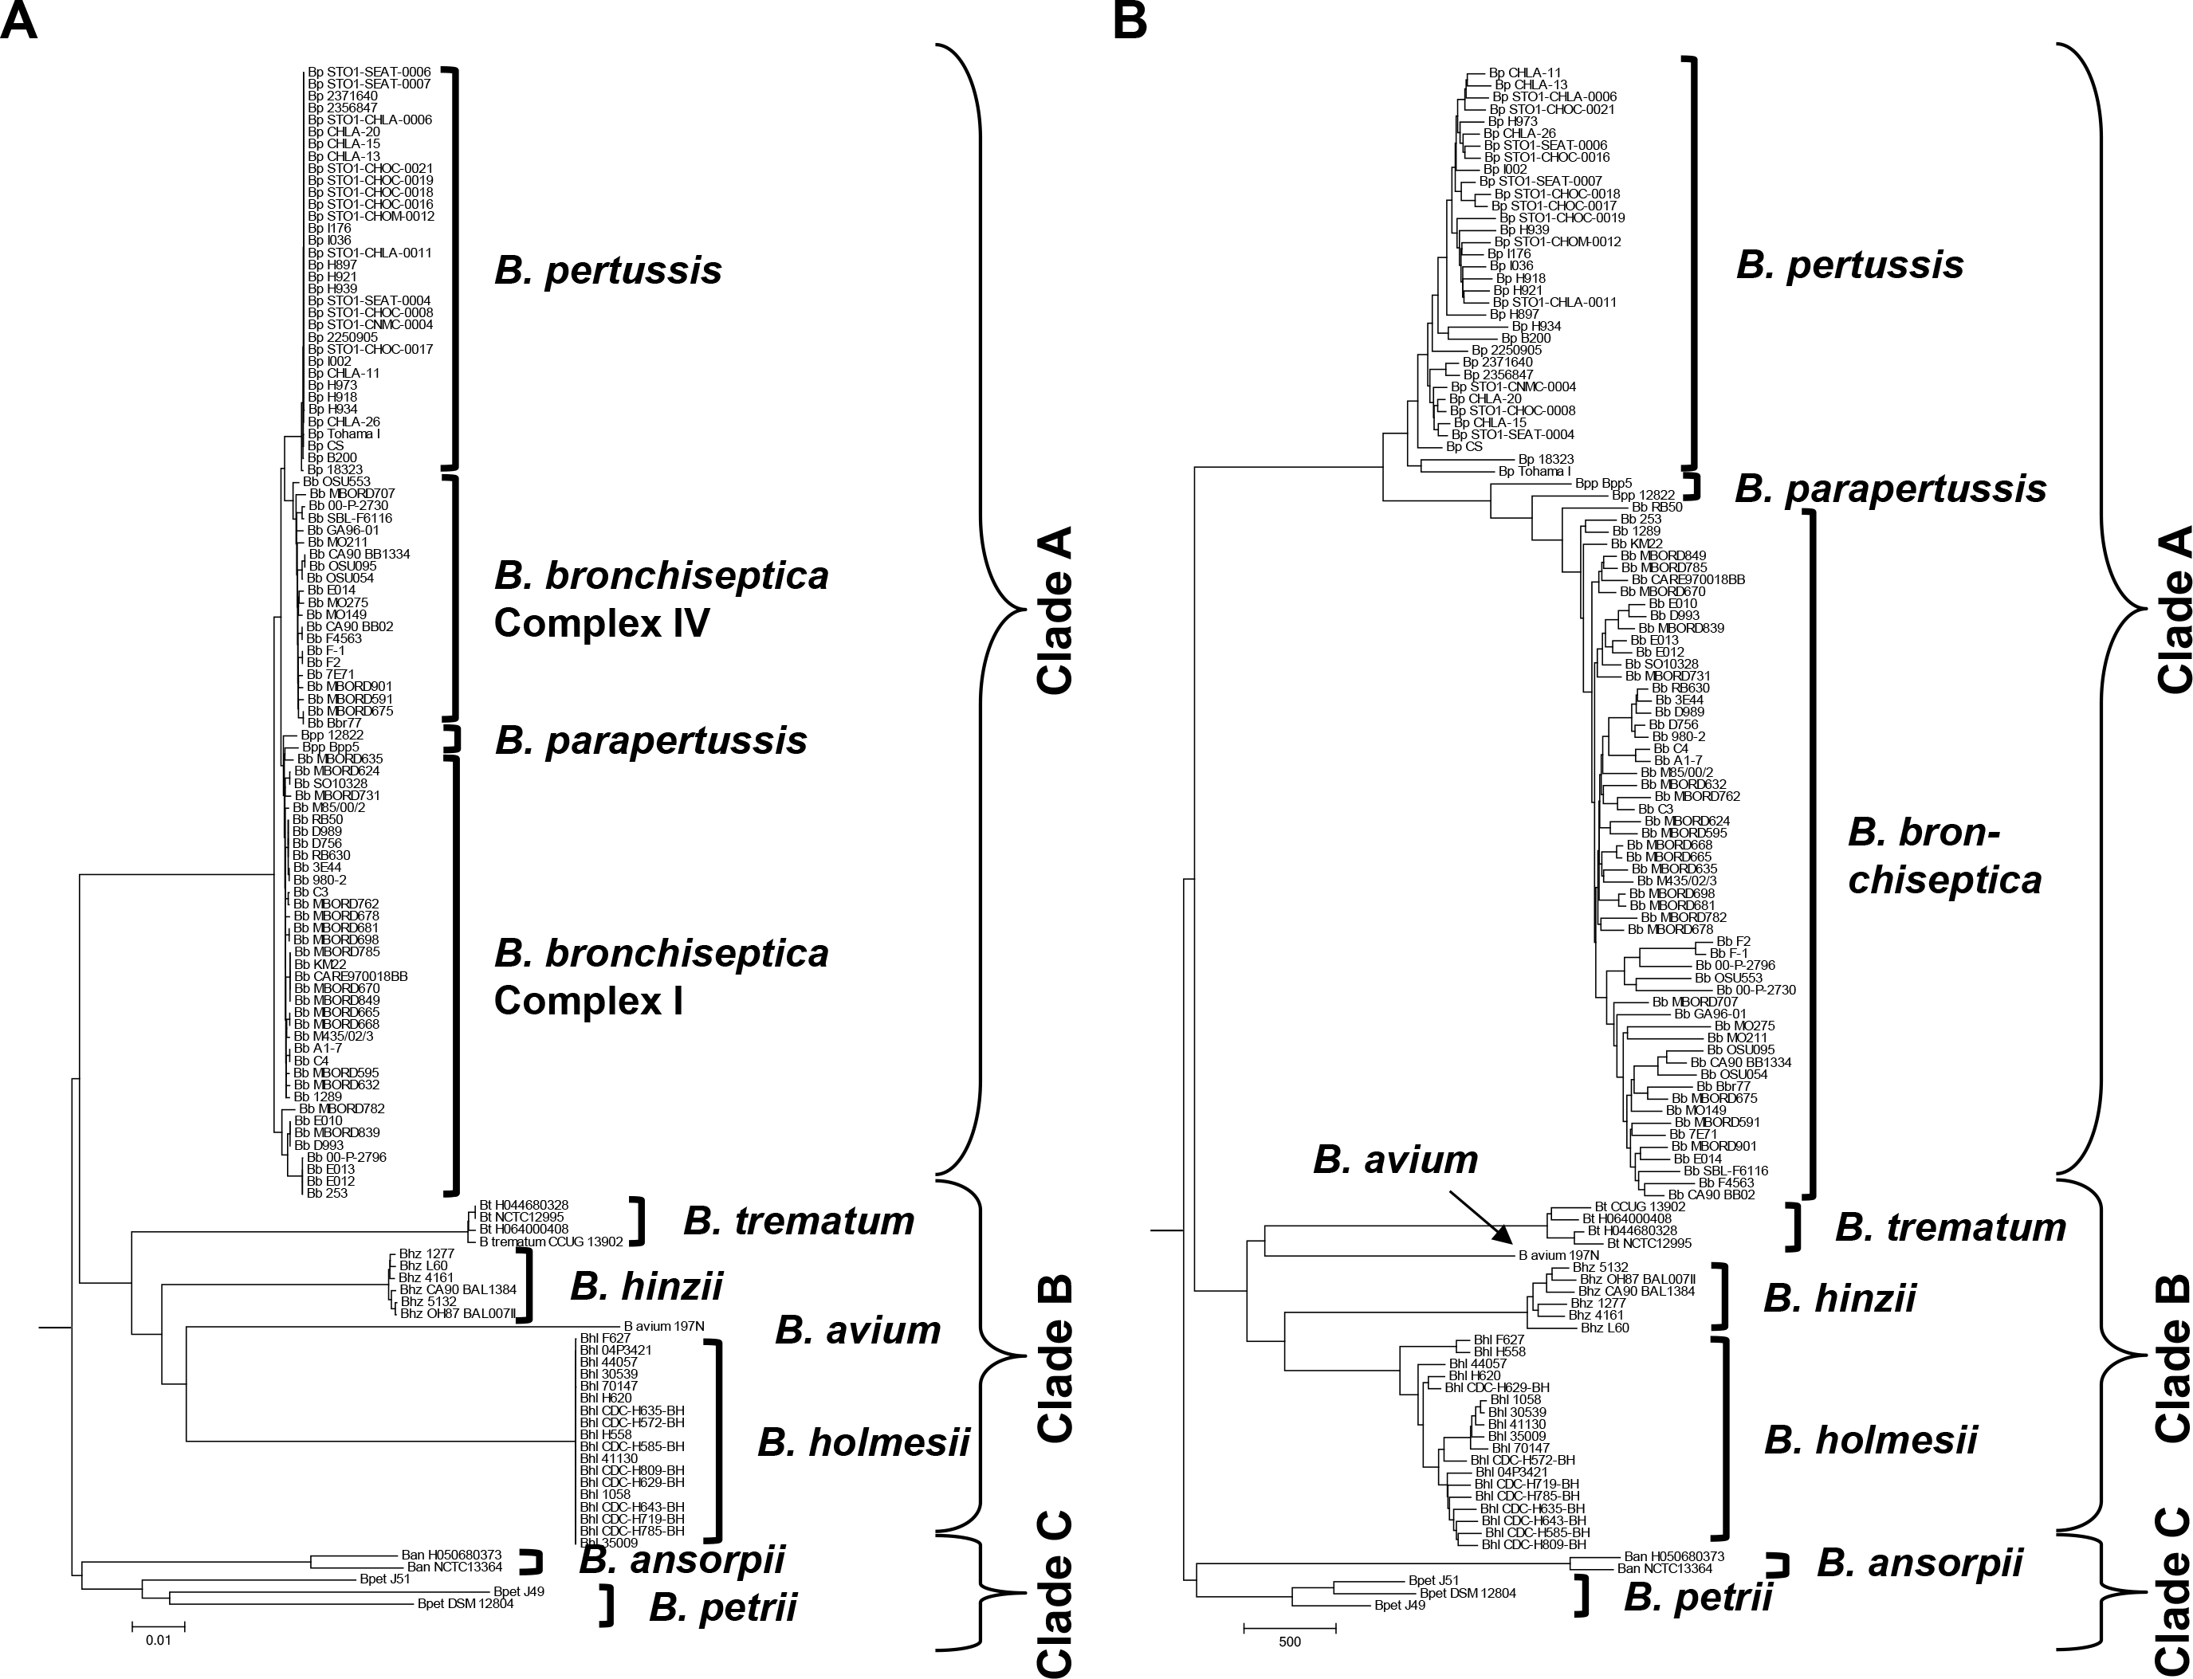
Display tree
SNP-based tree

Slide 31
SNP-based tree
gene presence/absence-based tree

Slide 32
Neighbor-joining trees of 16S rRNA gene sequences and
8 concatenated ATP synthase proteins from Bordetella
A) 16S rRNA
B. bronchiseptica
B. parapertussis
B. pertussis
B. hinzii
B. holmesii
B. trematum
B. petrii
B. avium
B. ansorpii
Burkholderia
0.01
B) ATP synthase
B. holmesii
B. hinzii
B. avium
B. pertussis
B. trematum
B. bronchiseptica
B. parapertussis
B. petrii
Ralstonia
B. ansorpii
Burkholderia
0.05

Slide 33
R: Calculate Distance matrices of SNPs and Genes
R: Calculate Mantel correlation between 2 phylogenies
a <-read.table(“fake5_gene1”, header = TRUE, sep = “\t”
## load data gene 1
x = t(a) ## transform data to genomes by row and SNPs by col
SEQ1.dist <- as.dist(dist(x, “manhattan”)) ## calc matrix
m1 <- as.table(SEQ1.dist) ## write as table
#############################################################
z <-read.table(“fake5_gene2”, header = TRUE, sep = “\t”
## load data gene 2
y = t(z) ## transform data to genomes by row and SNPs by col
SEQ2.dist <- as.dist(dist(y, “manhattan”)) ## calc matrix
m2 <- as.table(SEQ2.dist) ## write as table

Slide 34
R: Calculate Distance matrices of SNPs and Genes
R: Calculate Mantel correlation between 2 phylogenies
m3 <-mantel.rtest(SEQ1.dist, SEQ2.dist, nrepet = 99999)
fileConn <- file(“output.txt”)
write.lines(paste(m3[2:4], sep = “\t”), fileConn)
close fileConn
cat output.txt
extract values from output.txt
cat output.txt | awk ‘NR==1’ > t1
cat output.txt | awk ‘NR==2’ > t2
cat output.txt | awk ‘NR==3’ > t3
printf “r = $(cat t1) \n nrepet = $(cat t2) \n p-value = $(cat t3) \n” >> $NAMEGENE1-$NAMEGENE2.out

Slide 35
extract values from output.txt
cat output.txt | awk ‘NR==1’ > t1
cat output.txt | awk ‘NR==2’ > t2
cat output.txt | awk ‘NR==3’ > t3
printf “r = $(cat t1) \n nrepet = $(cat t2) \n p-value = $(cat t3) \n” >> $NAMEGENE1-$NAMEGENE2.out
cat $NAMEGENE1-$NAMEGENE2.out
Dataset from file ‘9BordetellaSNP’: 265372 loci.
Dataset from file ‘ATPsynthase_AA’: 2125 loci.
r = 0.65755
nrepet = 99999
p-value = 0.00483
# R^2 = 0.4324

Slide 36
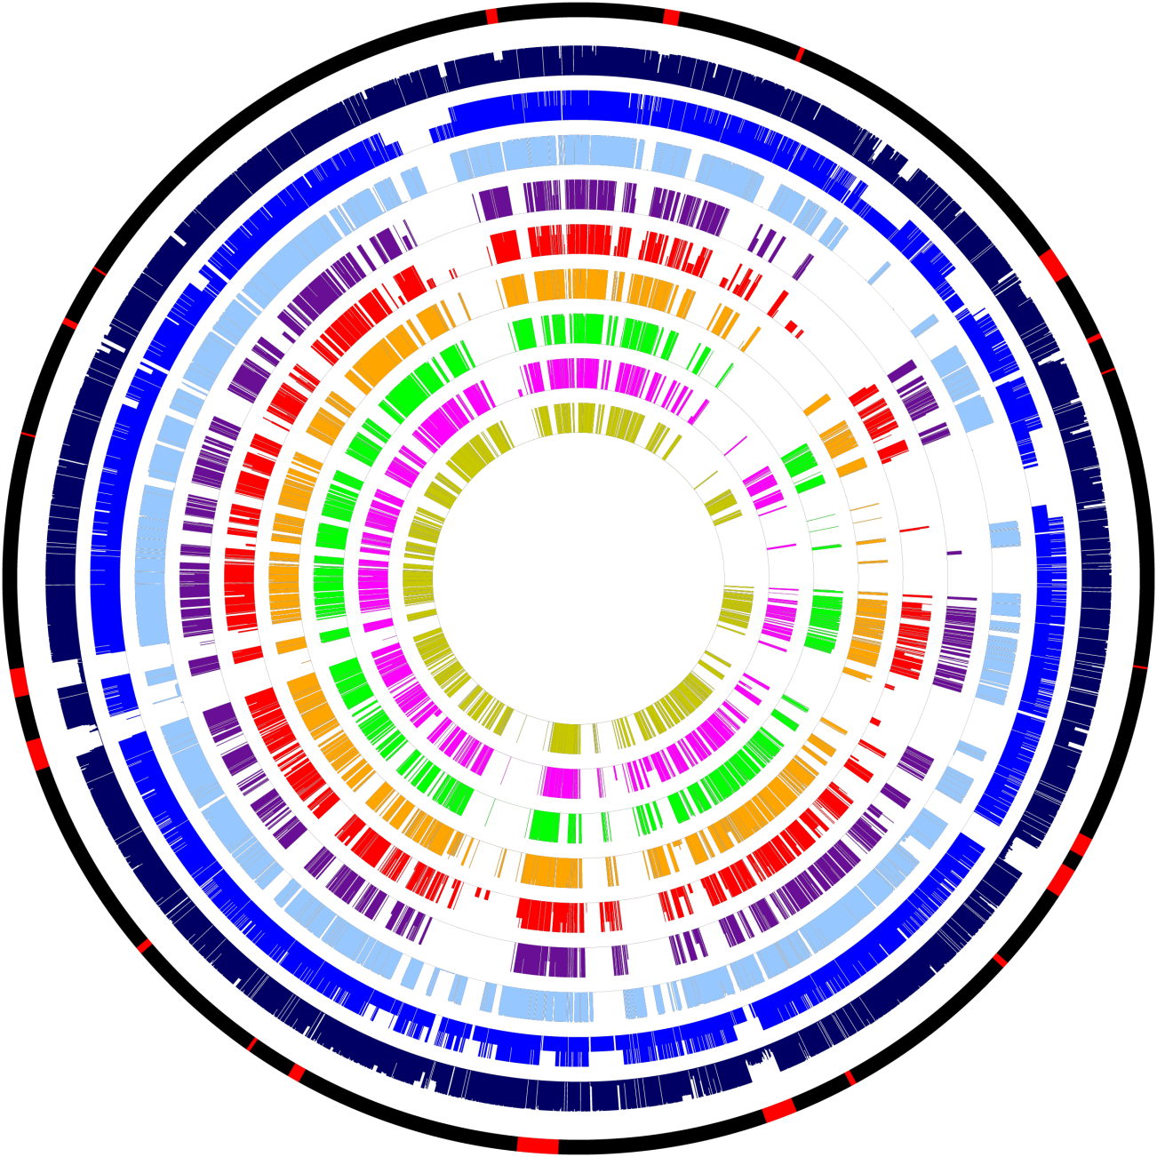
Presence and absence of genes in 128 genomes from 9 Bordetella species
PT
O-antigen
ACT
Virtual chromosome of
the B. bronchiseptica
RB50 reference genome
with key factor genes or
gene clusters in red.
Proportion of genes
present in individual
genomes per species
color-coded by
species.
A thin line for each gene
indicates the percentage
of genomes in each
species containing this
gene.
colored: gene(s) present
white: gene(s) absent
Φ – prophage
Heme
Pilus D
T6SSa
Φ
Φ
BrkB
DNT
Alca-
ligin
Φ
PRN
Φ
T3SS
Φ
Pilus C
Pilus A
BvgAS
FhaB
Enterobactin
Capsule A
Pilus B
Capsule A
Φ
Flagella/
Chemotaxis

Slide 37
Presence and absence of genes in 128 genomes from 9 Bordetella species
PT
O-antigen
ACT
Heme
Pilus D
T6SSa
Circles
1: Virtual chromosome of
B. bronchiseptica RB50
with genes of interest;
2: B. bronchiseptica
(based on 58 genomes);
3: B. parapertussis (2);
4: B. pertussis (34);
5: B. ansorpii (2);
6: B. petrii (3);
7: B. hinzii (6);
8: B. holmesii (18);
9: B. trematum (4);
10: B. avium (1)
Φ
Φ
BrkB
DNT
Alca-
ligin
Φ
PRN
Φ
T3SS
Φ
Pilus C
Pilus A
BvgAS
FhaB
Enterobactin
Capsule A
Pilus B
Capsule A
Φ
Flagella/
Chemotaxis

Slide 38
Presence and absence of virulence-associated key factors

Slide 39
Acquisition
IS481
O-Antigen, T6SSa
B. pertussis
Loss
Pilus D
Pilus ABC
PRN
Degenerate
ACT, DNT, PT, PRN, Pilus D
B. bronchiseptica (Complex IV)
O-antigen, Alcaligin
T6SSa, DNT, PT, O-antigen
T2SSa, Capsule B, Cell
B. parapertussis
T6SSa
CT, Pilus D
PT
B. bronchiseptica (Complex I)
T6SSa
present in
Bordetella
ancestor:
BvgA/S
FHA
Pilus ABC
T2SSa
T3SS
T6SSa
T6SSb
Capsule A
Capsule B
Cellulose
Heme
Enterobactin
T6SSb, T2SSa, Pilus A
Capsule A, Cell
B. trematum
B. hinzii
T3SS
T6SSb
T6SSa
T6SSb
DNT, O-Antigen
Pilus A
B. avium
IS481, Alcaligin
Pilus ABC
B. holmesii
T2SSa, T6SSb, Capsule B, Cell, CT
T2SSb, ACT-like, Pilus EF, Capsule C
Heme
B. ansorpii
BvgAS, FHA, Capsule AB, Enterobactin
T6SSa
T3SS
Heme
B. petrii
Capsule AB, Cell
T2SSa
T6SSa

Slide 40
Presence and absence of virulence-associated key factors:
Are there similarities or trends to explain:
- host spectrum?
- infected organs?
- disease outcome?
Principal Component Analysis (PCA)
invented in 1901 by Karl Pearson
statistical procedure that converts a set of observations of possibly correlated
variables into a set of values of linearly uncorrelated variables
called principal components (PCs)
Principal Components are the underlying structure in the data
PCA mostly used as a tool in exploratory data analysis
it reveals the internal structure of the data in a way that best explains
the variance in the data
PC1 has the largest possible variance
accounts for as much of the variability in the data as possible
PC2 second largest variance in the data
PC3 third largest
resulting PCs are uncorrelated

Slide 41
Input
based on numbers
change nucleotides to allele numbers (e.g. A=1, C=2, G=3, T=4)
here presence and absence of genes as 1 and 0
computation in R using libraries gplots, gdata, and gtools
Species/factor | BvgAS | DNT | ACT | T2SSa | T2SSb | T2SSc | PilA | PilB | PilC | PilD | PilE | PilF | T3SS | PT | PRN | T6SSa | T6SSb
B.bronch1 | 1 | 1 | 1 | 0 | 0 | 0 | 1 | 1 | 1 | 1 | 0 | 0 | 1 | 1 | 1 | 1 | 0
B.bronch2 | 1 | 1 | 0 | 0 | 0 | 0 | 1 | 1 | 1 | 1 | 0 | 0 | 1 | 1 | 1 | 1 | 0
B.bronch3 | 1 | 0 | 0 | 0 | 0 | 0 | 1 | 1 | 1 | 1 | 0 | 0 | 1 | 0 | 1 | 1 | 0
B.bronch4 | 1 | 0 | 0 | 0 | 0 | 0 | 1 | 1 | 1 | 1 | 0 | 0 | 1 | 0 | 1 | 0 | 0
B.bronch5 | 1 | 0 | 0 | 0 | 0 | 0 | 1 | 1 | 1 | 1 | 0 | 0 | 1 | 0 | 1 | 1 | 0
B.bronch6 | 1 | 1 | 1 | 0 | 0 | 0 | 1 | 1 | 1 | 1 | 0 | 0 | 1 | 0 | 1 | 0 | 0
B.bronch7 | 1 | 0 | 1 | 0 | 0 | 0 | 1 | 1 | 1 | 1 | 0 | 0 | 1 | 1 | 1 | 0 | 0
B.bronch8 | 1 | 1 | 1 | 0 | 0 | 0 | 1 | 1 | 1 | 1 | 0 | 0 | 1 | 0 | 1 | 1 | 0
B.parahu | 1 | 1 | 1 | 0 | 0 | 0 | 1 | 1 | 1 | 1 | 0 | 0 | 1 | 0 | 1 | 1 | 0
B.paraov | 1 | 1 | 1 | 0 | 0 | 0 | 1 | 1 | 1 | 1 | 0 | 0 | 1 | 0 | 1 | 1 | 0
B.pertussis1 | 1 | 1 | 1 | 0 | 0 | 0 | 0 | 0 | 0 | 0 | 0 | 0 | 1 | 1 | 1 | 0 | 0
B.pertussis2 | 1 | 1 | 1 | 0 | 0 | 0 | 0 | 0 | 0 | 0 | 0 | 0 | 1 | 1 | 0 | 0 | 0
B.holmesii | 1 | 0 | 0 | 0 | 0 | 0 | 0 | 0 | 0 | 0 | 0 | 0 | 0 | 0 | 0 | 0 | 0
B.hinzii1 | 1 | 0 | 0 | 1 | 0 | 0 | 1 | 1 | 1 | 0 | 0 | 0 | 0 | 0 | 0 | 0 | 1
B.hinzii2 | 1 | 0 | 0 | 1 | 0 | 0 | 1 | 1 | 1 | 0 | 0 | 0 | 0 | 0 | 0 | 0 | 0
B.avium197N | 1 | 1 | 0 | 1 | 0 | 0 | 1 | 1 | 1 | 0 | 0 | 0 | 0 | 0 | 0 | 0 | 1
B.trematum | 1 | 0 | 0 | 0 | 0 | 0 | 0 | 1 | 1 | 0 | 0 | 0 | 0 | 0 | 0 | 0 | 0
B.petriiJ49 | 1 | 0 | 0 | 0 | 0 | 0 | 1 | 1 | 1 | 0 | 0 | 0 | 0 | 0 | 0 | 1 | 0
B.petriiJ51 | 1 | 0 | 0 | 1 | 0 | 0 | 1 | 1 | 1 | 0 | 0 | 0 | 0 | 0 | 0 | 1 | 0
B.petriiDSM | 1 | 0 | 0 | 1 | 0 | 0 | 1 | 1 | 1 | 0 | 0 | 0 | 0 | 0 | 0 | 1 | 0
B.ansorpii1 | 0 | 0 | 0 | 1 | 1 | 1 | 1 | 1 | 1 | 0 | 1 | 1 | 1 | 0 | 0 | 1 | 0
B.ansorpii2 | 0 | 0 | 0 | 1 | 1 | 1 | 1 | 1 | 1 | 0 | 1 | 1 | 1 | 0 | 0 | 1 | 0

Slide 42
# computation of PCA
rm(list = ls())
library(gplots)
library(gdata)
library(gtools)
g<-as.matrix(read.table("D:/Data/Virulence.txt", row.names=1,header=TRUE,check.names=TRUE, sep = "\t") )
h <- as.matrix(dist(g))
print(summary(pc<- princomp(h, cor=T)))
pc$loadings
pc$scores
ghi1 <- as.table(pc$scores)
ghi2 <- as.table(pc$loadings)
write.table(ghi1, file="D:/Data/PCA_scores.txt", sep="\t", row.names=T, col.names=T)
write.table(ghi2, file="D:/Data/PCA_loadings.txt", sep="\t", row.names=T, col.names=T)

Slide 43
# Let’s walk through:
library(gplots) # load library (gplots)
library(gdata) # load library (gdata)
library(gtools) # load library (gtools)
rm(list = ls()) # empty memory, optional
g<-as.matrix(read.table("D:/Data/Virulence.txt", row.names=1,header=TRUE,check.names=TRUE, sep = "\t") )
# read table "D:/Data/Virulence.txt" in matrix format into file "g"
# row.names=1 - table has 1 row name
(you can have several such as strain, year, country, etc)
# header=TRUE,check.names=TRUE - table has headers, check that column headers are unique
# sep = “\t” - columns are separated by tab
h <- as.matrix(dist(g))
# make distance matrix of file g

Slide 44
# Let’s walk through:
print(summary(pc<- princomp(h, cor=T)))
pc$loadings
pc$scores
# run principal component analysis of file h, save as pc
# print summary of data: pc$loadings and pc$scores
ghi1 <- as.table(pc$scores)
ghi2 <- as.table(pc$loadings)
# output of pc$scores in table format into file ghi1
# output of pc$loadings in table format into file ghi2
write.table(ghi1, file="D:/Data/PCA_scores.txt", sep="\t", row.names=T, col.names=T)
write.table(ghi2, file="D:/Data/PCA_loadings.txt", sep="\t", row.names=T, col.names=T)
# save ghi1 in table format as file “D:/Data/PCA_scores.txt”
# fields separated by tab, file has row names and column names
# save ghi2 in table format as file “D:/Data/PCA_loadings.txt”

Slide 45
Output PCA_scores
 | Comp.1 | Comp.2 | Comp.3 | Comp.4 | Comp.5 | Comp.6 | Comp.7 | Comp.8 | Comp.9 | Comp.10 | Comp.11 | Comp.12 | Comp.13 | Comp.14 | Comp.15 | Comp.16 | Comp.17
B.bronch1 | 3.940976 | -0.65934 | -0.35932 | -0.33097 | -0.78523 | -0.63582 | 0.106812 | -0.33411 | 0.251795 | -0.83729 | 0.111922 | -0.15431 | 0.170636 | -0.08216 | 0.037813 | -0.00413 | 0.001747
B.bronch2 | 3.467985 | -0.26221 | -0.73372 | -0.2848 | -0.10144 | -0.71256 | 0.308428 | -0.22728 | -0.31109 | -1.24364 | -0.05382 | 0.083955 | -0.1414 | 0.356394 | -0.19073 | 0.076178 | 0.032616
B.bronch3 | 3.0684 | 0.631039 | -1.6963 | -0.13845 | 1.265976 | -0.1194 | 0.149705 | 0.190226 | -0.5807 | -0.05045 | -0.21447 | 0.205404 | -0.35658 | -0.14436 | 0.076716 | -0.01255 | -0.0154
B.bronch4 | 2.877919 | 0.864665 | -0.92187 | -0.50047 | 1.548399 | -0.52757 | 0.272852 | -0.06821 | -0.03708 | 0.741385 | -0.115 | 0.200025 | -0.28327 | 0.32901 | -0.18223 | 0.105868 | 0.03109
B.bronch5 | 2.558964 | 0.94425 | -1.57696 | 0.238629 | 1.058568 | 0.560872 | -0.33912 | 0.777675 | -1.01252 | 0.00307 | -0.06791 | -0.1346 | 0.360272 | -0.21061 | 0.152336 | -0.06685 | -0.03566
B.bronch6 | 3.703721 | 0.005205 | -0.15197 | -0.67054 | -0.25434 | -0.31372 | 0.073549 | -0.37075 | 0.572002 | 0.745596 | 0.348163 | -0.55449 | -0.29786 | 0.186175 | -0.22708 | 0.059994 | -0.009
B.bronch7 | 3.338116 | -0.09097 | 0.052605 | -0.49044 | 0.440996 | -1.20112 | 0.187546 | -0.36444 | 0.738305 | 0.354975 | -0.02958 | 0.271254 | 0.893447 | -0.22867 | 0.262911 | -0.03553 | -0.00597
B.bronch8 | 3.44944 | 0.046542 | -0.74398 | -0.01318 | -0.81557 | 0.840945 | -0.51252 | 0.391626 | -0.2547 | 0.098619 | 0.353441 | -0.7869 | 0.291786 | -0.00693 | -0.08847 | 0.063754 | -0.00111
B.parahu | 3.535931 | -0.999 | -0.80005 | -0.49297 | -0.86969 | 0.71525 | 0.003884 | -0.33116 | 0.424089 | 0.051217 | -0.07841 | 0.168235 | -0.73995 | -0.52358 | 0.315321 | -0.20105 | -0.02009
B.paraov | 2.777047 | -1.18401 | -0.26294 | -0.11987 | -1.06511 | 1.975882 | -0.06008 | 0.00801 | 0.238236 | 0.190538 | -0.36508 | 0.660132 | 0.324452 | 0.363885 | -0.12001 | 0.127765 | 0.026893
B.pertussis1 | 1.766612 | -0.93116 | 3.810397 | 1.092294 | -0.48526 | -0.66592 | -0.37389 | 0.495592 | -0.3159 | 0.197566 | -0.16602 | 0.138258 | -0.03243 | 0.03203 | -0.30828 | -0.64827 | 0.06748
B.pertussis2 | 1.042796 | -0.71475 | 4.06178 | 1.310539 | -0.4259 | -0.61146 | -0.36971 | 0.496295 | -0.25876 | 0.112637 | 0.007457 | 0.10185 | -0.22765 | -0.03094 | 0.299929 | 0.635849 | -0.06987
B.holmesii | -0.90844 | 0.633103 | 3.204297 | 1.568969 | 1.713535 | 1.408775 | 1.119641 | -0.48406 | 0.37677 | -0.36079 | 0.207976 | -0.25971 | 0.060057 | -0.04288 | 0.032629 | -0.0665 | 0.014726
B.hinzii1 | -3.76295 | 2.059499 | 0.678829 | -2.13513 | -0.04269 | 0.056194 | 0.172072 | 0.893481 | 0.445499 | -0.20637 | 0.109606 | 0.198674 | 0.003395 | -0.4445 | -0.4889 | 0.187332 | 0.252445
B.hinzii2 | -3.49032 | 2.403655 | 0.407988 | -1.67139 | 0.238094 | 0.081278 | -0.45688 | 0.867654 | 0.753546 | -0.28505 | 0.032411 | -0.05082 | -0.12367 | 0.407449 | 0.390635 | -0.18896 | -0.30465
B.avium197N | -4.11968 | 0.903954 | 1.010648 | -2.19459 | -1.33046 | -0.10379 | 1.159603 | -0.52777 | -1.18332 | 0.367323 | 0.133672 | 0.006217 | 0.094045 | 0.060943 | 0.179615 | -0.05658 | -0.0558
B.trematum | -3.5035 | 1.965244 | 1.057325 | -0.72796 | 0.489283 | 0.188769 | -1.50747 | -1.4825 | -0.21438 | -0.10784 | -0.40126 | -0.10921 | 0.023846 | -0.04558 | -0.05005 | 0.025121 | 0.080502
B.petriiJ49 | -2.83216 | 1.640384 | -1.7567 | 2.252418 | -0.33904 | -0.112 | -0.34345 | -0.36313 | -0.09977 | 0.03703 | 0.891021 | 0.506595 | -0.00565 | -0.09372 | -0.19309 | 0.043179 | -0.19803
B.petriiJ51 | -3.55346 | 1.498028 | -1.8962 | 2.036387 | -0.63167 | -0.30027 | 0.132559 | 0.176598 | 0.17416 | 0.084028 | 0.128442 | 0.011786 | -0.05385 | 0.200129 | 0.255819 | -0.17234 | 0.291509
B.petriiDSM | -3.71508 | 0.948995 | -1.67945 | 1.984304 | -0.75985 | -0.37029 | 0.550464 | 0.119218 | 0.274471 | 0.107291 | -1.00195 | -0.38378 | 0.025422 | -0.11243 | -0.14713 | 0.119742 | -0.11404
B.ansorpii1 | -4.89809 | -5.10786 | -0.76678 | -0.41503 | 0.589317 | -0.08374 | -0.06736 | 0.020922 | 0.006431 | -0.01095 | 0.028432 | -0.03379 | 0.036317 | -0.07135 | -0.1765 | -0.02777 | -0.55157
B.ansorpii2 | -4.74422 | -4.59526 | -0.93764 | -0.29775 | 0.562071 | -0.0703 | -0.20664 | 0.116131 | 0.01294 | 0.011119 | 0.140955 | -0.08477 | -0.02136 | 0.10169 | 0.168743 | 0.035767 | 0.582183
Load in Excel and plot pairwise

Slide 46
A Species
B Host and disease
Supplementary Figure 4. Principal Component Analysis of presence/absence of virulence-associated factors in Bordetella genomes
by A) Bordetella species; B) host and disease. The genomes from each species were grouped by presence/absence of individual factors,
and any unique combination of factors was analyzed as separate data entry resulting in several data points per species. PC1 divides the
classical from the non-classical species, PC2 isolates B. ansorpii, and PC3 separates the genomes of the human-restricted B. pertussis and
B. holmesii from those of the other species. Bb B. bronchiseptica; Bpp B. parapertussis; Bp B. pertussis; Bhl B. holmesii; Bhz B. hinzii;
Bav B. avium; Bt B. trematum; Bpet B. petrii; Ban B. ansorpii

Slide 47
Example from human genetics:
Allele frequencies of 95 allozymes in Europe and the Middle East
Clinal gradients in principal components 1–3 in allozyme allele frequencies in Europeans
Piazza et al., (1995).
Genetics and the origin
of European languages
Proc. Natl. Acad. Sci. USA
Vol. 92, pp. 5836-5840

Slide 48
Example from human genetics and the human stomach bacterium Helicobacter pylori: Allele frequencies of 95 allozymes and H. pylori gene sequences in Europe and the Middle East
Similar clinal gradients between principal components 1–3 in European H. pylori and humans
Clinal gradients in principal components 1–3 in allozyme allele frequencies in Europeans
Linz et al., (2007).
An African origin for the intimate association
between humans and Helicobacter pylori
Nature Vol. 445, pp. 915-918
Piazza et al., (1995).
Genetics and the origin
of European languages
Proc. Natl. Acad. Sci. USA
Vol. 92, pp. 5836-5840

Slide 49
PCA of gene sequences from H. pylori in Europe
concatenated MLST sequences of H. pylori
sampled from patients at multiple locations
grouped by sampling location
changed nucleotides to allele numbers
ran PCA
subjected data from each individual PC to
spatial autocorrelation analysis in GS+ 7.0
(Geostatistics software for the Environmental Sciences)
- extrapolated data points throughout the grid
plotted onto a synthetic map of Europe using arcGIS
clines originally interpreted as genetic signatures
of episodic migratory events:
PC1: spread of agriculture from Middle East to Europe
PC2: introgression of Uralic speaking peoples
from northern Siberia into northern Europe
(Lapps, Finns, Estonians, Hungarians)
PC3: Spread of the Kurgan culture (pastoral nomads)
from Eurasian steppes after domestication of the horse

Slide 50
To be continued …
Questions?

