Slide 1

Introduction to High Performance Computing Using Sapelo2 at GACRC
Georgia Advanced Computing Resource Center
University of Georgia
Suchitra Pakala
pakala@uga.edu

Slide 2
Outline
High Performance Computing (HPC)
HPC at UGA - GACRC
Sapelo2 Cluster Overview
Architecture
Computing resources, Storage Environment
Software on Cluster
Job Submission Workflow
Access and Working with Sapleo2

Slide 3
High Performance Computing (HPC)
Cluster Computing

Slide 4
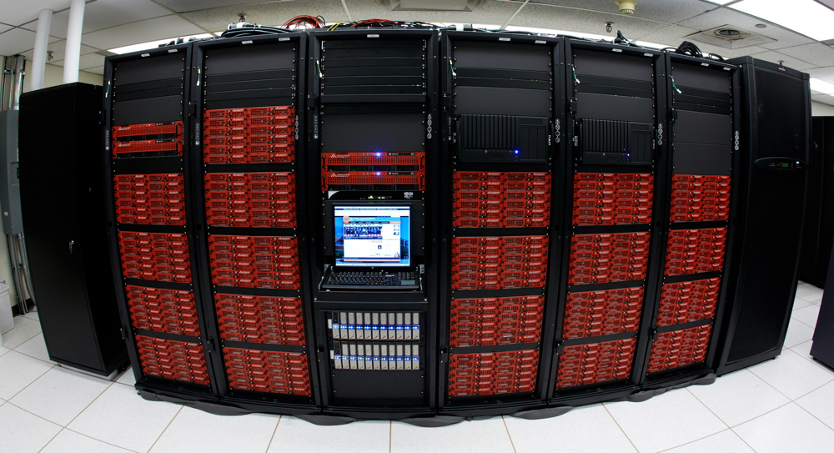
What is HPC?
High Performance Computing
Practice of aggregating computing power
Higher performance - when compared to regular Desktop or Laptops
Parallel processing for solving complex computational problems
Using advanced applications programs efficiently, reliably and quickly

Slide 5
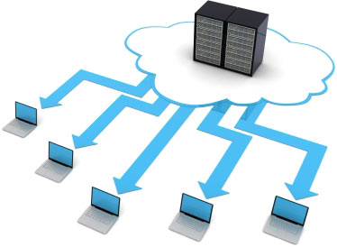
Also… Cluster Computing
A cluster:
Parallel or distributed processing system
Consists of a collection of interconnected stand alone computers
Working together as a single integrated computing resource
Provide better system reliability and performance
Appears to users as a single highly available system

Slide 6
Why use HPC?
A single computer (processor) is limited in:
Memory
Speed
Overall performance
A cluster of computers can overcome these limitations
Solves problems that cannot fit in a single processor's memory
Reduces computational time to reasonable expectations
Solves problems at finer resolution

Slide 7
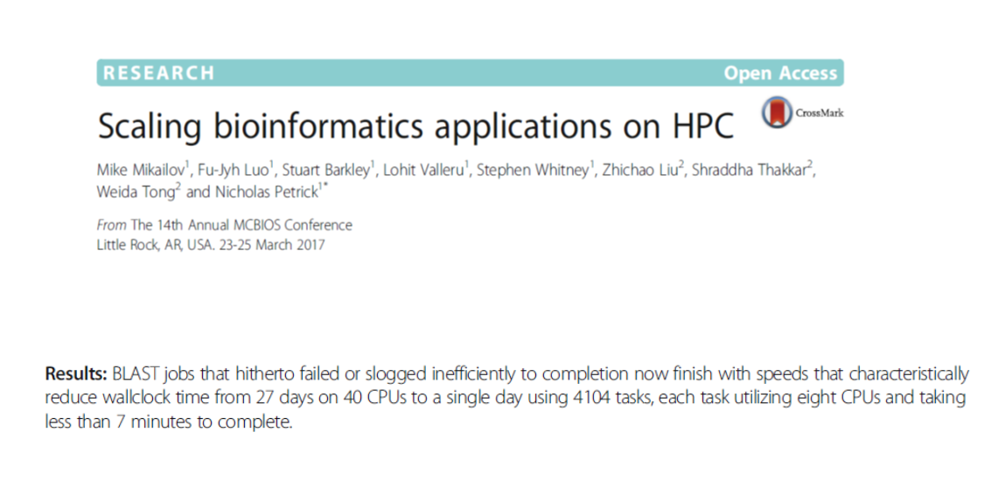

Slide 8
Components of HPC
Node – Individual computer in a cluster
Eg: Login node, Transfer node
Individual nodes can work together, talk to each other
Faster problem solving
Queue – Collection of compute nodes for specific computing needs on a cluster
Eg: batch, highmem_q, inter_q, gpu_q
Jobs – User programs that run on a cluster
Managed through a queueing system (Torque/Moab)

Slide 9
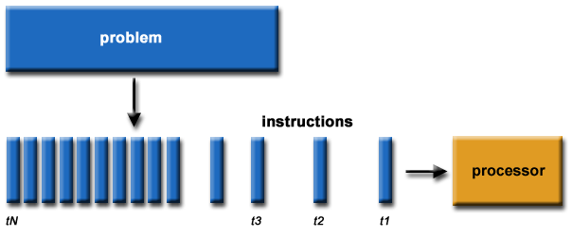

HPC - Submitting Jobs :
Serial Computing
A problem is broken into a discrete series of instructions
Instructions are executed sequentially
Executed on a single processor
Only one instruction may execute at any moment in time
Serial Computing

Slide 10
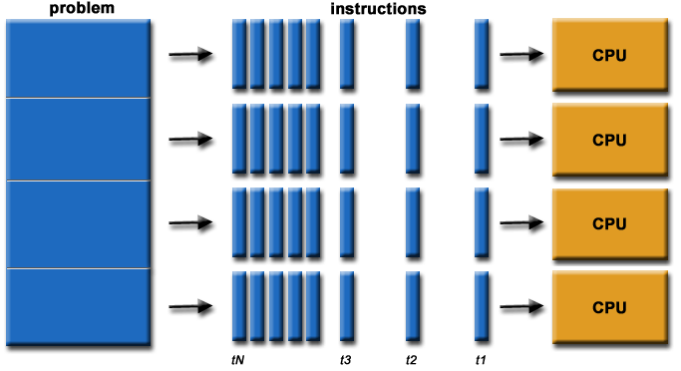
HPC - Submitting Jobs:
Parallel Computing
Parallel Computing
A problem is broken into discrete parts that can be solved concurrently
Each part is further broken down to a series of instructions
Instructions from each part execute simultaneously on different processors
An overall control/coordination mechanism is employed

Slide 11

Operating System: Linux
Several distributions - Ubuntu, CentOS, Fedora, RedHat, etc
Open Source, Multi-user, Multi-tasking operating system
Free, Stable, Secure, Portable

Slide 12
High Performance Computing at GACRC
Sapelo2

Slide 13
GACRC
We are the high-performance-computing (HPC) center at UGA
We provide to the UGA research and education community an advanced computing environment:
HPC computing and networking infrastructure located at the Boyd Data Center
Comprehensive collection of scientific, engineering and business applications
Consulting and training services
http://wiki.gacrc.uga.edu (GACRC Wiki)
https://wiki.gacrc.uga.edu/wiki/Getting_Help (GACRC Support)
http://gacrc.uga.edu (GACRC Web)

Slide 14
Sapelo2 Overview
Architecture
General Information
Computing resources
Storage Environment
Software on Cluster
Job submission Workflow

Slide 15


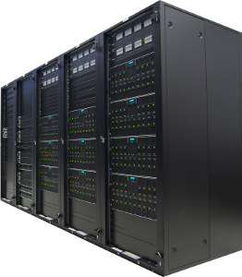
Cluster
Using a cluster involves 3 roles:
User(s): to submit jobs
Queueing System: to dispatch jobs to cluster, based on availability of resources
Cluster: to run jobs
Job submissions
Dispatch jobs

Slide 16
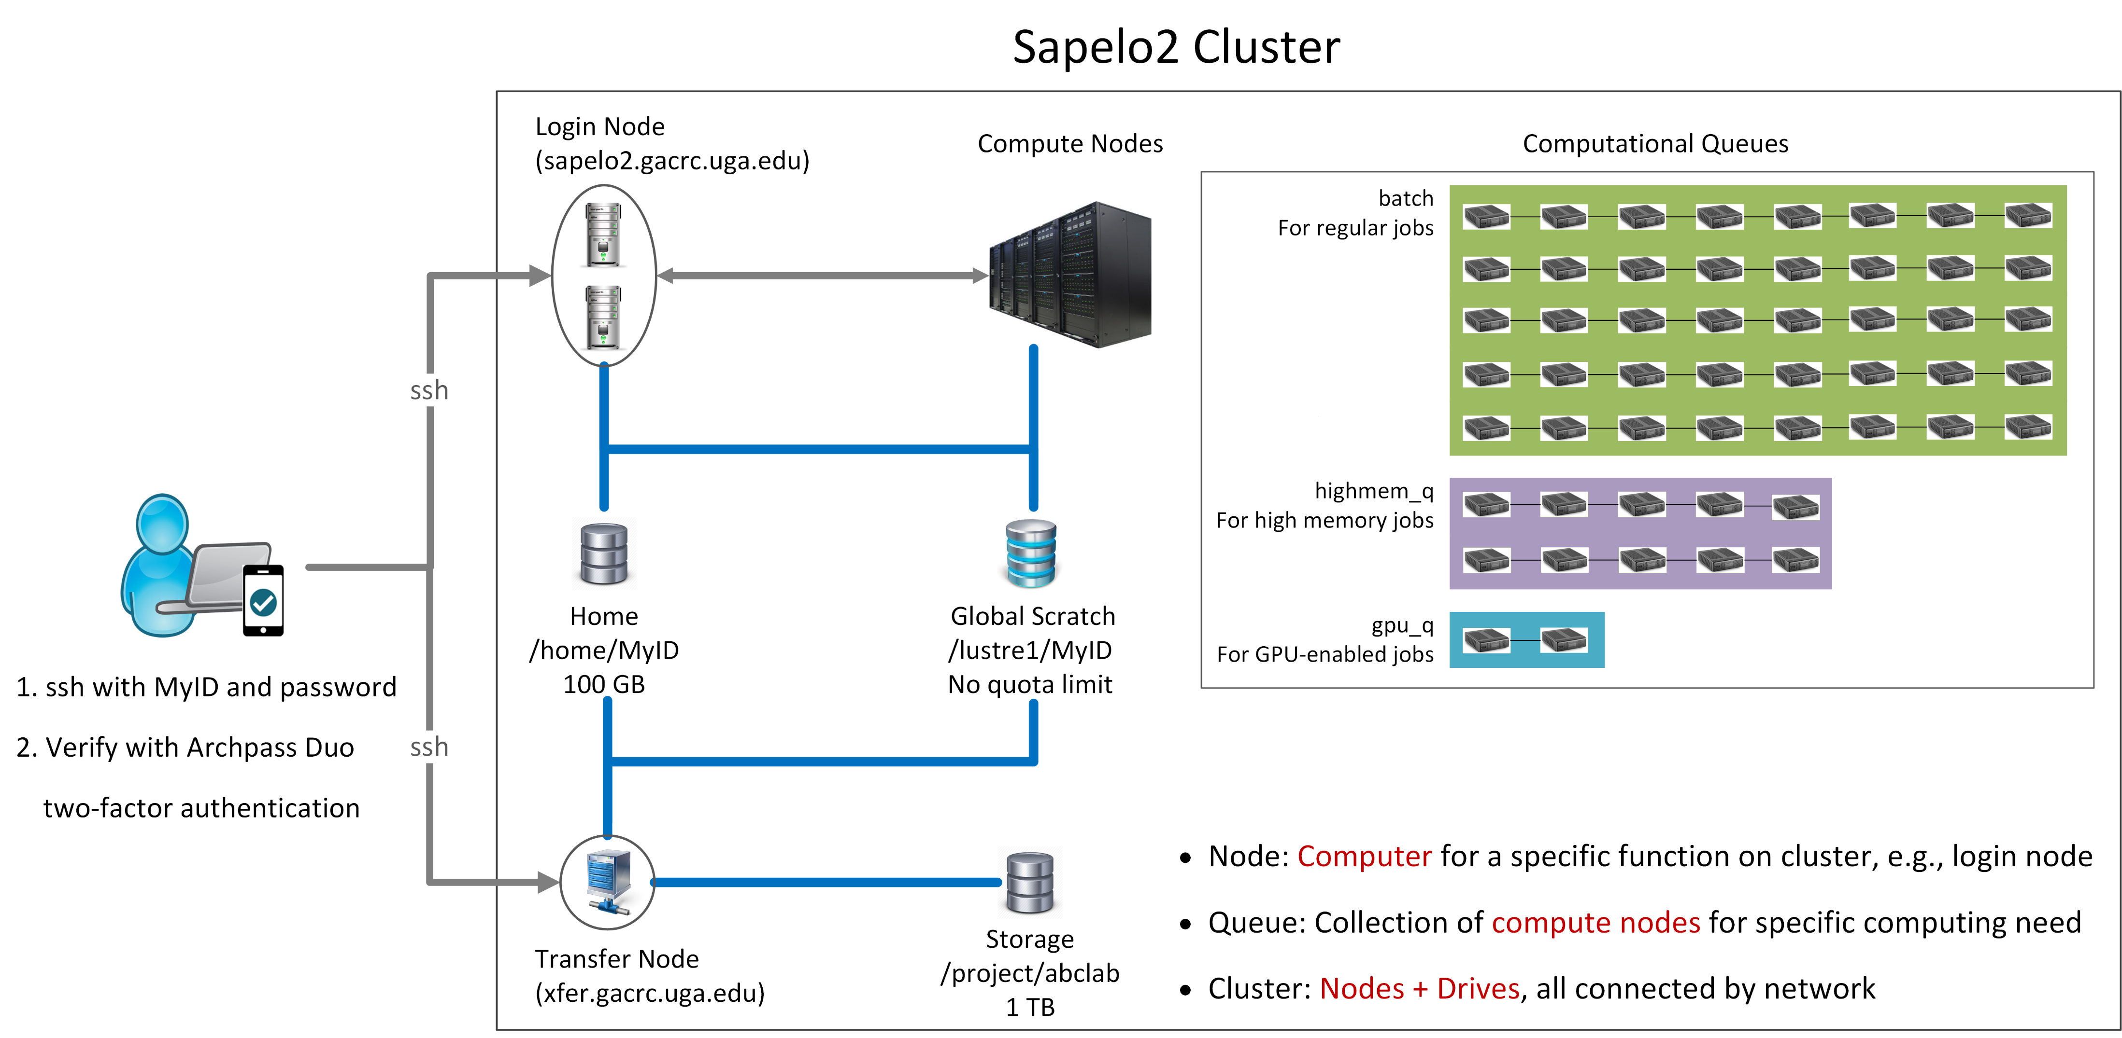

Slide 17
Sapelo2: A Linux HPC cluster (64-bit Centos 7)
Two Nodes:
Login node for batch job workflow: MyID@sapelo2.gacrc.uga.edu
Transfer node for data transferring: MyID@xfer.gacrc.uga.edu
Three Directories:
Home: Landing spot; 100GB quota; Backed-up
Global Scratch: High performance job working space; NO quota; NOT backed-up
Storage: Temporary data parking; 1TB quota (for group); Backed-up (ONLY accessible from Transfer node!)
Three Computational Queues: batch, highmem_q, gpu_q

Slide 18
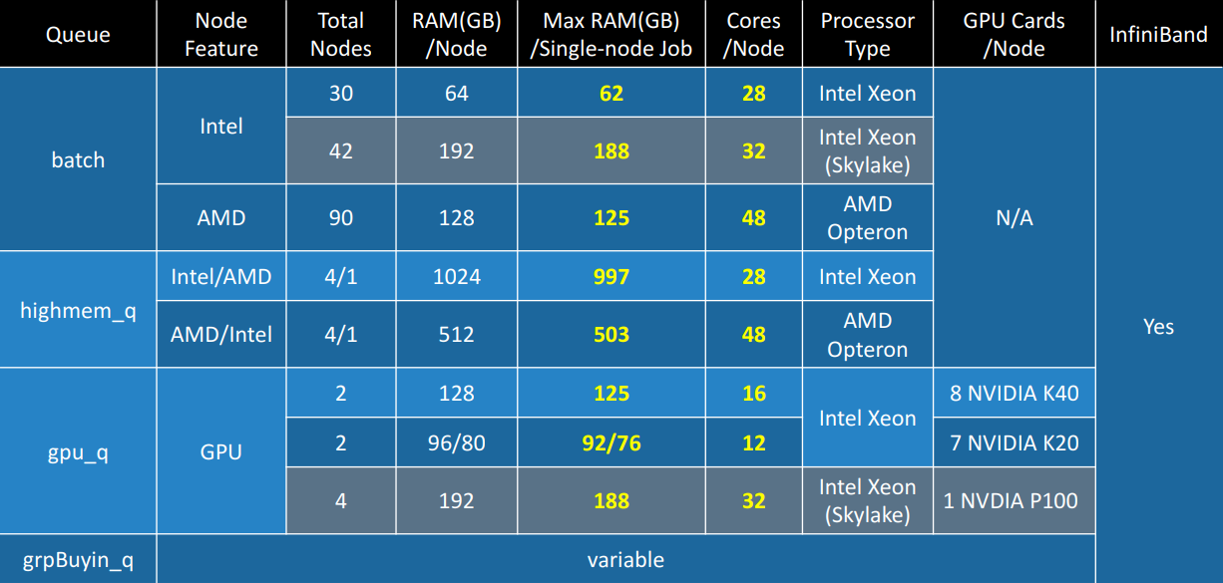
Four Computational Queues

Slide 19
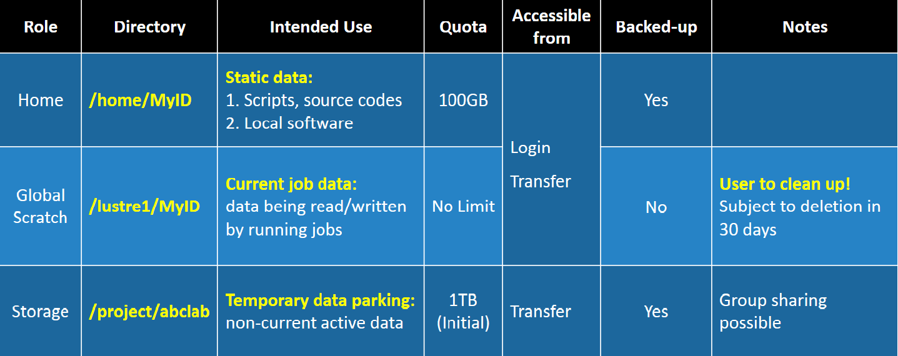
Three Directories

Slide 20
Software on Cluster
The cluster uses environment modules to define the various paths for software packages
Software names are long and have a EasyBuild toolchain name associated to it
Complete module name: Name/Version-toolchain, e.g., BLAST+/2.6.0-foss-2016b-Python-2.7.14
More than 600 modules currently installed on cluster
Out of these, around 260 modules are Bioinformatics applications – AUGUSTUS, BamTools, BCFTools, BLAST, Canu, Cutadapt, Cufflinks, Tophat, Trinity, etc
Others:
Compilers – GNU, INTEL, PGI
Programming – Anaconda, Java, Perl, Python, Matlab, etc
Chemistry, Engineering, Graphics, Statistics (R), etc

Slide 21
Job Submission Workflow
Log on to Login node using MyID and password, and two-factor authentication with Archpass Duo: ssh MyID@sapelo2.gacrc.uga.edu
On Login node, change directory to global scratch : cd /lustre1/MyID
Create a working subdirectory for a job : mkdir ./workDir
Change directory to workDir : cd ./workDir
Transfer data from local computer to workDir : use scp or SSH File Transfer to connect Transfer node
Transfer data on cluster to workDir : log on to Transfer node and then use cp or mv
Make a job submission script in workDir : nano ./sub.sh
Submit a job from workDir : qsub ./sub.sh
Check job status : qstat_me or Cancel a job : qdel JobID

Slide 22
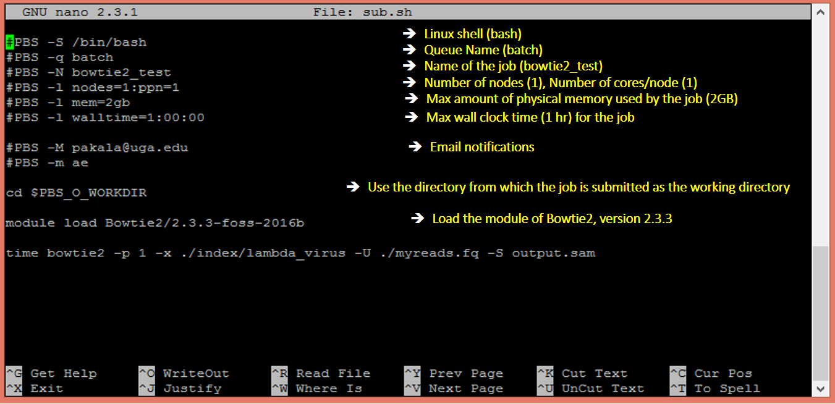
Example: Job Submission Script

Slide 23
Submit a job using qsub
pakala@sapelo2-sub2 workdir$ pwd
/lustre1/pakala/workdir
pakala@sapelo2-sub2 workdir$ ls
index myreads.fq sub.sh
pakala@sapelo2-sub2 workdir$ qsub sub.sh
11743.sapelo2
sub.sh is job submission script to
specify computing resources:
load software using ml load
run any Linux commands you want to run
run the software

Slide 24
Check job status using qstat_me
pakala@sapelo2-sub2 workdir$ qstat_me
Job ID Name User Time Use S Queue
------------------ ---------------- --------- -------- - -----
11743.sapelo2 bowtie2_test pakala 00:12:40 C batch
11744.sapelo2 bowtie2_test pakala 00:05:17 R batch
11746.sapelo2 bowtie2_test pakala 00:02:51 R batch
11747.sapelo2 bowtie2_test pakala 0 Q batch
R : job is running
C : job completed (or canceled or crashed) and is no longer running. (This status is displayed for 24 hours)
Q : job is pending, waiting for resources to become available
Note: “Time Use” is the CPU time, instead of the wall-clock time of your job staying on cluster!

Slide 25
Cancel job using qdel
pakala@sapelo2-sub2 workdir$ qdel 11746
pakala@sapelo2-sub2 workdir$ qstat_me
Job ID Name User Time Use S Queue
------------------ ---------------- --------- -------- - -----
11743.sapelo2 bowtie2_test pakala 00:12:40 C batch
11744.sapelo2 bowtie2_test pakala 00:05:17 R batch
11746.sapelo2 bowtie2_test pakala 00:03:15 C batch
11747.sapelo2 bowtie2_test pakala 0 Q batch
job 11746 status is changed from R to C
C status will stay in list for 24 hour

Slide 26
How to request Sapelo2 User Account
Resources available on Sapelo2

Slide 27
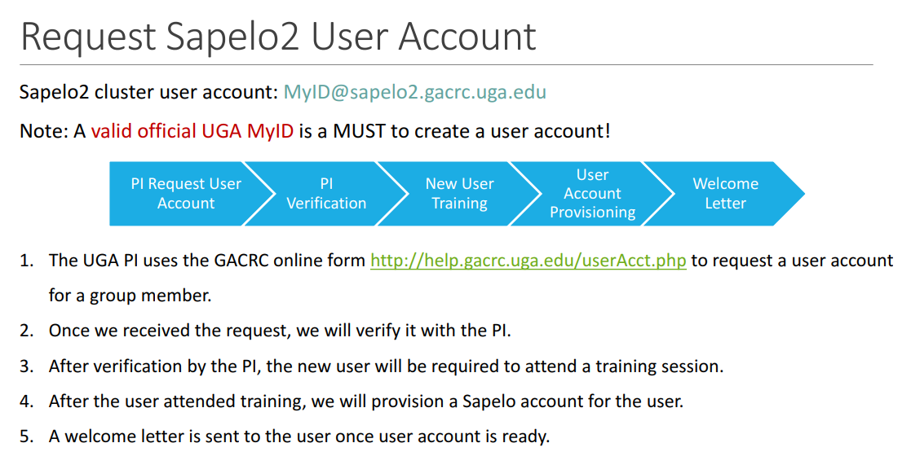

Slide 28
Resources on Sapelo2 - GACRC Wiki
Main Page: http://wiki.gacrc.uga.edu
Running Jobs: https://wiki.gacrc.uga.edu/wiki/Running_Jobs_on_Sapelo2
Software: https://wiki.gacrc.uga.edu/wiki/Software
Transfer Files: https://wiki.gacrc.uga.edu/wiki/Transferring_Files
Linux Commands: https://wiki.gacrc.uga.edu/wiki/Command_List
Training: https://wiki.gacrc.uga.edu/wiki/Training
User Account Request: https://wiki.gacrc.uga.edu/wiki/User_Accounts
Support: https://wiki.gacrc.uga.edu/wiki/Getting_Help

Slide 29
Thank You!

