Slide 1
Computational Model to Determine the Efficacy of Needle Exchange Programs During an HIV Outbreak
Allyson Loy
https://www.nytimes.com/2016/08/08/us/politics/mike-pence-needle-exchanges-indiana.html?_r=0

Slide 2
2015 HIV epidemic in Scott County, Indiana
J
F
M
A
M
January 11, 2015:
Indiana Department of Public Health began an investigation of a HIV epidemic due to injection drug use.
11 confirmed cases
March 26, 2015:
Institution of a Needle Exchange Program. 79 confirmed cases
May 2, 2015:
191 confirmed cases

Slide 3
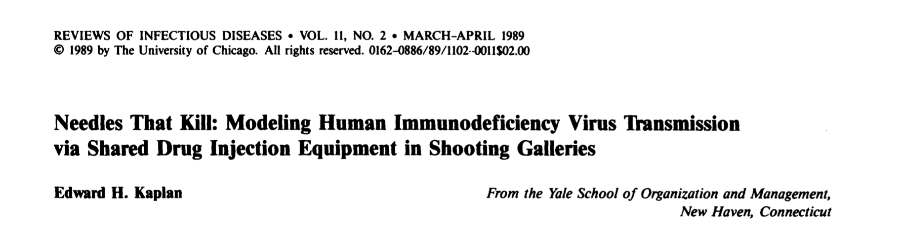
Infection Model of HIV

Slide 4
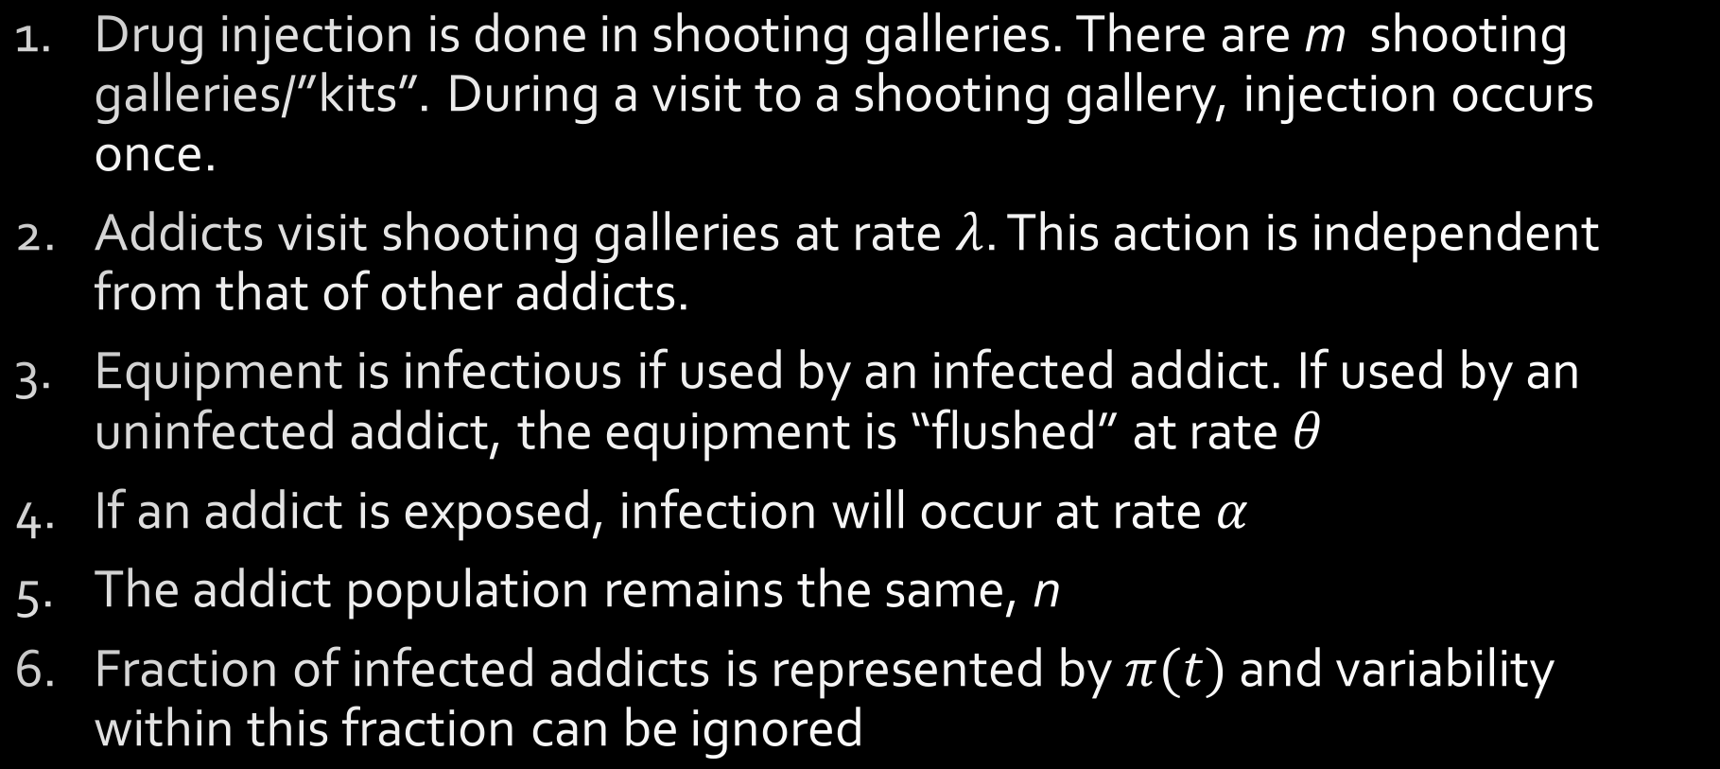
Assumptions
Drug injection is done in shooting galleries. There are m shooting galleries/”kits”. During a visit to a shooting gallery, injection occurs once.
Addicts visit shooting galleries at rate $λ$. This action is independent from that of other addicts.
Equipment is infectious if used by an infected addict. If used by an uninfected addict, the equipment is “flushed” at rate $θ$
If an addict is exposed, infection will occur at rate $α$
The addict population remains the same, n
Fraction of infected addicts is represented by $π(t)$ and variability within this fraction can be ignored

Slide 5
Infection Model of HIV
S
I

Slide 6

Infection Model of HIV
S
I
$$\frac{dβ(t)}{dt} × α$$

Slide 7
Infection Model of HIV
$\frac{dβ(t)}{dt}=λγπ\left(t\right)−λγβ(t)[1−\left[1−π\left(t\right)\right]\left(1−θ\right)]$
Visitation rate
X
Gallery ratio
X
Fraction infected
Visitation rate
X
Gallery ratio
X
Probability of exposure
Universe where this doesn’t happen
Fraction of addicts not infected
Probability of not flushing equipment
Rate of Exposure

Slide 8

Infection Model of HIV
$$\frac{dβ(t)}{dt}=λγπ\left(t\right)$$
Visitation rate
X
Gallery ratio
X
Fraction infected
Rate of Exposure

Slide 9
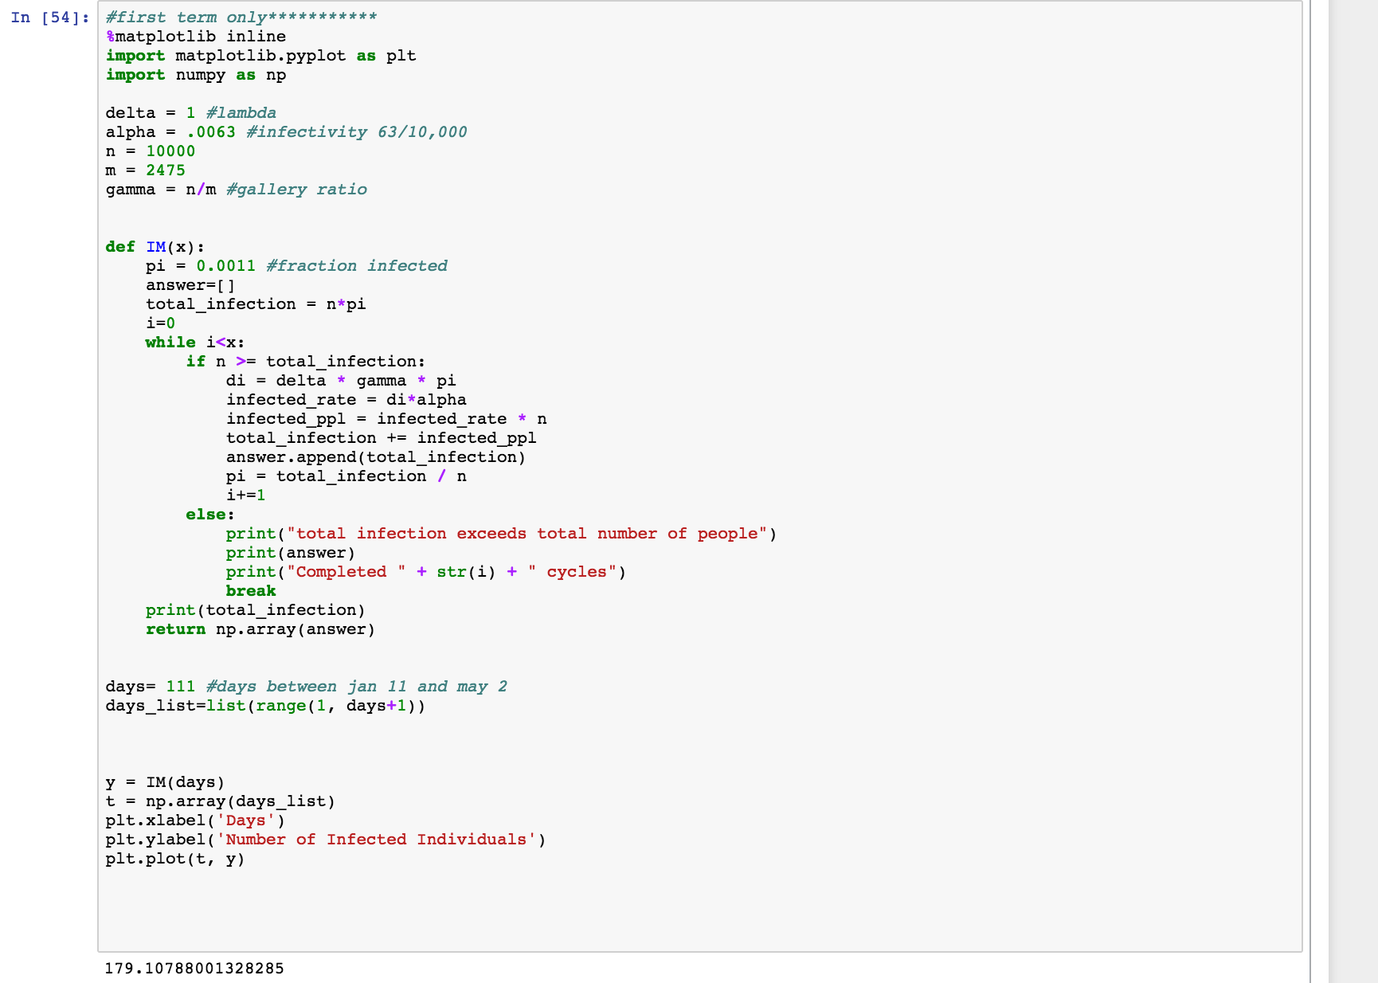
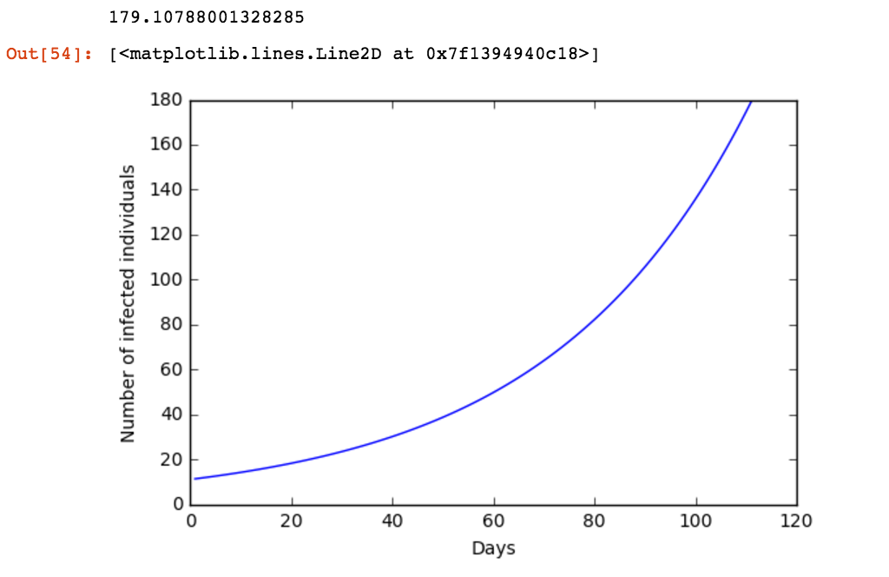
No Needle Exchange Program

Slide 10
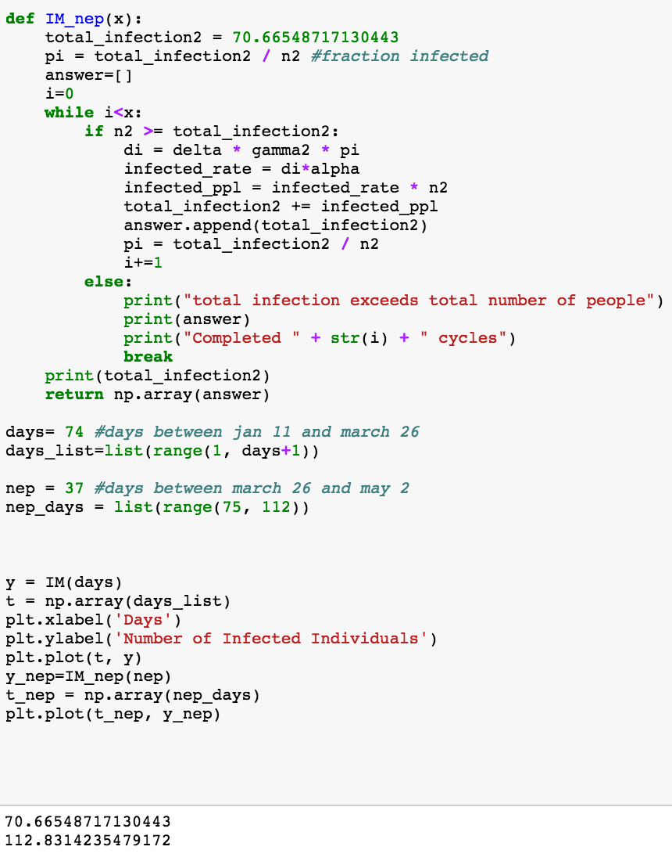
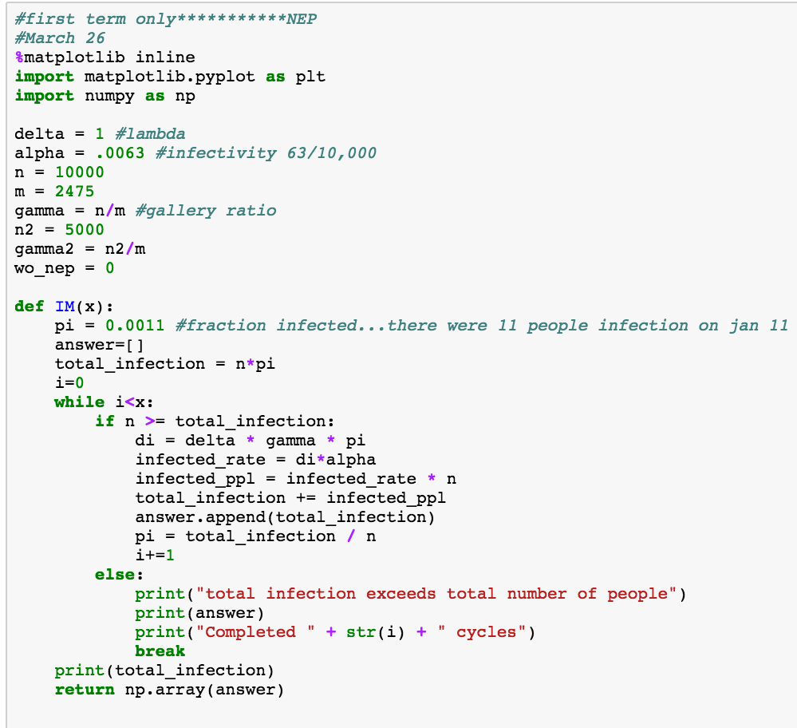
Needle Exchange Program: March 26th

Slide 11
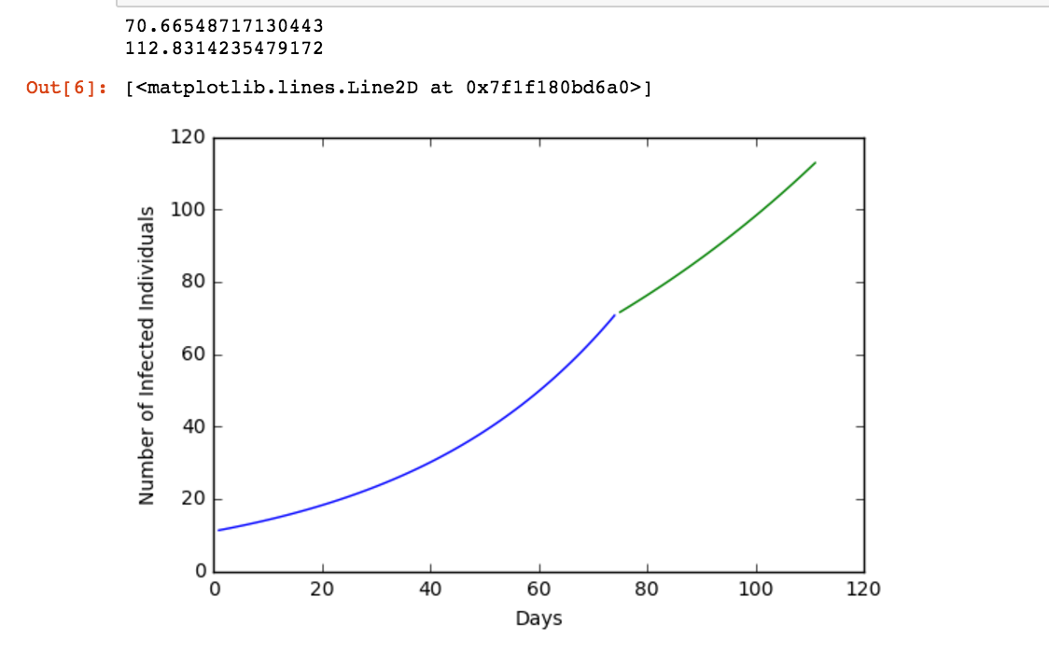
Needle Exchange Program: March 26th

Slide 12
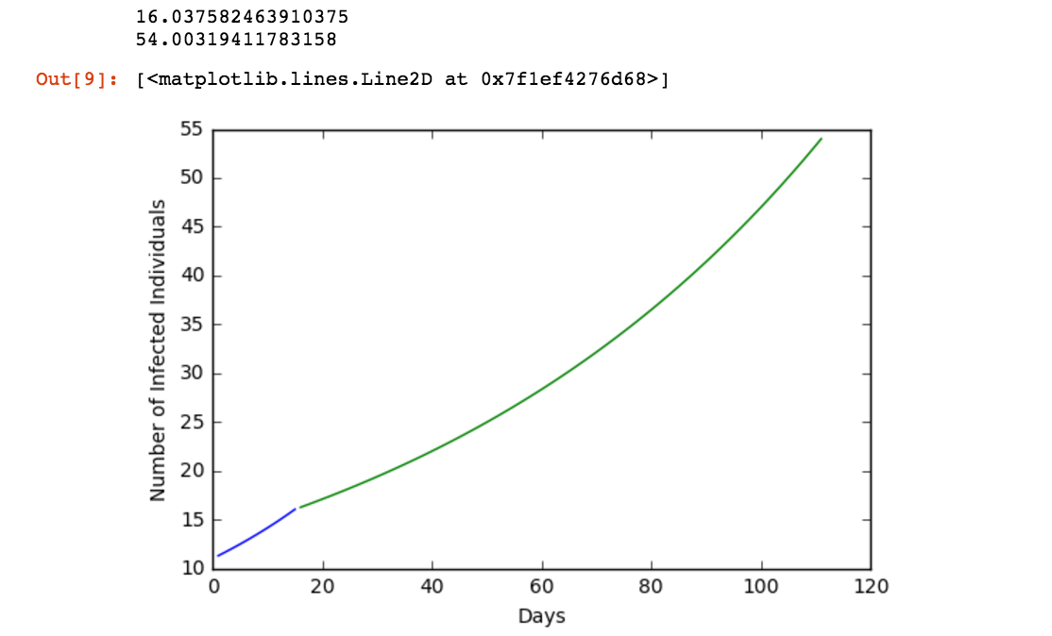
Needle Exchange Program: Jan 26th

Slide 13
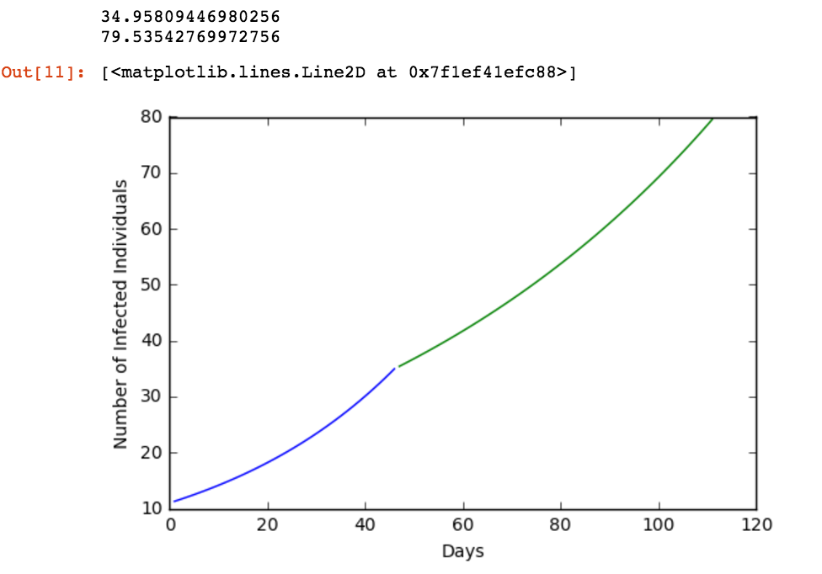
Needle Exchange Program: February 26th

Slide 14
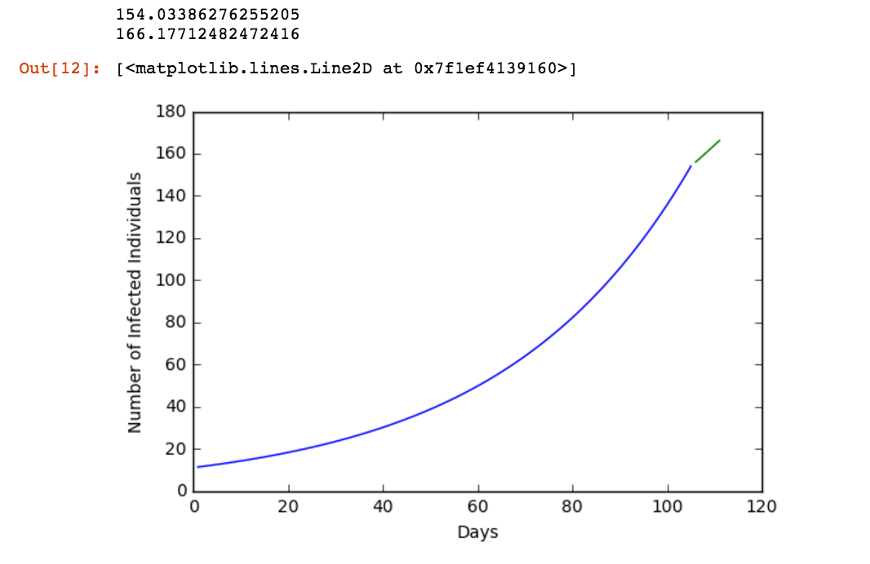
Needle Exchange Program: April 26th

Slide 15
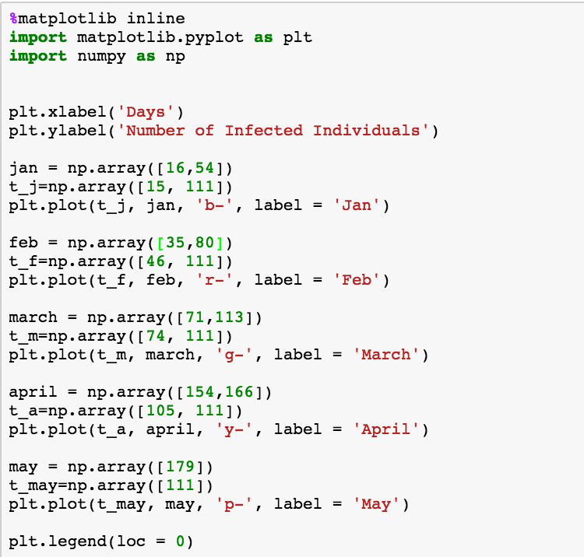
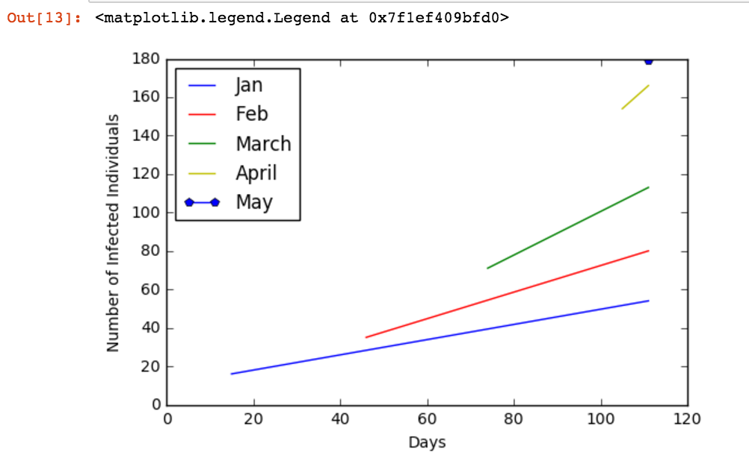
In Conclusion:

Slide 16
References
1. Runfola JK, House J, Miller L, Colton L, Hite D, Hawley A, Mead P, Schriefer M, Petersen J, Casaceli C, Erlandson KM, Foster C, Pabilonia KL, Mason G, Douglas JM. 2015. Outbreak of human pneumonic plague with dog-to-human and possible human-to-human transmission — Colorado, June–July 2014Morbidity and Mortality Weekly Report.
2. Indiana State Department of Health. 2015. Scott County Public Health Emergency Declaration Extended.
3. World Health Organization. 2004. Effectiveness of Sterile Needle and Syringe Programming in Reducing Hiv/Aids Among Injecting Drug Users. Who 1–30.
4. Kaplan EH. 1989. Needles That Kill : Modeling Human Immunodeficiency Virus Transmission via Shared Drug Injection Equipment in Shooting Galleries Author ( s ): Edward H . Kaplan Published by : Oxford University Press Stable URL : http://www.jstor.org/stable/4454849 Needle 11:289–298.
5. Atkinson J. 1996. A simulation model of the dynamics of HIV transmission in intravenous drug users. Comput Biomed Res 29:338–349.
6. Liang Y, Greenhalgh D, Mao X. 2016. A Stochastic Differential Equation Model for the Spread of HIV Amongst People Who Inject Drugs 2016:1–27.

