Slide 1
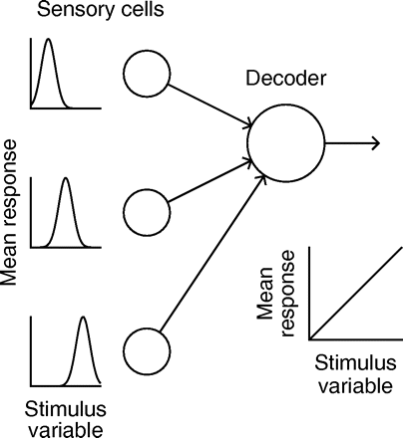
Sensory population response decoding
Chaisanguanthum et al. 2011

Slide 2
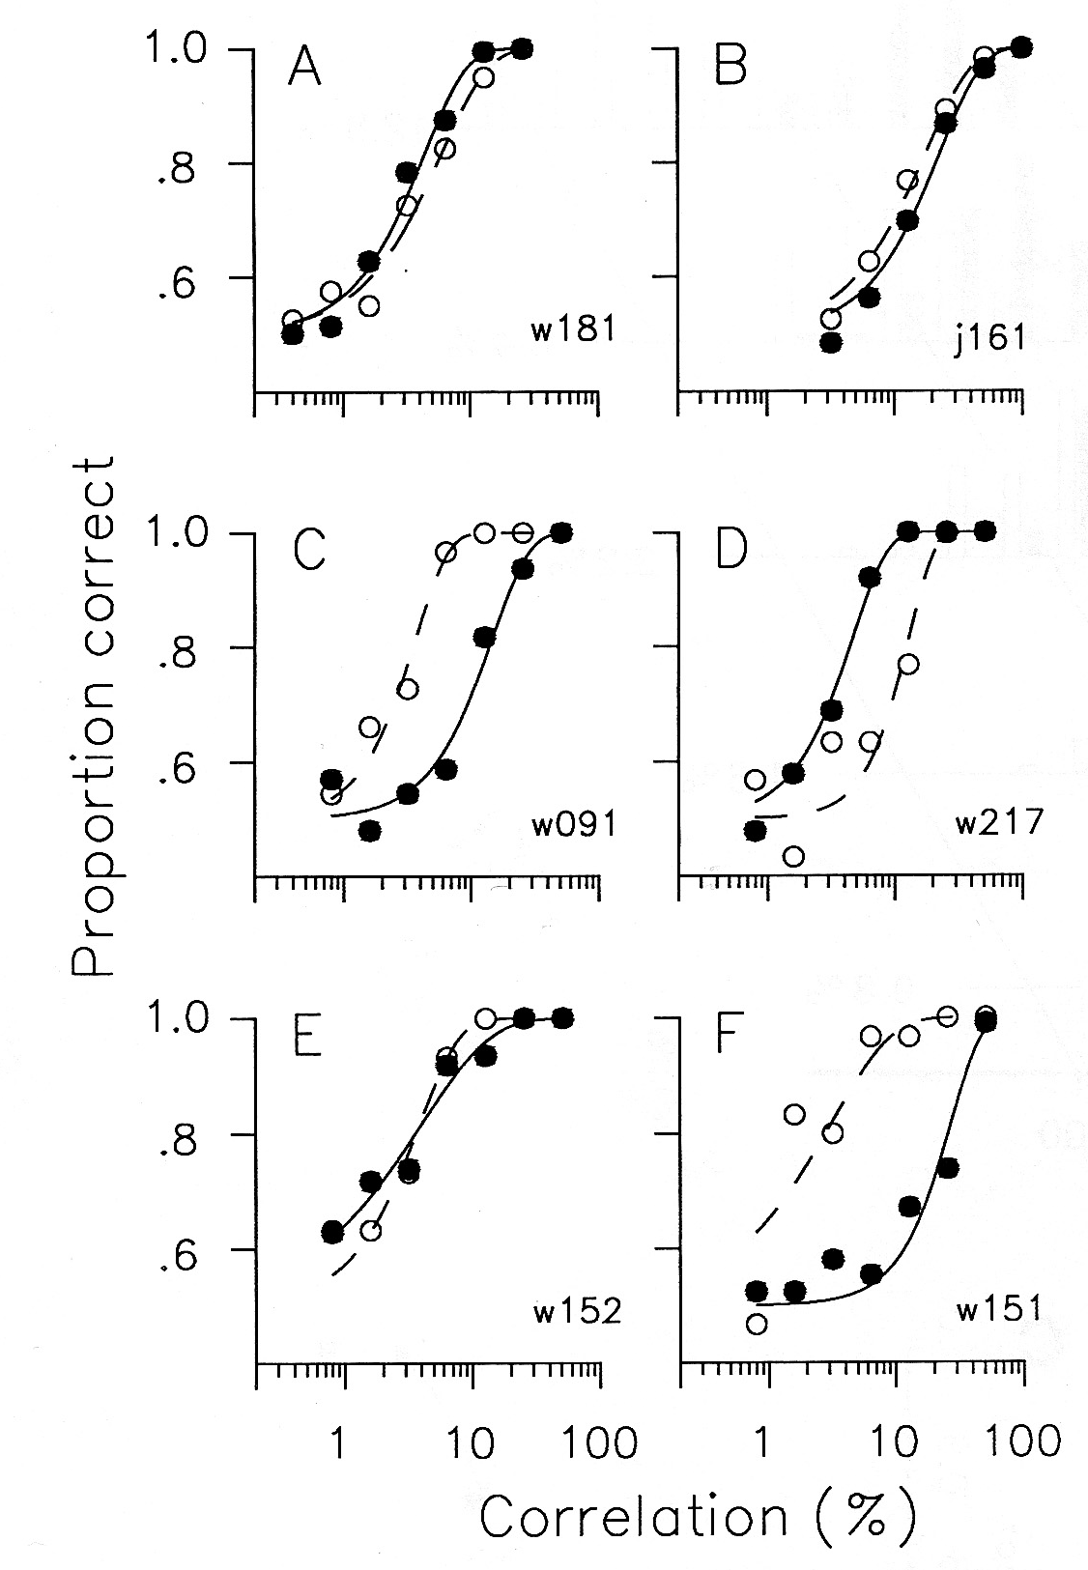
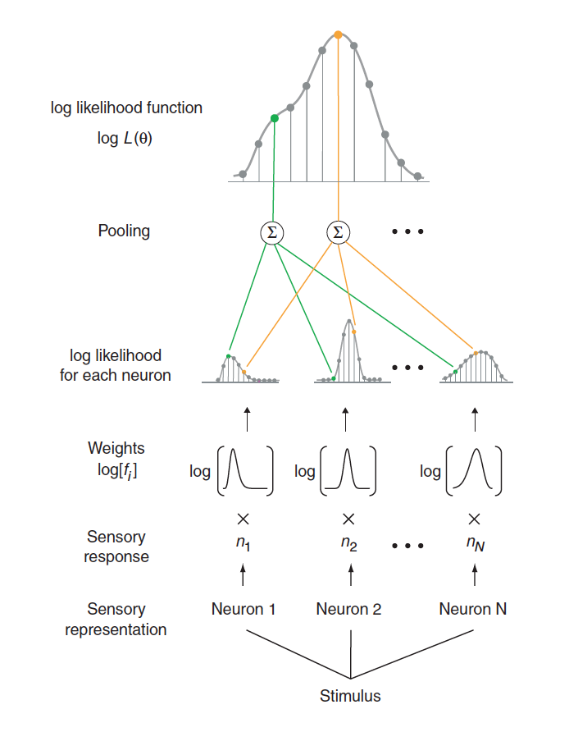
psychometric
neurometric
Britten et al. 1992
Jazayeri et al. 2006

Slide 3
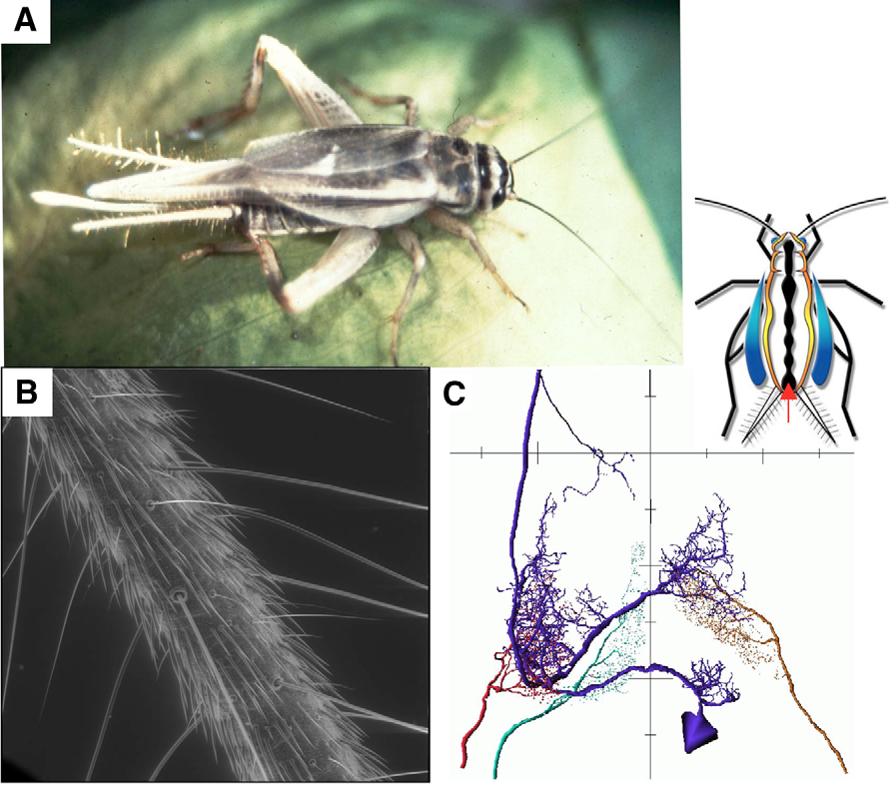
Jacobs et al. 2008

Slide 4
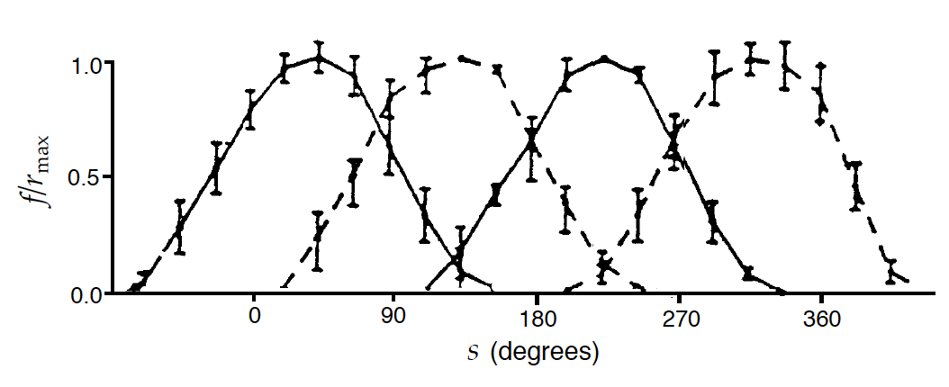
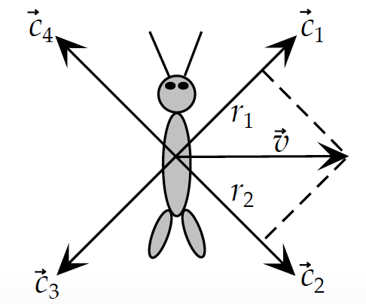

Theunissen and Miller, 1991

Slide 5
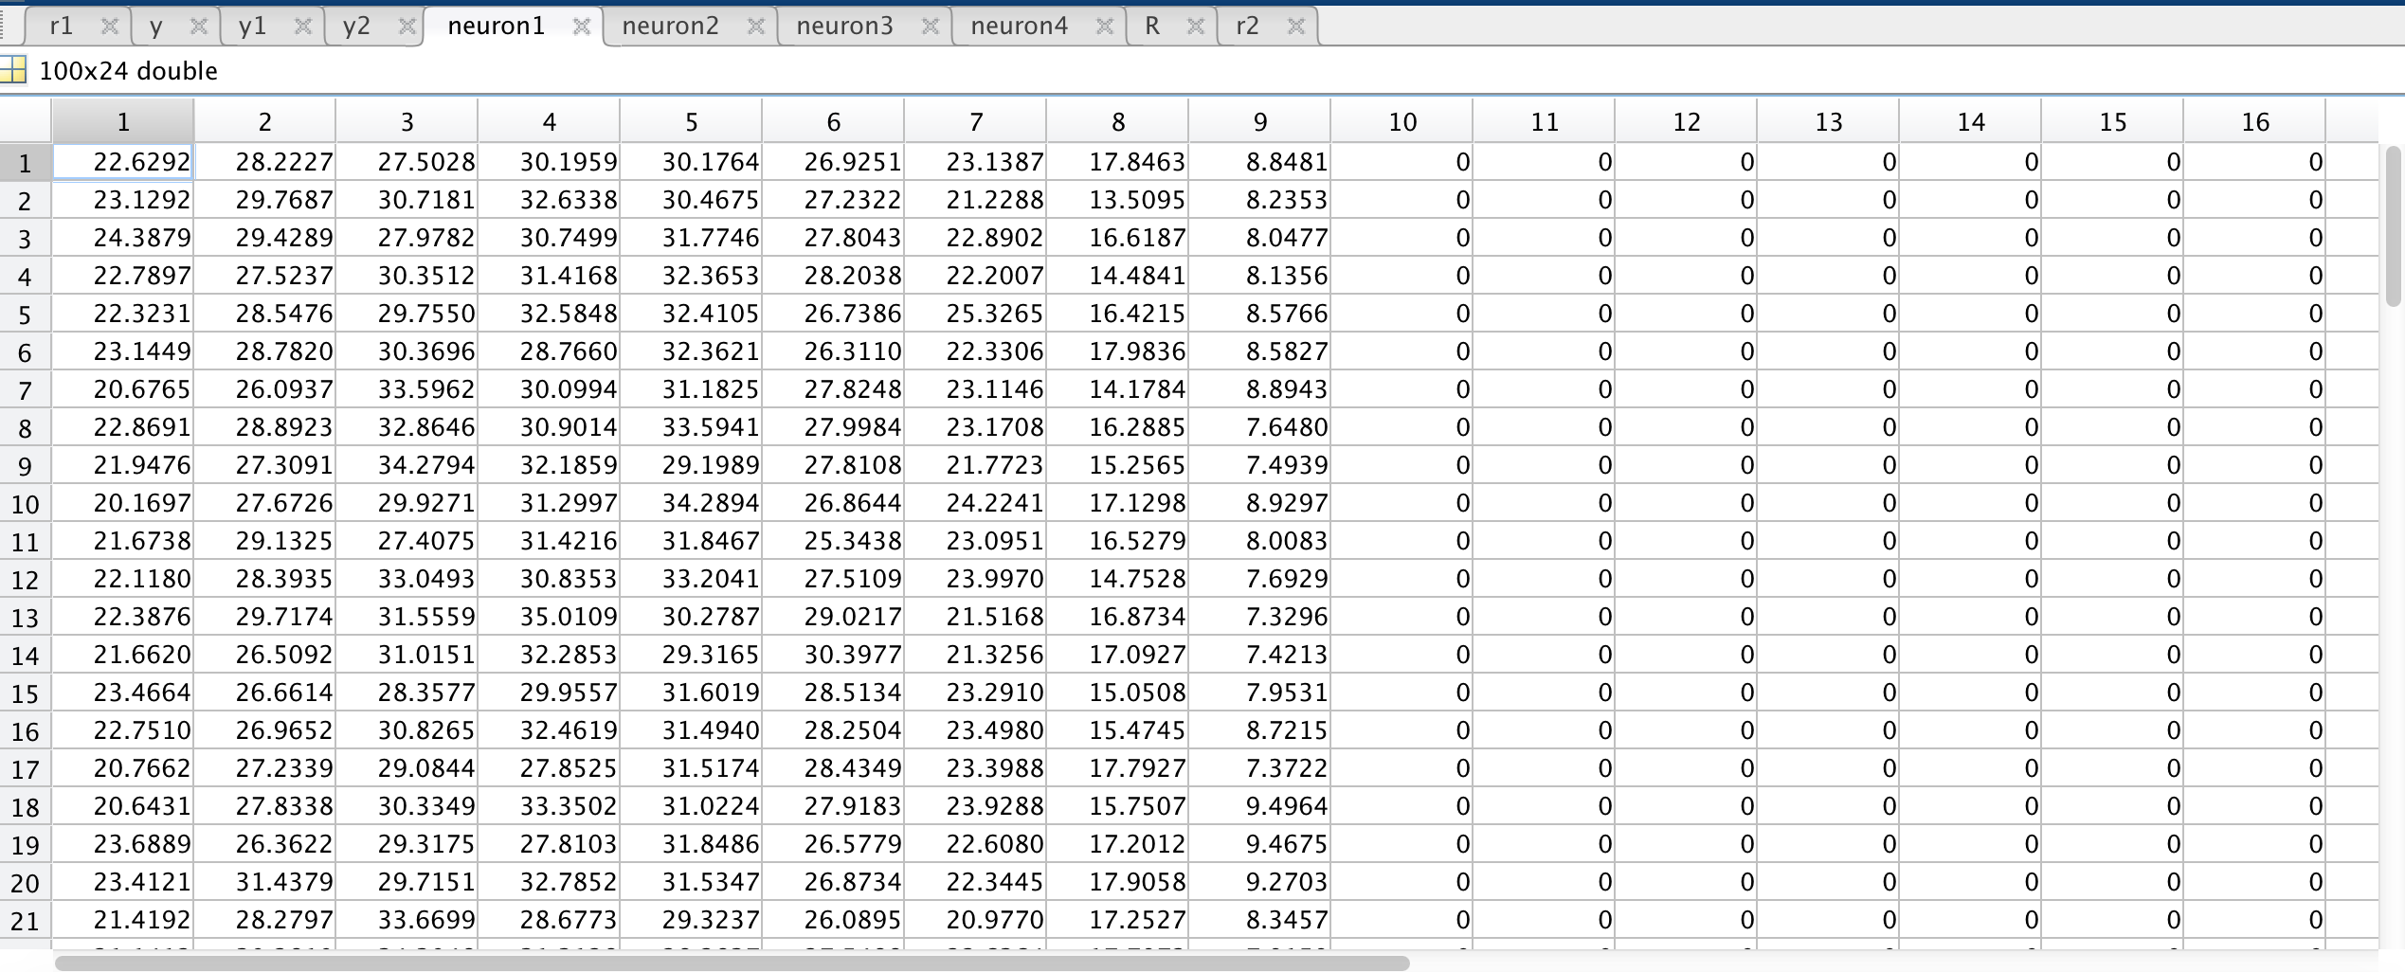

Slide 6
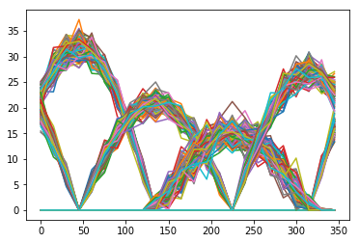
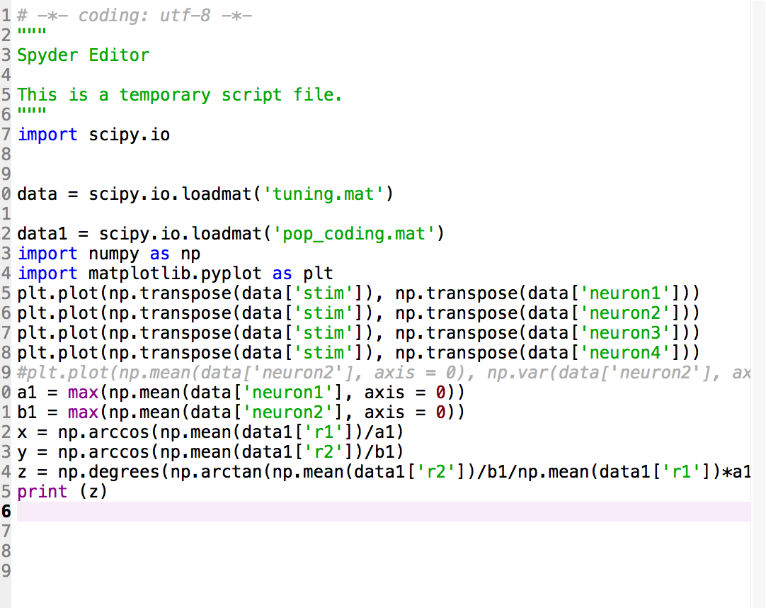

Slide 7




degree = np.degrees(np.arctan(np.mean('r2'])/max(neuron2)/np.mean(['r1'])*max(neuron1))
67.1718663003

Slide 8
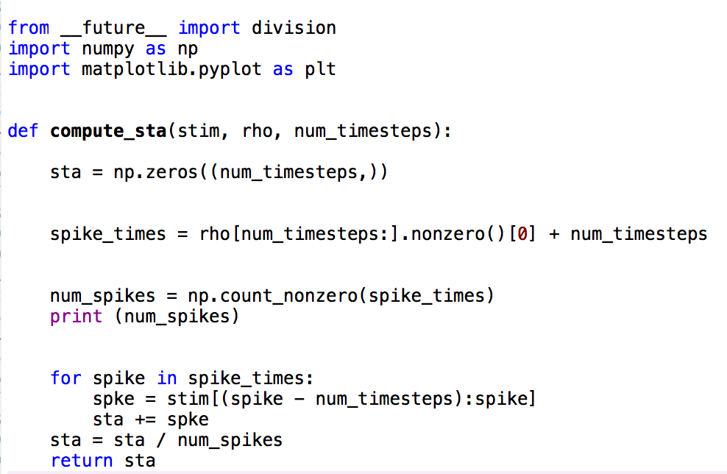
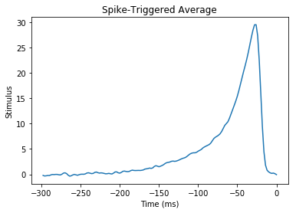
Compute the spike triggered average
It is calculated by averaging the stimulus that precedes a spike, over every spike fired by the neuron.

