Slide 1
Using Python to assess Epigenetic Cytosine methylation across generations
By Erin Wheatley

Slide 2
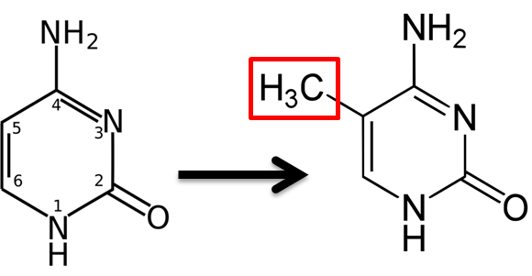
Background
Epigenetics is the Inheritance of Regulations, in which chromatin modifications can be inherited across generations.
The changes in expression due to environmental cues over the organisms lifetime can be inherited!
DNA Methylation of Cytosine (common to CpG islands) are associated with gene silencing through the formation of heterchromatin, blocking transcription of the gene and therefore limiting expression. Determination of Methyl groups becomes apparent against an un-methylated strand following Bisulfite Sequencing
CH₃
CH₃
5’CGCGCGCGCG 3’
3’GCGCGCGCGC 5’
CH₃
CH₃

Slide 3
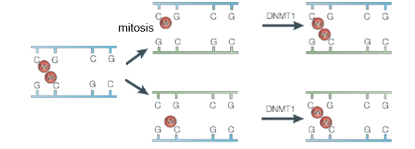
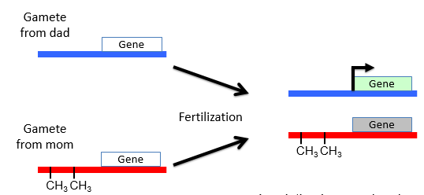
Methyl Groups added to DNA during gamete formation (Imprinting) though the patterns can differ between egg and sperm, expression depends on which parent provides the allele.
In my experiments I will assume that the subjects being studied the parental strand passes on for both P1 and F1 generations.

Slide 4
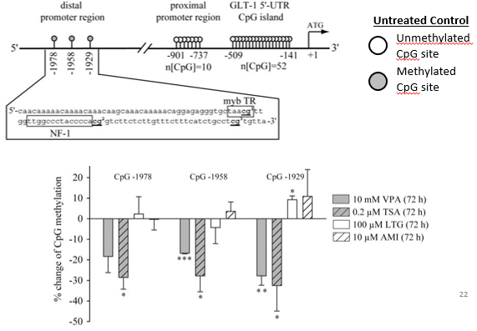
A known inhibitor of Histone acetyl transferase (HAT) proteins, altered by methylation to three promotor sites.

Slide 5
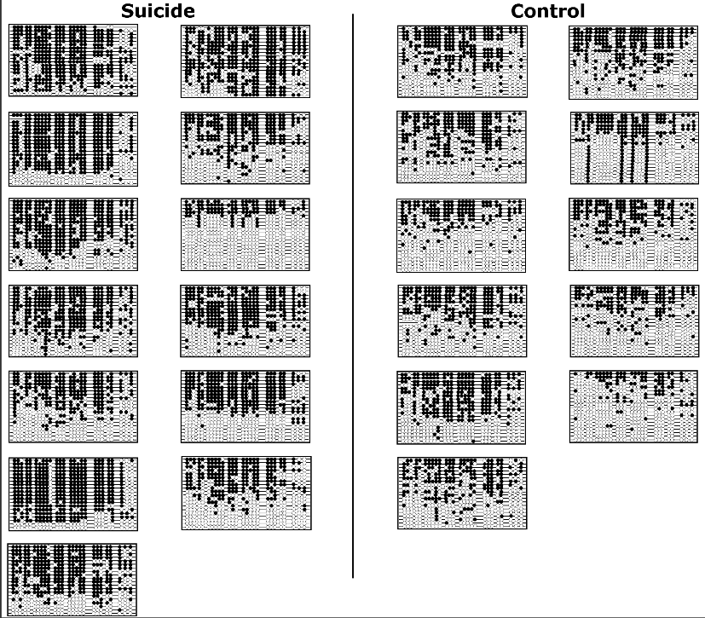
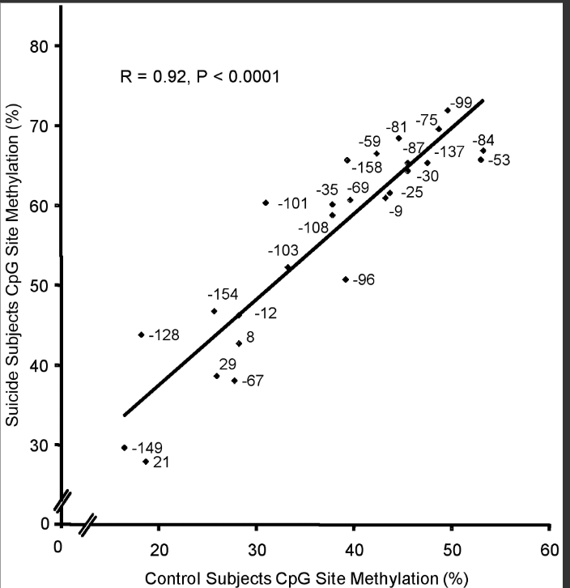
Methylation of rRNA promoters and The Suicide brain

Slide 6
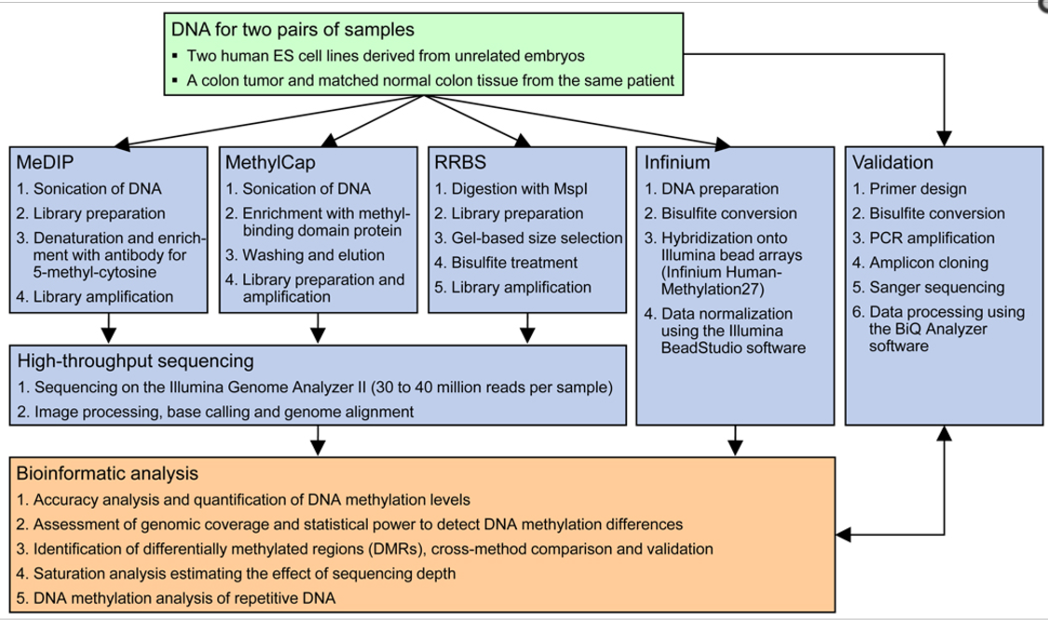
Current Studies and Literature
(X)

Slide 7
Goals
The goal of this project is to model and assess a population wide epigenetic mechanism known as methylation to further clarify and predict the next generation of methylated DNA in individuals that have experienced trauma.
My objectives are to isolate these CG methylation sites and assess the percentage of expression in the parental, F1 and F2 generations, determining if the percentage of sites remains constant or decreases with each generation.
The code I was hoping to create would be able to make the distinction of repeated methylated CG sites on a specified section of DNA, then compare the existing percentages across generations in order to determine if these sites moved forward with a regular frequency on this target strand.

Slide 8
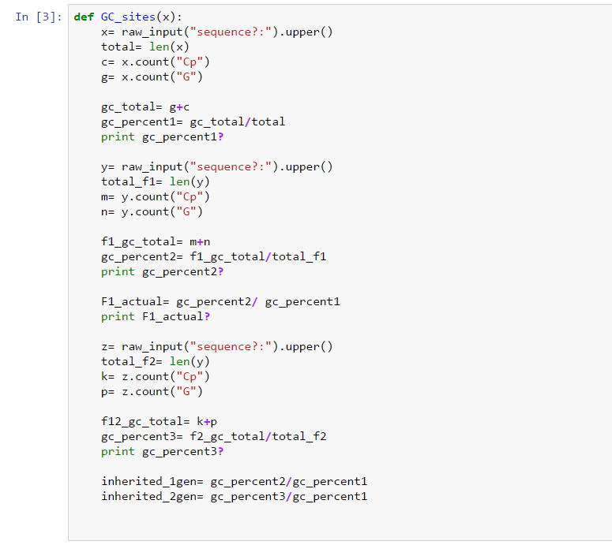
Python Methods
My intention here was to do a quick percentage assessment for each generation and then compare the percentages for both the F1 and F2 to the parental.
The flaw with this code, though it makes an accurate assessment to the amount of continued methylation, is that it does not capture direct locations nor does it account for the F1 experiencing their own chromatin remodeling due to trauma. This would work only under conditions where it was guaranteed only the parental experienced trauma.

Slide 9
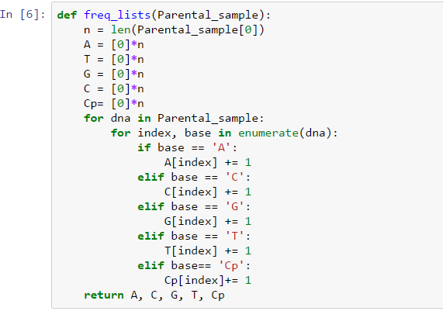
Methods Cont.
My next goal was creating a matrix of the individual frequencies, hoping to get a better image of the positions for each CpG pair. With this information I could then continue with the comparison of matrixes (and therefore location) to see if the percentages of continued methylation matched as the location of those sites became apparent with those frequencies.
In this Example I used the parent strand to build the matrix, but I did this for the following F1 and F2 generations and the next step became building the consensus between the matrices.

Slide 10
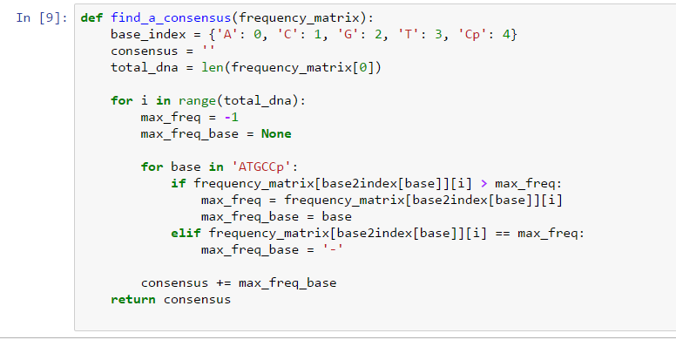
Methods Cont.
The Point of making a consensus for my matrices that just spits out the complied string based on frequency of the placement is to compare this strand to the parental. The strand that comes out, if methylation has carried on for both generations, should be incredibly similar to the parental strand with the given exception of point mutations altering frequencies of the other bases in the strand.

Slide 11
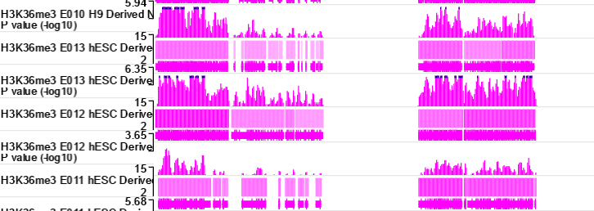
Expected Results
The results I anticipate center around the basis that methylated cytosine bases will continue to be translated to offspring during meiosis 1, and therefore I expect to see that the percentages of methylation will only increase and that the altered expression of the target gene remains consistent across both generations following the parental assessment.
The methylation of different areas as the generations pass along methylated DNA could also be a potential result that would have to be accounted for and tested to see how expression was or was not altered.
Above is a representation of methylation pattern expression in the DNA of a neural progenitor cultured cell (found here: x) With the assessment of multiple generations, the expectation is that the peaks would follow the same trend lines.

Slide 12
Conclusions
The examination of epigenetic markers and the study of the inheritance of changed gene expression can be incredibly useful in the prediction of the health in generations following trauma. Because the changed expression can be identified and trends for it can be easily followed through code, an individual looking to assess the nature of a cognitive impairment or disorder may be able to track their gene expression back through familial study and be able to make more educated treatment plans. As differences in expression are primarily seen in brain tissue ( see Prader Willi Syndrome and Angelman Syndrome) the influence of methylation on gene expression across generations will decipher how these inhibitors are able to influence lives.

