Slide 1
FISH (fluorescence in situ hybridization) image processing and Ab10 (abnormal chromosome 10) identification in cell nuclei of maize
Jianing Liu

Slide 2
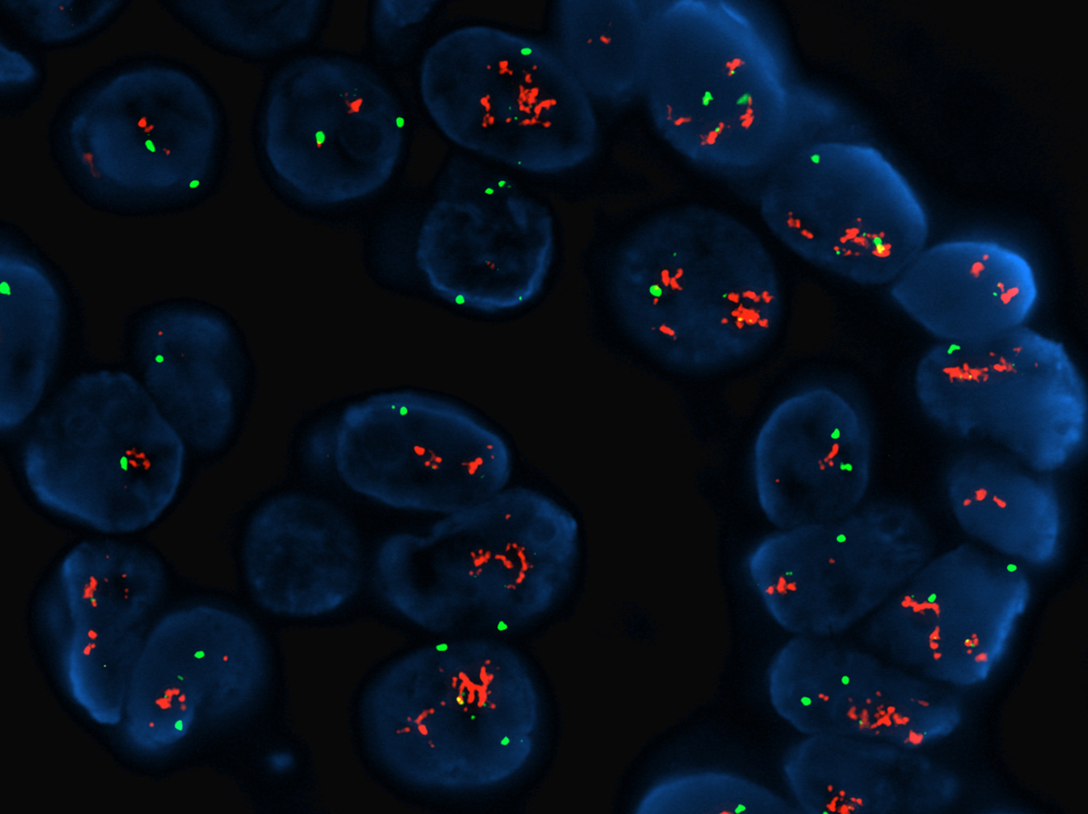
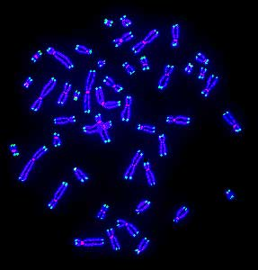
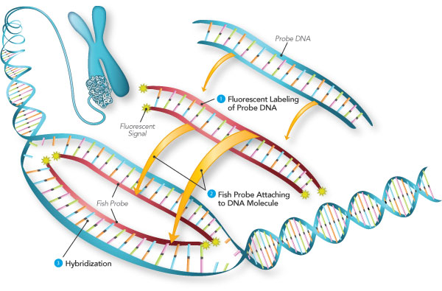
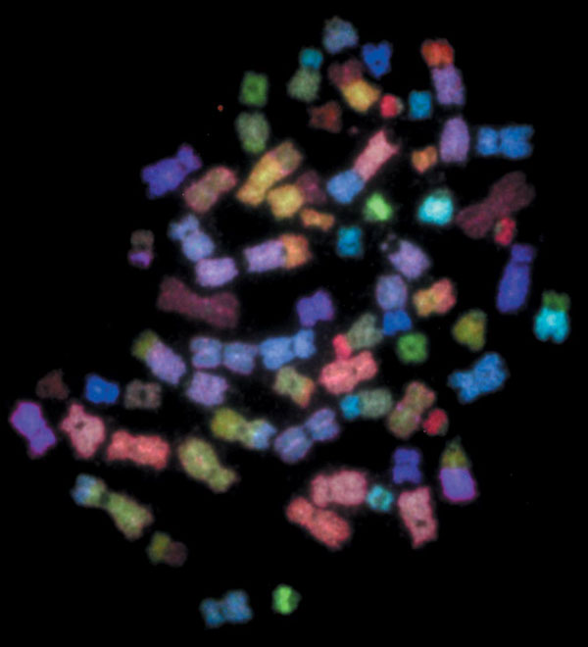
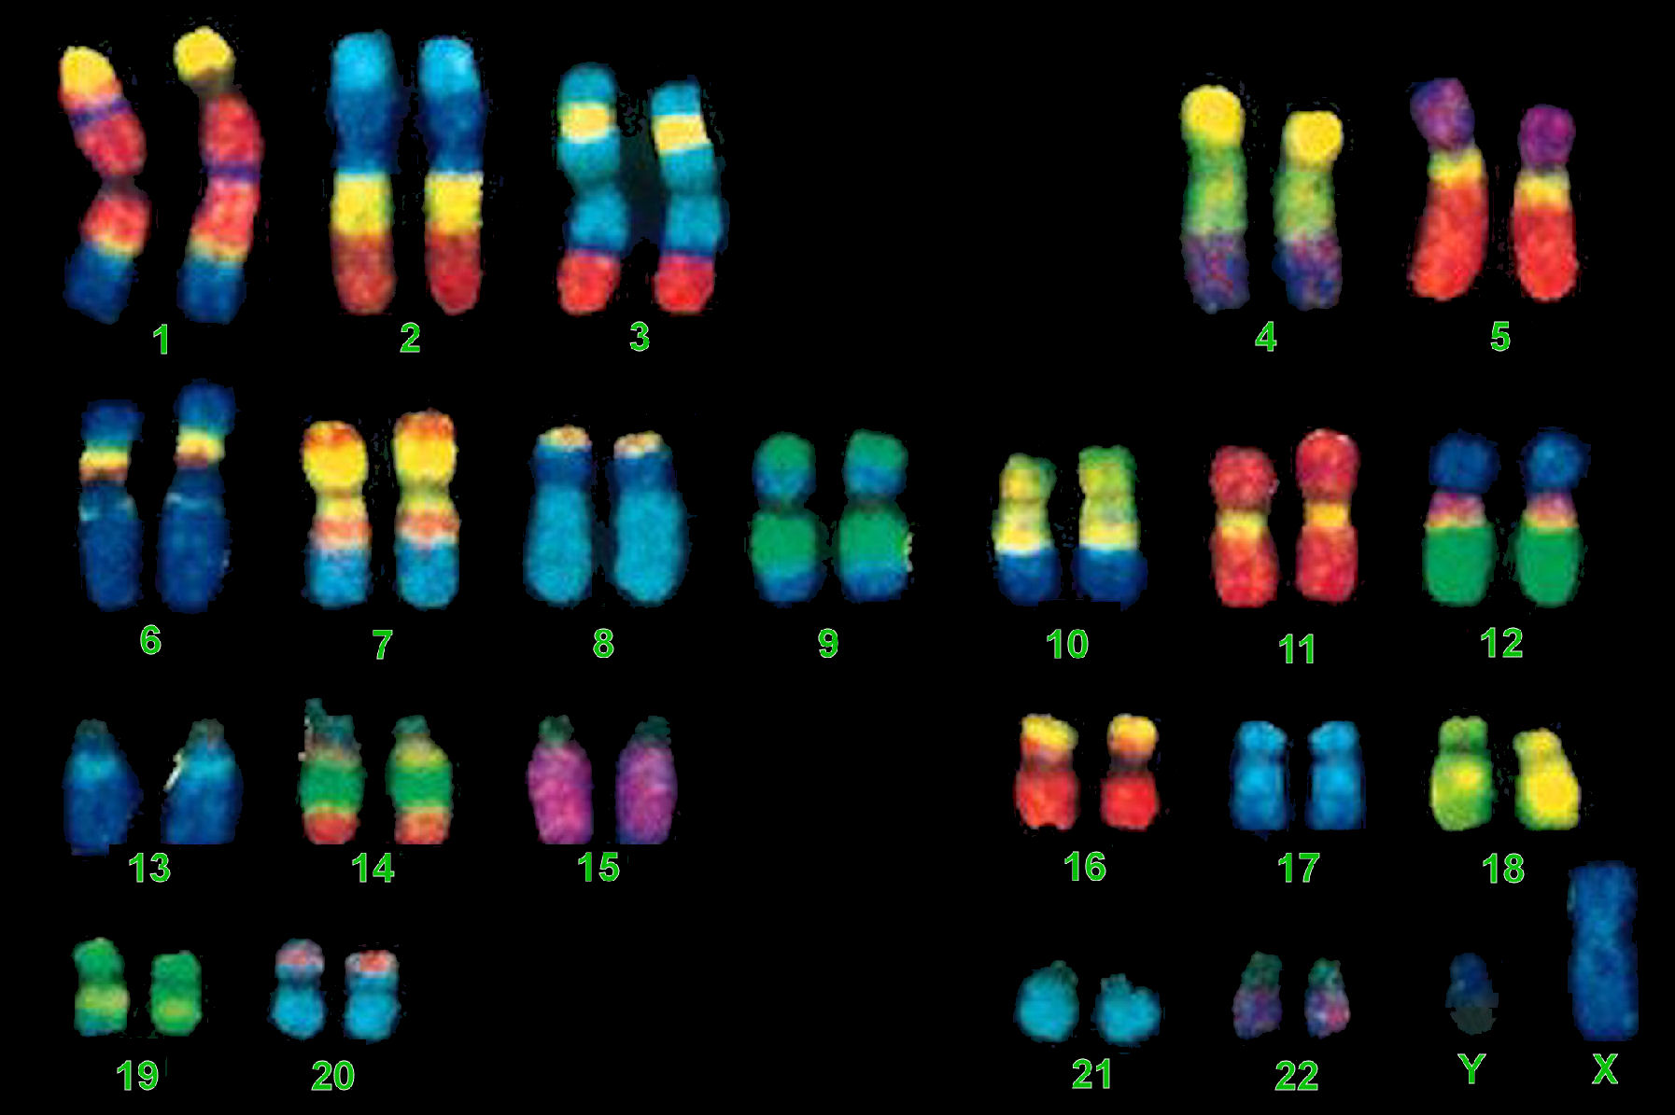
Fluorescence in situ hybridization
Cytogenetic technique
Fluorescent probes complementary to the gene/chromosomal regions of interest
https://www.mun.ca/biology/scarr/FISH_chromosome_painting.html
Notes:
Images of cells in microscopy at lower magnification
Each cell
Lable with multiple probes

Slide 3
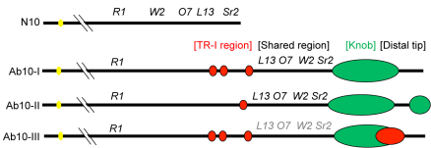
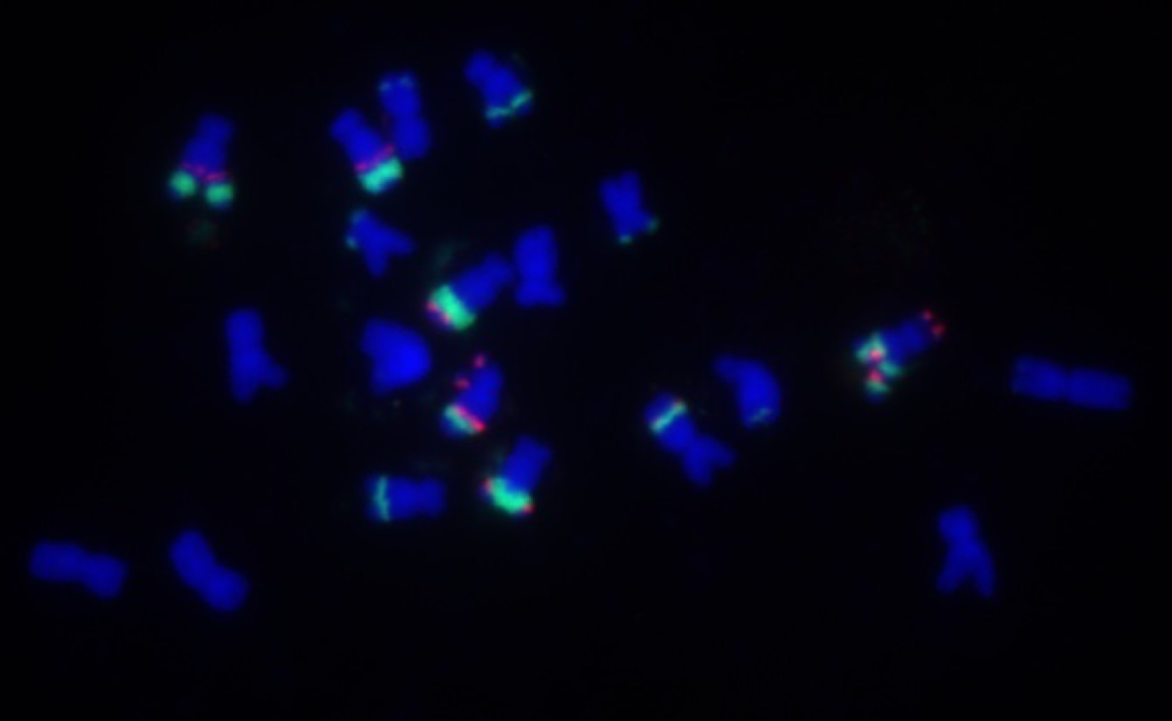
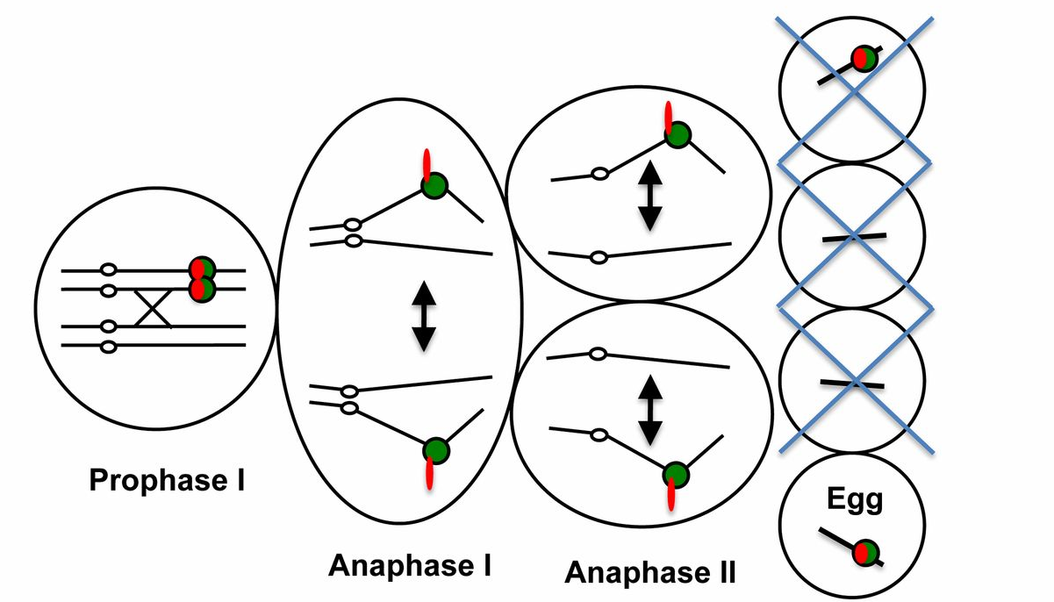
Ab10 (abnormal chromosome 10) in maize
DNA
Knob180
TR-1
Zea mays parviglumis Ab10-I
Kanizay, Lisa B., et al. Genetics 194.1 (2013): 81-89.
Notes:
FISH images of maize chromosomes, DNA stained with DAPI (blue), two probes (knob180- green, TR-1 –red)
Knob 180bp and 350-bp TR-1 (tandem repeat) both are knobs
Both the TR-1 and knob 180 repeats exhibit, meiotic drive resulting in the unequal segregation of alleles to progeny .

Slide 4


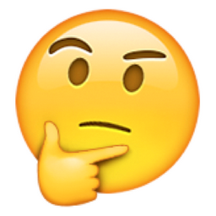
Proposal goals
Improve FISH image quality for visualization
Quantify the knob (Knob180 and TR1) size and intensity in each chromosome
Identify Ab10 based on their cytological features

Slide 5
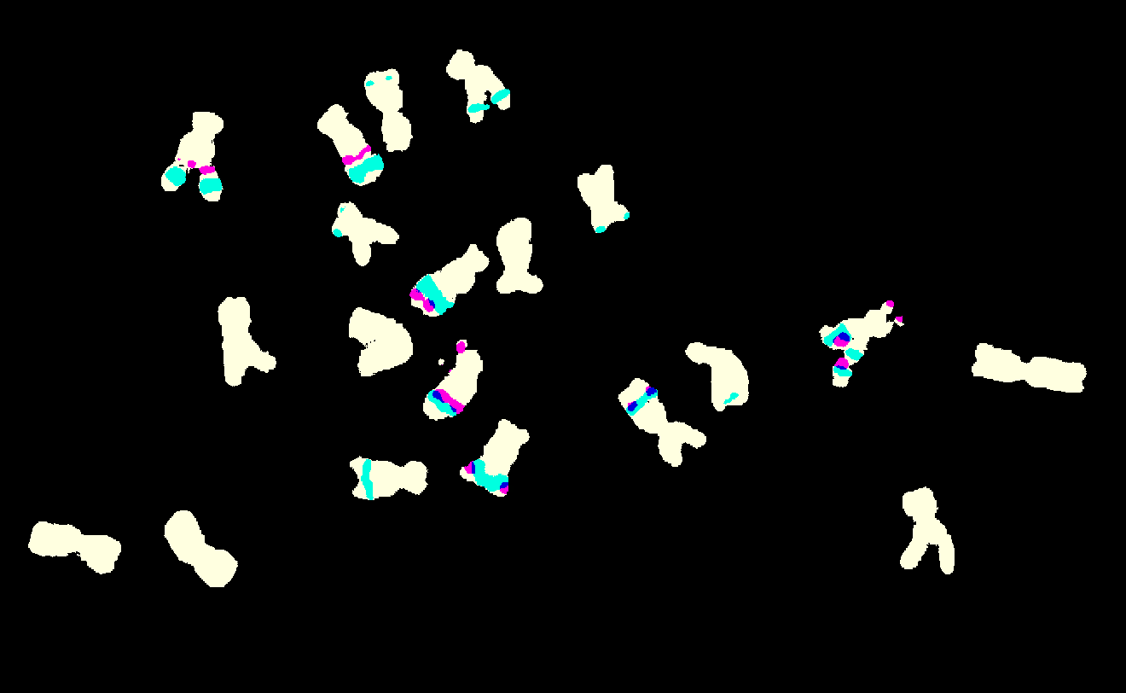
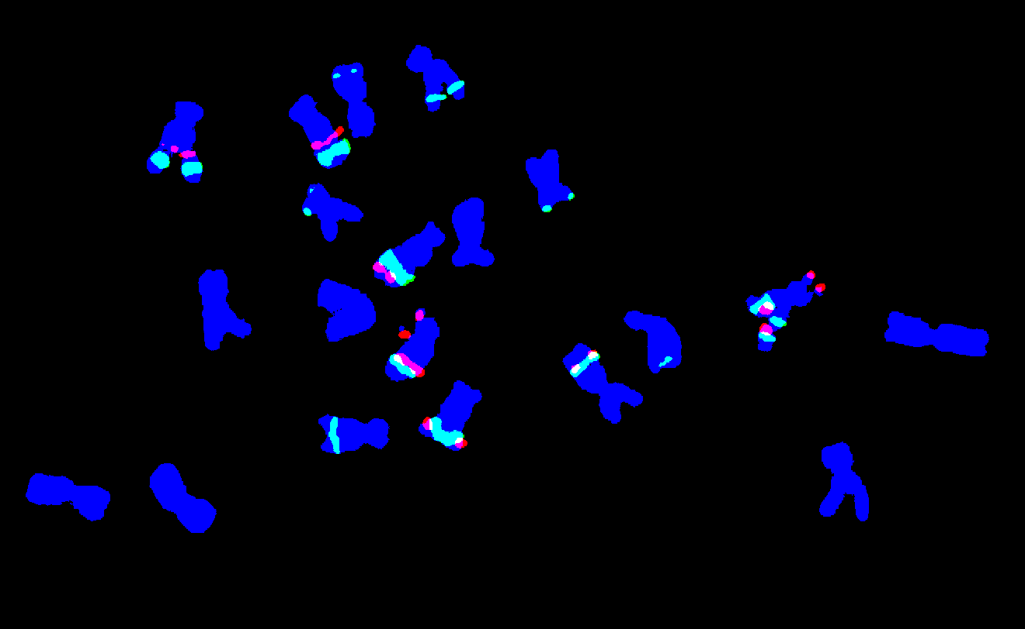
Image thresholding
from skimage import io
from skimage.filters import threshold_adaptive
import numpy as np
from skimage import color
# Load the image by skimage io ab10_2 = io.imread('/Users/JianingLiu/Downloads/ab10-typeI.png') ab10_2_gray = color.rgb2gray(ab10_2) # Separate out the channels r = ab10_2[:, :, 0] g = ab10_2[:, :, 1] b = ab10_2[:, :, 2] # Read in an RGB image and convert it to grayscale r_gray = color.rgb2gray(r) g_gray = color.rgb2gray(g) b_gray = color.rgb2gray(b) # Apply threshold to each channel and change boolean image from threshold_adaptive to 0/1 binary image g_bw = threshold_adaptive(g_gray, 47, offset=-20) * 1 r_bw = threshold_adaptive(r_gray, 65, offset=-25) * 1 b_bw = threshold_adaptive(b_gray, 83, offset=-10) * 1 combined_bw = np.zeros((g.shape[0],g.shape[1]), dtype=int) # Merge channels ab10_2_merge = np.ones((r.shape[0], r.shape[1], 3), 'uint8') ab10_2_merge[:, :, 0] = r_bw * 255 ab10_2_merge[:, :, 1] = g_bw * 255 ab10_2_merge[:, :, 2] = b_bw * 255 ab10_2_merge_fig = Image.fromarray(ab10_2_merge) ab10_2_merge_fig.save("/Users/JianingLiu/Downloads/ab10_1_merge.png")
color_b = b_bw - g_bw - r_bw ab10_color_merge = np.ones((r.shape[0], r.shape[1], 3), 'uint8') ab10_color_merge[:, :, 0] = r_bw * 255 + color_b * 255 ab10_color_merge[:, :, 1] = g_bw * 255 + color_b * 250 ab10_color_merge[:, :, 2] = b_bw * 240 ab10_color_merge_fig = Image.fromarray(ab10_color_merge) ab10_color_merge_fig.save("/Users/JianingLiu/Downloads/ab10_color_merge.png")
RGB Color Codes Chart - floral white

Slide 6
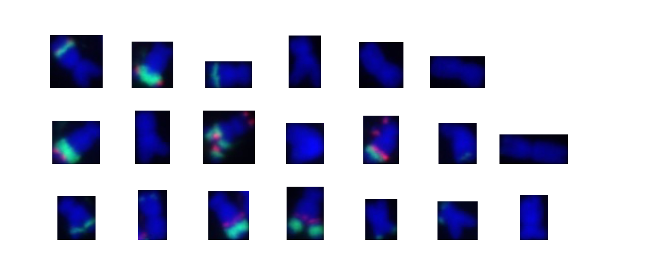
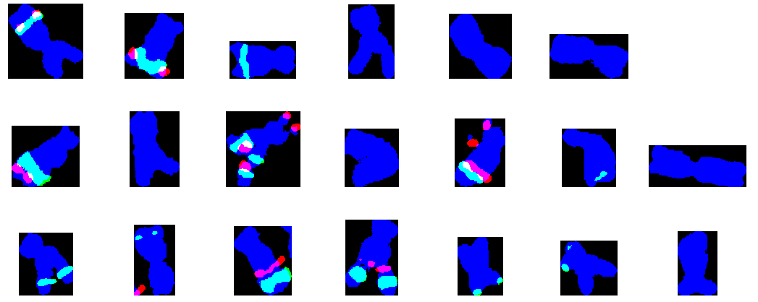
Isolate each chromosomal regions
from skimage.measure import label, regionprops
# Plot individual chromosomes with red/green fluorescence in bbox combined_bw = b_bw + g_bw + r_bw combined_bw[combined_bw >1] = 1 combined_label_image = label(combined_bw) combined_regions = regionprops(combined_label_image) regions_sliced = [] regions_sliced_widths = [] for region in combined_regions: if region.area > 100: regions_sliced.append(ab10_2_merge[region.bbox[0]:region.bbox[2], region.bbox[1]:region.bbox[3]])
for i, img in enumerate(regions_sliced): x = i % 7 y = int(i / 7) plt.figimage(img, 150 + 150 * x - regions_sliced_widths[i] / 2, 75 + 150 * y) plt.show()
Notes:
Combine the thresholded channels, as they all are binary (0/1), if there’s overlapping regions among the three channels, the added-up number will be 2 or 3 while the non-overlapped will be 1.
Change the overlapped region into 1. Use the index of the bounding box of combined regions to slice the original image and thresholded image.

Slide 7
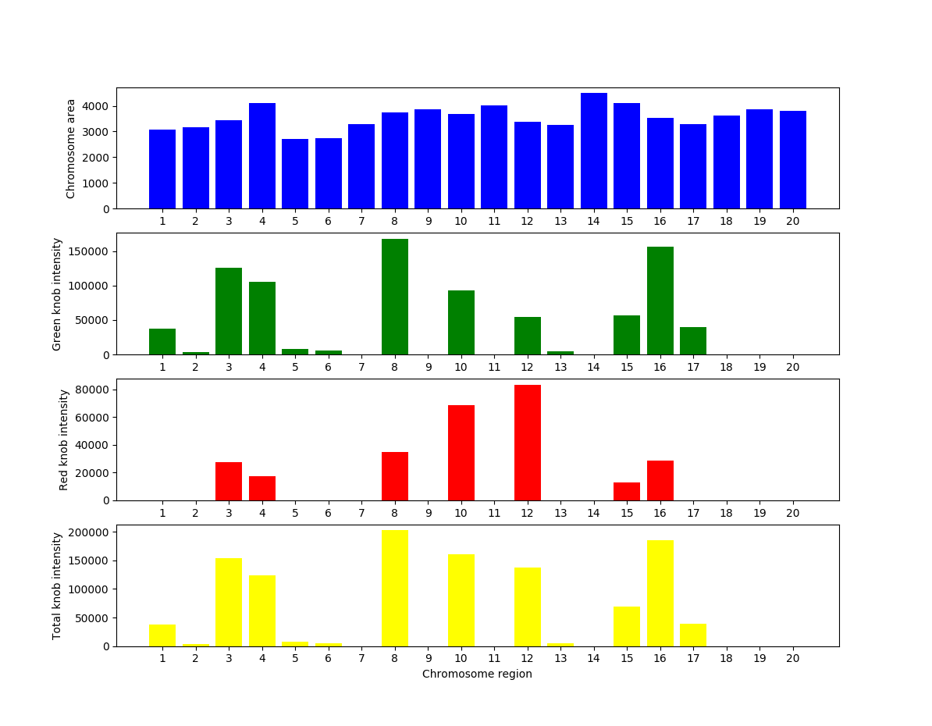
Quantify the knob intensity, size in each chromosomal region
#Centroid of green fluorescence regions located in the bbox of the same blue region are defined as belonging to one chromosome
g_regions = regionprops(g_label_image, g_gray) g_centroid = [] for region in g_regions: if region.area > 10: g_centroid.append(region.centroid)
b_bbox = [] for region in b_regions: if region.area > 100: b_bbox.append(region.bbox)
# Calculate the total area & intensity of green, red channel in each blue region (chromosome) g_total_area = np.zeros(len(b_area)) g_total_intensity = np.zeros(len(b_area)) g_belongs_to = np.zeros(len(g_centroid), dtype=np.int) i = 0 for gcen in g_centroid: j = 0 for box in b_bbox: if gcen[0]>box[0] and gcen[1] > box[1] and gcen[0] < box[2] and gcen[1] < box[3]: g_belongs_to[i] = j j += 1 i += 1 for i in range(len(g_belongs_to)): g_total_area[g_belongs_to[i]] += g_area[i] g_total_intensity[g_belongs_to[i]] += g_mean_intensity[i] * g_area[i]
import matplotlib.pyplot as plt
fig = plt.figure(figsize=(12,4)) ax = fig.add_subplot(411) xTickMarks = [str(i) for i in range(1,21)] chr = np.arange(1, len(g_total_intensity)+1) b_area_ratio = b_area ax.bar(chr,b_area_ratio,color='b',tick_label=xTickMarks) ax.set_ylabel('Chromosome area') ax = fig.add_subplot(412) ax.bar(chr,g_total_area,color='g',tick_label=xTickMarks) ax.set_ylabel('Knob area') ax = fig.add_subplot(413) area_ratio = g_total_intensity/b_area ax.bar(chr,area_ratio,color='cyan',tick_label=xTickMarks) ax.set_ylabel('Knob/Chromosome area ratio') ax = fig.add_subplot(414) ax.bar(chr,g_total_intensity,color='mediumseagreen',tick_label=xTickMarks) ax.set_ylabel('Knob intensity') plt.xlabel('Chromosome region') plt.show()
Notes:
As some chromosomes contain several knob regions, to quantify the knob intensity as well as size in each region, all of the green fluorescence regions whose centroid are located in the bounding box of blue areas are defined as belonging to one chromosome.

Slide 8
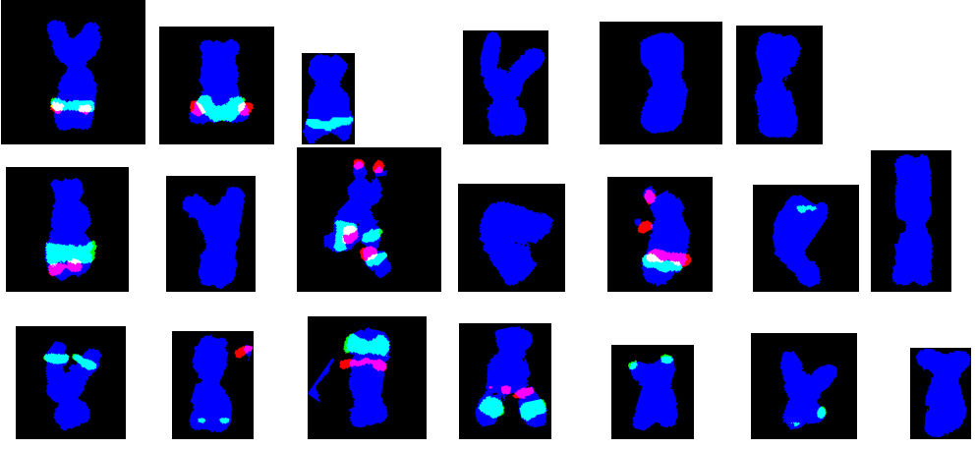
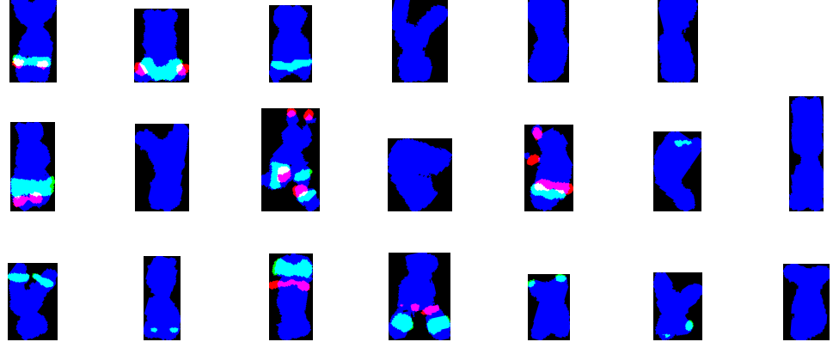
Rotate each chromosomal region
from skimage.transform import rotate
# Rotate the chromosomes in bbox by using regionprops.orientation function rtimg = rotate(ab10_2_merge[region.bbox[0]:region.bbox[2], region.bbox[1]:region.bbox[3]],90 -math.degrees(region.orientation), resize=True)
# Label the binary image of rotated region, and slice the labelled region with bbox rtbw = np.zeros((rtimg[:, :, 0].shape[0],rtimg[:, :, 0].shape[1]), dtype=int)
rtbw = rtimg[:, :, 0] + rtimg[:, :, 1] + rtimg[:, :, 2]
rtbw[rtbw > 1] = 1 rtbw_label = label(rtbw) rtbw_regions = regionprops(rtbw_label) max_area = 0. max_index = 0 for i,rt_region in enumerate(rtbw_regions): if rt_region.area > max_area: max_index = i max_area = rt_region.area max_region = rtbw_regions[max_index] regions_sliced.append(rtimg[max_region.bbox[0]:max_region.bbox[2],max_region.bbox[1]:max_region.bbox[3]]) regions_sliced_widths.append(max_region.bbox[3] - max_region.bbox[1])
Notes:
Rotate the images in bounding box of each chromosome region in the thresholded image, and as I chose resize=True along with rotation, the area of bounding box changed. Therefore new bounding box of each chromosome has to be redefined by labeling the binary image of rotated region, and slice the bounding box of labelled region.

Slide 9
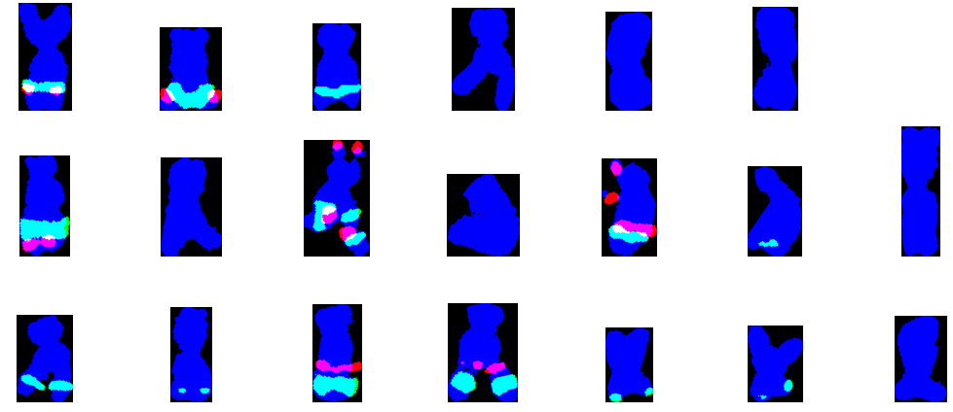
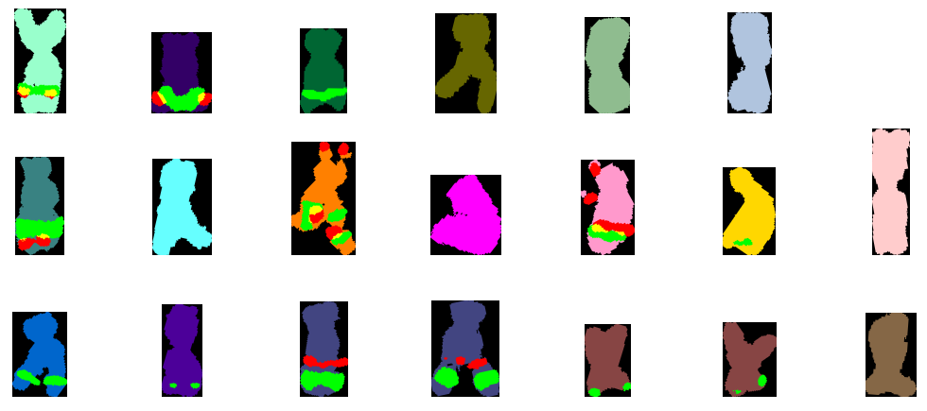
Rotate each chromosomal region
# Label rotated chromosome (blue region), calculate the centroid of the blue region
labels = label(chr_b) chr_regions = regionprops(labels) max_area = 0. max_index = 0 for i,chr_region in enumerate(chr_regions): if chr_region.area > max_area: max_index = i max_area = chr_region.area chr_b_region = chr_regions[i] chr_b_cen_y = chr_b_region.centroid[0]
# Label the rotated knobs (green region), and calculate the centriod of the green areas in each chromosome by adding up the centroid multiplying the area ratio/ total area of each green region
labels = label(chr_g) chr_regions = regionprops(labels) max_area = 0 area_weight = [] for chr_region in chr_regions: max_area += chr_region.area area_weight.append(float(chr_region.area)) area_weight = np.array(area_weight) / max_area chr_g_cen_y = 0.
# Compare the centroid of green region vs blue region, make the green area located in the bottom of each image for i,chr_region in enumerate(chr_regions): chr_g_cen_y += chr_region.centroid[0] * area_weight[i] if chr_g_cen_y < chr_b_cen_y: rtimg_chr = rotate(rtimg_chr,180)
chr_color = np.matrix([[0,102,204],[76,0,153],[66,69,129],[66,69,129],[135,69,68],[135,69,68],[133,103,70],[57,130,130],[102,255,255],[255,128,0],[255,0,255],[255,153,204],[255,215,0],[255,204,204],[153,255,204],[51,0,102],[0,102,51],[102,102,0],[143,188,143],[176,196,222],[128,0,0],[189,183,107]]) chr_b1 = chr_b - chr_g - chr_r chr_b1[chr_b1 < 0] = 0 ci = l % chr_color.shape[0] chrimg[:, :, 0] = chr_b1 * chr_color[ci,0] + chr_r * 255 chrimg[:, :, 1] = chr_b1 * chr_color[ci,1] + chr_g * 255 chrimg[:, :, 2] = chr_b1 * chr_color[ci,2]

Slide 10
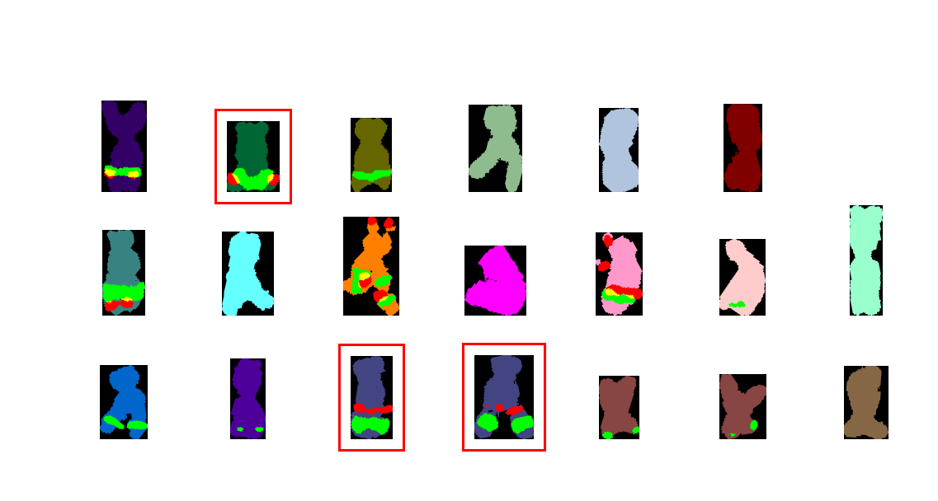
Identification of Ab10
Centroid location of Knob180 vs TR1
noTR1onTop = True for chr_region in chr_regions: if chr_region.centroid[0] > chr_b_cen_y: max_area += chr_region.area area_weight.append(float(chr_region.area)) else: area_weight.append(0.) if chr_region.area > 5: noTR1onTop = False area_weight = np.array(area_weight) / max_area chr_r_cen_y = 0. for i, chr_region in enumerate(chr_regions): chr_r_cen_y += chr_region.centroid[0] * area_weight[i] if chr_g_cen_y > chr_r_cen_y and chr_r_cen_y != 0: ab10[len(regions_sliced) - 1] = True and noTR1onTop

Slide 11
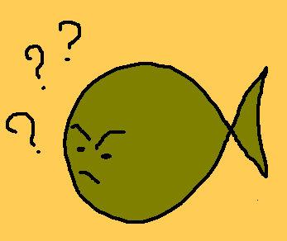
Questions?
Suggestions?

