Slide 1

LightGBM Parameters
Theres a lot…
About 33 for basic LightGBM, and around 100 if you want to get fancy
We will go over the essentials to get LightGBM tuned

Slide 2
Parameter | What it controls | Why its important
num_leaves | How big the tree gets | If the trees are too small, you underfit, too large, and you overfit!
colsample_bytree | The fraction of features used in each tree | Randomly selecting features helps improve out of sample accuracy. Using the right fraction depends on your data.
subsample | The fraction of observations used in each tree | Using a subset of observations in each tree also helps improve out of sample accuracy.
learning_rate | The learning rate of each new tree | This variable decides how much you incorporate each new tree into your model. Keeping it low helps you be more conservative to prevent overfitting.
min_split_gain | The minimum split gain | This requires each split of the tree to reduce your loss function by a minimum amount each time. Lower values prevent overfitting.

Slide 3

Tuning Parameters
Many Methods
GridSearchCV
BayesSearchCV
Optuna
Guess and check
We will go over GridSearch and BayesSearchCV
Part of Scikit-Learn’s optimization package

Slide 4
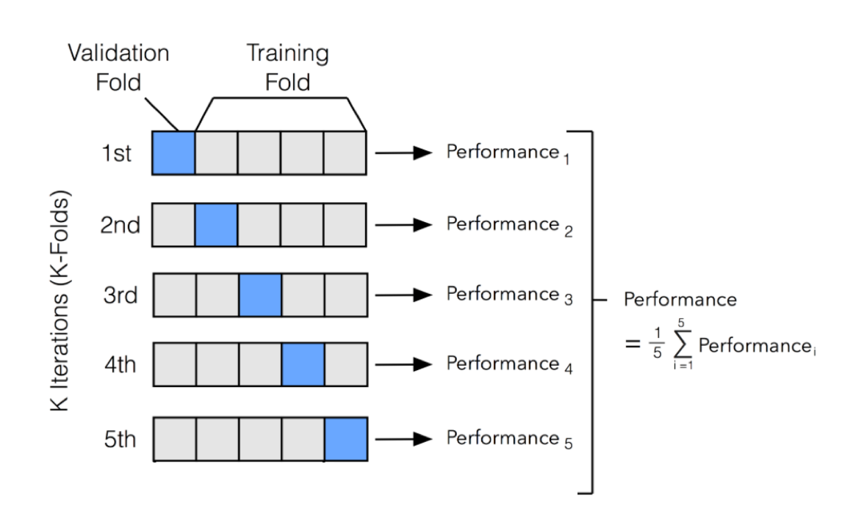
Cross Validation
Helps tune parameters
Split training data into groups.
Train on all groups except 1
Then test the out of sample performance on the last set
Repeat for all groups and average performance

Slide 5
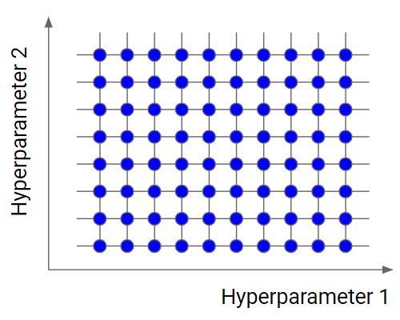
Grid Search CV
How it works
Re-runs model using all possible combinations of parameters
Uses cross-validation to decide which combination is best
Drawbacks
Can be very computationally intensive

Slide 6
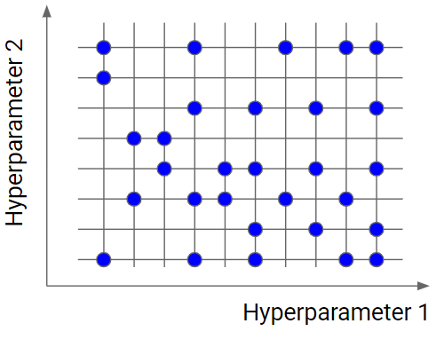
Bayes Search CV
How it works
Uses bayesain search methods to find optimal parameters
Will only try a fixed number of parameters given by
n_iter
Starts by trying a few random combinations
Then it searches near the best outcomes to find best combinations
This saves a LOT of processing time

Slide 7
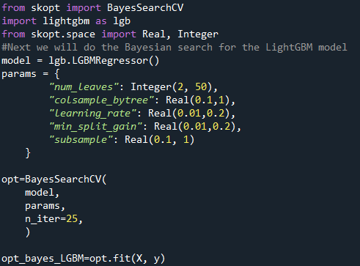
Bayes Search CV
Steps to implement
Define model
Define parameters
Define the BayesSearchCV
Fit the Model

Slide 8
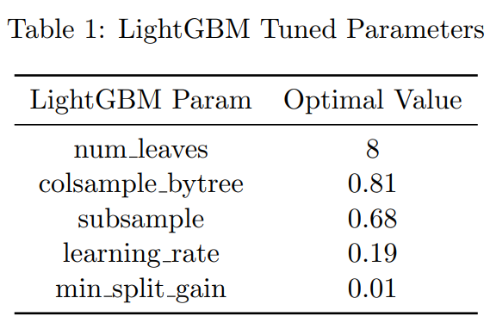
Example Predicting housing Prices
Kaggle Housing Price Competition
Housing data from Ames, Iowa
Input house information
# Rooms
Square Feet
Etc.
Output housing price predictions

Slide 9
Example Predicting housing Prices
Parameters selected by BayesSearchCV for predicting housing prices are

Slide 10
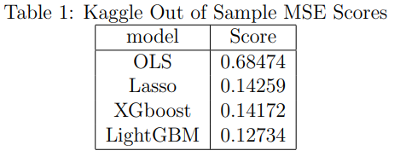
Example Predicting housing Prices
Kaggle competition out of sample MSE scores by model

