Slide 1
Jax!
Parker Ciaramella and Ociel Marin
10.25.21
Notes:
[Both say hi]

Slide 2
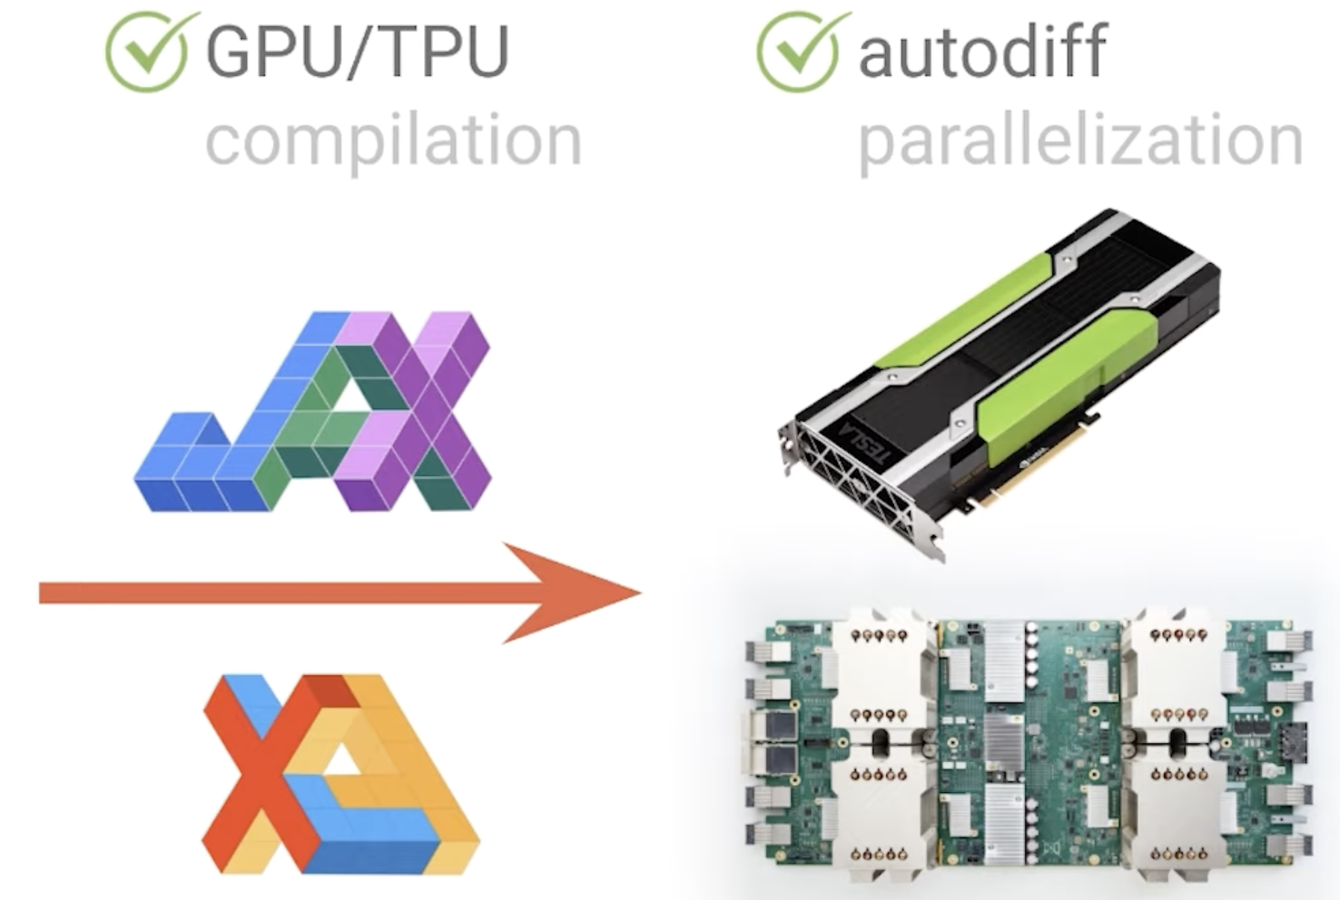
What is Jax?
NumPy… but stronger and faster!
Differentiating internal code
GPUs and CPUs
Notes:
[Ociel]

Slide 3
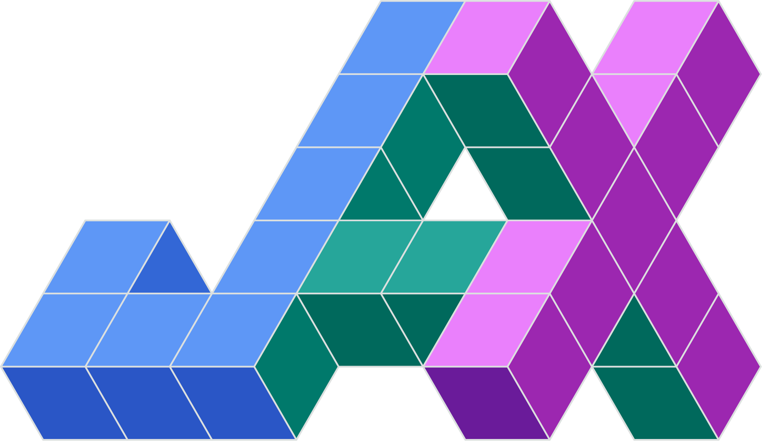
Motivations and Descriptions
Ongoing research to best optimize vectorized programming on large datasets
Developed at Google as a research project.
Notes:
[Ociel]

Slide 4
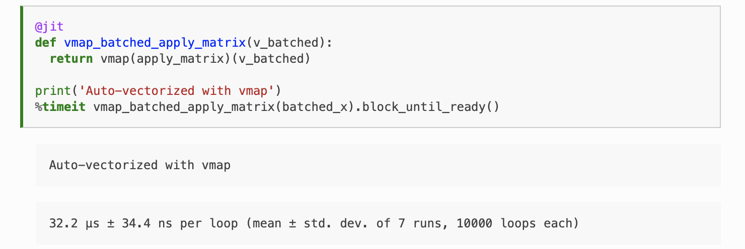
Functions of Jax (Performed in Demo)
Grad
VMAP
pmap (parallel)
JIT (annotation/func)
pjit (parallel)
Notes:
[Ociel]

Slide 5
JIT Compilation (Performed in Demo)
By default, Jax operates one at a time and in sequence
jit() function
The actual optimizer
XLA (Accelerated Linear Algebra) -> Compiler
Reduces Python overhead when calling JIT functions
Notes:
Parker

Slide 6

Advantages
FASTER programs!
Larger datasets can be utilized, mined, analyzed, etc.
Notes:
Parker

Slide 7
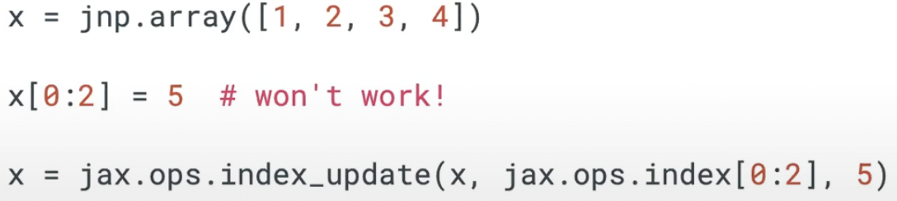
Limitations
JNP arrays are immutable!
Cannot update the array in place, only returned in a modified state.
Pure functions only for JIT!
“Not all JAX code can be JIT compiled, as it requires array shapes to be static & known at compile time.” - Jax Docs
Notes:
Parker

Slide 8
Resources for Slides & Demo
https://jax.readthedocs.io/en/latest/notebooks/quickstart.html
Jax Quickstart Documentation
https://www.youtube.com/watch?v=QkmKfzxbCLQ
Great Workshop done by a Student at UWaterloo
Notes:
Parker

Slide 9
Other Resources for Additional Research
XLA:
https://www.tensorflow.org/xla/
https://jax.readthedocs.io/en/latest/notebooks/XLA_in_Python.html
Notes:
Parker

