Slide 1
Reinforcement learning
In theory, in practice
Roi Ceren
Snr. Mgr. Data Science @ Cox Auto
roi.ceren@gmail.com
LI: roi-c

Slide 2
Outline
RL
Decision Processes
Q-Learning
PAC Learning
Application: RL in Sales Domain
AWS

Slide 3
Reinforcement learning
In agent-based reasoners

Slide 4



RL Background
Credit: MASPlan.org, flaticon.com

Slide 5
Decision processes
Decision problem: how to optimize behavior to maximize reward?
Choose the action that has the best expected outcome
Preferences
Agent
Action
R(a)
Reward

Slide 6
Decision processes
Rewards may be based on more than just the action, but also the physical state
Physical State
Action
Preferences
Agent
Action
R(s,a)
Reward

Slide 7
Decision processes
Sometimes the physical state is unknown, but the agent gets a clue as to where they are
Physical State
Observation
Action
Preferences
Agent
Action
R(s,a)
Reward

Slide 8
Decision processes
In the multiagent setting, additional agents affect the reward for each agent and the state
Physical State
Observation
Observation
Action
Action
Agent i
(Joint)
Preferences
Agent j
Action
Action
Reward
R(s, a_{i}, a_{j})
Reward

Slide 9
Decision processes
The Markov Decision Process (MDP) <S,A,T,R>
S: Set of physical states
A: Set of actions
T: S x A x S → [0,1]: State transition function
R: S x A → R: Reward function

Slide 10
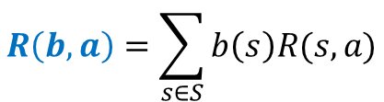
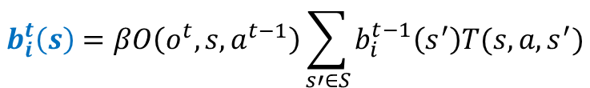
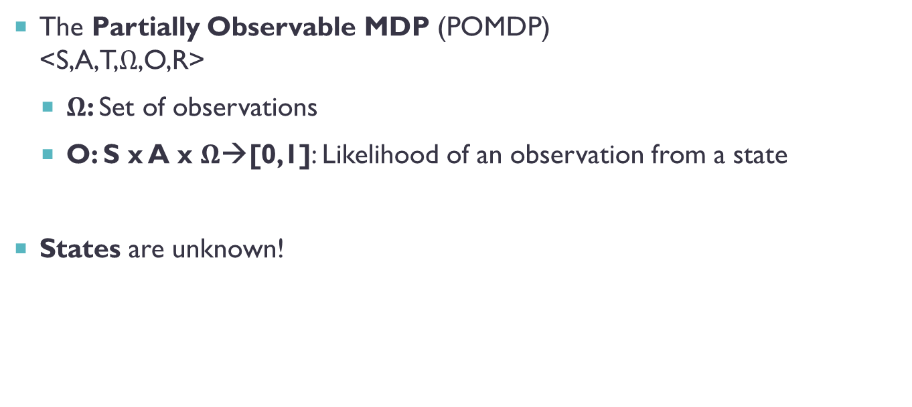
Decision processes
The Partially Observable MDP (POMDP) <S,A,T,$Ω$,O,R>
$Ω$: Set of observations
O: S x A x $Ω$→[0,1]: Likelihood of an observation from a state
States are unknown!
$$b_{i}^{t}\left(s\right)=βO\left(o^{t},s,a^{t−1}\right)\sum_{s′∈S}{b_{i}^{t−1}\left(s^{′}\right)T(s,a,s^{′})}$$
$$R\left(b,a\right)=\sum_{s∈S}{b\left(s\right)R(s,a)}$$

Slide 11
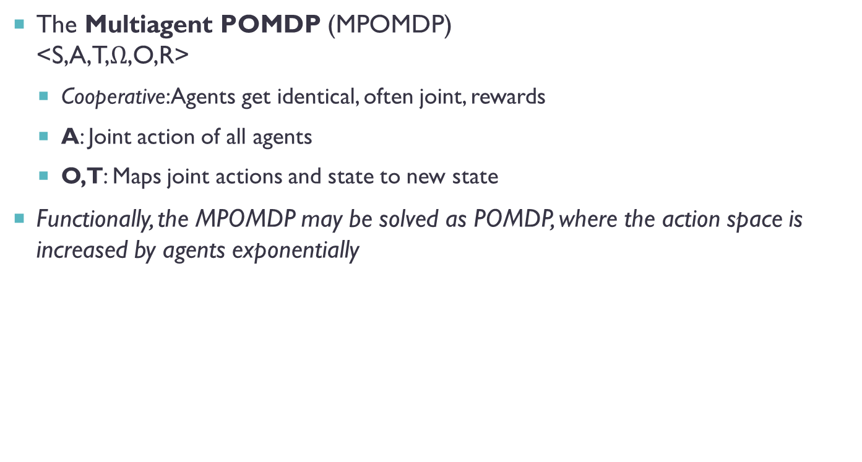
Decision processes
The Multiagent POMDP (MPOMDP) <S,A,T,$Ω$,O,R>
Cooperative: Agents get identical, often joint, rewards
A: Joint action of all agents
O,T: Maps joint actions and state to new state
Functionally, the MPOMDP may be solved as POMDP, where the action space is increased by agents exponentially

Slide 12
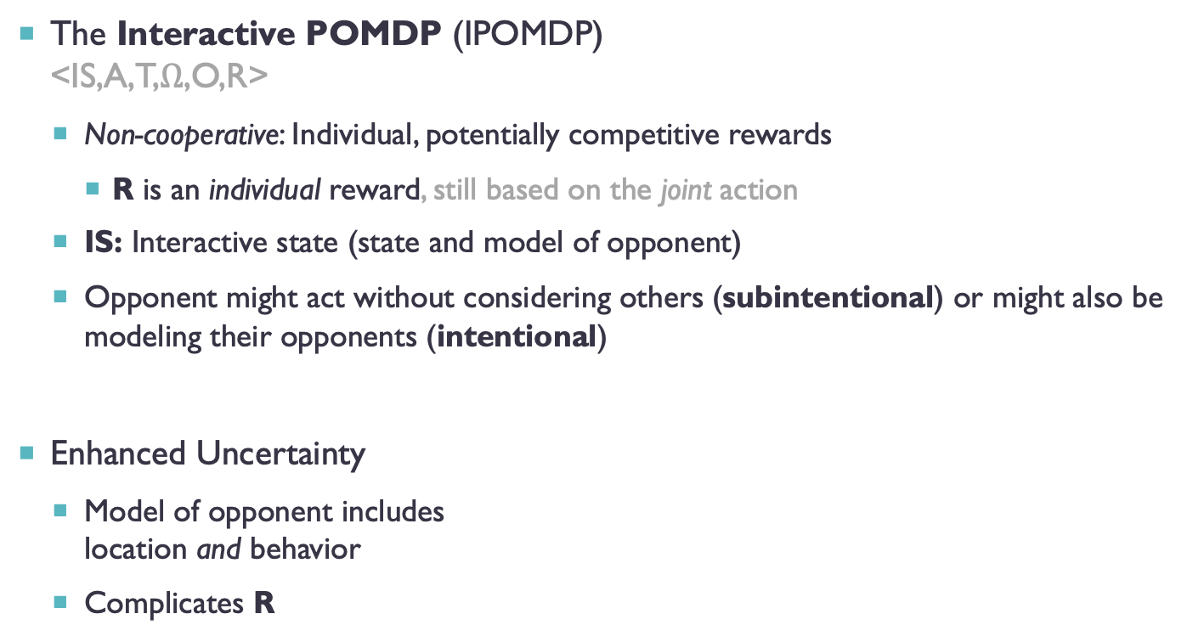
DECISION PROCESSES
The Interactive POMDP (IPOMDP) <IS,A,T,$Ω$,O,R>
Non-cooperative: Individual, potentially competitive rewards
R is an individual reward, still based on the joint action
IS: Interactive state (state and model of opponent)
Opponent might act without considering others (subintentional) or might also be modeling their opponents (intentional)
Enhanced Uncertainty
Model of opponent includes location and behavior
Complicates R
Interactive
State

Slide 13

Decision processes
Policies in MDPs map states to actions
POMDPs may map states or single observations to actions
A policy can also be a sequence of observations to actions
s1 | s2 | s3
a1 | a3 | a1
$$∅$$ | o1 | o2
a2 | a1 | a3
a2
o1
o2
a1
a3
o1
o2
o1
o2
a3
a1
a2
a2
horizon 3 policy tree

Slide 14
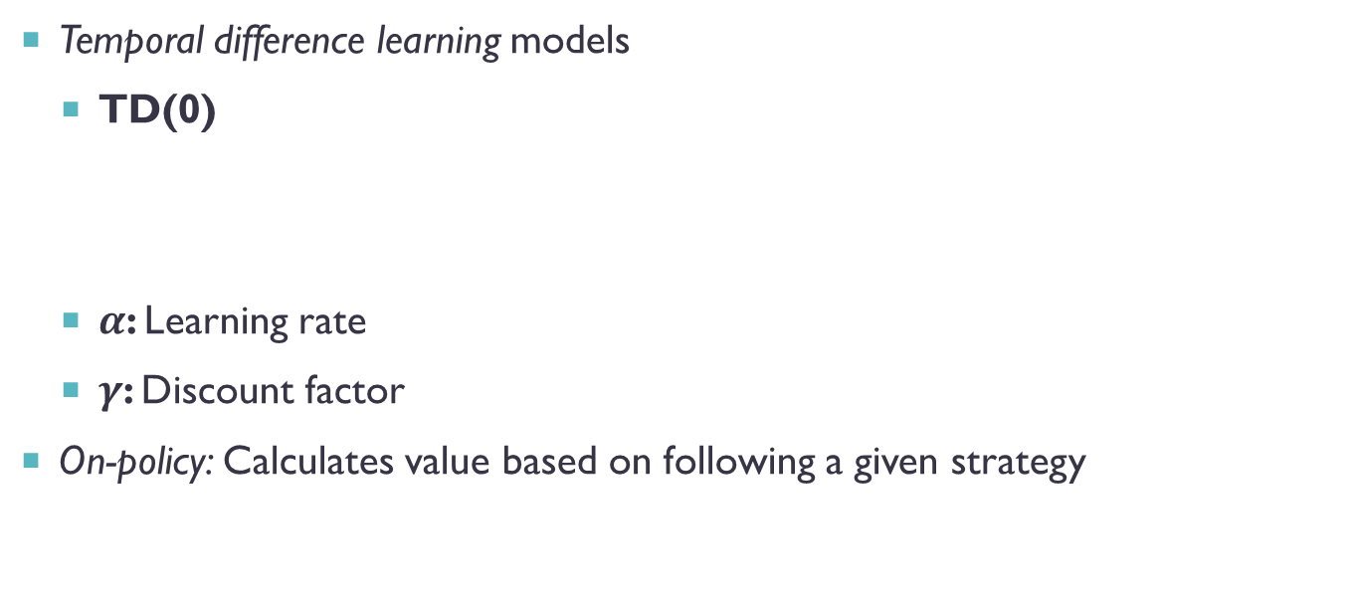
Q-learning
Temporal difference learning models
TD(0)
$α$: Learning rate
$γ$: Discount factor
On-policy: Calculates value based on following a given strategy
$$V\left(s;α\right)=\left(1−α\right)V\left(s\right)+α\left(r\left(s\right)+γ⋅V\left(s^{′}\right)\right)$$

Slide 15
Q-learning
Off-policy Q-learning considers actions
Future rewards consider the best action
On-policy State Action Reward State Action follows a policy
$$Q\left(s,a;α\right)=\left(1−α\right)Q\left(s,a\right)+α\left(r\left(s,a\right)+γ⋅\max_{a′}{Q(s′,a^{′})}\right)$$
$$Q\left(s,a;π,α\right)=\left(1−α\right)Q\left(s,a\right)+α\left(r\left(s,a\right)+γ⋅Q(s′,π(s))\right)$$

Slide 16
Q-learning: MONTE CARLO EXPLORING STARTS
Monte Carlo Exploring Starts for POMDPs (MCES-P) Theodore Perkins (AAAI 2002)
No
Current Strategy
Sample random
neighbor strategy
Is the neighbor better?
Have we sampled every neighbor enough times?
No
Retain
strategy
Yes
Yes
No
Have we sampled the current and neighbor strategies enough?
Terminate
Strategy is an optima!
Set neighbor
as current strategy
Yes

Slide 17

Q-learning: MONTE CARLO EXPLORING STARTS
Random observation sequence replaced with a random action
a2
a2
o1
o2
$$o_{2}:a_{3}→a_{2}$$
o1
o2
a1
a3
a1
a2
o1
o2
o1
o2
o1
o2
o1
o2
a3
a1
a2
a2
a3
a1
a2
a2

Slide 18


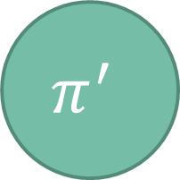
Q-learning: MONTE CARLO EXPLORING STARTS
$$π$$
$$π^{′}$$
$$o_{2}:a_{3}↔a_{2}$$

Slide 19


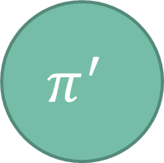
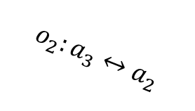
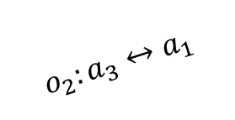
Q-learning: MONTE CARLO EXPLORING STARTS
$$π^{′}$$
$$o_{2}:a_{3}↔a_{1}$$
$$π$$
$$o_{2}:a_{1}↔a_{2}$$
$$o_{2}:a_{3}↔a_{2}$$
$$π^{′}$$

Slide 20
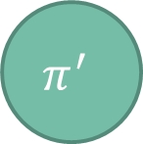
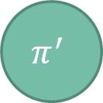

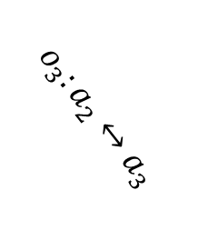

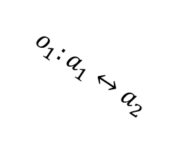
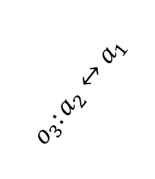


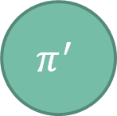
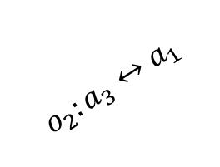
Q-learning: MONTE CARLO EXPLORING STARTS
$$π^{′}$$
$$π^{′}$$
$$o_{1}:a_{1}↔a_{2}$$
$$o_{2}:a_{3}↔a_{1}$$
$$π^{′}$$
$$o_{1}:a_{1}↔a_{3}$$
$$π$$
$$o_{2}:a_{3}↔a_{2}$$
$$π^{′}$$
$$o_{3}:a_{2}↔a_{1}$$
$$o_{3}:a_{2}↔a_{3}$$
$$π^{′}$$
$$π^{′}$$

Slide 21
Q-learning: MONTE CARLO EXPLORING STARTS
Local Neighborhood

Slide 22
Q-learning: MONTE CARLO EXPLORING STARTS
Pick random observation

Slide 23

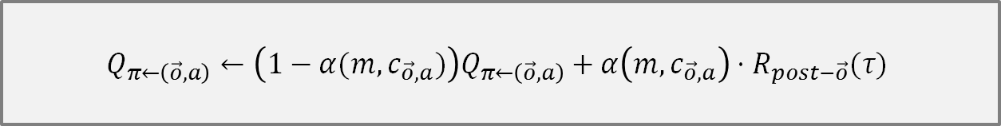


Q-learning: MONTE CARLO EXPLORING STARTS
Pick random observation
Pick random action
a1
Simulate
$$τ=\{a^{0},r^{0},o^{1},a^{1},r^{1},…o^{T−1},a^{T−1},r^{T−1}\}$$
Proportion of reward in $τ$ after seeing $\vec{o}$
$$α\left(m,c\right)=\frac{1}{1+c}$$
$$Q_{π←\left(\vec{o},a\right)}←\left(1−α(m,c_{\vec{o},a})\right)Q_{π←\left(\vec{o},a\right)}+α\left(m,c_{\vec{o},a}\right)⋅R_{post−\vec{o}}(τ)$$

Slide 24
Q-learning: MONTE CARLO EXPLORING STARTS
Pick random observation
Pick random action
Simulate

Slide 25
Q-learning: MONTE CARLO EXPLORING STARTS
Sample policies k times

Slide 26



Q-learning: MONTE CARLO EXPLORING STARTS
Sample policies k times
$$Q_{π^{′}}>Q_{π}+ε$$
$$π$$
$$π′$$

Slide 27
Q-learning: MONTE CARLO EXPLORING STARTS
Sample policies k times
$$Q_{π^{′}}>Q_{π}+ε$$

Slide 28
Q-learning: MONTE CARLO EXPLORING STARTS

Slide 29
PAC LEARNING
Picking a sample count
Low Samples
High Samples
Inaccurate Q-values
Cheap to run
Accurate Q-values
Expensive to run

Slide 30
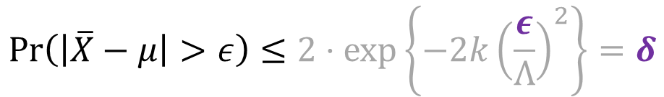

PAC LEARNING
Derive k!
Probably Approximately Correct (PAC) Learning
The probability of the sample average deviating from the true mean by more than $ε>0$ can be bound by probabilistic error $δ∈(0,1)$
Hoeffding’s Inequality
$$\operatorname{Pr}\left(\left|\overline{X}−μ\right|>ε\right)≤2⋅\exp\left\{−2k{\left(\frac{ε}{Λ}\right)}^{2}\right\}=δ$$
Sample count
Value bound

Slide 31
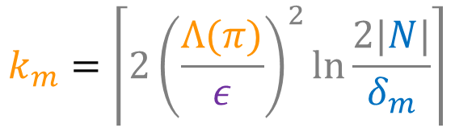


PAC LEARNING
$ε$ and $δ$ determine sample counts
$m:$ current transformations
$N:$ neighbor policies
$δ_{m}=\frac{6δ}{m^{2}π^{2}}$
$$k_{m}=\left\lceil 2{\left(\frac{Λ(π)}{ε}\right)}^{2}\ln{\frac{2|N|}{δ_{m}}}\right\rceil$$
$$Λ\left(π^{′},π\right)≜\max_{τ}{{(Q}_{π}−Q_{π^{′}})}−\min_{τ}{{(Q}_{π}−Q_{π^{′}})}≤2T\left(R_{max}−R_{min}\right)$$
$$Λ\left(π\right)=\max_{π^{′}∈neighbor\left(π\right)}{Λ(π′,π)}$$

Slide 32
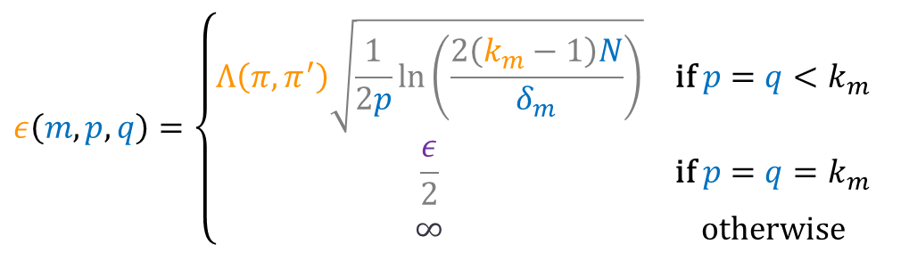

PAC LEARNING
We can transform early by modifying $ε$
Terminate when $k_{m}$ samples of each neighbor is taken or for all neighbor policies:
$$ε\left(m,p,q\right)=\left\{\begin{matrix}Λ\left(π,π^{′}\right)\sqrt{\frac{1}{2p}\ln\left(\frac{2\left(k_{m}−1\right)N}{δ_{m}}\right)} & \text{if} p=q<k_{m} \\ \frac{ε}{2} & \text{if} p=q=k_{m} \\ ∞ & \text{otherwise}\end{matrix}\begin{aligned} \\ \\ \end{aligned}\right.$$
$$Q_{\vec{o},a}<Q_{\vec{o},π(\vec{o})}+ε−ε(m,c_{\vec{o},a},c_{\vec{o},π\left(\vec{o}\right)})$$

Slide 33

PAC LEARNING
Then, with probability $1−δ$, MCESP+PAC
Transforms to $π$ that are guaranteed better than the current policy
Terminates with a $π$ that is an $ε$-local optima
No neighbor is better than the last policy by more than $ε$
https://arxiv.org/pdf/1901.01325.pdf

Slide 34
Reinforcement learning
In the sales domain

Slide 35
Data Science Process
Ideation
Ask interesting questions, get interesting answers.
Corporate Mission
Marketable
insights
Approach Identification
Find the question you want to answer
Solution Design
What answers to this question might our data hold? How can we get at it? Consider methods, perform ETL.
Experimentation
Test solutions and statistically analyze the output. Is the question answered?
Architect Solution
Integrate within the context of the existing tech stack
Productize
UX/UI, hook into APIs, etc. (other Engineering stuff...)
New feature

Slide 36
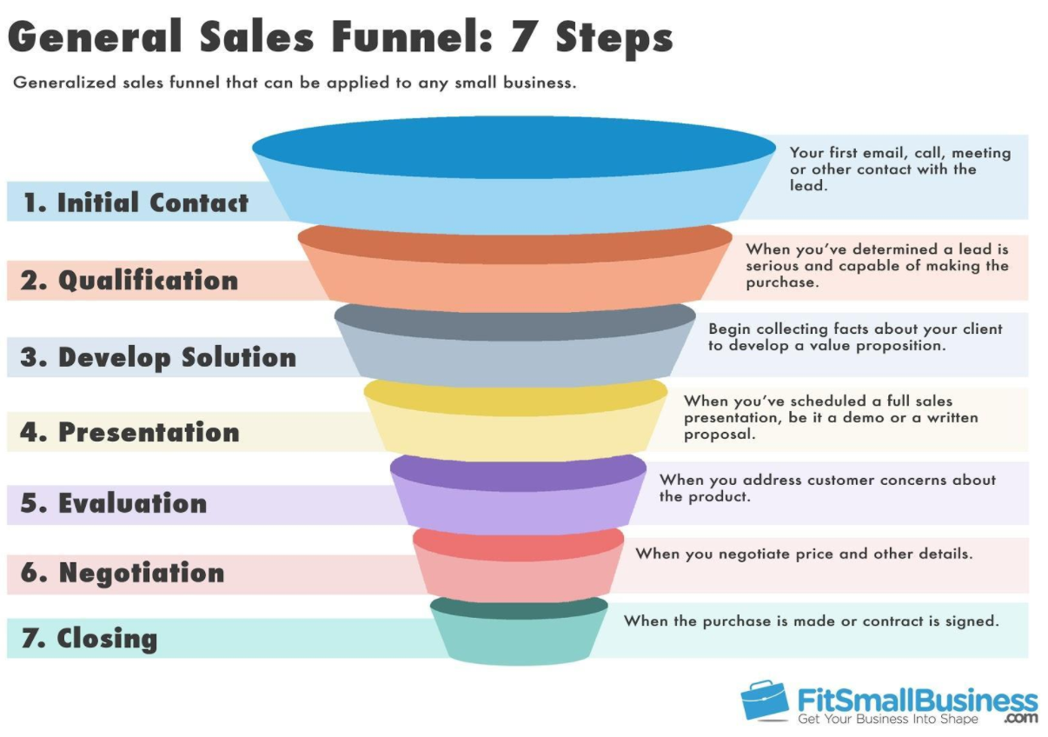
The sales domain

Slide 37

SALES ENGAGEMENT
Sales Development Representatives
Calendar
Owler/Crystal Knows
Dialer
Cadences
Account Executives
Meetings
Opportunities

Slide 38
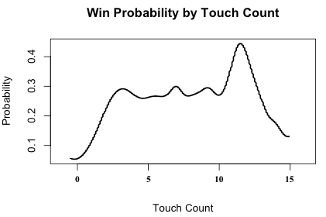
Derived Cadences - The Journey
Interesting Question: What’s the optimal number of touches?
Day 1
Day 2
Day 4
Day 5
Day 7
Day 11
Promising Perspective: Probability of Salesforce Opportunity Close status given Touch Count
E
C
E
C
C
E
W
Day 1
Day 1
Day 1
Day 2
Day 2
Day 2
C
C
C
C
C
C
L

Slide 39
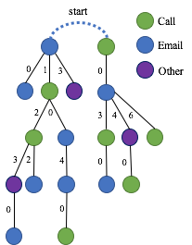
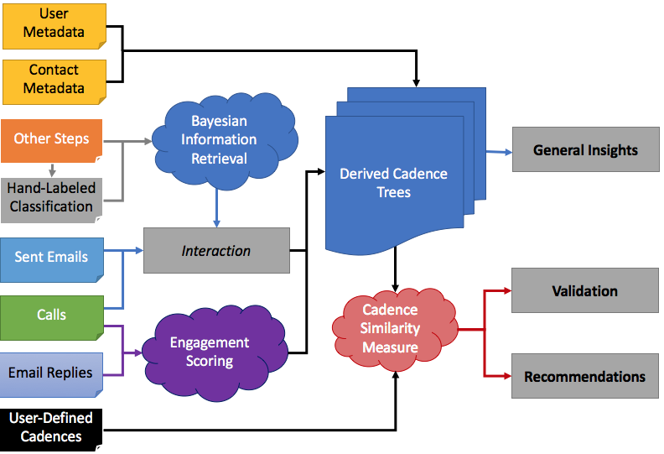
Derived Cadences - The Process

Slide 40
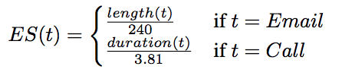
Derived Cadences - The Process
Optimizing Time Value
Day 1
Day 2
Day 4
Day 5
Day 7
Day 11
User:
E
C
E
C
C
E
Contact:
E
C
E
400 character reply
12 minute chat
750 character reply
Meeting scheduled
1.66
3.14
3.125

Slide 41
Derived Cadences - The Process
Aggregating Behavioral Data
E
Day 1
Day 2
Day 4
Day 5
Day 7
1
E
C
E
C
C
C
Day 1
Day 2
Day 4
Day 6
2
3
E
C
E
C
E
C
Day 1
Day 2
Day 5
Day 11
1
2
6
E
C
C
E
C
C
E
2
C

Slide 42
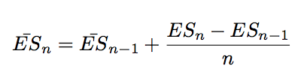
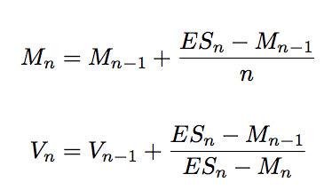
Derived Cadences - The Process
Aggregating Behavioral Data
E
1
C
E
1
Moving Average
C
2
3
E
C
Moving Variance
1
2
6
C
C
E
2
C

Slide 43

Derived Cadences - Actionable Insights
Day 1
Day 1
Day 4
Day 4
Day 8
Day 12
Pacing
Double Taps
C
E
C
E
E
C
89/100
Cadence Coach
Day 1
Day 2
Day 4
Day 6
Day 8
Day 11
Day 1
Day 3
Day 5
Day 7
Day 9
Day 11
Pacing
C
E
C
E
E
Channel Changes
C
E
C
E
E
E
C
92/100
Day 1
Day 1
Day 1
Day 3
Day 5
Day 8
Day 12
Pacing
1
3
5
7
9
11
Social Triple-Tap
E
C
E
LI
C
E
C
68/100
88/100

Slide 44
FIN

Slide 45
AWS
A taste

Slide 46

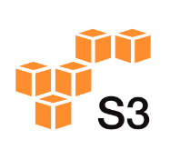







Common stack
Catalog
Stage
Ingest
Manipulate
Expose,
Visualize
Query

