Slide 1
Natural Language Processing (NLP)
Dario Chou & Akul Patel

Slide 2
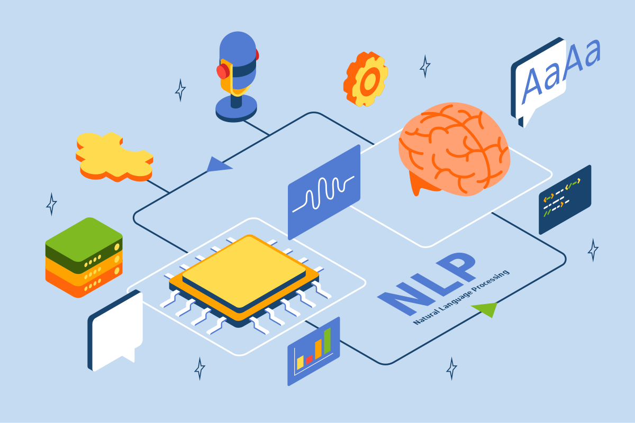
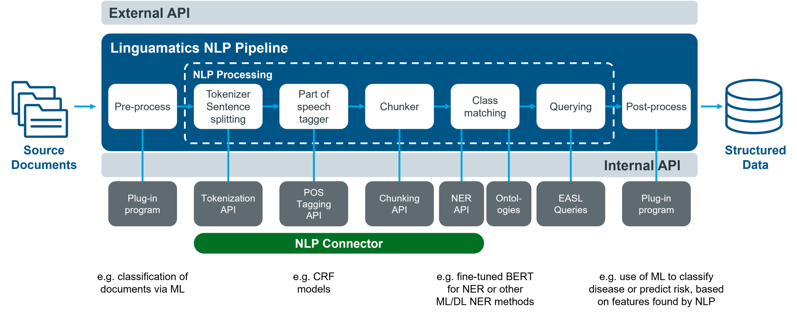
Introduction
Natural Language Processing is the study and analysis of human linguistics in order to achieve models and algorithms capable of understanding and generating human language. These models will use ML techniques to train computers to interpret and provide a diverse analysis on human text.
Notes:
akul

Slide 3
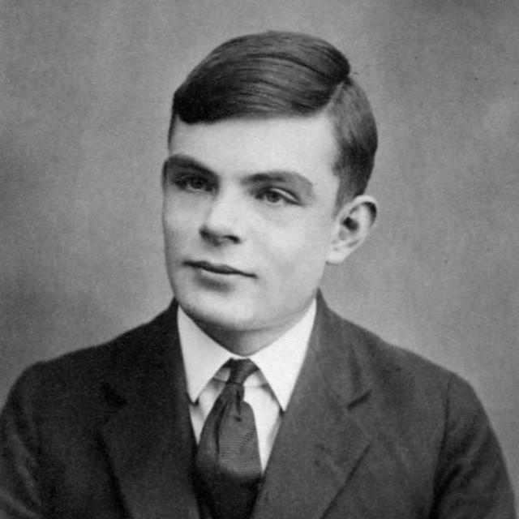
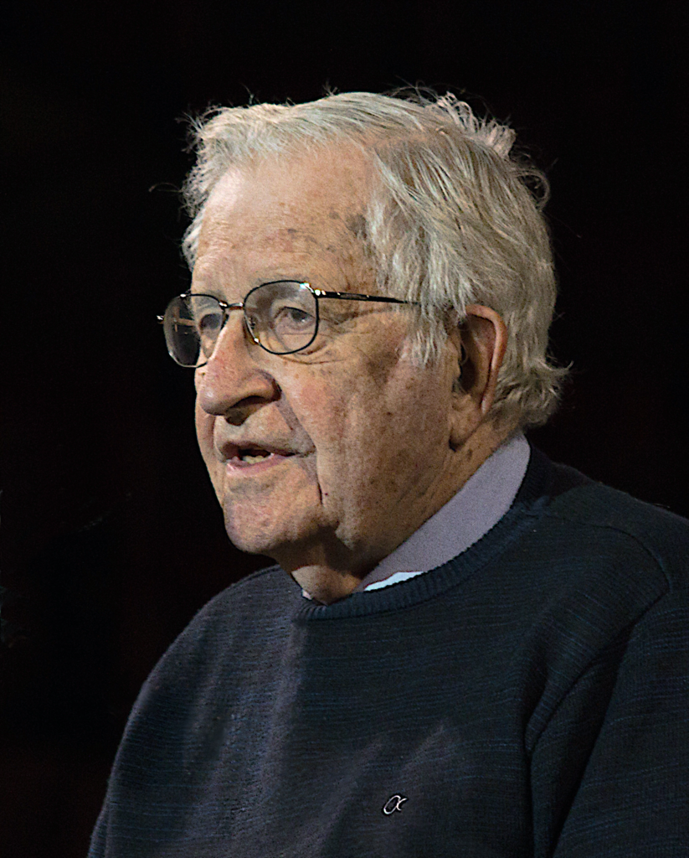
History
NLP came out of the need to translate different languages from one to another after WW2. At the time (1950-1960) it was very difficult to find some development on the topic. Then Alan Turing released “Computing Machinery and Intelligence” which mainly introduced the turing test. This lets us measure the computer's ability to recreate human behaviour, and to see how accurate that is. This set the foundation for NLP. Another contributor to NLP was Noam Chomsky. Chomsky provided for a formal, rule-based, system to process and interpret language based off grammatical rules and concepts for that given language.
Notes:
Dario - The first need for nlp appeared after ww2 in order to translate language. Alan turing released his book that introduced the turing test. This allowed to measure the computer ability to recreate human behavior.

Slide 4
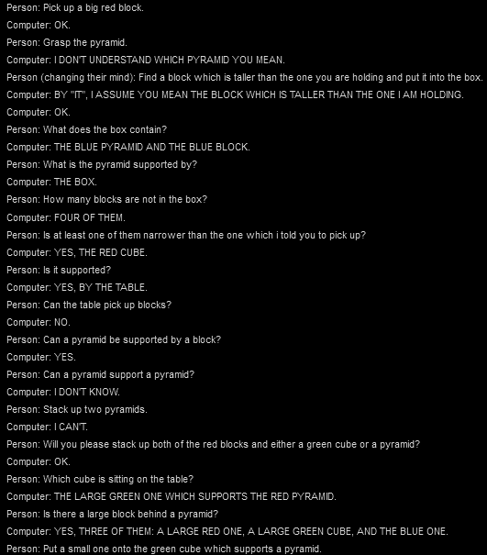
Initial Formulations
One initial formulation of NLP was SHRDLU (the name is derived from ETAOIN SHRDLU, which is a nonsensical phrase form from the error of a typewriter). SHRDLU was made by Terry Winograd at MIT. The program essentially lives in a virtual space filled with a bunch of different, manipulatable, geometric blocks. Stuff like cones, spheres, pyramids.
Terry also implemented basic physics concepts into the world, which is separate from the language parser but can still be interacted with. The program can do basic grammar analysis, hold a conversation with the user (see image on right), and answer commands/questions. This program was very successful demonstrating what AI can do at the time, and helped build more optimism for the field AI.
Notes:
Dario - First NLP is SHRDLU made by Terry Winograd at MIT in 1968. The program lives in a space filled with shapes that can be manipulated, and Terry also implemented basic physics concepts which allows the AI to interact with the objects.

Slide 5
NLP Approaches
Statistical:
Here the approach is to use statistical and probabilistic models to process natural language. The overall process would be to find large applicable data sets and train models to find patterns.
From that data, predictions can be made. More advanced techniques like ML and Deep Learning can find more complex patterns allowing for tasks like text classification and sentiment analysis.
Rule-Based:
This approach to processing language takes sets of already determined linguistics rules to perform various operations. This is similar to the way we use symbolic and propositional logic.
These approaches are typically beneficial for POS tagging, named entity recognition, and parsing.
Notes:
Akul -

Slide 6
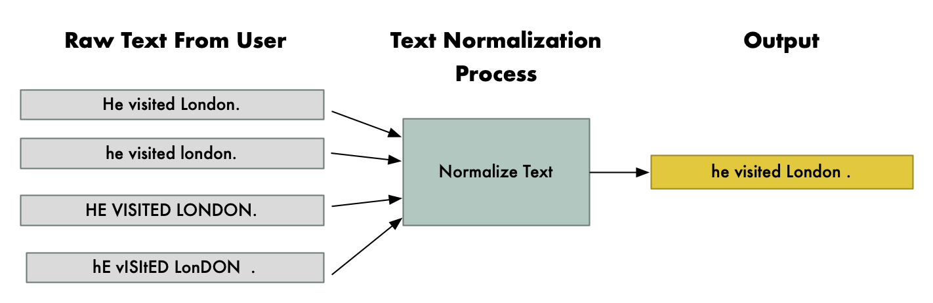
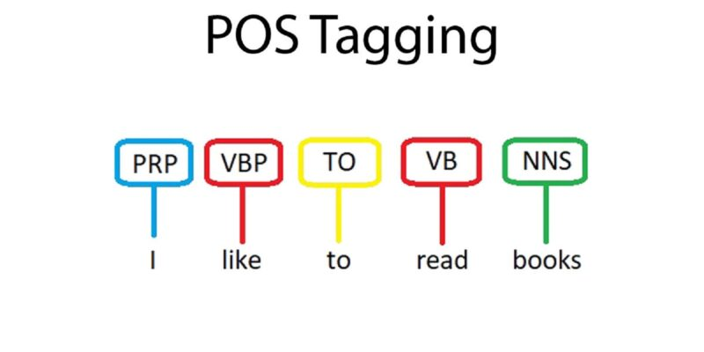
NLP Concepts/Terminology
Key Terminology:
Tokenization: The process of breaking down words into smaller units of text called tokens.
Text Normalization:
Lemmatization: The process to reduce words into their base form. Ex. Breaking -> break
Stemming: Stemming is a similar process to Lemmatization, but instead of considering the context and meanings of the words, it uses predetermined sets of rules to reduce words into their base form. This makes it faster that Lemmatization, but less accurate/meaningful.
POS Tagging: The process of tagging (assigning) a certain part of speech, like a verb or noun, to every word in the given text.
N - Gram: N-Grams are n sequences of items (usually words, can even be char) Ex. 1-gram: ‘dog’, 2-gram: ‘good morning’, 3-gram: ‘NLP is fun”
NER: Named Entity Recognition (NER) is identifying things like names, places, organizations etc.
Dependency Parsing:Analyzing the text to form relationships between words, showing how they depend on each other. This is helpful as it can provide needed context.
Notes:
Akul - These are concepts that can and will be shown when working with NLP.

Slide 7
Advantages and Drawbacks
Advantages:
Can allow for the easy automation of repetitive tasks. (e.g. summarization, data extraction, translations)
Allows for more intuitive and natural interactions with computers. Especially beneficial for those who aren’t as good with computers. (Future benefit)
Easy natural text generation
Data Analysis and Insights
Drawbacks:
Ambiguity. Depending on the model/system, it is commonly ambiguous, which can make interpretation harder, leading to inaccuracies.
Models can hold bias. This isn’t limited to things like political bias/prejudice, as models can hold a set bias, possibly from training, that will change how a text should have been processed.
Slang, Irony/Sarcasm, Contextual phrases. These are some linguistic components that are difficult to implement into NLP models. This requires broad, greater training data, more research, and frankly just more time to correctly develop models to have these features.
Notes:
Dario - pros: easy automation, more natural interactions, easy text generation and data analysis. cons: unclear models that are hard to interpret, models can hold biases, some of the linguistic components like slangs and irony requires broad training.

Slide 8
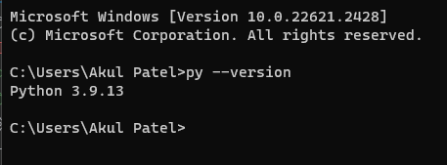
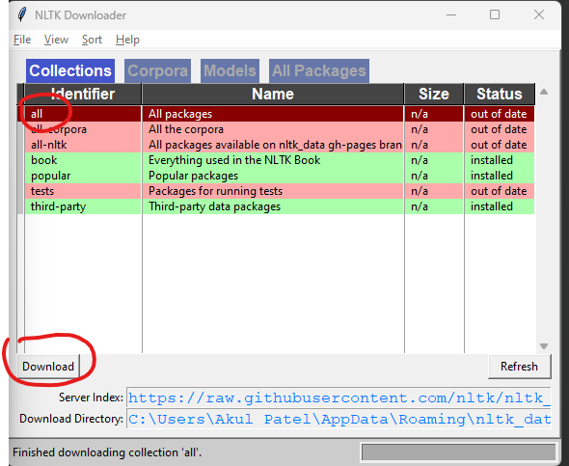
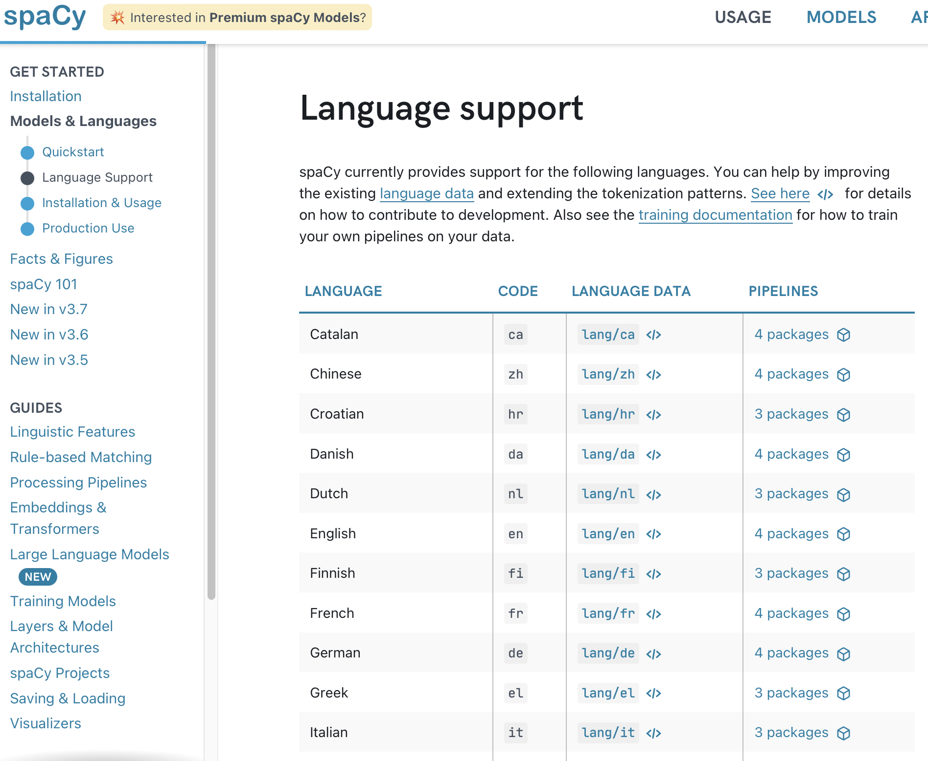

Getting Started With NLP!
Libraries (Primarily Python):
NLTK: Natural Language Toolkit is one of the best, comprehensive libraries available to process natural language.
Good for tokenization, stemming, parsing, tagging, and has over 50 corpora available. (Corpora being text datasets)
spaCy: This is a beginner friendly and rather simple library to start NLP with. It was made not for robustness, but for fast production.
Great for tokenization, supports statistical models, and has 50+ languages available.
Pattern: This is a very detailed and comprehensive library that’s good for sentiment analysis, SVM, clustering, POS tagging, parsing etc.
Biggest difference with the other is that this library has a lot of functionality. It also allows for data mining, vidualization, and web parsing. This is a fairly versatile library.
Installation of NLTK:
Check Python Version:
Pip install nltk, Import NLTK in python terminal, run nltk.download() cmd, then in the gui that pops up, select and download all packages.
Notes:
Akul -

Slide 9
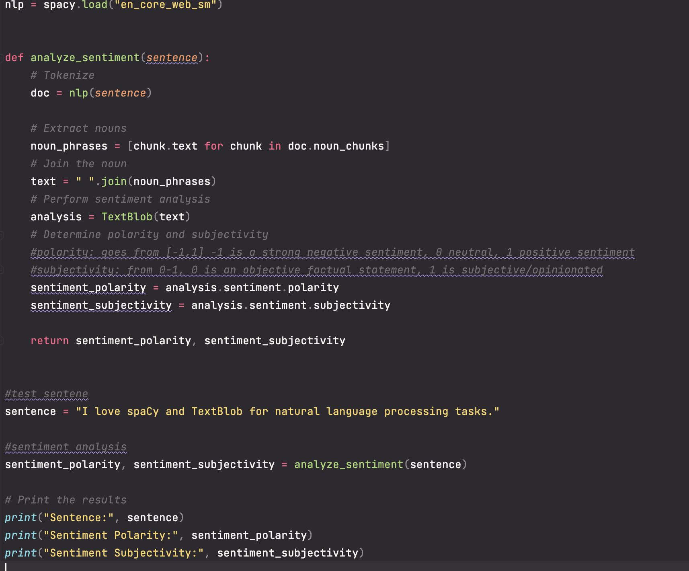
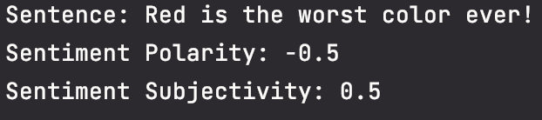
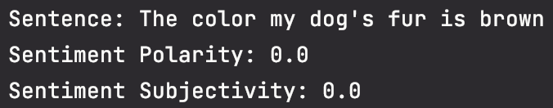
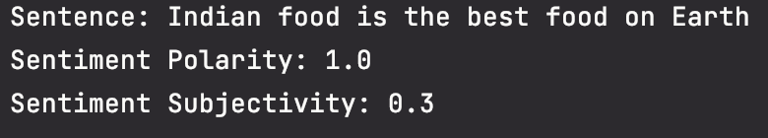
NLP Examples.
This is very simple ,NLP, sentiment analysis program. This program uses spaCY and TextBlob to first tokenize the given text, POS tagging the nouns, joining all the phrases, then inputting that to TextBlob to perform sentiment analysis on. Using the analysis given by TextBlob, I decided to show the polarity and subjectivity of a given sentence. The polarity ranges from -1 to 1, and grades the tone of the text. A value of -1 means strong negative sentiment, 0 is neutral, 1 is strong positive sentiment. Subjectivity ranges from 0 to 1, giving how subjective/objective a given sentence is. This can help determine factual statements.
The polarity and subjectivity score outputs are attached.
Notes:
Akul -

Slide 10
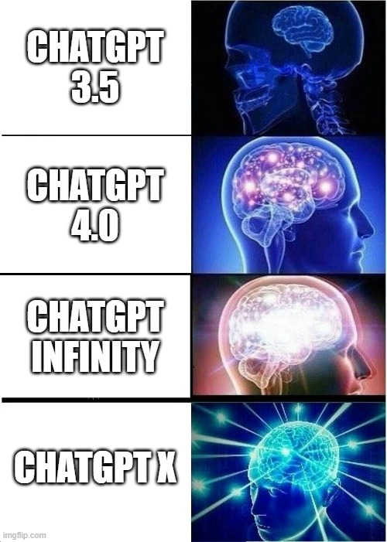
Future of NLP
According to the BCCReasearch blog, the NLP market is set to surge from surge from a valuation of $29.1 billion in 2023 to an impressive $92.7 billion by 2028.
In 2018, we had models that processed fewer than 100 million parameters. NLP models can now interpret more than 100 billion parameters, which indicates development of more than 1,000 fold.
According to research by Accenture, more than 75% of CEOs want to entirely alter their approach to managing customer relationships in order to keep up with changing consumer needs. Businesses are forced to implement NLP models as a result of customer expectations for quick interactions with brands.
Notes:
Dario - The surge in NLP market, Talk about the increase in parameters, talk about ceo wanting to alter their approach to keep up with customers expectations.

Slide 11
References
Amazon NLP Resource:
https://aws.amazon.com/what-is/nlp/#:~:text=Natural%20language%20processing%20(NLP)%20is,manipulate%2C%20and%20comprehend%20human%20language.
NLTK documentation
https://www.nltk.org/
Spacy doc.
https://spacy.io/usage/spacy-101
TextBlob doc.
https://textblob.readthedocs.io/en/dev/
IBM:
https://www.ibm.com/topics/natural-language-processing
BCCResearch
https://blog.bccresearch.com/natural-language-processing-industry

