Slide 1
Pyspark
Mani Deepika adusumilli
Lokesh adusumilli
Harish anand

Slide 2


What is pyspark?
PySpark is a Spark library in Python to run applications using Apache Spark capabilities.
Apache Spark is an analytical processing engine for large distributed data processing and Machine Learning applications.
Using PySpark we can run applications parallelly on the distributed clusters multiple nodes.

Slide 3

Why pyspark?
Apache Hadoop uses MapReduce while performing batch processing and it lacked real time processing feature.
Apache Spark solves both the problems by performing real time and batch processing.
It supports interactive queries and iterative algorithms.
It has its own cluster manager where it can host its application.

Slide 4
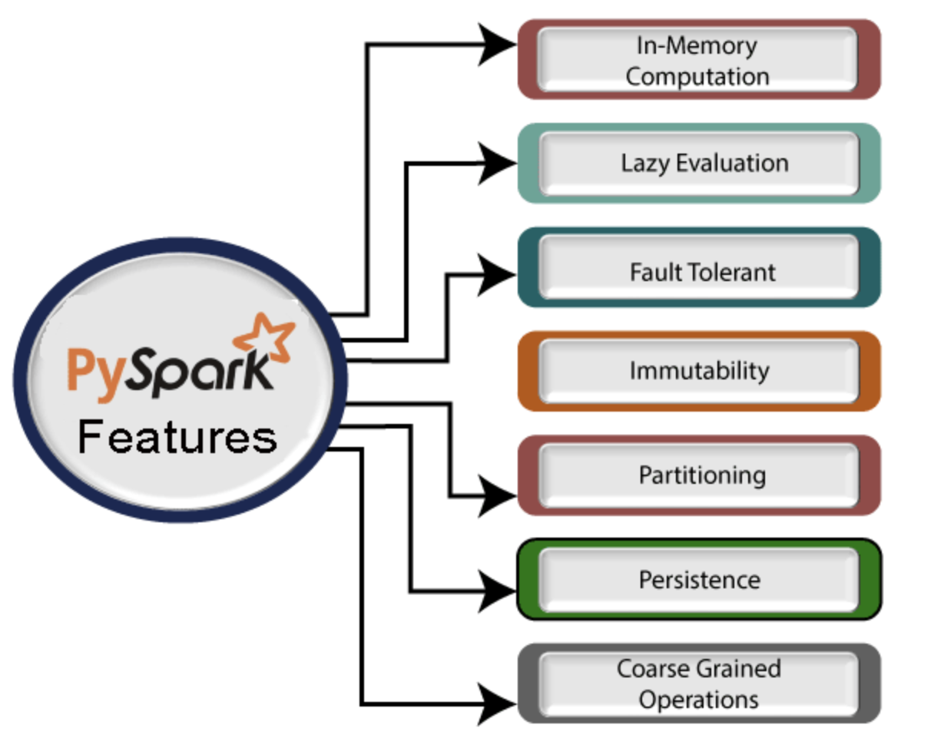
Pyspark features

Slide 5
Advantages of using pyspark
It allows to process data efficiently in distributed fashion.
Applications running on PySpark are 100 times faster than traditional systems.
It is used to process real time data using streaming and Kafka.
It has many machine learning and graph libraries

Slide 6
Disadvantages/shortcomings of pyspark
Complexity and Learning Curve
Requires deeper understanding of architectures (RDD, Dataframes, Transformations, Actions, Partitions and Cacheing)
Lack of flexibility as we can arise into a situation to convert into data type of format between Python and Spark.

Slide 7
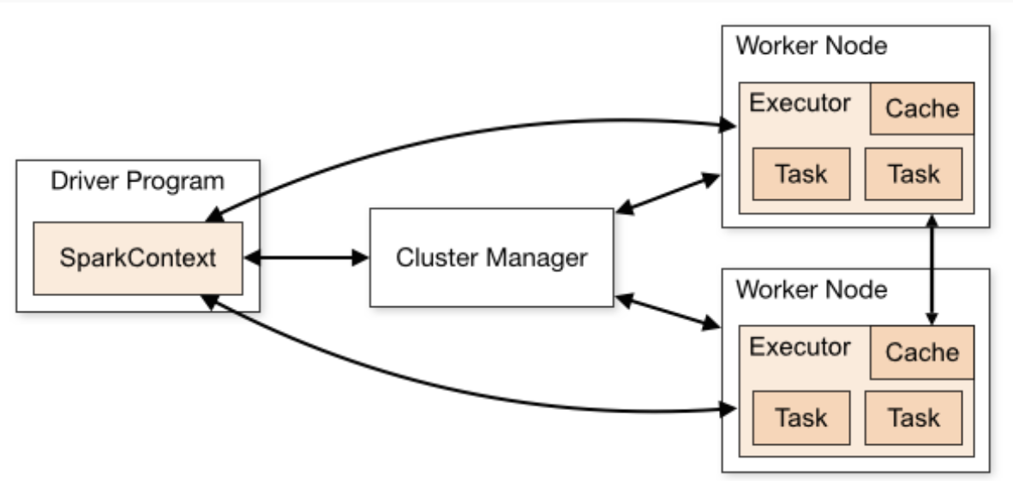
Pyspark architecture

Slide 8
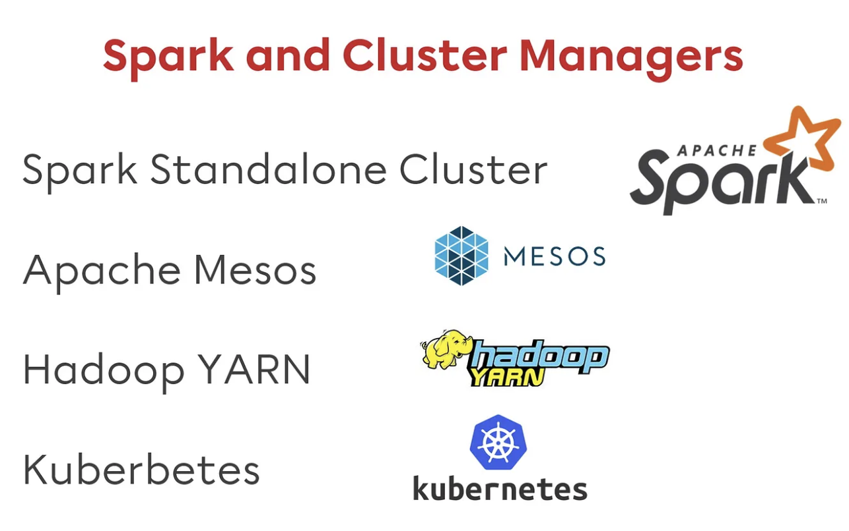
Cluster Manager types
Standalone
Apache
Mesos
Hadoop
YARN
Kubernetes
Local

Slide 9
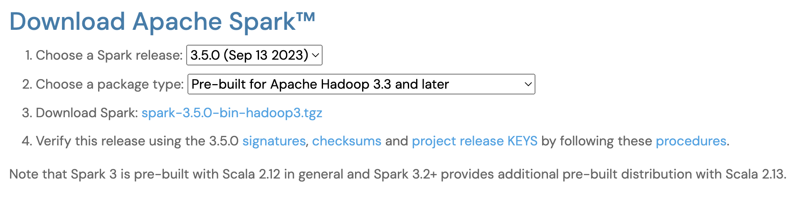
Pyspark Installation
It requires Java 1.8.0 above and Python 3.6 above
pip3 install pyspark

Slide 10
Pyspark modules and packages
PySpark RDD
PySpark Dataframe and SQL
PySpark Streaming
PySpark Mlib
PySpark GraphFrames
PySpark Resourse

Slide 11
Pyspark RDD (Resilient distributed dataset)
These are the elements that run and operate on multiple nodes to do parallel processing on a cluster.
RDDs are immutable, which means once you create it you cannot change it.
They are fault tolerant as well and ability to recover quickly after failure.
Two ways to apply operations in RDD
Transformation: filter, groupby, map
Action: preforms computation (count, first, max , reduce)

Slide 12
Broadcast and Accumulator
Broadcast variable are used to save the copy of data across all nodes.
Accumulator variables are used for aggregating the information through associate and communtative operations.
For Example, some operation are counters (incrementing variables)

Slide 13
SPARK files
In Apache Spark we can upload our file using sc.addfile and get the path on a worker using sparkfiles.get
The class methods are get(filename), get(rootdirectory)
Spark files resolve the path to files added through sparkContext.add(file)

Slide 14
PYSPARK Storage level
It decides where RDD should be stored, in the memory or over the disk or both.
It also decides whether to serialize RDD and to replicate RDD partitions.
class pyspark.StorageLevel(useDisk, useMemory, useOffHeap, deserialized, replication = 1)
Few of the storage levels are
DISK_ONLY: StorageLevel(True, False, False, False, 1)
DISK_ONLY_2: StorageLevel(True, False, False, False, 2)
MEMORY_AND_DISK: StorageLevel(True, True, False, False, 1)
MEMORY_AND_DISK_2: StorageLevel(True, True, False, False, 2)
MEMORY_AND_DISK_SER: StorageLevel(True, True, False, False, 1)

Slide 15
Serializers
It is used for performance tuning on Apache Spark.
It support custom serializer for transferring data which in turn enhances the performance.
While performing an RDD it has to serialized so it can be sent to each working node to execute on its segment of data.
They were two types
MarshalSerializer: faster than pickleserializer but supports few data types only
PickleSerializer: supports all data types but not as fast as marshalserializer

Slide 16
Pyspark dataframe
DataFrame is a distribution collection of data organized into named columns equivalent to a relational database but with richer optimizations.
While working with files we might come into a situation where we may not receive a file for processing in that case we have to create a dataframe manually with the same schema, which means same column names and data types.
spark.sparkContext.emptyRDD().
We can convert empty RDD to datafram using todf()
We can create empty dataframe with schema using df2 = spark.createDataFrame([], schema) df2.printSchema()

Slide 17
DATAFRAMES Functions
SHOW – used to display the contents of dataframe in a table row and column format.
SELECT – used to select single multiple column by index, all columns from the list and returns a new data frame from the selected columns.
COLLECT – it is an action operation that is used to retrieve all the elements of the dataset to the driver load.
FILTER – used to filter the rows from RDD based on the SQL expression. WHERE also performs the same operation
DISTINCT – used to drop or remove the duplicate rows from the dataframe
ORDERBY and SORT – to sort the dataframe by ascending or descending order based on single or multiple columns.
JOIN – used to combine tow dataframes
TRANSFORM – returns the new dataframe after applying the specified transformations
FLATMAP - operation that flattens the dataframe after applying function on every element and return a new dataframe

Slide 18
PYSPARK SQL
AGGREGATE
AGGREGATE FUNCTIONS
Average, Count, Max, Min, Sum, Variance
WINDOW
WINDOW FUNCTIONS
RANKING FUNCTIONS – row number, rank, dense rank
ANALYTIC FUNCTIONS – lead, lag, cume_dist
DATE
DATE AND TIMESTAMP
DATE – current date, to_date, months_between(end, start), month(column)
TIEMSTAMP – minute(column), _timestamp, current_timestamp

Slide 19
Pyspark datasources
Read csv file using csv("path") or format("csv").load("path") of DataFrameReader, you can read a CSV file into a PySpark DataFrame
Use the write() method of the PySpark DataFrameWriter object to write PySpark DataFrame to a CSV file.
SAVING MODES
overwrite – mode is used to overwrite the existing file.
append – To add the data to the existing file.
ignore – Ignores write operation when the file already exists.
error – This is a default option when the file already exists, it returns an error.

Slide 20
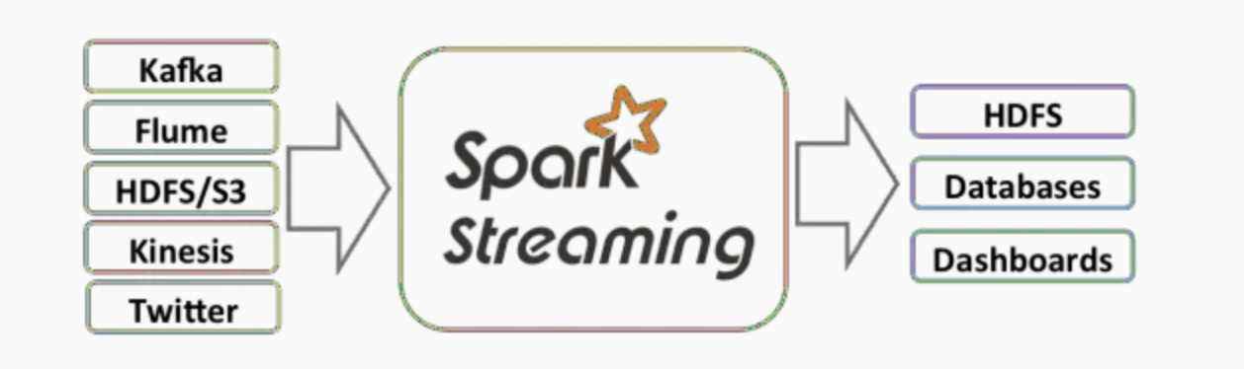
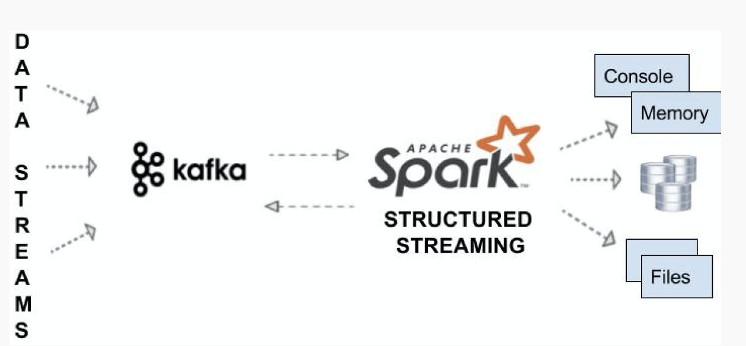
PYSPARK STreaming
PySpark Streaming is a scalable, high-throughput, fault-tolerant streaming processing system that supports both batch and streaming workloads. It is used to process real-time data from sources like file system folders, TCP sockets, S3, Kafka, Flume, Twitter, and Amazon Kinesis to name a few.

Slide 21
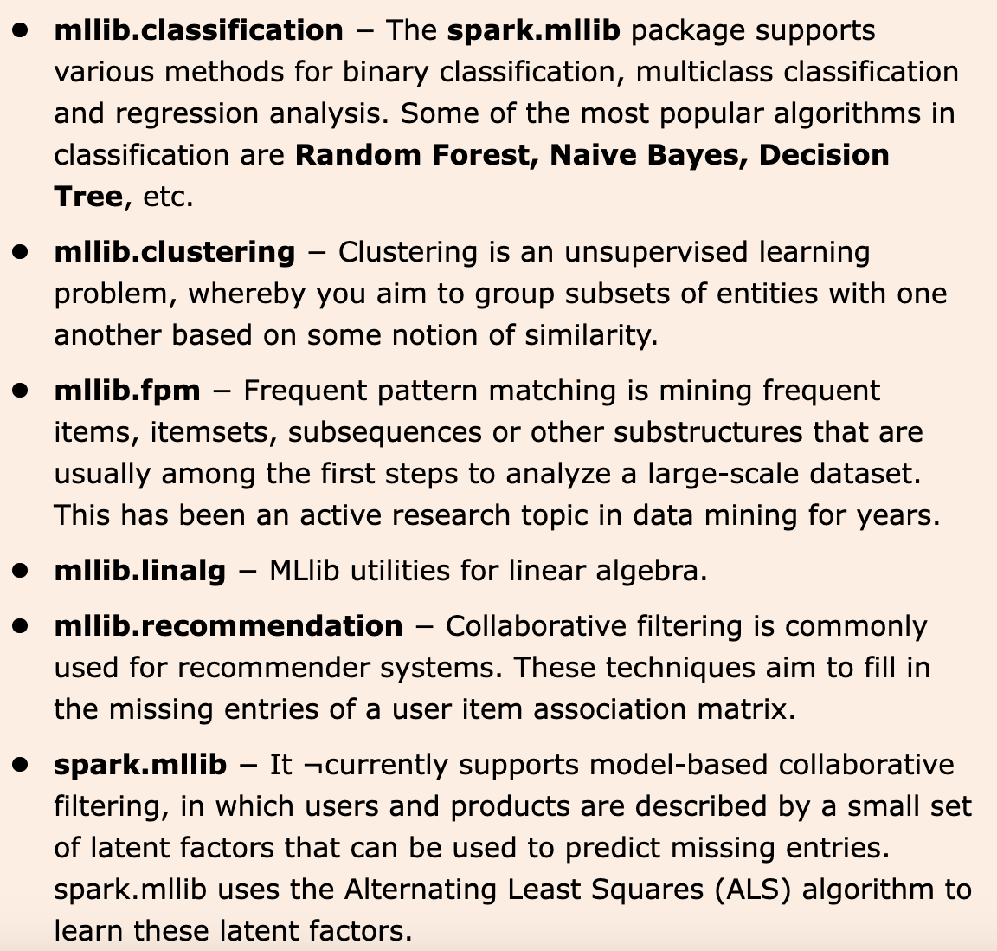
PYSPARK MLLIB
Apache Spark offers machine learning API MLLIB.

Slide 22
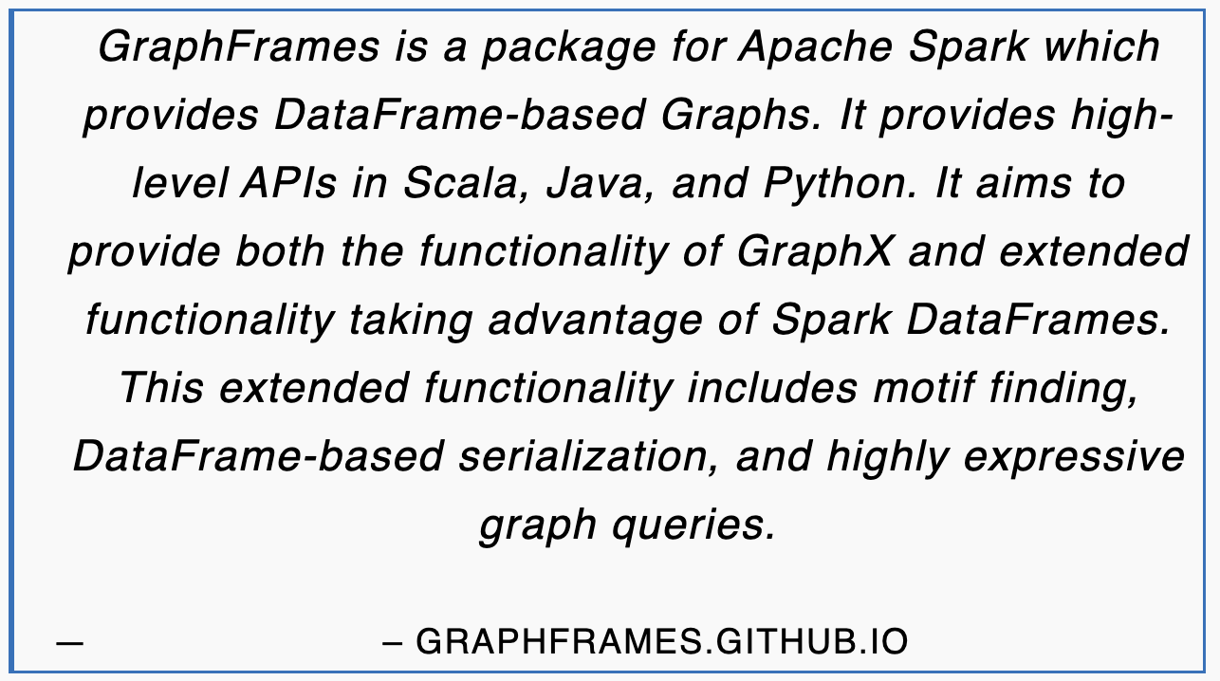
PYSPARK GRAPHFRAMES

Slide 23
PYSPARK Resource module
Class to hold information about a type of Resource. A resource could be a GPU, FPGA, etc. The array of addresses are resource specific and its up to the user to interpret the address.
One example is GPUs, where the addresses would be the indices of the GPUs
Parameters
name – the name of the resource
addresses – an array of strings describing the addresses of the resource
New in version 3.0.0.

Slide 24
references
https://sparkbyexamples.com/pyspark-tutorial/
https://www.tutorialspoint.com/pyspark/index.htm
https://www.javatpoint.com/pyspark
https://www.guru99.com/pyspark-tutorial.html

