Slide 1

CSCI 4360 Workshop:
Seaborn
Rohan desai &
Srikar Pottabathula

Slide 2
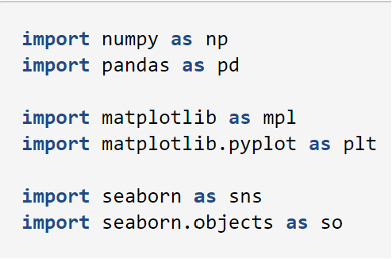
What is seaborn?
Seaborn is a Python data visualization library used for advanced statistical modeling and graphics
It has dependencies on numpy, pandas, and matplotlib (most people use seaborn alongside these)
Also works with scipy, statsmodels, and fastcluster

Slide 3
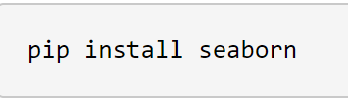


How To Install?
https://seaborn.pydata.org/installing.html

Slide 4
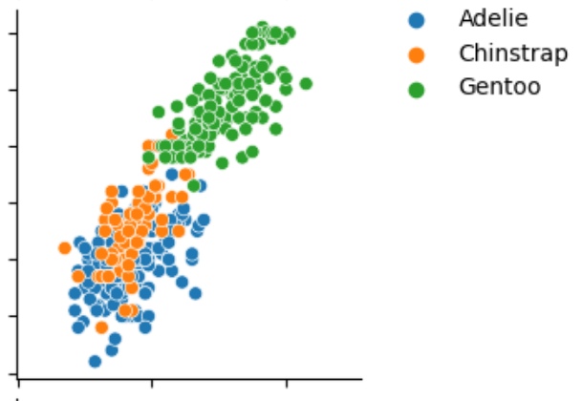
Advantages of seaborn
Makes complex graphs and charts easier to visualize with its aesthetically pleasing interface
Thanks to pandas, it works great with dataframes
Unique styles and color palettes allow easier visualization of statistical models

Slide 5
Disadvantages of seaborn
Limited chart types, dependent on matplotlib for very advanced charts
Similar to PowerBI and other data visualization tools, not super detailed
Does not support 3D visualizations

Slide 6
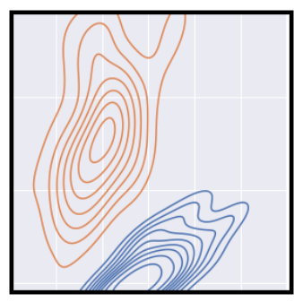
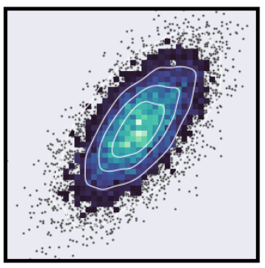
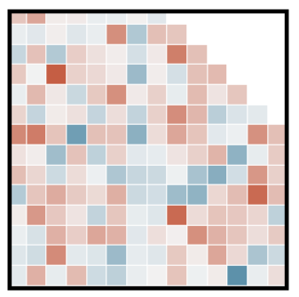
With that being said…
KDE Plot
Scatter plot
It is pretty good.
Heatmap

Slide 7

Seaborn.objects interface
Offers a better API that comprises of classes for transforming and plotting data
The purpose is to offer advanced plot customization without having to rely on matplotlib

Slide 8
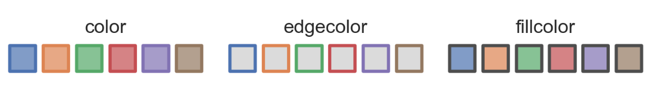
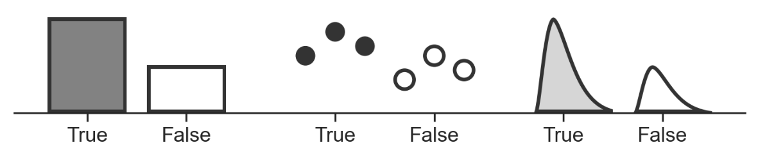
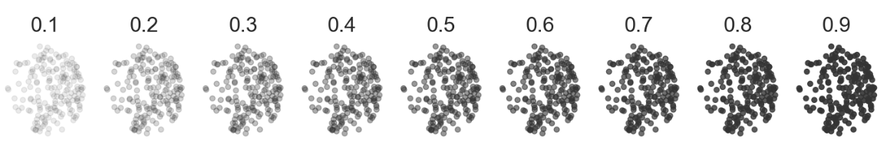
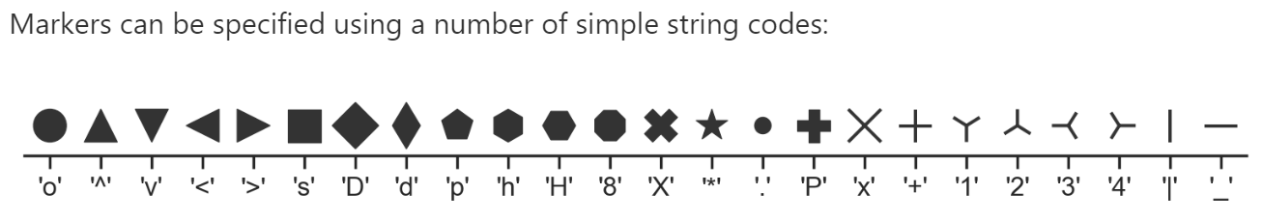
Mark Objects Properties
Color, edgecolor, fillcolor
“Alpha” property for opacity, useful for overplotting
Fill, marker, linestyle

Slide 9
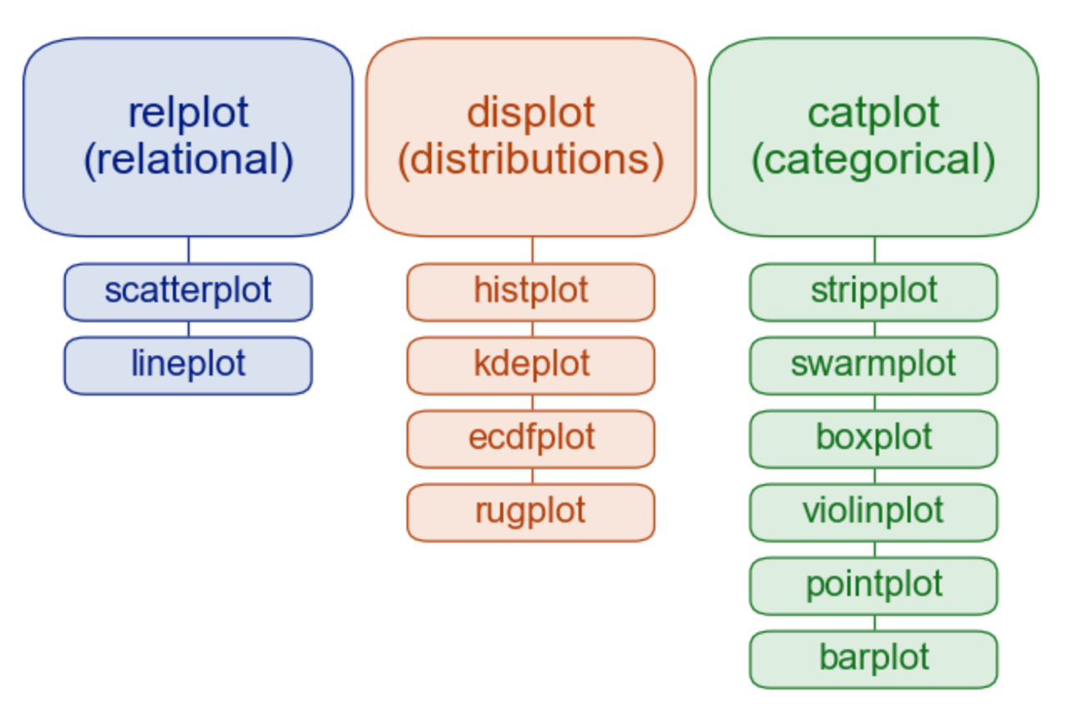
Seaborn Plotting Functions
Relplot, displot, and catplot are “figure-level” functions; interface with matplotlib through a seaborn object
The subplot below each are “axes-level” functions; plot data onto a single matplotlib.pyplot.Axes object

Slide 10
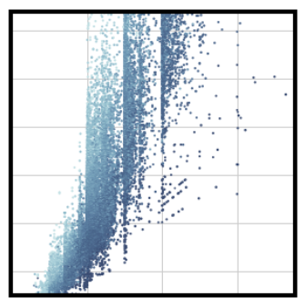
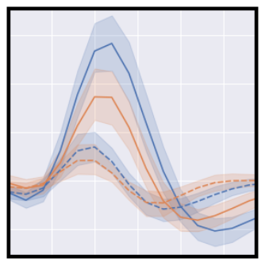
Relplots
Most common seaborn function
Used to visualize statistical relationships
Ex. Scatter plots, line plots

Slide 11
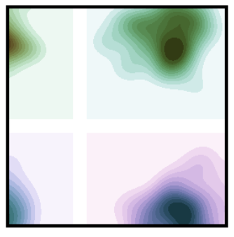
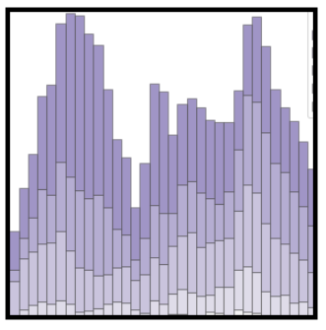
displots
Depicts data distribution
Visualizes range, skew, modality, outliers, etc.
Ex. Histograms, kernel density estimate plots (KDE), empirical cumulative distribution function plots (ECDF), rugplots (marginal distributions

Slide 12
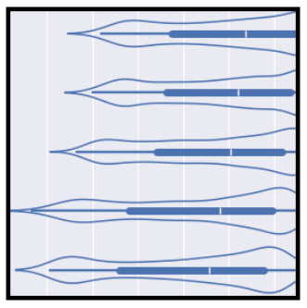
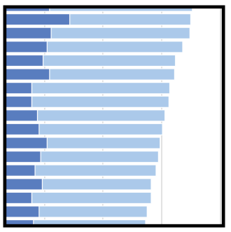
Catplots
Visualizes categorical data
3 main types:
1. categorical scatterplots (stripplot, swarmplot)
2. categorial distribution plots (boxplot, violinplot)
3. categorical estimate plots (pointplot, barplot)

Slide 13
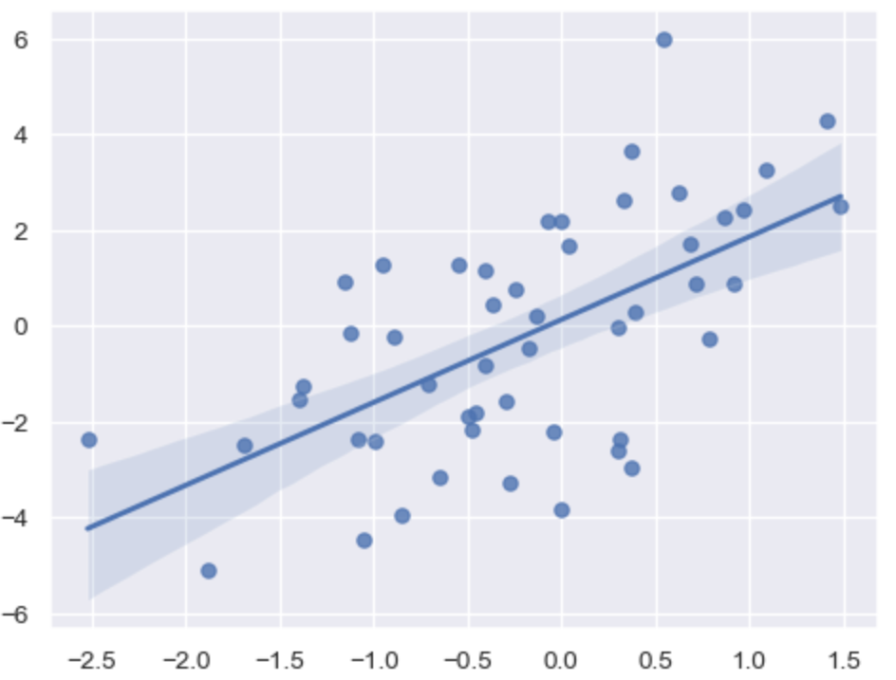
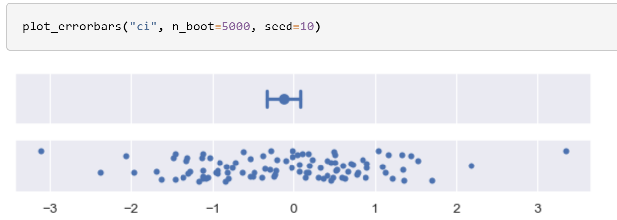
Error bars
Depicts error in estimation & regression plots
A relatively newer seaborn API

Slide 14
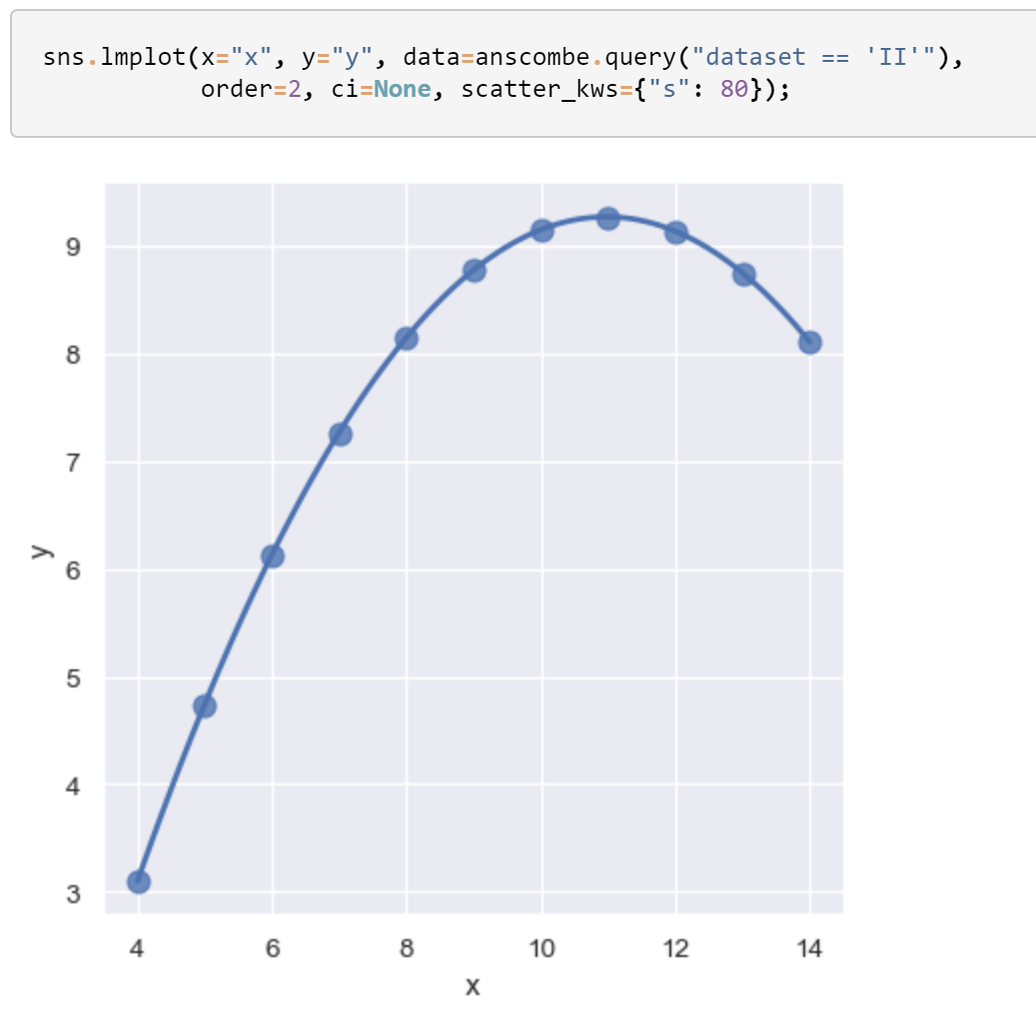
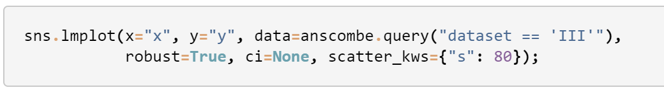
Regression
Linear fits are visualized through two functions: regplot & Lmplot
Works with polynomial regression, logistic regression, etc.
Can fit robust regression to account for outliers

Slide 15
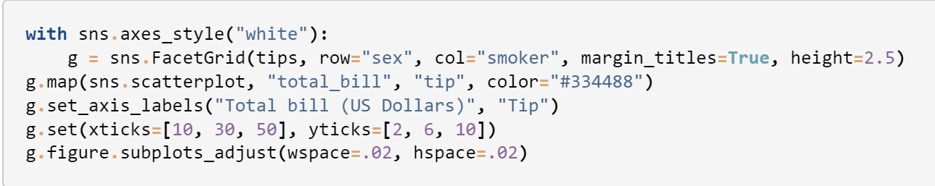
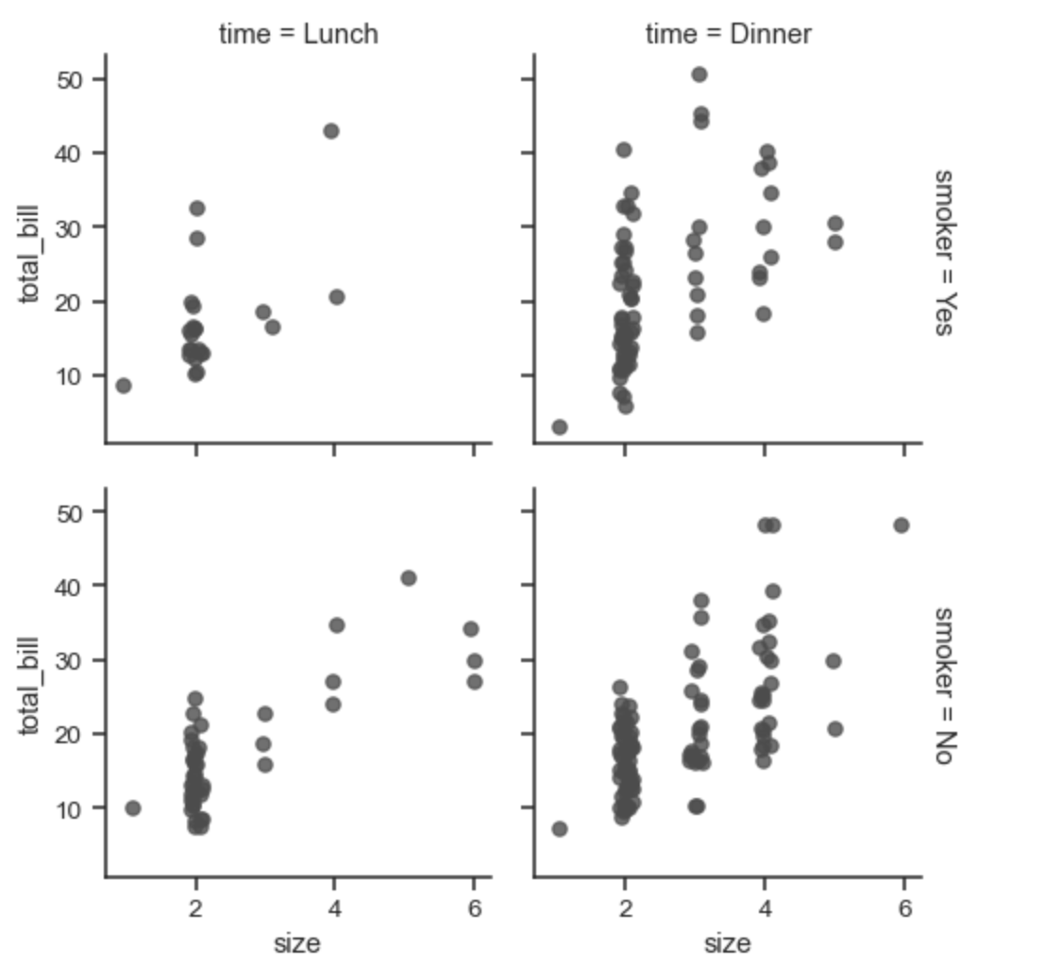
Multi-plot grids
Draws multiple instances of the same plot with a subset of the data in each instance
Multiple instances of the same plot are possible thanks to the FacetGrid class

Slide 16
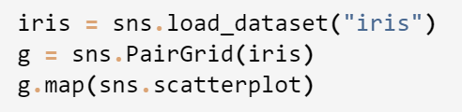
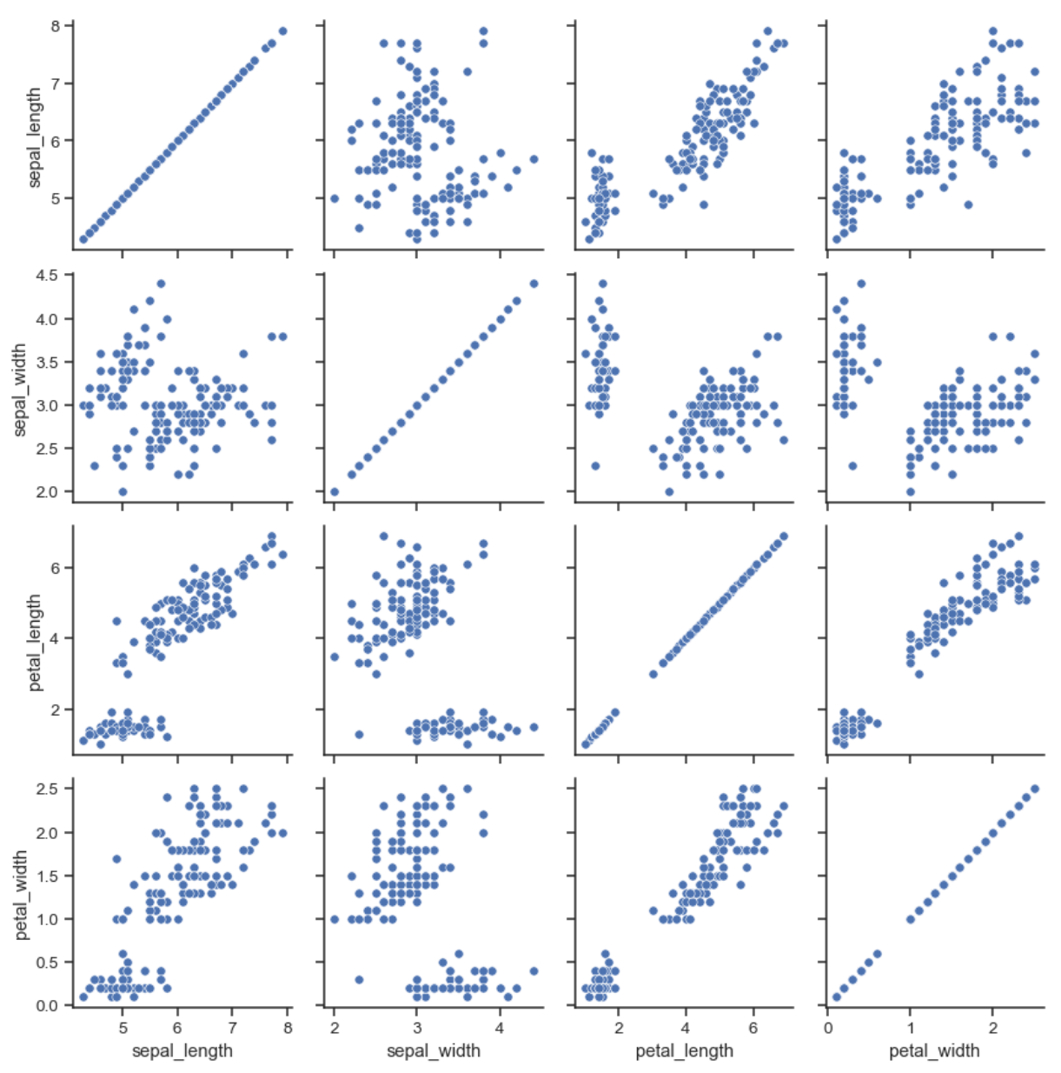
Pairwise relationships
The PairGrid function allows correlations between several variables to be viewed simultaneously

Slide 17
Final thoughts
There’s other programs, such as R, that can do the same type of modeling described, but Seaborn does it better
Great for data reports and presentations
Simplifies complex data
https://seaborn.pydata.org/index.html

