Slide 1
Azure ML
Brendan Gass
Arjun Kavungal

Slide 2
What is it?
Cloud-based service hosted by Microsoft that is used for machine learning and other various data science applications
Can be used with either the SDK or the Azure portal, which has a GUI

Slide 3
How to sign up
Students at UGA have access to a subscription service for Azure
To sign up, go to the Azure Microsoft website and log into your Microsoft student account, then click the student option on the subscription options

Slide 4
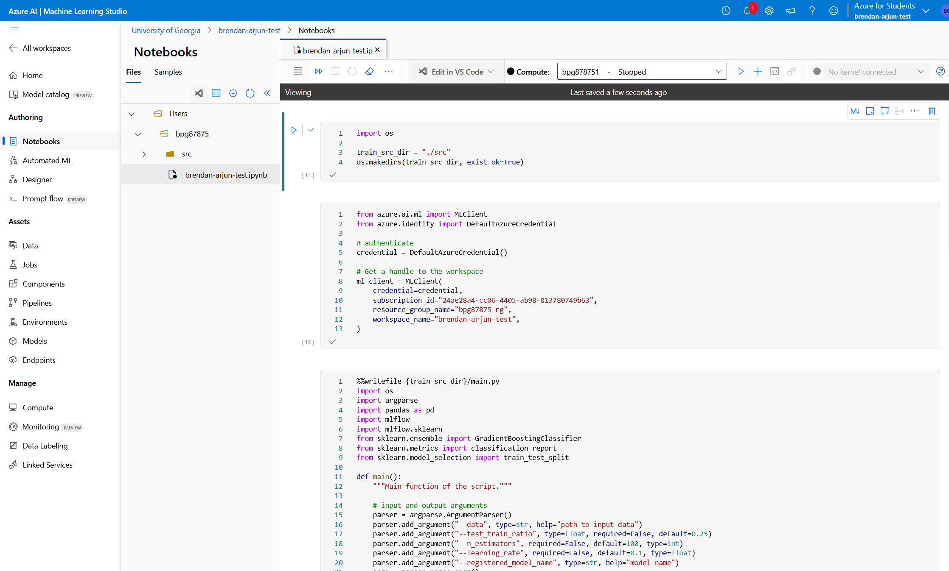

Slide 5
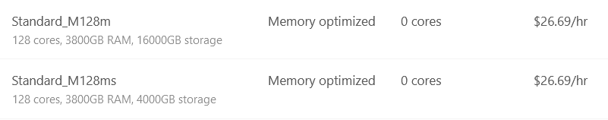

Slide 6
Azure ML designer
A drag and drop UI interface for machine learning pipelines in Azure ML workspaces.
You build a pipeline by dragging and dropping blocks and connecting them, much like Scratch or Wix

Slide 7
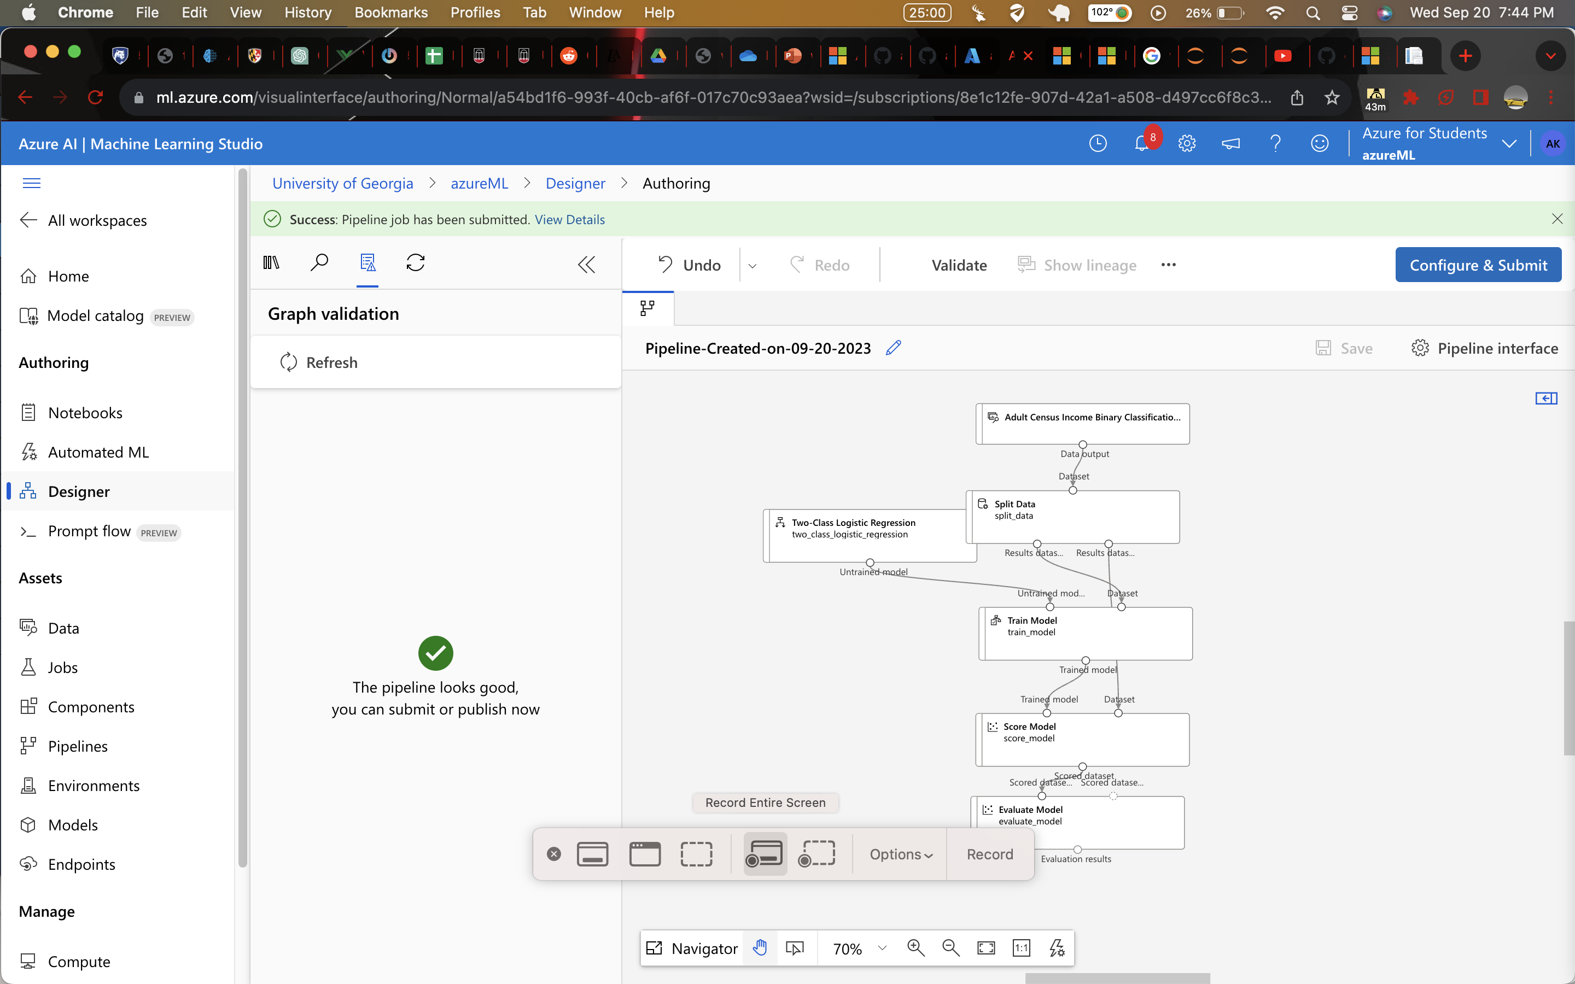

Slide 8
You can import data in multiple ways: URL, blob container, file share, data lake, sql database, or postgresql.
Most models can be done on Azure Designer: regression, clustering, classification, NLP, computer vision.
Provides a good option for those who don't want to (or can't) manually code various machine learning algorithms or other data workloads, especially those that only need to be tested once
For those that need to be ran repeatedly, a combination of custom code and block coding can be done to optimize the workload

