Slide 1
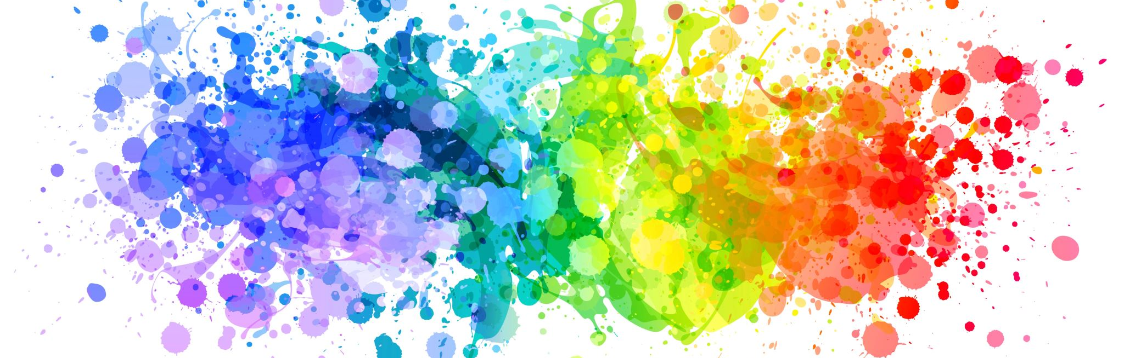
Matplotlib
CSCI 4360/6360 Data Science II
Department of Computer Science
University of Georgia
Presented by: Matthew Lawson, Karan Deshmane

Slide 2
Introduction to Matplotlib
Library created in 2003 by former Princeton graduate and neurobiologist John D. Hunter
Developed initially as a part of Hunter’s postdoc research with EEG data to provide 2D data visualization in Python
Designed to emulate MATLAB’s plotting capabilities given Hunter’s prior experience in MATLAB
Principle goal of ease of use and support of Python arrays to provide easy plotting capabilities
Heavy use of NumPy and other packages to provide performance for large arrays

Slide 3
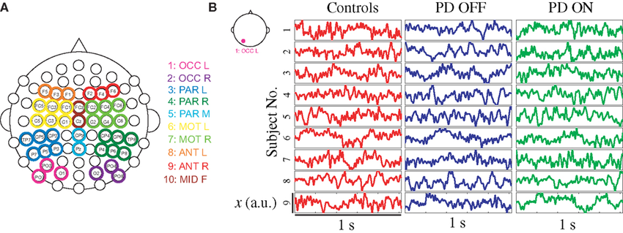
Context: EEG Data (Electroencephalography)
EEG is a method of recording electrical activity from the brain using electrodes to detect tiny electrical signals produced by brain activity
EEG produces various mappable frequencies of brain activity over time
Plotting frequencies essential to identifying patterns in brain activity
Example:

Slide 4
Dependencies
Requires several mandatory dependencies (3.8.1):
Python (>= 3.9)
contourpy (>= 1.0.1)
cycler (>= 0.10.0)
dateutil (>= 2.7)
fontTools (>= 4.22.0)
kiwisolver (>= 1.3.1)
NumPy (>= 1.21)
packaging (>= 20.0)
Pillow (>= 8.0)
pyparsing (>= 2.3.1)
importlib-resources (>= 3.2.0; only required on Python < 3.10)

Slide 5
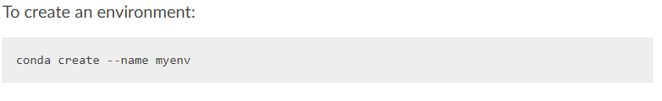
Installation
When installed via a package manager the previous dependencies are automatically installed (PIP, Conda)
Can download yaml environment file from documentation
Recommended to use package manager to install library in virtual environment:
Conda environment activation follows: “conda activate myenv” format

Slide 6
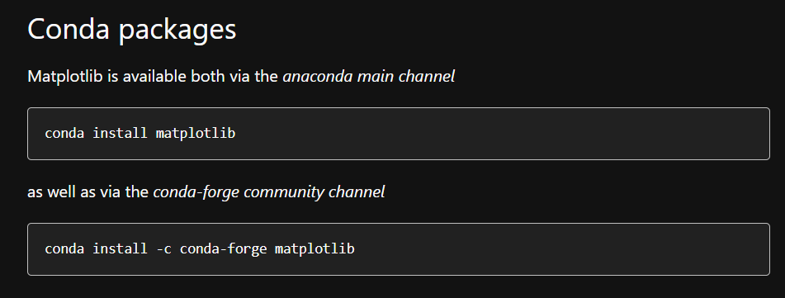
Installation - Conda
Once inside desired environment, conda install follows the usual “conda install” format using “matplotlib” keyword with desired installation channel :

Slide 7
Matplotlib Components
Matplotlib contains three main components:
Pylab interface (Pyplot) : Allows users to create plots with code syntax similar to MATLAB’s figure generating code
Matplotlib API: set of classes that create and manage figures, plots, text, lines, etc.
“Backends”: the set of device-dependent drawing renderers, that produce visual outputs (PNG outputs use Anti-Grain Geometry library, SVG backend produces scalable vector graphics outputs, etc.)

Slide 8

Pyplot Basics
Matplotlib graphs your data on figures, of which each can contain one or more individual axes
Figures can be thought of as windows, within which each window “pane” is an individual axes
The axes contains the actual plot and sits within the figure
Each figure and axes contains methods to control the format of each
We will explore these in the demo
To generate basic figure with one plot:

Slide 9
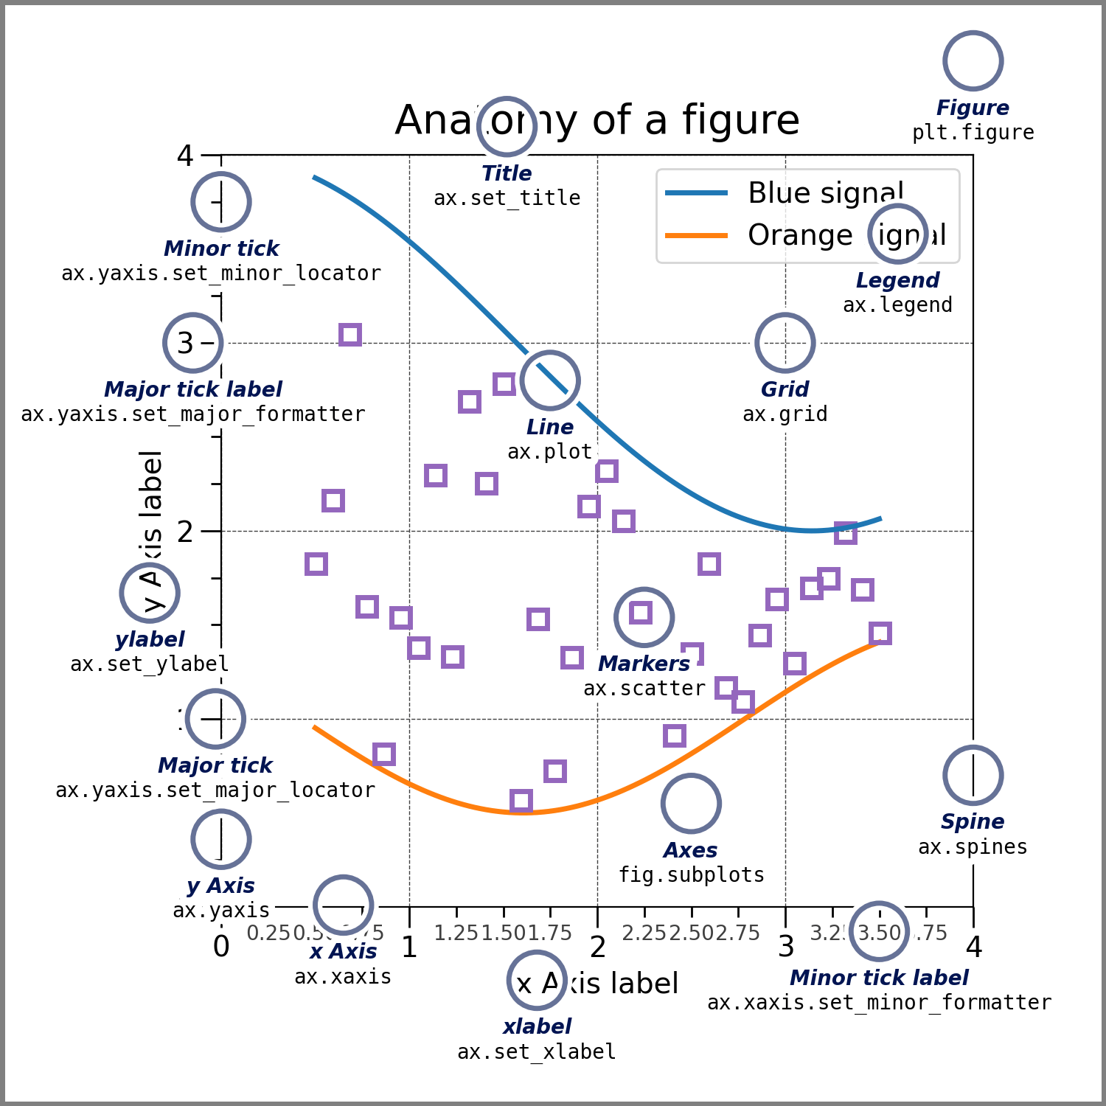
Pyplot Basics – Figure Elements
A basic figure in Matplotlib contains the following elements:

Slide 10
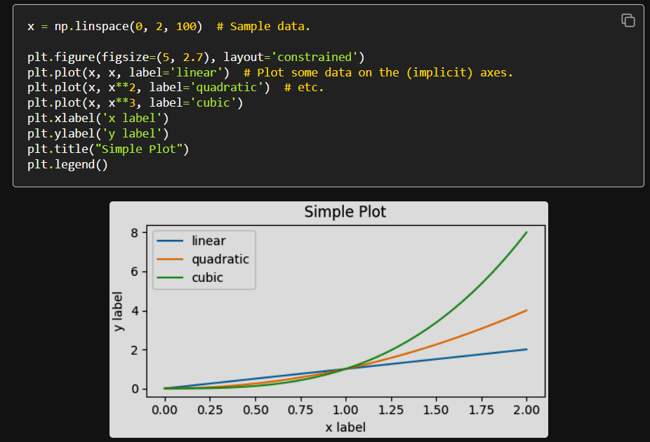
Figure-Axes Interactions
You can easily plot multiple axes on a single plot using the following syntax, allowing you to directly create the figure with specified size and layout parameters:

Slide 11
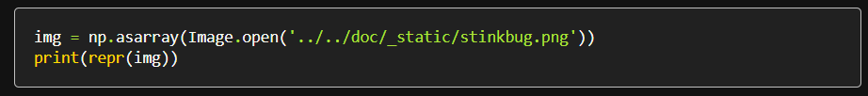
Image Basics
Plotting images in Matplotlib also relies on the Pyplot plotting interface
Using MPL you can analyze color distributions in RGB images, generate a variety of color maps, and perform a variety of functions on pixel values to produce various image effects
Image plotting workflow usually requires importing images as a Numpy array

Slide 12
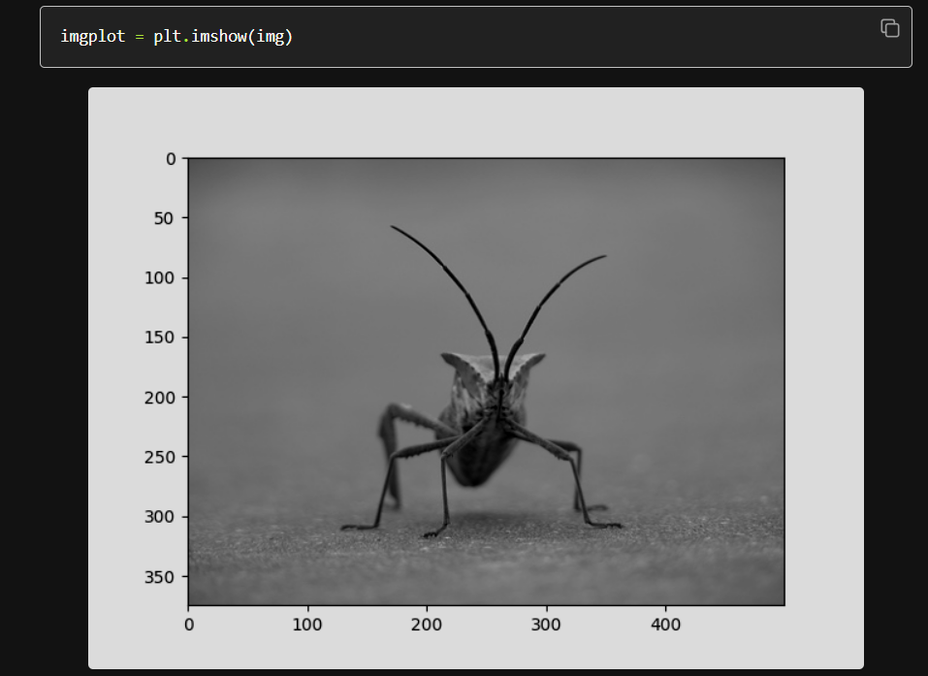
Image Basics
To plot the actual image, MPL uses the plt.imshow() syntax, which takes a NumPy array argument:

Slide 13
Advanced Uses
Outside of basic graphs and image plotting, matplotlib utility to support visualization for several topics we’ve covered in this course such as clustering
It also offers advanced capabilities for more sophisticated visualizations such as 3D Plotting, Animations and Interactive Plots

Slide 14
Matplotlib Demo

Slide 15
Matplotlib Tutorials
Matplotlib provides example tutorials in both Python source code and Jupyter Notebook formats:
https://matplotlib.org/stable/tutorials/index.htmlhttps://matplotlib.org/stable/tutorials/index.html

Slide 16
Sources
Matplotlib Documentation:
- https://matplotlib.org/stable/
EEG Visualization:
- https://www.researchgate.net/figure/A-Overview-of-EEG-data-clusters-used-in-analysis-and-B-randomly-selected-EEG-time_fig6_259492596

