Slide 1
Introduction to Dask
Scale the Python Tools You Love
Presenter: Cheng Tang & Renke He
Oct 30, 2023

Slide 2

What is Dask
Python library for parallel computing.
Extends familiar APIs from tools like Pandas and NumPy to larger-than-memory or distributed environments.
Accelerates custom systems.

Slide 3
Why is Dask
Built for Python: Integrate seamlessly with existing Python data tools.
Handle large datasets: Work with datasets that don't fit into memory.
Scalability: Scale from single machines to thousands of cores.

Slide 4
Comparison with Traditional Python Tools
NumPy and Pandas are in-memory, limiting data size.
Dask enables parallel and distributed computations.
Dask divides datasets into smaller chunks, and processes chunks in parallel.

Slide 5
For Example…
Numpy is a popular library for
Its high-level usable and flexible APIs.
High-performance implementation.
However, it’s not originally designed to
Scale beyond a single CPU.
Data that doesn’t fit in memory.

Slide 6
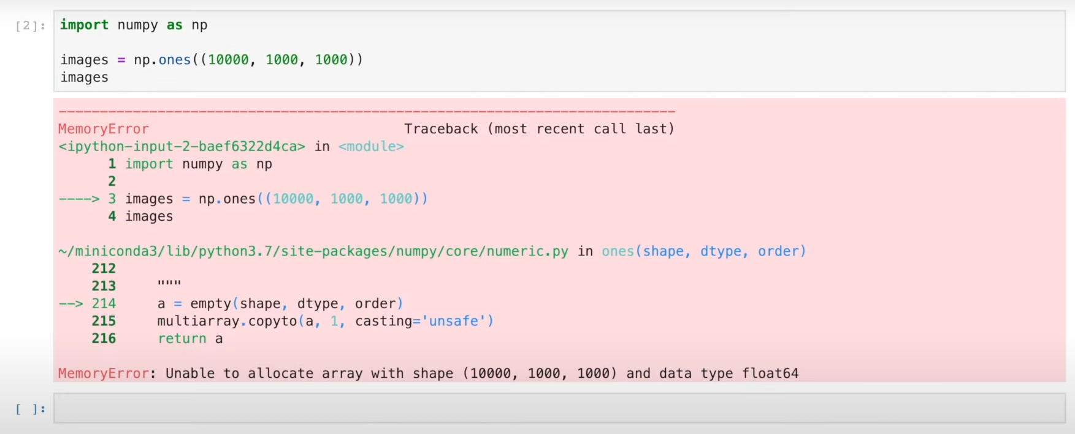
For Example…

Slide 7
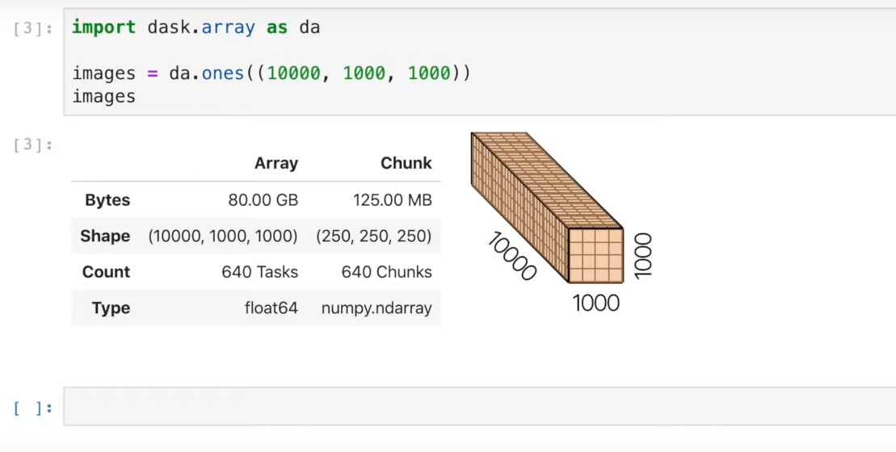
For Example…

Slide 8
Dask Components
Dask Arrays
Behave like NumPy arrays but allow operations to run in parallel.
Split into chunks, with operations applied chunk-wise.
Dask DataFrames
Similar to Pandas DataFrames but split along the index.
Support most common Pandas operations.
Dask Bags
Suitable for semi-structured data.
Parallel lists that support functional programming operations.
Dask Delayed
A way to parallelize existing Python codebases or libraries.
Wraps functions and their arguments to produce task graphs.

Slide 9
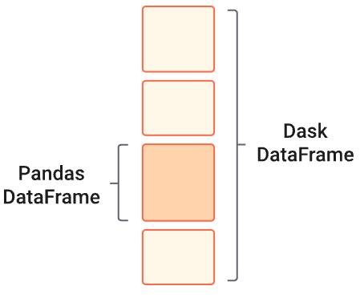
Dask DataFrame
A Dask DataFrame is a large parallel DataFrame composed of many smaller pandas DataFrames.
These pandas DataFrames may live on disk for larger-than-memory computing on a single machine, or on many different machines in a cluster.

Slide 10
Design the Dask DataFrame
Dask DataFrames coordinate many pandas DataFrames/Series arranged along the index.
A Dask DataFrame is partitioned row-wise, grouping rows by index value for efficiency.
These pandas objects may live on disk or on other machines.

Slide 11
Common Uses and Anti-Uses
Dask DF is used in situations where pandas is commonly needed, and when pandas fails due to data size or computation speed:
Manipulating large datasets, even when those datasets don’t fit in memory.
Accelerating long computations by using many cores.
Distributed computing on large datasets with standard pandas operations like groupby, join, and time series computations.

Slide 12
Common Uses and Anti-Uses
Dask DataFrame may not be the best choice in the following situations:
If your dataset fits comfortably into RAM on your laptop, then you may be better off just using pandas. There may be simpler ways to improve performance than through parallelism
If your dataset doesn’t fit neatly into the pandas tabular model, then you might find more use in dask.bag or dask.array
If you need functions that are not implemented in Dask DataFrame, then you might want to look at dask.delayed which offers more flexibility
If you need a proper database with all that databases offer you might prefer something like Postgres

Slide 13
Common Uses and Anti-Uses
Dask DataFrame may not be the best choice in the following situations:
If your dataset fits comfortably into RAM on your laptop, then you may be better off just using pandas. There may be simpler ways to improve performance than through parallelism
If your dataset doesn’t fit neatly into the pandas tabular model, then you might find more use in dask.bag or dask.array
If you need functions that are not implemented in Dask DataFrame, then you might want to look at dask.delayed which offers more flexibility
If you need a proper database with all that databases offer you might prefer something like Postgres

Slide 14
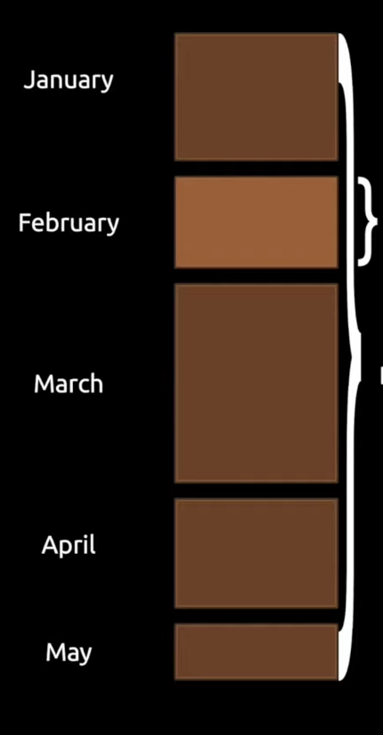

Some Fun Combinations
Pandas + Dask: Scalable Dataframes
Extends existing Python libraries.
Enables an easy transition for users.
Leverages existing work, rather than reinvents wheels.
Pandas DF
Dask DF

Slide 15
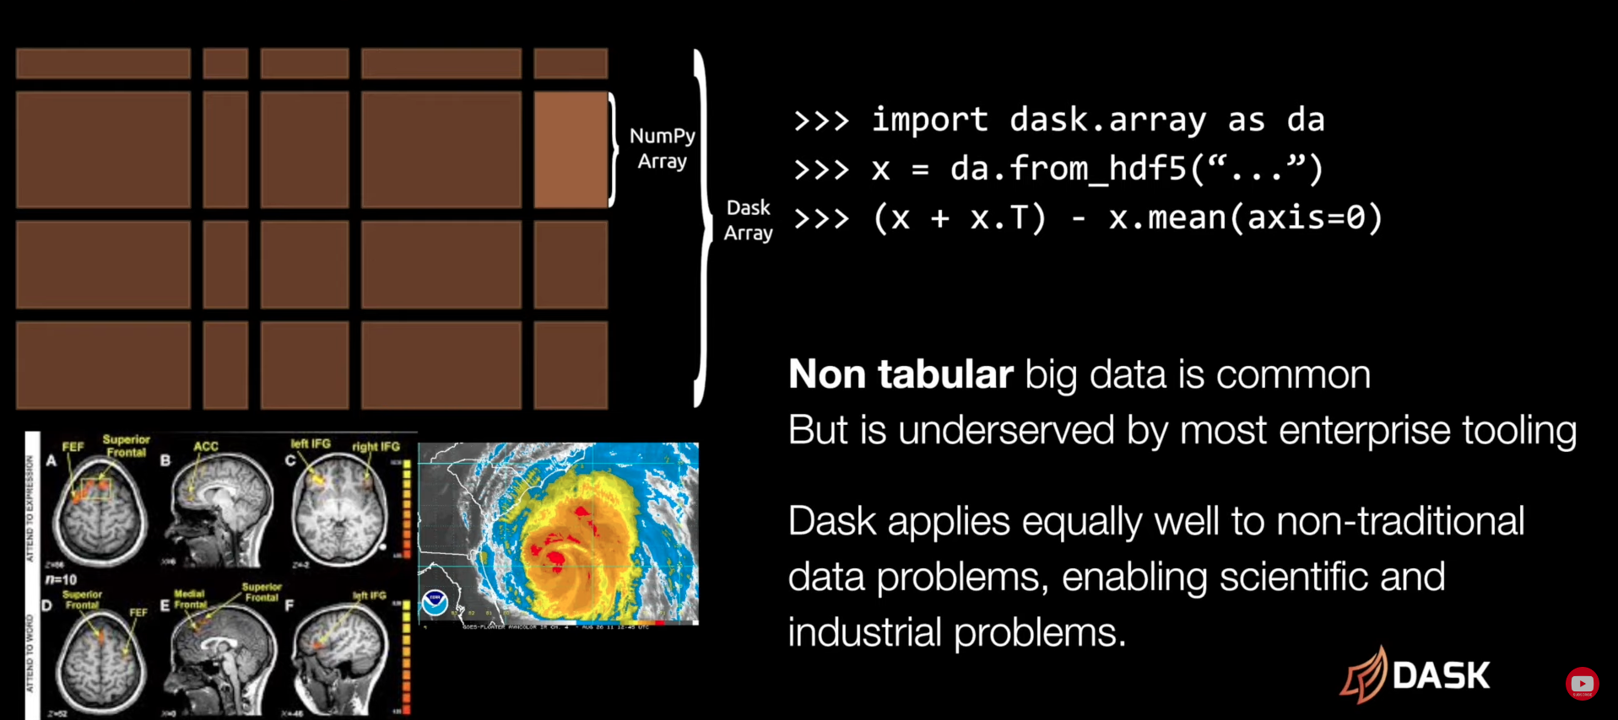
Some Fun Combinations
Numpy + Dask: Scalable Array Computing
Organize Numpy arrays into a grid.
Multi-dimensional computing.

Slide 16
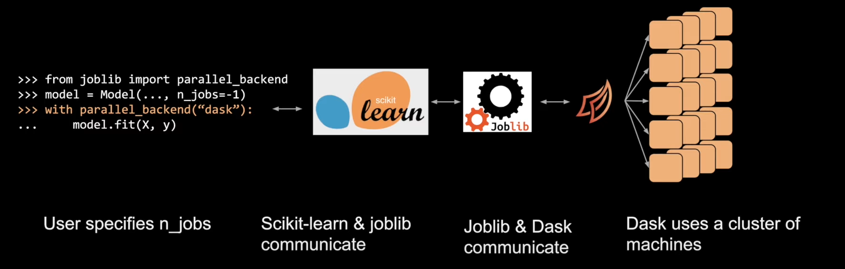
Some Fun Combinations
Scikit-Learn + Dask: Distributed Parallelism with Joblib
Many Scikit-Learn models are already designed for parallelism.
Can hand off this control to Dask.

Slide 17
How Does Dask Work
Client: submit tasks to be executed.
Scheduler: send tasks to workers for execution.
Workers: compute tasks / store and serve computed results.
Client
Scheduler
Worker
Worker
Worker

