Slide 1
Recurrent Neural Networks
CSCI 4360/6360 Data Science II

Slide 2
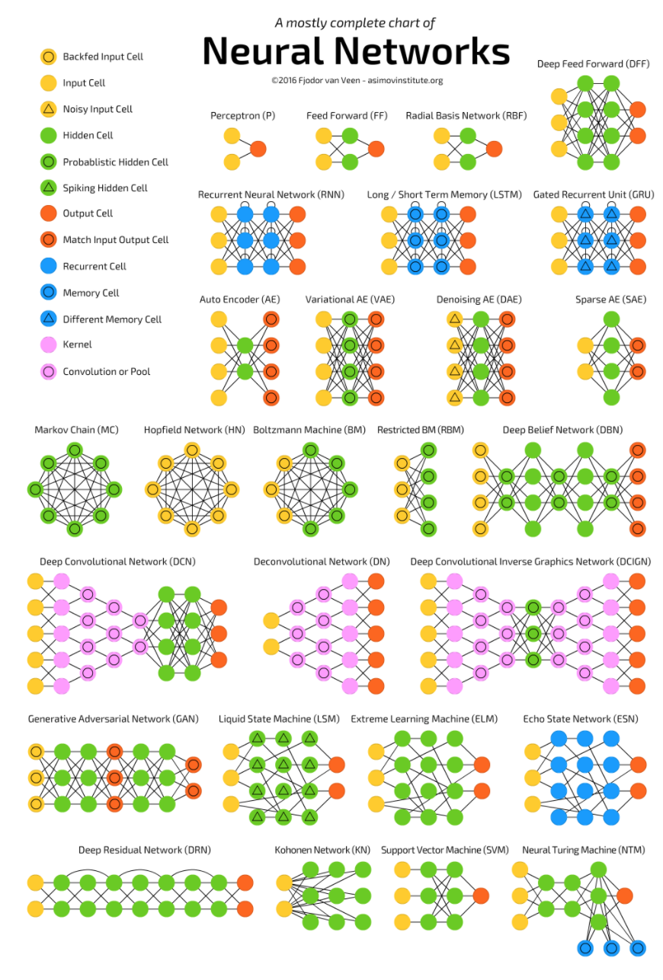
The Neural Network Zoo
http://www.asimovinstitute.org/neural-network-zoo/

Slide 3
The Neural Network Zoo
http://www.asimovinstitute.org/neural-network-zoo/
Today

Slide 4


Modeling Sequences
Input:
Output:
T and N not necessarily equal
Dimensions of X and Y not necessarily equal
Language Translation
Weather and Climate Forecasting
Automated Driving
Other “long-distance” time series data

Slide 5
Something we’ve seen before

Slide 6


Linear Dynamical Models
Two main components (using notation from Hyndman 2006):
Appearance Model
State Model

Slide 7
Autoregressive Models
This is the definition of a 1st-order autoregressive (AR) process!
Each observation (x_{t}) is a function of previous observations, plus some noise
Markov model!

Slide 8
Autoregressive Models
AR models can have higher orders than 1
Each observation is dependent on the previous d observations

Slide 9
Autoregressive Models
Concrete, a priori definition of what is important
n^{th}-order Markov process
n+1 terms and larger are explicitly ignored
No concept of attention
All n terms receive equal “attention” (computationally, if not also statistically)
Are you devoting equal time reading every word on this slide?
Cannot handle variable-length inputs, nor variable-length outputs
Contrast with CNNs: all input images have to be the same size (usually)
Contrast with [insert deep network of choice]: all outputs are the same, given any input

Slide 10
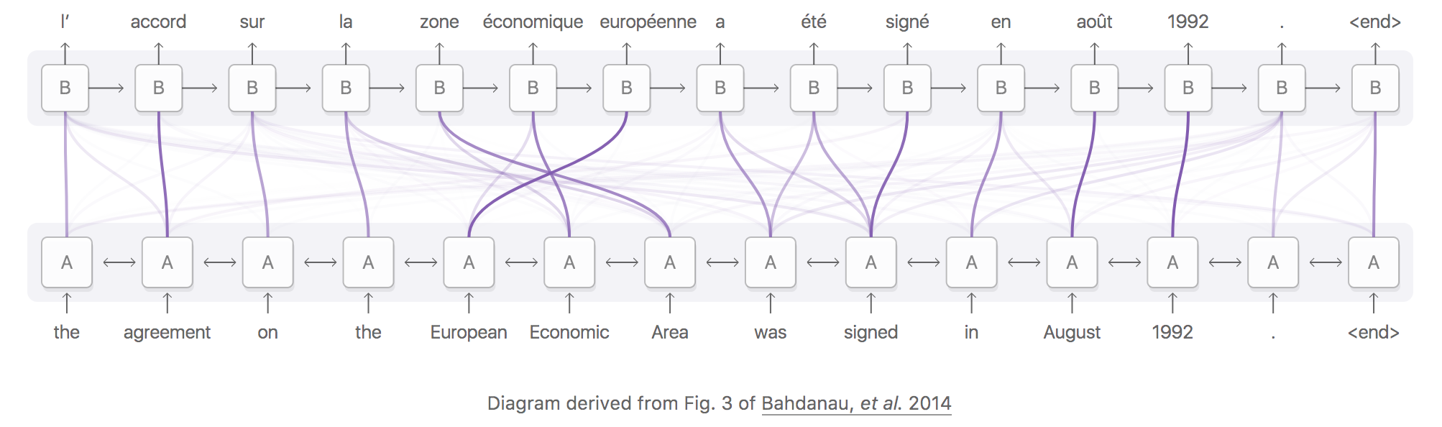
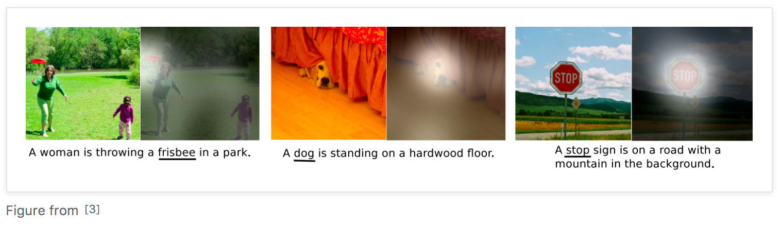
Attention
Some things are more important than others
Notes:
We’ll come back to this notion of Attention
- RNNs don’t explicitly implement this, but they were closer to it than anything before

Slide 11
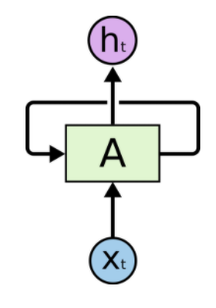
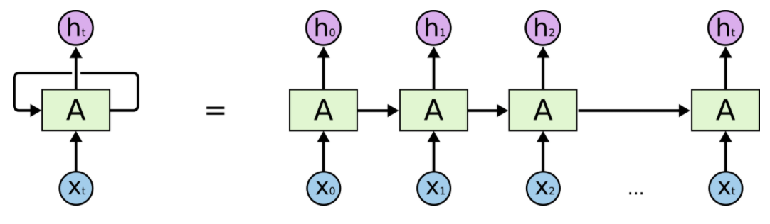
Recurrent Neural Networks
In short, recurrent neural networks (RNNs) break the typical “directed acyclic” pedagogy of deep networks by introducing self-loops
Allows information to persist through multiple iterations
We can get around problems introduced by loops by “unrolling” the loops
This permits backprop to work as usual
Notes:
a chunk of neural network, A, looks at some input xtxt and outputs a value htht. A loop allows information to be passed from one step of the network to the next.

Slide 12
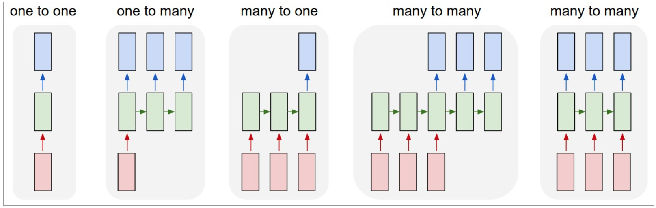
Recurrent Neural Network
“List” structure intrinsically handles variable-length data
Think: convolution, but over time instead of space
Notes:
From left to right:
(1) Vanilla mode of processing without RNN, from fixed-sized input to fixed-sized output (e.g. image classification).
(2) Sequence output (e.g. image captioning takes an image and outputs a sentence of words).
(3) Sequence input (e.g. sentiment analysis where a given sentence is classified as expressing positive or negative sentiment).
(4) Sequence input and sequence output (e.g. Machine Translation: an RNN reads a sentence in English and then outputs a sentence in French).
(5) Synced sequence input and output (e.g. video classification where we wish to label each frame of the video).
Notice that in every case are no pre-specified constraints on the lengths sequences because the recurrent transformation (green) is fixed and can be applied as many times as we like.

Slide 13
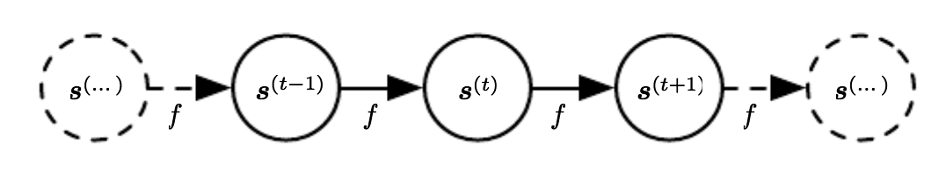
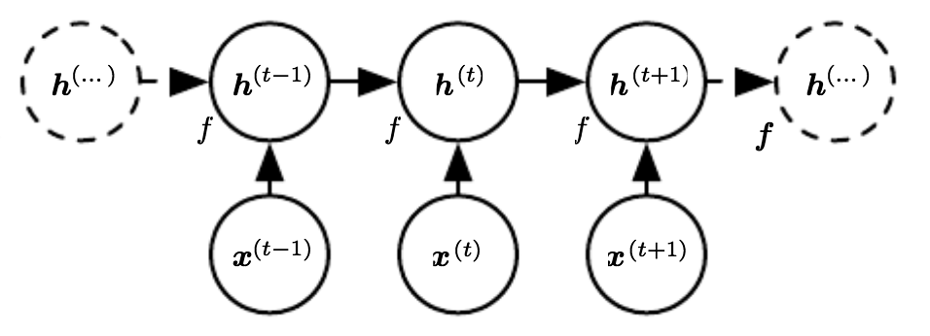
Recurrent Neural Networks
Use the same “parameter sharing” as CNNs
And linear dynamical systems!
f maps each time point to the next
Also updates internal state h

Slide 14



Recurrent Neural Networks
Four main equations at each time point
Bias term
Internal RNN state
Input
Update internal state
Activation function
Weights for hidden-to-hidden connections
Weights for input-to-hidden connections
Bias term
Internal RNN state
Predicted output
Final layer activation
Weights for hidden-to-output connections

Slide 15
Recurrent Neural Networks
RNNs are great for modeling sequences, but by themselves cannot capture attention
Long-term dependencies require an explicit “memory”

Slide 16
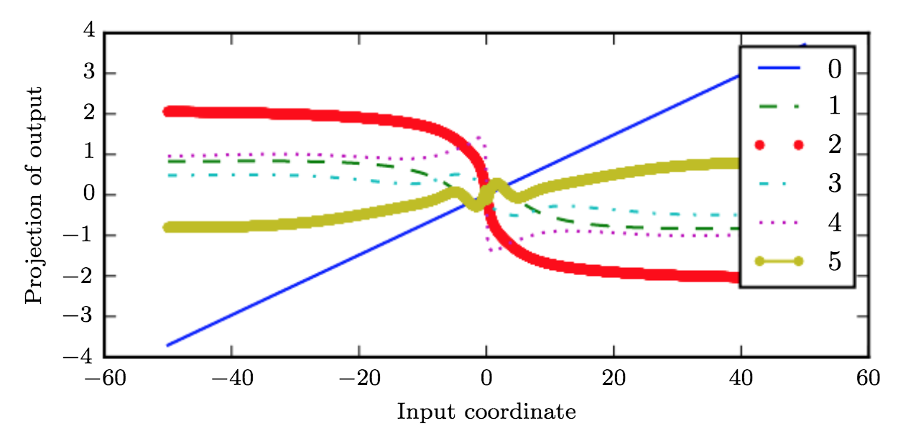
Long-term Dependencies
RNNs compose the same activation function repeatedly
Think: recurrence relations
Results in highly nonlinear behavior
Notes:
When composing many nonlinear functions
(like the linear-tanh layer shown here), the result is highly nonlinear, typically with most
of the values associated with a tiny derivative, some values with a large derivative, and
many alternations between increasing and decreasing. Here, we plot a linear projection of
a 100-dimensional hidden state down to a single dimension, plotted on the y-axis. The x
-axis is the coordinate of the initial state along a random direction in the 100-dimensional
space. We can thus view this plot as a linear cross-section of a high-dimensional function.
The plots show the function after each time step, or equivalently, after each number of
times the transition function has been composed

Slide 17




Long-term Dependencies
Put another way, recall the internal state update:
Where have we seen this before…
Eigenvalues are raised to the power t, decaying any eigenvalue < 1
Any component of h⁽⁰⁾ not aligned with largest eigenvalue will be discarded

Slide 18
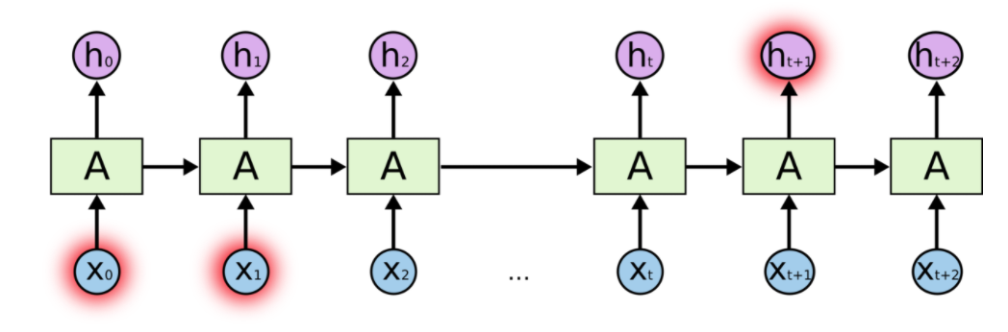
Long-term Dependencies
“I grew up in France… I speak fluent French.”
Notes:
Try to predict the last word in the sentence
Traditional RNNs would have trouble, especially as the gap indicated by “…” grows larger

Slide 19
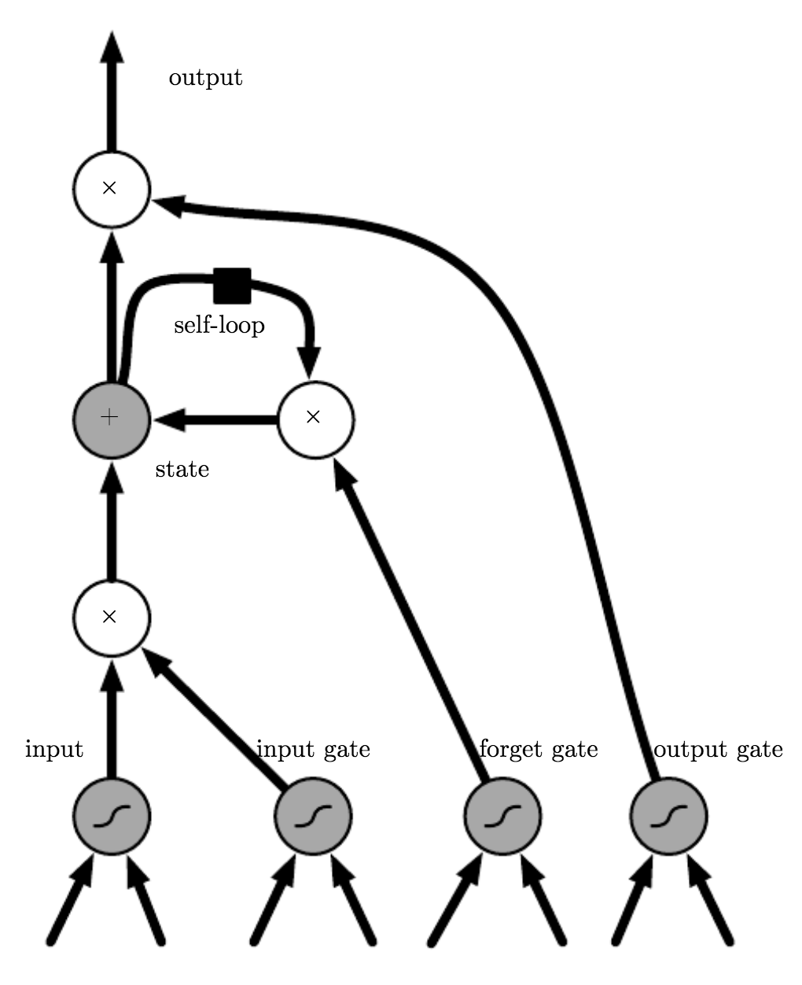
Long-Short Term Memory
Or “LSTM”
A variant of the gated RNN
Each hidden state comprises a forget gate
Determines what to “remember” and what to discard
Functions on self-loop input

Slide 20
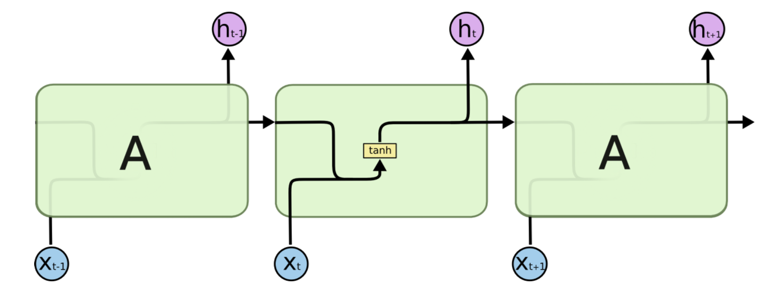
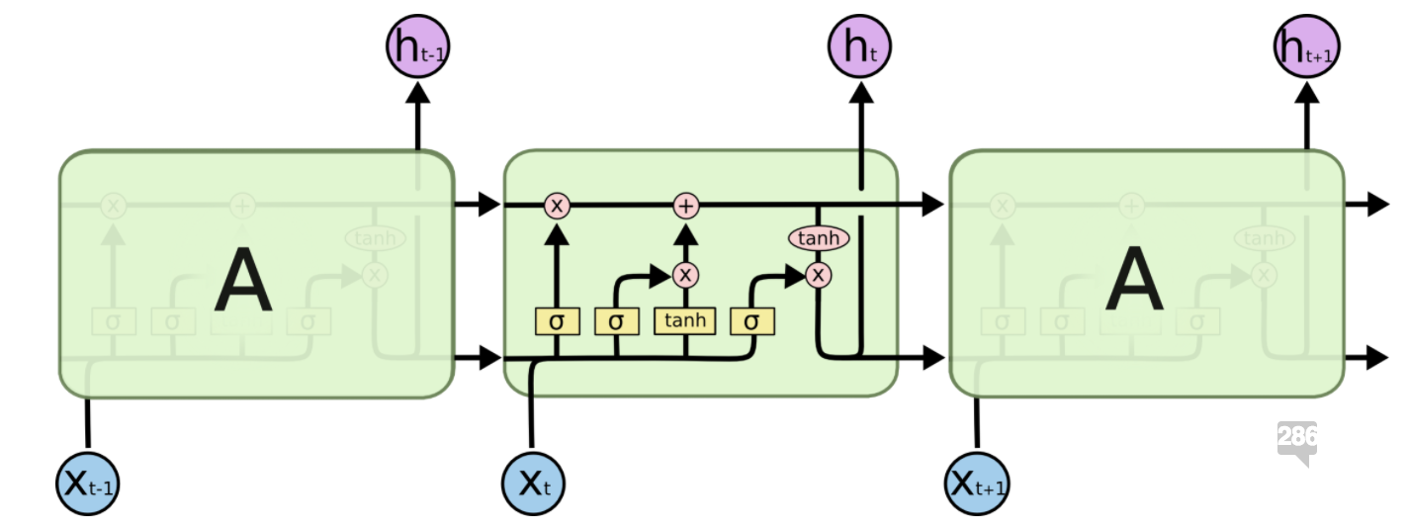
LSTM versus “vanilla” RNN
A “vanilla” RNN contains only a single activation
LSTMs have four interacting layers in each step

Slide 21
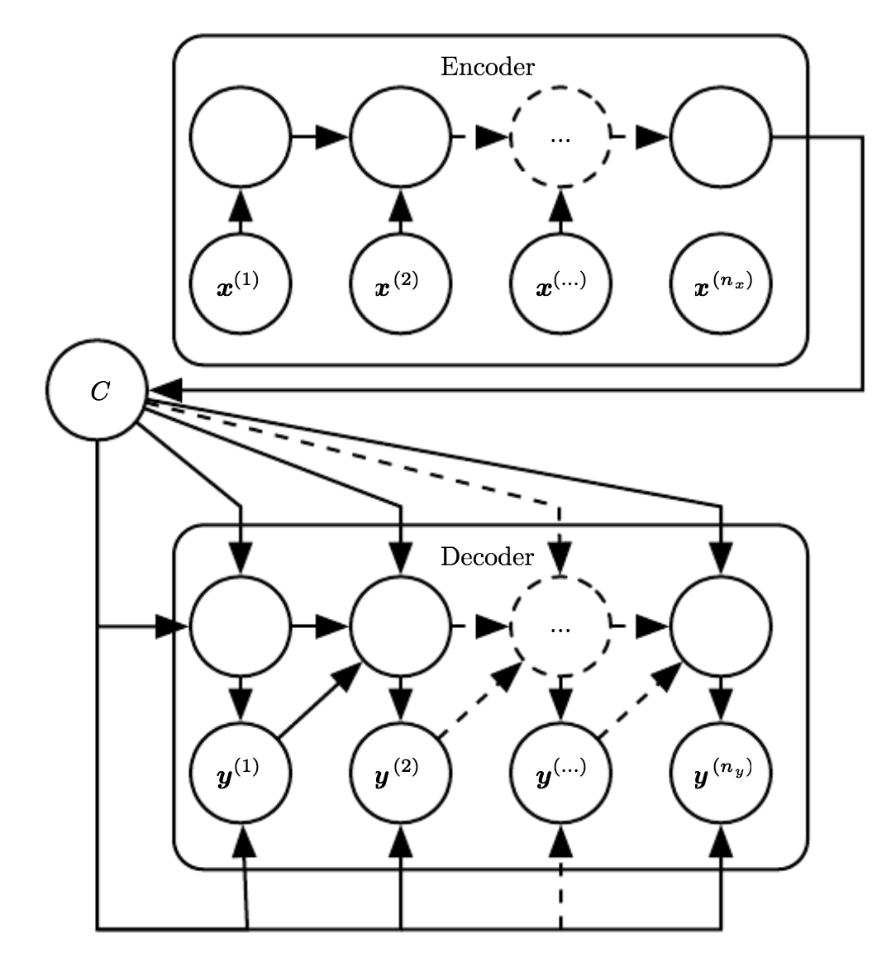
Encoder-Decoder Networks
Maps input to output sequences
Each mapping not necessarily of equal length!
C is a “semantic summary”
Think: input “subspace”
Have to ensure C is of sufficient dimensionality to represent input space

Slide 22
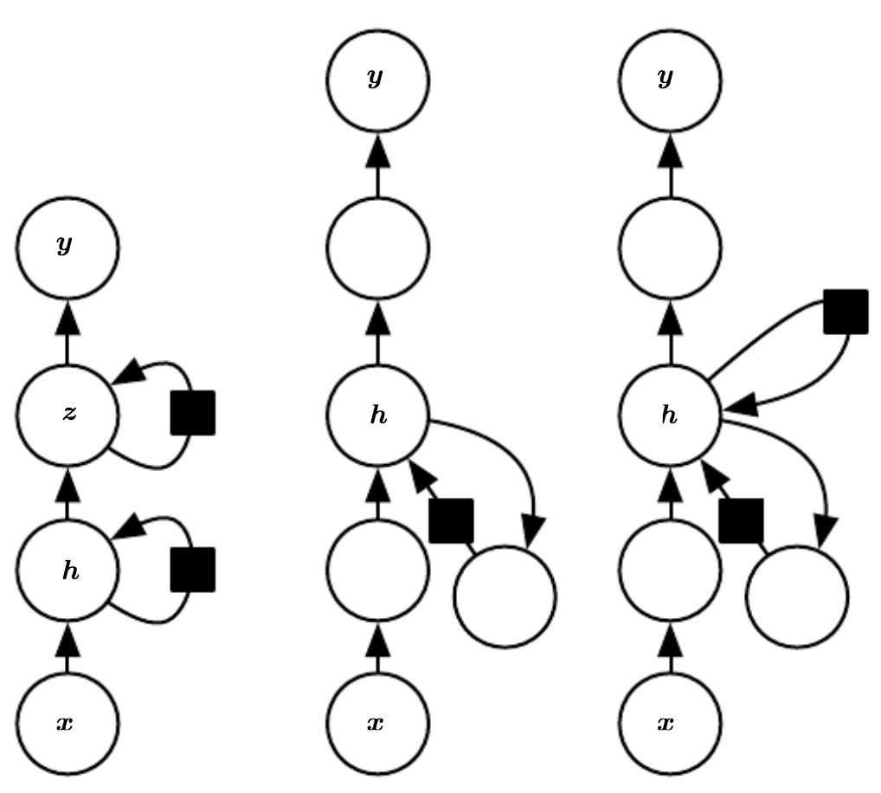
Deep Recurrent Networks
Each recurrent state can feed into a series of hidden states
Analogous to hidden markov models (HMMs) with attention and nearly infinite support for hidden states

Slide 23
Conclusions
Recurrent neural networks
A generalization of convolution (or is a convolution a generalization of recurrence?): uses same parameter-sharing idea
Introduces self-loops, but over discrete intervals: loops can be “unrolled” so backpropagation can still be used as normal
Still have trouble with long-term dependencies, such as language translation (vanishing / exploding gradient)
Long-short term memory
Introduce a series of gates within the self-loops
Gates determine what to remember, what to discard
No ill-conditioned gradients
Attention + Encoder-Decoder Networks
Starting to see the foundations for modern Transformers

Slide 24
References
Deep Learning Book, Chapter 10: “Sequence Modeling: Recurrent and Recursive Nets”, http://www.deeplearningbook.org/contents/rnn.html
“Attention and Augmented Recurrent Neural Networks”, https://distill.pub/2016/augmented-rnns/
“Understanding LSTM Networks” https://colah.github.io/posts/2015-08-Understanding-LSTMs/
“The Unreasonable Effectiveness of Recurrent Neural Networks” https://karpathy.github.io/2015/05/21/rnn-effectiveness/

