Slide 1


CSCI 4360/6360 Data Science II
Department of Computer Science
University of Georgia
Presented By: Karishma Hegde | Lahari Basavaraju | Shriya Garlapati

Slide 2
What is Keras?
A deep learning API written in Python, running on top of the machine learning platform TensorFlow.
Based on minimal structure that provides a clean and easy way to create deep learning models.
The core data structures of Keras are layers and models.
Supports multiple platforms and backends.
User friendly framework which runs on both CPU and GPU.
Highly scalability of computation.

Slide 3
Installation
Note: Requires Python 3.5 or higher.
Step 1:
Create Virtual Environment
Linux/Mac OS:
python3 -m venv kerasenv
Windows:
py -m venv keras
Step 2:
Activate The Environment
Linux/Mac OS:
$ cd kerasvenv kerasvenv $ source bin/activate
Windows:
.\env\Scripts\activate
Step 3:
Python Libraries
Numpy
Pandas
Scikit-learn
Matplotlib
Scipy
Seaborn

Slide 4
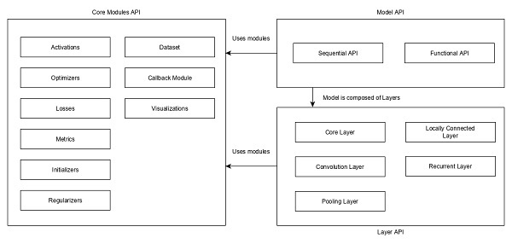
Architecture of Keras
Keras API can be divided into three main categories −
Model - represents ANNs
Layer - form the model
Core Modules - accessed for activation function, loss function, regularization function, etc.
Relationship between model, layer and core (source: www.tutorialspoint.com)

Slide 5
Model - Architecture of Keras
Keras Models are of two types
Sequential Model
Linear composition of Keras Layers.
Easy, minimal as well as has the ability to represent nearly all available neural networks.
from keras.models import Sequential //imports Sequential model from Keras models
from keras.layers import Dense, Activation //imports Dense layer and Activation module
model = Sequential() //create a new sequential model using Sequential API
model.add(Dense(512, activation = 'relu', input_shape = (784,))) //adds a dense layer (Dense API) with relu activation (using Activation module) function

Slide 6
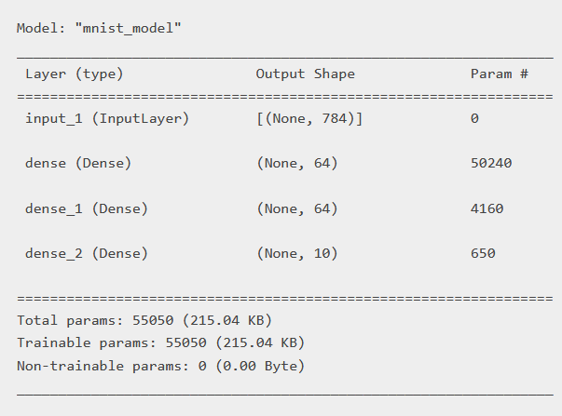
Model - Architecture of Keras
Functional API
Creates customized ANN models.
Handles models with non-linear topology, shared layers, and multiple inputs or outputs.
inputs = keras.Input(shape=(784,)) //create the input node
dense = layers.Dense(64, activation="relu") //create a new node in the graph of layers
x = dense(inputs)
x = layers.Dense(64, activation="relu")(x)
outputs = layers.Dense(10)(x) //add a few more layers to the graph of layers
model = keras.Model(inputs=inputs, outputs=outputs, name="mnist_model") //create a Model by specifying its inputs and outputs in the graph of layers
model.summary()

Slide 7
Layer - Architecture of Keras
Primary building block of Keras models.
Each layer receives input information, does some computation generates the transformed information.
The output of one layer will flow into the next layer as its input.
Keras layer requires below minimum details to create a complete layer:
Shape of the input data
Number of neurons / units in the layer
Initializers
Regularizers
Constraints
Activations

Slide 8
Layer - Architecture of Keras
Input Shape
Shape of the input data should be specified to create the first layer of the model.
Number of Neurons/Units in the Layer
Dense is an entry level layer provided by Keras, which accepts the number of neurons or units (32) as its required parameter.
Initializers
The initial weight to be assigned to the input data to indicate the neuron's signal strength.
Types:
Zeros - Generates 0 for all input data.
Ones - Generates 1 for all input data.
Constant - Generates a constant value (say, 5) specified by the user for all input data.
Identity - Generates identity matrix.

Slide 9
Layer - Architecture of Keras
Regularizers
Applies some penalties on the layer parameter during optimization.
Types include L1 and L2 optimization
Constraints
Aids in performance enhancement and offers fresh methods for utilizing unlabeled data.
Prunes output space, which boosts generalization and increases model learnability.
Types:
NonNeg UnitNorm | MaxNorm MinMaxNorm

Slide 10
Layer - Architecture of Keras
Activations
Employed to determine whether or not a particular neuron is active.
Performs a nonlinear transformation on the incoming data to improve the learning abilities of the neurons.
Output of a neuron depends on the activation function.
Types:
Linear Relu Softmax | Softplus Tanh Exponential

Slide 11
Modules - Architecture of Keras
Modules contains predefined classes, functions and variables which are useful for deep learning algorithm.
Backend Module -
Keras allows users to study its backend and make changes to some level in its backend.
For this task, Keras provides a backend module.Its default configuration is stored at $Home/keras/keras.json file.
{
"image_data_format": "channels_last",
"epsilon": 1e-07,
"floatx": "float32",
"backend": "tensorflow"
}

Slide 12
Modules - Architecture of Keras
Utils Module -
This module provides utilities for deep learning operations.
Types -
HDF5 Matrix - Converts input data in HDF5 format.
to_categorical - For one hot encoding of class vectors.
print_summary - To print the model summary.
from.utils import HDF5Matrix data=HDF5Matrix(‘data.hdf5’,’data’)
from keras.utils import to_categorical
labels = [0,1,2,3,4,5]
to_categorical(labels)
from keras.utils import print_summary
print_summary( model )

Slide 13
Modules - Architecture of Keras
Image Processing Module -
It provides methods to convert images to NumPy arrays.
The ImageDataGenerator class is used for real-time data augmentation.
Types -
apply_transform - apply some transformation to the image
flow - generate batches of augmented data
standardize - for normalization of input batch
apply_transform(x, transform_parameters)
flow(x, y, batch_size=32, shuffle, sample_weight, seed, save_to_dir, save_prefix='', save_format='png', subset)
standardize(x)

Slide 14
DEMO
Image Classification from Scratch

Slide 15
Resources
Keras Documentation - https://keras.io/getting_started/
Weights and Biases - https://h2o.ai/wiki/weights-and-biases/
Keras Modules - https://data-flair.training/blogs/keras-modules/
Image classification from scratch - https://keras.io/examples/vision/image_classification_from_scratch/
Keras Tutorial - https://www.tutorialspoint.com/keras/index.htm

