Slide 1

Deepika Vootla
Naga Sravani Komaravolu
Sree Ramya Yella
Tasneem Campwala

Slide 2
Overview
Introduction
ML Development challenges
How MLflow helps
Demo

Slide 3
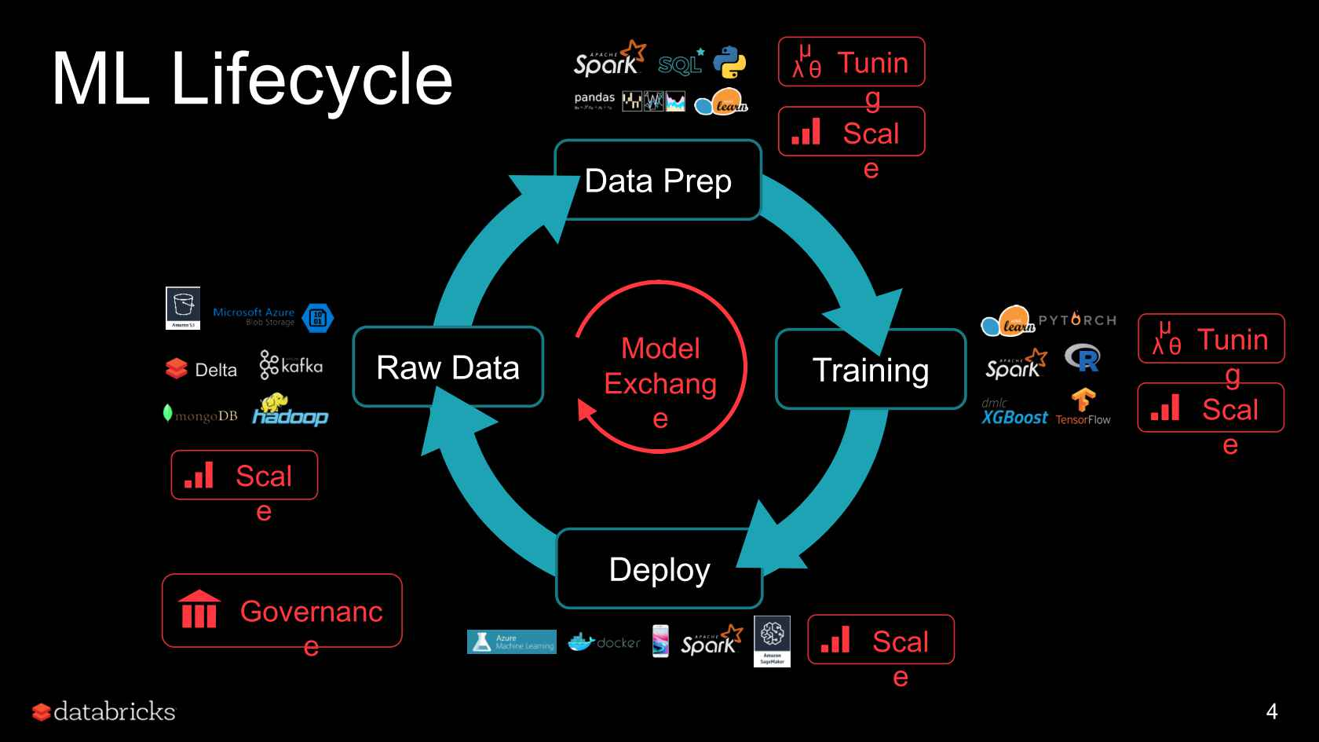

Slide 4
ML Development challenges
Multiple software tools to leverage
Tracking and reproducibility
Deployment issues
Scalability

Slide 5
Mlflow Features
Flexibility – works with any ML language, library
Reproducibility – Notebooks, local system, cloud
Scalability – Can be used irrespective of size of the organization

Slide 6
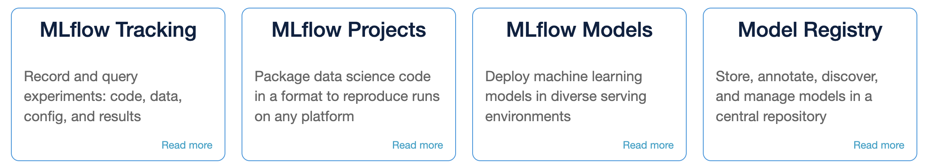
Mlflow Components

Slide 7
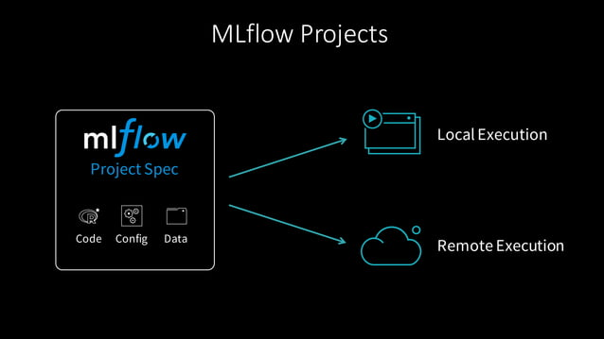
Projects

Slide 8

DEMO

Slide 9
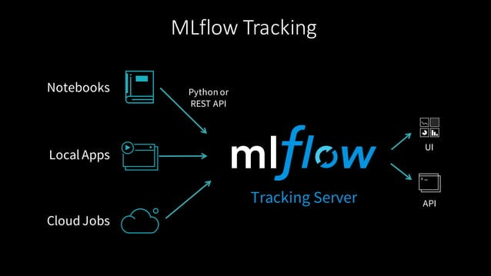
Tracking

Slide 10
Tracking – Key Concepts
Parameters – key-value inputs to the code
Metrics – numeric values (can update over time)
Source – training code that we ran
Version – of the training code
Artifacts – files including data and models
Tags and Notes – miscellaneous/additional information

Slide 11
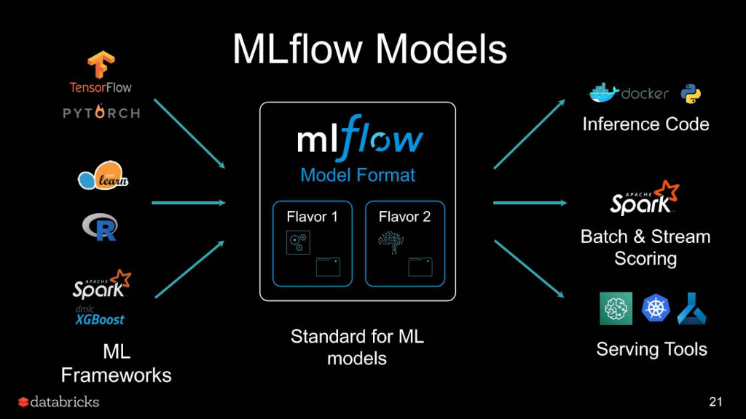
Models

Slide 12
Mlflow Models
MLflow Model Structure:
Configuration file
Evaluation dependencies (via conda environment)
Model Creation Utilities:
Supports serialization from various ML frameworks
Deployment APIs:
Deploy MLflow models effortlessly to multiple services
Available in Python, Java, R, and CLI

Slide 13

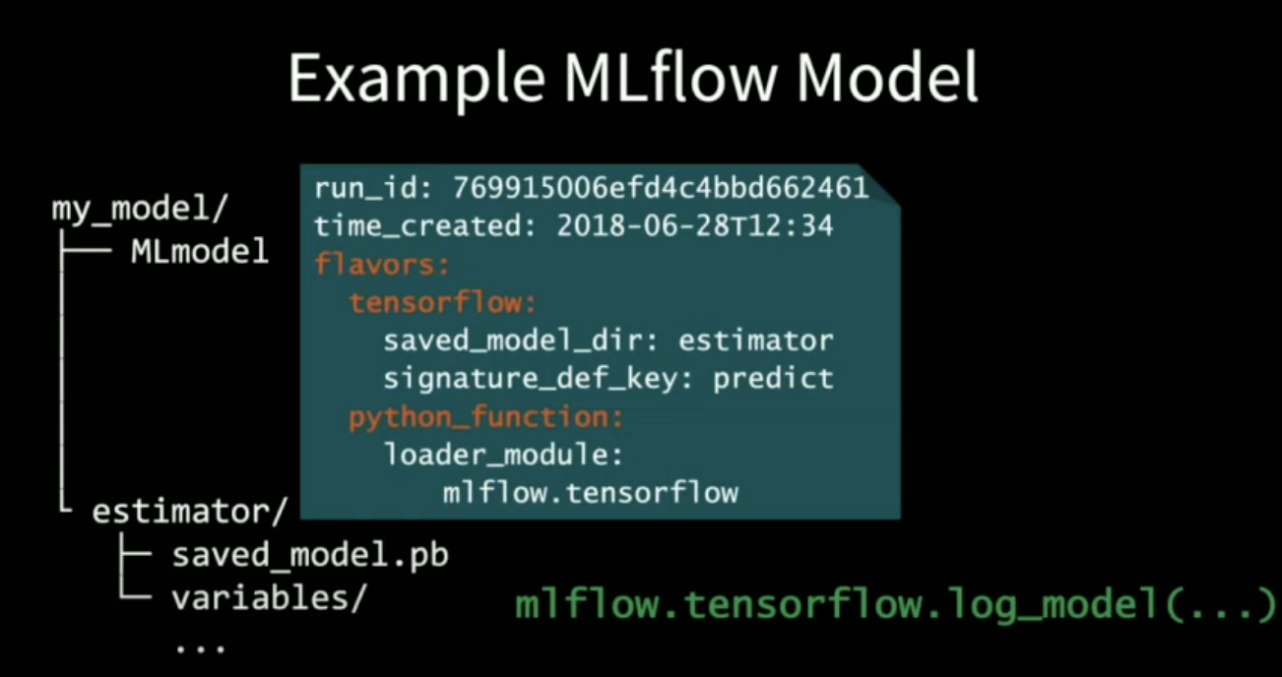

Slide 14
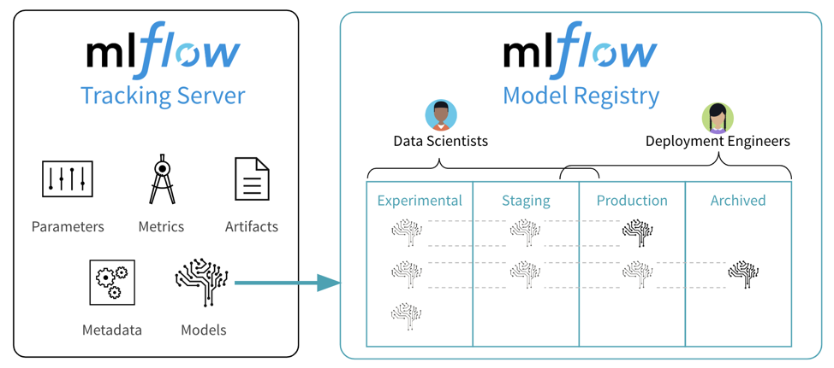
Registry

Slide 15
Model Registry - Concepts
Model
Registered Model
Model Version
Model Stage
Annotations and Descriptions
Model Alias –Eg; Refer to version 1 of MyModel by using the URI models:/MyModel@Champion.

Slide 16
References
https://mlflow.org/docs/latest/tutorials-and-examples/index.html
https://www.youtube.com/watch?v=VokAGy8C6K4
https://adatis.co.uk/mlflow-introduction-to-model-registry/
https://www.youtube.com/watch?v=859OxXrt_TI&ab_channel=InfoQ

Slide 17
THANK YOU

