Slide 1
Spectral Clustering
CSCI 4360/6360 Data Science II

Slide 2
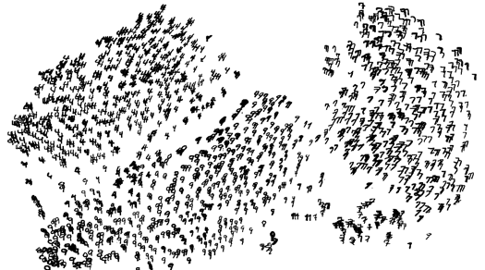
High Dimensional Data
Given a cloud of data points we want to understand its structure

Slide 3
The Problem of Clustering
Given a set of points, with a notion of distance between points, group the points into some number of clusters, so that
Members of a cluster are close/similar to each other
Members of different clusters are dissimilar
Usually:
Points are in a high-dimensional space
Similarity is defined using a distance measure
Euclidean, Cosine, Jaccard, edit distance, …

Slide 4
Example: Clusters & Outliers
x
xx x
x x
x x x
x
x x x
x
x
xx x
x x
x x x
x
x x x
x
x
x x
x x x x
x x x x
x x x
x x
x x
x x x x
x x x x
x x x
x x
x x
x x x x
x x x
x
x x
x x x x
x x x
x
x
Outlier
Cluster

Slide 5
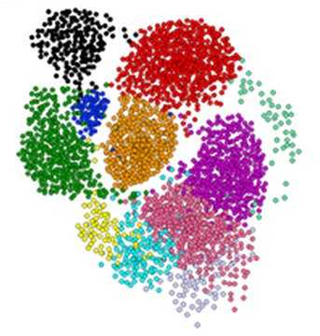
Clustering is a hard problem!

Slide 6
Why is it hard?
Clustering in two dimensions looks easy
Clustering small amounts of data looks easy
And in most cases, looks are not deceiving
Many applications involve not 2, but 10 or 10,000 dimensions
High-dimensional spaces look different: Almost all pairs of points are at about the same distance

Slide 7
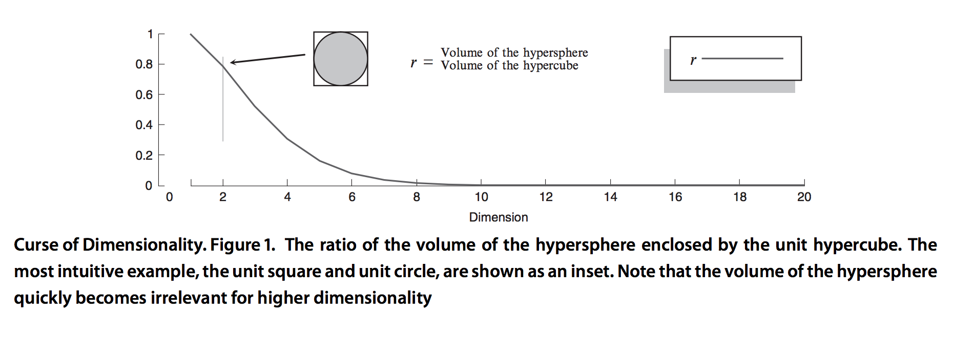
Curse of dimensionality
“Vastness” of Euclidean space
http://link.springer.com/referenceworkentry/10.1007%2F978-0-387-30164-8_192
Notes:
R = volume of hypersphere / volume of hypercube
What does it take for a ratio to go to zero? Either
numerator goes to 0
Denominator goes to infinity
We can generally assume the numerator isn’t going to 0; it’s staying the same
So denominator has to be going to infinity, or at least growing faster than the numerator

Slide 8
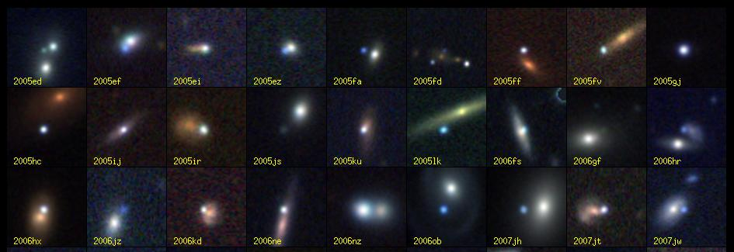
Clustering Problem: Galaxies
A catalog of 2 billion “sky objects” represents objects by their radiation in 7 dimensions (frequency bands)
Problem: Cluster into similar objects, e.g., galaxies, nearby stars, quasars, etc.
Sloan Digital Sky Survey

Slide 9
Clustering Problem: Music
Intuitively: Music divides into categories, and customers prefer a few categories
But what are categories really?
Represent a song by a set of customers who bought it:
Similar songs have similar sets of customers, and vice-versa

Slide 10
Clustering Problem: Music
Space of all music:
Think of a space with one dimension for each customer
Values in a dimension may be 0 or 1 only
A song is a point in this space (x₁, x₂,…, x_{k}), where x_{i} = 1 iff the i ^{th} customer bought the song
For Amazon, the dimension is tens of millions
Task: Find clusters of similar songs

Slide 11
Clustering Problem: Documents
Finding topics:
Represent a document by a vector (x₁, x₂,…, x_{k}), where x_{i} = 1 iff the i ^{th} word (in some order) appears in the document
It actually doesn’t matter if k is infinite; i.e., we don’t limit the set of words
Documents with similar sets of words may be about the same topic

Slide 12
Cosine, Jaccard, and Euclidean
As with songs we have a choice when we think of documents as sets of words or shingles:
Sets as vectors: Measure similarity by the cosine distance
Sets as sets: Measure similarity by the Jaccard distance
Sets as points: Measure similarity by Euclidean distance

Slide 13
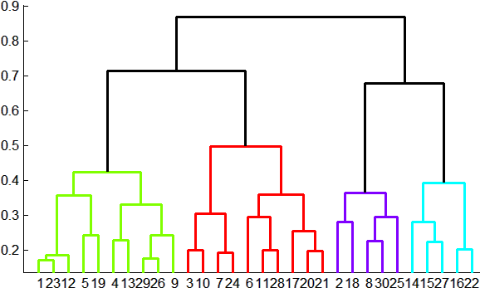
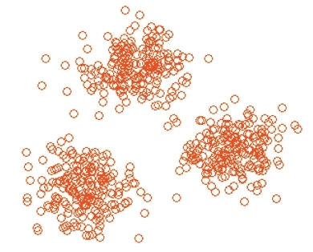
Overview: Methods of Clustering
Hierarchical:
Agglomerative (bottom up):
Initially, each point is a cluster
Repeatedly combine the two “nearest” clusters into one
Divisive (top down):
Start with one cluster and recursively split it
Point assignment:
Maintain a set of clusters
Points belong to “nearest” cluster

Slide 14
Hierarchical Clustering
Key operation: Repeatedly combine two nearest clusters
Three important questions:
1) How do you represent a cluster of more than one point?
2) How do you determine the “nearness” of clusters?
3) When to stop combining clusters?

Slide 15
Hierarchical Clustering
Key operation: Repeatedly combine two nearest clusters
(1) How to represent a cluster of many points?
Key problem: As you merge clusters, how do you represent the “location” of each cluster, to tell which pair of clusters is closest?
Euclidean case: each cluster has a centroid = average of its (data)points
(2) How to determine “nearness” of clusters?
Measure cluster distances by distances of centroids

Slide 16
Example: Hierarchical clustering
(5,3)
o
(1,2)
o
o (2,1) o (4,1)
o (0,0) o (5,0)
x (1.5,1.5)
x (4.7,1.3)
x (1,1)
x (4.5,0.5)
Data:
o … data point
x … centroid
Dendrogram

Slide 17
And in the Non-Euclidean Case?
What about the Non-Euclidean case?
The only “locations” we can talk about are the points themselves
i.e., there is no “average” of two points
Approach 1:
(1) How to represent a cluster of many points? clustroid = (data)point “closest” to other points
(2) How do you determine the “nearness” of clusters? Treat clustroid as if it were centroid, when computing inter-cluster distances

Slide 18
“Closest” Point?
(1) How to represent a cluster of many points? clustroid = point “closest” to other points
Possible meanings of “closest”:
Smallest maximum distance to other points
Smallest average distance to other points
Smallest sum of squares of distances to other points
For distance metric d clustroid c of cluster C is:
Datapoint
Centroid
Centroid is the avg. of all (data)points in the cluster. This means centroid is an “artificial” point.
Clustroid is an existing (data)point that is “closest” to all other points in the cluster.
X
Clustroid
Cluster on 3 datapoints

Slide 19
Defining “Nearness” of Clusters
(2) How do you determine the “nearness” of clusters?
Approach 2: Intercluster distance = minimum of the distances between any two points, one from each cluster
Approach 3: Pick a notion of “cohesion” of clusters, e.g., maximum distance from the clustroid
Merge clusters whose union is most cohesive

Slide 20
Cohesion
Approach 3.1: Use the diameter of the merged cluster = maximum distance between points in the cluster
Approach 3.2: Use the average distance between points in the cluster
Approach 3.3: Use a density-based approach
Take the diameter or avg. distance, e.g., and divide by the number of points in the cluster

Slide 21
Implementation
Naïve implementation of hierarchical clustering:
At each step, compute pairwise distances between all pairs of clusters, then merge
O(N³)
Careful implementation using priority queue can reduce time to O(N² log N)
Still too expensive for really big datasets that do not fit in memory

Slide 22
k–means Algorithm(s)
Assumes Euclidean space/distance
Start by picking k, the number of clusters
Initialize clusters by picking one point per cluster
Example: Pick one point at random, then k-1 other points, each as far away as possible from the previous points

Slide 23
Populating Clusters
1) For each point, place it in the cluster whose current centroid it is nearest
2) After all points are assigned, update the locations of centroids of the k clusters
3) Reassign all points to their closest centroid
Sometimes moves points between clusters
Repeat 2 and 3 until convergence
Convergence: Points don’t move between clusters and centroids stabilize

Slide 24
Getting the k right
WRONG
How to select k?
Try different k, looking at the change in the average distance to centroid as k increases
Average falls rapidly until right k, then changes little
Best value
of k
Average
distance to
centroid
k

Slide 25

Getting the k right

Slide 26
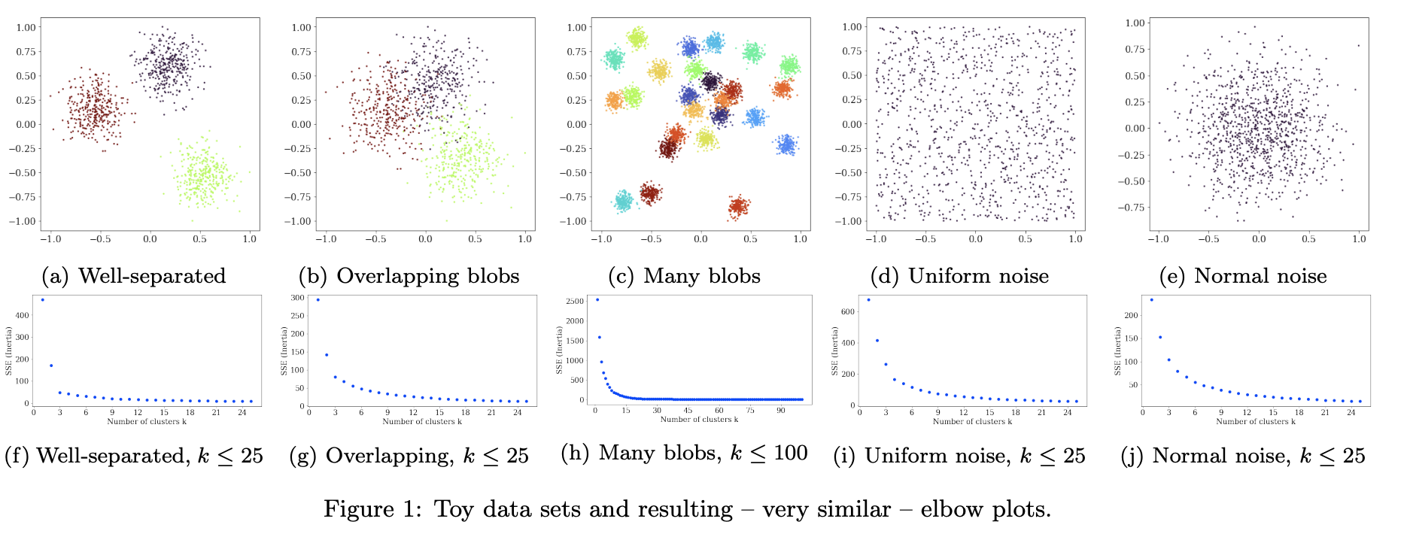
Problems with the elbow method
Heuristic with absolutely no theoretical support
Easy to draw very poor conclusions
Better alternatives have existed in the literature

Slide 27
Alternatives to the elbow method
Distance-based criteria
Compare diameter of clusters to cluster separation
Silhouette width measure
Information-theoretic criteria
Minimum description length
Trade-off between “compactness” of clusters vs number of clusters
Simulation-based criteria
“Gap” statistic: estimate a baseline error from randomized clustering, then choose a k that obtains a minimum relative error (i.e. largest gap)
Very sensitive to data preprocessing—authors recommend previous methods
Notes:
Silhouette width measure: average distance of a point to its own cluster compared to the average distance to the nearest other cluster

Slide 28
Example: Picking k
x
xx x
x x
x x x
x
x x x
x
Too few;
many long
distances
to centroid.
x
x x
x x x x
x x x x
x x x
x x
x x
x x x x
x x x
x
x

Slide 29
Example: Picking k
x
xx x
x x
x x x
x
x x x
x
x
Just right;
distances
rather short.
x x
x x x x
x x x x
x x x
x x
x x
x x x x
x x x
x
x

Slide 30
Example: Picking k
Too many;
little improvement
in average
distance.
x
xx x
x x
x x x
x
x x x
x
x
x x
x x x x
x x x x
x x x
x x
x x
x x x x
x x x
x
x

Slide 31
More K-means examples
http://www.naftaliharris.com/blog/visualizing-k-means-clustering/

Slide 32
Graph Partitioning
1
5
2
Undirected graph
Bi-partitioning task:
Divide vertices into two disjoint groups
Questions:
How can we define a “good” partition of ?
How can we efficiently identify such a partition?
6
4
3
A
5
B
1
2
6
3
4

Slide 33
Graph Partitioning
What makes a good partition?
Maximize the number of within-group connections
Minimize the number of between-group connections
5
1
2
6
4
3
A
B

Slide 34
Graph Cuts
Express partitioning objectives as a function of the “edge cut” of the partition
Cut: Set of edges with only one vertex in a group:
A
B
5
1
cut(A,B) = 2
2
6
4
3

Slide 35
Graph Cut Criterion
Criterion: Minimum-cut
Minimize weight of connections between groups
Degenerate case:
Problem:
Only considers external cluster connections
Does not consider internal cluster connectivity
arg min_{A,B} cut(A,B)
“Optimal cut”
Minimum cut

Slide 36
Graph Cut Criteria
Criterion: Normalized-cut [Shi-Malik, ’97]
Connectivity between groups relative to the density of each group
: total weight of the edges with at least one endpoint in :
Why use this criterion?
Produces more balanced partitions
How do we efficiently find a good partition?
Problem: Computing optimal cut is NP-hard

Slide 37
Spectral Graph Partitioning
A: adjacency matrix of undirected G
A_{ij} =1 if is an edge, else 0
x is a vector in ℜ^{n} with components
Think of it as a label/value of each node of
What is the meaning of A⋅ x?
Entry y_{i} is a sum of labels x_{j} of neighbors of i

Slide 38

What is the meaning of Ax?
j^{th} coordinate of A⋅ x :
Sum of the x-values of neighbors of j
Make this a new value at node j
Spectral Graph Theory:
Analyze the “spectrum” of matrix representing
Spectrum: Eigenvectors of a graph, ordered by the magnitude (strength) of their corresponding eigenvalues :
$$A⋅x=λ⋅x$$

Slide 39
Matrix Representations
Adjacency matrix (A):
n× n matrix
A=[a_{ij}], a_{ij}=1 if edge between node i and j
Important properties:
Symmetric matrix
Eigenvalues are real
Eigenvectors are orthogonal
 | 1 | 2 | 3 | 4 | 5 | 6
1 | 0 | 1 | 1 | 0 | 1 | 0
2 | 1 | 0 | 1 | 0 | 0 | 0
3 | 1 | 1 | 0 | 1 | 0 | 0
4 | 0 | 0 | 1 | 0 | 1 | 1
5 | 1 | 0 | 0 | 1 | 0 | 1
6 | 0 | 0 | 0 | 1 | 1 | 0
5
1
2
6
4
3

Slide 40
Matrix Representations
Degree matrix (D):
n× n diagonal matrix
D=[d_{ii}], d_{ii} = degree of node i
 | 1 | 2 | 3 | 4 | 5 | 6
1 | 3 | 0 | 0 | 0 | 0 | 0
2 | 0 | 2 | 0 | 0 | 0 | 0
3 | 0 | 0 | 3 | 0 | 0 | 0
4 | 0 | 0 | 0 | 3 | 0 | 0
5 | 0 | 0 | 0 | 0 | 3 | 0
6 | 0 | 0 | 0 | 0 | 0 | 2
5
1
2
6
4
3

Slide 41
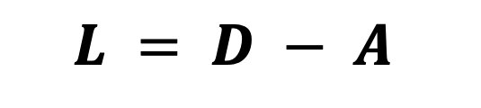
Matrix Representations
 | 1 | 2 | 3 | 4 | 5 | 6
1 | 3 | -1 | -1 | 0 | -1 | 0
2 | -1 | 2 | -1 | 0 | 0 | 0
3 | -1 | -1 | 3 | -1 | 0 | 0
4 | 0 | 0 | -1 | 3 | -1 | -1
5 | -1 | 0 | 0 | -1 | 3 | -1
6 | 0 | 0 | 0 | -1 | -1 | 2
Laplacian matrix (L):
n× n symmetric matrix
Important properties:
Eigenvalues are non-negative real numbers
Eigenvectors are real and orthogonal
1
5
2
6
4
3
$$L = D − A$$

Slide 42
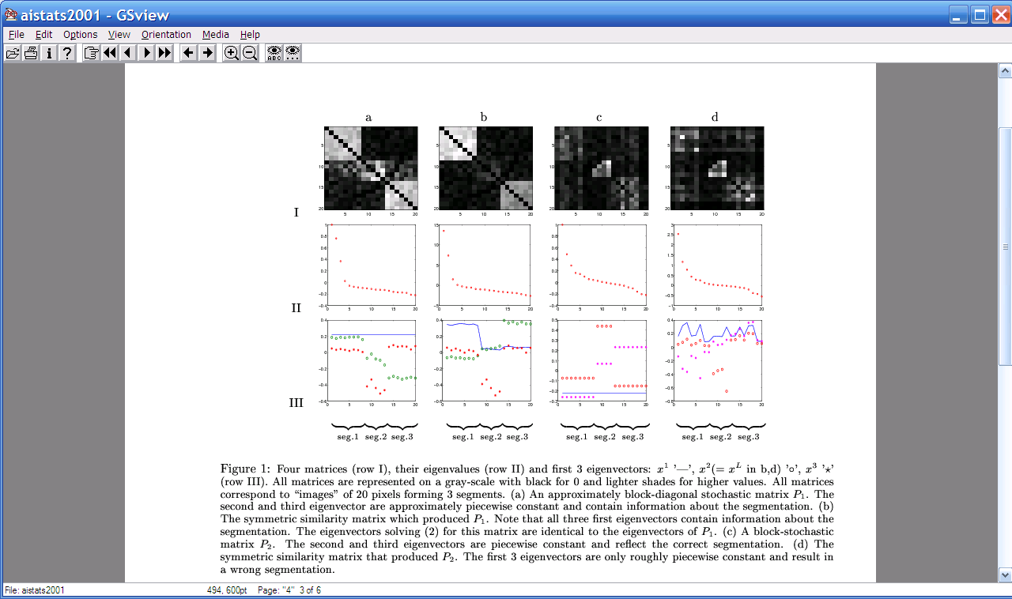
Spectral Clustering
Graph = Matrix
W*v₁ = v₂ “propogates weights from neighbors”
e₂
0.4
0.2
x
e₃
x
x
x
x
x
x
x
x
0.0
x
x
x
e₂
-0.2
y
z
y
y
z
-0.4
y
z
z
z
z
z
z
z
z
y
z
e₁
[Shi & Meila, 2002]
-0.4
-0.2
0
0.2

Slide 43
Spectral Clustering
If W is connected but roughly block diagonal with k blocks, then
the top eigenvector is a constant vector
the next k eigenvectors are roughly piecewise constant with “pieces” corresponding to blocks

Slide 44
Spectral Clustering
Outline of the algorithm:
Start with (ideally) block-diagonal A
Compute L = D - A
Find the top k+1 eigenvectors v₁,…,v_{k+1} of L
Discard the “top” one v₁ (the “trivial pair”)
Replace original data with k-dimensional vector x_{a} = <v₂(a),…,v_{k+1} (a)>
Cluster with k-means

Slide 45
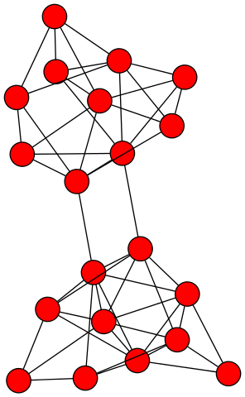
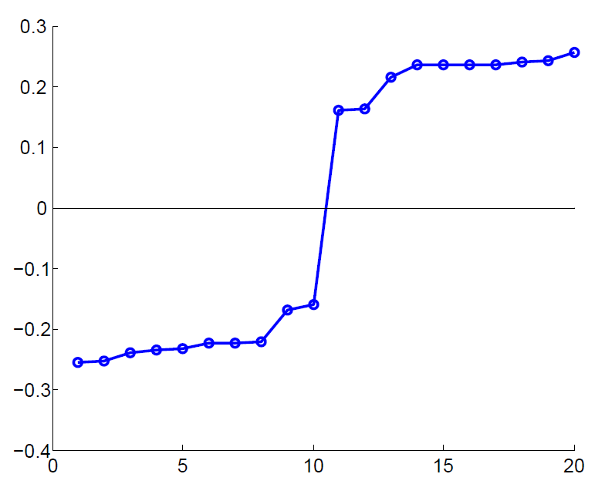
Example: Spectral Partitioning
Value of x₂
Rank in x₂
Notes:
Start with x2 because we threw away x1 (the “trivial” eigenvector, only present in a fully connected graph)

Slide 46
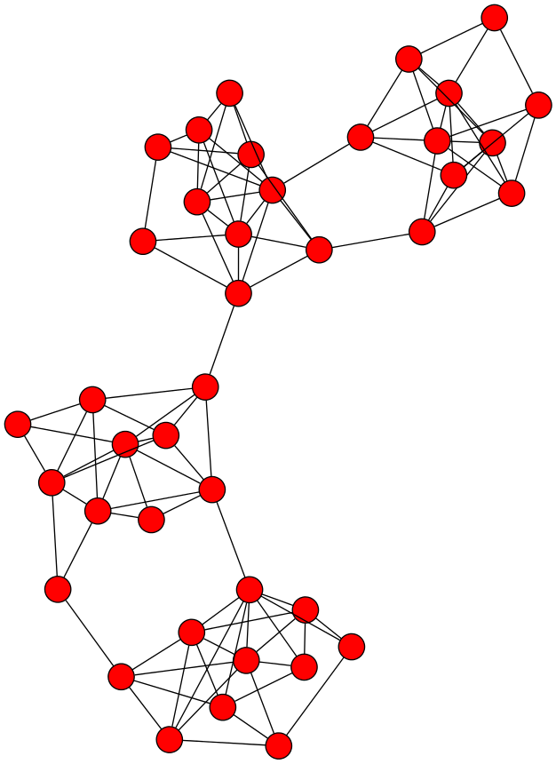
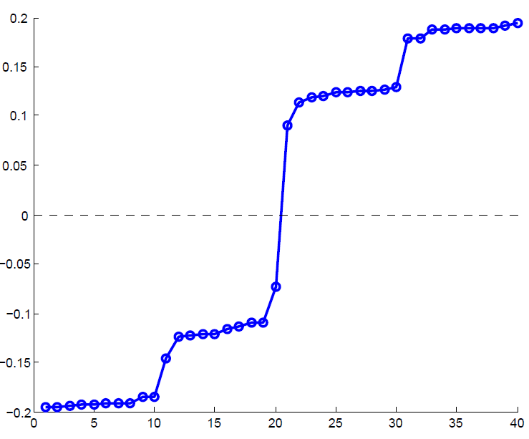
Example: Spectral Partitioning
Components of x₂
Value of x₂
Rank in x₂

Slide 47
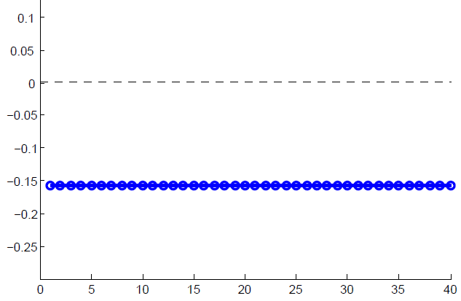
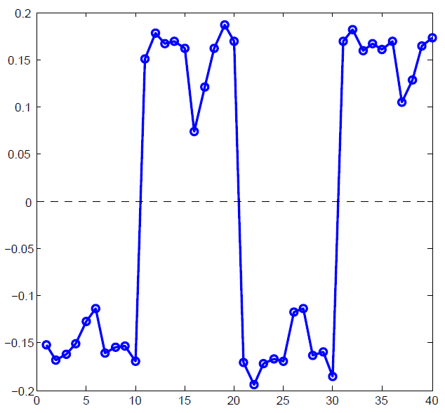
Example: Spectral partitioning
Components of x₁
Components of x₃

Slide 48
k-Way Spectral Clustering
How do we partition a graph into k clusters?
Two basic approaches:
Recursive bi-partitioning [Hagen et al., ’92]
Recursively apply bi-partitioning algorithm in a hierarchical divisive manner
Disadvantages: Inefficient, unstable
Cluster multiple eigenvectors [Shi-Malik, ’00]
Build a reduced space from multiple eigenvectors
Commonly used in recent papers
A preferable approach…

Slide 49
Why use multiple eigenvectors?
Approximates the optimal cut [Shi-Malik, ’00]
Can be used to approximate optimal k-way normalized cut
Emphasizes cohesive clusters
Increases the unevenness in the distribution of the data
Associations between similar points are amplified, associations between dissimilar points are attenuated
The data begins to “approximate a clustering”
Well-separated space
Transforms data to a new “embedded space”, consisting of k orthogonal basis vectors
Multiple eigenvectors prevent instability due to information loss

Slide 50
More terms
If A is an adjacency matrix (maybe weighted) and D is a (diagonal) matrix giving the degree of each node
Then L_{u} = D - A is the (unnormalized) Laplacian
W=AD⁻¹ is a probabilistic adjacency matrix
L_{n} = I - D^{-1/2}AD^{-1/2} is the (normalized or random-walk) Laplacian
The largest eigenvectors of W correspond to the smallest eigenvectors of L_{n}
So sometimes people talk about “bottom eigenvectors of the Laplacian”

Slide 51
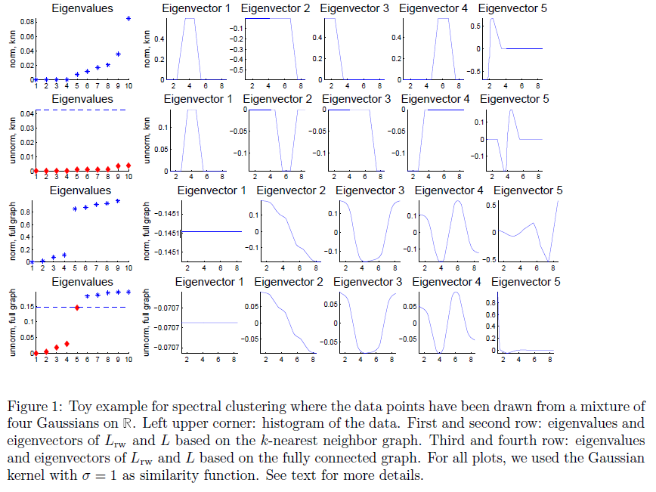
K-nn graph
(easy)
Fully connected graph,
weighted by distance

Slide 52
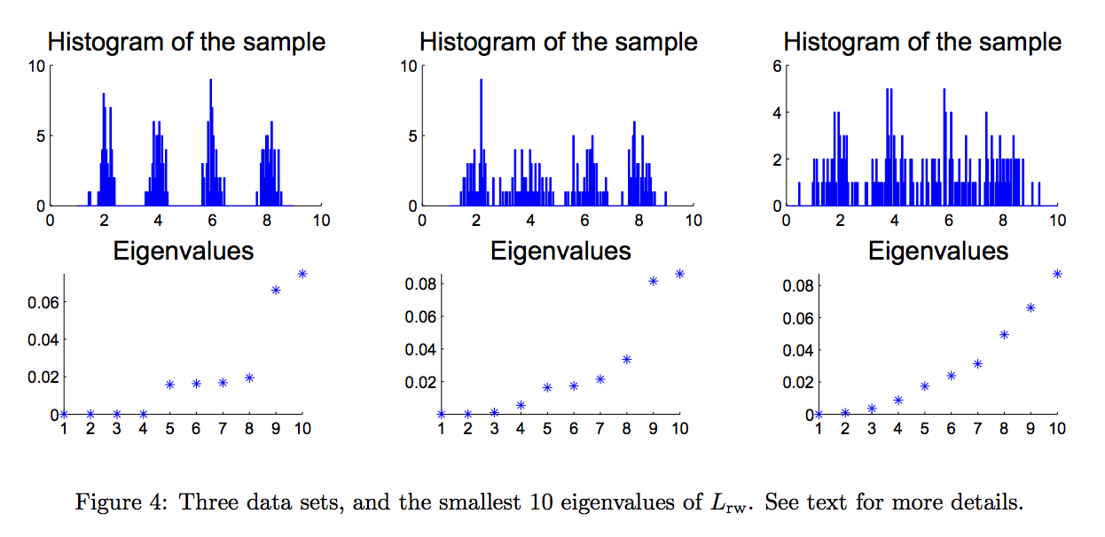
Spectrum from Data

Slide 53
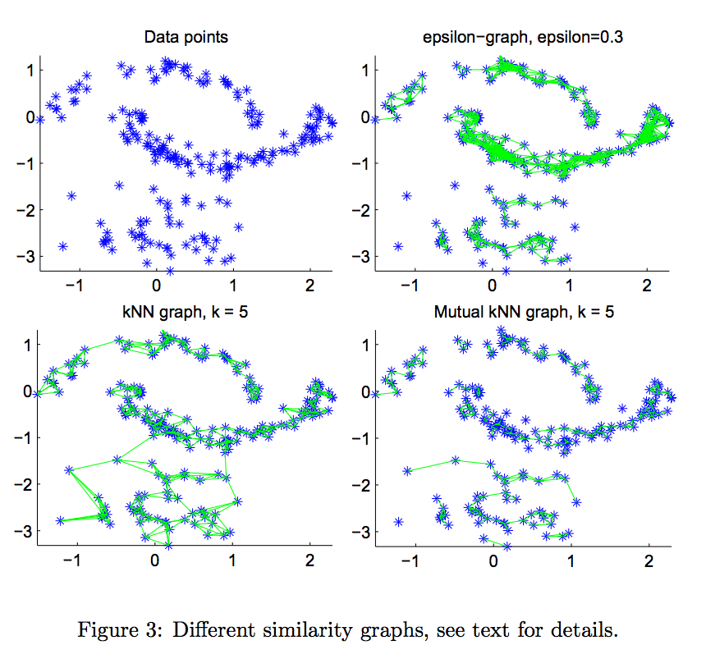
Similarity Graphs for Spectral Clustering

Slide 54
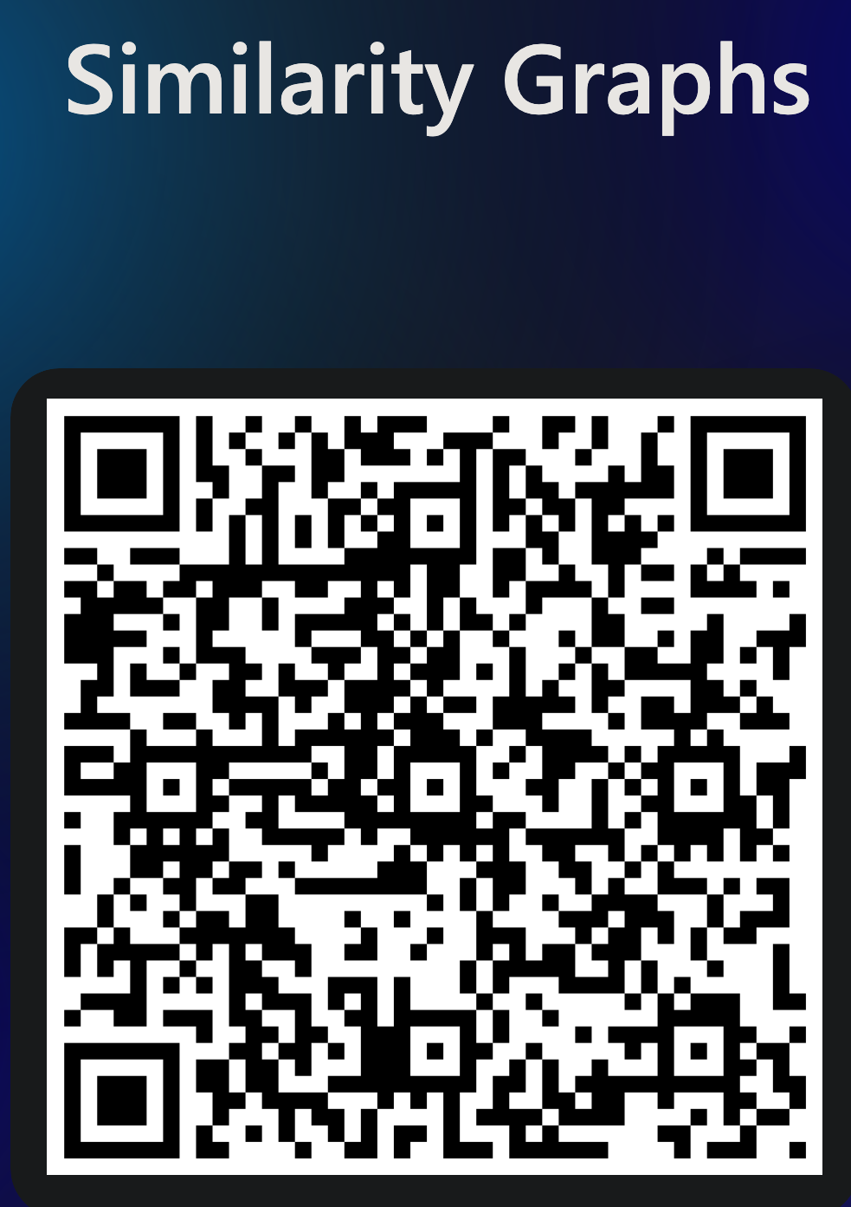


Slide 55
Spectral Clustering: Pros and Cons
Elegant, and well-founded mathematically
Works quite well when relations are approximately transitive (like similarity)
Does not assume any form of the data (compare to K-means)
Very noisy datasets cause problems
“Informative” eigenvectors need not be in top few
Performance can drop suddenly from good to terrible
Expensive for very large datasets
Computing eigenvectors is the bottleneck

Slide 56
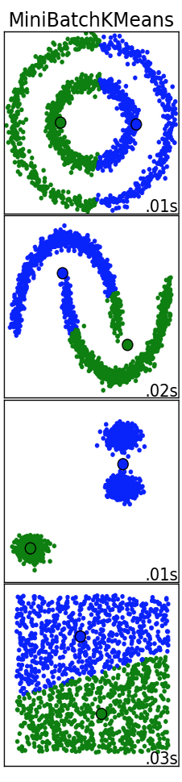
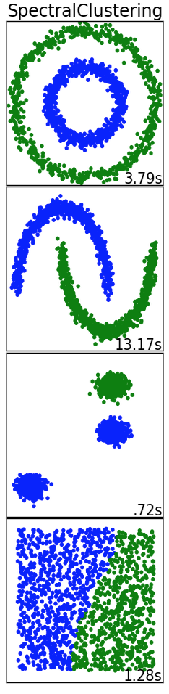
Use cases and runtimes
K-Means
Fast
“Embarrassingly parallel”
Not very useful on anisotropic data
Spectral clustering
Excellent quality under many different data forms
Much slower than K-Means

Slide 57
References
Spectral Clustering Tutorial: https://link.springer.com/content/pdf/10.1007/s11222-007-9033-z.pdf

