Slide 1
Biologically-Inspired Computing I: Optimization
CSCI 4360/6360 Data Science II

Slide 2
What is Optimization?
Formal: “Find a specific value of theta for which L is minimized”
Colloquial: “Give me the parameters that result in the function’s minimum”
Notes:
What are some examples of forms L can take?
“min” or “max” just means minimum or maximum of the function itself
“argmin” or “argmax” refers to the arguments / inputs to the function that result in its minimum or maximum
Local minimum? Global minimum?
Constrained optimization or unconstrained?
Convex, non-convex?
Discrete, continuous?

Slide 3
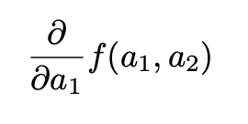
Tried and true
Where do we start?
Partial derivative
Set partial to zero
Solve for the minimum
Why doesn’t this work in modern ML? (even logistic regression!)
Notes:
Why doesn’t it work?
A lot of modern ML-–even logistic regression—does not have closed-form solutions
- requires approximations, e.g. gradient descent

Slide 4

Automatic Differentiation
Aka, “autodiff”
Core to TensorFlow, Keras, PyTorch
Requires a computational graph
Computes gradients during backpropagation
Notes:
Computing gradient descent can be… annoying (as we saw in HW1)
Computing gradient descent for arbitrary compute graphs—like deep neural networks with many, many layers—is borderline impossible, at least by hand
Enter autodiff!

Slide 5

Stochastic Differentiation
aka, Stochastic Gradient Descent (SGD)!
The source of noise in this case: the data (or lack thereof)
Partials w.r.t. a sample, or even a single data point
Other versions to reduce the noise
Preconditioned SGD
Variance reduction
Notes:
Why and under what conditions does “gradient descent” get the word “stochastic” put in front?

Slide 6
What do all these methods require?
Plenty of other optimization strategies along these lines
One thing they all share: require derivatives
Requires the function we’re optimizing L to have an explicit or known form
Requires evaluation of the derivative to be fairly inexpensive
Are there alternatives? Yes

Slide 7
Derivative-free Optimization (DFO)
Hill-climbing
Stochastic local search
Random search
Optimal transport (e.g., Wasserstein)
Today
Simulated Annealing
Evolutionary Algorithms
Particle Swarm
Notes:
Anyone know of any?
Hill-climbing is an easy one – very similar to SGD, but evaluates just the immediate neighborhood’s gradient
- greedy!

Slide 8

Annealing
Physical process of heating a solid until thermal stresses are released, then cooling it (very slowly) until crystals are perfectly arranged
Corresponds to a minimum energy state
Define an energy function
Temperature T is slowly decreased over time
Notes:
Technically from physics, not biology
The faster it’s cooled, the more quickly you arrive at a solution; however, the more slowly it is cooled, the better the solution will be

Slide 9
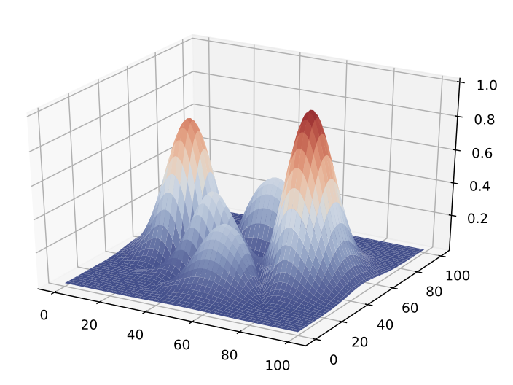
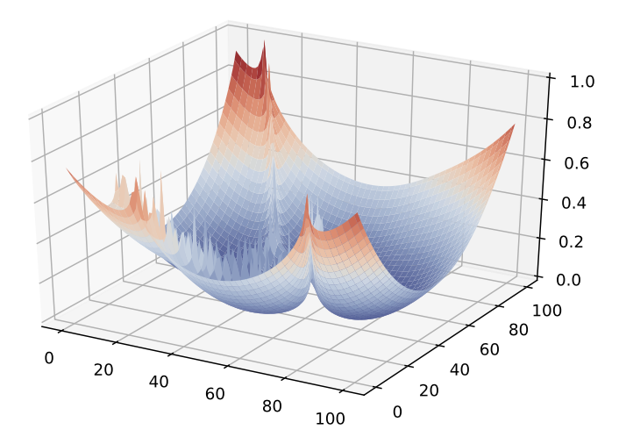
Annealing
A function we want to optimize
Its corresponding energy function
Notes:
Technically from physics, not biology
The faster it’s cooled, the more quickly you arrive at a solution; however, the more slowly it is cooled, the better the solution will be

Slide 10
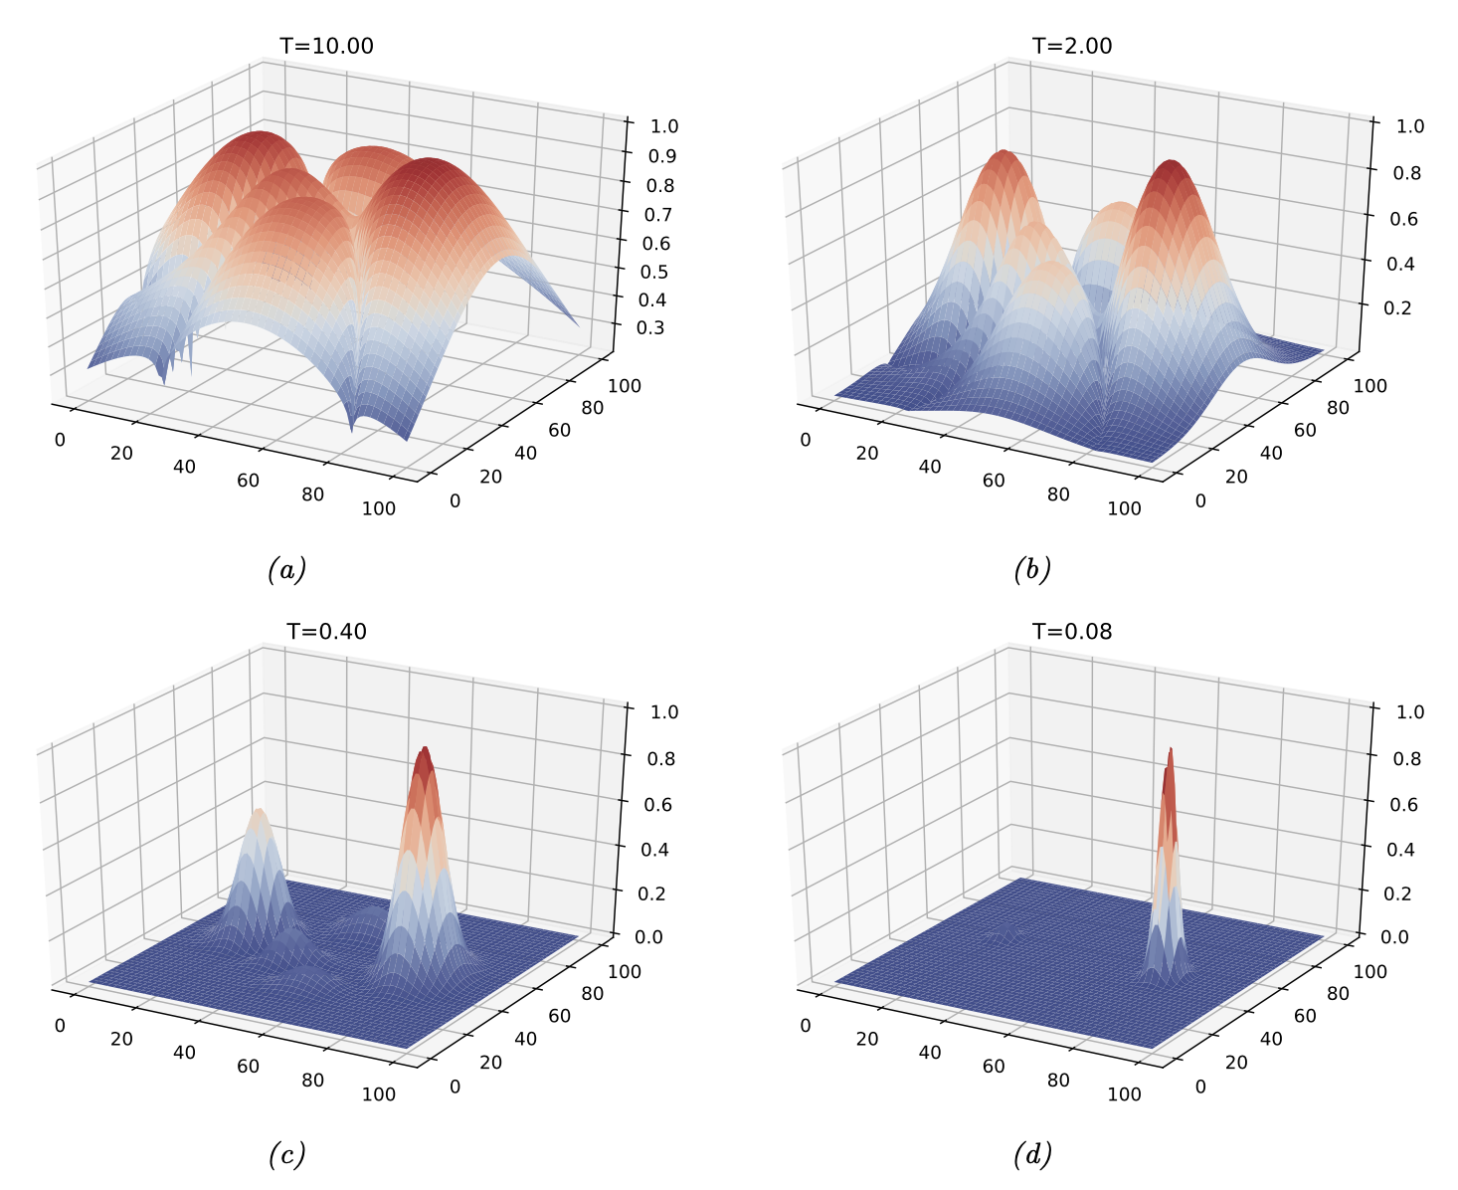
Annealing
Annealed versions of the energy function at different temperatures
T >>> 1, energy landscape is flatter
As T -> 0, landscape becomes sharper, highlighting high-probability global extrema
Notes:
At high temperatures, energy landscape is flatter
- means everything is roughly the same probability
- also means it is easier to move around and explore (high exploration, low exploitation)
As the temperature drops, energy landscape starts favoring certain extrema
- high probability for global optimum
- need to “follow” high probability peaks at different temperatures to see if they persist at those temperatures
- ”cooling schedule”: how fast to cool the temperature to maintain the highest probability extrema
- “acceptance probability”: the threshold at which we stop tracking our current candidate and jump to a new one

Slide 11
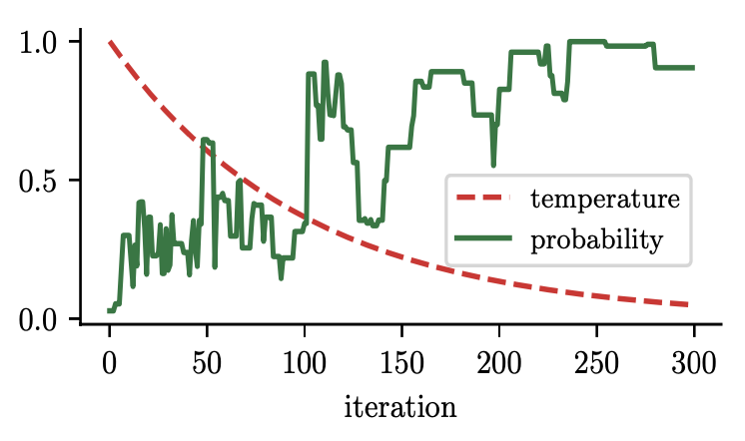
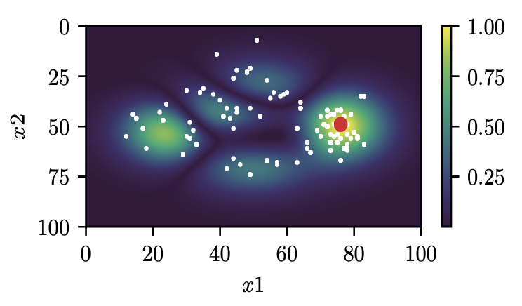
Annealing
The longer the experiment, the more confident the annealing will be
(Theoretically) Guaranteed to final global optimum
Run long enough
Good cooling schedule
etc

Slide 12
Evolutionary Algorithms (EA)
Annealing = (technically) guaranteed to find global optimum
EA = (technically) NOT guaranteed to find global optimum
Lots of caveats, on both
EA is a form of “stochastic local search”
Balance exploitation (local search) and exploration (global search)
Can find you a good local optimum quickly, with good chance of global optimum in a reasonable time frame

Slide 13
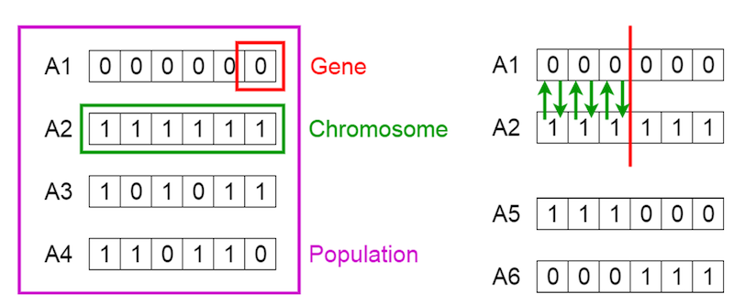
Evolutionary / Genetic Algorithms
Notes:
Vocabulary:
- gene
- chromosome
- population
- parents
- children
- crossover
- mutation
- fitness function

Slide 14
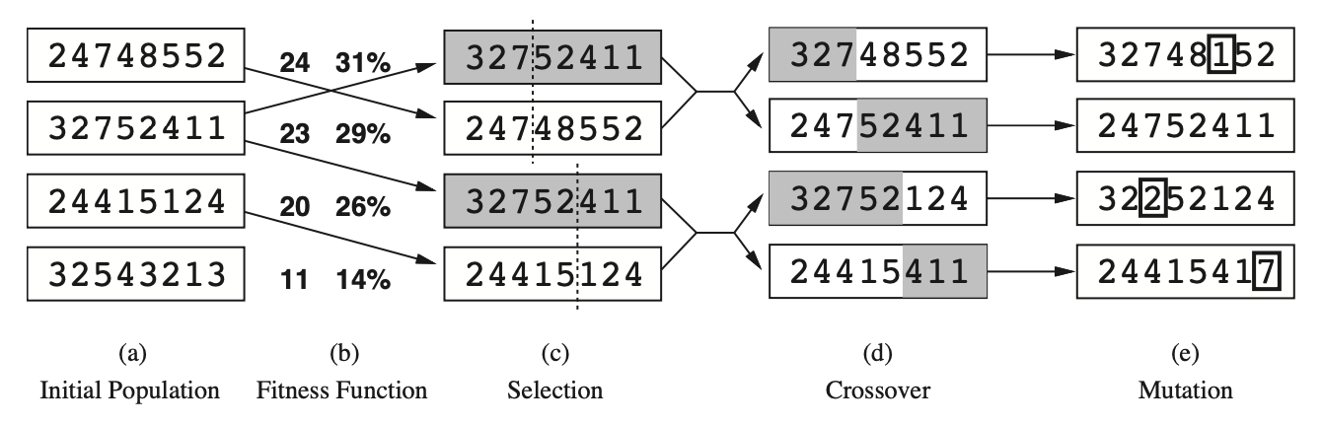
Evolutionary / Genetic Algorithms
Notes:
For each time point / generation
Alternatively, we can choose two parents and combine them in some way to create a child (recombination)

Slide 15
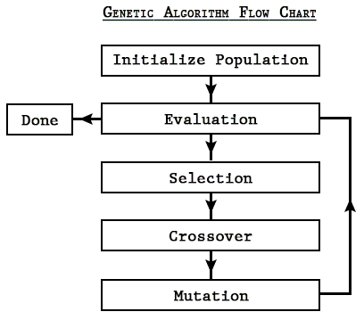
Evolutionary / Genetic Algorithms

Slide 16
Evolutionary / Genetic Algorithms
One way to conceptualize EAs/GAs: search!
Goal: find an optimal (or nearly-optimal) parameter combination without having to evaluate all possible parameter values
GA trade-offs exploration vs exploitation through population size, number of generations, cross-over, mutation

Slide 17

Particle Swarm Optimization (PSO)
The inspiration comes from watching large swarms of birds or schools of fish moving somewhat in unison, but with a few members taking some unexpected deviations.
A single particle in PSO compares well to a single individual in EA

Slide 18
PSO: Exploration vs Exploitation
Exploration: breadth over depth
Trying out a large range of values quickly
“Building an intuition” phase
Exploitation: depth over breadth
Zeroing in on a high-probability area
“Deep dive” phase
Pretty much every optimization strategy involves some trade-off between these two
If you notice your optimization procedure starting fast and then slowing down, it’s shifting from exploration into exploitation
Notes:
If it stayed in exploration mode, it’d overshoot the optimum.
Of course, conversely, if it stayed in exploration mode, it’d have a reasonable chance of giving you a reasonable solution (not an optimal one) very quickly
The switch from exploration to exploitation is itself a trade-off: to try and further optimize high-probability areas, but only after a quick global heuristic search
In doing both, you get some advantages of both, while trying to be as fast as possible and avoid their worst drawbacks

Slide 19
Particle Swarm Optimization
Like EA, you have a population of particles
Unlike EA, these particles remain the same
Each particle tracks its own search progress
Some global parameters to track
Hyperparameters modulating the exploration/exploitation trade-off
Some stochasticity (analogous to mutation) to prevent getting stuck
Simulate

Slide 20
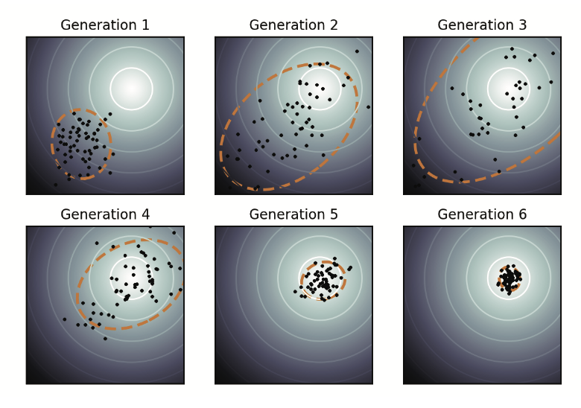
Particle Swarm Optimization
Notes:
See the swarm initially spread out early on (exploration), then see it converge to the global optimum near the end (exploitation)
This behavior is not always guaranteed but it is the desired behavior
(relies on trade-offs like population size, number of iterations, values of the various hyperparameters)

Slide 21
Advantages of Derivative-free methods
Can optimize pretty much anything
No need for a known or closed form derivative (“black box optimization”)
Just need some way of evaluating whether or not a specific guess is “good” (e.g., a fitness function)
Straightforward to implement
You implemented part of PSO in the midterm, theory in HW4 ☺
May still implement on a future HW
Only real constraint (usually) is time
Fairly resource-light, can scale up to use available resources

Slide 22
Disadvantages of Derivative-free methods
Often no convergence guarantees
EA is guaranteed to find a local optimum
Annealing is theoretically guaranteed to find a global optimum (but could be waiting until the heat death of the universe)
Relies heavily on hand-tuned hyperparameters
Temperature protocol, mutation rate, cognitive / social parameters
”Long tail” convergence
Can usually find a decent solution quickly, but optimal solutions may take a very long time

Slide 23
Stay tuned
More biologically inspired computing methods: neural networks!

Slide 24
References
“Probabilistic Machine Learning”, by Kevin Murphy https://probml.github.io/pml-book/
Book 2: “Probabilistic Machine Learning: Advanced Topics”, ch. 6

Slide 25
Quick Notes
All grades are on eLC!
Midterm (WITH +30 curve), HW1/2/3, and workshops (if you’ve given one)
Should have a good idea of your standing in the course
Still going through final project proposals
A note about “dropping” the final project
Final Project Update #1 is due THURSDAY, March 27
Very similar to proposal: 1 page limit
Discuss what you’ve done since proposal, any problems you’ve run into, and how you’ve worked around them (or plan to work around them)
Homework 4 is due MONDAY, March 31

